Slide 1
Developing Classification Models to predict diabetes
Lillian Mueller | ENPM808L | 4 Dec 2023

Slide 2




Introduction
Methodology
Agenda
results
discussion

Slide 3

Introduction
Diabetes and Prediabetes
Models to Facilitate Diabetes Prevention
Metabolic condition that affects millions of people globally
8th leading cause of death in United States
Types of Diabetes
Type 1
Type 2
gestational diabetes
Prediabetes
Higher than normal blood glucose levels
Early identification can allow individual to implement prevention strategies
Identify individuals who are at risk or already affected by diabetes
Use classification models to predict the likelihood of individuals have diabetes or prediabetes
Decision tree
Logistic regression
K-nearest neighbor
Naïve Bayes classifier
Linear discriminant analysis

Slide 4

Methodology
Cleaning the Dataset
Dataset sourced from Kaggle
Health indicators
Demographics
Lifestyle attributes
Cleaned each column to contain only numeric values
Scaled by ranges
Boolean features
Target Classification Prepressing
0 = no diabetes
1 = prediabetes
2 = diabetes
Model Variation Selection
Decision Tree
Entropy/Gini Criterion
Maximum depth
Logistic Regression
SAG/SAGA solver
L2 penalty or None
K-Nearest Neighbor
K values
Uniform/Distance weight
Naïve Bayes Classifier
Gaussian/Bernoulli
Linear Discriminant Analysis
Evaluation and Comparison
Accuracy
Overall correctness
Precision
Correctness when predicting a specific classification
Confusion Matrices
Visualize FP, TP, FN, FP
ROC Curves
Rank models on performance
Cross Validation
General accuracy and precision

Slide 5

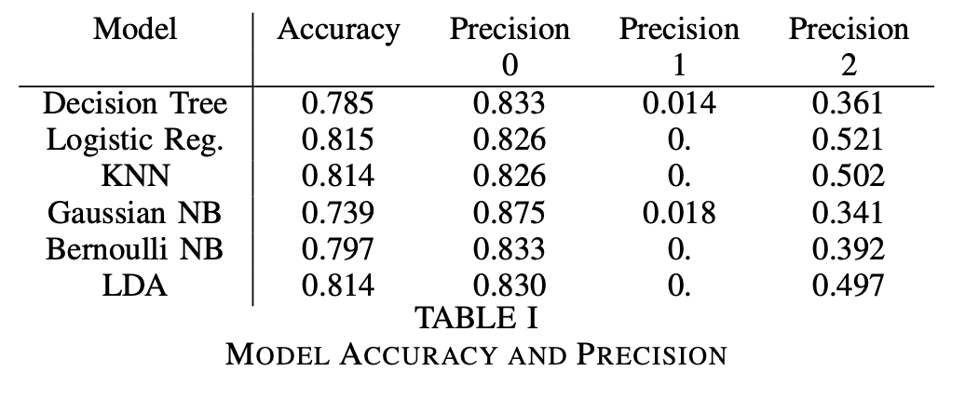
Results
Decision Tree
Gini Impurity Index
No maximum constraint
Logistic Regression
Stochastic Average Gradient Descent (SAGA)
No penalty
KNN
K = 25
Weighted distance using Euclidean
Naïve Bayes
Gaussian
Bernoulli
Linear Discriminant Analysis
Singular Value Decomposition (SVD)
Greatest Accuracy: Logistic Regression
Greatest Precision: Gaussian Naïve Bayes

Slide 6
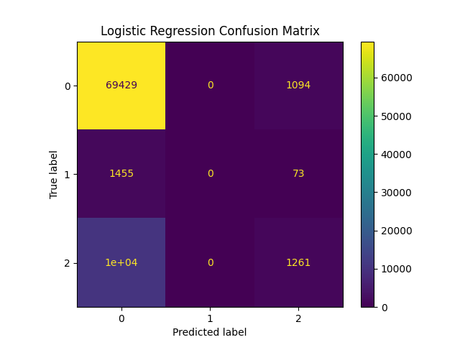
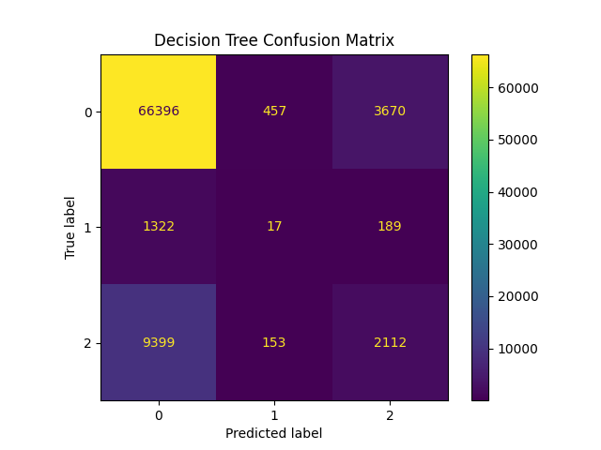
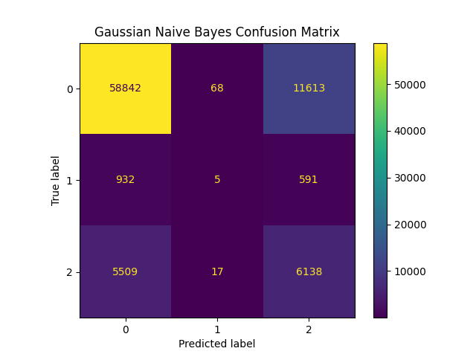
Results
Accuracy | .815
Precision | .826 | .0 | .521
Accuracy | .785
Precision | .833 | .014 | .361
Accuracy | .739
Precision | .875 | .018 | .341
Confusion Matrices

Slide 7
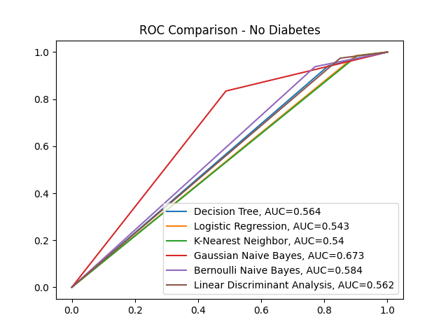
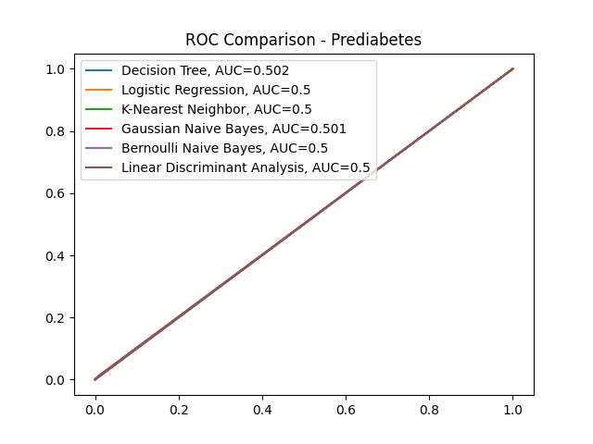
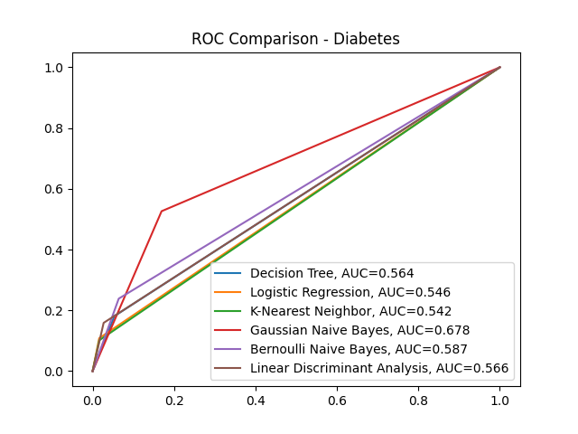
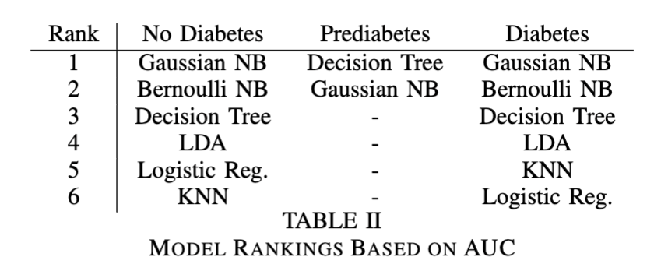
Results
Receiver Operating Characteristics Curves

Slide 8

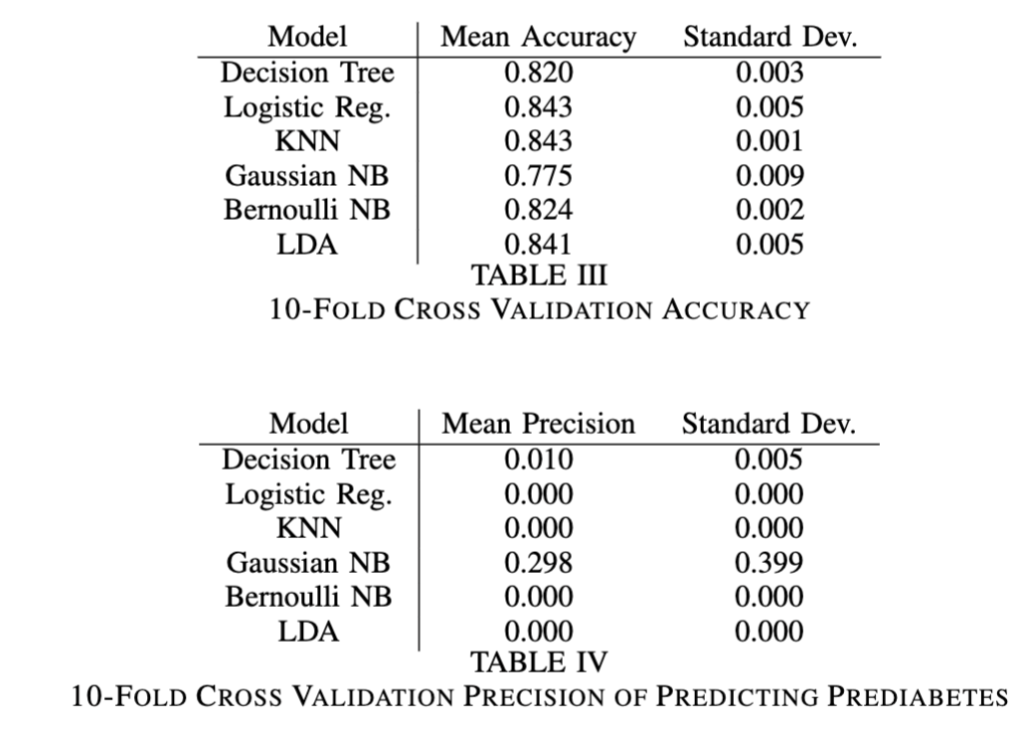
Discussion
Gaussian naïve Bayes classifier proved to be the best classification model for predicting diabetes
Accuracy versus Precision
When dealing with datasets with high imbalance, precision is a better performance indicator
High precision indicates fewer false positive predictions
High cost for misdiagnosis
Addressing the dataset’s imbalance to achieve better performing classification models
Resampling the data
Boosting or tree-based models
Collect more data

Slide 9

Citations
[1] “About Prediabetes and Type 2 Diabetes — National Diabetes Prevention Program — CDC.” Accessed: Nov. 23, 2023. [Online]. Available: https://www.cdc.gov/diabetes/prevention/about-prediabetes.html
[2] J. P. Crandall et al., “The prevention of type 2 diabetes,” Nat. Clin. Pract. Endocrinol. Metab., vol. 4, no. 7, pp. 382-393, Jul. 2008, doi: 10.1038/ncpendmet0843.
[3] “Diabetes Health Indicators Dataset.” Accessed: Nov. 23, 2023. [On-line]. Available: https://www.kaggle.com/datasets/alexteboul/diabetes-health-indicators-dataset
[4] L. Mueller and R. Hong, “Investigating Decision Trees”.
[5] ArnavR, “Scikit-learn solvers explained,” Medium. Accessed: Nov.25, 2023. [Online]. Available: https://medium.com/@arnavr/scikit-learn-solvers-explained-780a17bc322d
[6] L. Mueller and R. Hong, “Iris Classification Using Logistic Regression”.
[7] L. Mueller and R. Hong, “Evaluating the Performance of K-NearestNeighbors Classification”.7
[8] S. Ray, “Naive Bayes Classifier Explained: Applications and Practice Problems of Naive Bayes Classifier,” Analytics Vidhya. Accessed: Nov. 25, 2023. [Online]. Available:https://www.analyticsvidhya.com/blog/2017/09/naive-bayes-explained/
[9] L. Mueller, “Comparing Classifications Models Against the Naive Bayes Classifier and Linear Discriminant Analysis Model”.
[10] L. Mueller, “Evaluating Classifications Models using Confusion Matrices”.
[11] L. Mueller, “Ranking Classification Models using Receiver Operating Characteristics”.
[12] L. Mueller and R. Hong, “Using K-Fold Cross Validation on Decision Tree and Logistic Regression Models to Classify Iris Species”.
[13] “Accuracy vs. precision vs. recall in machine learning: what’s the difference?” Accessed: Nov. 26, 2023. [Online]. Available:https://www.evidentlyai.com/classification-metrics/accuracy-precision-recall
[14] R. Feki, “Imbalanced data: best practices,” Medium. Accessed: Nov. 26, 2023. [Online]. Available: https://rihab-feki.medium.com/imbalanced-data-best-practices-f3b6d0999f38

