Slide 1
Designing Testable Applications
Part I: Unit Tests

Slide 2
Agenda
Objectives
Unit Tests: Architecture Tips
Unit Tests: Architecture Samples
Feedback
Summary

Slide 3

Objectives
Divulge the use of best practices such as unit & integration testing and continuous integration
Provide developers with the necessary tools to design and develop applications using these practices (How?)
Advantages of using these practices (Why?)

Slide 4
Unit Tests: Architecture Tips & Samples

Slide 5
Tip 1: Program to an interface, not an implementation
Maintainability
Allows the internal implementation of the concrete classes to change without having to modify the application code.
Extensibility
Allows the creation of different concrete classes which implement the interface without having to modify the application code.
Testability (when used together with Tip 2)
Allows the use of Mock classes to unit test components
Application code does not depend on the concrete class

Slide 6
Tip 2: Use Constructor dependency injection
An injection is the passing of a dependency (a service) to a dependent object (a client). The service is made part of the client's state. The client does not build or find the service.
Requires the client to provide a parameter in a constructor for the dependency
public Constructor (IDependency dependency)
Removes all knowledge about a concrete implementation a client needs to use, promoting reusability, testability and maintainability
Mock objects can be injected for unit-testing
Adheres to Dependency inversion principle
Makes violations of the Single Responsibility Principle obvious
public Constructor(IClass1 c1, IClass2 c2, IClass3 c3, IClass4 c4, IClass5 c5, ……)
Dependency injection frameworks (IOC)
Ninject, SimpleInjector, Castle, Autofac, Unity, Spring.NET…

Slide 7
Tip 3: Favour composition over inheritance
Ideal for cases where a type will implement only some/part of the behaviour exposed by the superclass.
Allows subclasses to implement new functionality without affecting other subclasses.
Allows behaviour to change on the fly.
Prefer composition over inheritance as it is more malleable / easy to modify later, but do not use a compose-always approach

Slide 8
Tip 4: Generate Unit tests
How to write unit tests:
Setup preconditions
Execute the code to be tested
Assert on the expected results
A good unit test:
Documents your design
Has full control over all the pieces running
Can be run in any order if part of many other tests
Consistently returns the same result
Tests a single logical concept in the system
Is named clearly and consistently
Is readable
Is maintainable

Slide 9
Tip 5: Mock dependencies
Mock objects are simulated objects that mimic the behavior of real objects in controlled ways
Not all code is self contained
A unit test should test code without testing dependencies
Refer to Tips 1 and 2
Program to an interface, not an implementation
Use Constructor dependency injection
How to write unit tests using mocks:
Setup preconditions including the setup of mock objects
Inject mocked dependencies
Execute the code to be tested
Assert on the expected results
Verify that the mock object was called the expected number of times and with the expected parameters

Slide 10
Tip 6: Writing Testable Code
Don’t mix object graph instantiation with application logic
Ask for things, don't look for things
Don’t do work in constructor
Be careful with global state and singletons
Be careful with static methods
Favor polymorphism over conditionals
Don’t mix service objects with value objects
Don’t mix concerns

Slide 11
Tip 7: Use wrappers to encapsulate static dependencies
Avoids coupling your code directly to third-party libraries
You can change the third-party library without changing your code
Allows mocking of static third-party dependencies
Avoids the use of specific third-party library’s classes in your code
Do not always use wrappers for third-party dependencies

Slide 12
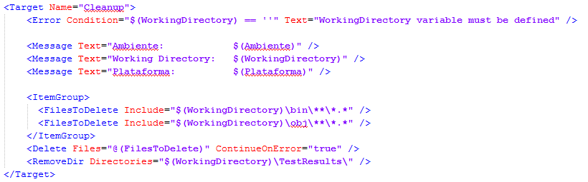
Tip 8: Create MSBuild configuration
Cleanup

Slide 13
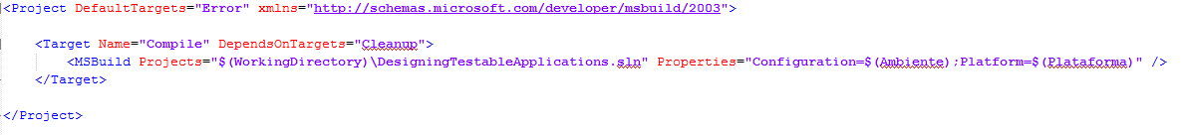
Tip 8: Create MSBuild configuration
Build solution

Slide 14
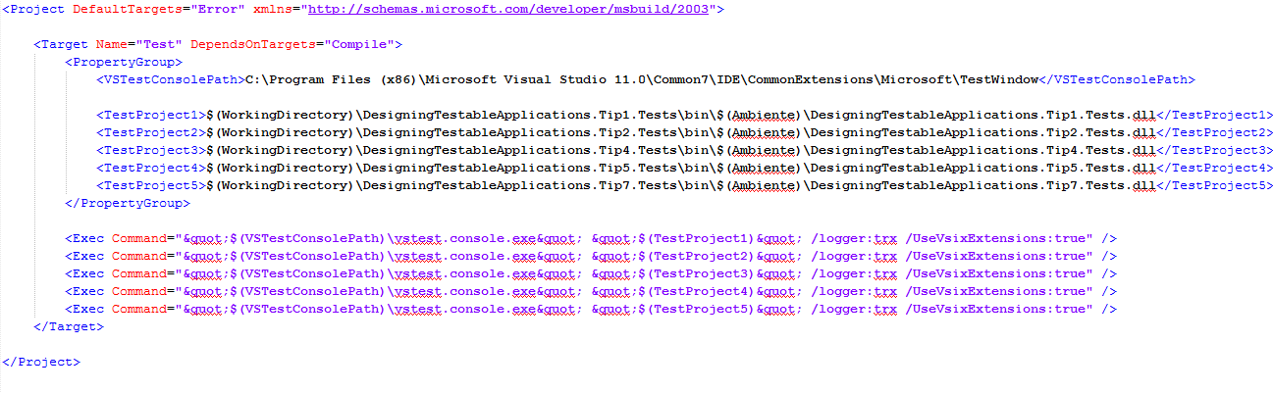
Tip 8: Create MSBuild configuration
Run Unit tests

Slide 15
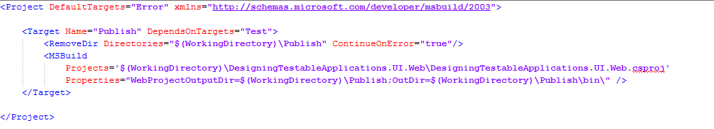
Tip 8: Create MSBuild configuration
Publish websites & services (optional)

Slide 16
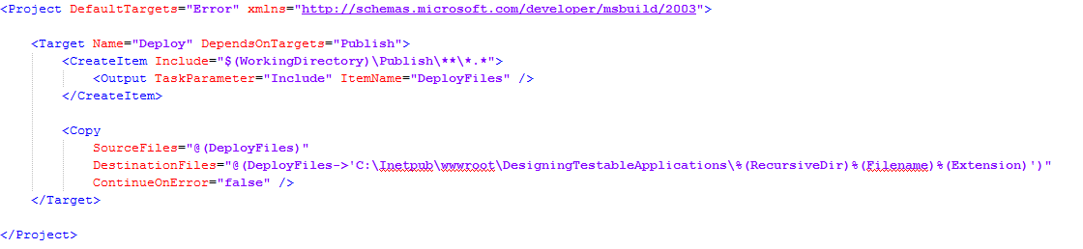
Tip 8: Create MSBuild configuration
Deploy (optional)

Slide 17
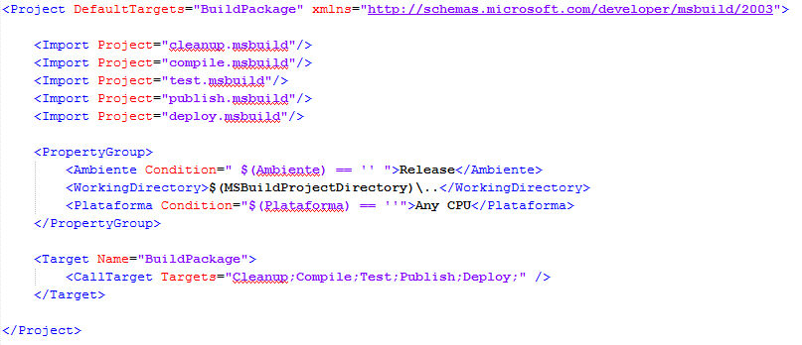
Tip 8: Create MSBuild configuration

Slide 18
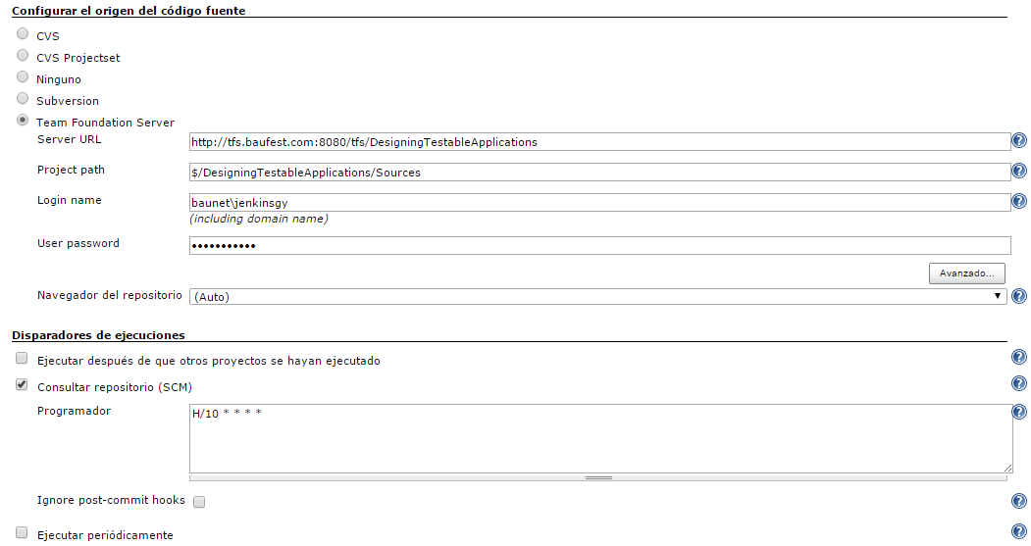
Tip 9: Upload solution to CI server
Set up CI Job (Jenkins)

Slide 19
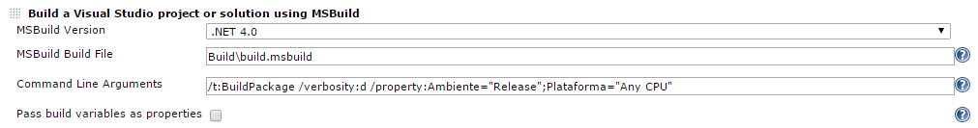
Tip 9: Upload solution to CI server
Run MSBuild file

Slide 20

Questions

Slide 21
Feedback

Slide 22
Feedback
What do you think about using these practices in your projects?
What advantages would you have by incorporating these practices in your current project?
What’s your take on the concepts of today’s talk?

Slide 23
Summary

Slide 24
Summary
These practices:
Make your code more maintainable
Minimize the number of errors in the final product
Allow early detection of errors in the development environment
Reduce development and maintenance time over the project’s lifecycle
Improve the quality of the final product

Slide 25
Summary
These practices will also:
Improve the development team’s internal organization
Maintain a current build always available for testing, demos or deployment
Allow you to generate metrics of code quality, test coverage, etc.

Slide 26
Part II: Scenes of the next episode…
Database Integration Tests
How to work with Legacy Code

Slide 27






Thanks! Leandro Goldin lgoldin@baufest.com Christian Smirnoff csmirnoff@baufest.com
USA
Tel +1 (617) 275-2420 1 Broadway 14th floor Cambridge, MA 02142
USA
Mexico
Tel.: +52 (55) 5531-8878 Fax: +52 (55) 5531-8878 Avda. Ejército Nacional 678, Col. Polanco Reforma,
Distrito Federal C.P. 11550
México D.F.
Argentina
Buenos Aires
Tel.: +54 (11) 4118-8080
Fax: +54 (11) 4118-8080
Roosevelt 1655
C1428BNC, Buenos Aires
Argentina
Santa Fe
Tel.: +54 (342) 412-0368
San Jerónimo 1838
S3000FPP, Santa Fe
Argentina
Spain
Tel.: +34 91 745-2763
Fax: +34 91 561-5626
c/ Francisco Giralte, 2
28002, Madrid
Spain

