Slide 1

Test-Oriented Development

Slide 2
Agenda
Objectives
Tip 1: Program to an interface, not an implementation
Tip 2: Use Constructor dependency injection
Tip 3: Favour composition over inheritance
Tip 4: Generate Unit tests
Tip 5: Mock dependencies
Tip 6: Writing Testable Code
Tip 7: Use wrappers to encapsulate static dependencies
Tip 8: Create MSBuild configuration
Tip 9: Upload solution to CI server

Slide 3
Objectives

Slide 4
Unit Test-oriented development Tips

Slide 5
Tip 1: Program to an interface, not an implementation
Maintainability
Allows the internal implementation of the concrete classes to change without having to modify the application code.
Extensibility
Allows the creation of different concrete classes which implement the interface without having to modify the application code.
Testability (when used together with Tip 2)
Allows the use of Mock classes to unit test components
Application code does not depend on the concrete class

Slide 6
Tip 2: Use Constructor dependency injection
An injection is the passing of a dependency (a service) to a dependent object (a client). The service is made part of the client's state. The client does not build or find the service.
Requires the client to provide a parameter in a constructor for the dependency
public Constructor (IDependency dependency)
Removes all knowledge about a concrete implementation a client needs to use, promoting reusability, testability and maintainability
Mock objects can be injected for unit-testing
Adheres to Dependency inversion principle
Makes violations of the Single Responsibility Principle obvious
public Constructor(IClass1 c1, IClass2 c2, IClass3 c3, IClass4 c4, IClass5 c5, ……)
Dependency injection frameworks (IOC)
Ninject, SimpleInjector, Castle, Autofac, Unity, Spring.NET…

Slide 7
Tip 3: Favour composition over inheritance
Ideal for cases where a type will implement only some/part of the behaviour exposed by the superclass.
Allows subclasses to implement new functionality without affecting other subclasses.
Allows behaviour to change on the fly.
Prefer composition over inheritance as it is more malleable / easy to modify later, but do not use a compose-always approach

Slide 8
Tip 4: Generate Unit tests
How to write unit tests:
Setup preconditions
Execute the code to be tested
Assert on the expected results
A good unit test:
Documents your design
Has full control over all the pieces running
Can be run in any order if part of many other tests
Consistently returns the same result
Tests a single logical concept in the system
Is named clearly and consistently
Is readable
Is maintainable

Slide 9
Tip 5: Mock dependencies
Mock objects are simulated objects that mimic the behavior of real objects in controlled ways
Not all code is self contained
A unit test should test code without testing dependencies
Refer to Tips 1 and 2
Program to an interface, not an implementation
Use Constructor dependency injection
How to write unit tests using mocks:
Setup preconditions including the setup of mock objects
Inject mocked dependencies
Execute the code to be tested
Assert on the expected results
Verify that the mock object was called the expected number of times and with the expected parameters

Slide 10
Tip 6: Writing Testable Code
Don’t mix object graph instantiation with application logic
Ask for things, don't look for things
Don’t do work in constructor
Be careful with global state and singletons
Be careful with static methods
Favor polymorphism over conditionals
Don’t mix service objects with value objects
Don’t mix concerns

Slide 11
Tip 7: Use wrappers to encapsulate static dependencies
Avoids coupling your code directly to third-party libraries
You can change the third-party library without changing your code
Allows mocking of static third-party dependencies
Do not always use wrappers for third-party dependencies

Slide 12
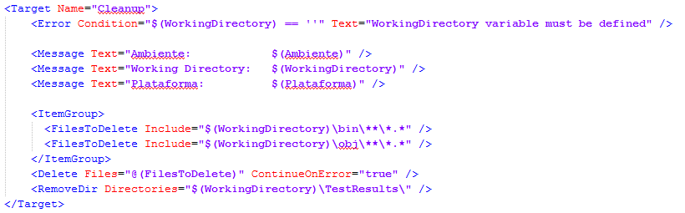
Tip 8: Create MSBuild configuration
Cleanup

Slide 13
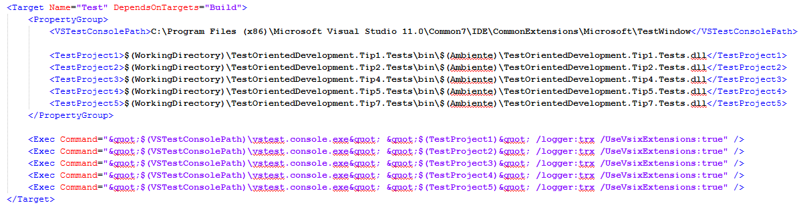
Tip 8: Create MSBuild configuration
Build solution
Run Unit tests

Slide 14
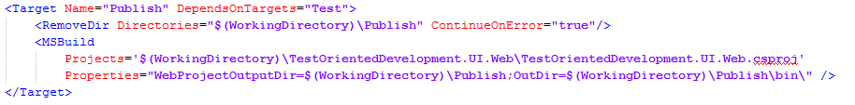
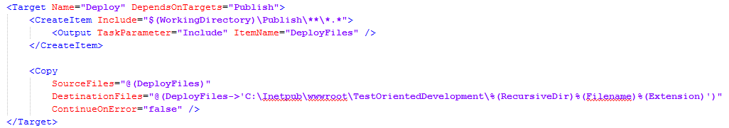
Tip 8: Create MSBuild configuration
Publish websites & services (optional)
Deploy (optional)

Slide 15
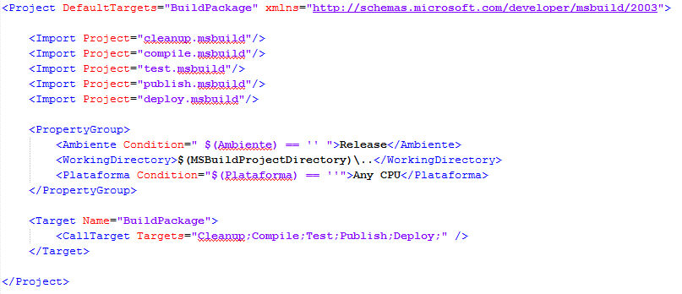
Tip 8: Create MSBuild configuration

Slide 16
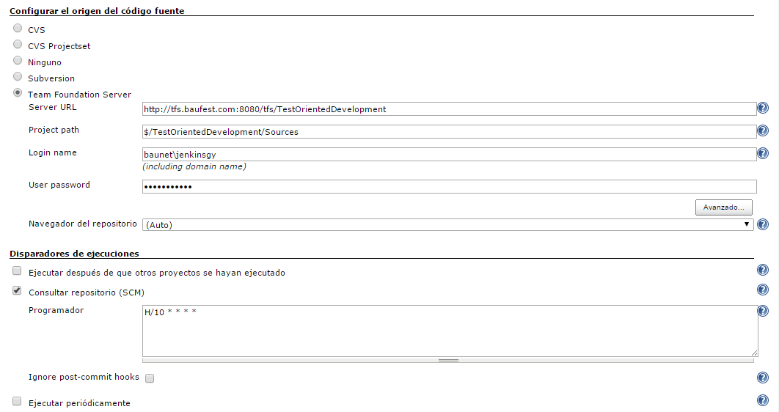
Tip 9: Upload solution to CI server
Set up CI Job (Jenkins)

Slide 17
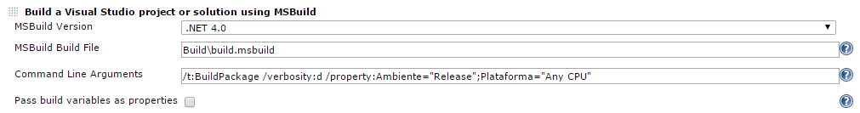
Tip 9: Upload solution to CI server
Run MSBuild file

Slide 18
DB Integration test-oriented development Tips

Slide 19
Tip 1: Generate creation scripts for DB, Tables, Views, SPs, Functions

Slide 20
Tip 2: Generate “master” data insertion scripts

Slide 21
Tip 3: Execute scripts automatically

Slide 22
Tip 4: Setup CI to regenerate DB on each build

Slide 23
Tip 5: Setup test data (initialization & cleanup)

Slide 24
Tip 6: Generate Integration tests

Slide 25
Tip 7: Add task to CI

Slide 26
Working with Legacy code

Slide 27
Tip 1: Decouple method code

Slide 28
Tip 2: Test method

Slide 29
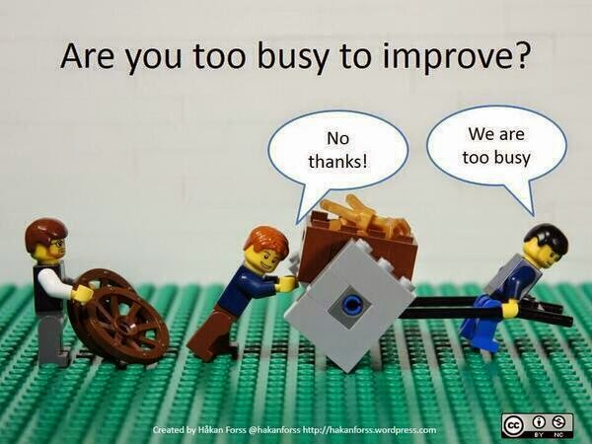
Tip 3: Refactoring

Slide 30

¡Muchas Gracias!
Argentina
Tel.: +54 (11) 4118-8080
Fax: +54 (11) 4118-8080
Roosevelt 1655
C1428BNC, Buenos Aires
Argentina
México
Tel.: +52 (55) 5284-2842 Fax: +52 (55) 5284-2803 Avda. Ejército Nacional 678, Col. Polanco Reforma,
Distrito Federal C.P. 11550
México D.F.
USA
Tel +1 (617) 275-2420 1 Broadway 14th floor Cambridge, MA 02142
EE.UU
España
Tel.: +34 91 745-2763
Fax: +34 91 561-5626
c/ Francisco Giralte, 2
28002, Madrid
España
info@baufest.com
baufest.com
Santa Fe
Tel.: +54 (342) 412-0368
San Jerónimo 1838
S3000FPP, Santa Fe
Argentina

