Slide 1
Crossbar Scheduling Algorithms for Input-Queued Switches
Long Gong
Committee: Jun (Jim) Xu (Advisor),
Mostafa H. Ammar, Ellen W. Zegura, Siva Theja Maguluri, Bill Lin
Notes:
Hello everyone. Welcome to my defense presentation.
My name is Long Gong, and my advisor is Prof. Jim Xu.
My thesis presentation topic is Crossbar …

Slide 2
Input-Queued Crossbar Switches
Background & Motivation
SERENADE
QPS
QPS-r
SB-QPS
Packets
Input 1
VOQ 1
Crossbar
Output 1
Segment
Assemble
VOQ N
Input N
VOQ 1
Output N
Segment
Assemble
VOQ N
Segment variable-size packets into fixed-size
Reassemble packets before they leave
Notes:
Nowadays, many high-performance switching systems employ a single crossbar to interconnect the input ports and the output ports.
To solve the HOL blocking issue, each input port has N virtual output queues (VOQs). The VOQ j at input port I serves as a buffer for packets going from input port I to output port j.
For example, here the VOQ 1 at input port 1 buffers the packets that want to go from input port 1 to output port 1.
In this presentation, we also adopt the standard assumption. That is all incoming packets are segmented into fixed-size before they are put into the corresponding VOQs and then reassembled
before they leave the switch.
Note that many commercial high-performance input-queued switches do use this approach.

Slide 3
Crossbar Scheduling: Definition
Background & Motivation
SERENADE
QPS
QPS-r
SB-QPS
Which input connects to which output?
Input 1
VOQ 1
Crossbar
Output 1
Input 1
Output 1
VOQ N
Input 2
Output 2
?
Input N
VOQ 1
Output N
VOQ N
Input N
Output N
During each switching cycle, or time slot
Each input can only connect to a single output
Each output can only be connected by a single input
Notes:
In an input-queued switch, each input port can only connect to a single output port and vice versa in each switching cycle, or time slot.
Hence, input-queued switches need to decide which input port connects to which output port per time slot. More specially, they need to compute a one-to-one matching between input ports and output ports.
That is the task of the crossbar scheduling algorithm.

Slide 4

Crossbar Scheduling: Model (1/2)
Background & Motivation
SERENADE
QPS
QPS-r
SB-QPS
Abstraction
N$×$ N Crossbar Switch
Bipartite Graph
Input 1
VOQ 1
Crossbar
Output 1
Input 1
Output 1
VOQ N
Input 2
Output 2
Input N
VOQ 1
Output N
VOQ N
Input N
Output N
Notes:
An NXN crossbar is generally modeled as a weighted bipartite graph, with the N input ports and the N output ports represented as the two disjoint vertex sets, respectively.
An edge between an input i and an output port j corresponds to the VOQ j at the input port i, and its weight is the queue length (\ie the number of packets buffered) of the VOQ.
Clearly, under such a model, each valid crossbar schedule, i.e., which input port connects to which output port during each switching cycle, is just a matching in this bipartite graph.

Slide 5
Crossbar Scheduling: Model (2/2)
Background & Motivation
SERENADE
QPS
QPS-r
SB-QPS
Input 1
VOQ 1
Crossbar
VOQ 2
Output 1
Input 1
Output 1
VOQ 3
VOQ 4
Input 2
VOQ 1
VOQ 2
Output 2
Input 2
Output 2
VOQ 3
VOQ 4
Input 3
VOQ 1
VOQ 2
Output 3
Input 3
Output 3
VOQ 3
VOQ 4
Input 4
VOQ 1
VOQ 2
Output 4
Input 4
Output 4
VOQ 3
VOQ 4
Notes:
Let’s see a simple example. Here, we use the thicknesses to represent the weight of each edge in the bipartite graph.
We note that some crossbar scheduling algorithms will not use the weight information

Slide 6
Examples of Matchings
Background & Motivation
SERENADE
QPS
QPS-r
SB-QPS
Maximal Matching
Maximum Cardinality Matching
Maximum Weighted Matching
Notes:
Here, we show three important types of bipartite matchings and use those of the bipartite graph shown in the previous slide.
MM: it is no longer a matching, when any edge not in S is added to it
MCM: A matching with the largest possible number of edges.
These two matchings do not take into the weight information into consideration.
that has the largest total weight among all matchings.
Any MCM or MWM is also a MM, but neither converse is generally true.

Slide 7
Examples of Matchings
Background & Motivation
SERENADE
QPS
QPS-r
SB-QPS
Maximal Matching
Maximum Cardinality Matching
Maximum Weighted Matching
Notes:
Here, we show three important types of bipartite matchings and use those of the bipartite graph shown in the previous slide.
MM: it is no longer a matching, when any edge not in S is added to it
MCM: A matching with the largest possible number of edges.
These two matchings do not take into the weight information into consideration.
that has the largest total weight among all matchings.
Any MCM or MWM is also a MM, but neither converse is generally true.

Slide 8
Crossbar Scheduling: (Informal) Formulation
Background & Motivation
SERENADE
QPS
QPS-r
SB-QPS
objective maximize throughput; and/or
minimize (mean) delay
subject to
Throughput: the average number of packets that exit an output port during each time slot
Matching Constraint
Timing Constraint
Delay: the number of time slots elapsed since the arrival of a packet to its eventual departure from the switch
The connections between the input and output ports should be a valid matching.
For example, at 40 Gbps, 64-byte packets require one matching every 12.8 ns.
Implementation Constraint
The algorithm should be simple to implement in hardware.
Notes:
The goal of crossbar scheduling is to compute “high-quality” matchings that can maximize the throughput and minimize the queueing delay.
Besides the matching constraint, there are some other constraints for crossbar scheduling. The timing constraint, …
Since the crossbar scheduling algorithms mostly implemented in hardware, therefore, the scheduling policy should be simple to implement in hardware.
Let’s remove the timing and implementation constraints from this formulation, but keep in mind that a desired crossbar scheduling algorithm should have very low time complexity and should be simple to implement.

Slide 9



Existing Research Work: Optimal Policies for Throughput
Background & Motivation
SERENADE
QPS
QPS-r
SB-QPS
objective maximize throughput
subject to
attain 100% throughput
matching constraint
The connections between the input and output ports should be a valid matching.
Maximum Weighted Matching (MWM) [McKeown99]
SERENA [Giaccone03]
Fair-Frame [Neely07]
Maximum Cardinality Matching (MCM) cannot attain 100% throughput [Keslassy03]
Notes:
First, let’s only consider the objective of maximizing the throughput, since it is much simpler.
For this optimization problem, many optimal solutions or policies, have been proposed and proved by various researchers.
For example, …
You might think that maximum cardinality matching should also be among those optimal policies, since it maximizes the instantaneous throughput every switching cycle, or in other words, it tries to transmit
as many as possible packets for each switching cycle. Suprisingly, it have been proved that MCM cannot attain 100%.

Slide 10


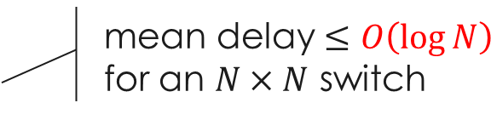
Existing Research Work : “The Best Policy” for (Mean) Delay
Background & Motivation
SERENADE
QPS
QPS-r
SB-QPS
objective minimize (mean) delay
subject to
matching constraint
The connections between the input and output ports should be a valid matching.
mean delay $≤O\left(\log{N}\right)$ for an $N×N$ switch
Fair-Frame [Neely07]
Notes:
Now let’s consider the objective of minimizing the mean delay. As expected, this problem is much more complicated. To the best of my knowledge, no optimal policy have been found until today.
The best policy along this objective is Fair-Frame. It provably attains 100% and achieves a mean delay no larger than O(log N). We note that here “The Best Policy” is placed in double quotation marks because it is only the best theoretical result that has been proved.
As we will show later, empirically, the average queueing delay of Fair-Frame is much higher than that of MWM.

Slide 11
Crossbar Scheduling: Tradeoff
Background & Motivation
SERENADE
QPS
QPS-r
SB-QPS
Quality of the matching
Time to compute the matching
Notes:
In the previous few slides, we only considered the matching constraint. However, when designing crossbar scheduling algorithms, the other two constraints, especially the timing constraint has to be considered.
Because there is a well-known tradeoff between the quality of the matching and the amount of time needed to compute the matching.

Slide 12





Existing Research Work
Background & Motivation
SERENADE
QPS
QPS-r
SB-QPS
RR/LQF [Hu16] | <100% |  | $$O(\log{N})$$ parallel
HRF [Hu18] | <100% |  | $$O(1)$$ parallel
iSLIP [McKeown99a] | <100% |  | $$O(\log^{2}N)$$ parallel
SERENA [Giaccone03] | 100% |  | $$O(N)$$ centralized
Fair-Frame [Neely07] | 100% |  | $$O(N^{1.5}\log{N})$$ centralized
MWM [McKeown99] | 100% |  | $$O(N^{2.5}\log{W})$$ centralized
throughput
(average) delay
complexity
Notes:
For example, …

Slide 13
Scheduling for Input-Queued Crossbar Switches: Motivation
Background & Motivation
SERENADE
QPS
QPS-r
SB-QPS
Achieve better tradeoff
Quality of the matching
Time to compute the matching
Notes:
The target of this work is to achieve better tradeoff.
Clearly, we can either improve the quality of the matchings or decrease the computational complexity. In this work, we proposed a solution to improve the performance with very low computational overhead.

Slide 14
Research Aspects in This Thesis
Background & Motivation
SERENADE
QPS
QPS-r
SB-QPS
1
Efficient bipartite matching algorithms
low in time complexities
excellent throughput and delay performances
2
Theoretical analysis
throughput analysis
delay bound analysis
Notes:
This work consists of two research aspects. The first aspect is to investigate …, The second aspect is to analyze the throughput and delay performance guarantees of some of the proposed algorithms. In the presentation, I will focus on the first aspect. Details on the second aspect can be found in my thesis.

Slide 15
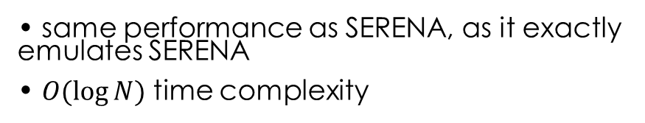
Research Contribution
Background & Motivation
SERENADE
QPS
QPS-r
SB-QPS
SERENADE
[HPSR’20]
same performance as SERENA, as it exactly emulates SERENA
$O(\log{N})$ time complexity
throughput
QPS
[SIGMETRICS’17]
general add-on approach to boost the performance of existing algorithms
O(1) additional time complexity
throughput
QPS-r
[ValueTools’20]
comparable performance as maximal matching algorithms
O(1) time complexity
throughput
delay
much better throughput performance than QPS-r
O(1) time complexity
SB-QPS
Notes:
Along the two research aspects, we have made four breakthroughs. Our first breakthrough is SERENADE that exactly emulates SERENA and has a low per-port time complexity of O(log N). Since SERENADE exactly emulates SERENA, it can also attain 100% throughput. Our second breakthrough is Queue-Proportional Sampling (QPS). QPS is a general add-on approach to augment and significantly boost the throughput and delay performances of other crossbar scheduling algorithms such as iSLIP and SERENA. O(1) … We have proved that one of QPS-augmented algorithm, called QPS-SERENA, can attain 100% throughput. Our third breakthrough is QPS-r, a standalone parallel iterative algorithm that simply runs r iterations of QPS to compute a matching with O(1) time complexity per port. Yet, it has comparable throughput and delay performances as the maximal matching algorithms both in theory and in practice. We have proved that QPS-r can attain at least 50% throughput and guarantee an average delay bound independent of switch size.
Building upon QPS and QPS-r, we have made our last breakthrough: Small-Batch QPS (SB-QPS), a batch scheduling algorithm that has much better throughput performance than QPS-r, yet also has a time complexity of O(1).

Slide 16
Research Contribution
Background & Motivation
SERENADE
QPS
QPS-r
SB-QPS
SERENADE
[HPSR’20]
same performance as SERENA, as it exactly emulates SERENA
$O(\log{N})$ time complexity
throughput
QPS
[SIGMETRICS’17]
general add-on approach to boost the performance of existing algorithms
O(1) additional time complexity
throughput
QPS-r
[ValueTools’20]
comparable performance as maximal matching algorithms
O(1) time complexity
throughput
delay
much better throughput performance than QPS-r
O(1) time complexity
SB-QPS
Notes:
We have described the first three breakthroughs in detail in my thesis proposal last year as preliminary research works, so in this presentation, we will make a quick review of them and then dive into the last piece of this work, which is the proposed work in my thesis proposal.

Slide 17
Background & Motivation
SERENADE
QPS
QPS-r
SB-QPS
100% throughput
SERENADE: A Parallel Iterative Algorithm for
Crossbar Scheduling in Input-Queued Switches
Parallelizing SERENA
Quality of the matching
Time to compute the matching
Notes:
Our first algorithm, SERENADE, achieved better tradeoff by parallelizing SERENA.

Slide 18
SERENA: Overview
Background & Motivation
SERENADE
QPS
QPS-r
SB-QPS
SERENA
Arrival graph
Full matching
Final
Matching
Matching in the previous time slot
Notes:
To explain SERENADE, we first describe SERENA.
SERENA consists of two steps. The first step is to derive a full matching from the set of packet arrivals. The second step is to merge this full matching with the full matching used in the previous time slot, to arrive at the full matching to be used
for the current time slot.

Slide 19
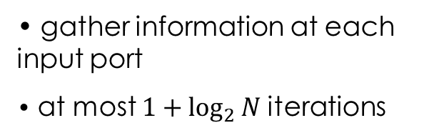
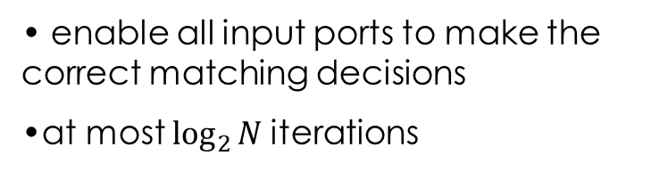
SERENADE: Overview
Background & Motivation
SERENADE
QPS
QPS-r
SB-QPS
SERENA
Easy to parallelize
Hard to parallelize
Arrival graph
Full matching
Final
Matching
Matching in the previous time slot
SERENADE (SERENA, the Distributed Edition)
Knowledge Discovery
(Distributed) Binary Search
gather information at each input port
at most $1+\log_{2}{N}$iterations
enable all input ports to make the correct matching decisions
at most $\log_{2}{N}$iterations
Notes:
Although the first step of deriving a full matching from the arrival graph alone has a computational complexity of O(N). We have shown in our paper that this step can be solved with a classical parallel algorithm, whose per-port computational complexity is O(log N).
Parallelizing the second step - the merge procedure, which also has a computational complexity of O(N), is much more challenging. The primary contribution of SERENADE is to reduce this complexity to O(log N) per port via parallelization.
SERENADE consists of two stages: The knowledge-discovery stage and the distributed binary search stage.
The knowledge-discovery stage is to gather information at each input port. It has at most 1+logn iterations.
After this stage, some input ports might be able to make the same decisions as they would under SERENA, whereas other input ports are not able to do so.
Then, in the distributed binary search stage, those input ports will also be able to make the same matching decisions as they would do under SERENA by performing an additional distributed binary search for the designated input port in each cycle

Slide 20
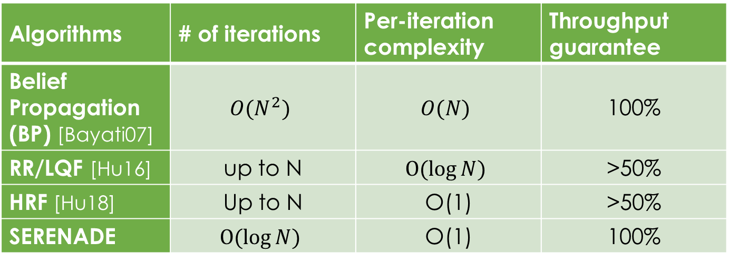
Comparison against Prior Parallel Iterative Algorithms
Background & Motivation
SERENADE
QPS
QPS-r
SB-QPS
Algorithms | # of iterations | Per-iteration complexity | Throughput guarantee
Belief Propagation (BP) [Bayati07] | $${O(N}^{2})$$ | $$O(N)$$ | 100%
RR/LQF [Hu16] | up to N | $$O(log{N})$$ | >50%
HRF [Hu18] | Up to N | O(1) | >50%
SERENADE | $$O(log{N})$$ | O(1) | 100%
Notes:
Now, let’s compare our SERENADE with some representative parallel iterative algorithms that also have throughput performance guarantees. A family of parallel iterative algorithms, based on belief-propagation (BP), emulate the computation of MWM with O(N2 ) iterations, each of which has O(N) time complexity.
Unlike BP and SERENADE, many parallel iterative algorithms do not make use of the edge weight (queue length) information. Those algorithms usually compute, with up to N iterations, another type of matching called maximal matching. Two state-of-the-art algorithms in this family are RR/LQF (Round Robin combined with Longest Queue First) and HRF (Highest Rank First). We note that both RR/LQF and HRF usually only run one or two iterations to reduce time complexity by sacrificing performance guarantee (i.e., at least 50% throughput guarantee).

Slide 21
Background & Motivation
SERENADE
QPS
QPS-r
SB-QPS
100% throughput
ONLY for
QPS-SERENA
Queue-Proportional Sampling: A Better Approach to Crossbar
Scheduling for Input-Queued Switches
Boost the performances of existing algorithms
Quality of the matching
Time to compute the matching
Notes:
Now, let’s make a review of QPS that achieved better tradeoff by boosting the performances of the existing crossbar scheduling algorithms.

Slide 22
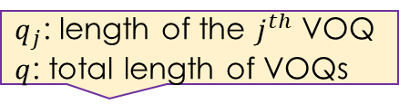
Queue-Proportional Sampling (QPS): Overview
Background & Motivation
SERENADE
QPS
QPS-r
SB-QPS
Proposing (at any input port)
$q_{j}$: length of the $j^{th}$ VOQ
$q$: total length of VOQs
Step 1: Sample an output port $j$ with probability $\frac{q_{j}}{q}$
Step 2: Send $q_{k}$ to output port $k$ (assume $k$ is sampled is Step 1)
Accepting (at any output port)
Accept the one with the largest VOQ length if receiving one or more proposals
Notes:
QPS has two stages: proposing and accepting.
In the proposing stage, each input port first samples out an output port with the probability proportional to the corresponding VOQ length, then the input port sends a proposal requests together with the VOQ length to the output port that is sampled.
In accepting stage, each output port upon receiving one or more proposals, it accepts the one with the largest VOQ length. Note that, besides the “longest VOQ first”, we also investigate other accepting strategies, such as proportional accepting.

Slide 23

QPS-Augmented Schemes
Background & Motivation
SERENADE
QPS
QPS-r
SB-QPS
iSLIP
Request
Grant
Accept
run $\log_{2}{N}$ iterations
Notes:
We let’s see how iSLIP and SERENA are augmented by our QPS.
ISLIP is a parallel iterative crossbar scheduling algorithm. Each iteration contains three stages: request, grant, and accept.
In the request stage, each input port sends requests to all output ports of which the corresponding VOQs are not empty.
In the grant stage, each output port, upon receiving requests from multiple input ports, grants to one in a round-robin order, enforced through a grant pointer.
Finally, in the accept stage, each input port, upon receiving grants from multiple output ports, accepts one in a round-robin order, enforced similarly through an accept pointer.
iSLIP usually runs log N iterations.

Slide 24
QPS-Augmented Schemes
Background & Motivation
SERENADE
QPS
QPS-r
SB-QPS
QPS-iSLIP
Only those un-matched ports in QPS
QPS
Request
Grant
Accept
run $\log_{2}{N}$ iterations
Notes:
QPS-augmented iSLIP, namely QPS-iSLIP can be viewed as adding a 0^{th} iteration. In this iteration, QPS is executed to generate a starter matching.
This starter matching is the refined by iSLIP.

Slide 25
QPS-Augmented Schemes
Background & Motivation
SERENADE
QPS
QPS-r
SB-QPS
QPS-iSLIP
Only those un-matched ports in QPS
QPS
Request
Grant
Accept
run $\log_{2}{N}$ iterations
SERENA
Arrival graph
Full matching
Final
Matching
Matching in the previous time slot
Notes:
As mentioned earlier, SERENA is a good crossbar scheduling algorithm that attains 100% throughput with a computational complexity of O(N).
Recall that, it first derives a full matching from the arrival graph, and then merge this full matching with
the matching used in the previous time slot. The only difference between SERENA and QPS augmented SERENA, namely QPS-SERENA is that
QPS-SERENA replaces the arrival graph with a starter matching generated by QPS.

Slide 26
QPS-Augmented Schemes
Background & Motivation
SERENADE
QPS
QPS-r
SB-QPS
QPS-iSLIP
Only those un-matched ports in QPS
QPS
Request
Grant
Accept
run $\log_{2}{N}$ iterations
QPS-SERENA
QPS
Arrival graph
Full matching
Final
Matching
Matching in the previous time slot
Notes:
The only difference between SERENA and QPS augmented SERENA, namely QPS-SERENA is that
QPS-SERENA replaces the arrival graph with a starter matching generated by QPS.

Slide 27
Maximum Achievable Throughput: QPS-iSLIP vs. iSLIP
Background & Motivation
SERENADE
QPS
QPS-r
SB-QPS
Simulation Setup
32X32 switch
i.i.d. Bernoulli arrivals
an offered load close to1
improvement
0 | 0.1768 | 0.1261 | 0.0489
Traffic | Uniform | Quasi-diagonal | Log-Diagonal | Diagonal
iSLIP | 100.00% | 81.70% | 83.85% | 83.47%
QPS-iLSIP | 100.00% | 99.38% | 96.46% | 88.35%

Slide 28
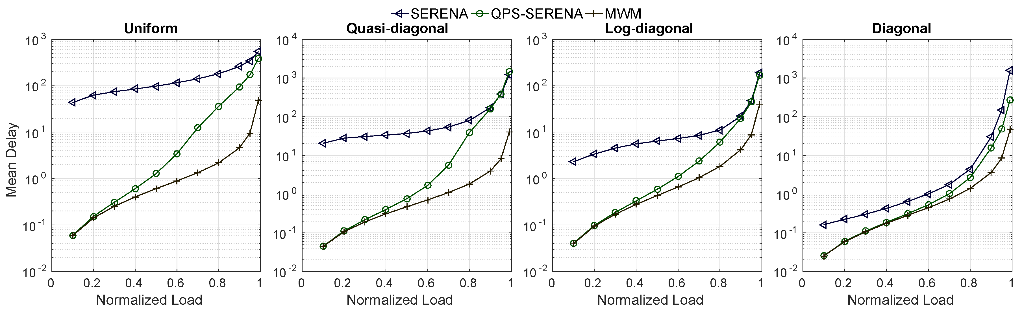
Mean Delay: QPS-SERENA vs. SERENA
Background & Motivation
SERENADE
QPS
QPS-r
SB-QPS
Simulation Setup
32X32 switch
i.i.d. Bernoulli arrivals
offered loads from 0 to 1
average queueing delay measured in number of time slots or switching cycles
Mean Delay
Normalized Load
QPS-SERENA is up to 1000x better than SERENA
Notes:
Now, we compare the delay performances of QPS-SERENA with those of SERENA. The results are shown in the figure, where the x-axis is the normalized load ranging from 0 to 1, and the y-axis is the mean delay, more precisely, the average queueing delay measured … Note that the y-axis is in log-scale.

Slide 29
Background & Motivation
SERENADE
QPS
QPS-r
SB-QPS
>50% throughput
order-optimal delay bound
delay bound is independent of switch size
QPS-r: A Cost-Effective Iterative Switching Algorithm for Input-Queued Switches
New O(1) algorithm
Same performance as maximal matchings
Quality of the matching
Time to compute the matching
Notes:
Now, let’s make a quick review of our three breakthrough, QPS-r, it achieved better tradeoff by producing matchings that have the same quality as those produced by MM, yet having a much lower time complexity.

Slide 30


QPS-r: Overview
Background & Motivation
SERENADE
QPS
QPS-r
SB-QPS
QPS-iSLIP
Only those un-matched ports in QPS
QPS
Request
Grant
Accept
run $\log_{2}{N}$ iterations
QPS-r
Only those un-matched ports in QPS
QPS
QPS Proposing
LVF Accepting
Longest VOQ First
run $r−1$ iterations
Notes:
Like QPS-iSLIP, QPS-r can be viewed as a QPS-augmented crossbar scheduling algorithm, more precisely, after generating a starter matching, we use QPS again to refine the matching to arrive at a final matching.

Slide 31
QPS-r: Overview
Background & Motivation
SERENADE
QPS
QPS-r
SB-QPS
QPS-iSLIP
Only those un-matched ports in QPS
QPS
Request
Grant
Accept
run $\log_{2}{N}$ iterations
QPS-r
Longest VOQ First
QPS Proposing
LVF Accepting
run r (QPS) iterations
Notes:
Or in other words, QPS-r simply runs r iterations of QPS to arrive at a final matching.

Slide 32
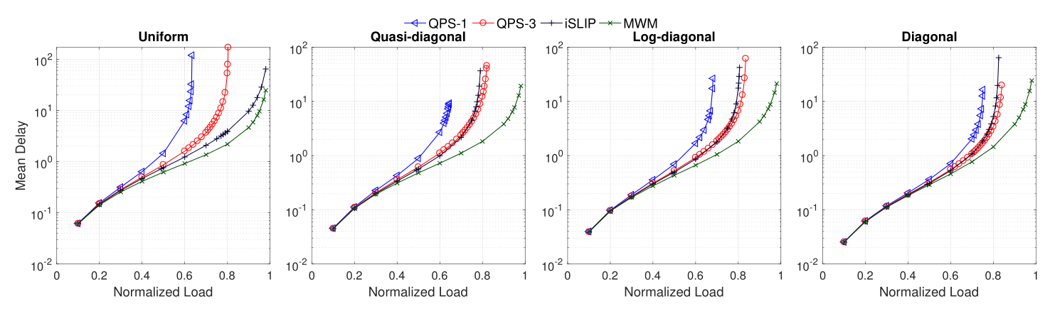
Mean Delay: QPS-r vs iSLIP
Background & Motivation
SERENADE
QPS
QPS-r
SB-QPS
Simulation Setup
64X64 switch
i.i.d. Bernoulli arrivals
offered loads from 0 to 1
Mean Delay
Normalized Load
QPS-3 delivers slightly better delay performance than iSLIP under all non-uniform traffic patterns

Slide 33
Small-Batch QPS (SB-QPS)
Background & Motivation
SERENADE
QPS
QPS-r
SB-QPS
Same complexity as QPS-r
Better throughput performance than QPS-r
Quality of the matching
Time to compute the matching
Notes:
Finally, let’s dive to our last algorithm, SB-QPS, that has same time complexity as QPS-r, yet delivers better throughput performance than QPS-r

Slide 34
Small Batch QPS (SB-QPS): Motivation (1/2)
Background & Motivation
SERENADE
QPS
QPS-r
SB-QPS
Observations
The throughput of QPS-3 is only around 80% (under uniform traffic)
80%
75%
63%
(maximum sustainable) throughput of QPS-r grows very slowly with r
r=1
r=2
r=3
Maximum sustainable throughput of QPS-r for uniform traffic
Notes:
As we have shown, QPS-r strikes excellent balance between the quality of the matching and the amount of time needed to compute a matching.
However, even when r = 3, its throughput is only around 80%. And this throughput grows very slowly.
This motivates us to design …

Slide 35


Small Batch QPS (SB-QPS): Motivation (2/2)
Background & Motivation
SERENADE
QPS
QPS-r
SB-QPS
Iteration 1
Iteration 2
Case I: multiple input ports propose to the same output port
Case II: an input port proposes to an output port that was matched in previous iterations
better proposing strategy with less collisions
relatively low throughput
accepting strategy that can address collisions better
SB-QPS
Notes:
Recall that in QPS-r, when an output port gets multiple proposals, it simply accepts the one with the longest VOQ length, and all other proposals are discarded.
Besides, when an input port proposed to …, this proposal will always be rejected in QPS-r.
Both cases result in the relatively low throughput in QPS-r. One possible solution is to design better … without increasing the time complexity. However, it is a complicated task.
In this work, we adopt another possible solution. That is to design new accepting strategy that can address the above two cases of collisons better by exercising another degree of freedom when accepting.

Slide 36


Batch Scheduling
Background & Motivation
SERENADE
QPS
QPS-r
SB-QPS
(Regular) Crossbar Scheduling Algorithm
$$t$$
Batch size T is desired to be small
Batch Scheduling Algorithm
T time slots
T time slots
T time slots
T time slots
$$t$$
Notes:
In all the algorithms we described in earlier slides, a matching decision is made every time slot.
An alternative type of algorithm is called batch scheduling, in which multiple consecutive time slots are grouped as a batch. The matching decisions are batch-computed.
As indicated by its name, SB-QPS is a batch scheduling algorithm.
It is desired that the batch size T should be small because a packet arriving at the beginning of a batch has to wait until at least the beginning of the next batch. In other words, a larger batch size usually will result in higher packet delay.

Slide 37
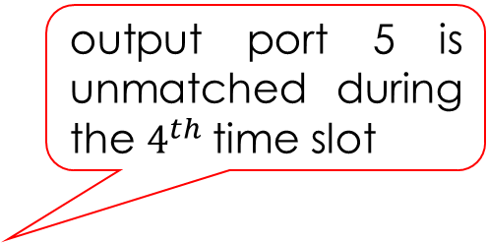
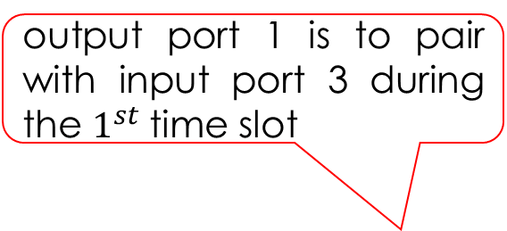

The Joint Calendar (Schedule)
Background & Motivation
SERENADE
QPS
QPS-r
SB-QPS
output port 1 is to pair with input port 3 during the $1^{st}$time slot
Output Ports
$$O_{1}$$ | $$O_{2}$$ | $$O_{3}$$ | $$O_{4}$$ | $$O_{5}$$ | $$O_{6}$$ | $$⋯$$ | $$O_{N}$$
1
2
3
4
5
$$⋮$$
T
$$I_{3}$$ | $$−$$ | $$I_{N}$$ | $$I_{1}$$ | $$I_{2}$$ | $$−$$ | $$⋯$$ | $$I_{5}$$
output port 5 is unmatched during the $4^{th}$time slot
$$I_{N}$$ | $$I_{6}$$ | $$I_{7}$$ | $$−$$ | $$I_{3}$$ | $$I_{1}$$ | $$⋯$$ | $$I_{8}$$
$$−$$ | $$I_{4}$$ | $$I_{3}$$ | $$I_{9}$$ | $$I_{1}$$ | $$I_{2}$$ | $$⋯$$ | $$I_{N}$$
Time Slots
$$I_{N−1}$$ | $$I_{6}$$ | $$−$$ | $$I_{7}$$ | $$−$$ | $$I_{5}$$ | $$⋯$$ | $$I_{3}$$
$$I_{N−2}$$ | $$I_{N−3}$$ | $$I_{1}$$ | $$I_{9}$$ | $$I_{7}$$ | $$I_{8}$$ | $$⋯$$ | $$−$$
$$⋮$$ | $$⋮$$ | $$⋮$$ | $$⋮$$ | $$⋮$$ | $$⋮$$ | $$⋱$$ | $$⋮$$
$$I_{1}$$ | $$I_{2}$$ | $$I_{3}$$ | $$−$$ | $$−$$ | $$I_{5}$$ | $$⋯$$ | $$I_{N−1}$$
Notes:
The T schedules (matchings) over a batch of T time slots can be viewed as a T × N table with TN cells in it. EaEach column corresponds to the schedule of an output port and each row a time slot.
The content of the cell at the t th row and j th column is the input port that O_j is paired with during time slot t. For example,

Slide 38
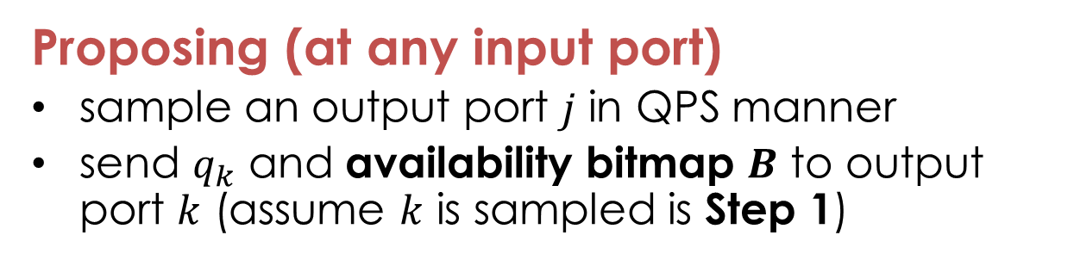
Overview of An SB-QPS Iteration
Background & Motivation
SERENADE
QPS
QPS-r
SB-QPS
1
Proposing (at any input port)
sample an output port $j$ in QPS manner
send $q_{k}$ and availability bitmap $B$ to output port $k$ (assume $k$ is sampled is Step 1)
2
Accepting (at any output port)
sort received proposals in a descending order
process them one after another; each with the First Fit Accepting (FFA)
Notes:
SB-QPS is a parallel iterative algorithm: The input and output ports run T QPS-like iterations (one per time slot) in a batch to collaboratively pack the table shown in the previous slide.
Each iteration of SB-QPS, like that of QPS, consists of two phases: a proposing phase and an accepting phase.
The proposing phase is identical to that of QPS: each input port

Slide 39






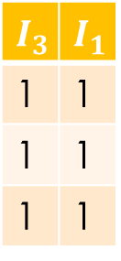
Example
Background & Motivation
SERENADE
QPS
QPS-r
SB-QPS
An illustrative example for a $4×4$ switch with batch size $T=3$
VOQ length
$$O_{1}$$ | $$O_{2}$$ | $$O_{3}$$ | $$O_{4}$$
$$O_{1}$$
1
1
1
$$I_{3}$$ | $$I_{1}$$
1 | 1
1 | 1
1 | 1
$$−$$ | $$−$$ | $$−$$ | $$−$$
$$−$$ | $$−$$ | $$−$$ | $$−$$
$$−$$ | $$−$$ | $$−$$ | $$−$$
bitwise&
1
1
1
$$t$$
Notes:
Now, let’s see an example over a 4X4 crossbar with a batch size of 3. At the beginning of an arbitrary batch, the joint calendar is empty, or in other words, none of the four output ports is matched.
Since the proposing is the same as QPS, here we focus on the accepting phase at output 1; that at any other output port is identical.
Clearly, now, all time slots of output port 1 are available; hence its availability bitmap has all entries to be 1. Assume that it receives two proposals from input port 1 and 3 respectively.
It first sorts them according to the lengths of the corresponding VOQs. Then, it tries to accommodate input port 3 as it has a longer VOQ length with the FFA strategy, which simply finds the first time slot in which both output port 1 and input port 3 are available. Or the first bit that is 1 in their bitwise-AND bitmap. Clearly, it is the first time slot.

Slide 40
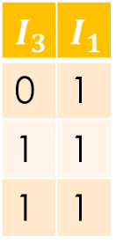


Example
Background & Motivation
SERENADE
QPS
QPS-r
SB-QPS
An illustrative example for a $4×4$ switch with batch size $T=3$
VOQ length
$$O_{1}$$ | $$O_{2}$$ | $$O_{3}$$ | $$O_{4}$$
$$O_{1}$$
0
1
1
$$I_{3}$$ | $$I_{1}$$
0 | 1
1 | 1
1 | 1
$$I_{3}$$ | $$−$$ | $$−$$ | $$−$$
$$−$$ | $$−$$ | $$−$$ | $$−$$
$$−$$ | $$−$$ | $$−$$ | $$−$$
bitwise&
1
1
1
$$t$$
Notes:
Then, we update both availability bitmaps and the joint calendar.

Slide 41
Example
Background & Motivation
SERENADE
QPS
QPS-r
SB-QPS
An illustrative example for a $4×4$ switch with batch size $T=3$
VOQ length
$$O_{1}$$ | $$O_{2}$$ | $$O_{3}$$ | $$O_{4}$$
$$O_{1}$$
0
1
1
$$I_{3}$$ | $$I_{1}$$
0 | 1
1 | 1
1 | 1
$$I_{3}$$ | $$−$$ | $$−$$ | $$−$$
$$−$$ | $$−$$ | $$−$$ | $$−$$
$$−$$ | $$−$$ | $$−$$ | $$−$$
bitwise&
0
1
1
$$t$$
Notes:
It then tries to accommodate input port 1;

Slide 42
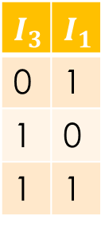


Example
Background & Motivation
SERENADE
QPS
QPS-r
SB-QPS
An illustrative example for a $4×4$ switch with batch size $T=3$
VOQ length
$$O_{1}$$ | $$O_{2}$$ | $$O_{3}$$ | $$O_{4}$$
$$O_{1}$$
0
0
1
$$I_{3}$$ | $$I_{1}$$
0 | 1
1 | 0
1 | 1
$$I_{3}$$ | $$−$$ | $$−$$ | $$−$$
$$I_{1}$$ | $$−$$ | $$−$$ | $$−$$
$$−$$ | $$−$$ | $$−$$ | $$−$$
bitwise&
0
1
1
$$t$$
Notes:
Unlike in QPS where this proposal will always be rejected; here, it is accepted using the second time slot within the batch.

Slide 43

Example
Background & Motivation
SERENADE
QPS
QPS-r
SB-QPS
An illustrative example for a $4×4$ switch with batch size $T=3$
VOQ length
$$O_{1}$$ | $$O_{2}$$ | $$O_{3}$$ | $$O_{4}$$
$$O_{1}$$
0
0
1
$$I_{3}$$ | $$I_{1}$$
0 | 1
1 | 0
1 | 1
$$I_{3}$$ | $$−$$ | $$I_{4}$$ | $$I_{2}$$
$$I_{1}$$ | $$−$$ | $$−$$ | $$−$$
$$−$$ | $$−$$ | $$−$$ | $$−$$
$$t$$
Notes:
Similar operations are performed at other output ports; and four packets are packed in the joint calendar after the first iteration.

Slide 44


Example
Background & Motivation
SERENADE
QPS
QPS-r
SB-QPS
An illustrative example for a $4×4$ switch with batch size $T=3$
VOQ length
VOQ length
$$O_{1}$$ | $$O_{2}$$ | $$O_{3}$$ | $$O_{4}$$
$$O_{1}$$
0
0
1
$$I_{3}$$ | $$I_{1}$$
0 | 1
1 | 0
1 | 1
$$O_{1}$$
0
0
1
$$I_{2}$$ | $$I_{1}$$
0 | 1
1 | 0
1 | 1
$$I_{3}$$ | $$−$$ | $$I_{4}$$ | $$I_{2}$$
$$I_{1}$$ | $$−$$ | $$−$$ | $$−$$
$$−$$ | $$−$$ | $$−$$ | $$−$$
bitwise&
0
0
1
$$t$$
Notes:
Then, SB-QPS runs the second iteration. Assume output port 1 also receives two proposals. Similarly, it first tries to accommodate the proposal from input port 2.
The third time slot was selected by the FFA strategy.

Slide 45
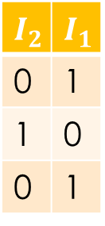


Example
Background & Motivation
SERENADE
QPS
QPS-r
SB-QPS
An illustrative example for a $4×4$ switch with batch size $T=3$
VOQ length
VOQ length
$$O_{1}$$ | $$O_{2}$$ | $$O_{3}$$ | $$O_{4}$$
$$O_{1}$$
0
0
1
$$I_{3}$$ | $$I_{1}$$
0 | 1
1 | 0
1 | 1
$$O_{1}$$
0
0
0
$$I_{2}$$ | $$I_{1}$$
0 | 1
1 | 0
0 | 1
$$I_{3}$$ | $$−$$ | $$I_{4}$$ | $$I_{2}$$
$$I_{1}$$ | $$−$$ | $$−$$ | $$−$$
$$I_{2}$$ | $$−$$ | $$−$$ | $$−$$
bitwise&
0
0
1
$$t$$
Notes:
Now it tries to accommodate that from input port 1

Slide 46
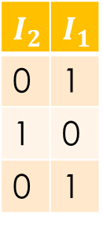

Example
Background & Motivation
SERENADE
QPS
QPS-r
SB-QPS
An illustrative example for a $4×4$ switch with batch size $T=3$
VOQ length
VOQ length
$$O_{1}$$ | $$O_{2}$$ | $$O_{3}$$ | $$O_{4}$$
$$O_{1}$$
0
0
1
$$I_{3}$$ | $$I_{1}$$
0 | 1
1 | 0
1 | 1
$$O_{1}$$
0
0
0
$$I_{2}$$ | $$I_{1}$$
0 | 1
1 | 0
0 | 1
$$I_{3}$$ | $$−$$ | $$I_{4}$$ | $$I_{2}$$
$$I_{1}$$ | $$−$$ | $$−$$ | $$−$$
$$I_{2}$$ | $$−$$ | $$−$$ | $$−$$
bitwise&
0
0
0
$$t$$
Notes:
Clearly, no available time slot can be found anymore; so this proposal is rejected.

Slide 47

Example
Background & Motivation
SERENADE
QPS
QPS-r
SB-QPS
An illustrative example for a $4×4$ switch with batch size $T=3$
VOQ length
VOQ length
$$O_{1}$$ | $$O_{2}$$ | $$O_{3}$$ | $$O_{4}$$
$$O_{1}$$
0
0
1
$$I_{3}$$ | $$I_{1}$$
0 | 1
1 | 0
1 | 1
$$O_{1}$$
0
0
0
$$I_{2}$$ | $$I_{1}$$
0 | 1
1 | 0
0 | 1
$$I_{3}$$ | $$−$$ | $$I_{4}$$ | $$I_{2}$$
$$I_{1}$$ | $$I_{4}$$ | $$I_{3}$$ | $$−$$
$$I_{2}$$ | $$−$$ | $$−$$ | $$−$$
$$t$$
Notes:
Clearly, no available time slot can be found anymore; so this proposal is rejected.

Slide 48



Example
Background & Motivation
SERENADE
QPS
QPS-r
SB-QPS
An illustrative example for a $4×4$ switch with batch size $T=3$
VOQ length
VOQ length
$$O_{1}$$ | $$O_{2}$$ | $$O_{3}$$ | $$O_{4}$$
$$O_{1}$$
0
0
1
$$I_{3}$$ | $$I_{1}$$
0 | 1
1 | 0
1 | 1
$$O_{1}$$
0
0
0
$$I_{2}$$ | $$I_{1}$$
0 | 1
1 | 0
0 | 1
$$O_{1}$$
0
0
0
$$I_{3}$$ | $$−$$ | $$I_{4}$$ | $$I_{2}$$
$$I_{1}$$ | $$I_{4}$$ | $$I_{3}$$ | $$−$$
$$I_{2}$$ | $$−$$ | $$−$$ | $$−$$
$$I_{2}$$ | $$−$$ | $$I_{3}$$ | $$I_{4}$$
$$t$$
Notes:
Then, SB-QPS runs the third iteration; and here we assume that it receives no proposals.

Slide 49



Example
Background & Motivation
SERENADE
QPS
QPS-r
SB-QPS
An illustrative example for a $4×4$ switch with batch size $T=3$
VOQ length
VOQ length
$$O_{1}$$ | $$O_{2}$$ | $$O_{3}$$ | $$O_{4}$$
$$O_{1}$$
0
0
1
$$I_{3}$$ | $$I_{1}$$
0 | 1
1 | 0
1 | 1
$$O_{1}$$
0
0
0
$$I_{2}$$ | $$I_{1}$$
0 | 1
1 | 0
0 | 1
$$O_{1}$$
0
0
0
$$I_{3}$$ | $$−$$ | $$I_{4}$$ | $$I_{2}$$
$$I_{1}$$ | $$I_{4}$$ | $$I_{3}$$ | $$−$$
$$I_{2}$$ | $$−$$ | $$I_{3}$$ | $$I_{4}$$
$$−$$ | $$−$$ | $$−$$ | $$−$$
$$−$$ | $$−$$ | $$−$$ | $$−$$
$$−$$ | $$−$$ | $$−$$ | $$−$$
$$t$$
Notes:
After all iterations finish, the resulted joint calendar will be used to transmit packets in the next batch; and the SB-QPS starts to fill a new joint calendar.

Slide 50
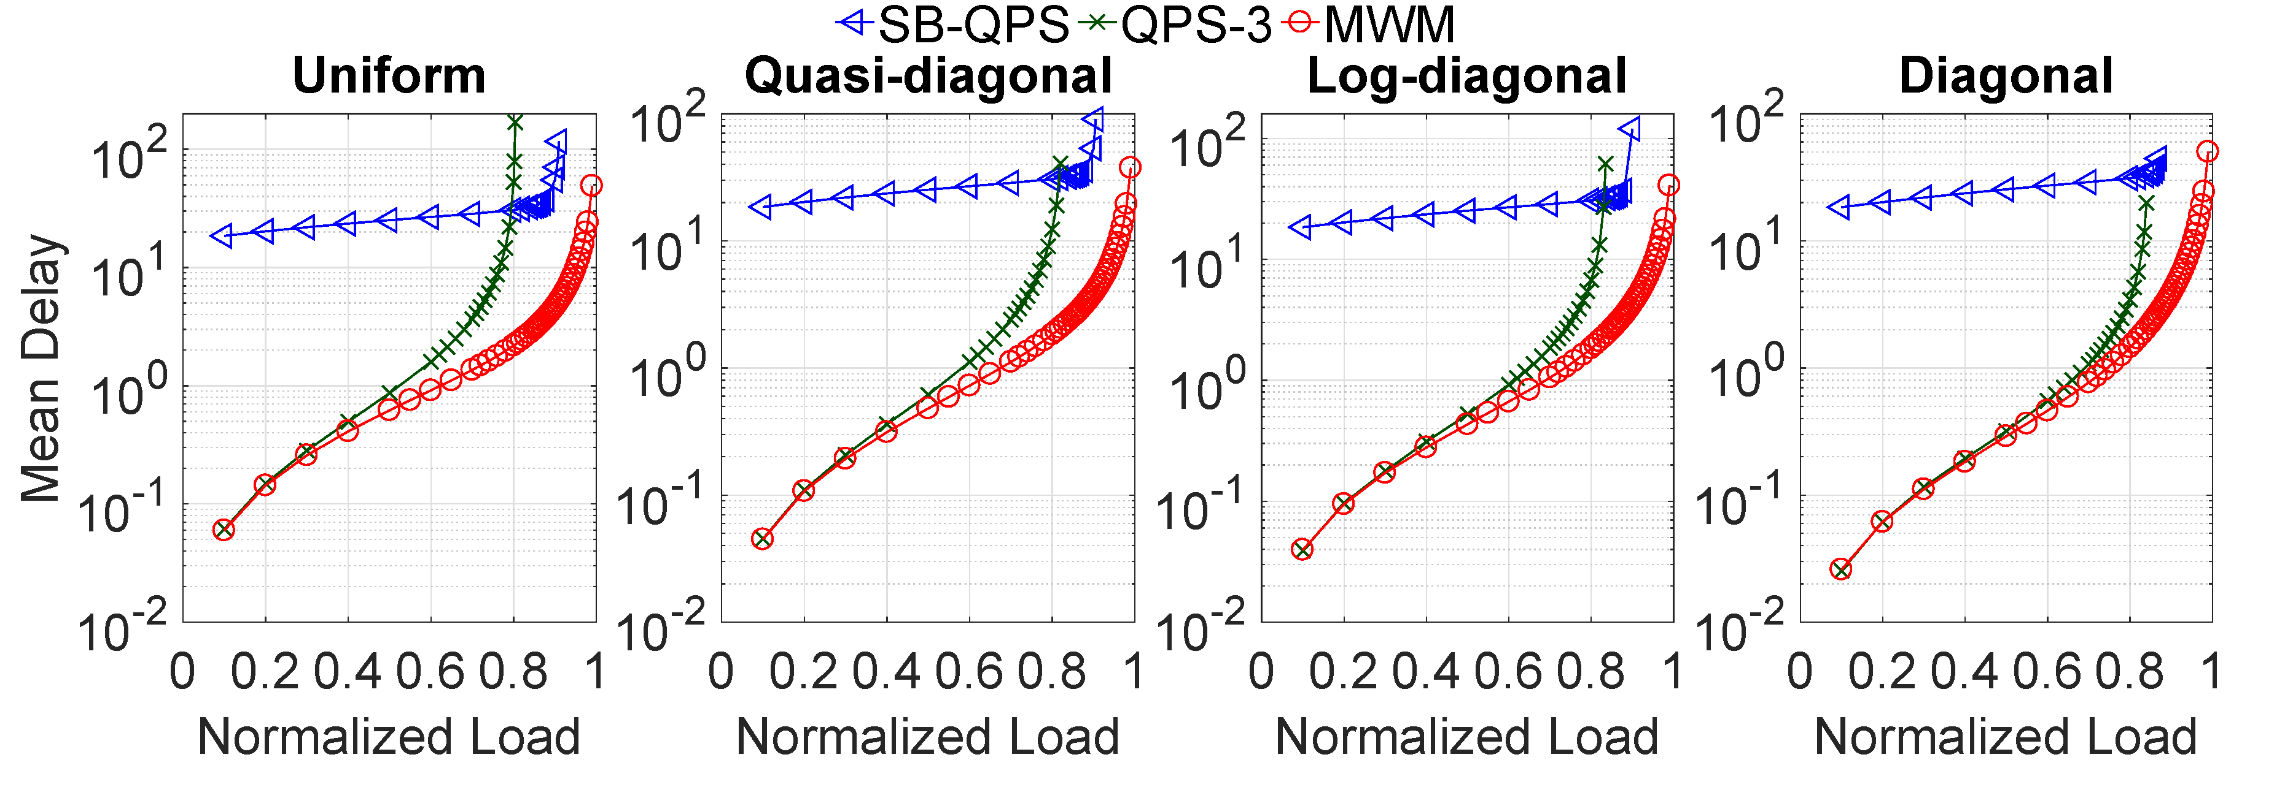
Maximum Sustainable Throughput: SB-QPS vs. QPS-3
Background & Motivation
SERENADE
QPS
QPS-r
SB-QPS
Simulation Setup
64X64 switch
i.i.d. Bernoulli arrivals
T=32
offered loads from 0 to 1
0.11
0.09
0.06
0.03
~0.91
~0.91
~0.90
~0.87
~0.80
~0.82
~0.84
~0.84
Mean Delay
Normalized Load
Notes:
In all the algorithms we described in earlier slides, a matching decision is made every time slot.
An alternative type of algorithm is called batch scheduling, in which multiple consecutive time slots are grouped as a batch. The matching decisions are batch-computed.
As indicated by its name, SB-QPS is a batch scheduling algorithm.
It is desired that the batch size T should be small because a packet arriving at the beginning of a batch has to wait until at least the beginning of the next batch. In other words, a larger batch size usually will result in higher packet delay.

Slide 51
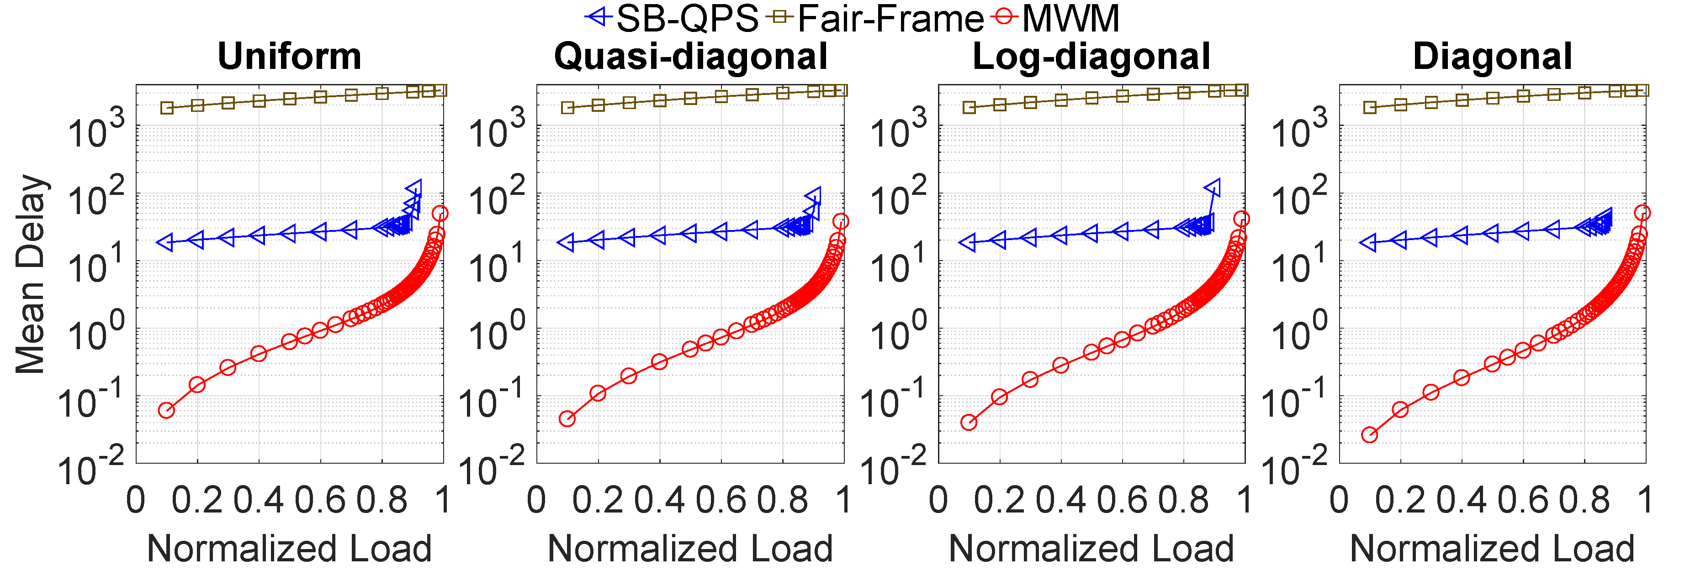
SB-QPS vs. Fair-Frame
Background & Motivation
SERENADE
QPS
QPS-r
SB-QPS
Simulation Setup
64X64 switch
i.i.d. Bernoulli arrivals
T=32
offered loads from 0 to 1
Mean Delay
~100x better
Normalized Load
SB-QPS is roughly 100x better than Fair-Frame
under light and moderate traffic
Notes:
In all the algorithms we described in earlier slides, a matching decision is made every time slot.
An alternative type of algorithm is called batch scheduling, in which multiple consecutive time slots are grouped as a batch. The matching decisions are batch-computed.
As indicated by its name, SB-QPS is a batch scheduling algorithm.
It is desired that the batch size T should be small because a packet arriving at the beginning of a batch has to wait until at least the beginning of the next batch. In other words, a larger batch size usually will result in higher packet delay.

Slide 52
References
[McKeown99] N. McKeown, "The iSLIP scheduling algorithm for input-queued switches," IEEE/ACM Transactions on Networking, vol. 7, no. 2, pp. 188–201, 1999.
[McKeown99a] N. McKeown, A. Mekkittikul, V. Anantharam, and J. Walrand, "Achieving 100% throughput in an input-queued switch," IEEE Transactions on Communications, vol. 47, no. 8, pp. 1260–1267, 1999.
[Keslassy03] I. Keslassy, Rui Zhang-Shen and N. McKeown, "Maximum size matching is unstable for any packet switch," in IEEE Communications Letters, vol. 7, no. 10, pp. 496-498, Oct. 2003.
[Giaccone03] P. Giaccone, B. Prabhakar, and D. Shah, “Randomized scheduling algorithms for high-aggregate bandwidth switches,” IEEE Journal on Selected Areas in Communications, vol. 21, no. 4, pp. 546–559, 2003.
[Bayati07] M.Bayati,B.Prabhakar,D.Shah,andM.Sharma,“Iterativeschedulingalgorithms,” in Proceedings of the IEEE International Conference on Computer Communications (INFOCOM), Anchorage, AK, USA, 2007, pp. 445–453.
[Neely07] M. J. Neely, E. Modiano, and Y. S. Cheng, "Logarithmic Delay for N × N Packet Switches Under the Crossbar Constraint," IEEE/ACM Transactions on Networking, vol. 15, no. 3, pp. 657–668, 2007.
[Hu16] B. Hu, K. L. Yeung, Q. Zhou, and C. He, "On iterative scheduling for input-queued switches with a speedup of 2 − 1/N," IEEE/ACM Transactions on Networking, vol. 24, no. 6, pp. 3565–3577, 2016.
[Hu18] B. Hu, F. Fan, K. L. Yeung, and S. Jamin. 2018. "Highest rank first: a new class of single-iteration scheduling algorithms for input-queued switches," IEEE Access 6 (2018), 11046–11062.

Slide 53
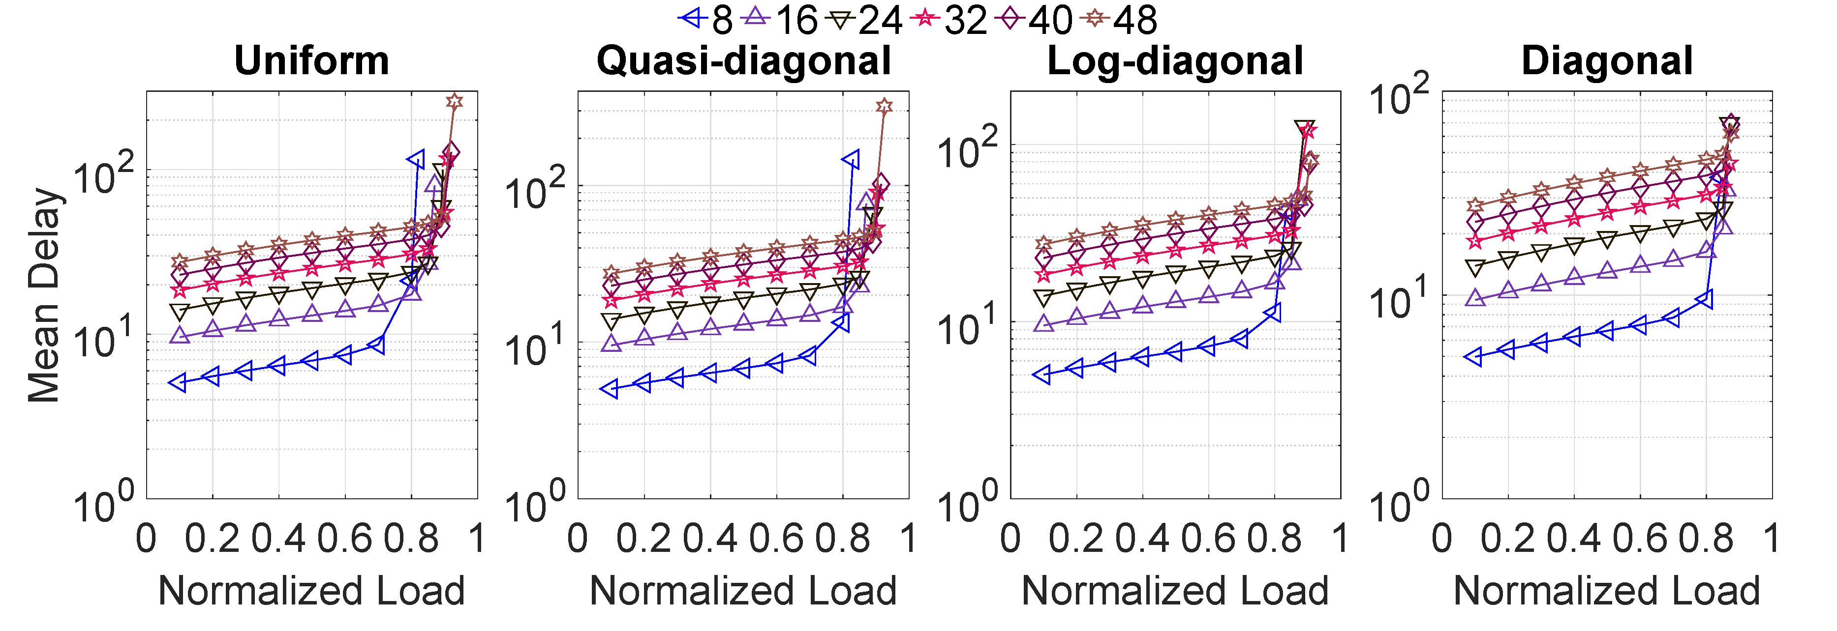
SB-QPS: Different Batch Sizes
Simulation Setup
64X64 switch
i.i.d. Bernoulli arrivals
T=8..48
offered loads from 0 to 1
Mean Delay
Normalized Load
Notes:
In all the algorithms we described in earlier slides, a matching decision is made every time slot.
An alternative type of algorithm is called batch scheduling, in which multiple consecutive time slots are grouped as a batch. The matching decisions are batch-computed.
As indicated by its name, SB-QPS is a batch scheduling algorithm.
It is desired that the batch size T should be small because a packet arriving at the beginning of a batch has to wait until at least the beginning of the next batch. In other words, a larger batch size usually will result in higher packet delay.

Slide 54
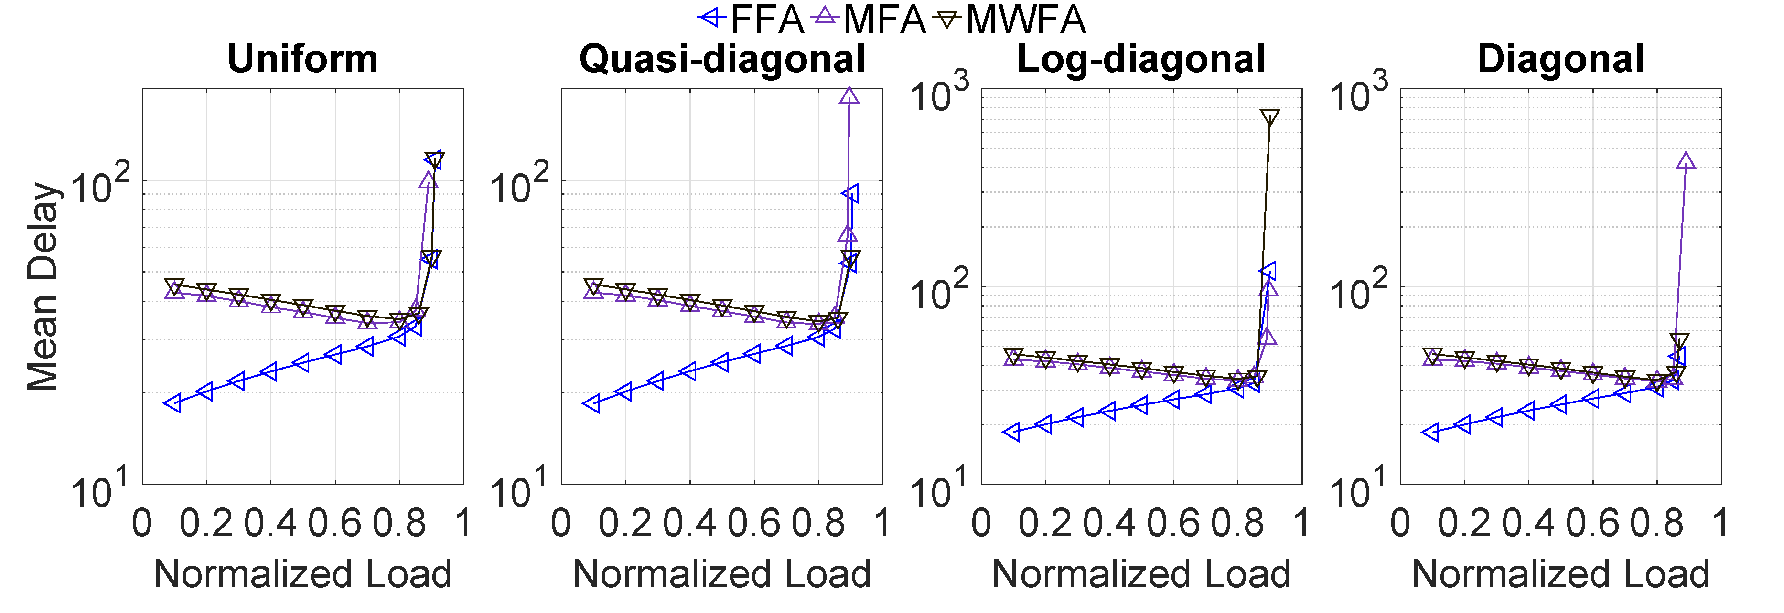
SB-QPS: Different Accepting Strategies
Simulation Setup
64X64 switch
i.i.d. Bernoulli arrivals
T=32
offered loads from 0 to 1
Mean Delay
Normalized Load
Notes:
In all the algorithms we described in earlier slides, a matching decision is made every time slot.
An alternative type of algorithm is called batch scheduling, in which multiple consecutive time slots are grouped as a batch. The matching decisions are batch-computed.
As indicated by its name, SB-QPS is a batch scheduling algorithm.
It is desired that the batch size T should be small because a packet arriving at the beginning of a batch has to wait until at least the beginning of the next batch. In other words, a larger batch size usually will result in higher packet delay.

Slide 55
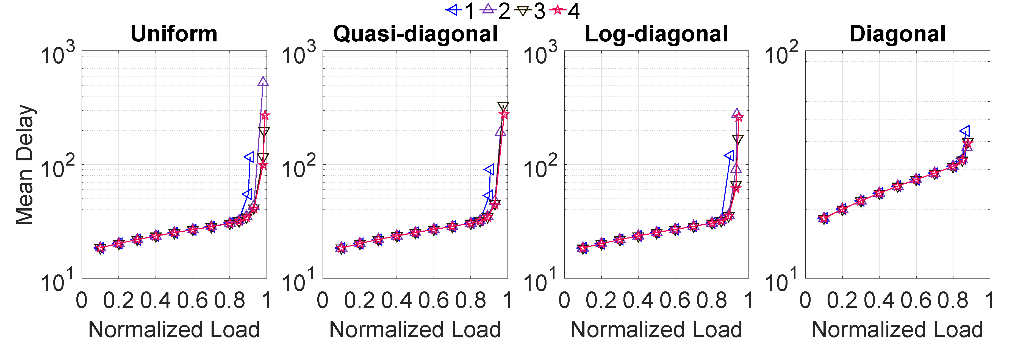
SB-QPS: Multiple Iterations
Simulation Setup
64X64 switch
i.i.d. Bernoulli arrivals
T=32
offered loads from 0 to 1
Mean Delay
Normalized Load
Notes:
In all the algorithms we described in earlier slides, a matching decision is made every time slot.
An alternative type of algorithm is called batch scheduling, in which multiple consecutive time slots are grouped as a batch. The matching decisions are batch-computed.
As indicated by its name, SB-QPS is a batch scheduling algorithm.
It is desired that the batch size T should be small because a packet arriving at the beginning of a batch has to wait until at least the beginning of the next batch. In other words, a larger batch size usually will result in higher packet delay.

Slide 56
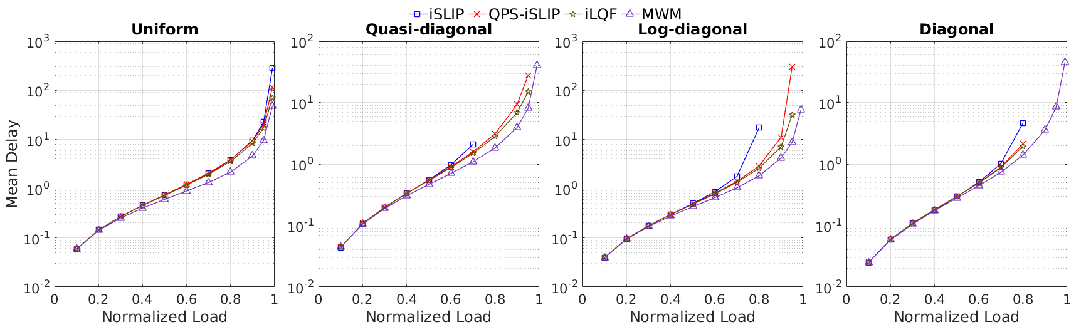
Mean Delay: QPS-iSLIP vs. iSLIP
Simulation Setup
32X32 switch
i.i.d. Bernoulli arrivals
offered loads from 0 to 1
Mean Delay
Normalized Load

Slide 57
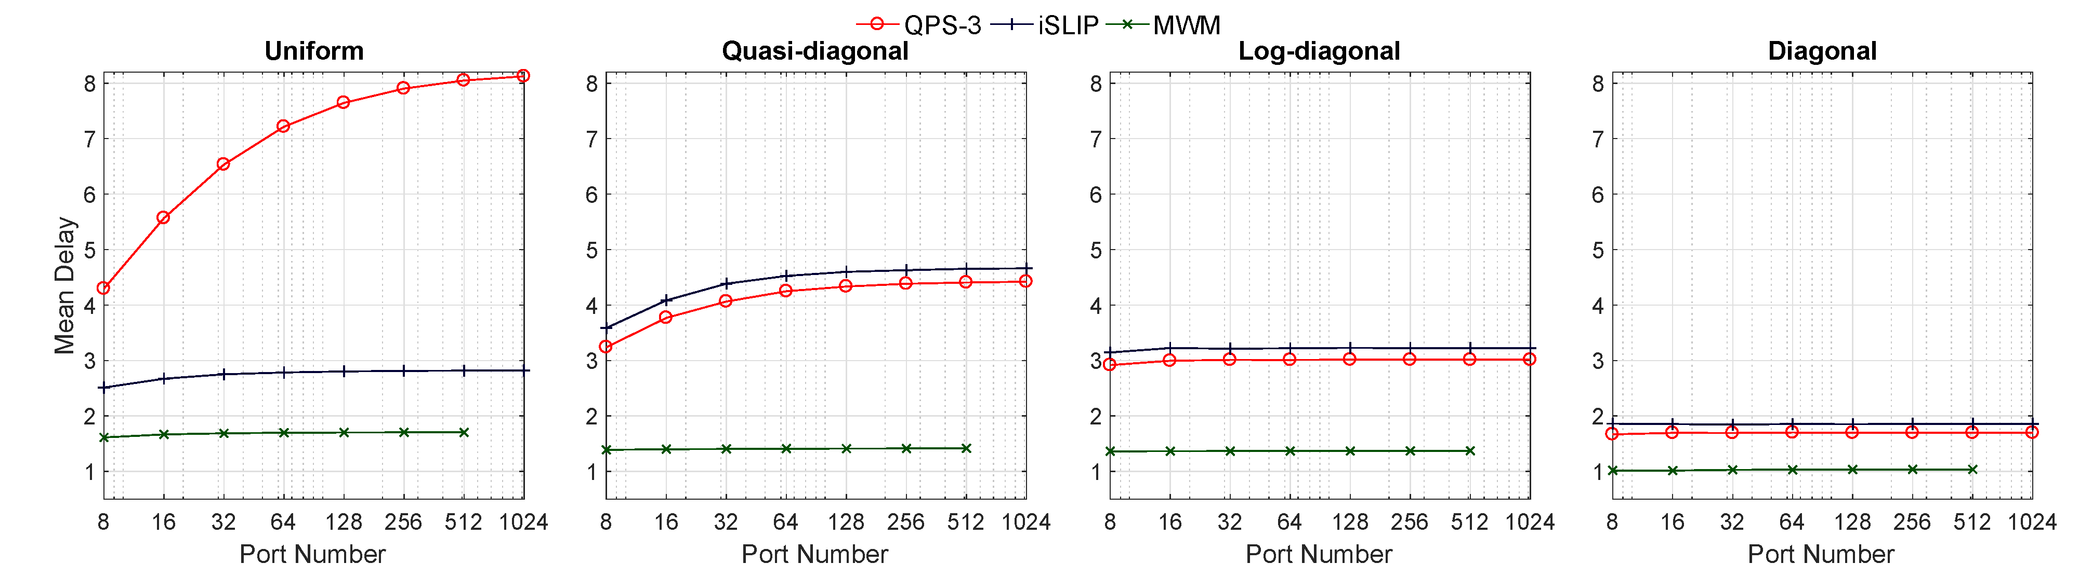
Mean Delay Scaling w.r.t. Number of (Input/Output) Ports
Simulation Setup
# of ports from 8 to 1024
i.i.d. Bernoulli arrivals
offered load: 0.75
Mean Delay
# of Ports
Notes:
The mean delays of QPS-3 are slightly lower (i.e., better) than those of iSLIP under all traffic patterns except the uniform. In addition, the mean delay curves of QPS-3 remain almost flat (i.e., constant) under log-diagonal and diagonal traffic patterns. Although they increase with N under uniform and quasi-diagonal traffic patterns, they eventually almost flatten out when N gets larger (say when N ≥ 128).

Slide 58
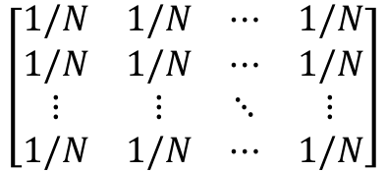
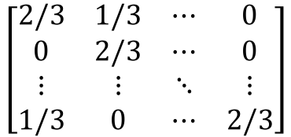
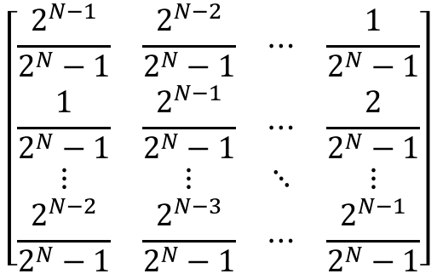
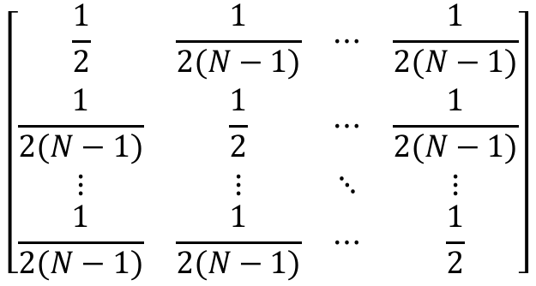
Four Traffic Patterns
Uniform
Quasi-diagonal
$$\left[\begin{matrix}1/N & 1/N & ⋯ & 1/N \\ 1/N & 1/N & ⋯ & 1/N \\ ⋮ & ⋮ & ⋱ & ⋮ \\ 1/N & 1/N & ⋯ & 1/N\end{matrix}\right]$$
$$\left[\begin{matrix}\frac{1}{2} & \frac{1}{2(N−1)} & ⋯ & \frac{1}{2(N−1)} \\ \frac{1}{2(N−1)} & \frac{1}{2} & ⋯ & \frac{1}{2(N−1)} \\ ⋮ & ⋮ & ⋱ & ⋮ \\ \frac{1}{2(N−1)} & \frac{1}{2(N−1)} & ⋯ & \frac{1}{2}\end{matrix}\right]$$
Log-diagonal
$$\left[\begin{matrix}\frac{2^{N−1}}{2^{N}−1} & \frac{2^{N−2}}{2^{N}−1} & ⋯ & \frac{1}{2^{N}−1} \\ \frac{1}{2^{N}−1} & \frac{2^{N−1}}{2^{N}−1} & ⋯ & \frac{2}{2^{N}−1} \\ ⋮ & ⋮ & ⋱ & ⋮ \\ \frac{2^{N−2}}{2^{N}−1} & \frac{2^{N−3}}{2^{N}−1} & ⋯ & \frac{2^{N−1}}{2^{N}−1}\end{matrix}\right]$$
Diagonal
$$\left[\begin{matrix}2/3 & 1/3 & ⋯ & 0 \\ 0 & 2/3 & ⋯ & 0 \\ ⋮ & ⋮ & ⋱ & ⋮ \\ 1/3 & 0 & ⋯ & 2/3\end{matrix}\right]$$
Notes:
(I) \emph{Uniform}: packets arriving at any input port go to each output port with probability $\frac{1}{N}$. (II) \emph{Quasi-diagonal}: packets arriving at input port $i$ go to output port $j \!=\! i$ with probability $\frac{1}{2}$ and go to any other output port with probability $\frac{1}{2(N-1)}$. (III) \emph{Log-diagonal}: packets arriving at input port $i$ go to output port $j = i$ with probability $\frac{2^{(N-1)}}{2^N - 1}$ and go to any other output port $j$ with probability equal $\frac{1}{2}$ of the probability of output port $j - 1$ (note: output port $0$ equals output port $N$). (IV) \emph{Diagonal}: packets arriving at input port $i$ go to output port $j \!=\! i$ with probability $\frac{2}{3}$, or go to output port $(i\, \text{mod} \, N) + 1$ with probability $\frac{1}{3}$.

Slide 59
Some Concepts
Throughput
the average number of packets that exit an output port during each time slot. It is a value between 0 and 1 (i.e., 100%). Throughout this work, we mean normalized throughput whenever we use the word "throughput".
Delay
the number of time slots elapsed since the arrival of a packet to its eventual departure from the switch

Slide 60
Starvation Issue
We believe the primary mission of a crossbar scheduling algorithm is to deliver excellent performance under admissible workloads; such “grace under fire” (proportional fairness and lack of starvation even when severely overloaded) is a secondary consideration and can be better achieved through other “knobs or levers" orthogonal to switching such as congestion control, packet scheduling, or traffic policing/shaping.

Slide 61
Why Only Synthetic?
almost all work on input-queued switch scheduling in the literature used roughly the same set of synthetic traffic loads (as used in this work) for performance evaluations, since it is not known whether we can meaningfully combine N “scalar” (per-port) packet-level traces into an “N-dimensional” switch-wide traffic workload, in a principled manner.
it appears to us the only additional information we can glean from trace-driven simulation, in this crossbar scheduling context, is how the scheduling algorithm reacts to the (TCP/UDP) flow dynamics -- most notably skewness and burstiness -- that are captured in the trace(s). In our simulation studies, we have thoroughly evaluated the impact of both skewness and burstness on the delay performances of QPS-augmented algorithms, using the 4 different traffic patterns and the bursty ON-OFF traffic arrivals respectively.

