Slide 1
iDEC: Indexable Distance Estimating Codes for Approximate Nearest Neighbor Search
Long Gong¹
Huayi Wang¹, Mitsunori Ogihara², Jun Xu¹
¹Georgia Tech ²University of Miami
Notes:
Hello everyone, my name is Long Gong. I am from Georgia Tech. My advisor is Prof. Jun Xu.
Today, my topic is …
This work is done in collaboration with Prof. Mistsunori Ogihara, from University of Miami.

Slide 2

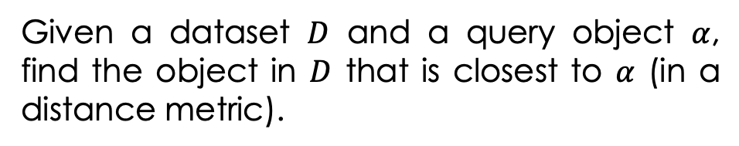

Nearest Neighbor (NN)
Background & Motivation
iDEC Framework
iDEC-based Solutions
Conclusion
Exact Nearest Neighbor Search
Distance Metric
Given a dataset $D$ and a query object $α$, find the object in $D$ that is closest to $α$ (in a distance metric).
Hamming distance
Edit distance
etc
the nearest neighbor $β^{∗}$
query object $α$
Notes:
NN search is a fundamental algorithmic problem, with numerous applications in various areas of computer science, such as recommendations, near-duplication detections. In the exact version of this problem,
given a database D and a query object a, we search for the one in D that is closest to according to certain distance metric. Typical distance metrics are Hamming distance, Edit distance, Euclidean distance, and angular distance. A natural solution to this problem is exhaustive search (or brute-force linear scan). When the dimension of the metric space the objects in D lie in is small, many multi-dimensional search
data structures, for example k-d trees, can do much better than the brute-force algorithm.

Slide 3
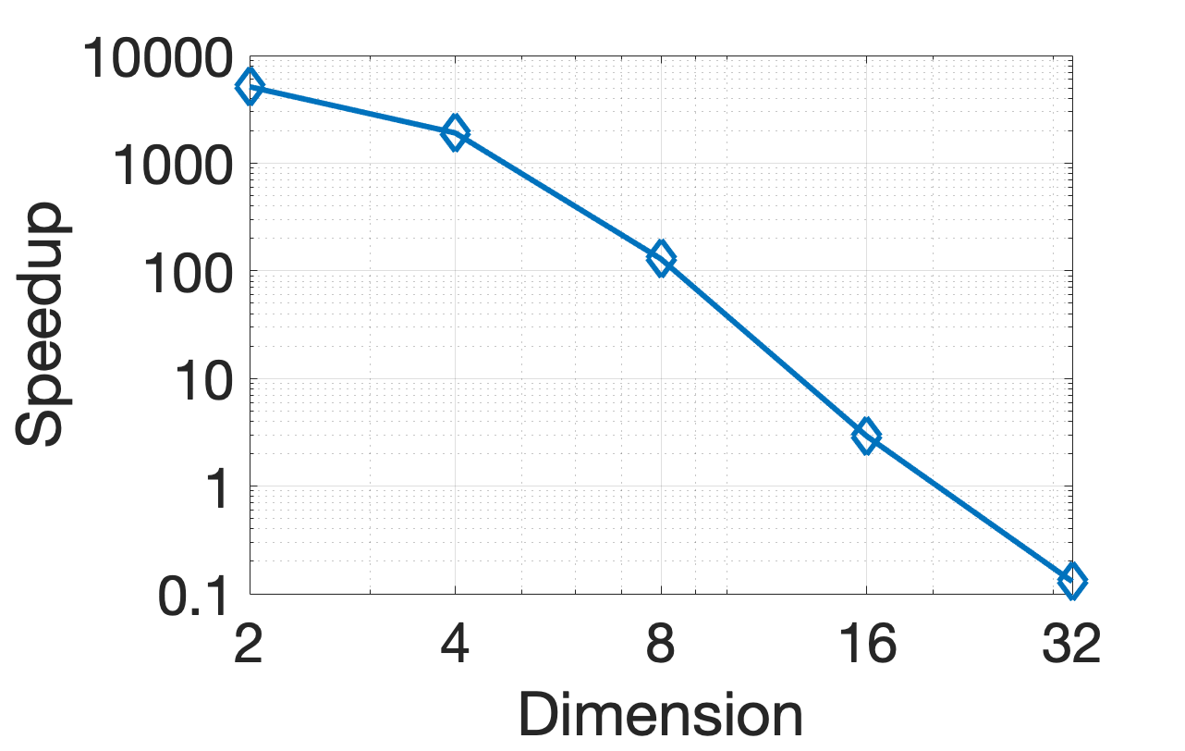
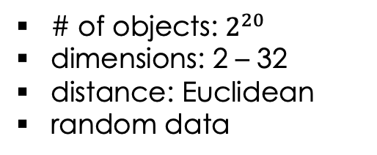
Curse of Dimensionality
Background & Motivation
iDEC Framework
iDEC-based Solutions
Conclusion
the dimension of the objects
NN search becomes difficult when d is large
speedup of k-d tree with respect to the brute force algorithm
5122.03
1908.26
# of objects: $2^{20}$
dimensions: 2 – 32
distance: Euclidean
random data
129.02
2.92
0.13
compiler: Apple clang 11.0.0
OS: macOS Catalina
CPU: 1.6 GHz Intel Core i5
DRAM: 4 GB
dimension
2 4 8 16 32
Notes:
However, when the dimension d becomes large, as is in many big data applications, such multi-dimensional data structures perform even worse than the brute-force algorithm in terms of query time or query speed, due to the so-called “curse of dimensionality”. Here, we use k-e tree as an example, we can see that when the dimension of the objects is small, k-d tree can be up to 3 orders of magnitude faster than the brute-force algorithm. However, when the dimension gets larger the advantage of k-d tree becomes smaller and smaller, and when the dimension is larger than 20, it starts to perform no better than the brute-force algorithm.

Slide 4


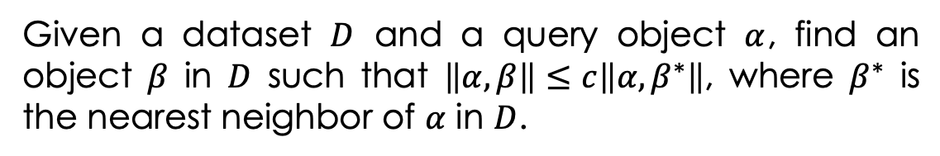


Approximate NN
Background & Motivation
iDEC Framework
iDEC-based Solutions
Conclusion
Approximate Nearest Neighbor Search
c-ANN
Given a dataset $D$ and a query object $α$, find an object $β$ in $D$ such that $\left\|α,β\right\|≤c\left\|α,β^{∗}\right\|$, where $β^{∗}$ is the nearest neighbor of $α$ in $D$.
the nearest neighbor $β^{∗}$
cr
$$r$$
query object $α$
c-ANN of $α$
Notes:
The curse of dimensionality and the search for efficient nearest neighbor solutions have led to the question whether we can do better if approximate solutions are allowed, since in many real-life applications good approximate solutions are sufficient. In the approximate nearest neighbor search problem, the accepted answer can be any object that is located within c times the minimum distance. The parameter c is usually called the approximation ratio, and the answers to this problem are usually called c-ANN. More precisely, given a database D and a query object a, the ANN search problem asks to search any object in D that is located no more than c times farther than the exact nearest neighbor.

Slide 5


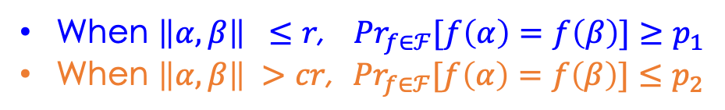



Locality-Sensitive Hashing (LSH)
Background & Motivation
iDEC Framework
iDEC-based Solutions
Conclusion
hash family $ℱ=\{h:ℋ→U\}$ with the following nice collision property
collision probability
$${Pr}_{f∈ℱ}[f\left(α\right)=f\left(β\right)]$$
1
When $\left\|α,β\right\| ≤r$, ${Pr}_{f∈ℱ}[f\left(α\right)=f\left(β\right)]≥p_{1}$
When $\left\|α,β\right\| >cr$, ${Pr}_{f∈ℱ}[f\left(α\right)=f\left(β\right)]≤p_{2}$
$$p_{1}$$
distance between $α$ and $β$
$$p_{2}$$
0
$$\left\|α,β\right\|$$
0
r
cr
Notes:
LSH is a celebrated family of ANN solutions. The key part in the design of LSH is its hash family with a nice collision property: The collision probability monotonically decreases with the distance between the two objects. More precisely, when …

Slide 6
Hard Decision Decoding
Background & Motivation
iDEC Framework
iDEC-based Solutions
Conclusion
query object $α$ is decoded to “the codeword” that is exactly equal to its hash value
buckets to which the query object hashed
Hash Table 1
Hash Table 2
Hash Table L
Notes:
In a classic LSH-based scheme, a large number of hash tables are required to achieve a high enough accuracy.
The objects in the database are stored in each of these hash tables using the hash functions from the corresponding LSH family.
During the query process, all objects located in the same hash bucket as the query object are checked and the best one is returned as the answer. We regard this search procedure as hard-decision decoding, since the query object …

Slide 7
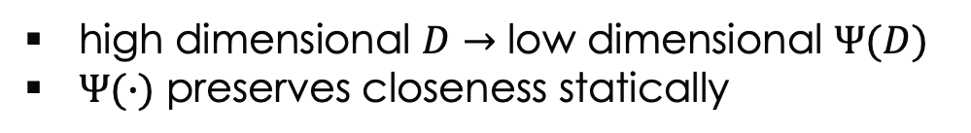
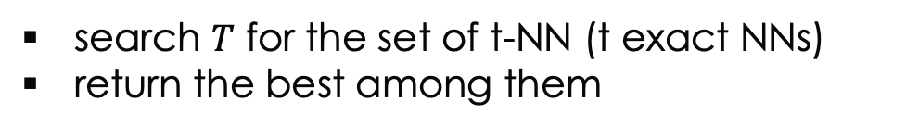
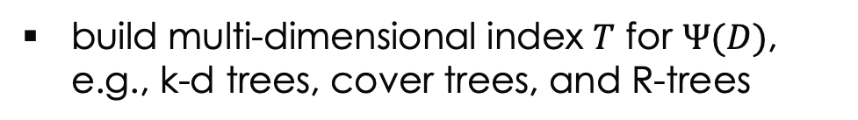
iDEC Framework: Overview
Background & Motivation
iDEC Framework
iDEC-based Solutions
Conclusion
$Ψ(D)≜\left\{Ψ\left(β\right): β∈D\right\}$, where $Ψ(∙)≜\left\langle ψ_{1}(∙),ψ_{2}(∙),⋯,ψ_{m}(∙)\right\rangle$
Dimensionality Reduction
high dimensional $D$ $→$ low dimensional $Ψ(D)$
$Ψ(∙)$ preserves closeness statically
Indexing
build multi-dimensional index $T$ for $Ψ(D)$, e.g., k-d trees, cover trees, and R-trees
Soft-decision
decoding
Query
search $T$ for the set of t-NN (t exact NNs)
return the best among them
Notes:
In this work, we propose indexable distance estimating codes, iDEC for short. iDEC extends and improves LSH framework in a fundamental and systematic way.
This framework consists of three major components: Dimensionality reduction, indexing, and query. The dimensionality reduction maps the original dataset D that lies in a high-dimensional space to \phi(D) that lies in a low-dimensional space using some random projection function \phi(*). This random projection function should perverse closeness statically.
We note that this framework is shared by all iDEC-based ANN solutions. Each solution however uses a different random projection function \phi.
An ANN query over the original dataset D is then converted to one over the low-dimensional dataset \phi(D). As mentioned earlier, by building a multi-dimensional index for the low-dimensional dataset \phi(D), the query over the low-dimensionsal space can be efficiently computed. Several candidate multi-dimensional data structures are suitable for iDEC-based solutions, such as …
The query process is simply to first search T for the set of … This query process can be viewed as decoding of phi(alpha). Clearly, this decoding is soft-decision in nature, because among the objects in \phi(D), we are not looking for the exact match with \phi(alpha) as in classical LSH-based schemes, but rather its nearest neighbors.

Slide 8
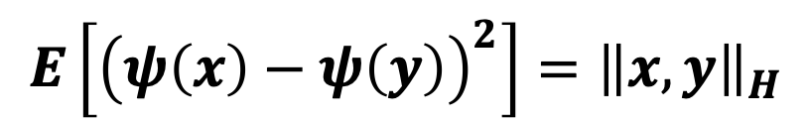
iDEC-based Solution for ANN-H
Background & Motivation
iDEC Framework
iDEC-based Solutions
Conclusion
Each $ψ_{i}$ in $Ψ$ is a ToW function $ψ\left(x\right)≜\left\langle x,R\right\rangle$ where R is $±1$ random vector
statistical
closeness preservation
$$E\left[{\left(ψ\left(x\right)−ψ\left(y\right)\right)}^{2}\right]={\left\|x,y\right\|}_{H}$$
Hamming distance between x and y
ANN search in high-dimensional space with Hamming distance
t-NN search in low-dimensional space with Euclidean distance
Notes:
Now, let’s see our iDEC-based solution for ANN search in Hamming distance which we refer to as ANN-H. As mentioned earlier, an iDEC-based solution is completely specified when the underlying \phi is. In our ANN-H solution, each …, This \phi function maps two strings close in Hamming distance to two integers close statically in Euclidean.
With such an underlying random projection function, the 1-NN search in the original high dimensional dataset D is converted to the t-NN …

Slide 9
ANN-H Evaluation: Datasets
Background & Motivation
iDEC Framework
iDEC-based Solutions
Conclusion
 | dataset | n | dimension | type
small | Audio | 54,187 | 192 | audio
 | Mnist | 69,000 | 768 | image
 | Enron | 94,851 | 1,344 | text
medium | GIST1M | 982,661 | 960 | image
 | SIFT1M | 993,244 | 128 | image
 | GloVe | 1,192,505 | 128 | text
large | GIST80M | 72,908,143 | 384 | image
 | SIFT1B | 995,534,710 | 128 | image
binarization
Hamming datasets
Notes:
Now, let’s evaluate the performance of our iDEC-based ANN-H solution. We use 8 publicly available datasets of diverse dimensions, sizes and types, that are widely used in the ANN literature. All these datasets are originally in Euclidean space. Like in most existing ANN-H work, we binarize each of them into a dataset in Hamming space.

Slide 10
ANN-H Evaluation: Index Size
Background & Motivation
iDEC Framework
iDEC-based Solutions
Conclusion
dataset | SRS^{[sun14]} | iDEC
Audio | 2.2 MB | 1.6 MB
Mnist | 2.8 M | 2.0 MB
Enron | 3.8 MB | 2.8 MB
GIST1M | 39.8 MB | 28.0 MB
SIFT1M | 40.2 MB | 28.5 MB
GloVe | 48.2 MB | 34.0 MB
GIST80M | 2,868.7 MB | 2,073.2 MB
SIFT1B | CR | 19,251.8 MB
crash due to lack of memory during index construction
[sun14] Y. Sun, W. Wang, J. Qin, Y. Zhang, and X. Lin. SRS: Solving c-approximate nearest neighbor queries in high dimensional Euclidean space with a tiny index. PVLDB, 8(1):1-12, 2014.
Notes:
Now let’s see some experimental results. Here, we only present the comparisons against one of the state-of-the-art LSH-based solutions, called SRS. More experimental results, such as the comparisons against the state-of-the-art non-LSH-based solutions can be found in our paper. This table compares index sizes of iDEC against those of SRS under all datasets. Here CR …
It clearly shows that the index sizes of iDEC are at least 1.3 times smaller than those of SRS.

Slide 11

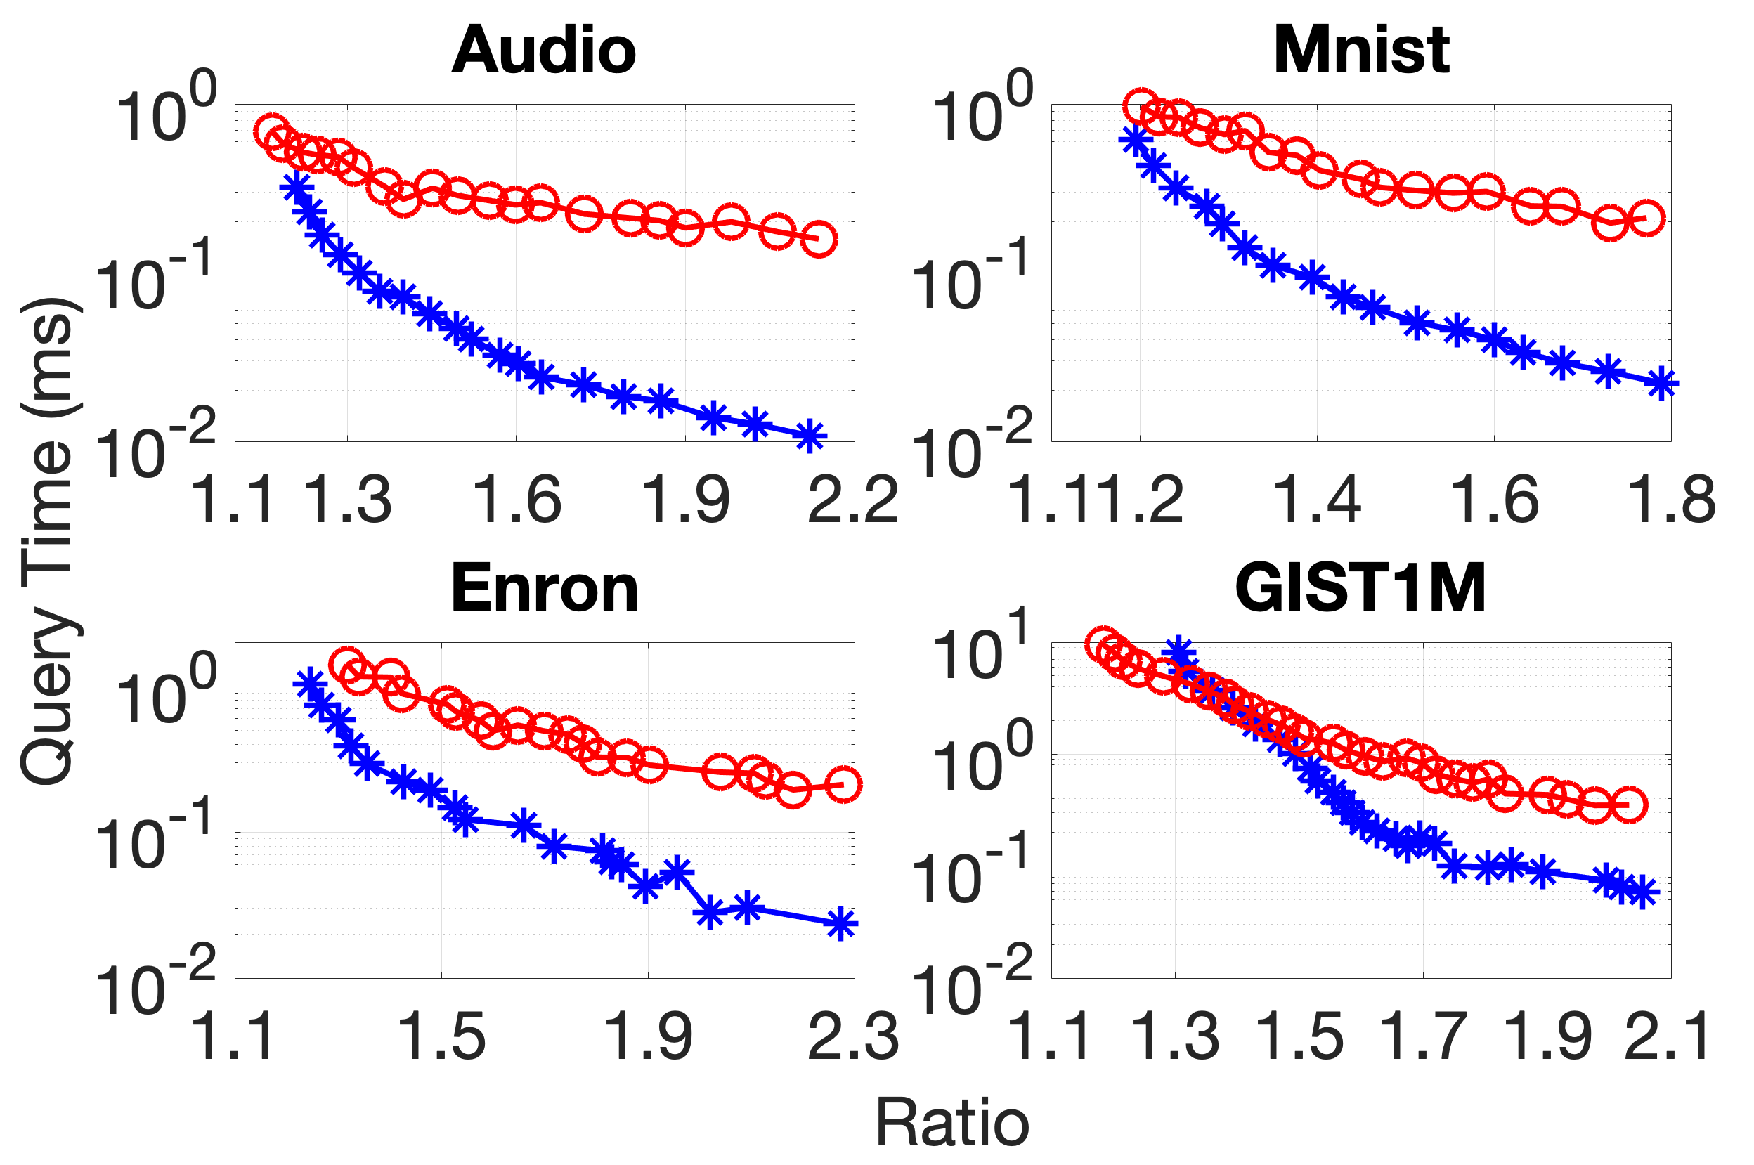
ANN-H Evaluation: Query Performance (1/2)
Background & Motivation
iDEC Framework
iDEC-based Solutions
Conclusion
Notes:
Now let’s see the comparisons of their query performances using approximation ratio as the query quality metric. In our paper, we have shown query performance comparisons using MAP as the query quality metric.
Here are the results on the first four datasets.

Slide 12
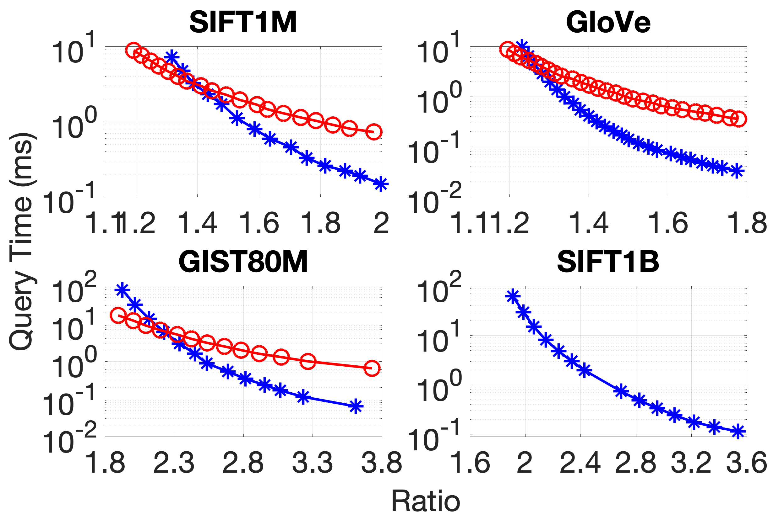
ANN-H Evaluation: Query Performance (2/2)
Background & Motivation
iDEC Framework
iDEC-based Solutions
Conclusion
SRS crashed due to lack of memory during index construction
Notes:
Here are the results for the rest four datasets. Note that on the largest dataset, the SIFT1B dataset, SRS …, so we did not obtain its query performance.
The two figures clearly show that on all the 7 datasets compared on, iDEC significantly outperforms SRS except for a few approximation ratios that are close to 1 (or those close to 2 on the GIST80M dataset)

Slide 13
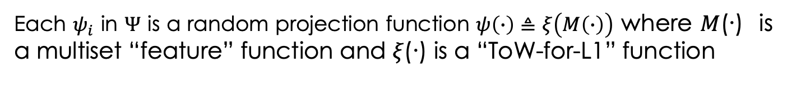
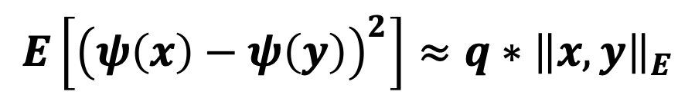
iDEC Solution for ANN-E
Background & Motivation
iDEC Framework
iDEC-based Solutions
Conclusion
Each $ψ_{i}$ in $Ψ$ is a random projection function $ψ\left(∙\right)≜ξ\left(M\left(∙\right)\right)$ where 𝑀(∙) is a multiset “feature” function and 𝜉(∙) is a “ToW-for-L1” function
statistical
closeness preservation
$$E\left[{\left(ψ\left(x\right)−ψ\left(y\right)\right)}^{2}\right]≈q∗{\left\|x,y\right\|}_{E}$$
Edit distance between x and y
ANN search in high-dimensional space with edit distance
t-NN search in low-dimensional space with Euclidean distance
Notes:
Now, let’s see our iDEC-based solutions for ANN search in Edit distance which we refer to as ANN-E. In our ANN-E solution, each …, This \phi function maps two strings close in Edit distance to two integers close statically in Euclidean distance.
With such an underlying random projection function, the 1-NN search in the original high dimensional dataset D is converted to the t-NN …

Slide 14
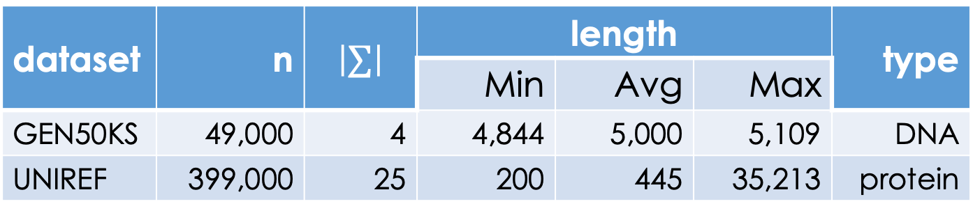
ANN-E Evaluation: Datasets
Background & Motivation
iDEC Framework
iDEC-based Solutions
Conclusion
alphabet size
dataset | n | $$\left|∑\right|$$ | length |  |  | type
 |  |  | Min | Avg | Max
GEN50KS | 49,000 | 4 | 4,844 | 5,000 | 5,109 | DNA
UNIREF | 399,000 | 25 | 200 | 445 | 35,213 | protein
Notes:
Now, let’s evaluate the performance of our iDEC-based ANN-E solutions. We use two string datasets: GEN50KS and UNIREF. The parameters of the two datasets are summarized in this table.

Slide 15
ANN-E Evaluation: Experimental Results
Background & Motivation
iDEC Framework
iDEC-based Solutions
Conclusion
dataset | recall | algorithm | query time (ms) | index size (MB)
GEN50KS | 0.95 | CGK-LSH^{[zhang17]} | 6,652.1 | 53.9
 |  | multiset-iDEC | 26.8 | 2.1
 |  | context-iDEC | 7.0 | 2.0
UNIREF | 0.93 | CGK-LSH^{[zhang17]} | 355.1 | 322.3
 |  | multiset-iDEC | 147.9 | 17.1
 |  | context-iDEC | 146.4 | 16.9
[zhang17] H. Zhang and Q. Zhang. EmbedJoin: Efficient edit similarity joins via embeddings. In Proceedings of the ACM SIGKDD International Conference on Knowledge Discovery and Data Mining, pages 585-594, Halifax, NS, Canada, Aug. 2017.
Notes:
Now, we compare the performances of iDEC, including multiset-iDEC and context-iDEC, with that of CGK-LSH, the state-of-the-art solution to ANN-E.
Here, we only present the results for a single target recall value for each dataset, for more experimental results please refer to our paper.
We can see that both multiset-iDEC and context-iDEC outperform CGK-LSH significantly and our context-iDEC performs the best among the three ANN-E solutions.

Slide 16
Conclusion
Background & Motivation
iDEC Framework
iDEC-based Solutions
Conclusion
Proposed indexable distance estimating codes (iDEC)
Proposed one iDEC-based solution for ANN-H
Proposed two iDEC-based solutions for ANN-E
Demonstrated that iDEC-based solutions outperform the respective state-of-the-art LSH-based solutions

