Slide 1
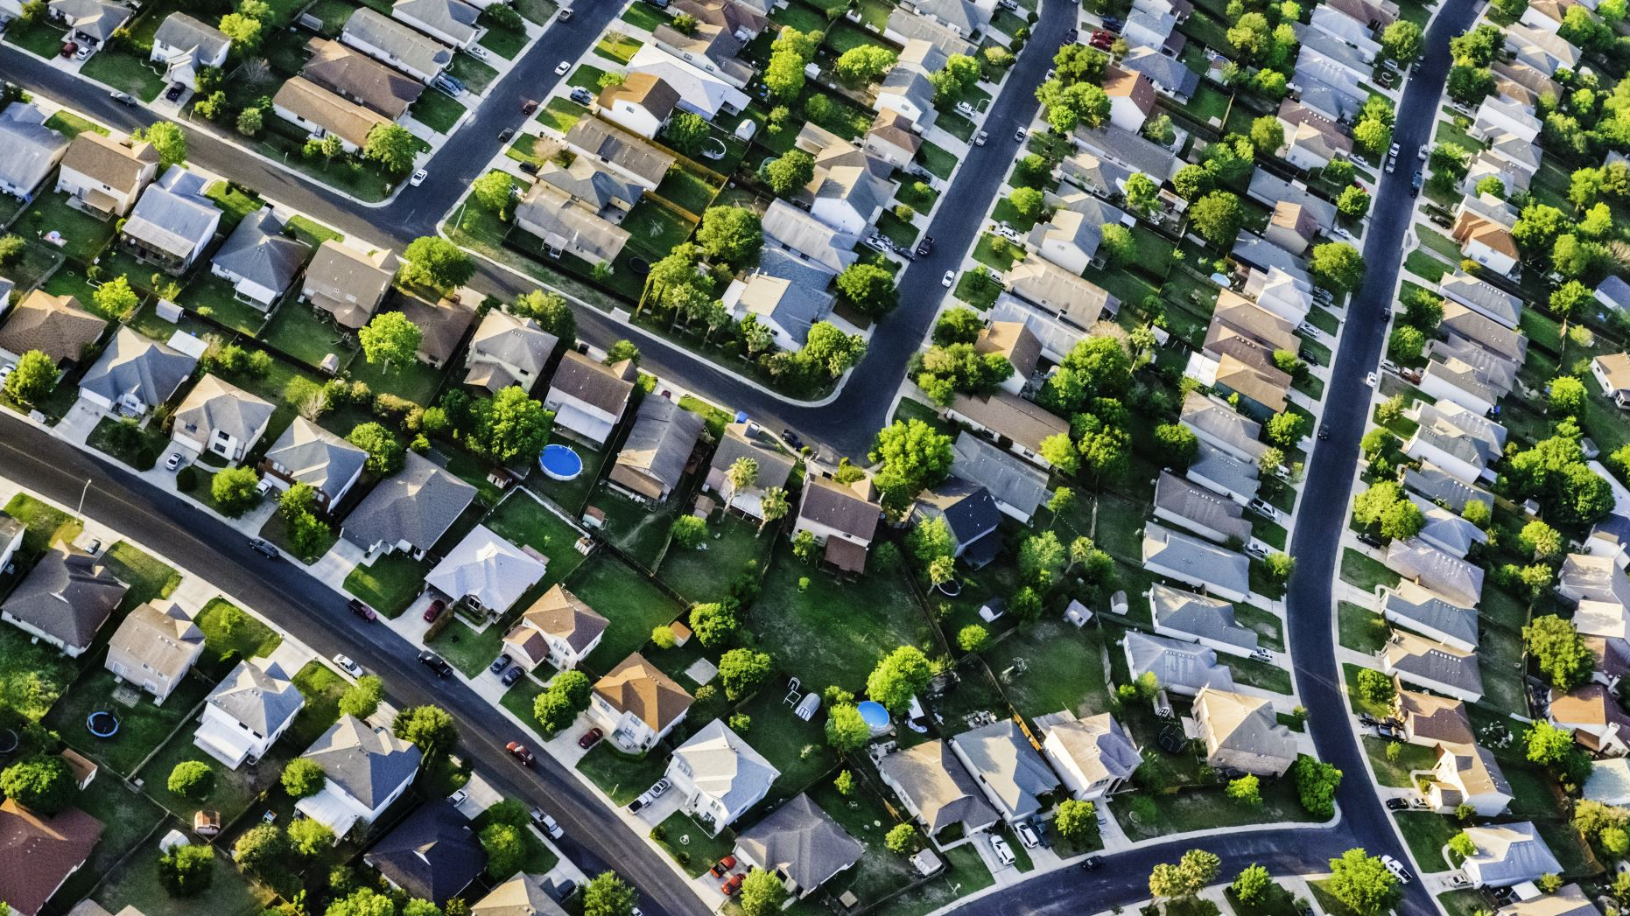
Consulting home sellers on house features that increase home values – Ames, Iowa
Luisa Gonzalez

Slide 2
Problem Statement
Home sellers seek to maximize sale prices. One way to increase home value is through home improvements and renovations that make a property more appealing to buyers
However, these projects can be very costly and home sellers may not get a return on their investment.

Slide 3
The Data
In this analysis we explore the data from the the Ames Assessor's Office which was used to assess values for individual residential properties sold in Ames, IA from 2006 - 2010.
2930 total observations
Train dataset includes only 2051 observations
Test dataset includes 878 observations
81 variables
Including our target variable

Slide 4
Linear Regressions
Used to analyze how changes in each independent variable is related to the dependent variable
Results are easily interpretable
Perfect for analyzing a continuous target variable

Slide 5
Getting to the model
Numerical/Categorical EDA
Lasso to broaden my search
Back to linear regression with Lasso variables
Lasso to focus the variables
Back to a final linear model

Slide 6
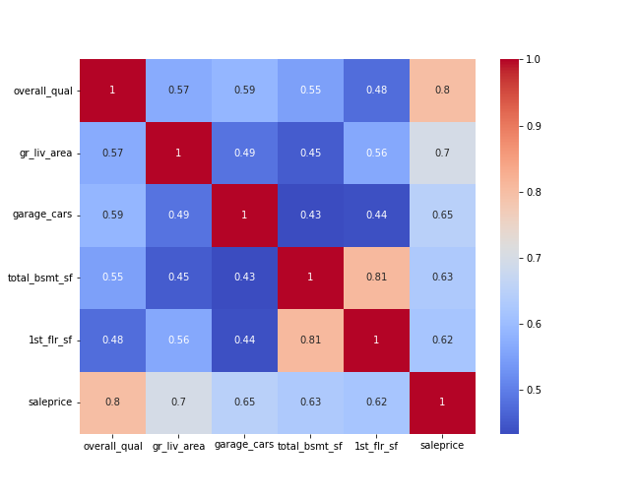
1St Model – 4 features
The first model focused on numerical variables that strongly correlated with sale price
Dropped total_bsmt_sf
R-squared score of .77 on the training data
R-squared score of .79 on the val data

Slide 7
Adding categorical data
Box Plots
Groupby() & intuition
Added: Neighborhood, Masonry veneer type, Proximity to Conditions, Air Condition
Saw only slight improvement in the model ☹

Slide 8
Lasso
Narrow down from 81 to 25 features
Helped me broaden my categories with some confidence that lasso had decreased noise and some multicollinearity

Slide 9
Getting closer
Modeled on 25 features, including features relevant to clients
Achieved R-squared scores of .85 on the training data and .84 on the validation data
Mean-absolute-error of $21,287

Slide 10
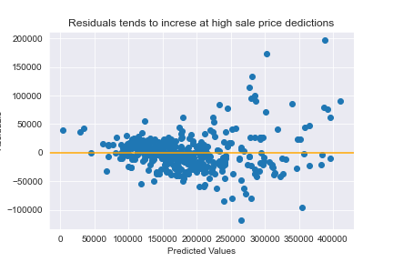
Residuals – What do the misses look like?
The residuals spread out even more when the model tries to explain high priced houses

Slide 11
Lasso Again!
Saw signs of multicollinearity – like negative coefficients that should be positive
Narrowed features from 25 to 21
Similar R-squared score of .84 but MAE of $20,801

Slide 12
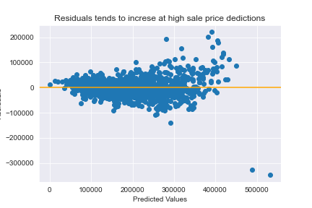
Residuals – What do the misses look like?
The residuals spread out even more when the model tries to explain high priced houses

Slide 13
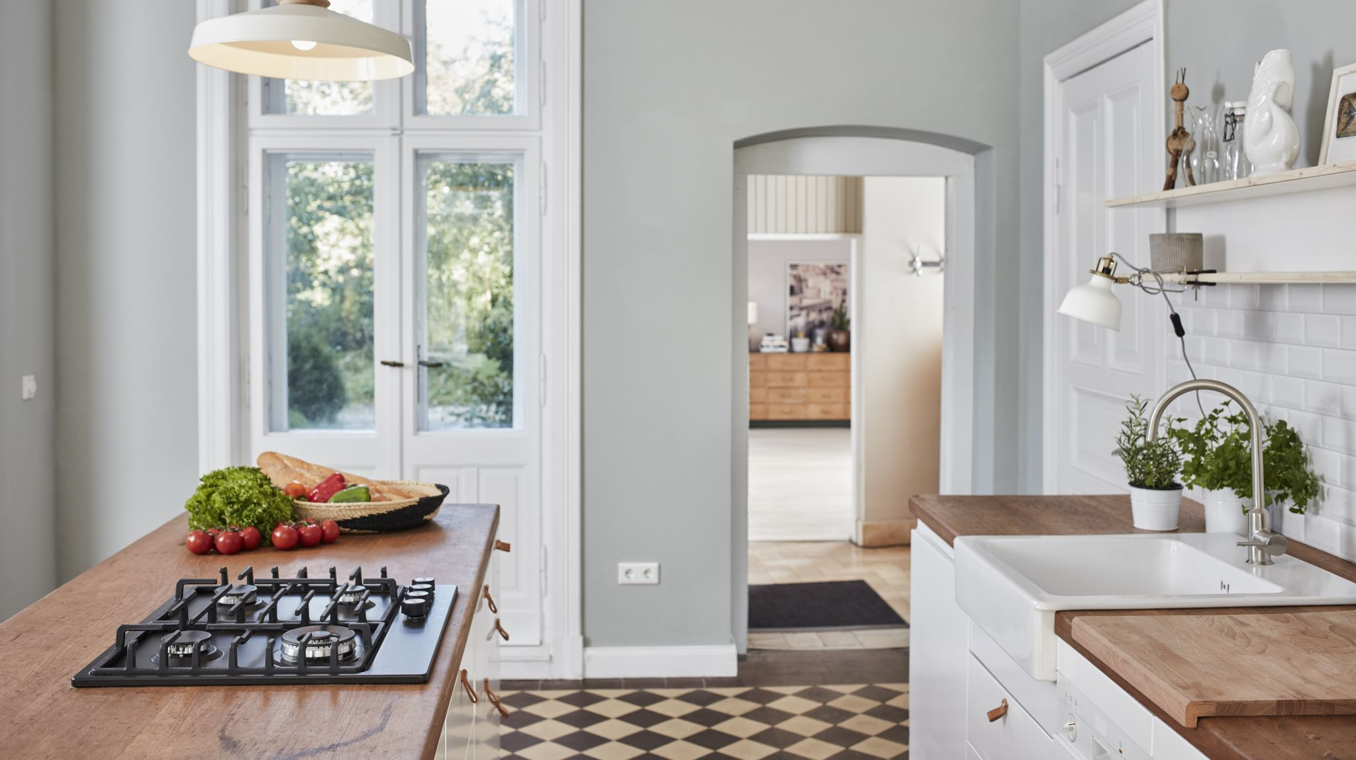
Using the model

Slide 14
Analysis of relevant coefficients
Feature | Type | Range | Coefficient | Example
Kitchen Quality | Ordinal | 1 -5 | $15,580 | Avg to excellent: + $31,160
Basement Finished Area | Ordinal | 0 - 6 | $3,876 | Unfinished to Avg: + $7,752
Wood Deck (SF) | Continuous | -- | $22.64 | $8000 for 350 sq ft
Central Air | Nominal | Y/N | $4,911 | Adding: +$4911
Paved Driveway | Ordinal | Y/P/N | $5,191 | N to fully paved: + $5,191
External Condition | Ordinal | 1 - 5 | $18,400 | Fair to good: + $36,800
Garage Quality | Ordinal | 0 - 5 | $2,558 | Fair to good: + $5,116
Electrical | Ordinal | 1 - 5 | $316 | Poor to excellent : +$1,234

Slide 15
Questions?

