Slide 1
Software “Bug”
How to report a bug effectively

Slide 2
“Bug” definition
What is a Software bug?
“A software bug is an error, flaw, failure or fault in a computer program or system that causes it to produce an incorrect or unexpected result, or to behave in unintended ways”
Wikipedia

Slide 3
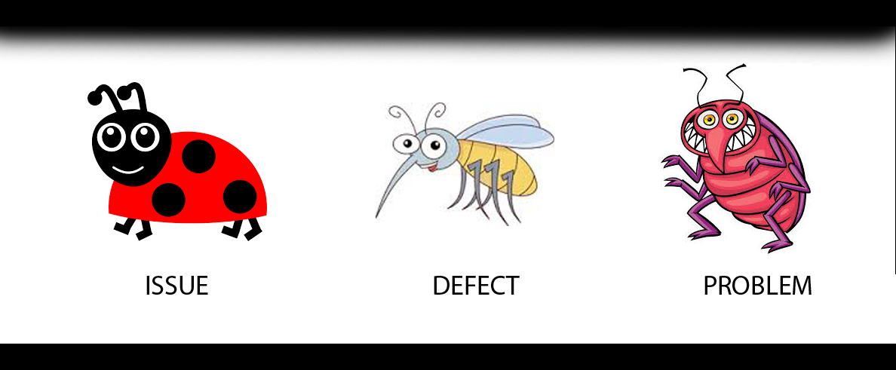
“Bug” names

Slide 4
Catch the “bug”
Developers team - free
QA team - $$
Managers team - $$$
Clients - $$$$$$$$

Slide 5
Bug report
Bad:
Error when click on Save button.
Good:
Error 2012 had appeared when was trying to Save a new document.
Notes:
Bad: OK button is ugly
Good: Button “OK” is brown instead green (according design requirements).
Bad: Filter is not working properly
Good: Filtering by Customer ID shows only customer names.
Bad: View Permission is not working
Good: User without View permission can see the public filters.
Bad: Error message appeared when click on Save button.
Good: Error 2012 appeared when trying to Save a new document.
Bad: Total price is displayed in wrong currency
Good: Total price is displayed in USD instead EUR

Slide 6
Bug report
A good bug report should include :
Bug title/subject
Bug specification
Description
Step to reproduce
Attachments

Slide 7
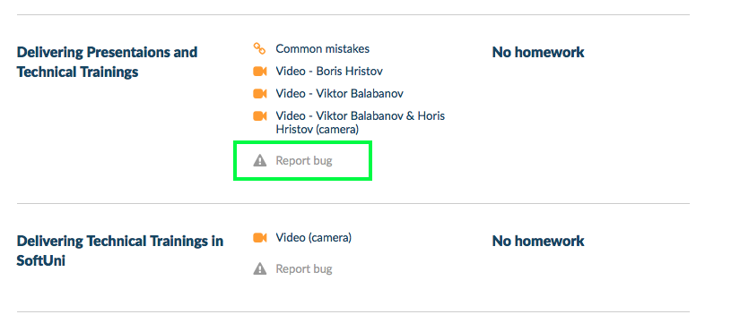

Slide 8
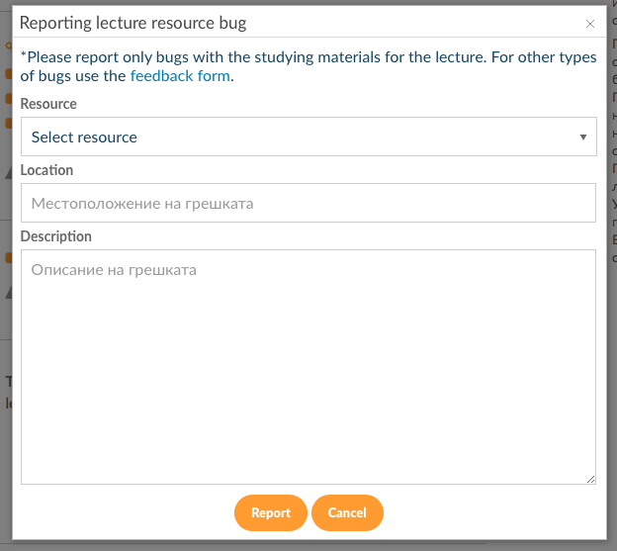

Slide 9
In conclusion…
“A well described bug is on a half fixed.”

Slide 10
Thank you !
Questions?

