Slide 1

TEAM “BRATION”
QA Fundamentals - 2015
https://github.com/lgoychev/Team-Bration

Slide 2
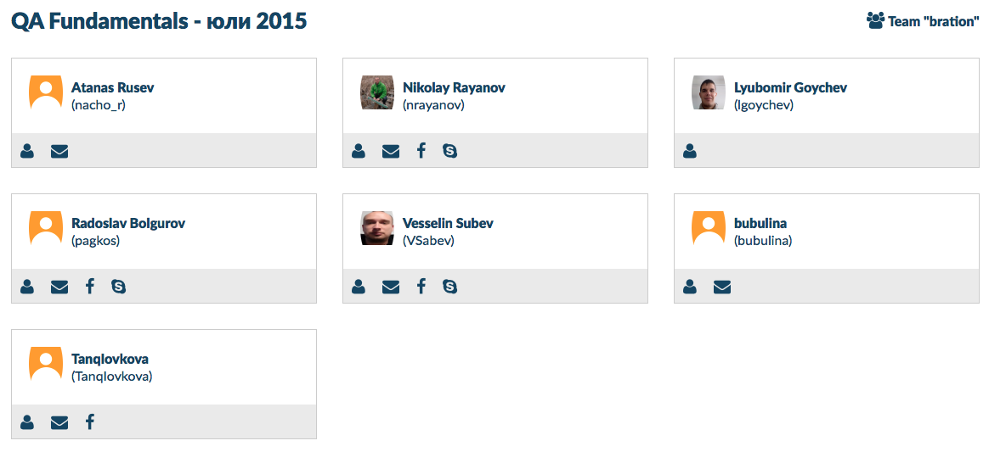
Team “BRATION”
https://github.com/lgoychev/Team-Bration
QA Fundamentals - 2015

Slide 3

JCNEx
Java Contract Number Extractor
by team “Bration”
QA Fundamentals - 2015

