Slide 1

TEAM “BRATION”
QA Fundamentals Course @ SoftUni
2015
https://github.com/lgoychev/Team-Bration

Slide 2
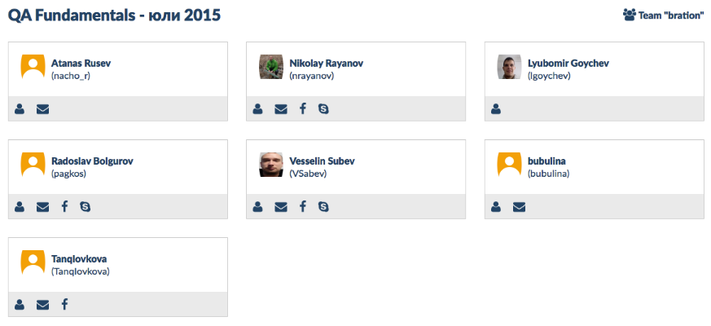
Team “BRATION”
https://github.com/lgoychev/Team-Bration
QA Fundamentals Course @ SoftUni 2015

Slide 3

JCNEx
by team “Bration”
Project scopes
Finding team members
Brainstorm meeting to find best idea for project
Research for best SRS document templates
Write a SRS document with functionality description and use case
Codding
Release the application
QA Fundamentals Course @ SoftUni 2015

Slide 4
JCNEx
Java Contract Number Extractor
by team “Bration”
QA Fundamentals Course @ SoftUni 2015

Slide 5
JCNEx
by team “Bration”
How it works..
Explain JCNEx Functionality SRS document and how it can be use.
QA Fundamentals Course @ SoftUni 2015

Slide 6
JCNEx
by team “Bration”
How to test..
Explain how Test plan and test methodology
QA Fundamentals Course @ SoftUni 2015

