Slide 1

TEAM “BRATION”
Teamwork Project
https://github.com/lgoychev/Team-Bration
QA Fundamentals Course @ SoftUni 2015

Slide 2
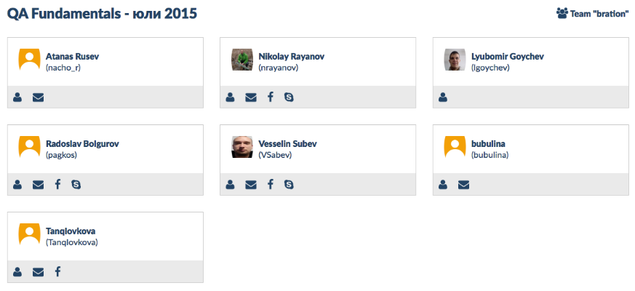
Team “BRATION”
Active team members
QA Fundamentals Course @ SoftUni 2015

Slide 3
Team responsibilities
 | Name | Title | Responsibilities
1 | Lyubomir Goychev | Project Manager | Accomplishing the stated project objectives
2 | Tanq Iovkova | QA Team Lead | Lead all testing activities
3 | Tina Tomova | QA Engineer | Design and execute test cases
4 | Nikolay Rayanov | Developer | Designs the application
5 | Vesselin Sabev | QA Engineer | Design and execute test cases
QA Fundamentals Course @ SoftUni 2015

Slide 4
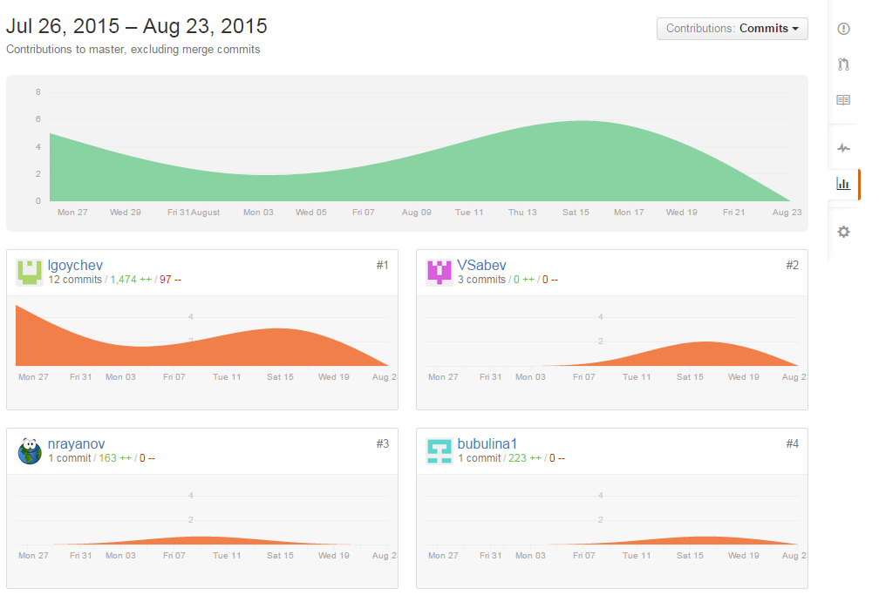
Github account
https://github.com/lgoychev/Team-Bration
QA Fundamentals Course @ SoftUni 2015

Slide 5

JCNEx
Java Contract Number Extractor
by team “Bration”
QA Fundamentals Course @ SoftUni 2015

Slide 6
JCNEx
by team “Bration”
Product Functions
<Invoice>
<Date>2015/08/08</Date>
<PONumber>CTN1245-BR0001</PONumber>
<TotalNet>100. 00</TotalNet>
<TotalVAT>20.00</TotalVAT>
<TotalGross>120.00</TotalGross>
</Invoice>
<Invoice>
<Date>2015/08/08</Date>
<PONumber>CTN1245</PONumber>
<Contract>-BR0001</Contract>
<TotalNet>100. 00</TotalNet>
<TotalVAT>20.00</TotalVAT>
<TotalGross>120.00</TotalGross>
</Invoice>
JCNEx
SOURCE
OUTPUT
QA Fundamentals Course @ SoftUni 2015

Slide 7
JCNEx
by team “Bration”
Product Perspective
Web Portal
Web Server
JCNEx Java
File processing
DataBase
DB Server
QA Fundamentals Course @ SoftUni 2015

Slide 8
JCNEx
by team “Bration”
Software Requirement
Specification (SRS)
Introduction
Product Perspective
Product Functions
Specific Requirements
QA Fundamentals Course @ SoftUni 2015

Slide 9
JCNEx
by team “Bration”
How it works..
Live Demo
QA Fundamentals Course @ SoftUni 2015

Slide 10
JCNEx
by team “Bration”
User Interface
Login screen
Registration form
Choose file screen
Prompt messages
QA Fundamentals Course @ SoftUni 2015

Slide 11
JCNEx
by team “Bration”
User interface
Live Demo
QA Fundamentals Course @ SoftUni 2015

Slide 12
JCNEx
by team “Bration”
How to test..
Test plan
Test Progress Book
Manual testing
Automation testing (in progress)
QA Fundamentals Course @ SoftUni 2015

Slide 13
JCNEx
by team “Bration”
Thank you!
Questions?
QA Fundamentals Course @ SoftUni 2015

