Slide 1
Using a classical model to provide insights through Agent-Based Simulation

Slide 2


Slide 3
Using a classical model to provide insights through Agent-Based Simulation

Slide 4


M.Sc Leonardo Grando.
Master in Technology - FT/Unicamp (2020).
PhD Candidate -FT/Unicamp - 2021 ~ 2025 (est.).
9 years industry experience.
l189052@dac.unicamp.br
Orcid: https://orcid.org/0000-0002-0448-209X

Slide 5
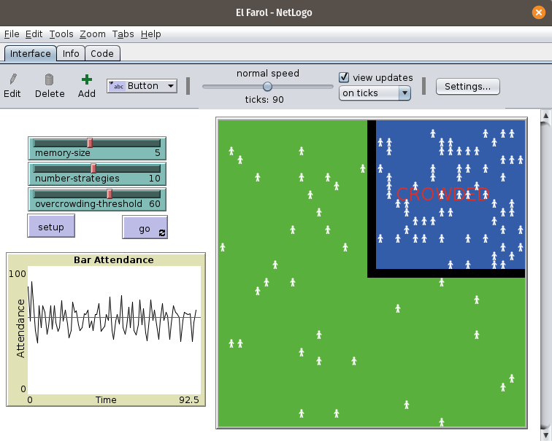

Objective:
Create an Agent-Based Simulation Model model to simulate a drone swarm energy supply using as reference a classical economic model El Farol Bar Problem [Arthur 1994].
Fig 1 - Drones Swarm Representation in Model
Fig 2 - Netlogo El Farol Model

Slide 6
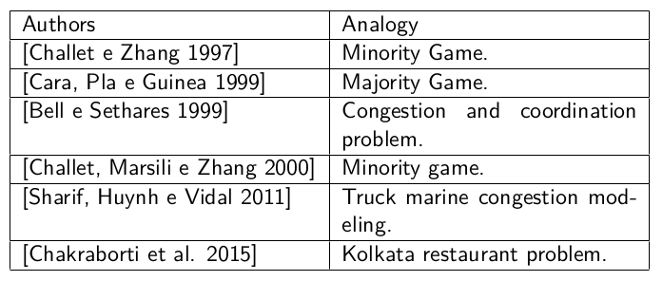
Classical Model: El Farol Bar Problem (EFBP):
N agents
Confort threshold B
Agents have m last L attendance history to take their decision
Each agent have a bag of k strategy (ex: moving average,
cycle detector. and others)
The unique information was the last attendance values.
Theses strategies compete with each other inside agents.
If L > B → All agents have an unpleasant night
L ≤ B → All agents have a good night
Model already used in another's congestion problems and analogies (Table 1)
Example: Minority game - used to simulate stock market [Challet, Marsili and Zhang. 2000].
Agents Decisions were made by an inductive way (not rational);
No communication between agents;
Fluctuations around a threshold;
Nash Equilibrium (60/40)
Table 1 - EFBP Analogies

Slide 7
Energy supply is a big problem for IoT devices, we can improve by:
Reducing device energy usage;
Better energy supply;
Better energy ways.
Simulation objective: Create a drone swarm recharging coordination procedure → Drones swarm can continue their jobs perpetually.
Jobs as: Disaster recovery [Horio et al. 2019], Products delivery[Zoricak 2013], Security, Survey, Monitoring, Surveillance, Leisure Pursuit, Environmental Mapping, Search and Rescue[Tahir et al. 2019], bringing Cellular Connectivity after a Hurricane that destroys a telecommunications infrastructure in Porto Rico [Mazur e Wiśniewski 2018], Aerial Cinematographers[Caraballo et al. 2020]. Wild forest spot fire detector [Hampson 2021]

Slide 8
Energy supply is a big problem for IoT devices, we can improve by:
Reducing device energy usage;
Better energy supply;
Better energy ways.

Slide 9
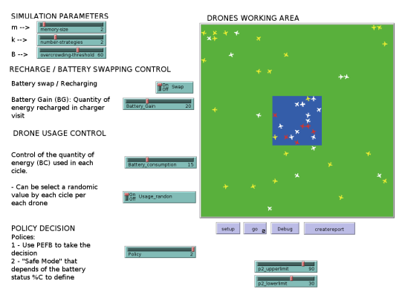
Our analogy
Simulations Parameters
Switches
Recharging área
Fig 3 - Simulation GUI - Netlogo

Slide 10
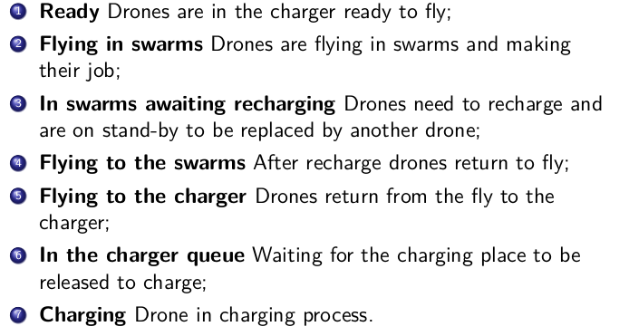
The model development needs to consider some characteristics as:
Physical: Battery Capacity, Energy supply (recharging or swap), battery usage, and recharging rates;
Logic: When battery recharging, drones states (working or charging, or inoperative).
Boggio - Dandry and Soyata (2018) propose seven steps to a perpetual drone's flight:
Our model has its recharging logic inspiration in this model

Slide 11
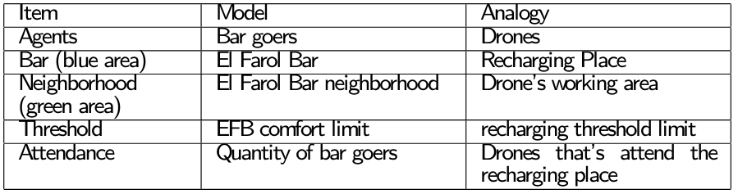
Model Abstractions:
The recharging only occur if L ≤ B and near B;
We consider no time expended to recharge or battery swap;
No communication between drones about their recharging decision (another's communication types can happen)
The recharging process didn’t consider a queue.
Drones don’t have a path or a job description (but a random battery usage);
Table 2 - Model Abstractions

Slide 12

Conclusions:
When developing a simulation model, we always need to check if the model has adequate accuracy with the study subject (Validation) and if we are creating the correct model (Verification) ;
It's an endless game;
This work is under development, publications and results were in progress.
E-mail contact:
l189052@dac.unicamp.br \ ursini@ft.unicamp.br \ paulomartinsphd@gmail.com
Publish work:
Acknowledgment: This study was financed in part by the Coordenação de Aperfeiçoamento de Pessoal de Nı́vel Superior - Brasil (CAPES) - Finance Code 001.

Slide 13
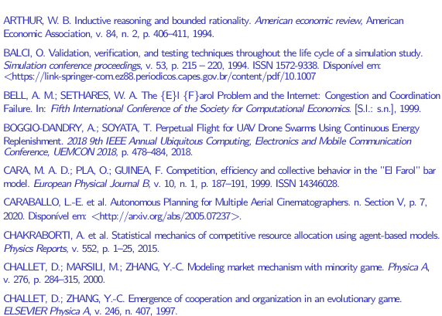
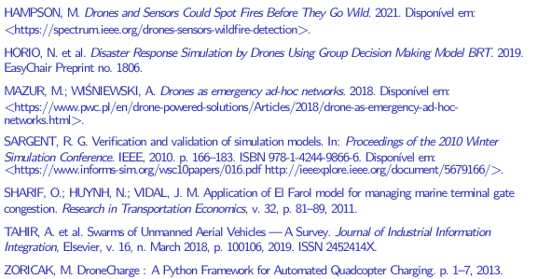
References

