Slide 1
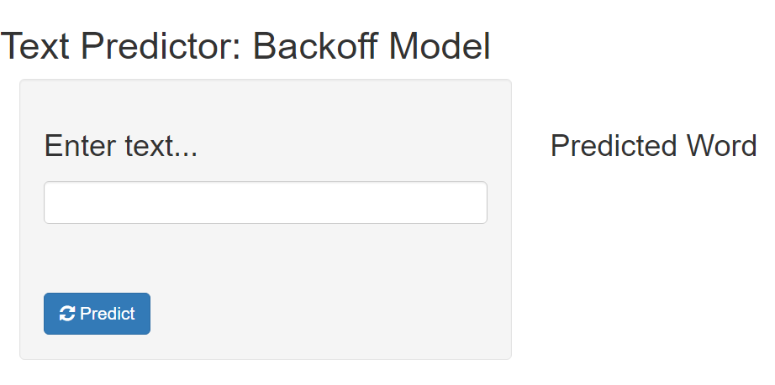
Simple UI that can run on a smartphone
Application runs in a 1Gb Shinyapps.io virtual machine
After initial load, predictions provided with subsecond response time
Achieved over 30% accuracy in testing, which exceeds commercial text predicting products such as SwiftKey
To use the application, enter text string and press the <predict> button

