Slide 1
Reading Fixed Record and Hierarchical Files in R
Len Greski
Atlanta R Users Group January 28, 2021

Slide 2
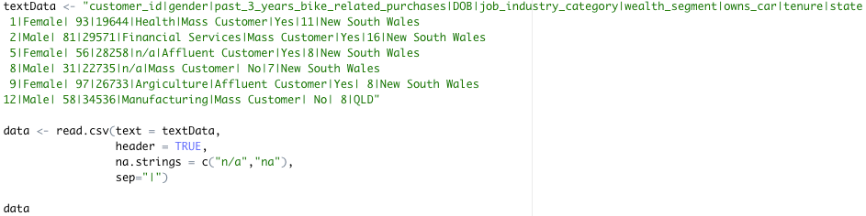
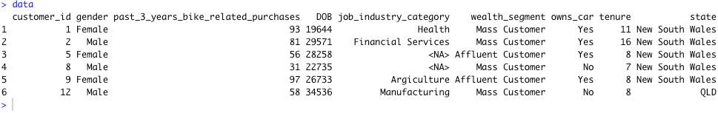
Starting with the basics
Source: Remove NA values with tidyverse mutate
Notes:
Base R provides a number of ways to read data into R. As students are introduced to the language they are quickly taught some key R functions for loading data into R, such as read.csv() and read.table()
* Content from a

Slide 3
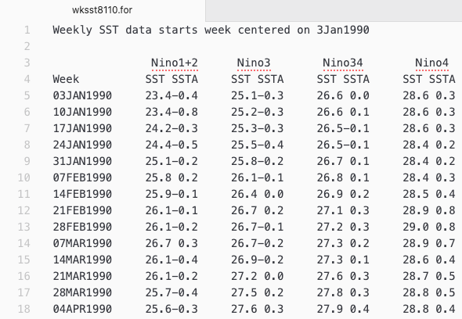
What happens when the data looks like this?
How many columns?
What separates the columns?
What does the .for file extension mean?
Why does government data have to be such a pain to read?
Source: NOAA Sea Surface Temperature Anomaly Readings, 1990 - present

Slide 4
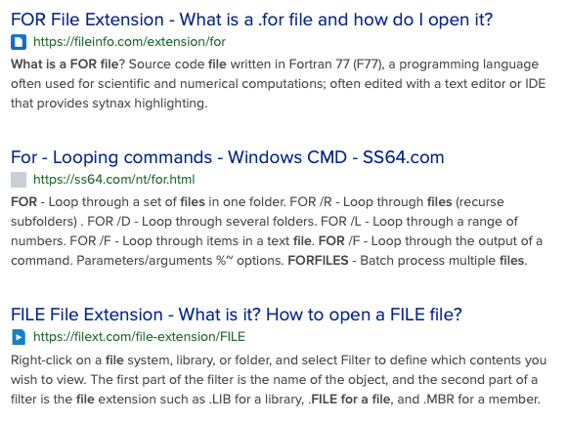
What is a .for file?

Slide 5
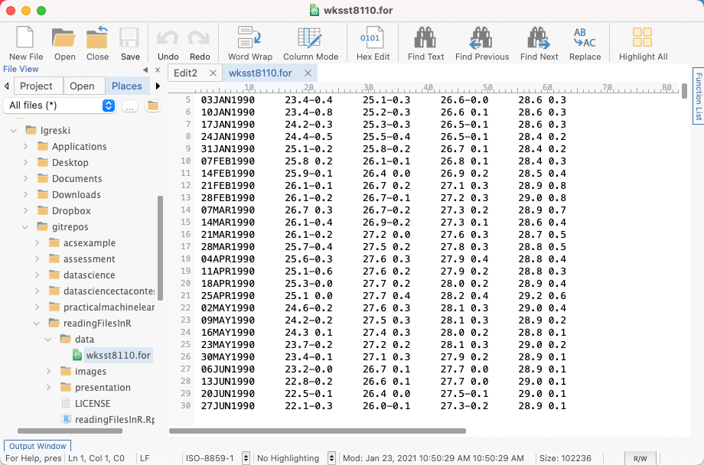
Identifying start and end columns
# 02 - 10 week as DDMMMYYYY
# 16 - 19 nino1and2sst
# 20 - 23 nino1and2ssta
# 29 - 32 nino3sst
# 33 - 36 nino3ssta
# 42 - 45 nino34sst
# 46 - 49 nino34ssta
# 55 - 58 nino4sst
# 59 - 62 nino4ssta

Slide 6
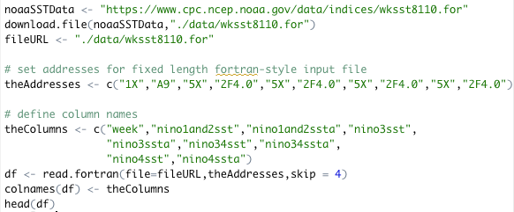
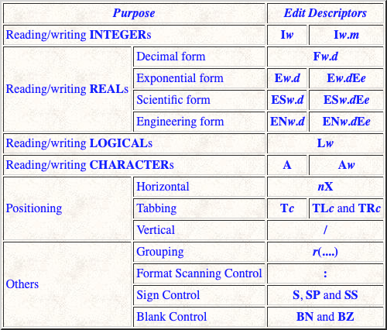
Alternative 1: read.fortran()
Source: Michigan Technological University CS201 – Fortran Formats

Slide 7
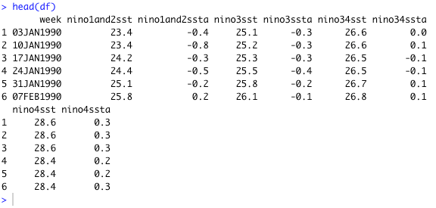
…and the output

Slide 8
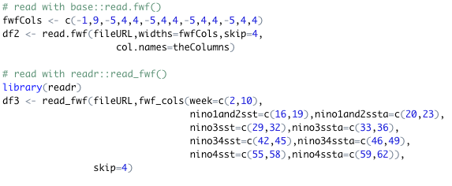
Alternatives: read.fwf() and read_fwf()

Slide 9
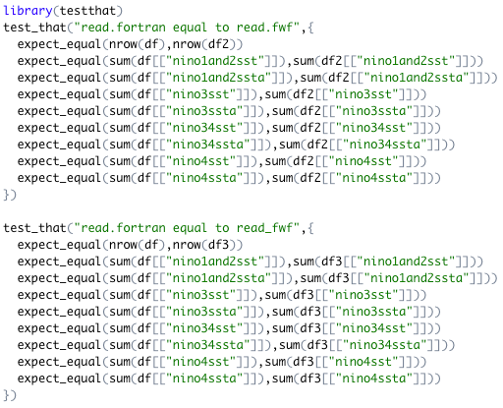
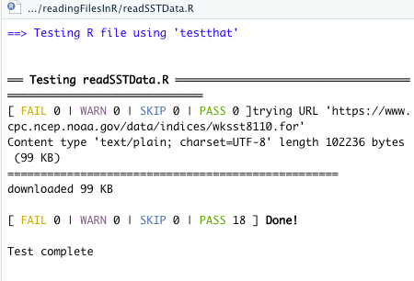
Checking our results…

Slide 10
A more complicated file:

