Slide 1
Reading Fixed Record and Hierarchical Files in R
Len Greski January 28, 2021
Level: basic / intermediate

Slide 2
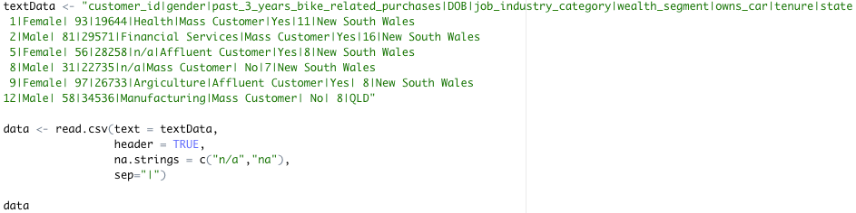
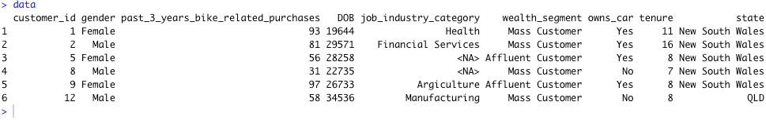
Starting with the basics
Source: Remove NA values with tidyverse mutate
Notes:
Base R provides a number of ways to read data into R. As students are introduced to the language they are quickly taught some key R functions for loading data into R, such as read.csv() and read.table()
* Content from a

Slide 3
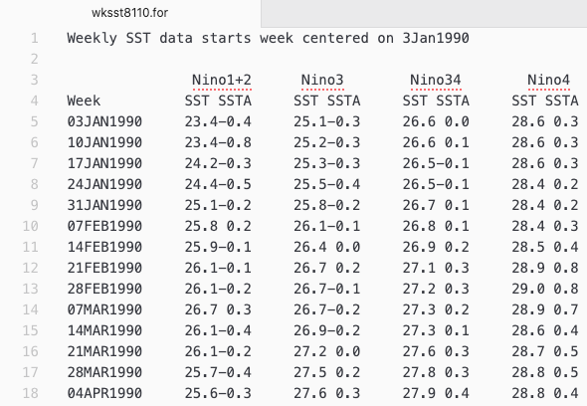
What happens when the data looks like this?
What does the .for file extension mean?
How many columns?
What separates the columns?
How does one handle variable names for the data set?
Why does government data have to be such a hassle to read?
Source: NOAA Sea Surface Temperature Anomaly Readings, 1990 - present

Slide 4
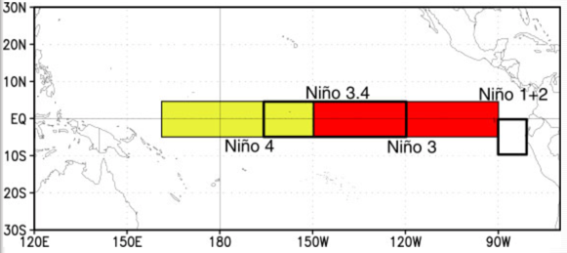
Background: El Niño Southern Oscillation
A combined atmospheric and ocean system consisting of four regions for which the NOAA collects data.
Reference: El Niño Southern Oscillation, NOAA Website

Slide 5
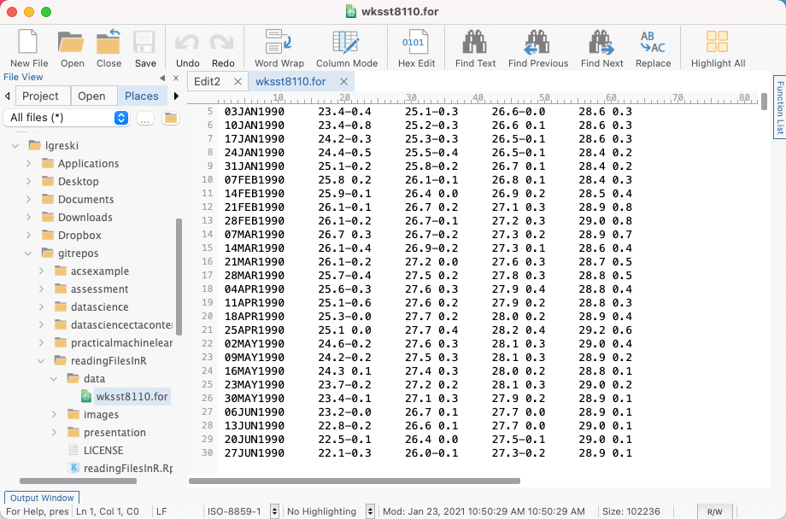
Identifying start and end columns
# 02 - 10 week as DDMMMYYYY
# 16 - 19 nino1and2sst
# 20 - 23 nino1and2ssta
# 29 - 32 nino3sst
# 33 - 36 nino3ssta
# 42 - 45 nino34sst
# 46 - 49 nino34ssta
# 55 - 58 nino4sst
# 59 - 62 nino4ssta

Slide 6
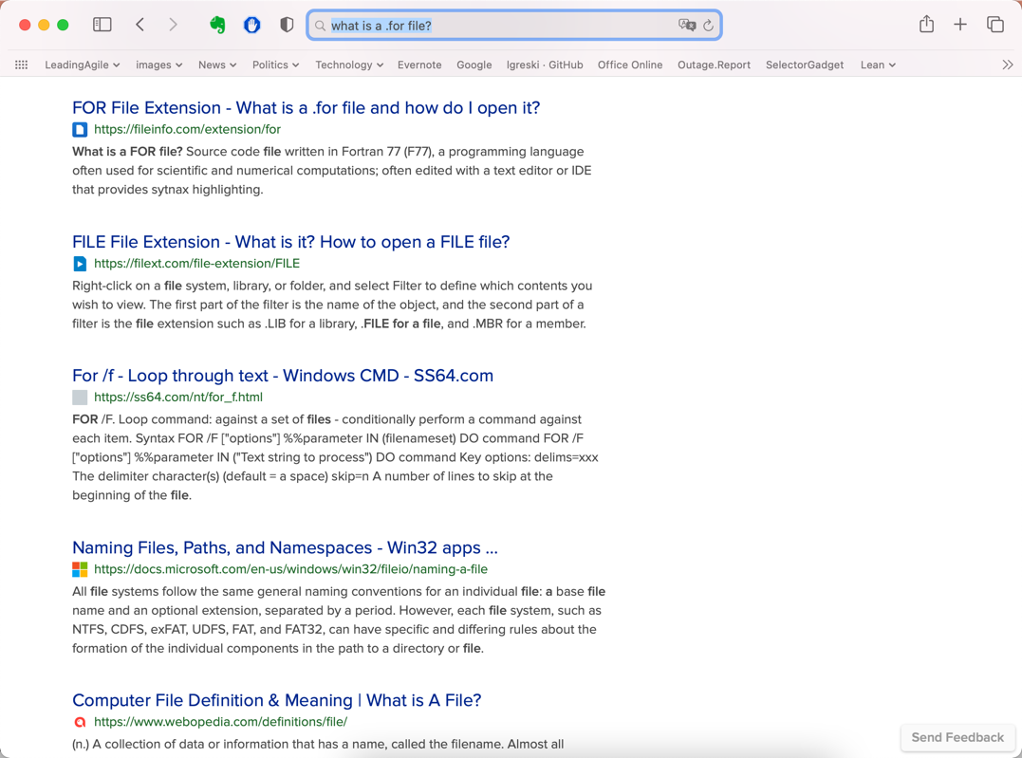
What is a .for file?

Slide 7
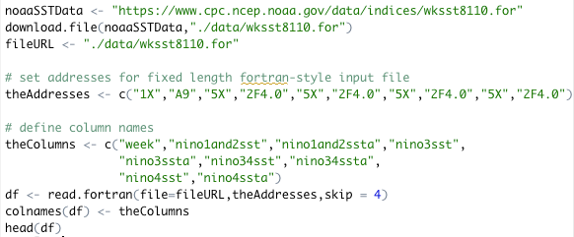
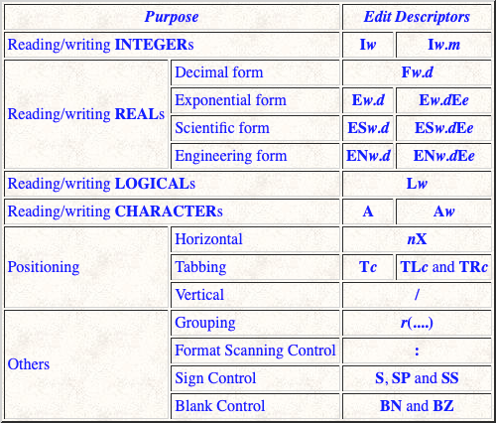
“Yes Virginia, there is a read.fortran()”
Reference: Michigan Technological University CS201 – Fortran Formats

Slide 8
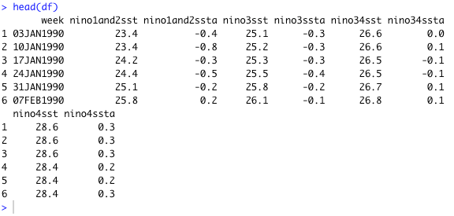
…and the output

Slide 9
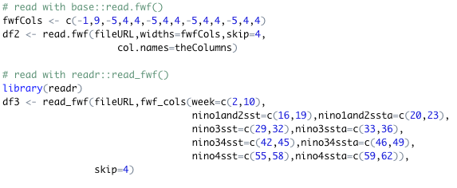
Alternatives: read.fwf() and read_fwf()

Slide 10
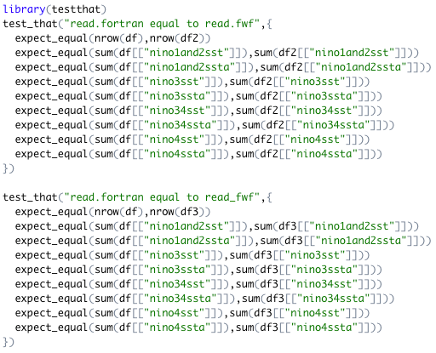
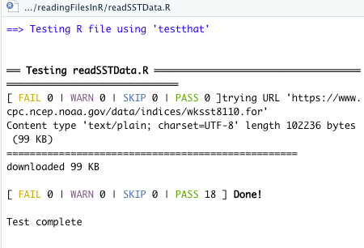
Checking our results…

Slide 11
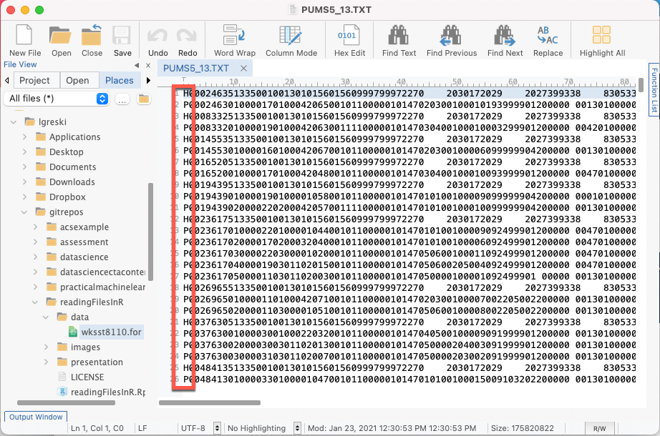
A hierarchical file: 2000 American Community Survey data
Two types of records, Household and Person
Data elements vary by record type
Varying numbers of person records per household
Data on each type of record is in fixed format
How does one go about reading and analyzing the person-level data?
Notes:
Reading of hierarchical files is a big weak spot in R.

Slide 12
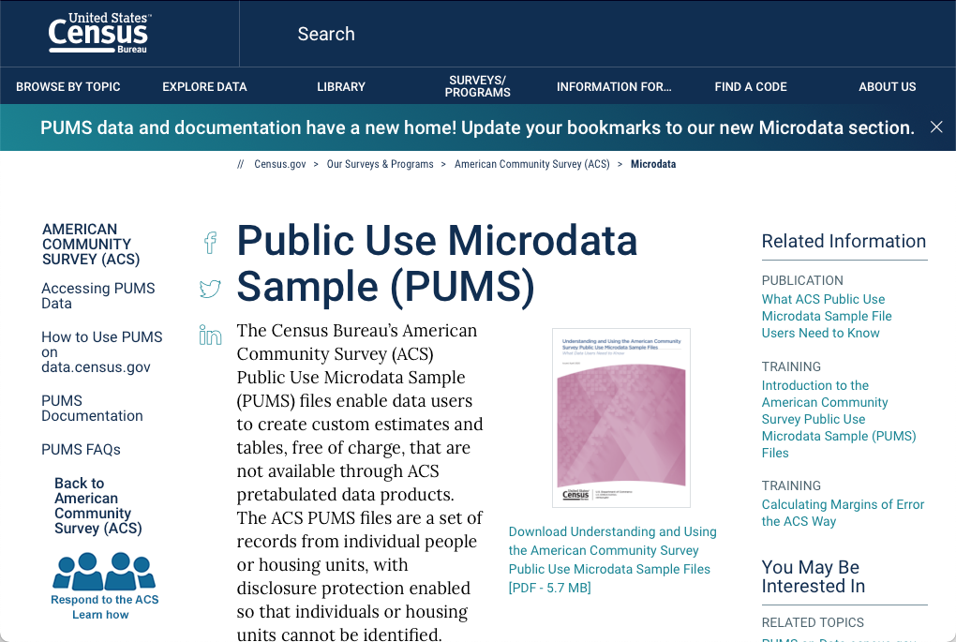
Background
Reference: Public Use Microdata Sample, U. S. Census Bureau

Slide 13
Considerations
Lots of variables
Large file size (Georgia file is 167Mb)
Using the data dictionary to configure the data read function
Separating 5% sample information from 1% sample information
Eliminating value labels from the codebook

Slide 14
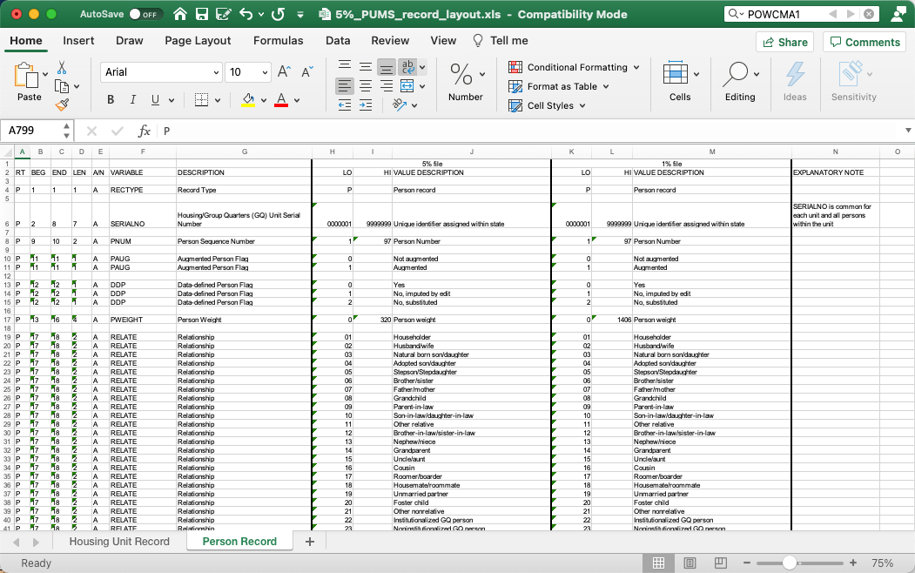
PUMS Codebook

Slide 15
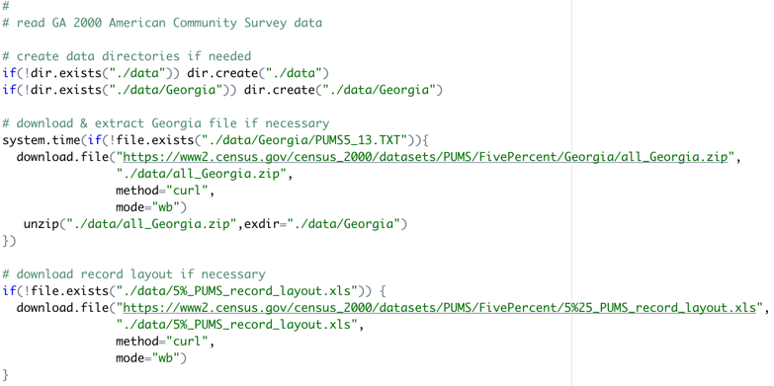
Obtaining the data
Note: there is a revised PUMS file stored in the same location as the original, but the revised file is not in zip format so it takes about 10 minutes to download.
Notes:
Talk about importance of reproducibility – downloads are provided so the work is reproducible
Why store data in a /Georgia subdirectory? This allows us to abstract the code into a function, where we can use the state names to drive an apply() function to read data for multiple states.

Slide 16

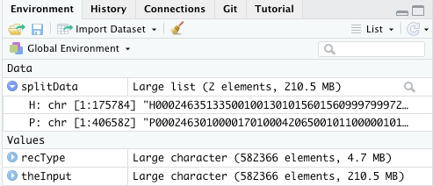
Read & split the records by record type

Slide 17
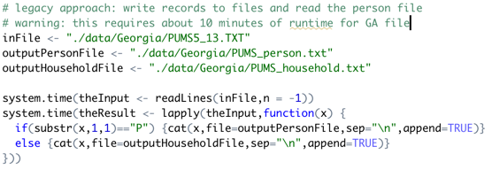
Alternate approach: don’t try this at home

Slide 18
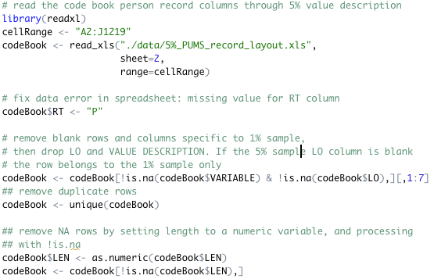
Read & clean the codebook

Slide 19
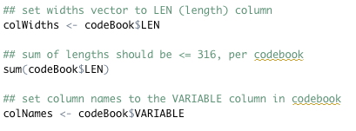
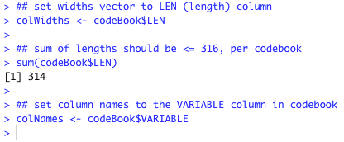
Use codebook to configure read_fwf()

Slide 20

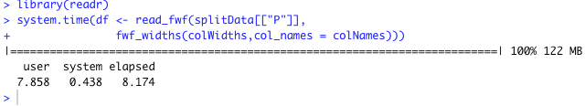
Read the file

Slide 21

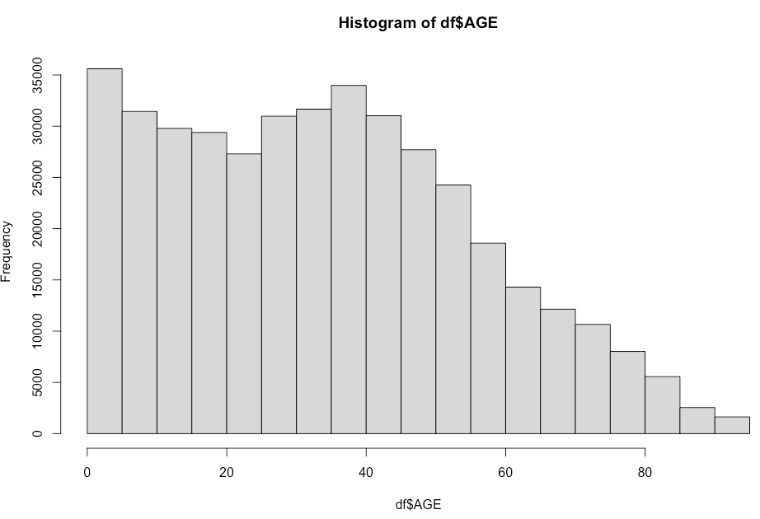

Run a simple analysis

Slide 22
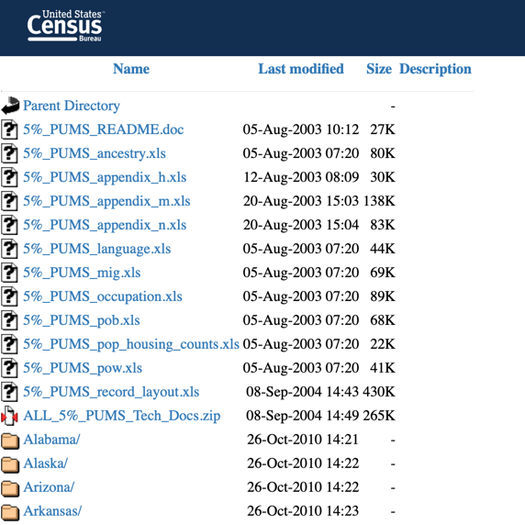
Generalizing the solution
We can use the state names to drive
an apply() function to download and process the data for multiple states.
Reference: https://www2.census.gov/census_2000/datasets/PUMS/FivePercent/

Slide 23
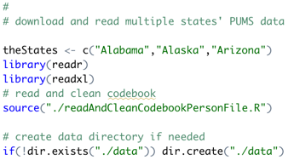
First, the setup

Slide 24
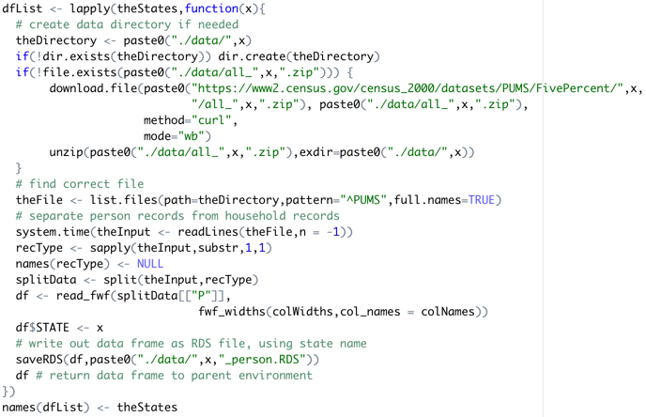
Next, the load process driven by lapply()

Slide 25
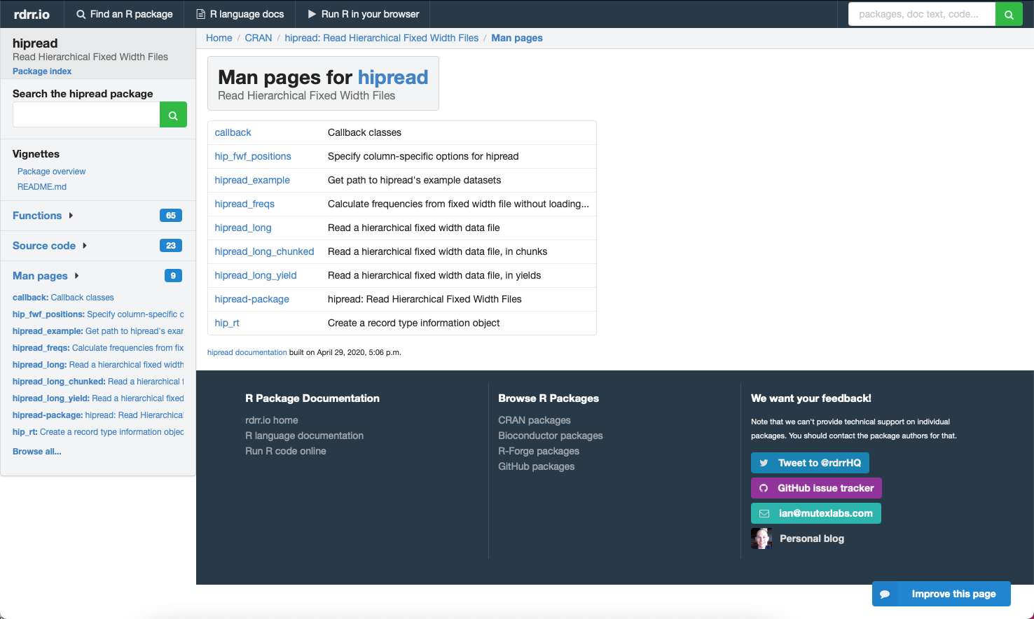
Isn’t there a package for this?

Slide 26
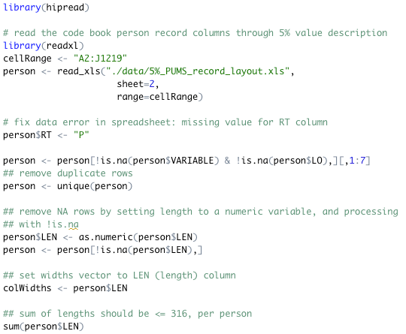
A hipread solution: read the person dictionary

Slide 27
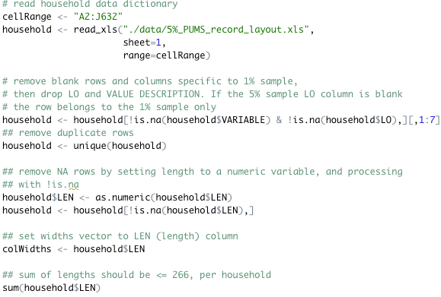
A hipread solution: read the household dictionary

Slide 28
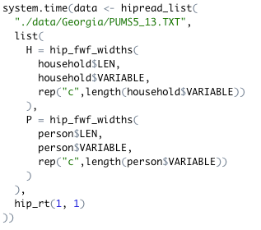
…and then read the raw datra

Slide 29
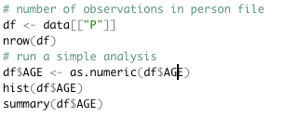
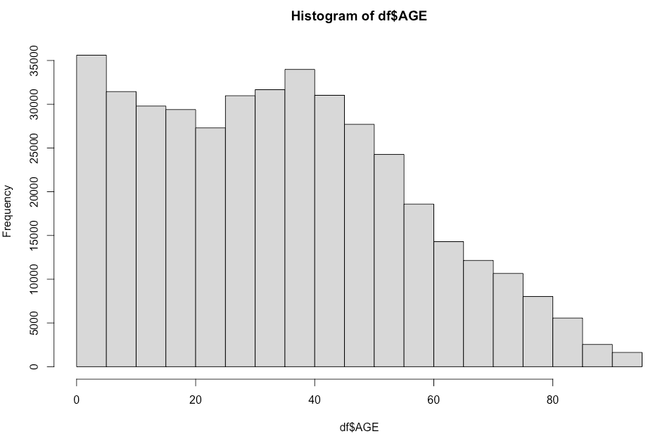
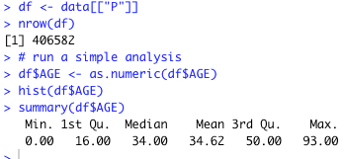
Verifying results

Slide 30
Q & A

Slide 31






About Len
Len Greski currently serves as Principal Consultant at LeadingAgile, the leader in helping large companies generate economic value through agile transformation. Len started his career at Information Resources Inc., developing statistical and AI models to predict consumer behavior. He learned R in 2015 when he needed a way to analyze the value of a software portfolio without spending $9,000 on a copy of SAS. Len has mentored hundreds
of thousands of students in the Johns Hopkins University Data Science Specialization on
Coursera, having served as a Community Mentor since 2015. Len has a top 5% ranking on Stackoverflow.com, where he primarily answers questions about R.
len@greskilabs.com
lgreski
lgreski/readingFilesInR – repository where tonight’s code and presentation are stored
lgreski
Data Science Depot blog: https://lgreski.github.io/datasciencedepot/

