Slide 1
Testing for Reproducible Research
Len Greski August 24, 2022
Level: beginner, intermediate

Slide 2
From requirements to code
…building on the legacy of software product development

Slide 3

What happens with business requirements
Epics
Large chunks of capability with measurable business value, typically can be delivered within 3 months
Features
Smaller chunks of capability supporting an epic, and are typically delivered in 2 weeks or less
Stories
A single, implementable thing that has value, scoped between 1 – 2 days

Slide 4
From stories to working tested product
Story Written
“As a <role> I want to <do something> so that <statement of business value> happens”
Acceptance Criteria Defined
Statements indicating how we know that a story has been implemented correctly, including positive, negative, and edge cases
Components Designed
Behaviors required to support the story along with the information needed to support the behavior are assigned to components within the system
Components Built
Code to support the required behaviors and information is developed within the programming language used for the software application in which the requirements are implemented
Components Tested
Various forms of testing are conducted to ensure the story fulfills the requirements, including unit testing, integration testing, user acceptance testing, and performance testing

Slide 5
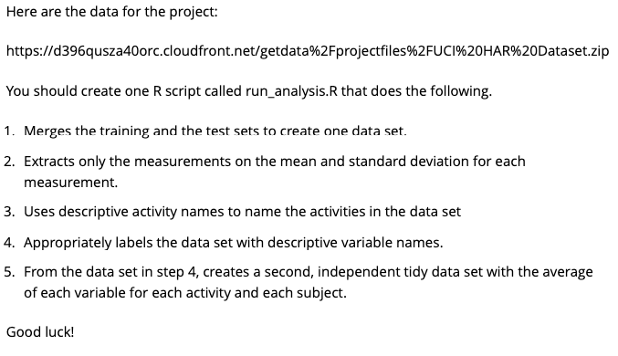
…but data science is different

Slide 6
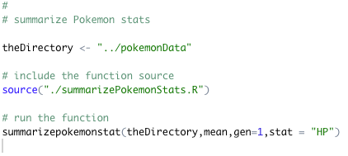
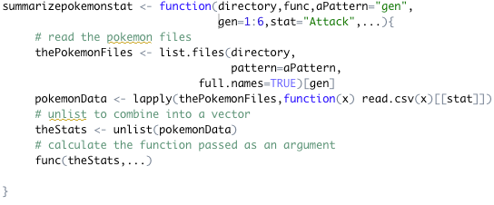
Scripts vs. modules
Testing of scripts is different than testing of modules (objects, functions, or macros, depending on the language)

Slide 7
Testing for reproducibility
The ability to verify that code run to reproduce an analysis is using the same data and algorithms as the original analysis by passing a set of assertions against the data and environment; making it easy for others to reproduce your analysis

Slide 8
What must be tested?
At run time
During development
Data sources & characteristics
The runtime environment
The expectations / expected values for functions or methods
Handling of inputs (valid & invalid)
Handling of logic for known cases
Edge cases, such as the natural log of 0
Purpose: find and alert the user about user errors, data anomalies
Purpose: ensure the software produces intended results, both during initial development as well as when
new features are added to the system
Package: Use the assertive family of packages for runtime testing
Package: use the testthat package for development time testing

Slide 9
What must be tested?
At run time
During development
Data sources & characteristics
The runtime environment
The expectations / expected values for functions or methods
Handling of inputs (valid & invalid)
Handling of logic for known cases
Edge cases, such as the natural log of 0
Tonight’s focus
Purpose: find and alert the user about user errors, data anomalies
Purpose: ensure the software produces intended results, both during initial development as well as when
new features are added to the system
Package: Use the assertive family of packages for runtime testing
Package: use the testthat package for development time testing

Slide 10
Data Characteristics

Slide 11
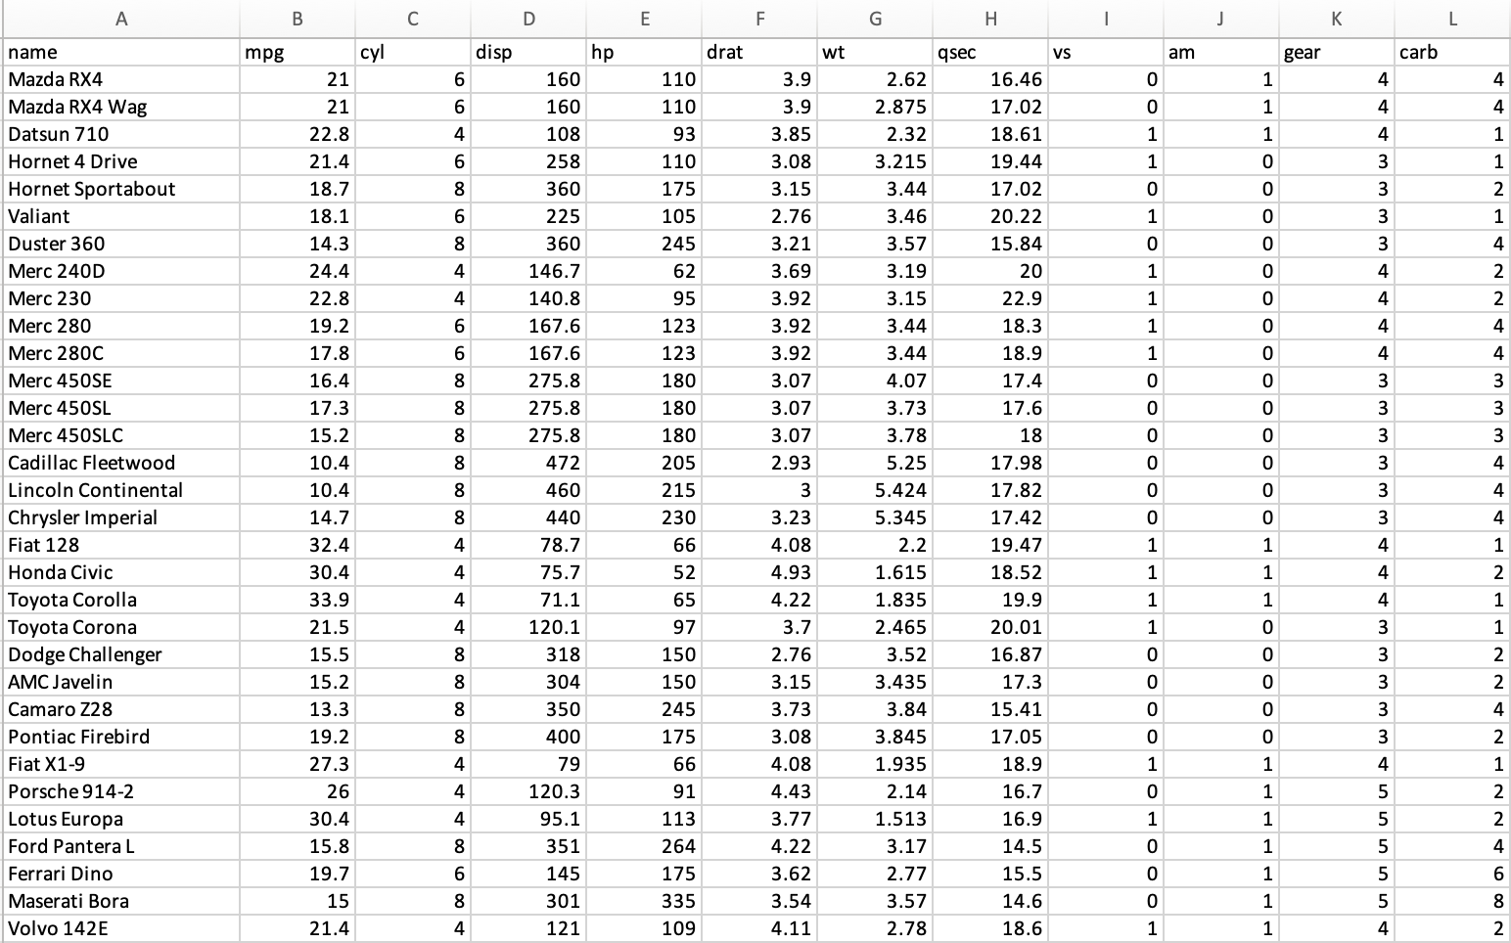
Can you find the errors?

Slide 12
Can you find the errors?
Missing manufacturer names
Incorrect coding of Mazda rotary engine as S, Porsche flat engine as V
Inclusion of a diesel powered vehicle (Mercedes 240D)

Slide 13
Tests to run on input files
Number of rows
Number of columns
Checksums for numeric columns
Specific values at specific locations for character columns

Slide 14
The approach
Identify an independent source of information
Observe / measure things
Write assertions / tests to validate accuracy when the data is read
Read the data
Run the assertions

Slide 15
Example: mtcars data in Excel
Number of columns: 12, including make/model
Number of rows: 32
Checksum for am – 13
Checksum for wt – 192.952
Make / model in row 17: Chrysler Imperial
max(disp) – 472
min(hp) -- 52

Slide 16
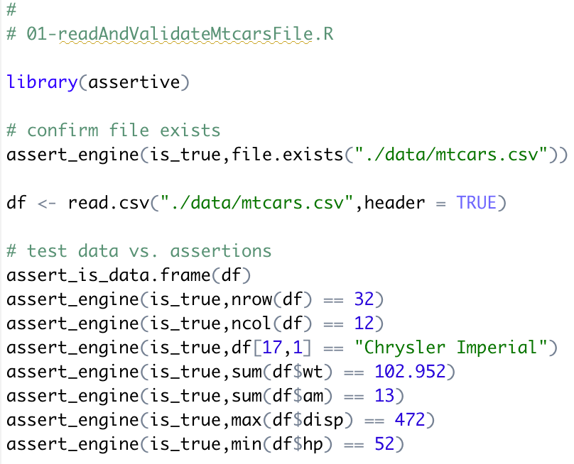
Read & Validate

Slide 17
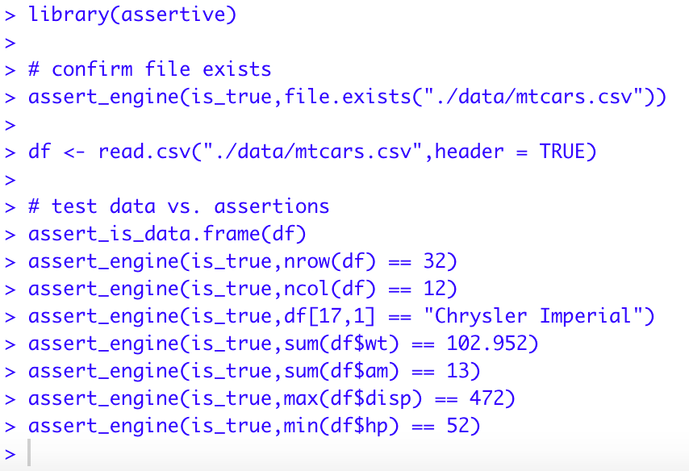
…when the tests pass

Slide 18
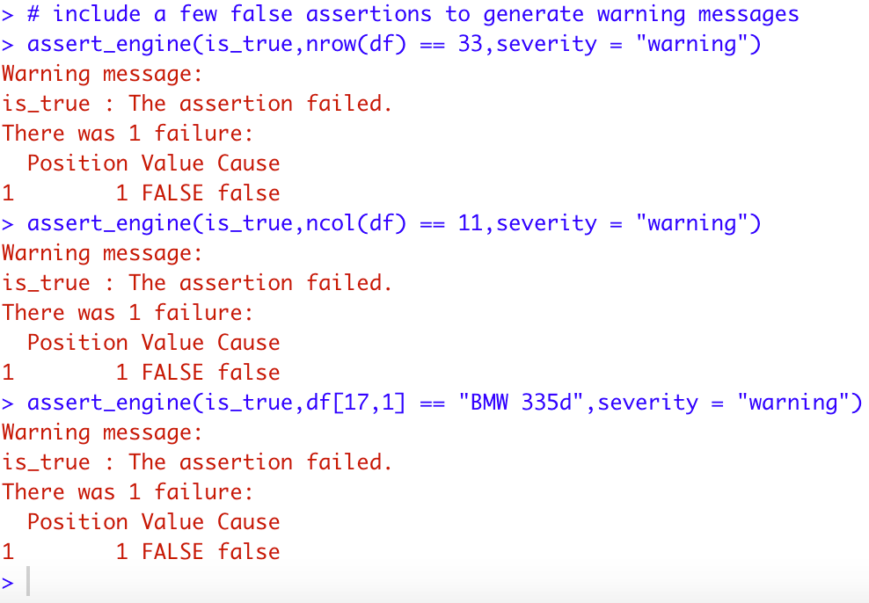
Add a few failing tests

Slide 19
Testing the runtime environment

Slide 20
Testing the runtime environment
Do I have the necessary packages installed?
Do I have enough memory to process the data?
Am I running the most recent version of R?
Do I have a 64-bit operating system?
Do I have sufficient disk space to run the analysis?
Warning: no easy way to test available disk space that works across operating systems

Slide 21
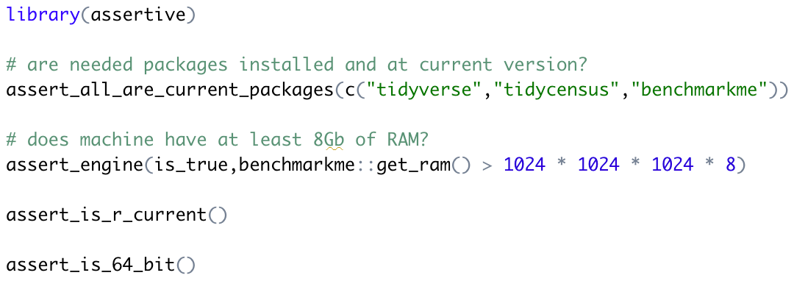
Testing the runtime environment

Slide 22
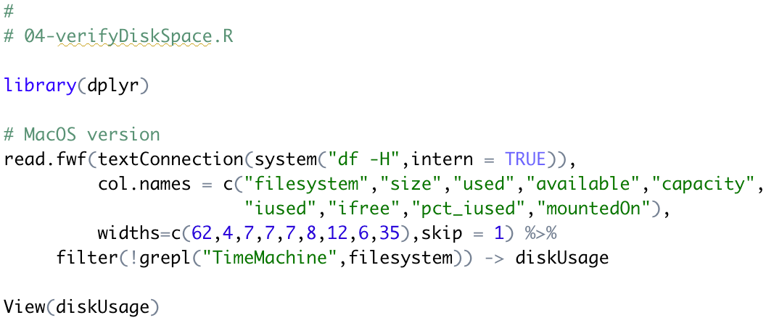
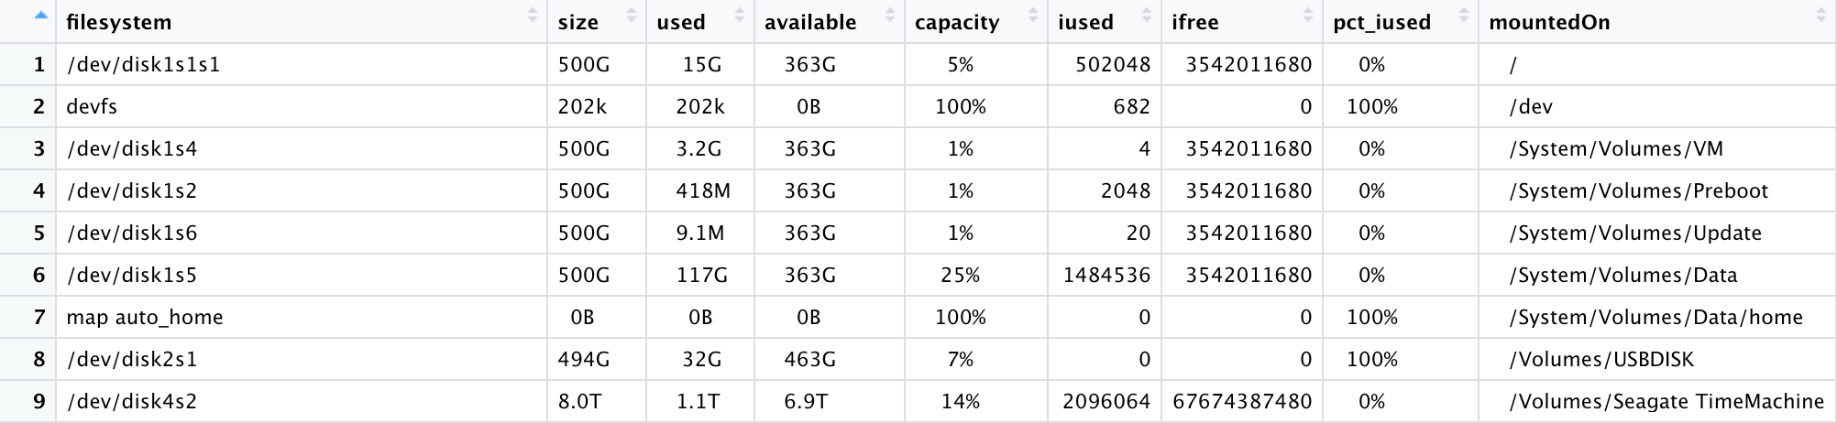
Checking disk space

Slide 23
Q & A

Slide 24
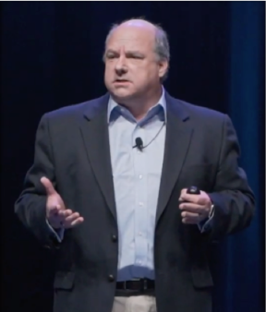





About Len
Len Greski currently leads the Architecture practice at LeadingAgile, the leader in helping large companies generate economic value through agile transformation. Len started his career at Information Resources Inc., developing statistical and AI models to predict consumer behavior. He learned R in 2015 when he needed a way to analyze the value of a software portfolio without spending $9,000 on a copy of SAS. Len has mentored hundreds
of thousands of students in the Johns Hopkins University Data Science Specialization on
Coursera, having served as a Community Mentor since 2015. Len has a top 5% ranking on Stackoverflow.com, where he primarily answers questions about R.
len@greskilabs.com
lgreski
lgreski/tidyverse-vs-flatfiles – repository where tonight’s code and presentation are stored
lgreski
Data Science Depot blog: https://lgreski.github.io/datasciencedepot/

