Slide 1
Tidycensus vs. Flat Files
Len Greski August 24, 2022
Level: intermediate

Slide 2
Background
January 2021 R Users Group presentation on reading flat files ended with a hierarchical file layout based on U.S. Census data
During the Q&A, a question was asked about tidycensus and how it compared to reading the files directly

Slide 3
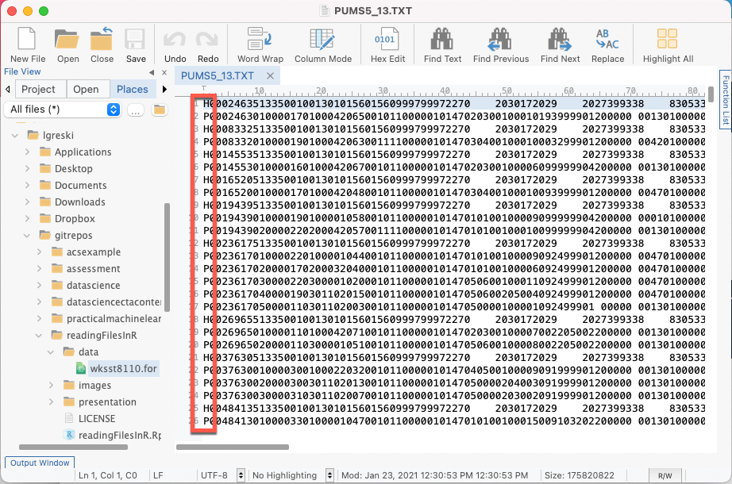
Where we left our topic: 2000 American Community Survey data
Two types of records, Household and Person
Data elements vary by record type
Varying numbers of person records per household
Data on each type of record is in fixed format
How does one go about reading and analyzing the person-level data?
Notes:
Reading of hierarchical files is a big weak spot in R.

Slide 4
Considerations
Lots of variables
Large file size (Georgia file is 167Mb)
Using the data dictionary to configure the data read function
Separating 5% sample information from 1% sample information
Eliminating value labels from the codebook

Slide 5
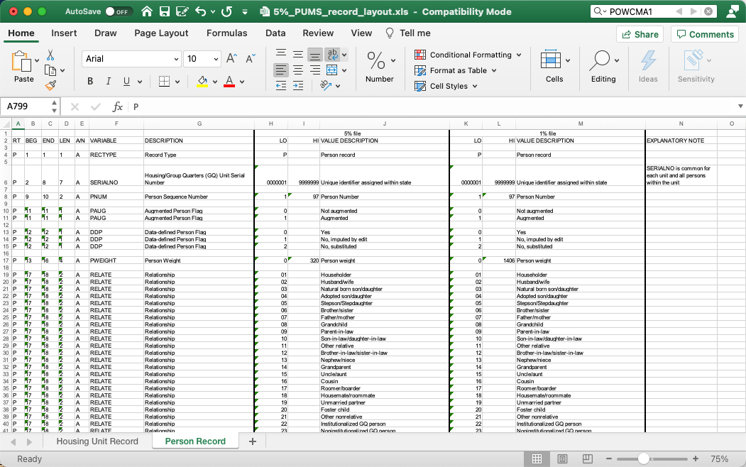
PUMS Codebook

Slide 6
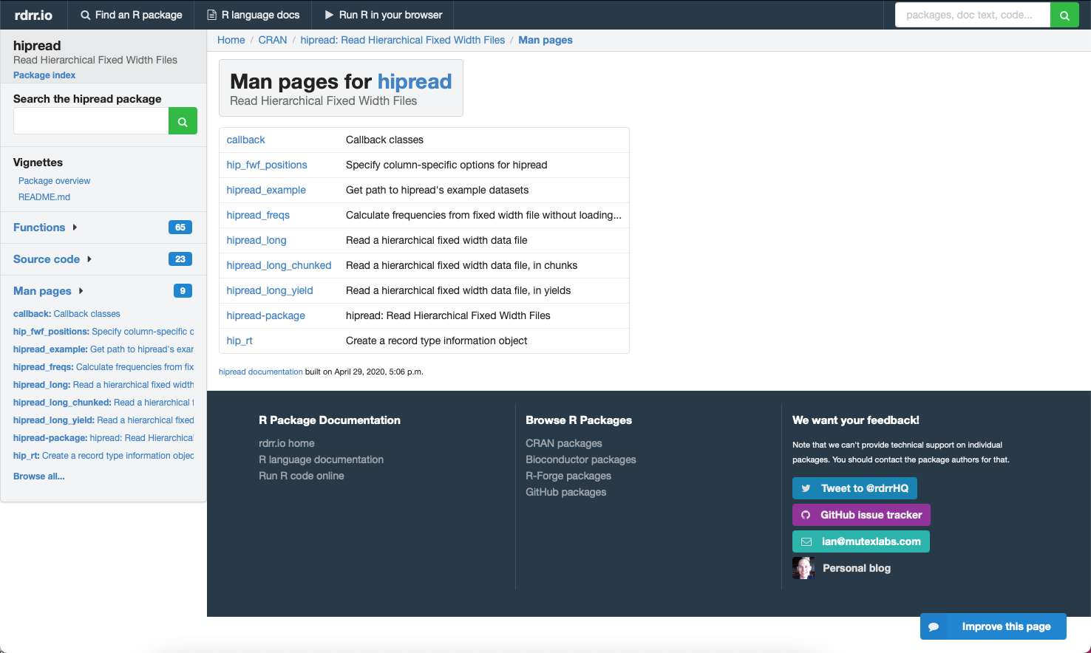
Isn’t there a package for this?

Slide 7
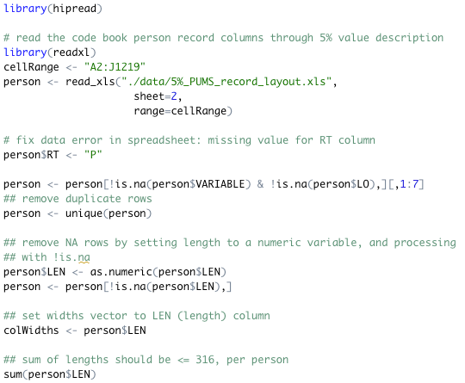
A hipread solution: read the person dictionary

Slide 8
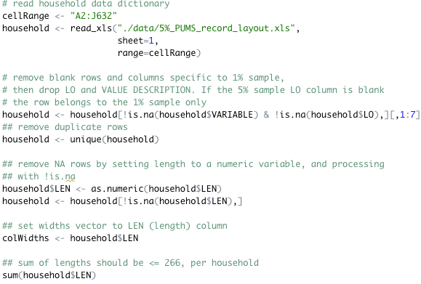
A hipread solution: read the household dictionary

Slide 9
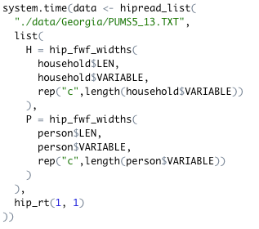
…and then read the raw datra

Slide 10
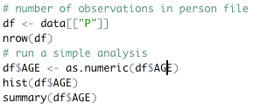
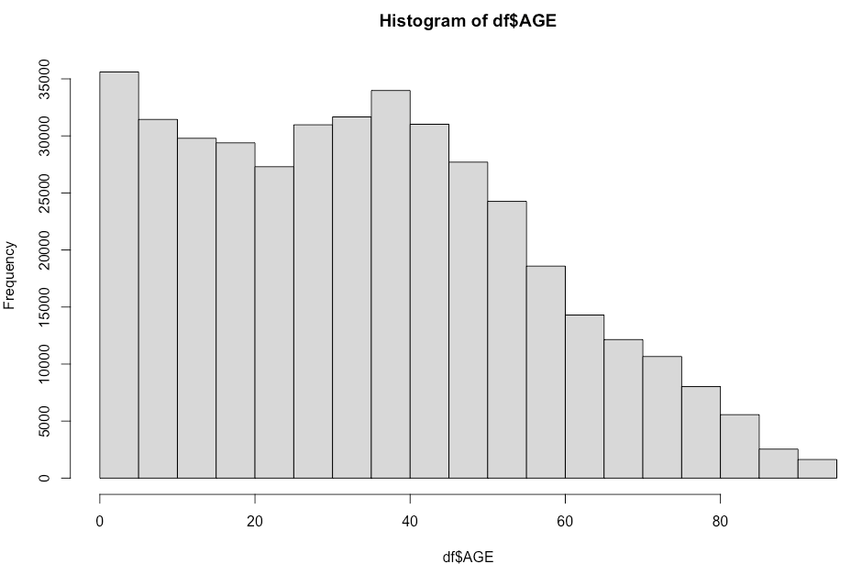
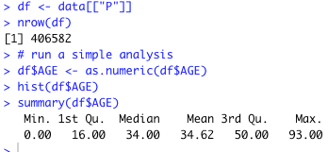
Verifying results

Slide 11
Comparing to tidycensus isn’t easy…

Slide 12
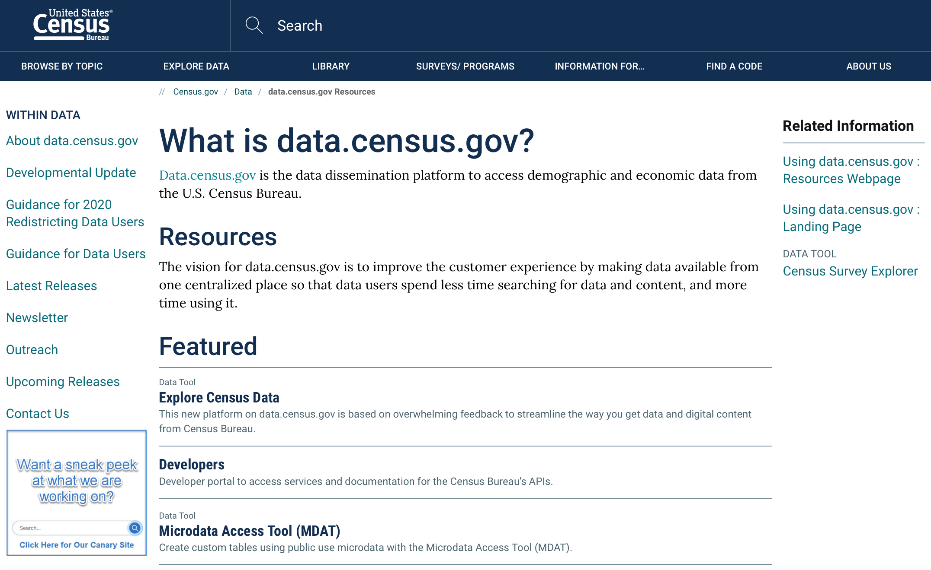
The Census Bureau isn’t sitting still

Slide 13

What is Tidycensus?
An R package that enables API-based access to a subset of U.S. Census data. It generates tidyverse compatible data frames (i.e. tibbles), and includes simple feature geometry

Slide 14
The process
Setup
Obtain an API access key from the Census Bureau
Install tidyverse and tidycensus
Cache the API key in .Renviron
Access data
Identify features and sample replicates to be downloaded
Download data
Save to local disk to avoid having to repeatedly access API
Analyze data

Slide 15
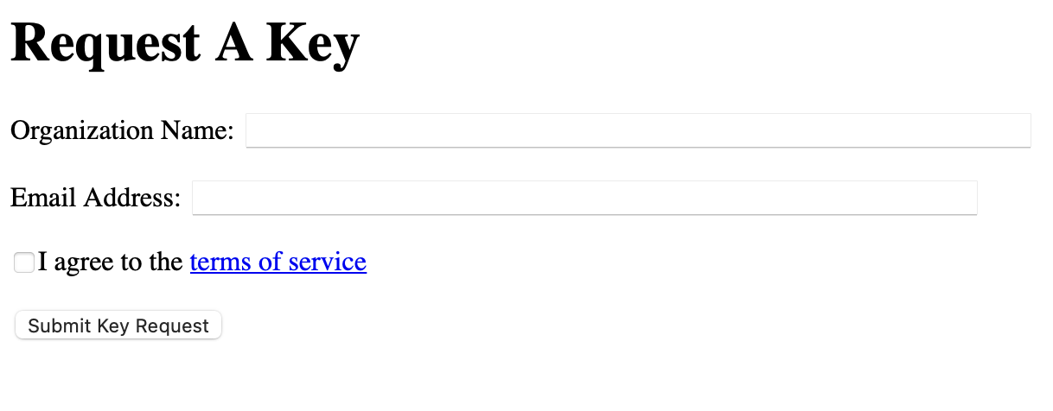
Setup
https://api.census.gov/data/key_signup.html

Slide 16
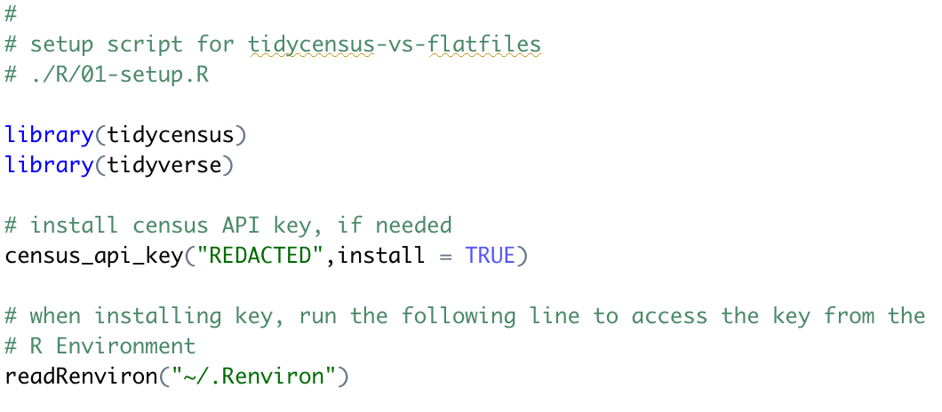
Install packages and API key

Slide 17
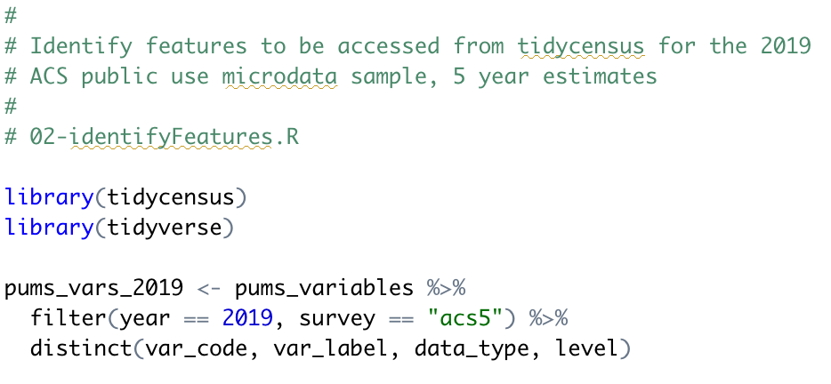
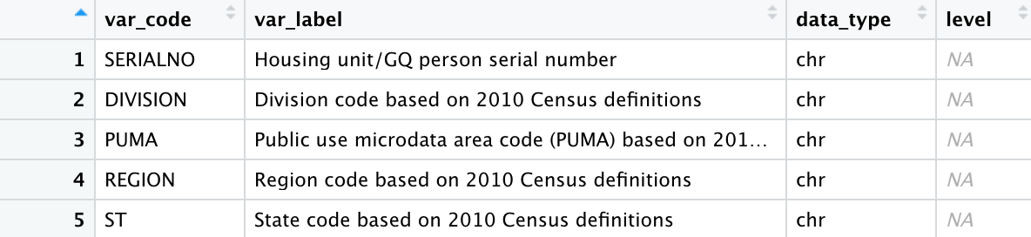
Identify features
Considerations
Household or Person records?
Include empty households?
Include sampling replicates?

Slide 18
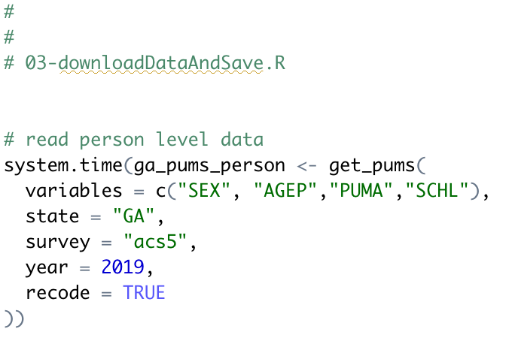
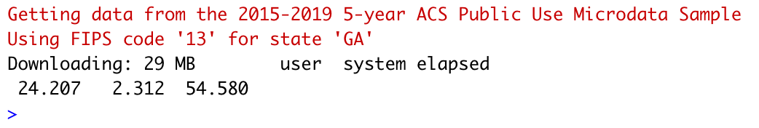
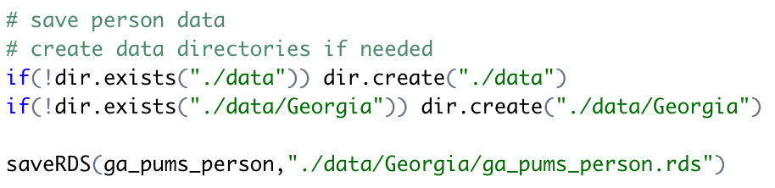
Download data & save
NOTE: these downloads take time!

Slide 19
Q & A

Slide 20






About Len
Len Greski currently leads the Architecture practice at LeadingAgile, the leader in helping large companies generate economic value through agile transformation. Len started his career at Information Resources Inc., developing statistical and AI models to predict consumer behavior. He learned R in 2015 when he needed a way to analyze the value of a software portfolio without spending $9,000 on a copy of SAS. Len has mentored hundreds
of thousands of students in the Johns Hopkins University Data Science Specialization on
Coursera, having served as a Community Mentor since 2015. Len has a top 5% ranking on Stackoverflow.com, where he primarily answers questions about R.
len@greskilabs.com
lgreski
lgreski/tidyverse-vs-flatfiles – repository where tonight’s code and presentation are stored
lgreski
Data Science Depot blog: https://lgreski.github.io/datasciencedepot/

