Slide 1
Tidycensus vs. Flat Files
Len Greski August 24, 2022
Level: intermediate

Slide 2
Background
January 2021 R Users Group presentation on reading flat files ended with a hierarchical file layout based on U.S. Census data
During the Q&A, a question was asked about tidycensus and how it compared to reading the files directly

Slide 3
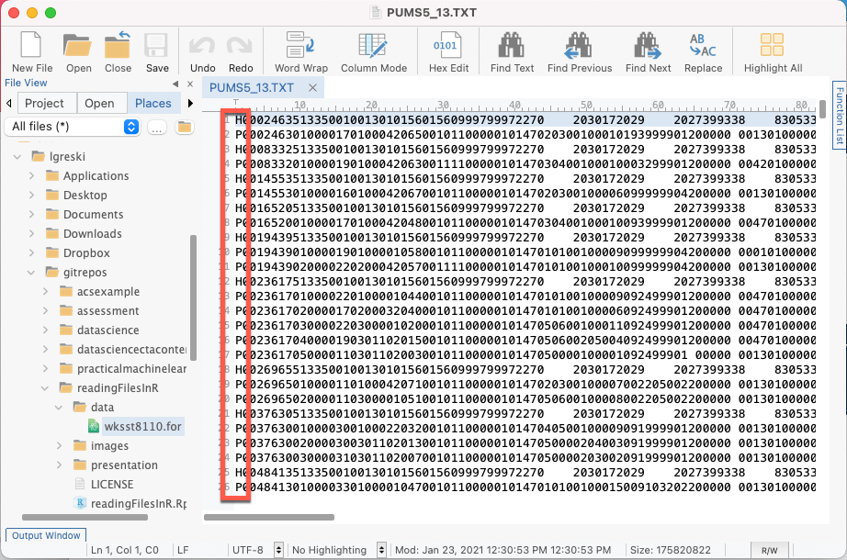
Where we left our topic: 2000 American Community Survey data
Two types of records, Household and Person
Data elements vary by record type
Varying numbers of person records per household
Data on each type of record is in fixed format
How does one go about reading and analyzing the person-level data?
Notes:
Reading of hierarchical files is a big weak spot in R.

Slide 4
Considerations
Lots of variables
Large file size (Georgia file is 167Mb)
Using the data dictionary to configure the data read function
Separating 5% sample information from 1% sample information
Eliminating value labels from the codebook

Slide 5
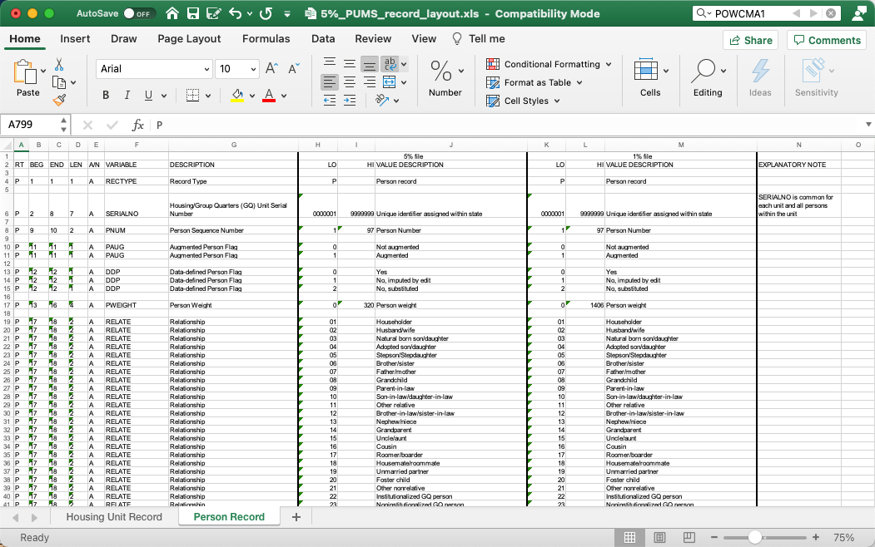
PUMS Codebook

Slide 6
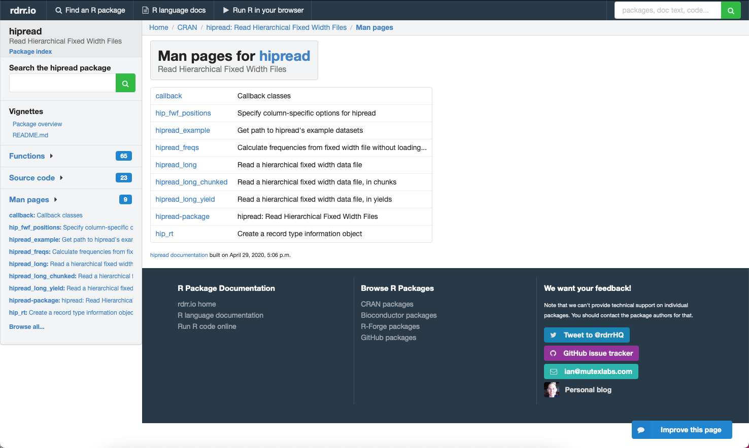
Isn’t there a package for this?

Slide 7
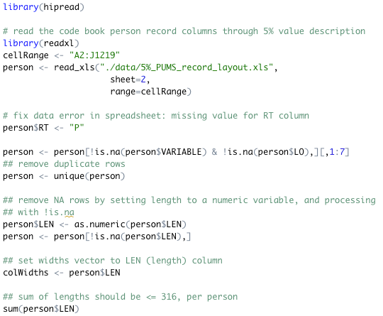
A hipread solution: read the person dictionary

Slide 8
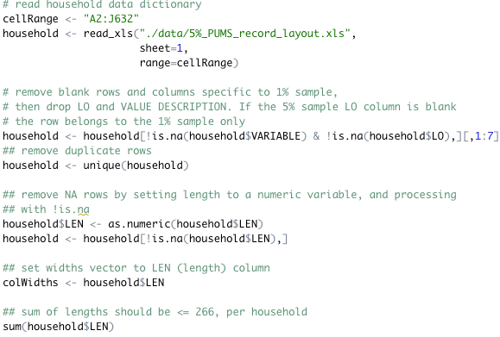
A hipread solution: read the household dictionary

Slide 9
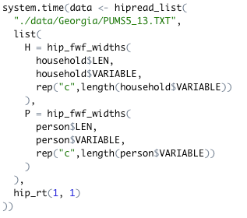
…and then read the raw data

Slide 10
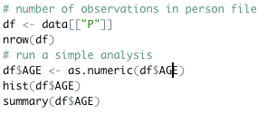
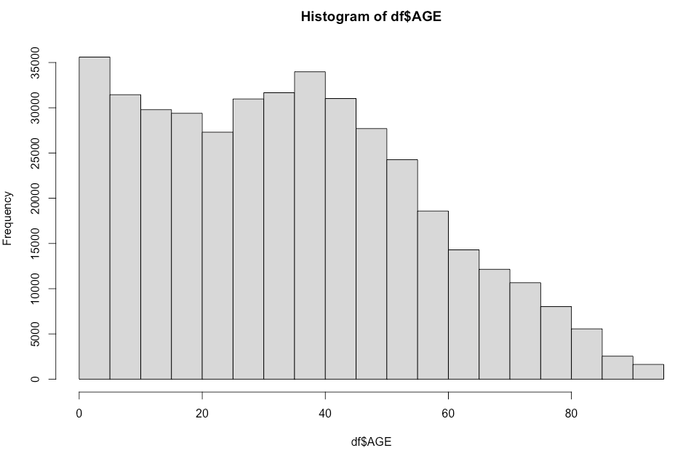
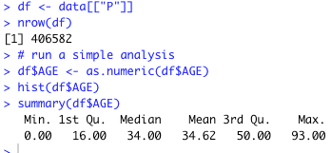
Verifying results

Slide 11
Comparing to tidycensus isn’t so easy…

Slide 12
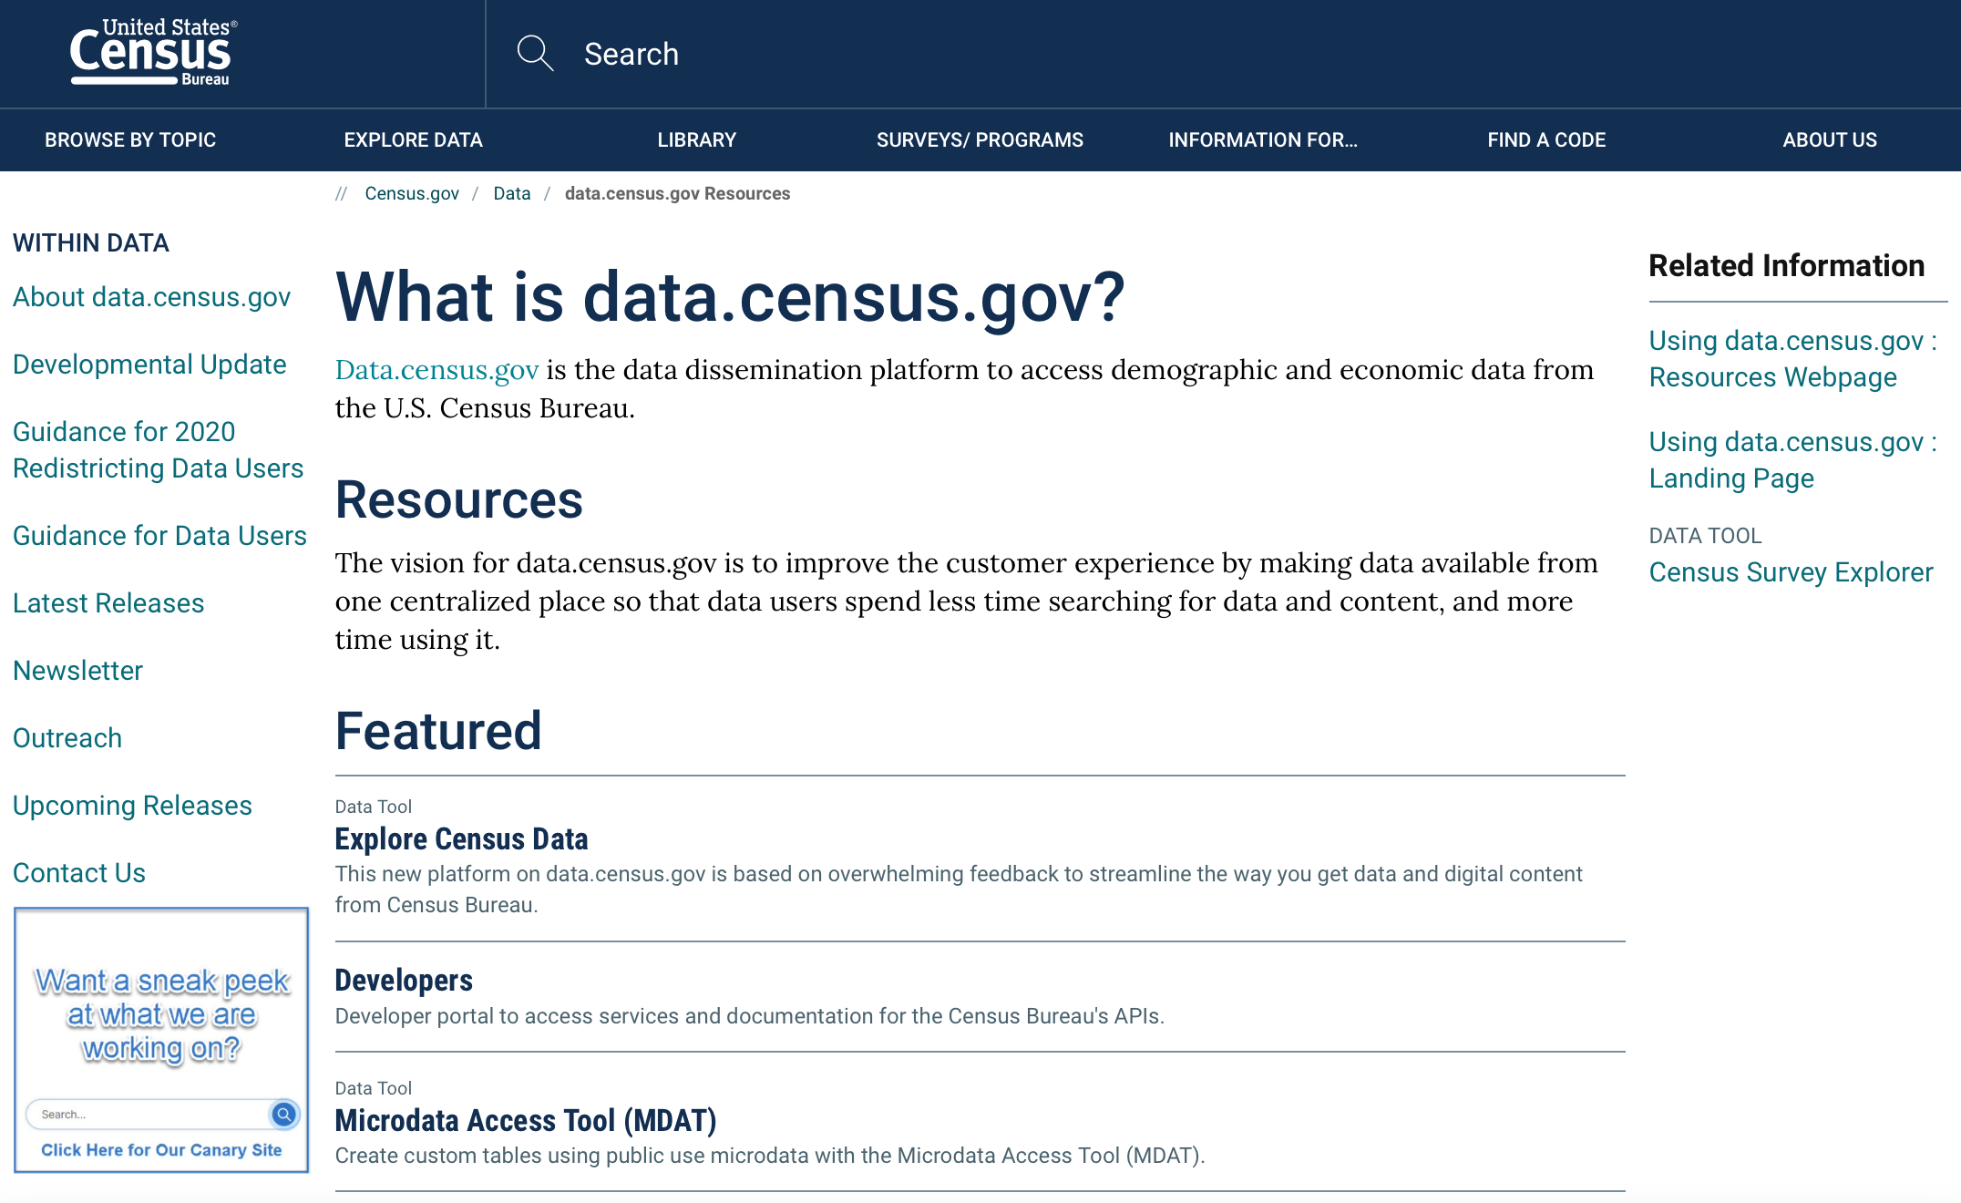
The Census Bureau isn’t sitting still

Slide 13

What is Tidycensus?
An R package that enables API-based access to a subset of U.S. Census data. It generates tidyverse compatible data frames (i.e. tibbles), and includes simple feature geometry

Slide 14
The process
Setup
Obtain an API access key from the Census Bureau
Install tidyverse and tidycensus
Cache the API key in .Renviron
Access data
Identify features and sample replicates to be downloaded
Download data
Save to local disk to avoid having to repeatedly access API
Analyze data

Slide 15
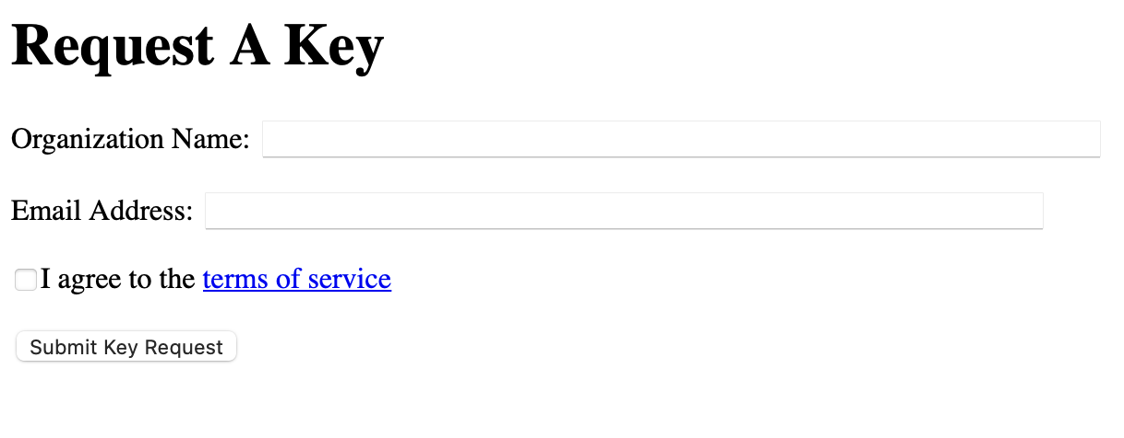
Setup
https://api.census.gov/data/key_signup.html

Slide 16
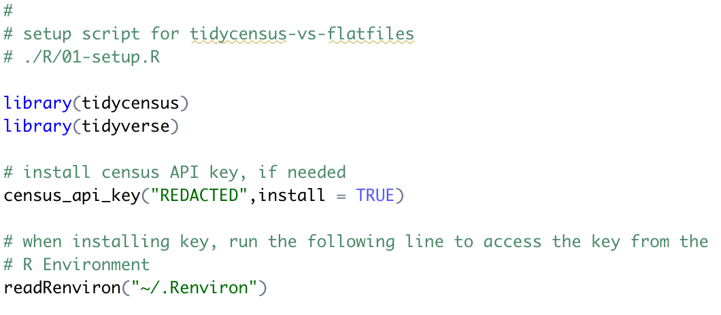
Install packages and API key

Slide 17
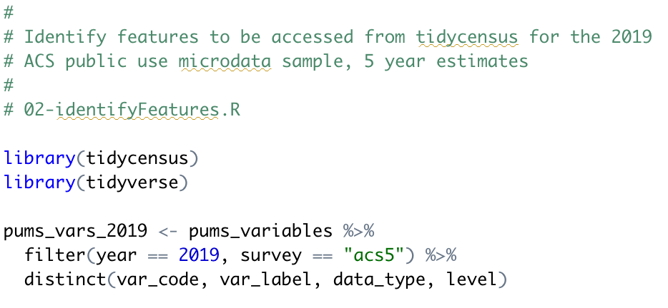
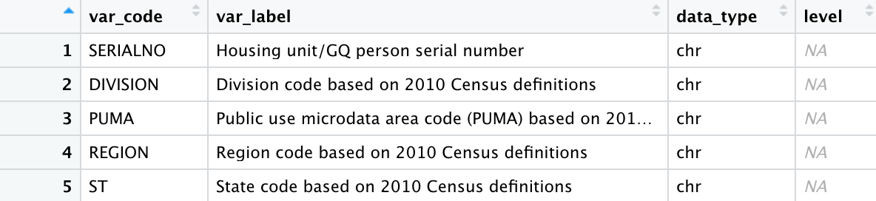
Identify features
Considerations
Household or Person records?
Include empty households?
Include sampling replicates?

Slide 18
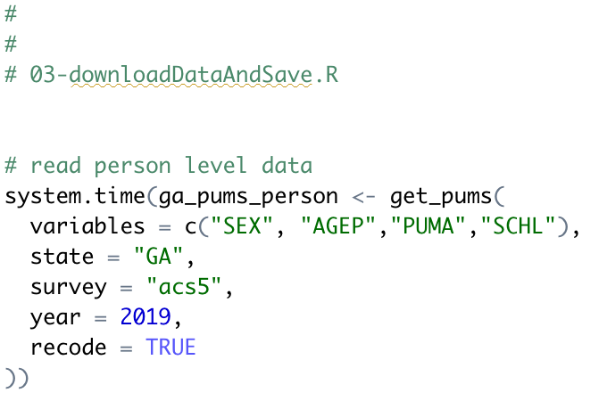
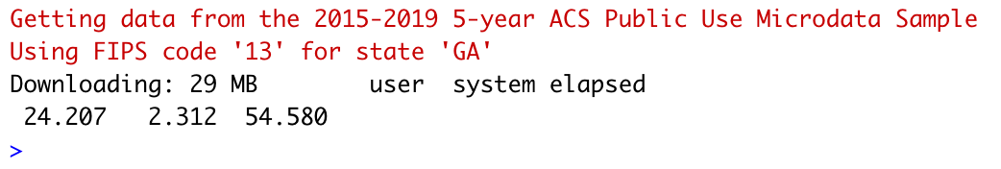
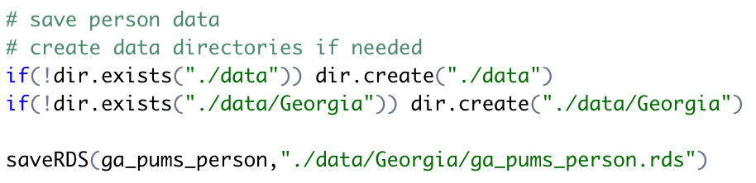
Download data & save
NOTE: these downloads take time!

Slide 19
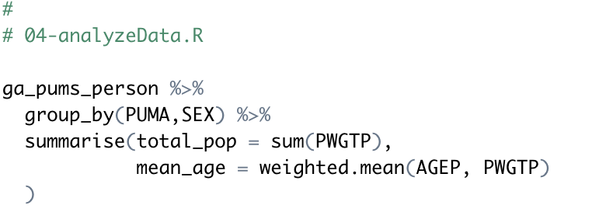
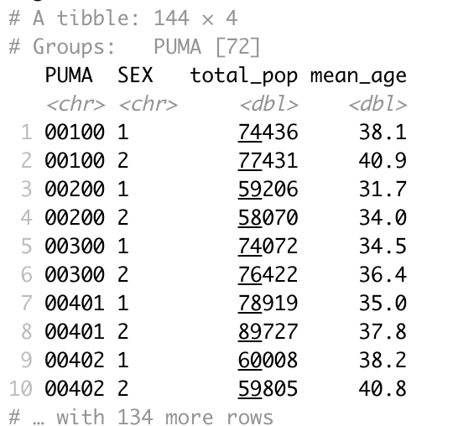
A simple analysis: weighted average age
NOTE: PWGTP is the population weighting factor, so its sum represents the total population in a PUMA

Slide 20
Can we replicate this with flat files?

Slide 21
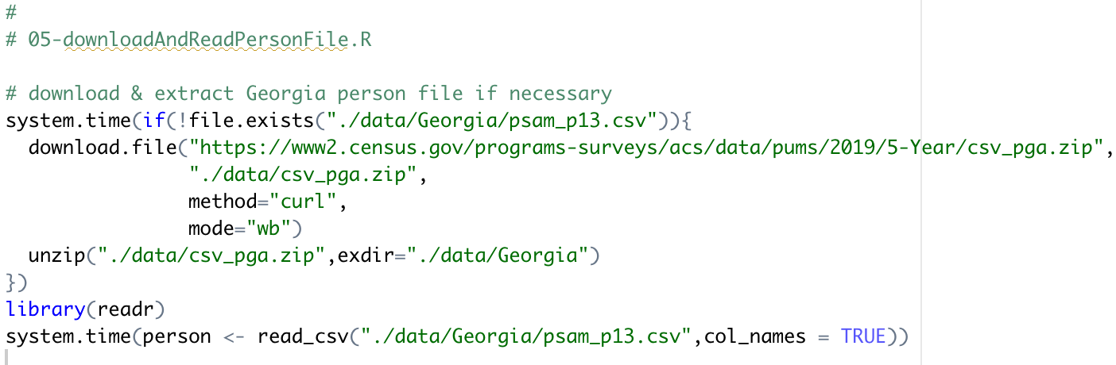
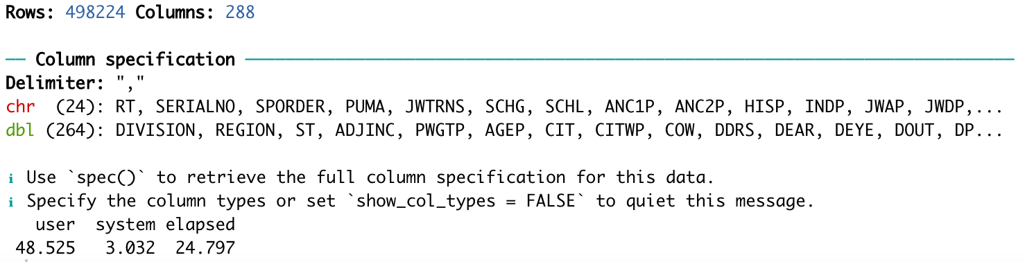
Download & read
NOTE: no more hierarchical files!
no unwieldy fixed records!

Slide 22
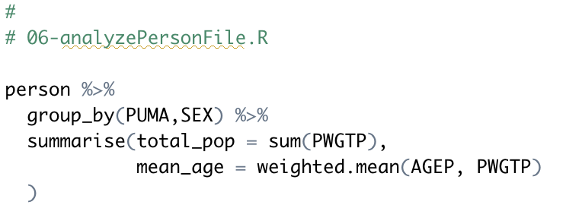
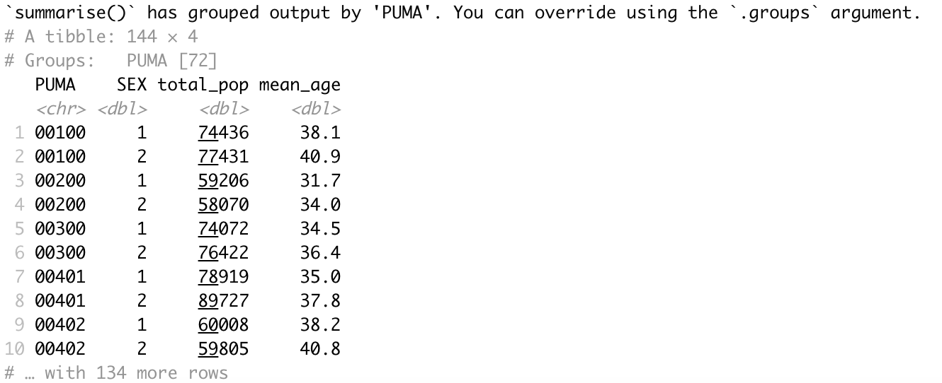
Calculate weighted average age by PUMA

Slide 23
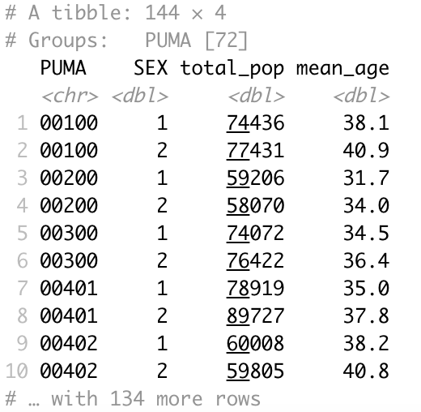
Hmm… does this look familiar?
Tidycensus
Flat File

Slide 24
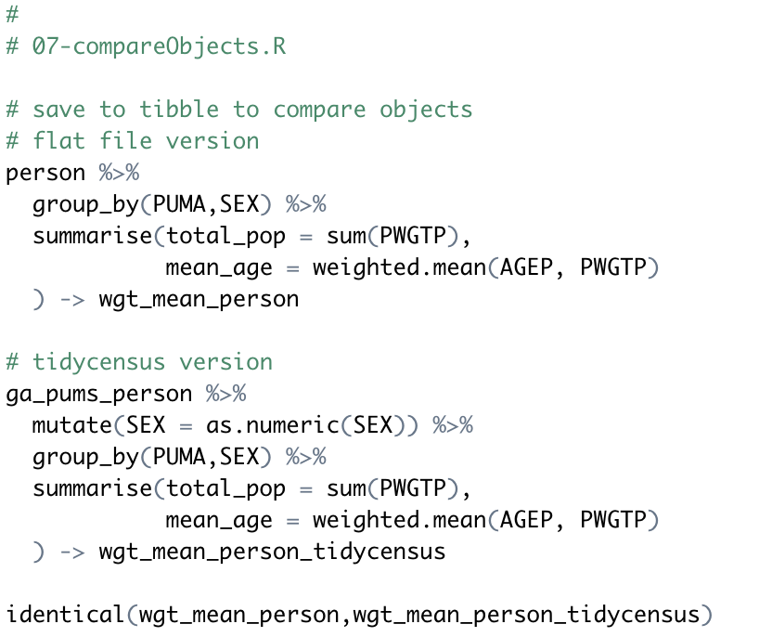
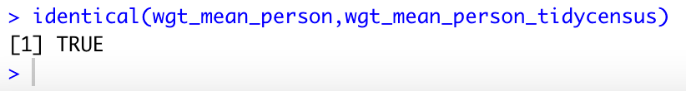
Verifying the results

Slide 25
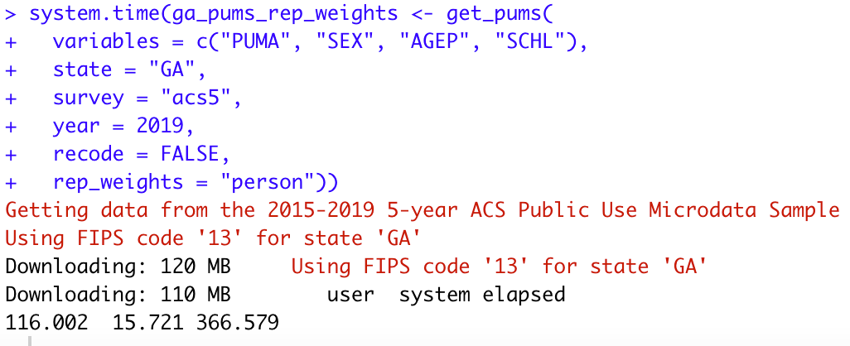
A more complicated example: Calculating standard errors
NOTE: 6+ minute download due to need for 80 replicate weight columns

Slide 26
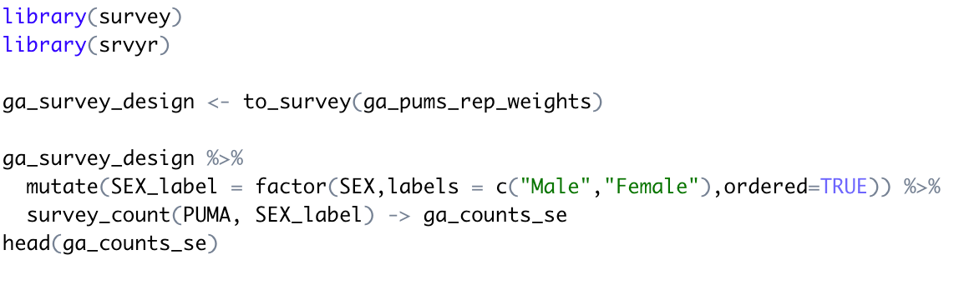
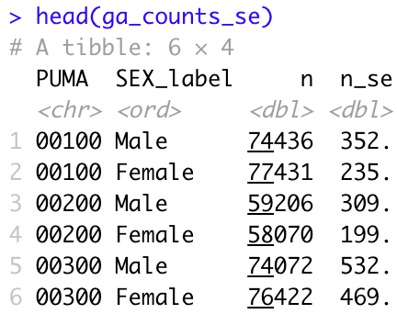
Calculating standard errors…

Slide 27
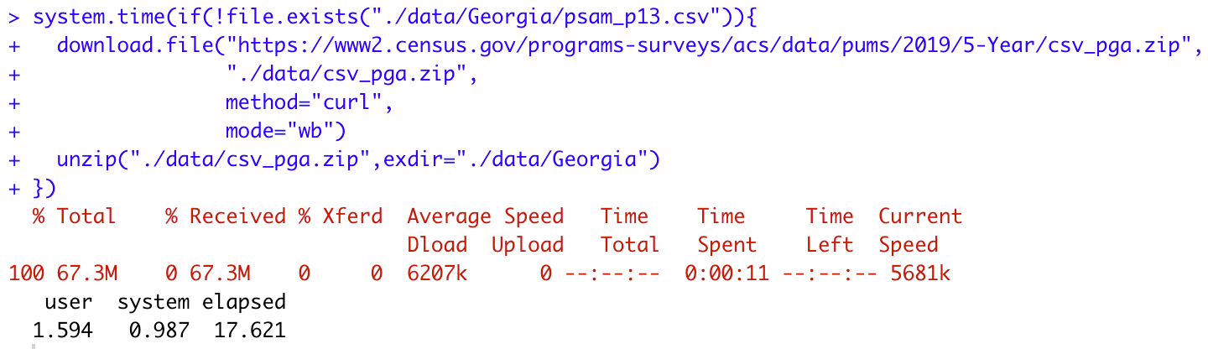
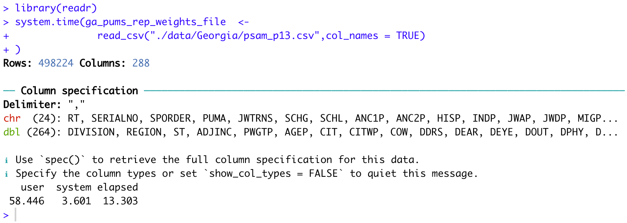
Flat file version: Calculating standard errors

Slide 28
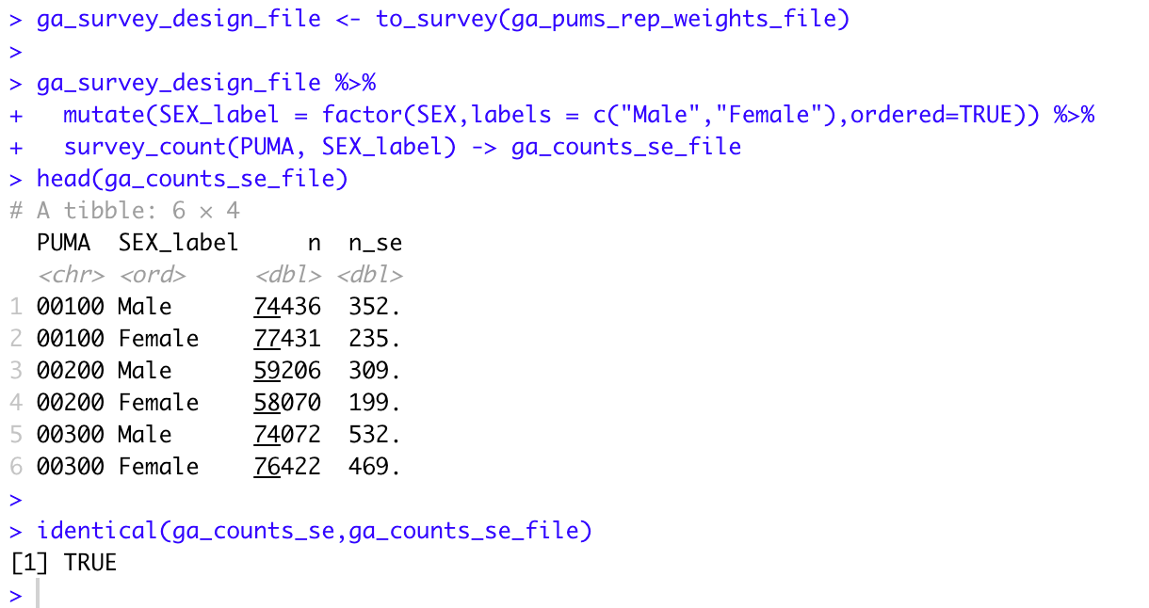
Calculating standard errors…
Bottom line: results from tidycensus are easily replicated with a flat file solution

Slide 29
Tidycensus: pros & cons
Pros
Cons
Ability to select a subset of features for analysis, include multiple states
Easy to access data dictionary
Ability to automatically recode factor variables
Documentation includes examples that are easy to understand
Easy to combine with survey, srvyr packages for weighted calculations, standard errors
Need to register with Census Bureau to obtain an API key
Downloads are slow, especially with individual replicate weights
Only a subset of U.S. Census Bureau APIs are currently supported
Managing replicates across multiple analyses / API extracts
Unclear how changes in underlying data are reflected in API
Access to housing info is not intuitive

Slide 30
Flat Files: pros & cons
Pros
Cons
No need to register with Census Bureau, just find the files you need, download and go
Download simplicity – one download gets all the data
Download speed
Easy to combine with survey, srvyr packages for weighted calculations, standard errors
Easier to build a completely reproducible analysis, starting with the download
All features must be downloaded for person or household file
Multi-state analysis requires multiple downloads of large files

Slide 31
Q & A

Slide 32






About Len
Len Greski currently leads the Architecture practice at LeadingAgile, the leader in helping large companies generate economic value through agile transformation. Len started his career at Information Resources Inc., developing statistical and AI models to predict consumer behavior. He learned R in 2015 when he needed a way to analyze the value of a software portfolio without spending $9,000 on a copy of SAS. Len has mentored hundreds
of thousands of students in the Johns Hopkins University Data Science Specialization on
Coursera, having served as a Community Mentor since 2015. Len has a top 5% ranking on Stackoverflow.com, where he primarily answers questions about R.
len@greskilabs.com
lgreski
lgreski/tidyverse-vs-flatfiles – repository where tonight’s code and presentation are stored
lgreski
Data Science Depot blog: https://lgreski.github.io/datasciencedepot/

