Slide 1

Betapond Platform
Peter Elger
CTO
peter.elger@betapond.com
68 Merrion Square,
Dublin 2
http://www.betapond.com
1

Slide 2


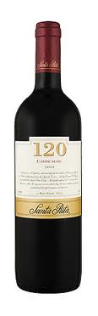
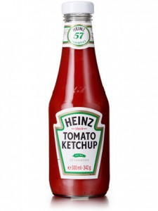




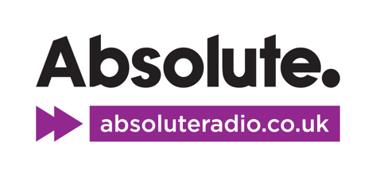



Who are we and what do we do?
We are a software company
We build and license Social and Mobile technology and services to large brands and agencies in Ireland and the UK
Our technology enables brands to self manage competitions and promotions, primarily on the Facebook platform.
Core role in multiple high profile Facebook communities of 100k fans+
We actively Collaborate with the 3CS on mutually beneficial research and development.
2

Slide 3

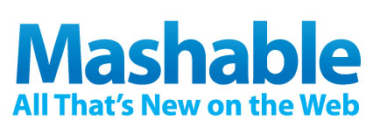
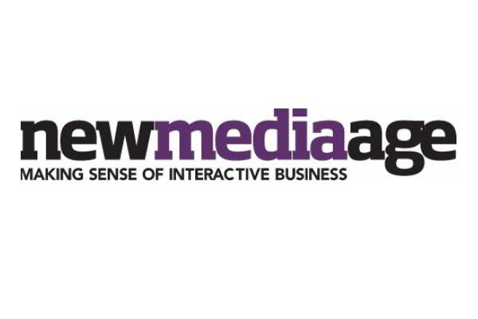

Industry Coverage
“If you were wondering how organisations and brands might take advantage of Facebook Places, a new Facebook application from the UK tourist agency VisitBritain provides a good example of things to come” (November 2010)
5 Creative Facebook Places Marketing Campaigns – (Jan 2011)
“The campaign VisitBritain launched this week shows that using Facebook Places in a more interesting way can provide engaging content and cost-effective, clever campaigns” (November 2010 & January 2011)
“Expect travel companies and tourism agencies around the world to install similar apps” (November 2010)

Slide 4
The Problem
In order to service our client needs we must...
Run MANY social and mobile web applications
For many account managers - Working for many brands / Agencies
Each application may be very short lived -
  Really only relevant for the lifetime of an individual campaign
Must support front end customization per application without breaking existing deployment
Traffic profile is typically a short (1-2 week) burst of high intensity traffic followed by a long drop off
The Traditional Approach
Relational database
With a CMS - page fragments stored in the database
Rails / Django / PHP - Don’t scale well under the scenario above
Won’t provide the required operational characteristics

Slide 5
The Solution
Adopt a new technology stack
That scales to MANY MANY more requests per second out of the box
That supports even more rapid development than the current agile frameworks (rails, django, cake...)
That is already partly understood by many programmers today and therefore has a shallow learning curve
Allows us to run many applications on a single server and handle traffic spikes better.
Is built upon proven robust technology.

Slide 6
Zeppelin
Open source MVC framework layered over node.js and jquery
Comprises both server side and client side portions
Template processing occurs on the client
  templates look like standard jsp / erb type pages
Low friction rapid development environment
  everything is javascript
  no mental disconnect (Javascript, Ruby, SQL)
High performance out of the box
  node.js
  do as much as possible on the client (view processing)
  low overhead as a typical request response cycle fetches JSON directly from the datastore and returns it to the view on the client for formatting with no intermediate processing
Simple to use and configure - avoid hidden “magic”
Designed to serve up multiple (x10 x20....) applications for each stack instance
Betapond Platform is built on top of Zeppelin

Slide 7
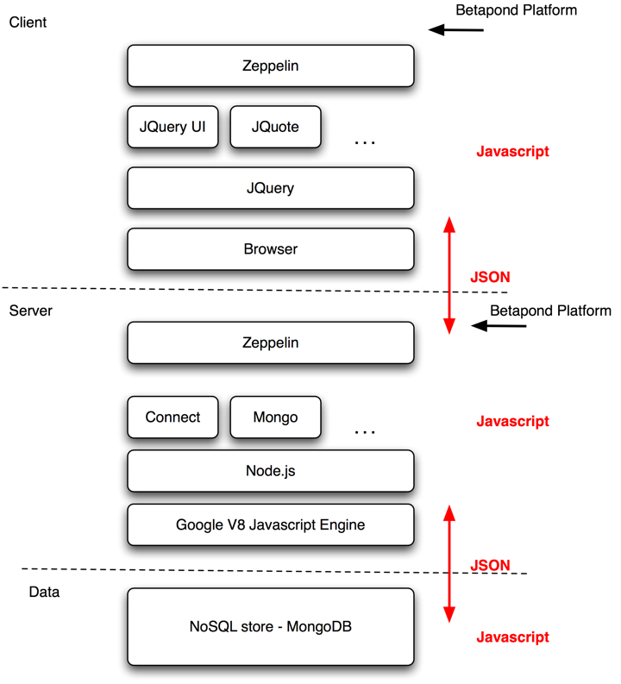

Slide 8
Summary
Javascript is the language of the cloud
The future is html5 / css / javascript
The Apps of today become html5 offline web apps on cloud desktops / devices
Over time objective C (iPhone) and java (Android SDK) will be replaced by this model
An all javascript development environment is a liberating experience
Want to get involved
  @pelger
  peter.elger@betapond.com
Fork me
  https://github.com/pelger/Zeppelin
WE ARE HIRING
Questions ?

