Slide 1


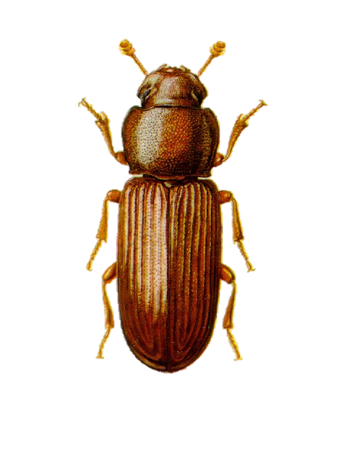
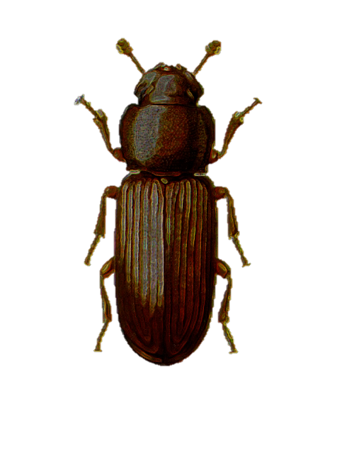


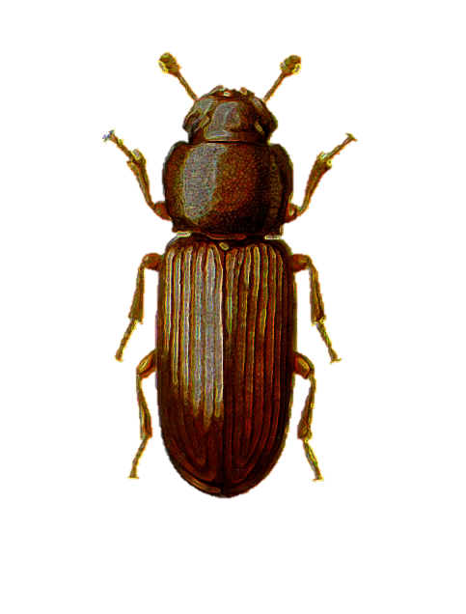
Image citation: Queensland department of Primary Industries (dead link)
30°C
Double-male polyandry
Single-male monandry
Founder
females
Mating
24h
24h
48h
38°C
Oviposition
7
days
7
days
Gen 1
count
count
Development
28
days
28
days
Mating &
Oviposition
7
days
7
days
Gen 2
Count population size X 10 generations

Slide 2

1
1
24h
24h
Notes:
Make male and female symbols black
White numbers on males
Shift generation delimiters

