Slide 1
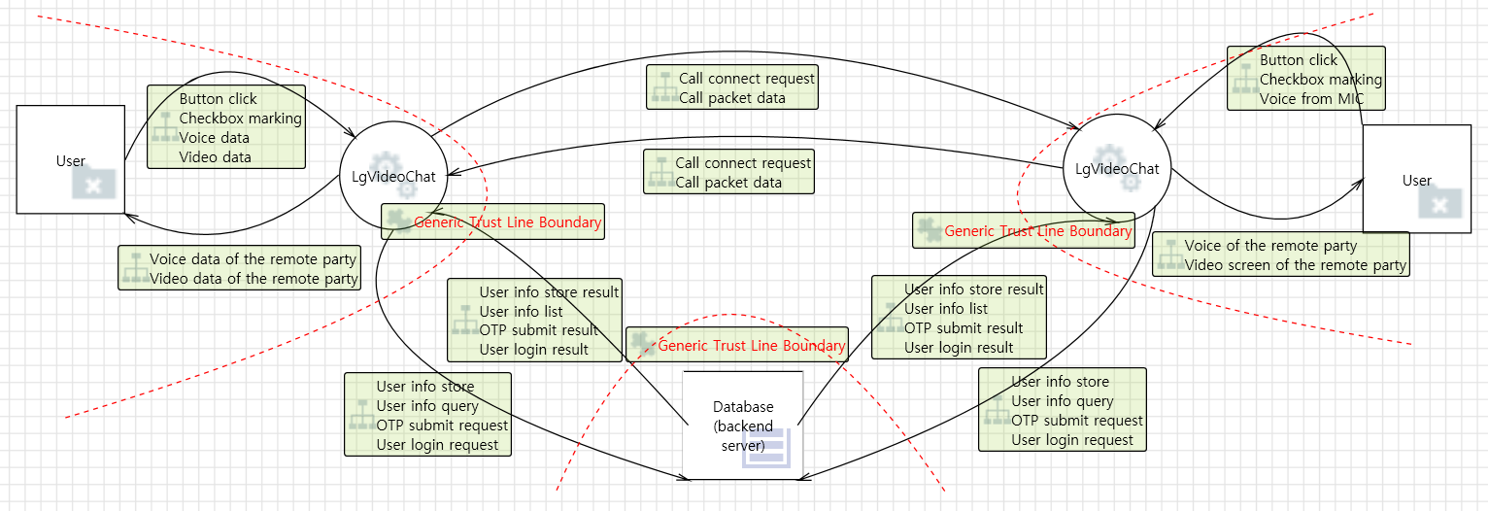
Initial system design

Slide 2
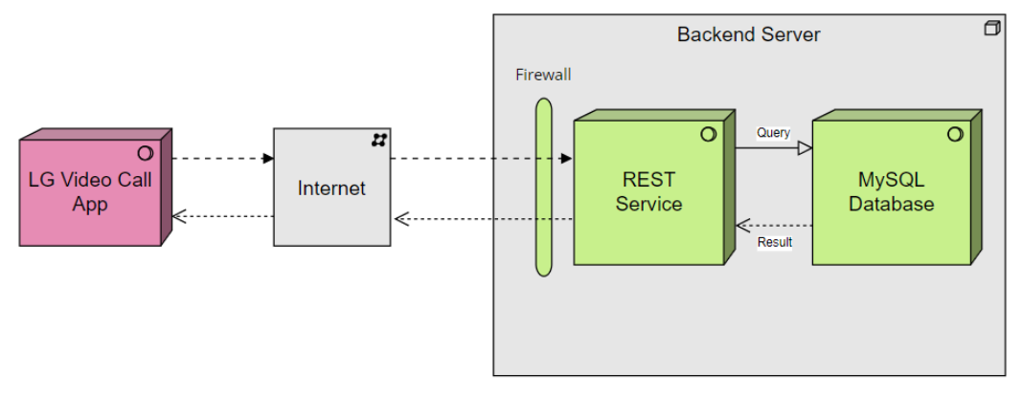
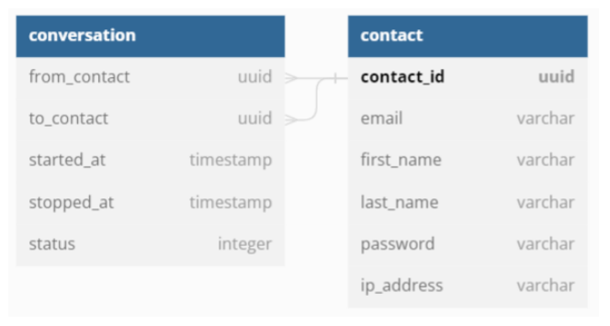
Initial system design (backend server)

Slide 3







Overall system design
VideoChat app
VideoChat app
Call packet data Call Connection/Disconnection request
User
Storing log file
Storing log file
User registration request/response User login request/response
Contact info query/response
User registration request/response User login request/response
Contact info query/response
Backend Server
Storing log file
System entity
encryption
input
validation
data
flow
two factor authentication
hash
certificate
file system

Slide 4
User Registration Process
BackEnd Server
LgVideoChat
Client (user)
Write a E-mail and duplication check request
Request duplication check
response duplication check fail
Input data check fail
response duplication check fail
Response duplication check success
Input data check success
Response duplication check success
Write a user info(pw, ip address etc) & confirm
Request new user registration
Response registration fail
Input data check fail
Response registration fail
User check the e-mail & activate new user
Send E-mail( for activation )
Input data check Success
Response registration success
Response registration success

Slide 5
User Login Process
BackEnd Server
LgVideoChat
Client (user)
Write user info (Email & pw) & request OTP code
request OTP code
Response user info check fail
Input data check fail
Response user info check fail
Send E-mail( OTP info )
Input data check Success
User check OTP code
Input OTP code & confirm
Login request
Response Fail result
OTP info check Fail
Response Fail result
Response Login Success
OTP info check Success
Response Login Success

Slide 6
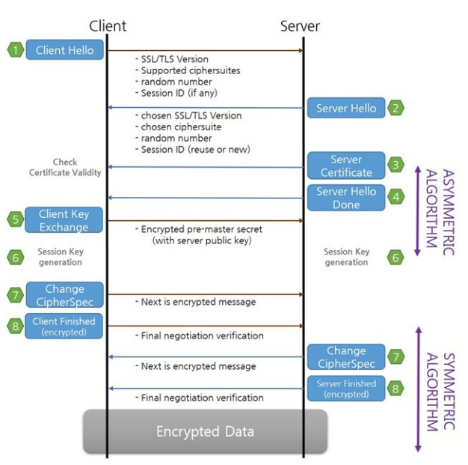
Server authentication & Secure communication

Slide 7
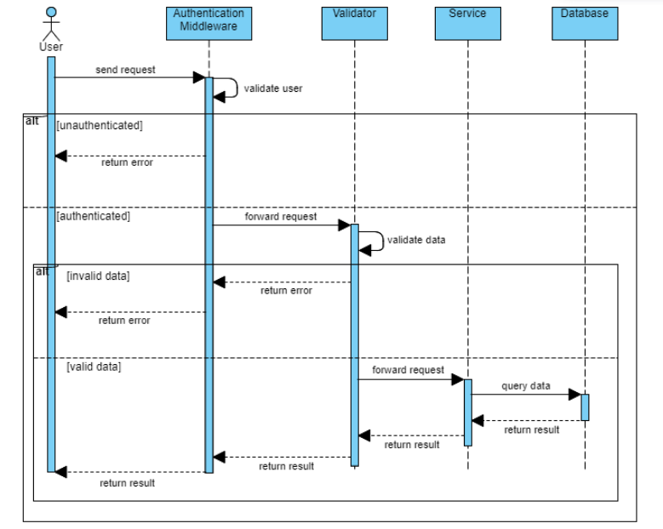
Input validation check by backend server

Slide 8
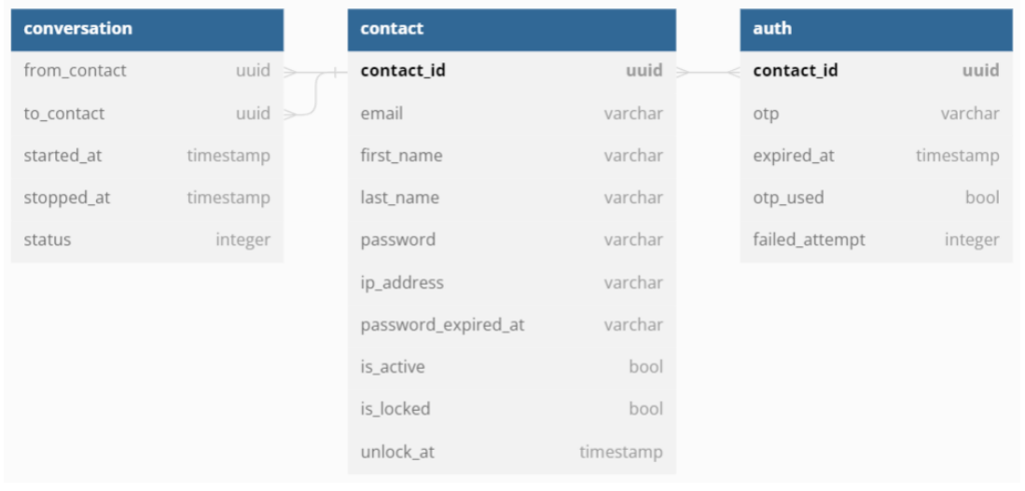
Database table design for two factor authentication

