Slide 1
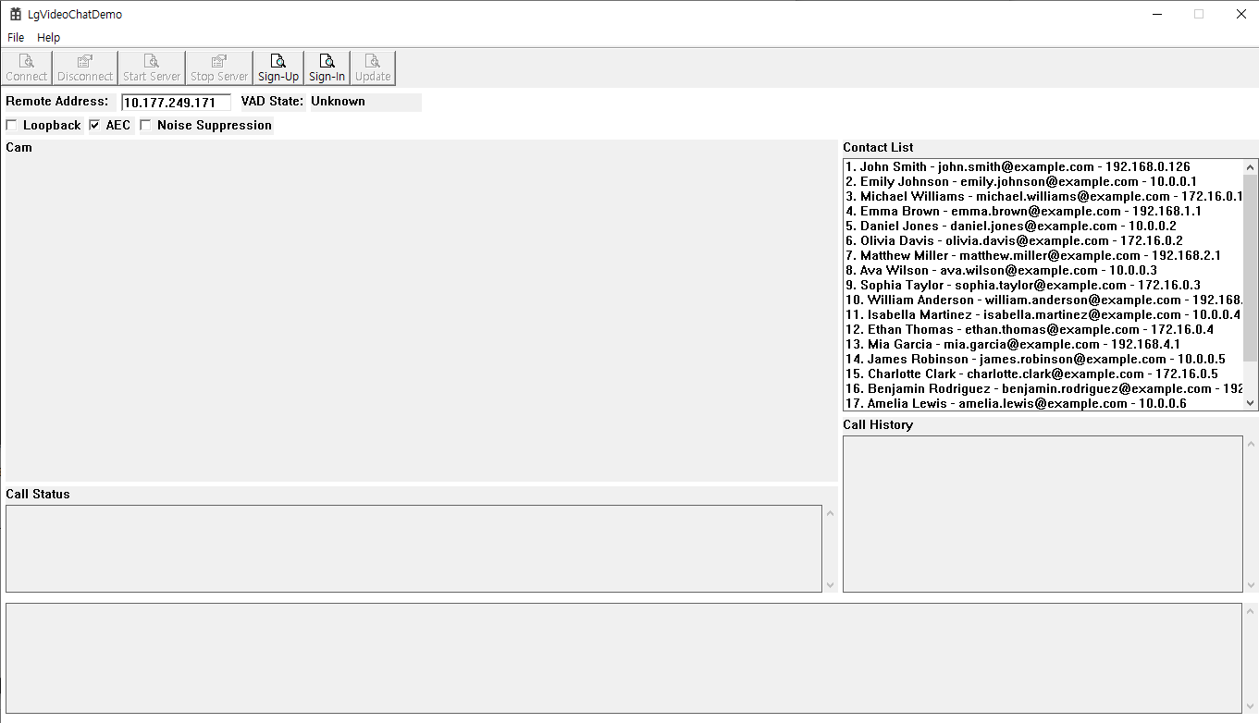
LgVideoChatDemo

Slide 2
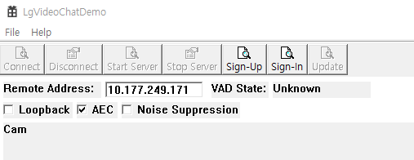
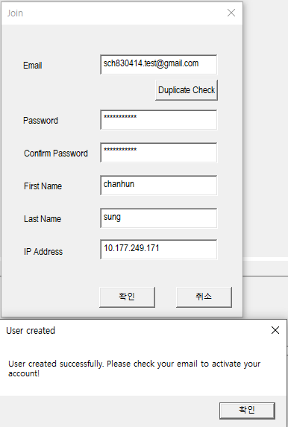
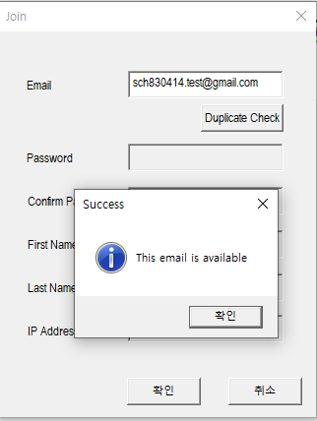
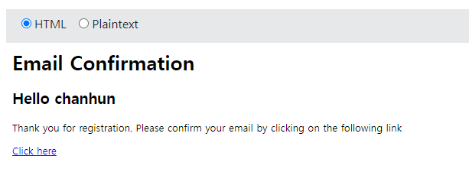
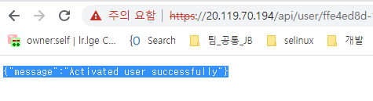
1. Sign-up
Check your e-mail Confirmation
Input a e-mail address and press “Duplicate Check”
Input a e-mail address and press “Duplicate Check”
If sign-up success, notification message will be displayed

Slide 3
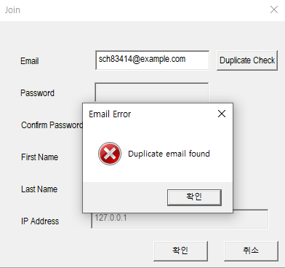
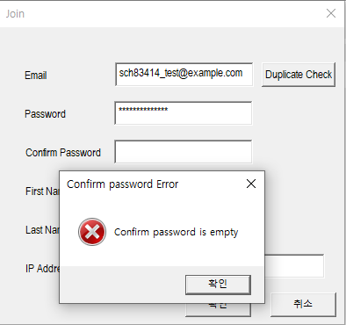
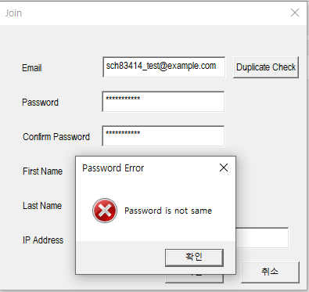
1. Sign-up (cont.)
- Error Case
If e-mail is already exist, the a notification popup will be displayed.
All items are mandatory.
If some items are empty, a notification popup will be displayed.
If password is not matched, a notification popup will be displayed.

Slide 4
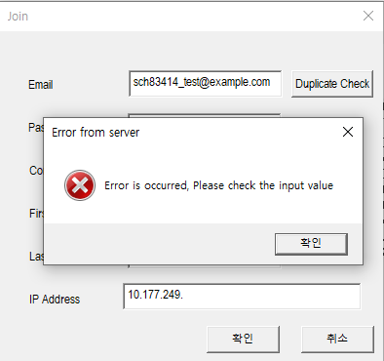
1. Sign-up (cont.)
- Error Case
If input value is wrong, a notification popup will be displayed. Ex). IP Address

Slide 5
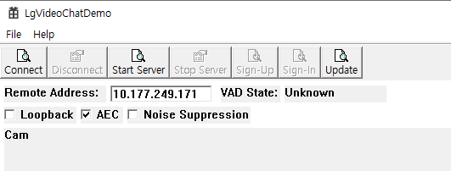
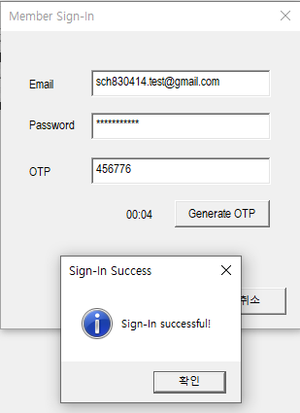
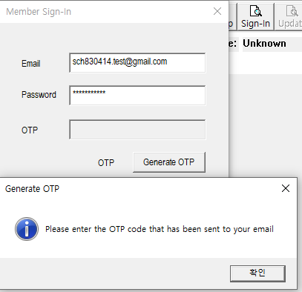
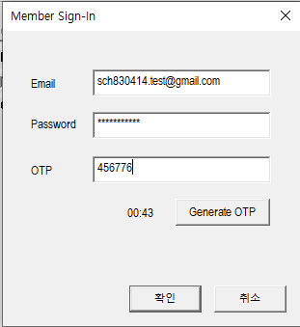
2. Sign-in
- After sign-in success, sign-up & sign-in are disabled. - Update is enabled
Write a e-mail address & password
Press “generate OTP”
OTP send your registered e-mail
- Input your OTP code & press “confirm”
- If OTP code matched, sign-in will be success.

Slide 6
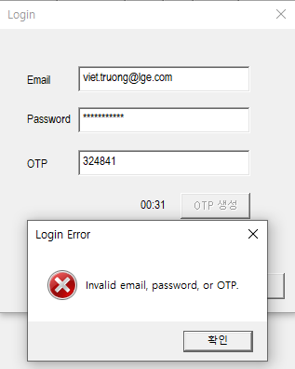
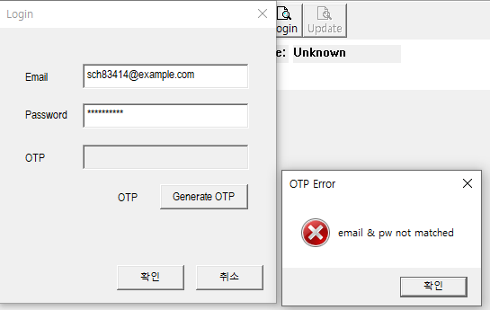
2. Sign-in (cont.)
- Error Case
If OTP code not matched, a notification popup is displayed.
If e-mail and password is not matched, a notification popup will be displayed.

Slide 7
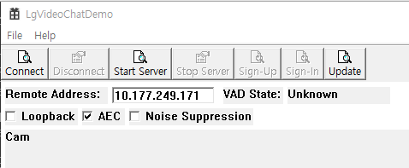
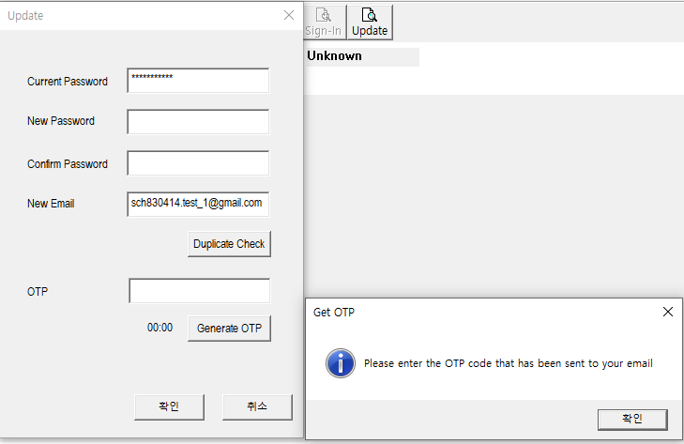
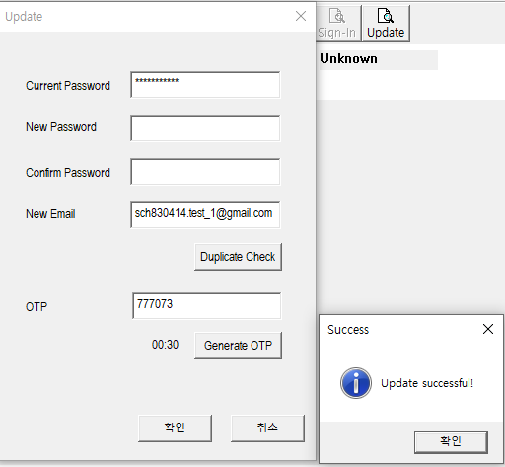
3. Update
- e-mail update
Set a Current password, New e-mail address
Press “Duplicate Check”
Press “Generate OTP”
Check your e-mail for OTP code.
E-mail will be chage

Slide 8
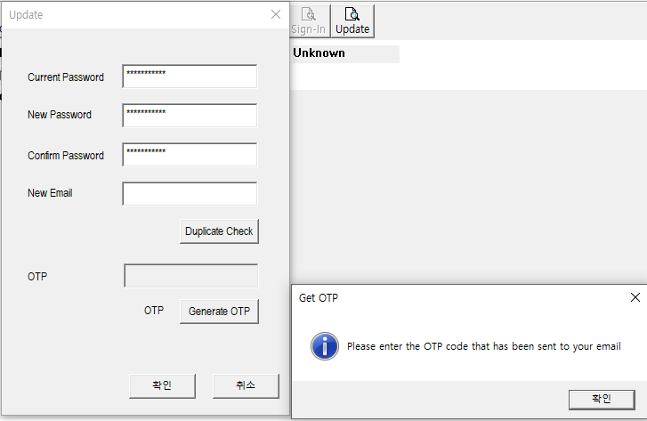
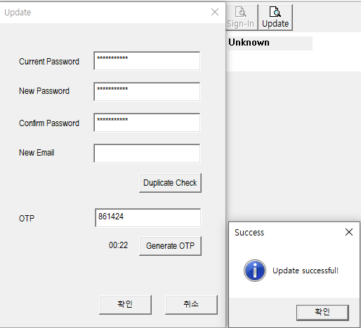
3. Update (cont.)
- Password update
Input a current password
Input a new password & confirm password
Press “Generate OTP”
Check your e-mail for OTP code.
Password will be change

Slide 9
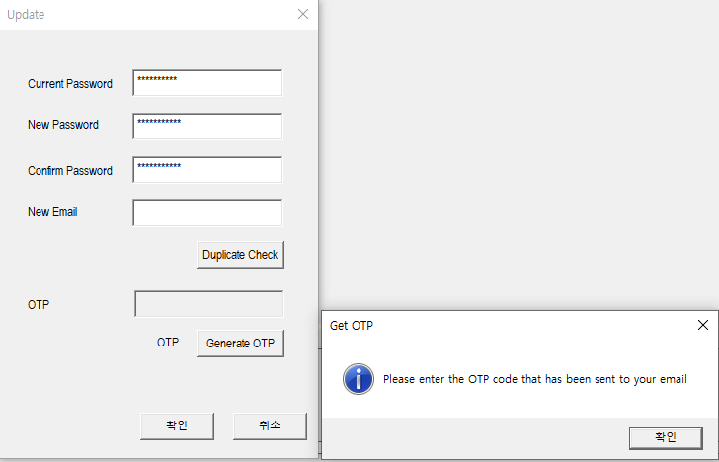
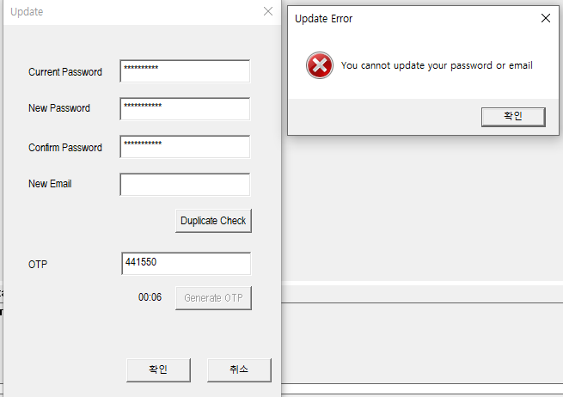
3. Update (cont.)
- Error Case (current password is wrong when changing password)
After input OTP code and confirmation, a notification popup will be displayed.

Slide 10
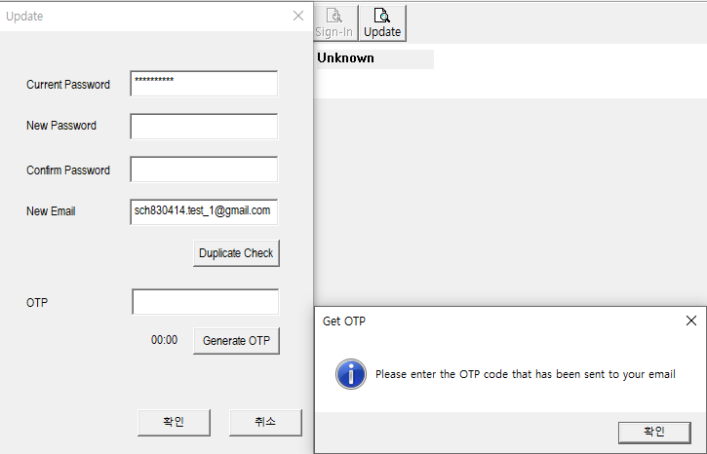
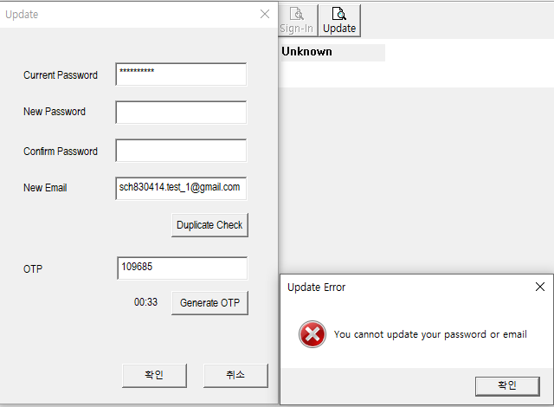
3. Update (cont.)
- Error Case (current password is wrong when changing e-mail)
Afer input a OTP code, a notification popup will be displayed.

Slide 11
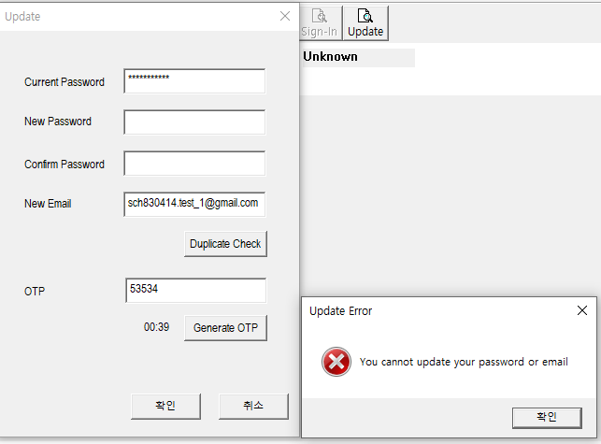
3. Update (cont.)
- Error Case (input OTP code is wrong when changing e-mail)
If the OTP code is wrong, a notification popup will be displayed.

Slide 12
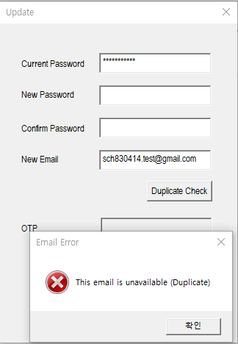
3. Update (cont.)
- Error Case (new Email is already registered)
If the email is alreay registered, a notification popup will be displayed.

Slide 13
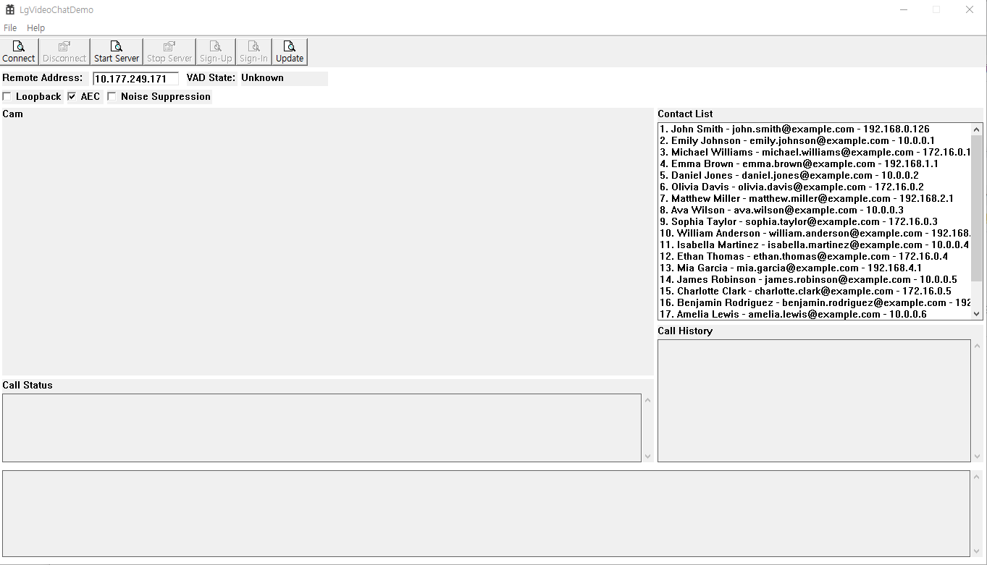

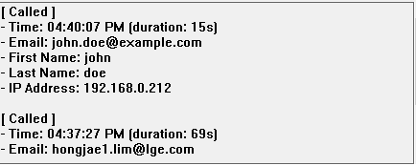

4. Etc
Request call connect
Request start server
Displays the user's contact list. If you want to call, you can select one and connect.
Displays call history
Displays the call status ( calling or waiting ) if status is calling, show other party information

Slide 14
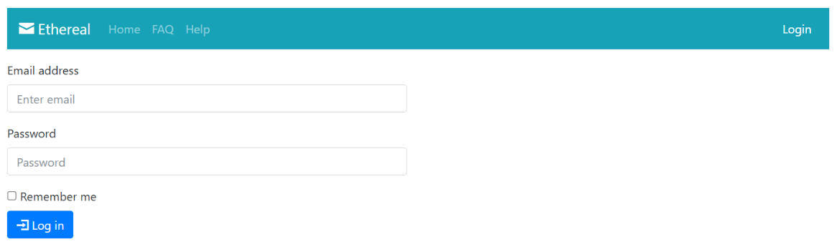
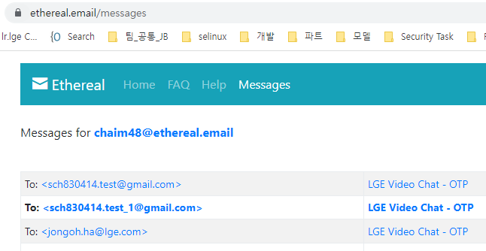
5. Fake Email Service
All emails are set to be received to the account below.
Since the mail is received to the account below, not the actual registered mail, you can check the OTP reception and activation mail in the account below.
Email: chaim48@ethereal.email
Password: eezpJY5ZAR8V9hRQbT
Fake Email Service
Go to https://ethereal.email and login.

