Slide 1
修士論文発表
Sub-optimally Solving the Multiple Watchman Route Problem
総合文化研究科広域科学専攻修士二年 福永研究室 劉冠廷

Slide 2
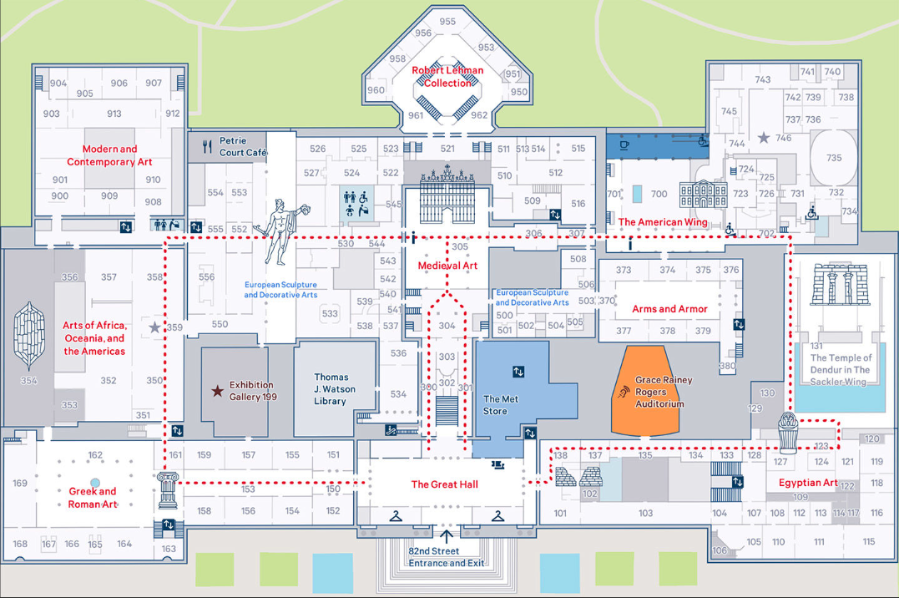

Introduction
URL：https://www.metmuseum.org/de-de/visit

Slide 3
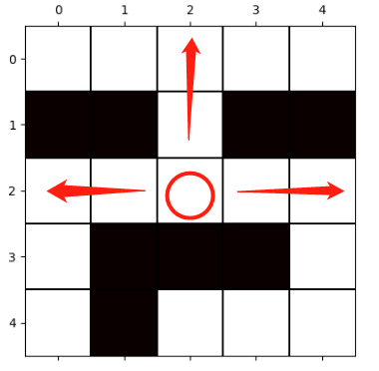
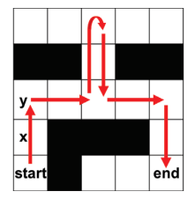
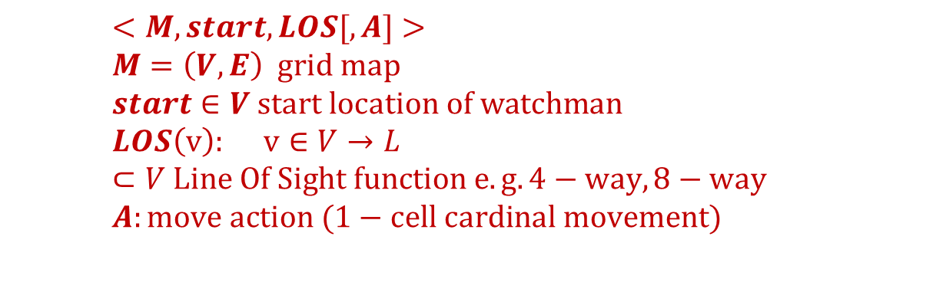
Watchman Route Problem (WRP)
Problem Definition
$$<M, start,LOS[,A]> \\ M=\left(V,E\right) grid map \\ start∈V start location of watchman \\ LOS\left(v\right): v∈V→L⊂V Line Of Sight function e.g. 4−way,8−way \\ A:move action (1−cell cardinal movement)$$
4-way LOS
The task is to find a path \pi_0,..\pi_k for an agent (watchman) on a map M such that every location on M the map is seen by the agent.
\forall v \in V, v \in { LOS(pi_0) \union LOS(pi_1) \union, …, LOS(pi_k)}
A watchman path

Slide 4
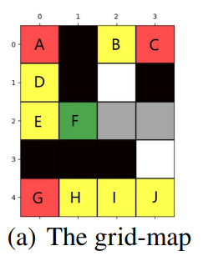
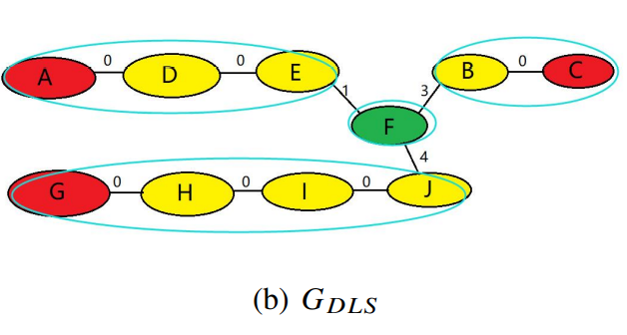
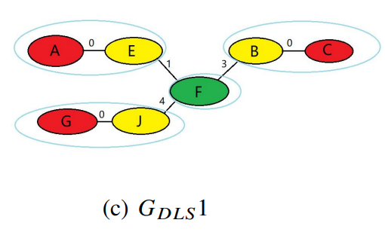
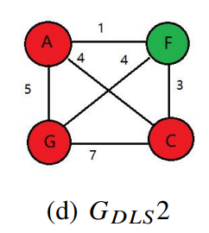
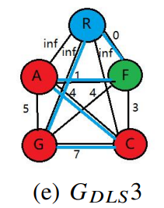

Lower bound of WRP
Aggregating Singleton lower bound (AGS)
S: current node
For every p∈S.unseen
$$h_{p}=min q∈LOS(p)d\left(S.location,q\right) \\ hAGS=maxp∈\text{S}\text{.}\text{unseenhp}\text{(}\text{S}\text{)}$$
Graph lower bound for WRP(MST,TSP)
Watchman Cell(Green)
Pivots(Red)
Watchers(Yellow)
Other(Gray, White)

Slide 5
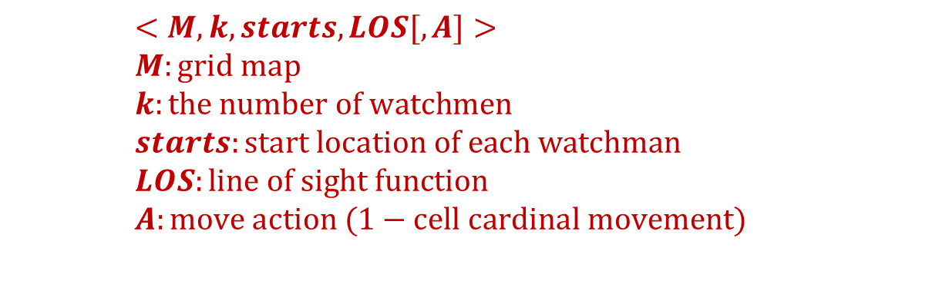
Multiple Watchman Route Problem (MWRP)
Problem Definition
$$<M, k, starts,LOS[,A]> \\ M:grid map \\ k:the number of watchmen \\ starts:start location of each watchman \\ LOS:line of sight function \\ A:move action (1−cell cardinal movement)$$
task: find a path for each of the watchmen from its start cell through the grid such that all empty cells (white cells) in the map will be covered by line-of-sight (LOS) from at least one cell of one of the paths
objective function：
MinSum: Minimize the cost of the longest path among the paths.
MinMax: Minimize the sum of the costs of all the paths

Slide 6
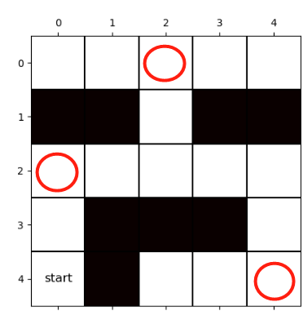
Previous Work on MWRP
Existing Methods
decouple method (AGP+MTSP)
[Faigl et al.,2006]
(Self-organizing map) SOM method
[Faigl et al.,2010]
Related Problems
Art Gallery Problem(AGP)
place the minimum number of guards necessary to collectively cover the interior of a given area.
Multiple Travelling Salesman Problem (MTSP)
find k paths starting and finishing at the same depot which
visits every vertex exactly once with minimum sum of weight
Disadvantages of Previous Work
Visibility Constraint (line-of-sight)
Circular path requirement
AGP solution
MTSP solution
(k=1)

Slide 7
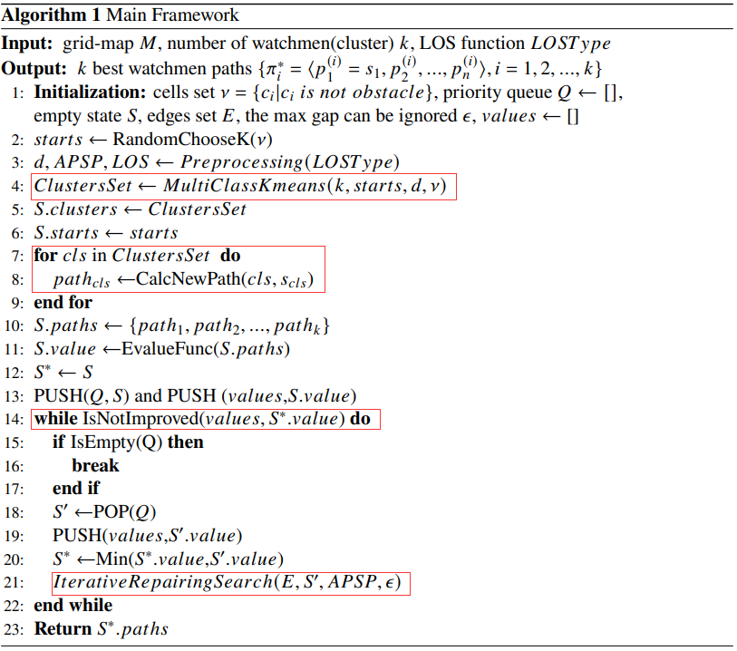
Proposed method
2 Stages
1-st Stage：
partition all cells of the grid into different groups(clusters) using a multi-class connected
clustering algorithm,
2-nd Stage：
generate-and-repair search
route generation level
find initial solution with WRP solver
route repair level
reassign cells among different clusters, repeatedly repair paths to improve the solution quality
terminal condition

Slide 8
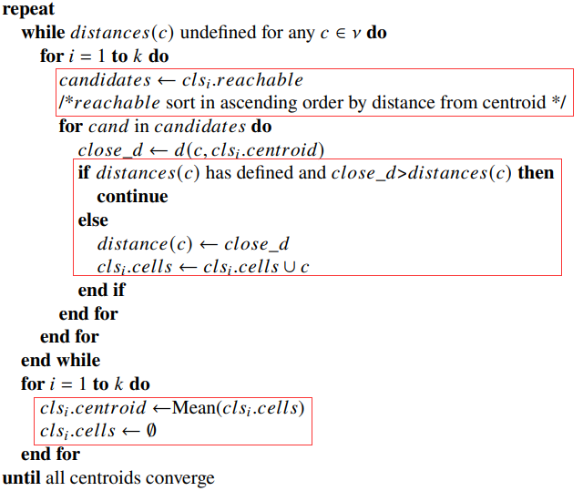
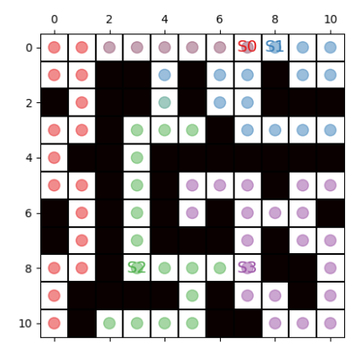

Proposed method
1-st stage: multi-class connected clustering algorithm
$$k:the number of watchmen\left(clusters\right)$$
$$\left\{s1,s2,…,s_{k}\right\} :starting locations of watchmen$$ dc$\left(c\right):distance\left(c,cluster\left(c\right).centroid\right) if cluster\left(c\right)!= \backslash null, else undefined.$
Process:
1.Initialization: $for i∈\left\{1,2,…,k\right\}, cls_{i}.centroid=s_{i}, cluster\left(c\right)= \backslash null for all c∈V.$
2. choose new members from $clsi.reachable$
($set of cells that reachable from cluster i$)
3. whether cell is belonging to other clusters
4.after all cells are assigned, recalculate centroids
5. repeat 2~4 until centroids converge

Slide 9
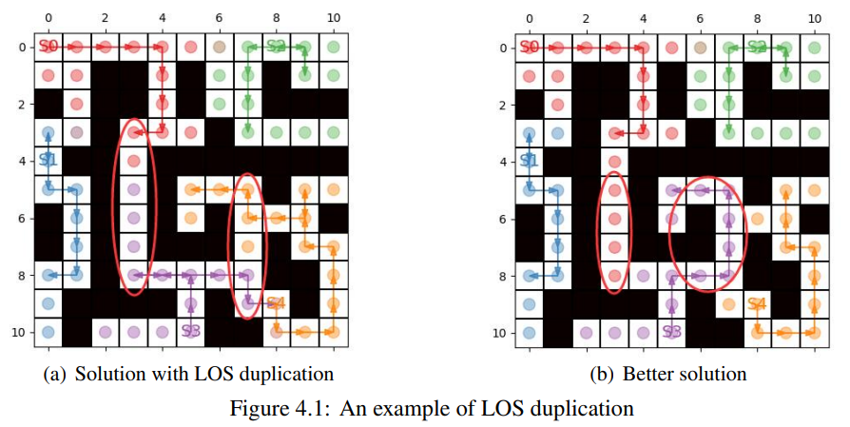
Proposed method
2-nd stage: generate-and-repair search
Route Generation Level:
apply WRP solver to find initial solution (find k best paths for each watchman at each cluster)
Reason why most initial solutions have poor quality →LOS duplication
LOS duplication: cell in LOS of multiple paths.

Slide 10
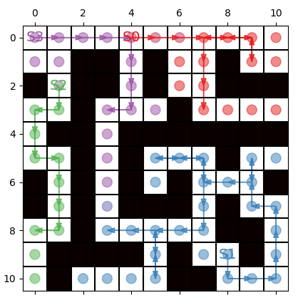
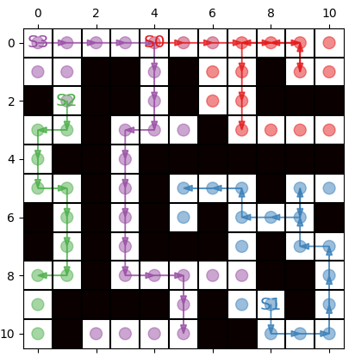
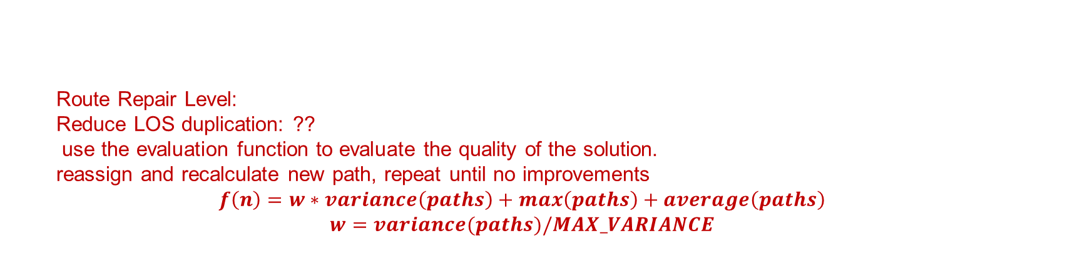
Proposed method
2-nd stage: generate-and-repair search
Route Repair Level:
Reduce LOS duplication: ??
use the evaluation function to evaluate the quality of the solution.
reassign and recalculate new path, repeat until no improvements
$$f\left(n\right)=w∗variance\left(paths\right)+max\left(paths\right)+average\left(paths\right)$$
$$w=variance(paths)/MAX_VARIANCE$$
Initial solution:
[12,28,9,8]
repaired result:
[12,15,9,17]

Slide 11
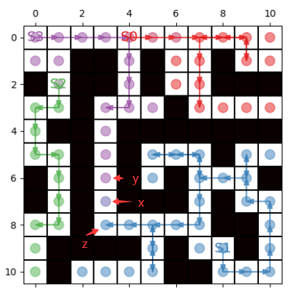
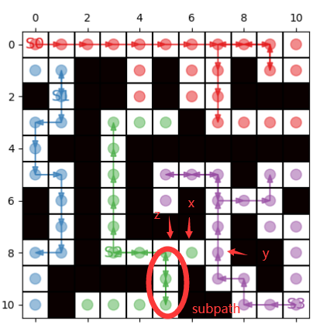
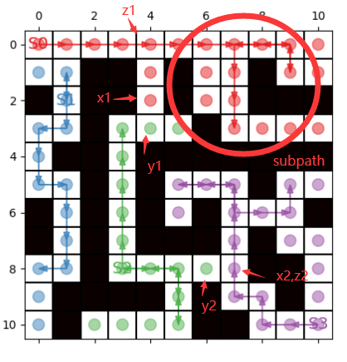





Proposed method
Iterative Repairing Search
Process:
1. find edge $(x,y)$at boundary of cluster
$$clsA=cluster\left(x\right),clsB=cluster(y)$$
consider reassign cells from clsA to clsB
such that $len\left(pathclsA\right)−len\left(pathclsB\right)>ε$
2. find z: cell on path of clsA nearest to x.
figure 1
figure 3
figure 2

Slide 12

Proposed method
Iterative Repairing Search
Process:
1. find edge $(x,y)$at the boundary of cluster
$$clsA=cluster\left(x\right),clsB=cluster(y)$$
consider reassign cells from clsA to clsB.
ensure $len\left(pathclsA\right)−len\left(pathclsB\right)>ε$
2. find z: the cell on the path of clsA nearest to x.
3. $need assign=x,z,APSP\left(x,z\right), RelativeCell\left(z\right)$
$$APSP\left(x,z\right): shorests path between x and z$$
$$RelativeCell\left(z\right): set of cells that need to be$$
$$reassigned if z is reassigned$$
1） $RelativeCell\left(z\right)=z$: if remove z from clsA has no influence on connectivity of clsA
2） $RelativeCell\left(z\right)=subpath of pathclsA$
(1) z occurs once: remainder of path after z
(2) z occurs multiple times: subpath of path_{clsA}
between 2 furthest z instances apart in path_{clsA}
4. outliers: path_{clsA} can’t “see” after assignment.
figure 1
figure 3
figure 2

Slide 13
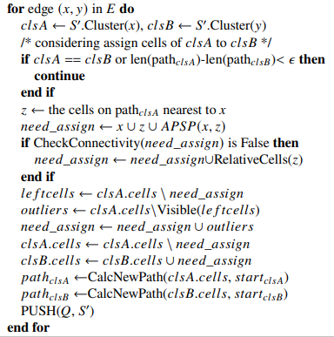

Proposed method
Iterative Repairing Search
$$\text{ν}\text{ : }\text{cells} \text{set}$$
$$E:edges set$$
$$ε\text{: }\text{the} \text{max} \text{gap} \text{can} \text{be} \text{ignored} \\ Q:priority queue \\ starts=\left\{s1,s2,…,sk\right\}$$ $d\left(x,y\right):for x,y∈$ν
$the shortest distance between x and y$

Slide 14
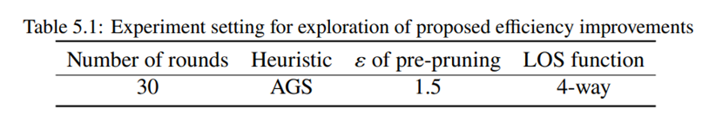
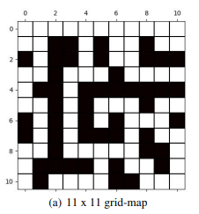
Experiment Results
Exploration of Proposed Efficiency Improvements

Slide 15
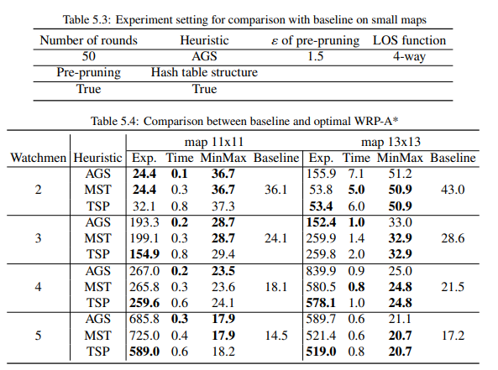
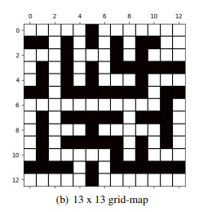
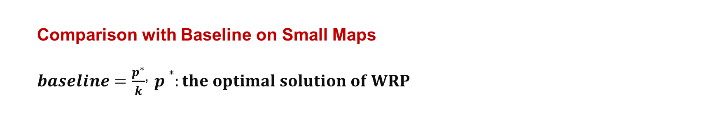
Experiment Results
Comparison with Baseline on Small Maps
$baseline=\frac{p^{∗}}{k}$, $p∗:the optimal solution of WRP$
Exp.：the number of node expansion

Slide 16
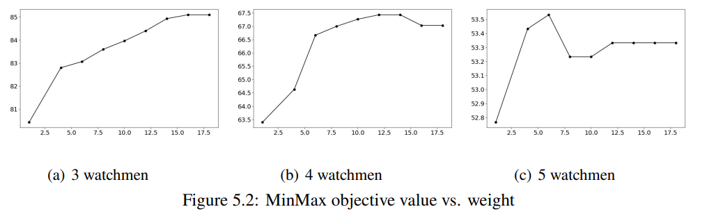
Experiment Results
Exploration of Weighted A* search

Slide 17
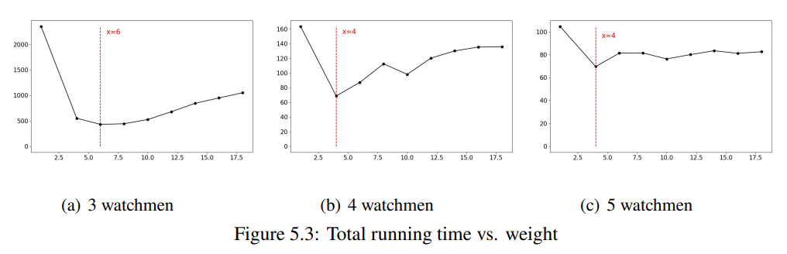
Experiment Results
Exploration of Weighted A* search

Slide 18
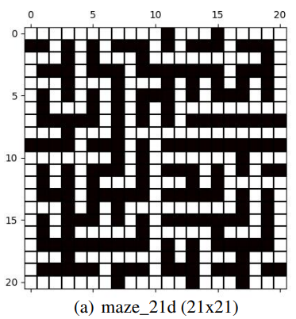
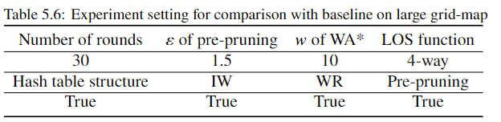
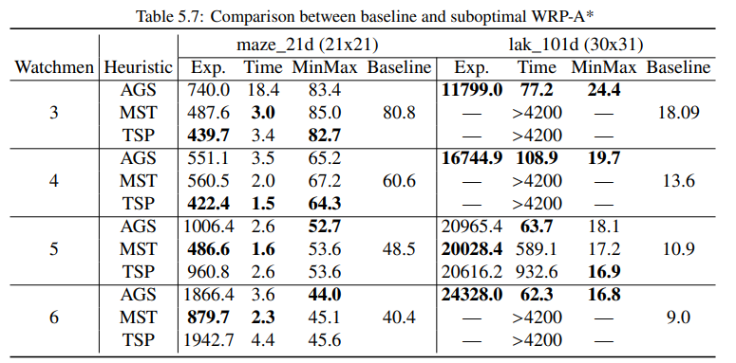
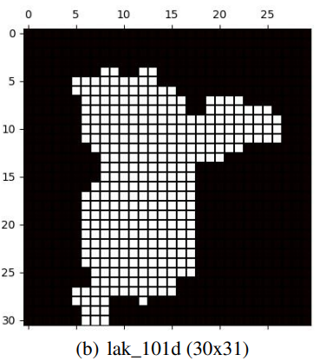
Experiment Results
Comparison with Baseline on Larger Maps
Exp.：the number of node expansion

Slide 19
Conclusion
Contributions
Future work

Slide 20
Future Work
1. New evaluation function for the MinSum criterion
2. Improvement of the conditions for expanding new nodes In iterative repairing
algorithm
3. Guarantee of robustness of our method

Slide 21
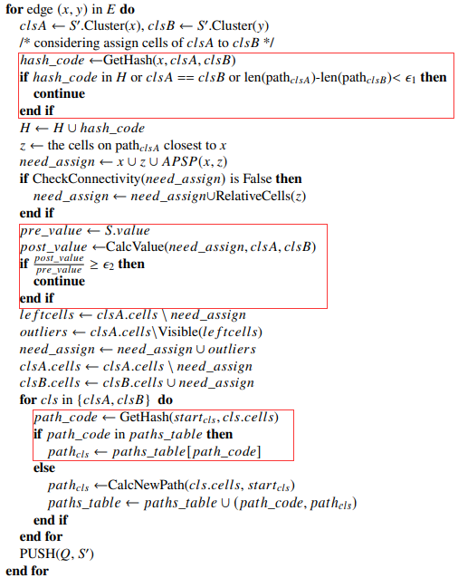

Proposed method
Efficiency Improved measures
1. Hash Table Structure
1) Skipping nodes that have already occurred
2) Storage of existing paths for reuse.
2. Pre-pruning
Prevent the generation of a node with poor solution quality.
Predict the solution quality (the value of evaluation function $f\left(n\right))$after the assignment operation and compare it with the original one to determine whether to retain the node.
Definition:
$lenclsA=\left|need_assign∩cells of pathclsA\right|$
the length that the path of cluster A will reduce $$lenclsB=|need_assign \backslash cells of clsB|$$
the length that the path of cluster B will increase.
$ε\text{2}\text{: }\text{the} \text{bound} \text{to} \text{decide} \text{whether} \text{to} \text{expand}$

