Slide 1
修士論文発表
Sub-optimally Solving the Multiple Watchman Route Problem
総合文化研究科広域科学専攻修士二年 福永研究室 劉冠廷
研究方向：組み合わせ最適化

Slide 2
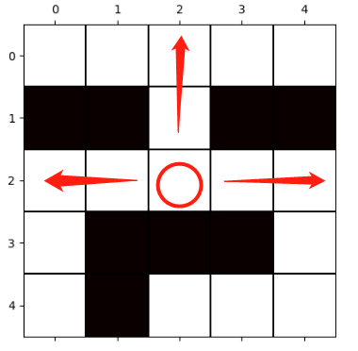
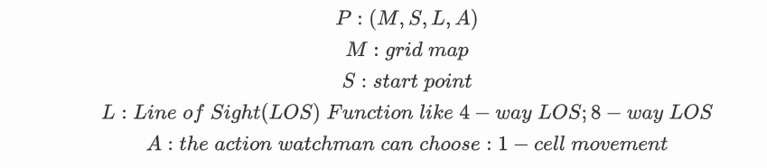
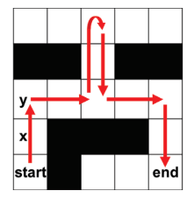
観察者路線問題（Watchman Route Problem）
要件定義
4-way-LOS関数
WRP [Chin et al.,1986]
計算幾何学における最適化問題。NP困難であることが証明された
目的は、障害物が存在する状況で与えられたエリア全体を守るために警備員がとるべき最短ルートを計算すること

Slide 3
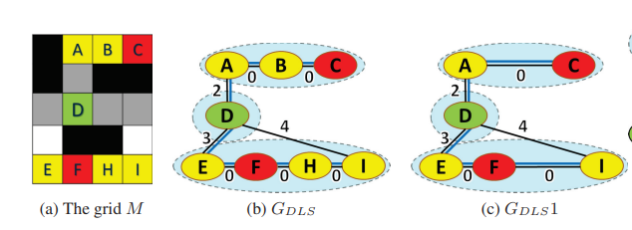
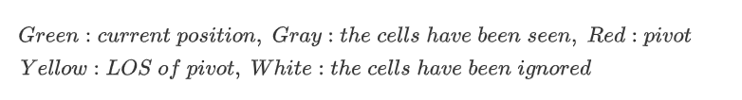
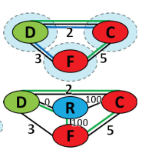


A* (A-star)探索アルゴリズム
定義
最短経路を見つけることができる経路探索アルゴリズム [Hart et al.,1968]
$$f\left(n\right)=g\left(n\right)+h\left(n\right)$$
$g\left(n\right):$ スタートから現地点までのコスト
$h\left(n\right):$ 現地点からゴールまでの予想されるコストの下界(heuristic function)
Graph heuristics for WRP
[Seiref S et al., 2020]
素集合(disjoint set)の下でpivot数を最大化
$h\left(n\right)$は最小生成木(MST問題)か巡回セールスマン問題(TSP)ソルバーにより算出

Slide 4

多観察者路線問題（Multiple Watchman Route Problem）
MWRP問題定義
n人のwatchman→ｎ個のルート
目標：地図にある全てのCellを見守るｎ個のルートを見つける
セルとセルの間に移動コスト≈ 移動エネルギー(MinSum) or 時間(MinMax)
評価基準：
MinSum:ｎ個のルートの総合的な長さを最小化する
MinMax:ｎ個のルートの中に一番長いほうを最小化する

Slide 5
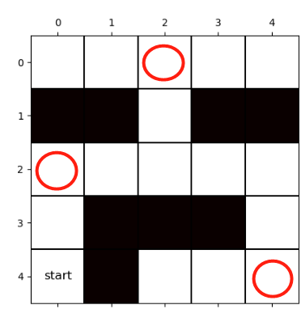
既存研究
関連問題
Art Gallery Problem(AGP) [Klee et al.,1973]
障害物が存在する状況で与えられたエリア全体を守るために必要な最小警備員数
Travelling Salesman Problem(TSP)
ある都市を出発したセールスマンがすべての都市を一度ずつ訪問し、出発点に戻る最短経路を求める
MWRP既存アルゴリズム
Using AGP+TSP algorithm to solve MWRP [T. Danner et al.,2000]
Using (Self-organizing map)SOM to solve MWRP with restricted visibility range [Faigl et al.,2010]

Slide 6
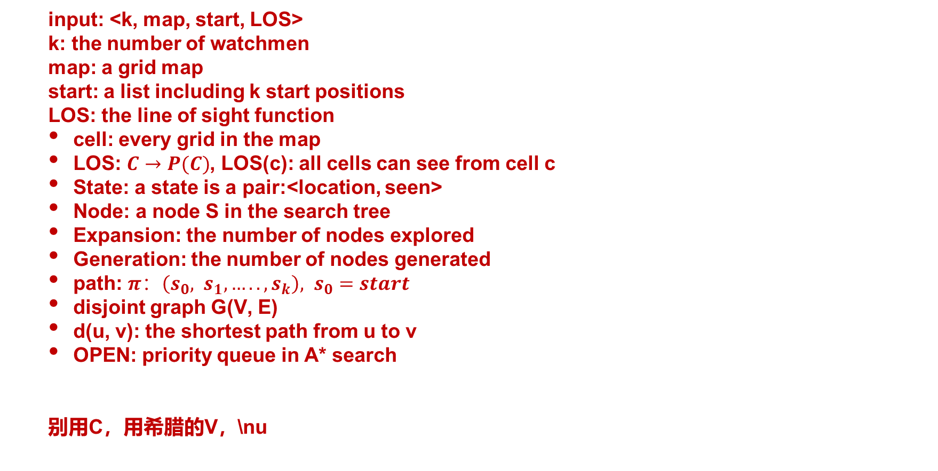
definition:
input: <k, map, start, LOS>
k: the number of watchmen
map: a grid map
start: a list including k start positions
LOS: the line of sight function
cell: every grid in the map
LOS: $C→P(C)$, LOS(c): all cells can see from cell c
State: a state is a pair:<location, seen>
Node: a node S in the search tree
Expansion: the number of nodes explored
Generation: the number of nodes generated
path: $π：\left(s_{0}, s_{1}, …..,s_{k}\right), s_{0}=start$
disjoint graph G(V, E)
d(u, v): the shortest path from u to v
OPEN: priority queue in A* search
别用C，用希腊的V，\nu

Slide 7
提案手法
2-stage solver
1-st stage：
a multi-class connected clustering algorithm
partition the whole map into k clusters (one cell can belong to multiple clusters)
Assign cells in the same cluster to each watchman
2-nd stage：
primal-dual search algorithm
primal level: apply WRP solver for each watchman to find k best paths at each cluster
dual level: use the evaluation function to score the solution found by the lower level, reassign cells during search process, then recalculate new path. Then repeat until no improvements.

Slide 8
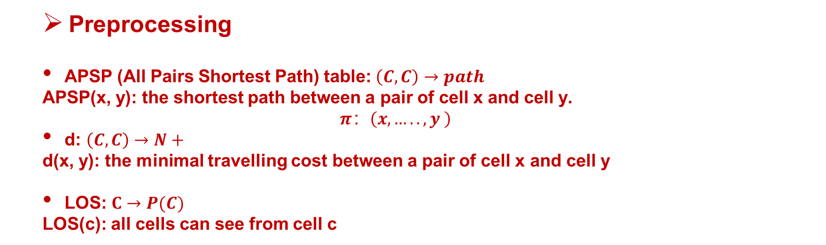
提案手法
Preprocessing
APSP (All Pairs Shortest Path) table: $\left(C, C\right)→path$
APSP(x, y): the shortest path between a pair of cell x and cell y.
$$π：\left(x,…..,y \right)$$
d: $\left(C, C\right)→N+$
d(x, y): the minimal travelling cost between a pair of cell x and cell y
LOS: $C→P(C)$
LOS(c): all cells can see from cell c

Slide 9

提案手法
2-レベル アルゴリズム
$$f\left(n\right)=g\left(n\right)+h\left(n\right)$$
1-st level(A* star):
観察者それぞれ担当エリアに対してWRPソルバーを適用し、最短経路を見つける
（情報共有の代わりに各自探索）
$g\left(n\right):$ スタートから現地点までのコスト
$h\left(n\right):$ グラフヒューリスティックス(MST,TSPなど)
2-nd level:
クラスタリングの平衡性の調整と類似し、平衡性と連通性をチェックする同時に、調整を行う
$g\left(n\right):$ 最長経路の長さ(MinMax) or 長さの和(MinSum)
$h\left(n\right):$ variance of paths
early stop, max_iterを設定し、ベストソリューションがでるまで繰り返す

Slide 10
提案手法
1-st stage: multi-class connected clustering algorithm
the number of clusters＝the number of watchmen
guarantee the connectivity in each cluster and run a multi-class k-means clustering algorithm which means one cell can belong to multiple class
preparation:
process： (Pseudocode)
1. Initialize each cluster center as the start cell of each watchman
2. for each cluster, find the nearest connected cell based on the distance from the center and add it as a new member.
If cell X has belong to another cluster and the distance between X and that cluster center is smaller than the distance between X and the current cluster center, the assignment is refused.
3. after all cells are assigned, recalculate the new center for each cluster
4. repeat steps 2 and 3 until all the centers of the cluster become stable

Slide 11

提案手法
2-nd stage: primal-dual algorithm
primal level (WRP-A*):
WRP-A*: the variant of A* that works on the search tree defined for WRP
apply WRP-A* solver for each watchman to find k best paths at each cluster
$$f\left(n\right)=g\left(n\right)+h\left(n\right)$$
$g\left(n\right):$ the travelling cost from start
$h\left(n\right):$ admissible heuristics (MST, TSP, Aggregating Singleton Heuristics)
dual level (cell reassignment):
use the evaluation function to score the solution found by the lower level, reassign cells based on the score and recalculate new path, repeat until no improvements
$$f\left(n\right)=w∗variance\left(paths\right)+max\left(paths\right)+average\left(paths\right)$$
$$w=variance(paths)/MAX_VARIANCE$$
set early stop and max iteration, repeat until max iteration or no better solution is found.

Slide 12
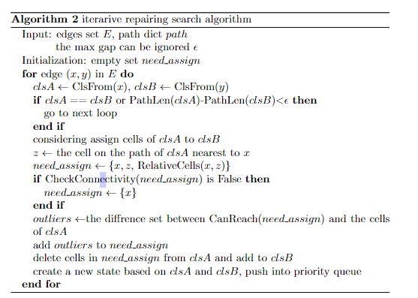
提案手法
2-level primal-dual algorithm

Slide 13
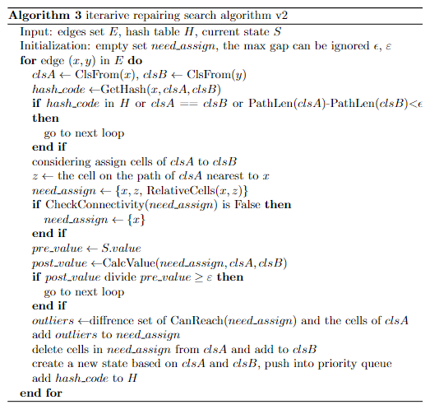
提案手法
techniques that reduce the size of the search tree

Slide 14
提案手法
techniques that speed up the search process
1. data structure(based on profiling)
2. hash table
3. hyper-parameter

Slide 15
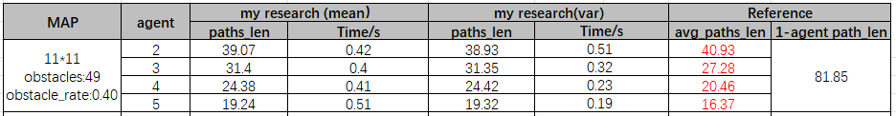
実験結果
random start
test_time: 100
metric: MinMax

