Slide 1
修士論文発表
Sub-optimally Solving the Multiple Watchman Route Problem
総合文化研究科広域科学専攻修士二年 福永研究室 劉冠廷

Slide 2
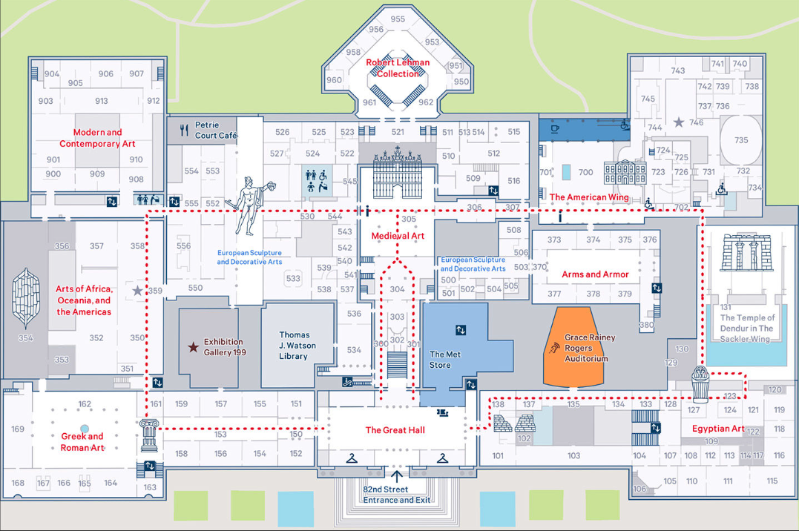

Introduction
You are a guard of a museum, your duty is to patrol the interior of the museum to ensure the safety of all the exhibits on the floor.
you need a short path to see all items.
URL：https://www.metmuseum.org/de-de/visit
Notes:
To do so, you need a short path that you are able to see all items in rooms. However, in many cases, due to the large area, it is unrealistic to patrol the entire museum with only one guard. Naturally, multiple guards are considered. The aim turns to find multiple routes so that every items inside the museum is visible from at least one of the routes. This multi-person version of WRP is multiple watchman route problem, we call it MWRP. In our thesis, we formulate it as a search problem on a grid-map.

Slide 3
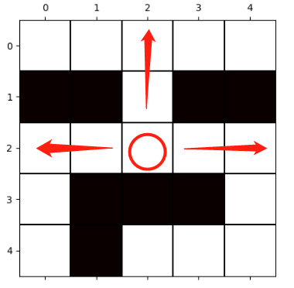
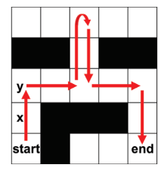
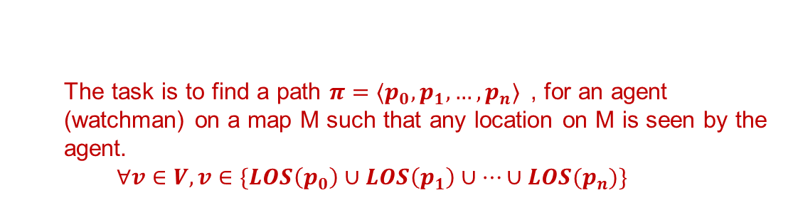

Watchman Route Problem (WRP)
Problem Definition
$$<M, start,LOS[,A]> \\ M=\left(V,E\right): grid map \\ start∈V:start location of watchman \\ LOS\left(v\right):v∈V→L⊂V \\ Line Of Sight function e.g. 4−way,8−way \\ A:move action (1 cell cardinal movement)$$
4-way LOS
The task is to find a path $π=⟨p_{0},p_{1},…,p_{n}⟩$, for an agent (watchman) on a map M such that any location on M is seen by the agent.
$$∀v∈V,v∈\{LOS\left(p_{0}\right)∪LOS\left(p_{1}\right)∪…∪LOS(p_{n})\}$$
A watchman path
Notes:
I'd like to first give the specific definition about WRP. Here is the input. M, start, LOS:xxx4-way,8-way, but you sight may be blocked by obstacles

Slide 4
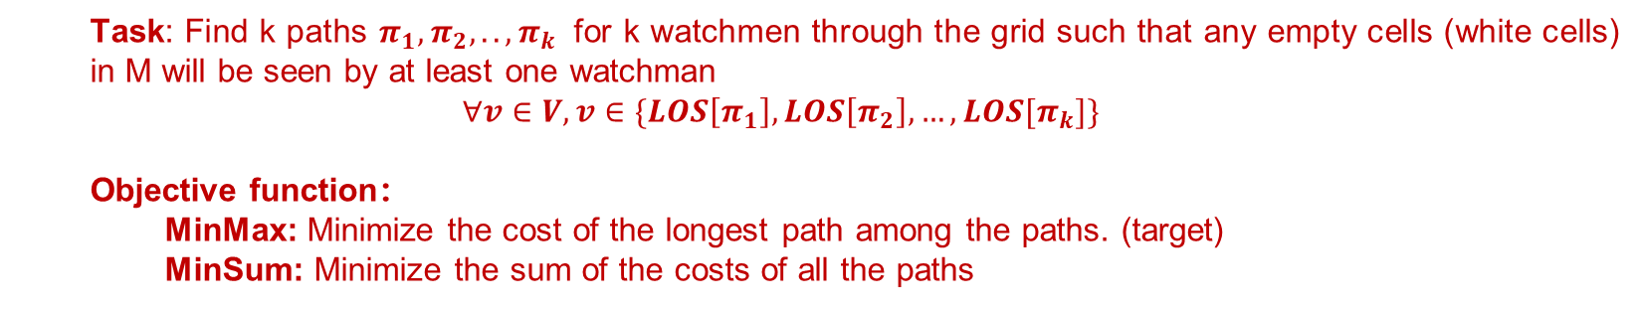
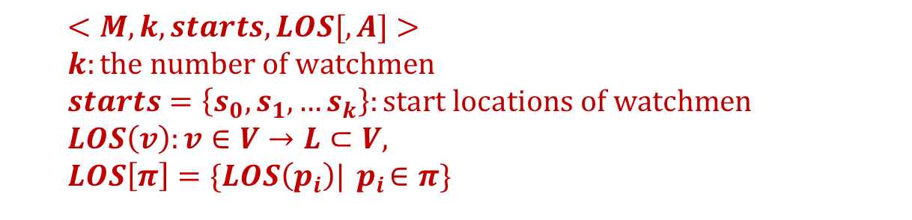
Multiple Watchman Route Problem (MWRP)
Problem Definition
$$<M, k, starts,LOS[,A]> \\ k:the number of watchmen \\ starts=\left\{s_{0},s_{1},…s_{k}\right\}:start locations of watchmen$$
$$LOS\left(v\right):v∈V→L⊂V, \\ LOS\left[π\right]=\{LOS\left(p_{i}\right)|{ p}_{i}∈π\}$$
Task: Find k paths $π_{1},π_{2},..,π_{k}$ for k watchmen through the grid such that any empty cells (white cells) in M will be seen by at least one watchman
$$∀v∈V,v∈\{LOS\left[π_{1}\right], LOS\left[π_{2}\right],…,LOS[π_{k}]\}$$
Objective function：
MinMax: Minimize the cost of the longest path among the paths. (target)
MinSum: Minimize the sum of the costs of all the paths
Notes:
then we are going to introduce MWRP, most terms are the same. k, starts, specially, for path pi, we define LOS[pi], just how many cells will be seen by following this path. The task turns to ….

Slide 5
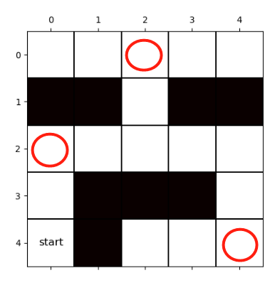
Previous Work on MWRP
Existing Methods
Decouple method (AGP+MTSP)
[J Faigl et al.,2006]
(Self-organizing map) SOM method
[J Faigl et al.,2010]
Related Problems
Art Gallery Problem(AGP)
place the minimum number of guards necessary to collectively cover the interior of a given area.
Multiple Travelling Salesman Problem (MTSP)
find k paths starting and finishing at the same depot which
visits every vertex exactly once with minimum sum of weight
Disadvantages of Previous Work
Visibility Constraint (line-of-sight)
e.g. different LOS for different watchmen
Cycle path requirement
AGP solution
MTSP solution
(k=1)
Notes:
Most researchers are considering solving MWRP in a polygon instead of a grid-map before. To our best knowledge there are mainly two methods to solve MWRP: xxxxxxxxxxxxxxxxx. However, both methods have the same disadvantages: First, they are unable to handle MWRP with a free LOS function setting, such as different LOS for different watchmen. Second, the solution of both methods must be a cycle, start and end in the same place. In our research, we removed these limitations.

Slide 6
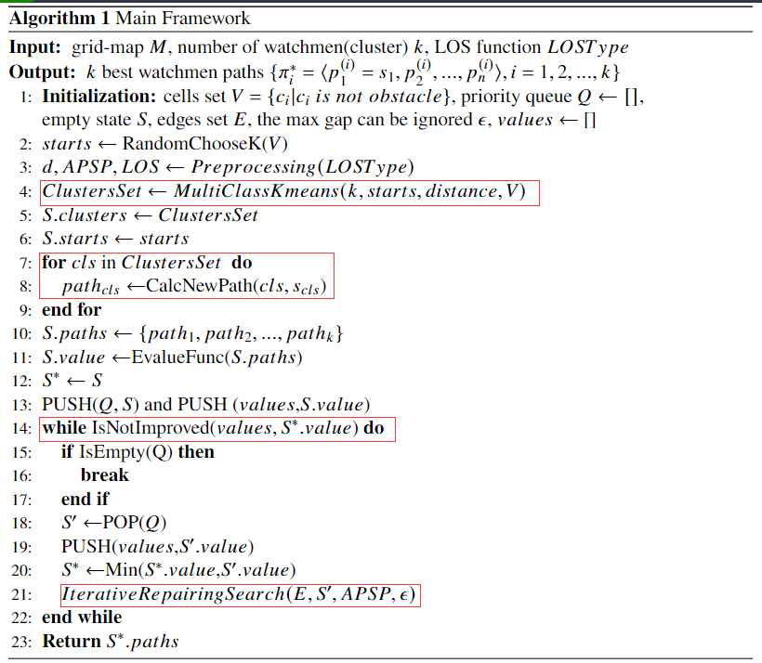
Proposed method
2 Stages
1-st Stage：
Partition all cells of grid-map into different groups(clusters) using a multi-class connected clustering algorithm
2-nd Stage：
Generate-and-repair search
route generation level
Find initial solution with WRP solver
route repair level
Reassign cells among different clusters, repeatedly repair paths to improve the solution quality
terminal condition
Notes:
From now on, I'd like to illustrate our proposed method. we try to solve MWRP on a grid map in two stages. first stage… we then apply a generate-and-repair algorithm in the second stage. at route generation level, we find paths at each cluster with the WRP solver to generate initial solution. At route repair level….

Slide 7
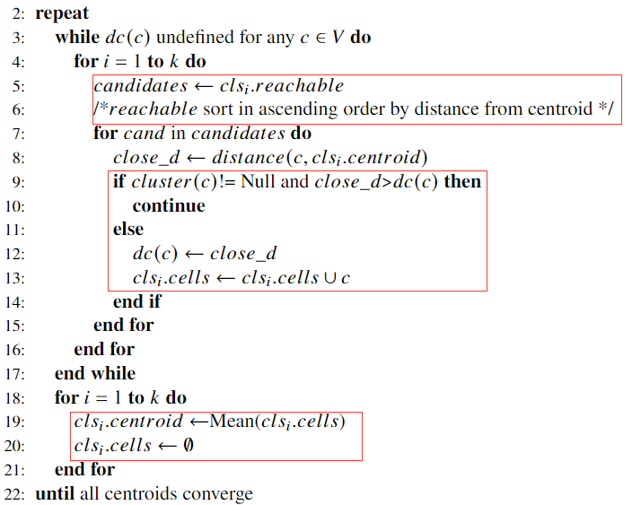
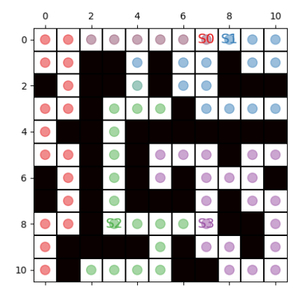

Proposed method
1-st stage: multi-class connected clustering algorithm
$$k:the number of watchmen\left(clusters\right)$$
$\left\{s1,s2,…,s_{k}\right\}:$ starting locations of watchmen $$dc\left(c\right):distance\left(c,cls_{i}.centroid\right) if c∈cls_{i}.cells$$
$else undefined$
Process:
1.Initialization:
$∀c∈V,cluster\left(c\right)=Null$
$$for i∈\left\{1,2,…,k\right\}, cls_{i}.centroid=s_{i},$$
2. Choose new members from $clsi.reachable$
($set of cells that reachale from cluster i$)
3. Whether cell is belonging to other clusters
4.After all cells are assigned, recalculate centroids
5. Repeat 2~4 until centroids converge
(e.g.)
Notes:
Then we explain the scheme of these algorithms. Here are some expressions, dc is the distance between a cell c and the centroid of cluster to which cell c belongs. If cell c doesn’t belong to any cluster, then its dc value will be undefined. We initialize the centroids as each watchman's start location. For keeping connectivity, we maintain a list called reachable in each cluster for identifying all the cells that can reach from a cluster and sort them …. Every time we choose the closest cell in the reachable set for the cluster. if cluster(c) is not null, means that cell c has been assigned to another cluster, we must consider whether it should belong to multiple clusters. If the current closest distance is greater than dc(c), which means cell c has belonged to a closer cluster, so we stop the assignment. Otherwise, we treat c as a multi-class cell. After all cells are assigned, we recalculate the new centroid as the mean of each cluster. step5. (example)

Slide 8
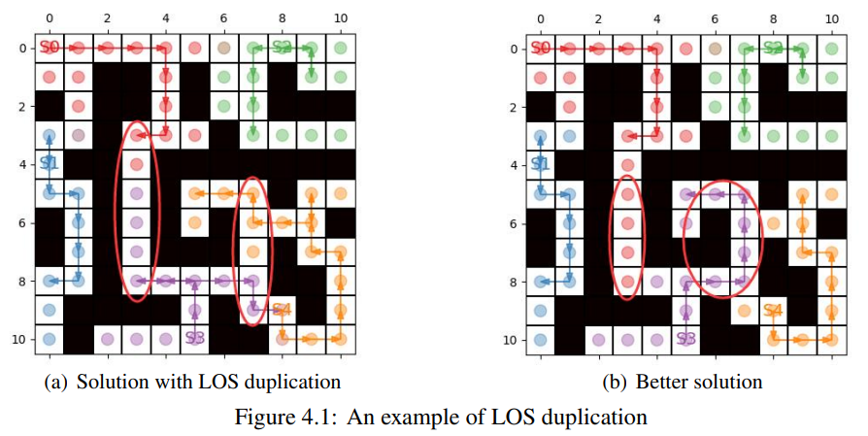
Proposed method
2-nd stage: generate-and-repair search
Route Generation Level:
Apply WRP solver to find initial solution (find k best paths for each watchman at each cluster)
Reason why most initial solutions with poor solution quality → LOS duplication
LOS duplication: cells in LOS of multiple paths.
Notes:
As mentioned before, we find initial solution at Route Generation Level. But the quality of initial solution is often unsatisfactory.
the reason for this phenomenon is the LOS duplication, which is one cell has been seen multiple times unnecessarily.(example) cells in these two areas have been seen by different watchmen although they only need to be seen once. If we reduce the LOS duplication, a better solution can be obtained

Slide 9
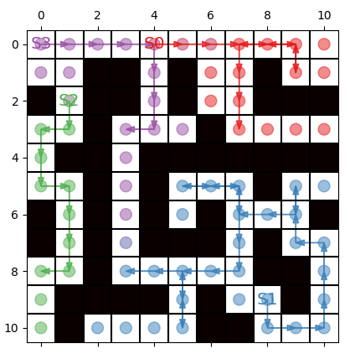
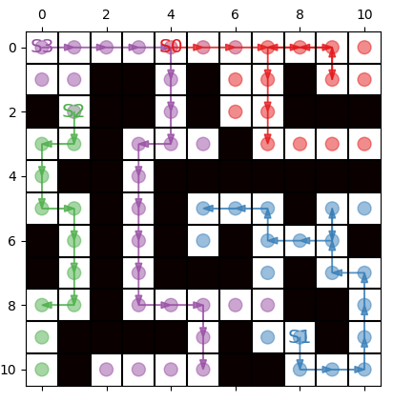
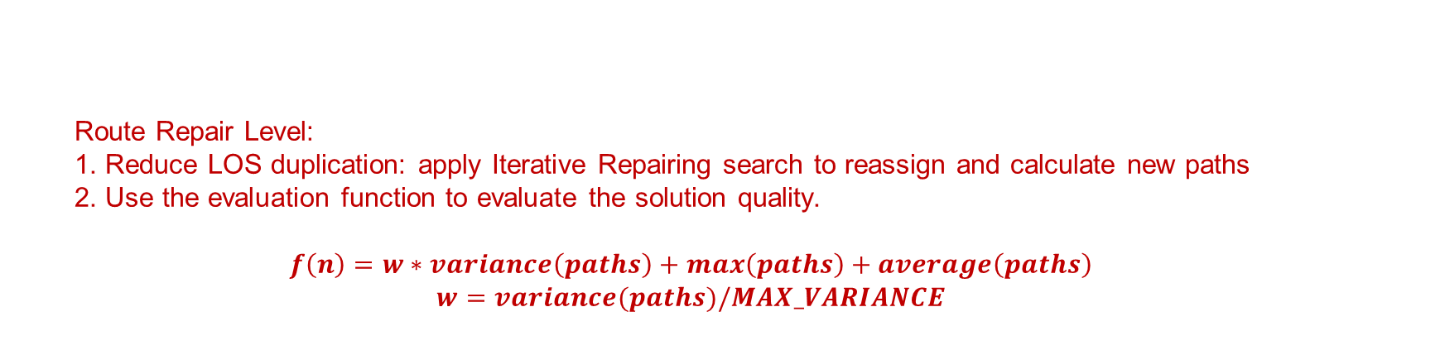
Proposed method
2-nd stage: generate-and-repair search
Route Repair Level:
1. Reduce LOS duplication: apply Iterative Repairing search to reassign and calculate new paths
2. Use the evaluation function to evaluate the solution quality.
$$f\left(n\right)=w∗variance\left(paths\right)+max\left(paths\right)+average\left(paths\right)$$
$$w=variance(paths)/MAX_VARIANCE$$
Initial solution:
[12,28,9,8]
repaired result:
[12,15,9,17]
Notes:
Thus in route repair level, we aim to reduce LOS duplication…. Besides, we use the evaluation function to evaluate the solution quality, helping us decide whether to expand the node. the evaluation function is composed of three parts……………….. In some extreme cases, the variance may be much larger than the other two parts. To balance the weight of each value, we add a scaling factor w to variance. Also we give an example of generate-and-repair search, the max value decrease from 28 to 17 and become more balanced.

Slide 10
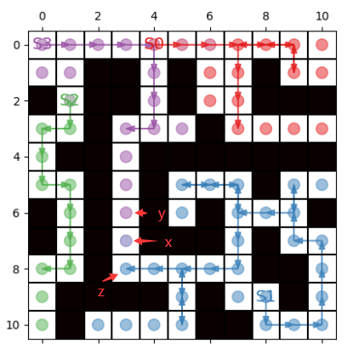
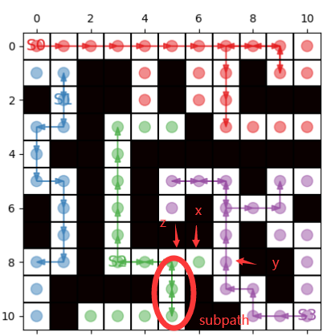
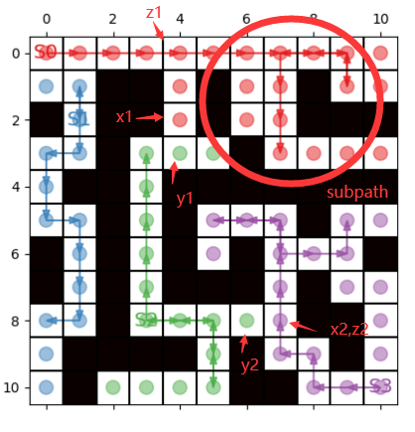

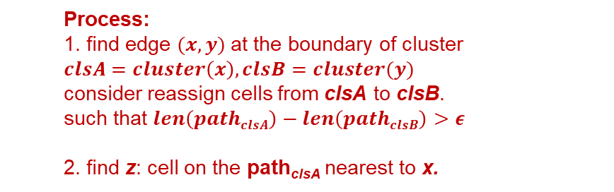




Proposed method
Iterative Repairing Search
Process:
1. find edge $(x,y)$at the boundary of cluster
$$clsA=cluster\left(x\right),clsB=cluster(y)$$
consider reassign cells from clsA to clsB.
such that $len\left(pathclsA\right)−len\left(pathclsB\right)>ε$
2. find z: cell on the path_{clsA} nearest to x.
3. $need assign=x∪z∪APSP\left(x,z\right)∪RelativeCells\left(z\right)$
$$APSP\left(x,z\right): shorests path between cell x and cell z$$
$$RelativeCells\left(z\right): set of cells that need to be$$
$$reassigned if z is reassigned$$
1） $RelativeCells\left(z\right)=z$: if remove z from clsA has no influence on connectivity of clsA
2） $RelativeCells\left(z\right)=subpath of pathclsA$
(1) z occurs once: remainder of path after z
(2) z occurs multiple times: subpath of path_{clsA}
between 2 furthest z instances apart in path_{clsA}
4. outliers: clsA can’t reach after assignment.
(marked with yellow color)
figure 1
figure 3
figure 2
Notes:
Here we give the details about our Iterative Repairing Search. Since LOS duplication must happen at the boundary of cluster. thinking edge(x,y) is the edge connecting two different clusters, and cell x is from clsA and cell y is from clsB. ...clsA->clsB.. to reduce LOS duplication. To do this, we must ensure pathclsA>pathblsB so that the solution quality wouldn't be worse.
However, most of time, reassign one cell has a trivial help for proceeding the search process, the path may not change at all. To enhance the pace of path repairing process, let 𝑧 be the cell on the path of clsA nearest to 𝑥, we try to assign xxx. APSP, RelativeCells. the value of RelativeCells is determined according to the situaion. we’ll use examples to explain it. (1) otherwise: (2)xxx. In addition, there may be some outliers, cells that become unreachable from clsA after the assignment. (yellow) they are also need to be assigned. (remind that there are some cells belonging to multiple clusters, but actually it has no impact on our search process, we can add a loop for multi-class cells and in each iteration we can treat it as single class cell)

Slide 11
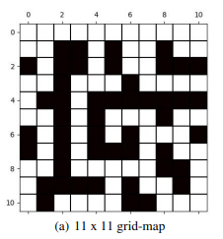
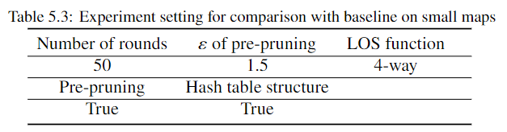
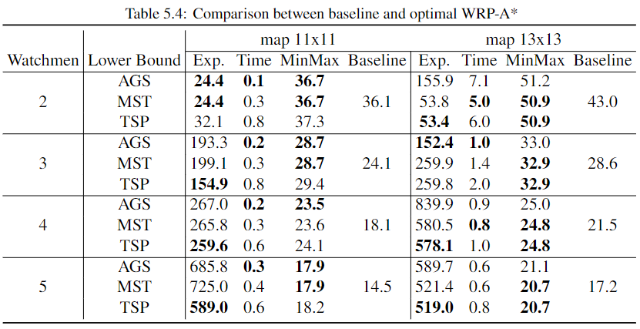
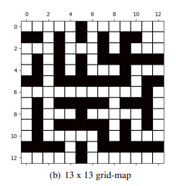
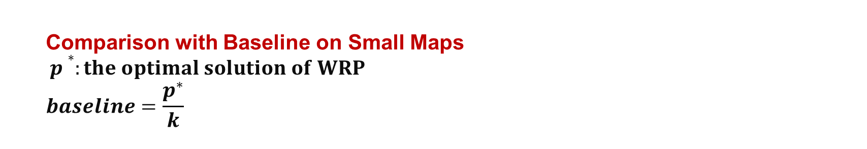
Experiment Results
Comparison with Baseline on Small Maps
$p∗:the optimal solution of WRP$
$$baseline=\frac{p^{∗}}{k}$$
(baseline is not lower bound)
Exp.：the number of node expansion
Notes:
Then, we give our experiment results. By defining p* as the optimal solution of WRP, we use p* divide k as our baseline. we generate 50 map instances by randomly select the start locations of watchmen.

Slide 12
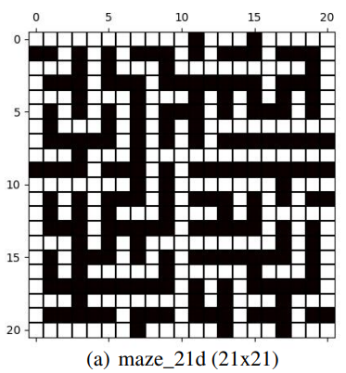
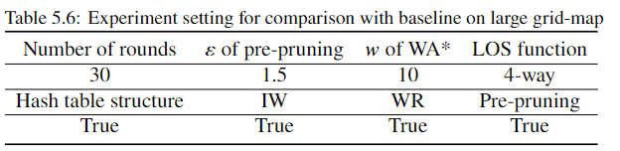
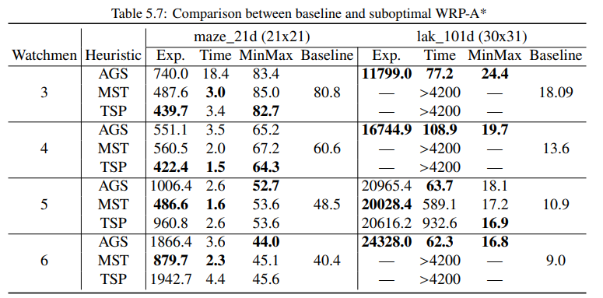
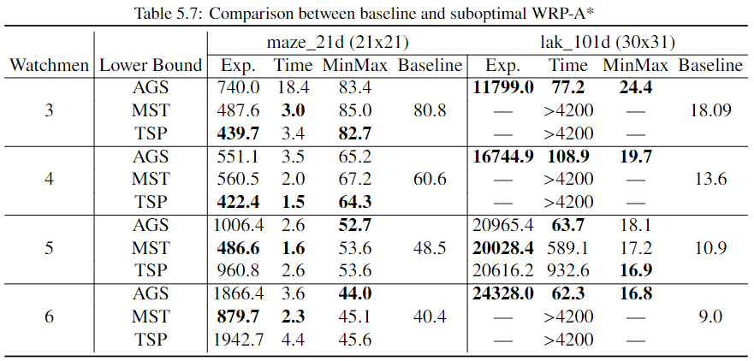
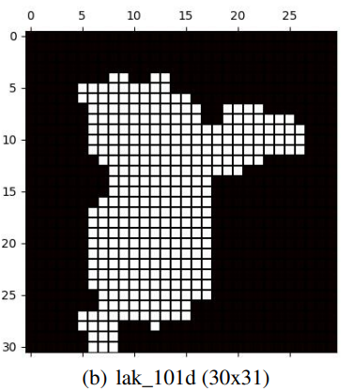
Experiment Results
Comparison with Baseline on Larger Maps
Exp.：the number of node expansion
Notes:
also, we test our method on larger maps, due to computing resource and time constraints, we only conducted 30 rounds on both maps. The main difference between these two maps is the presence of open areas. b map has a large open area that includes all empty cells. resulting in The magnitude of node expansion is completely different. The number of node expansion of map B is more than ten times that of map A. And we are failed to find solution in many cases.
Besides, About map a, the performance of our method is relatively well. But the solution quality of map B seems not good enough, we suspect the reason is in such an open area, there will inevitably be a larger number of LOS duplications, resulting in the decrease of solution quality.

Slide 13
Conclusion
Contributions
1. Nearly good solution quality and demonstrate its feasibility and potentiality
2. Independent of the visibility constraint
3. Removing cycle path requirement
Future Work
1. New evaluation function for the MinSum criterion
2. Improvement of the conditions for expanding new nodes In iterative repairing
algorithm (spending too much time on maps with open area)
Notes:
we proposed a new method consists of a multi-class connected clustering algorithm and a generate-and-repair algorithm. our method..
that’s all my presentation

Slide 14
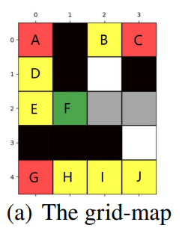
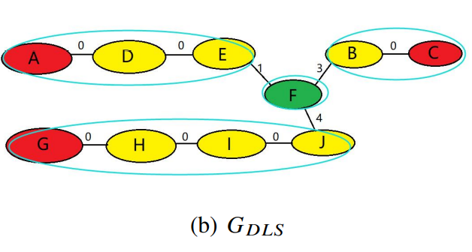
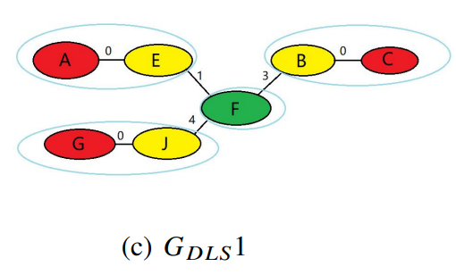
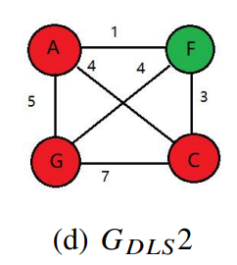
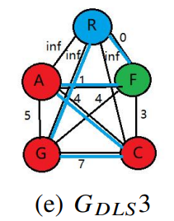

Lower Bound of WRP
Aggregating Singleton lower bound (AGS)
S: current node
For every p∈S.unseen
$$h_{p}=min q∈LOS(p)d\left(S.location,q\right) \\ hAGS=maxp∈\text{S}\text{.}\text{unseenhp}\text{(}\text{S}\text{)}$$
Graph lower bound for WRP(MST,TSP)
Watchman Cell(Green)
Pivots(Red)
Watchers(Yellow)
Other(Gray, White)

Slide 15
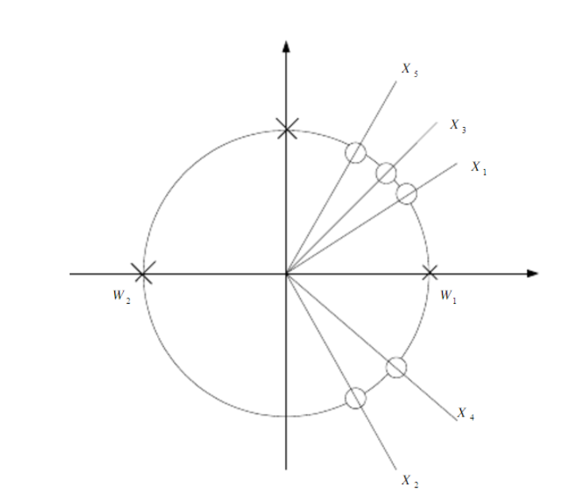
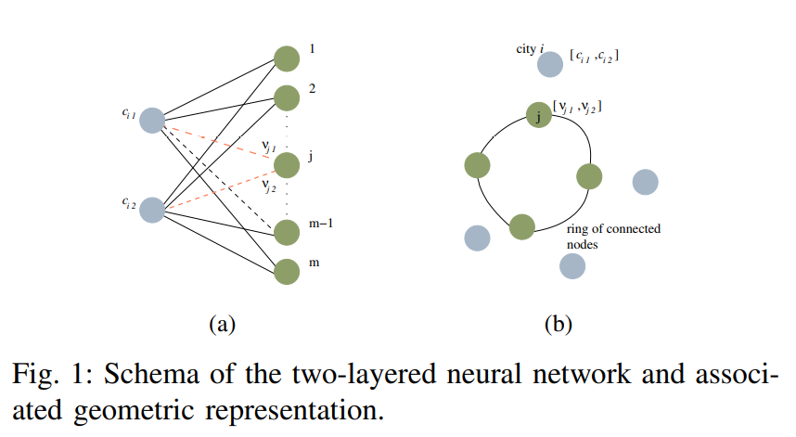
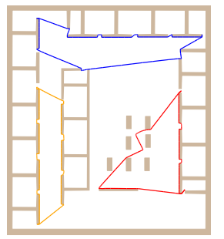
SOM
W₁
W₂
[J Faigl. 2010]
Notes:
Most researchers are considering solving MWRP in a polygon instead of a grid-map before. To our best knowledge there are mainly two methods to solve MWRP: xxxxxxxxxxxxxxxxx. However, both methods have the same disadvantages: First, they are unable to handle MWRP with a free LOS function setting, such as different LOS for different watchmen or unlimited visibility. Second, the solution of both methods must be a cycle, start and end in the same place. In our research, we removed these limitations.

Slide 16
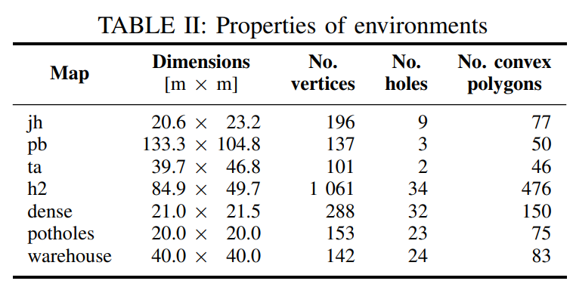
SOM
Notes:
we proposed a new method consists of a multi-class connected clustering algorithm and a generate-and-repair algorithm. our method..
that’s all my presentation

Slide 17
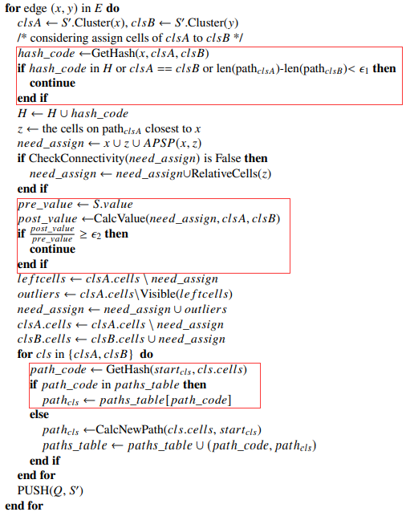

Proposed method
Efficiency Improved measures
1. Hash Table Structure
1) Skipping nodes that have already occurred
2) Storage of existing paths for reuse.
2. Pre-pruning
Prevent the generation of a node with poor solution quality.
Predict the solution quality (the value of evaluation function $f\left(n\right))$after the assignment operation and compare it with the original one to determine whether to retain the node.
Definition:
$lenclsA=\left|need_assign∩cells of pathclsA\right|$
the length that the path of cluster A will reduce $$lenclsB=|need_assign \backslash cells of clsB|$$
the length that the path of cluster B will increase.
$ε\text{2}\text{: }\text{the} \text{bound} \text{to} \text{decide} \text{whether} \text{to} \text{expand}$

Slide 18
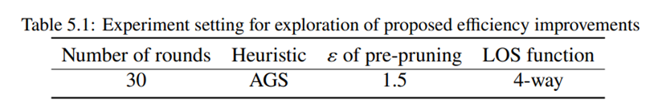
Experiment Results
Exploration of Proposed Efficiency Improvements

Slide 19
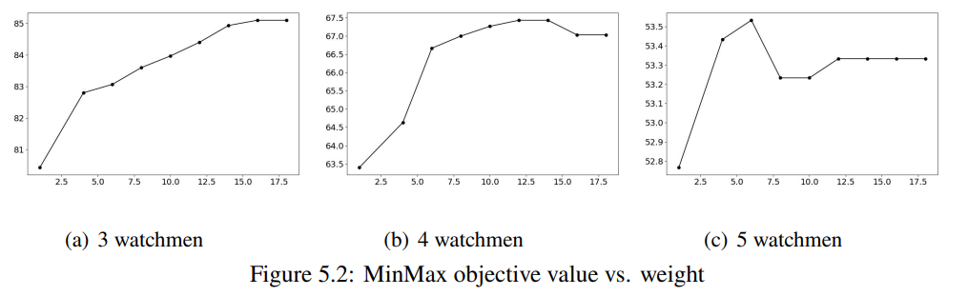
Experiment Results
Exploration of Weighted A* search

Slide 20
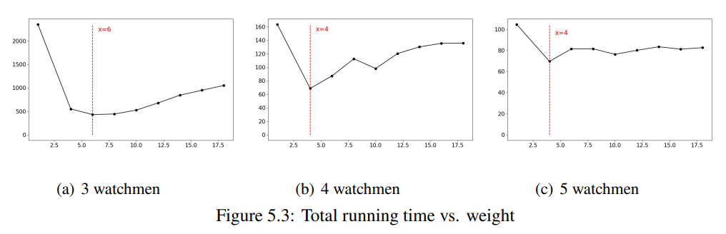
Experiment Results
Exploration of Weighted A* search

