Slide 1
numba：60-》70s
auto experiment function complete

Slide 2
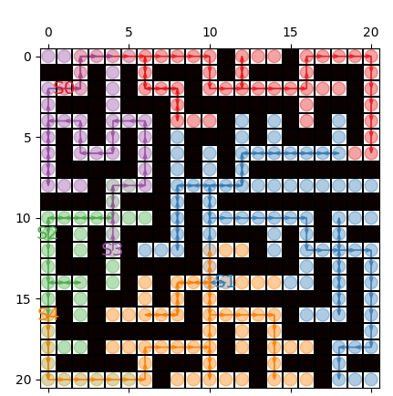
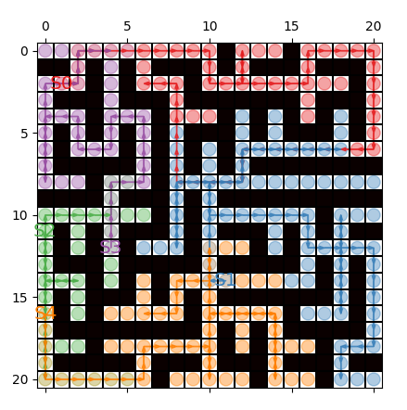
map:21*21
IW: Ignoring White cells
WR: Removing Likely Redundant Pivots
non-optimal situation-1
about speed-up options: IW, WR
[57, 75, 29, 36, 50]
[47, 75, 27, 36, 50]

Slide 3
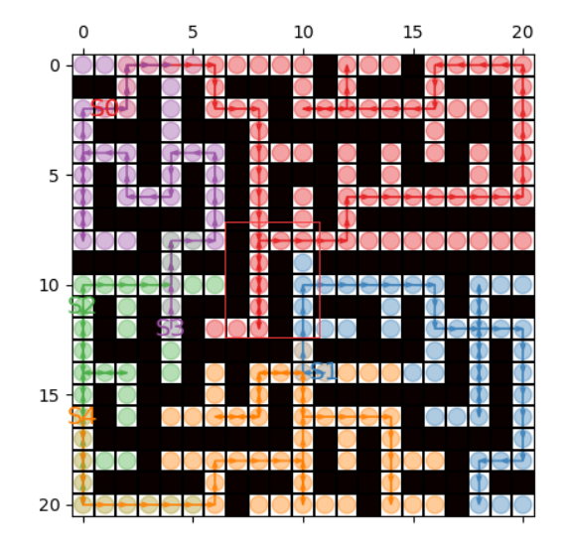
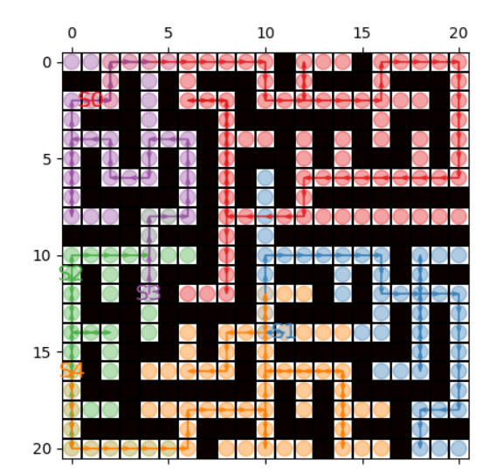
map:21*21
IW: Ignoring White cells
WR: Removing Likely Redundant Pivots
non-optimal situation-2
about speed-up options: IW, WR
should be the same,
but become worse

Slide 4
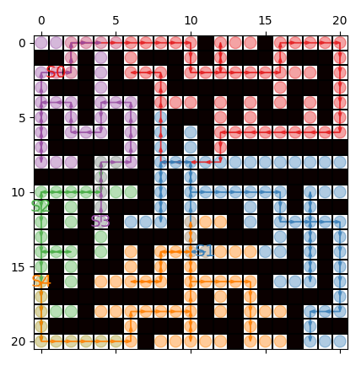
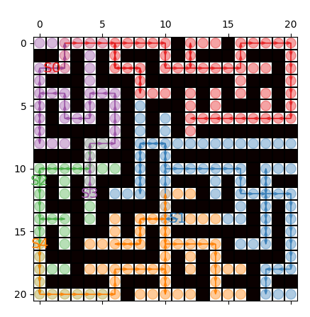
non-optimal situation-2
about heuristic function
agg_h: [57, 55, 27, 36, 50]
MST:[55, 55, 27, 34, 50]

Slide 5
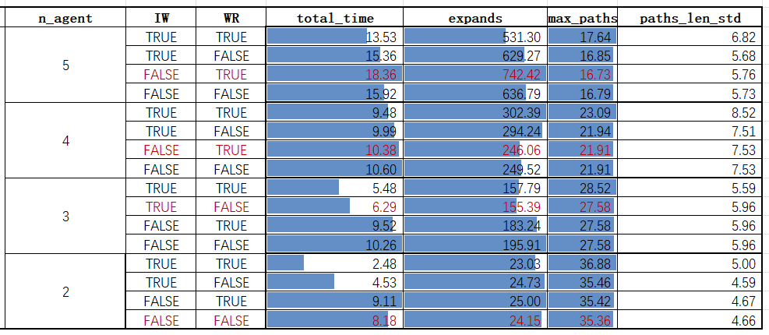
hyper-parameter choose：
map:11*11
IW: Ignoring White cells
WR: Removing Likely Redundant Pivots
test time: 33

