Slide 1
修士研究報告
Sub-optimally Solving the Multiple Watchman Route Problem with Heuristic Search
総合文化研究科広域科学専攻修士二年 福永研究室 劉冠廷
研究方向：組み合わせ最適化

Slide 2
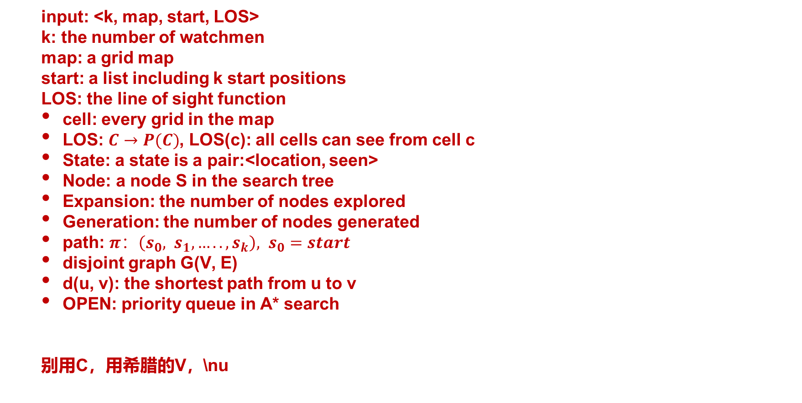
definition:
input: <k, map, start, LOS>
k: the number of watchmen
map: a grid map
start: a list including k start positions
LOS: the line of sight function
cell: every grid in the map
LOS: $C→P(C)$, LOS(c): all cells can see from cell c
State: a state is a pair:<location, seen>
Node: a node S in the search tree
Expansion: the number of nodes explored
Generation: the number of nodes generated
path: $π：\left(s_{0}, s_{1}, …..,s_{k}\right), s_{0}=start$
disjoint graph G(V, E)
d(u, v): the shortest path from u to v
OPEN: priority queue in A* search
别用C，用希腊的V，\nu

Slide 3
提案手法
2-stage solver
1-st stage：
a multi-class connected clustering algorithm
partition the whole map into k clusters (one cell can belong to multiple clusters)
Assign cells in the same cluster to each watchman
2-nd stage：
primal-dual search algorithm
primal level: apply WRP solver for each watchman to find k best paths at each cluster
dual level: use the evaluation function to score the solution found by the lower level, reassign cells during search process, then recalculate new path. Then repeat until no improvements.

Slide 4
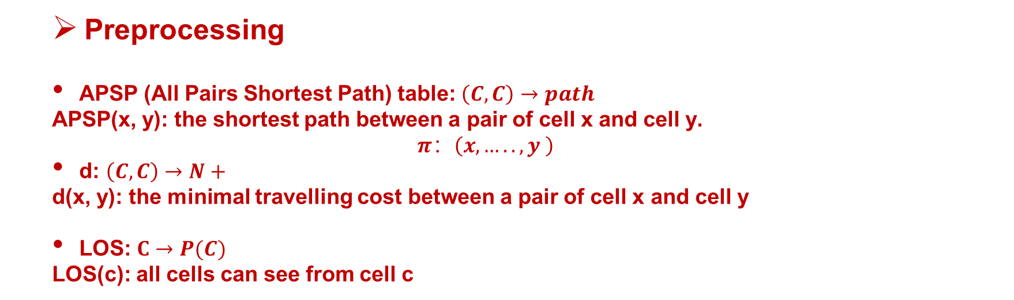
提案手法
Preprocessing
APSP (All Pairs Shortest Path) table: $\left(C, C\right)→path$
APSP(x, y): the shortest path between a pair of cell x and cell y.
$$π：\left(x,…..,y \right)$$
d: $\left(C, C\right)→N+$
d(x, y): the minimal travelling cost between a pair of cell x and cell y
LOS: $C→P(C)$
LOS(c): all cells can see from cell c

Slide 5
提案手法
1-st stage: multi-class connected clustering algorithm
the number of clusters＝the number of watchmen
guarantee the connectivity in each cluster and run a multi-class k-means clustering algorithm which means one cell can belong to multiple class
preparation:
process： (Pseudocode)
1. Initialize each cluster center as the start cell of each watchman
2. for each cluster, find the nearest connected cell based on the distance from the center and add it as a new member.
If cell X has belong to another cluster and the distance between X and that cluster center is smaller than the distance between X and the current cluster center, the assignment is refused.
3. after all cells are assigned, recalculate the new center for each cluster
4. repeat steps 2 and 3 until all the centers of the cluster become stable

Slide 6

提案手法
2-nd stage: primal-dual algorithm
primal level (WRP-A*):
WRP-A*: the variant of A* that works on the search tree defined for WRP
apply WRP-A* solver for each watchman to find k best paths at each cluster
$$f\left(n\right)=g\left(n\right)+h\left(n\right)$$
$g\left(n\right):$ the travelling cost from start
$h\left(n\right):$ admissible heuristics (MST, TSP, Aggregating Singleton Heuristics)
dual level (cell reassignment):
use the evaluation function to score the solution found by the lower level, reassign cells based on the score and recalculate new path, repeat until no improvements
$$f\left(n\right)=w∗variance\left(paths\right)+max\left(paths\right)+average\left(paths\right)$$
$$w=variance(paths)/MAX_VARIANCE$$
set early stop and max iteration, repeat until max iteration or no better solution is found.

Slide 7
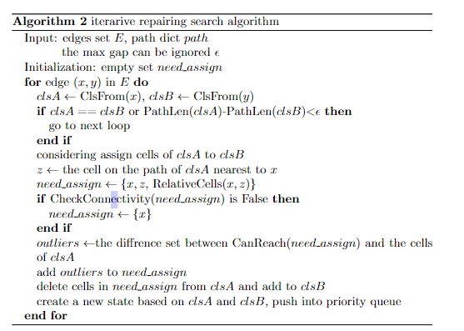
提案手法
2-level primal-dual algorithm

Slide 8
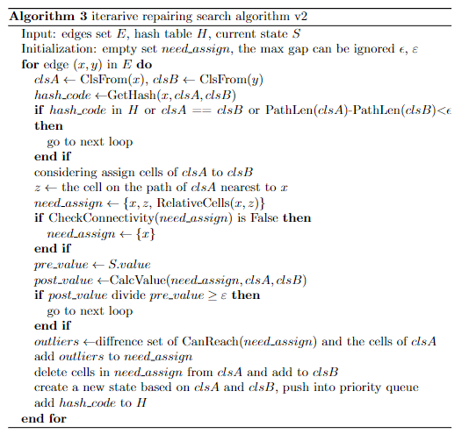
提案手法
techniques that reduce the size of the search tree

Slide 9
提案手法
techniques that speed up the search process
1. data structure(based on profiling)
2. hash table
3. hyper-parameter

