Slide 1

Parsing Markup Languages with Python
Parsing HTML
BeautifulSoup
Formatting the soup
HTML soup components
Finding tags in the soup
Dr. Tateosian
References http://www.w3schools.com/html/default.asp
http://www.crummy.com/software/BeautifulSoup/
http://www.hellboundhackers.org/articles/841-using-python-39;s-htmlparser-class.html
Notes:
Many organizations post geospatial datasets on the web that are frequently updated and hosted in a way that Python can extract them. Python can identify the links in the page. Then, using these data links, Python can download the data. This video provides a brief introduction to parsing using a package called BeautifulSoup. We’ll look at an example that reformats the markup soup, we’ll review terminology for the soup ingredients, and last we’ll parse a Google page with Python and extract every link on the page.

Slide 2
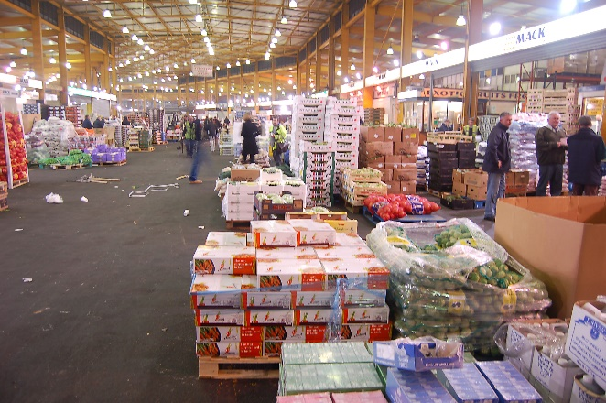
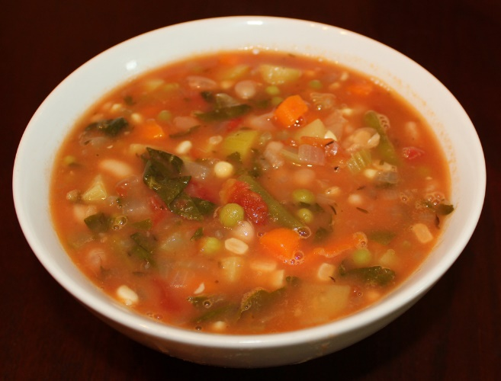
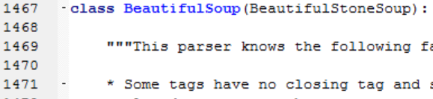
How can you work with existing ML pages?
Parse
  Break into manageable pieces.
  Extract needed information.
BeautifulSoup module
  A markup language parser (see Ch 20 sample scripts)
  Contains a BeautifulSoup class which makes Soup Objects from markup language text.
  Soup Objects have markup language-related methods and properties. Soup methods: Prettify, FindAll,…
Notes:
Raleigh’s farmer’s market has a wholesale pavilion. Before they banned it, people used to buy a huge box of mangos and then parse them out into piles of 6 mangos and resell them to other customers. This is parsing. Fishing all the green beans out of your soup and putting them in your napkin is parsing. Finding all of the names of the images embedded in an html file. Getting a list of all of the weather data zipfiles on an webpage is parsing.
There are a number of different modules for parsing markup languages. We’re going to use a popular one named BeautifulSoup. It comes as a package which requires installation, but there’s also a Python script version that can simply be imported like any other user defined module. You have a copy of this one in the gispy chapter 20 sample scripts directory. BeautifulSoup.py contains defines a class, also called BeautifulSoup. We will be instantiating soup objects with this class and using them to parse markup language text.
Note… HTMLParser module is a built-in module for parsing markup languages. Lower level than BeautifulSoup.

Slide 3
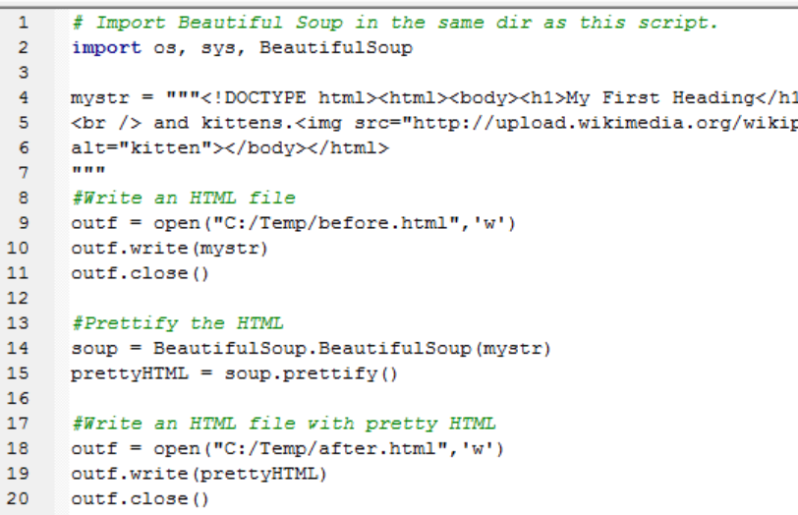
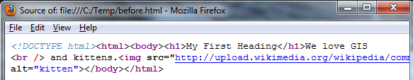
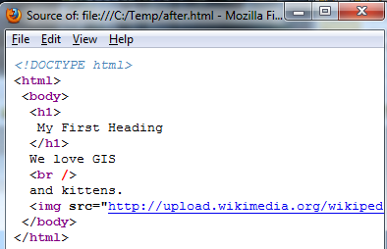
Writing Readable HTML
BEFORE
import BeautifulSoup, create a soup object, ‘prettify’ the soup.
soup.prettify() reformats the HTML. Adds line breaks & indentation to improve readability.
AFTER

Slide 4
In class – Identify these HTML components
start tag names
attribute names
attribute values
contents (text between opening and closing tags pairs)
<img src=“smiley.gif" alt=“Smiley face" width="42" height="42" />
<a href="http://www.bbc.co.uk/comedy/littlebritain/">NCSU GIS</a>
<br>
<ol type='a'>
<li>Coffee</li>
<li>Tea</li>
<li>Milk</li>
</ol>

Slide 5
Solutions–HTML components
<img src=“smiley.gif" alt=“Smiley face" width="42" height="42" />
<a href="http://www.bbc.co.uk/comedy/littlebritain/">NCSU GIS</a>
<br>
<ol type='a'>
<li>Coffee</li>
<li>Tea</li>
<li>Milk</li>
</ol>
Note about quotes
type = ‘a’
type = “a”
Both work.
start tag names
  img, a, br, ol, li
attribute names
  img: src, alt, width, height
  a: href
  br: n/a
  ol: type
  li: n/a
attribute values
  img: “smiley.gif”, “Smiley face”,”42”, “42”
  a: http://www.bbc.co.uk/comedy/littlebritain/
  ol: ‘a’
contents (stuff between opening & closing tags pairs)
  img: n/a
  a: NCSU GIS
  br: n/a
  ol: <li>Coffee</li>, <li>Tea</li>, <li>Milk</li>
  li: Coffee ...
Notes:
img, a, br, ol, li
img: src, alt, width, height
a: href
br: n/a
ol: type
li: n/a
img: “smiley.gif”, “Smiley face”,”42”, “42”
img: n/a
a: NCSU GIS
br: n/a
ol: <li>Coffee</li>, <li>Tea</li>, <li>Milk</li>
li: Coffee ...

Slide 6
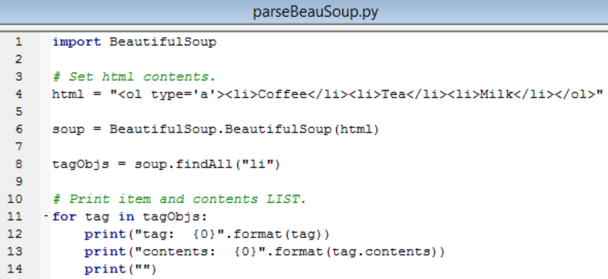
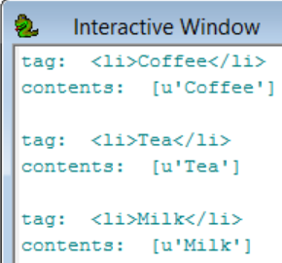
Consuming the soup with findAll
findAll method returns tag objects for all instances of the given tag.
soup.findAll("li") returns a Python list of tag objects, one for each <li> tag.
Notes:
import BeautifulSoup
# Set html contents.
html = "<ol type='a'><li>Coffee</li><li>Tea</li><li>Milk</li></ol>"
soup = BeautifulSoup.BeautifulSoup(html)
tagObjs = soup.findAll("li")
# Print item and contents LIST.
for tag in tagObjs:
print("tag: {0}".format(tag))
print("contents: {0}".format(tag.contents))
print("")
# Print item and FIRST item in content list.
for tag in tagObjs:
print("tag: {0}".format(tag))
print("contents: {0}".format(tag.contents[0]))
print("")

Slide 7
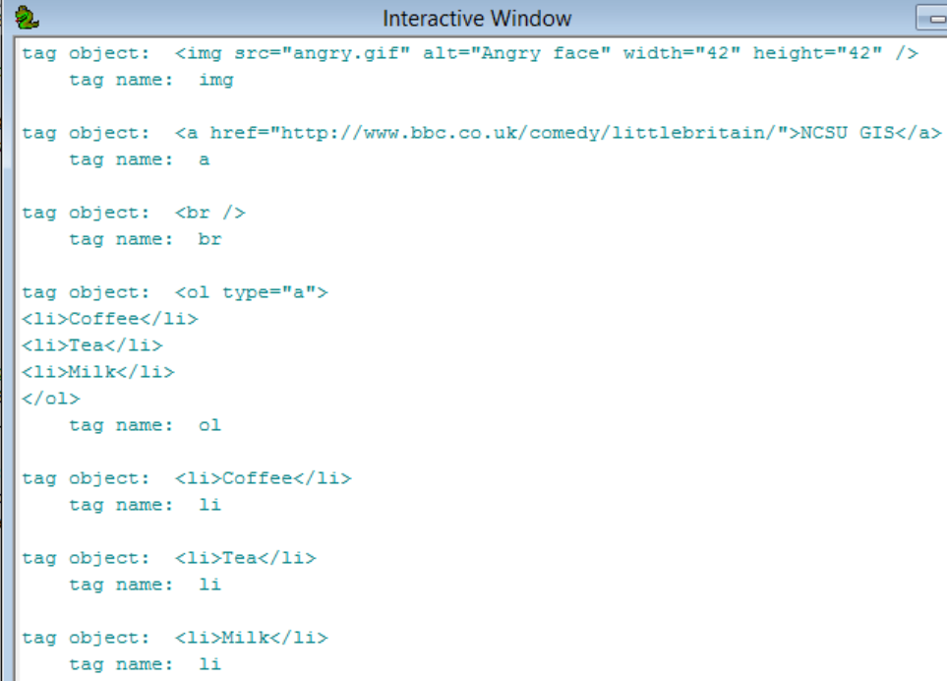
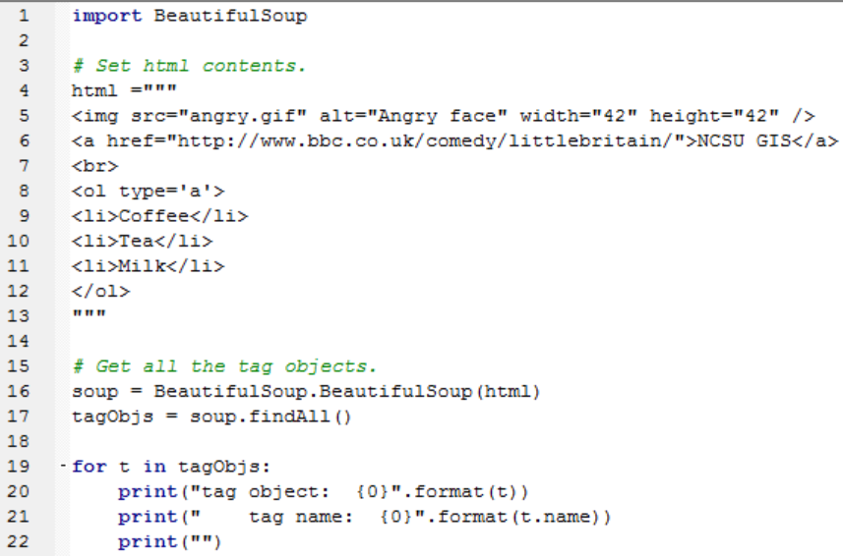
Tag Object name Property
tag objects have properties: contents, name, & attrs
soup.findAll()returns tag object for all the tags
Notes:
import BeautifulSoup
# Set html contents.
html ="""
<img src="angry.gif" alt="Angry face" width="42" height="42" />
<a href="http://www.bbc.co.uk/comedy/littlebritain/">NCSU GIS</a>
<br>
<ol type='a'>
<li>Coffee</li>
<li>Tea</li>
<li>Milk</li>
</ol>
"""
soup = BeautifulSoup.BeautifulSoup(html)
tagObjs = soup.findAll()
for t in tagObjs:
print("tag object: {0}".format(t))
print(" tag name: {0}".format(t.name))
print("")

Slide 8
Example tag objects, t1 and t2
t1: <img src="angry.gif" alt="Angry face" width="42" height="42" />
t2: <a href="http://www.bbc.co.uk/comedy/littlebritain/">NCSU GIS</a>
tag name property
  >>> t1.name
  img
  >>> t2.name
  a
attrs property – ordered list of tuples (attr. name, value) pairs.
  >>> t1.attrs
  [(u'src', u'angry.gif'), (u'alt', u'Angry face'), (u'width', u'42'), (u'height', u'42')]
  >>> t2.attrs
  [(u'href', u'http://www.bbc.co.uk/comedy/littlebritain/')]
contents property – a list of contents between the opening and closing of this tag.
  >>> t1.contents
  []
  >>> t2.contents
  [u'NCSU GIS']

Slide 9
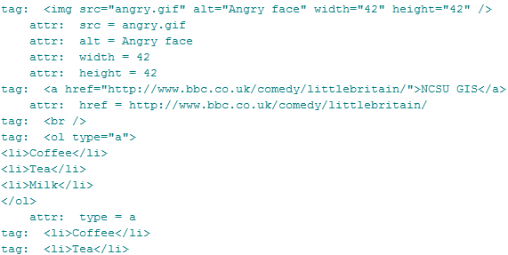
Handling attributes
Attritributes are (name, value) pairs.
Iterate with 2 variables in for loop.
soup = BeautifulSoup.BeautifulSoup(html)
tags = soup.findAll()
for tag in tagObjs:
print("tag: {0}".format(tag))
for attr, value in tag.attrs:
print(" attr: {0} = {1}".format(attr,value))
Notes:
import BeautifulSoup
# Set html contents.
html ="""
<img src="angry.gif" alt="Angry face" width="42" height="42" />
<a href="http://www.bbc.co.uk/comedy/littlebritain/">NCSU GIS</a>
<br>
<ol type='a'>
<li>Coffee</li>
<li>Tea</li>
<li>Milk</li>
</ol>
"""
# Get all the tag objects.
soup = BeautifulSoup.BeautifulSoup(html)
tagObjs = soup.findAll()
for tag in tagObjs:
print("tag: {0}".format(tag))
for attr, value in tag.attrs:
print(" attr: {0} = {1}".format(attr,value))

Slide 10
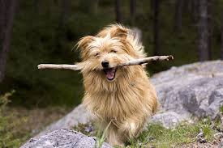
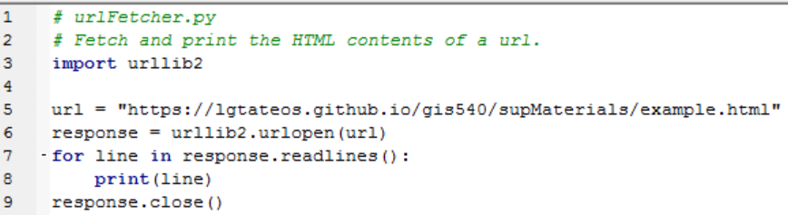
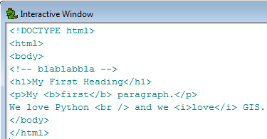
Fetching HTML
urllib2
  Built-in module for fetching web page
  content
  urlopen function returns a file object open for reading (similar to myfile = open(‘data.txt’, ‘r’) )
Notes:
# urlFetcher.py
# Fetch and print the HTML contents of a url.
import urllib2
url = "https://lgtateos.github.io/gis540/supMaterials/example.html"
response = urllib2.urlopen(url)
for line in response.readlines():
print(line)
response.close()

Slide 11
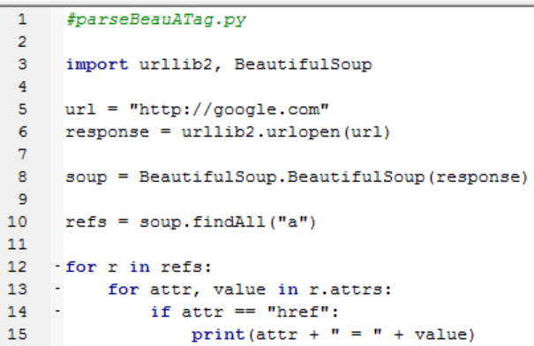
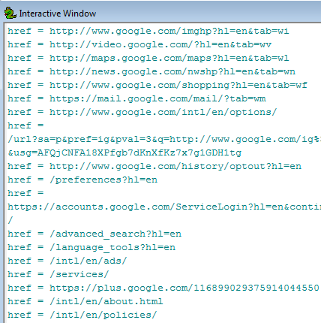
Getting the links in a page
Line 3 -- import urllib2 and BeautifulSoup
Line 6 – fetch URL contents
Line 8 -- call BeautifulSoup method on the url contents.
Line 10 -- get a list of “a” tags in the contents
Line 12 – loop through the “a” tags
Line 13 – loop through the attrs property
Notes:
#parseBeauATag.py
import urllib2, BeautifulSoup
url = "http://google.com"
response = urllib2.urlopen(url)
soup = BeautifulSoup.BeautifulSoup(response)
refs = soup.findAll("a")
for r in refs:
for attr, value in r.attrs:
if attr == "href":
print(attr + " = " + value)

Slide 12

Summing up
Topics discussed
    Generating readable HTML
    Fetch HTML
    Parsing with BeautifulSoup
Up next
    WakeGov data download
    Working with KML
Additional topics
    many more tags, css, javascript
Notes:
thanks for pic from http://twi-star.blogspot.com/2009/11/central-park-remember-me-set-stalking.html

Slide 13
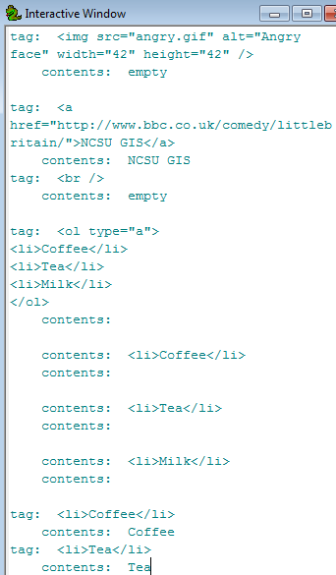

Handling contents and attributes
Contents and attributes are lists.
Usually want first content item.
Can iterate through contents
Attritributes are (attr name, value) pairs.
Iterate with 2 variables in for loop.

Slide 14
What to do once you have the page?
Download and import BeautifulSoup.
import os, sys, urllib2
curDir = os.path.dirname(sys.argv[0])
sys.path.append(curDir) #Make sure path is appended to import local module
import BeautifulSoup
Get the html using urllib2 (or other means).
import urllib2
url = "https://lgtateos.github.io/gis540/supMaterials/example.html"
html = urllib2.urlopen(url)
print html
>>> <ol type='a'><li>Coffee</li><li>Tea</li><li>Milk</li></ol>
Call the BeautifulSoup method on the html; This returns a soup object.
soup = BeautifulSoup.BeautifulSoup(html)
Notes:
#parseBeauATag.py
import os, sys, urllib2
curDir = os.path.dirname(sys.argv[0])
#Make sure path is appended to import local module
sys.path.append(curDir)
import BeautifulSoup
html = "<ol type='a'><li>Coffee</li><li>Tea</li><li>Milk</li></ol>"
soup = BeautifulSoup.BeautifulSoup(html)
items = soup.findAll("li")
for i in items:
print "Item: {0} Contents: {1}".format(i, i.contents[0])

Slide 15
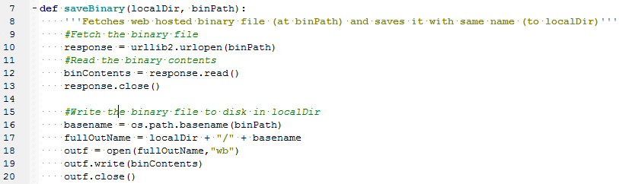
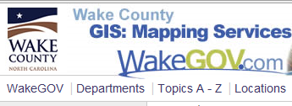
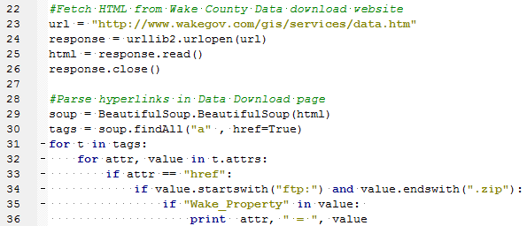
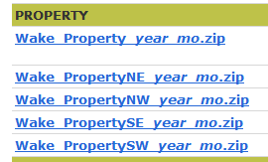
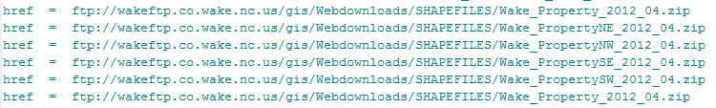
Wake County Data Download
Notes:
http://www.wakegov.com/gis/services/Pages/data.aspx
#wakeURL_solution.py
import os,urllib2, sys, zipfile, traceback
sys.path.append("C:/Temp") #Make sure path is appended to import local module
import BeautifulSoup
def fetchBinary(localDir, binPath):
'''Fetches web hosted binary file (at binPath) and saves it with same name (to localDir)'''
#Fetch the binary file
response = urllib2.urlopen(binPath)
#Read the binary contents
binContents = response.read()
response.close()
#Write the binary file to disk in localDir
basename = os.path.basename(binPath)
outf = open(localDir + "/" + basename,"wb")
outf.write(binContents)
outf.close()
def unzip(zip,dest):
'''Unzip a compressed file (zip) into the destination directory (dest).'''
print "Unzipping", zip, "to", dest
#Get a zipfile object
zip = zipfile.ZipFile(zip, 'r')
if not os.path.exists(dest):
os.makedirs(dest)
#Get a list of files in the archive
zipList = zip.namelist()
for filename in zipList:
#Get the binary file contents and print the byte count in the current file
binContents = zip.read(filename)
print ' Unzipping file:', filename, 'with', len(binContents), 'bytes..'
#Write the binary file to disk
outf = open(dest + filename, 'wb')
outf.write(binContents)
outf.close()
zip.close
print "Extraction complete."
#Fetch HTML from Wake County Data download website
url = "http://www.wakegov.com/gis/services/data.htm"
response = urllib2.urlopen(url)
html = response.read()
response.close()
#Parse hyperlinks in Data Download page
soup = BeautifulSoup.BeautifulSoup(html)
workingDir= "C:/Temp/aaa/"
tags = soup.findAll("a" , href=True)
#Loop through the links in the html
for t in tags:
#Loop through the attributes in the current link
for attr, value in t.attrs:
#Find the link destination attribute
if attr == "href":
#Find the ftp zipfile link destinations
if value.startswith("ftp:") and value.endswith(".zip"):
#Find the links relating to Wake_Streets
if "Wake_Property" in value:
print attr, " = ", value

Slide 16
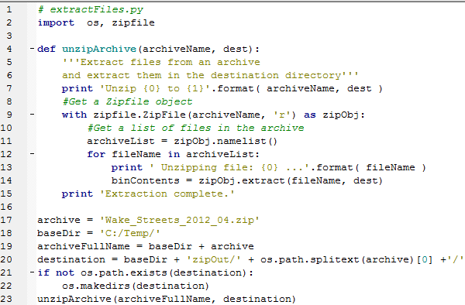
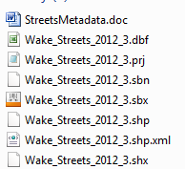
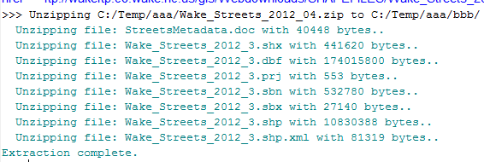
Unzipping compressed data
Import zipfile (built-in Python module).
Get zipfile object for given compressed file (e.g., Wake_Streets.zip)
Get the list of files in the zip object -- zip.namelist()
For each file in list,
  Extract the binary contents -- zipObject.Extract(fileName, dest)
Notes:
# extractFiles.py
import os, zipfile
def unzipArchive(archiveName, dest):
'''Extract files from an archive
and extract them in the destination directory'''
print 'Unzip {0} to {1}'.format( archiveName, dest )
#Get a Zipfile object
with zipfile.ZipFile(archiveName, 'r') as zipObj:
#Get a list of files in the archive
archiveList = zipObj.namelist()
for fileName in archiveList:
print ' Extract file: {0} ...'.format( fileName )
binContents = zipObj.extract(fileName, dest)
print 'Extraction complete.'
archive = 'Wake_Streets_2012_04.zip'
baseDir = 'C:/Temp/'
archiveFullName = baseDir + archive
destination = baseDir + 'zipOut/' + os.path.splitext(archive)[0] +'/'
if not os.path.exists(destination):
os.makedirs(destination)
unzipArchive(archiveFullName, destination)

Slide 17
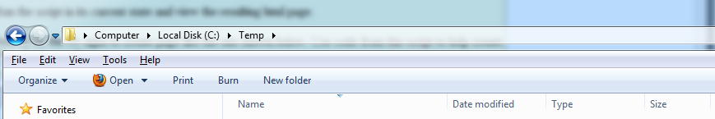
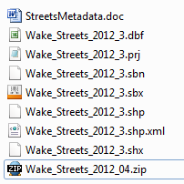
In class - wakeURL.py
1. Save BeautifulSoup.py and wakeURL.py in C:/Temp
2. Add code to import BeautifulSoup. (don't forget to append this directory to the system path)
3. Run the script in its current state and view the resulting print statements.
4. Search for the ## signs and add code there to make procedures work and then to call them.
Notes:
import os,urllib2, BeautifulSoup
def saveFTP(localDir, ftpPath):
response = urllib2.urlopen(ftpPath)
ftpFile = response.read()
response.close()
basename = os.path.basename(ftpPath)
fullOutName = localDir + "/" + basename
outf = open(fullOutName,"wb")
outf.write(ftpFile)
outf.close()
url = "http://www.wakegov.com/gis/services/data.htm"
#url = "http://www4.ncsu.edu/~lgtateos/"
response = urllib2.urlopen(url)
html = response.read()
response.close()
soup = BeautifulSoup.BeautifulSoup(html)
references = soup.findAll("a" , href=True)
for link in references:
linkRef = link['href']
if linkRef.startswith("ftp:") and linkRef.endswith(".zip"):
if "Wake_Property" in linkRef:
print link['href']
saveFTP("C:/Temp", linkRef)

Slide 18

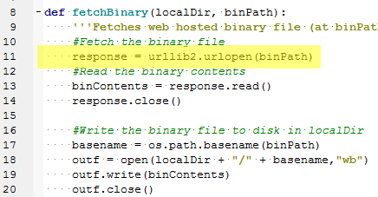
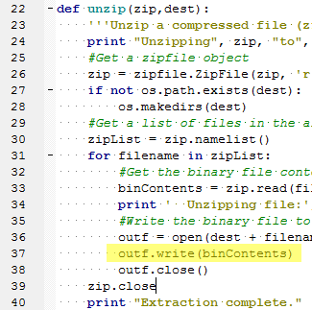
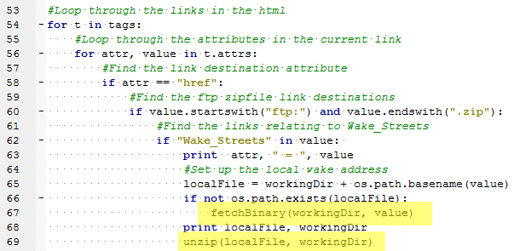
wakeURL followup
Notes:
#wakeURL_solution.py
import os,urllib2, sys, zipfile, traceback
sys.path.append("C:/Temp") #Make sure path is appended to import local module
import BeautifulSoup
def fetchBinary(localDir, binPath):
'''Fetches web hosted binary file (at binPath) and saves it with same name (to localDir)'''
#Fetch the binary file
response = urllib2.urlopen(binPath)
#Read the binary contents
binContents = response.read()
response.close()
#Write the binary file to disk in localDir
basename = os.path.basename(binPath)
fullOutName = localDir + "/" + basename
outf = open(fullOutName,"wb")
outf.write(binContents)
outf.close()
def unzip(zip,dest):
'''Unzip a compressed file (zip) into the destination directory (dest).'''
print "Unzipping", zip, "to", dest
zip = zipfile.ZipFile(zip, 'r')
if not os.path.exists(dest):
os.makedirs(dest)
for filename in zip.namelist():
try:
bytes = zip.read(filename)
print ' Unzipping file:', filename, 'with', len(bytes), 'bytes..'
fullname = dest + filename
file(fullname, 'wb').write(zip.read(filename))
except:
print "Unzip failed for", filename
traceback.print_exc( )
zip.close
print "Extraction complete."
#Fetch HTML from Wake County Data download website
url = "http://www.wakegov.com/gis/services/data.htm"
response = urllib2.urlopen(url)
html = response.read()
response.close()
#Parse hyperlinks in Data Download page
soup = BeautifulSoup.BeautifulSoup(html)
workingDir= "C:/Temp/aaa/"
tags = soup.findAll("a" , href=True)
for t in tags:
for attr, value in t.attrs:
if attr == "href":
if value.startswith("ftp:") and value.endswith(".zip"):
if "Wake_Streets" in value:
print attr, " = ", value
fetchBinary(workingDir, value)
unzip(workingDir + os.path.basename(value), workingDir)

Slide 19
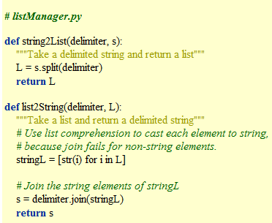

Recall – append path of non-builtin
append path for user-defined modules or module that is not built-in
import sys
append system path
import non built-in module
Example:
resides in C:/Temp

