Slide 1
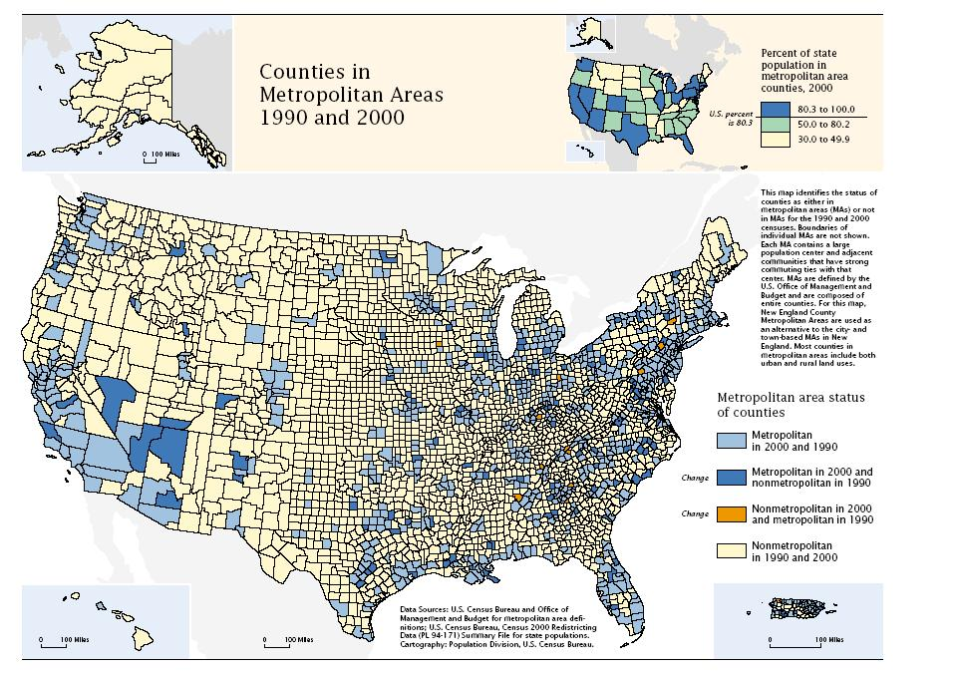
Mapping with arcpy
Brewer, Cynthia A., and Trudy A. Suchan. Mapping Census 2000: The geography of US diversity, 2000: Census 2000 special reports. Vol. 1. No. 1. US Department
of Commerce, Economics and Statistics Administration, US Census Bureau, 2001.
GIS540
Dr. Tateosian
Center for Geospatial Analytics
North Carolina State University
Notes:
This lesson returns to arcpy functionality to discuss the Python mapping capabilities. arcpy can automate map publication and manage existing project documents. The mapping module has Python classes that mimic the organization of ArcGIS Pro. Keep in mind our recent discussion of user-defined classes. The terms property and method will reappear as we go over these mapping classes. In this lecture, you will also see how to manipulate (add, remove, or move) map layers, how to modify map surrounds, such as the title and north arrow, and finally, how to modify the symbology of map layers.

Slide 2
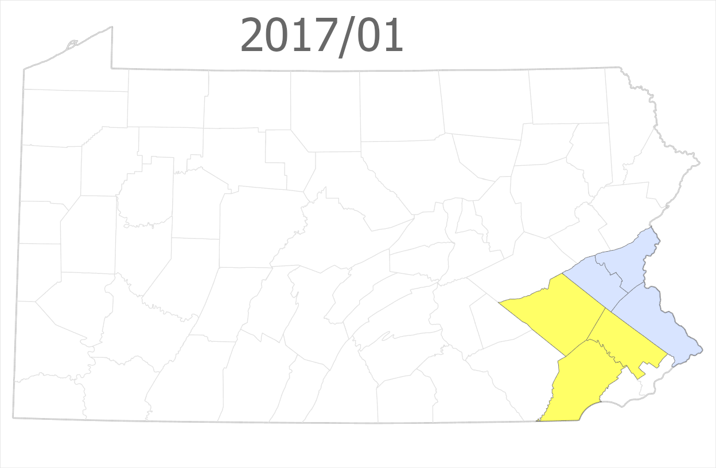
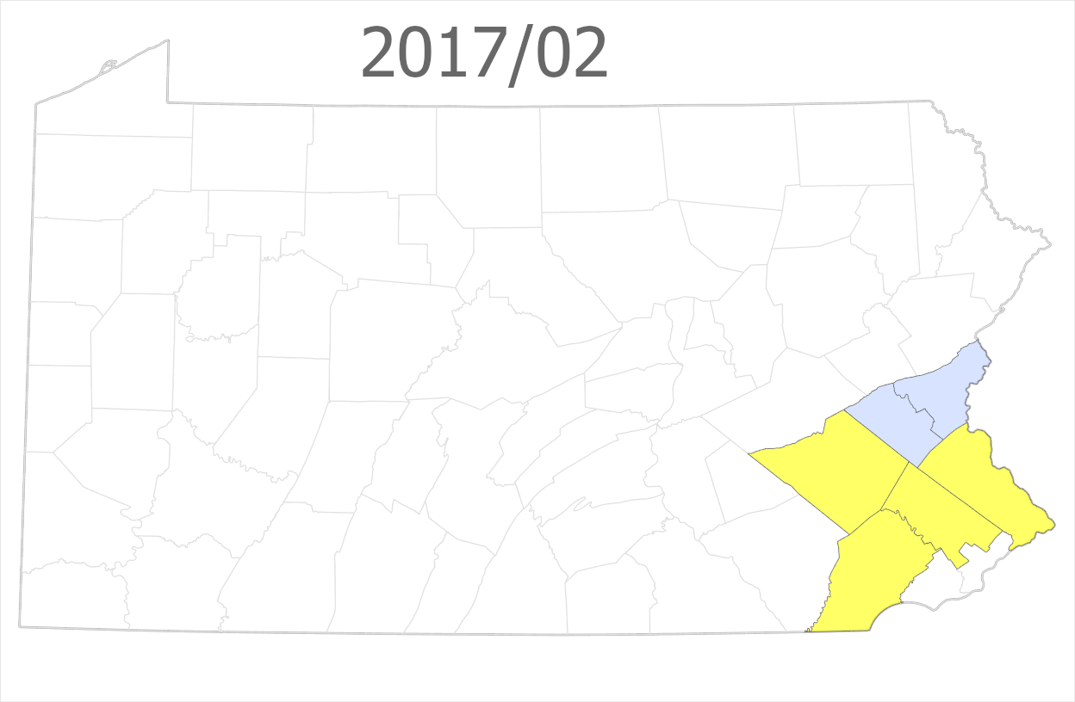
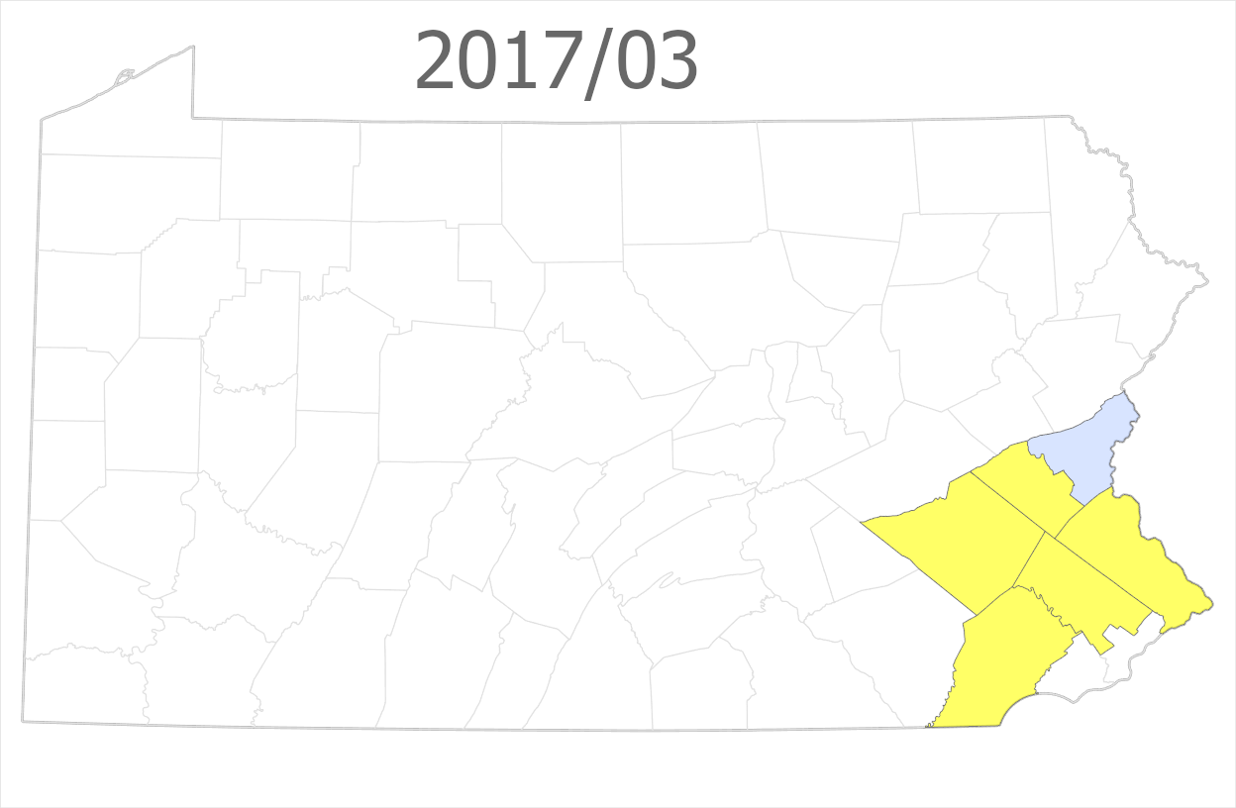
Spotted lanternfly:
2017 official records vs. news articles
time

Slide 3
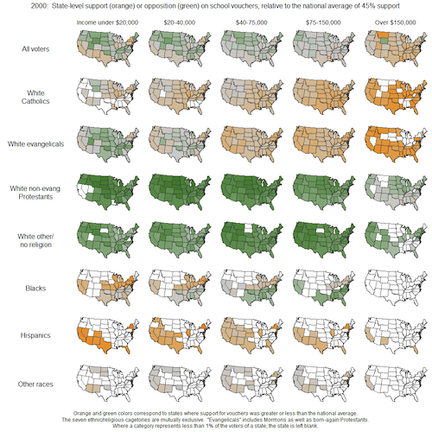
Support for school vouchers
voter
race
income level
Notes:
Small multiples use the same basic map to display different slices of a data set.

Slide 4
title
unique color
graduated color
text
box
legend
scale
Brewer, Cynthia A., and Trudy A. Suchan. Mapping Census 2000: The geography of US diversity, 2000: Census 2000 special reports. Vol. 1. No. 1. US Department of Commerce, Economics and Statistics Administration, US Census Bureau, 2001.

Slide 5
mp
The module for mapping in Python

Slide 6
With mp, you can…
Inventory project contents (list maps, list layer, list elements, etc.)
Add, move, remove data
Symbology (color, size, style, etc.)
Modify layout elements around the map (title, legend, text boxes, etc.)
Export maps (as pdf, png, etc.)
Change base maps

Slide 7
With mp, you cannot…
Create new projects
Create new maps
Create new elements around the map (title, north arrow, legend, etc.)

Slide 8
How it works
Manually:
Create a project with a map.
Add desired layout elements.
Use manually created map as a template.
Populate the map using code:
Add layers.
Edit title, text boxes.
Export png or pdf.
Save a copy of the project.

Slide 10
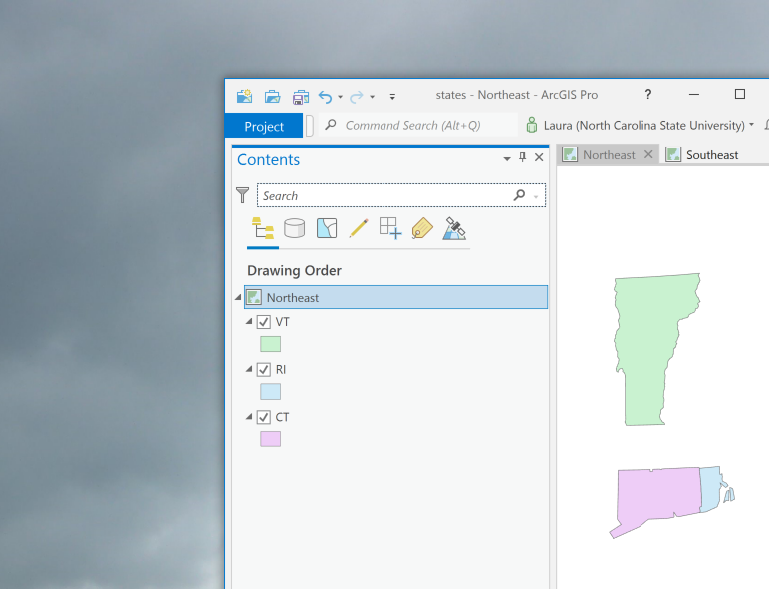

ArcGIS Pro project hierarchy
Project (has maps and layouts)
Map (has layers)
Layers

Slide 11








ArcGIS Pro project hierarchy
Project (has maps and layouts)
Maps (have layers)
Map (has layers)
Layers
Notes:
Showing transition for ArcGIS Desktop to Pro.

Slide 12
Getting a Project object
Scripts need this to work with the maps the project contains.
import arcpy
# Create a Project object.
aprx = arcpy.mp.ArcGISProject("CURRENT")
Project Project object
object constructor
# ... (this is where you would do mapping things.)
# Delete the Project object near the end of the code. del aprx

Slide 13
The “CURRENT” project
Use the project name "CURRENT" to create the Project object when …
working inside ArcGIS Pro. This means running a Jupyter Notebook inside Pro, using the Pro Python window, or in a Script Tool.
Otherwise, you need to specify a project full path file name.
import arcpy
# Create a Project object.
aprx = arcpy.mp.ArcGISProject("CURRENT")
# ... (this is where you would do mapping things)
del aprx
Notes:
Use the project name "CURRENT" to create the Project object when …
working inside ArcGIS Pro. This means in a Notebook, the Python window, or in a Script Tool.
Otherwise, you need to specify a project full path file name.

Slide 14
A project name
Use the project's full path file name to create the Project object when …
working outside of ArcGIS Pro. This means in a PyCharm, Visual Studio Code, other IDEs, a DOS command line, etc.
import arcpy
project_dir = "C:/gispy/data/ch24/projects/states/"
# Create a Project object.
aprx = arcpy.mp.ArcGISProject(project_dir + 'states.aprx')
# ... (this is where you would do mapping things)
del aprx
Notes:
Use the project name "CURRENT" to create the Project object when …
working inside ArcGIS Pro. This means in a Notebook, the Python window, or in a Script Tool.
Otherwise, you need to specify a project full path file name.

Slide 15
Robust project name code
To write code that will work either way, use error handling (try/except keywords)
import arcpy
project_dir = "C:/gispy/data/ch24/projects/states/"
try:
# When working inside ArcGIS Pro,
# use the project name "CURRENT"
aprx = arcpy.mp.ArcGISProject("CURRENT")
except OSError:
# When working outside ArcGIS Pro,
# use the project full path file name.
aprx = arcpy.mp.ArcGISProject(project_dir + "states.aprx")
# ... (this is where you would do mapping things)
del aprx
Notes:
This code will try to use the “CURRENT” project to create the mapping object. If this fails, it will try to use the project specified by this full path file name (project_dir + 'states.aprx') .

Slide 16
If the project & script are together
If script is in the project directory,...
import arcpy, os, sys
project_dir = os.path.dirname(sys.argv[0])
try:
# When working inside ArcGIS Pro,
# use the project name "CURRENT"
aprx = arcpy.mp.ArcGISProject("CURRENT")
except OSError:
# When working outside ArcGIS Pro,
# use the project full path file name.
aprx = arcpy.mp.ArcGISProject(project_dir + "states.aprx")
# ... (this is where you would do mapping things)
del aprx
Notes:
This code will try to use the “CURRENT” project to create the mapping object. If this fails, it will try to use the project specified by this full path file name (project_dir + 'states.aprx') .

Slide 17
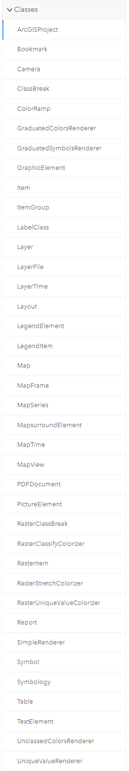
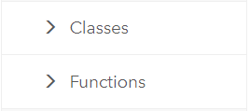
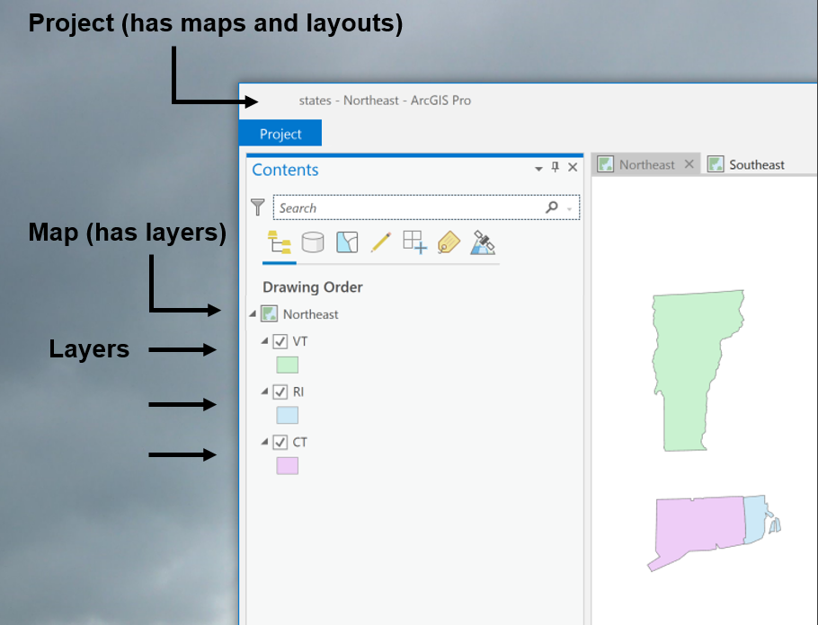
arcpy.mp classes
arcpy.mp module has classes.
Classes: ArcGISProject, Map, Layout, Layer, Symbology, TextElement, and more
Notes:
The mapping module has a set of classes and a set of functions. Looking at the online help for the mapping module, you’ll see a folder for classes (expanded in the left screen shot) and a folder for functions, (expanded in the right screen shot). The classes include a ArcGISProject class, a Map Class, a Layer class, and many others. The functions are grouped into two categories: Functions for exporting and printing the map (most of these are for exporting. you can’t see the entire list here, but there is also a PrintMap function) and then the other category if for managing documents and layers.

Slide 18
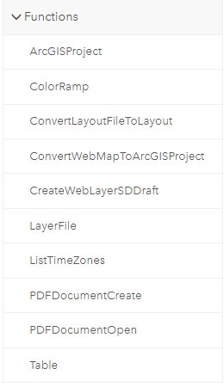
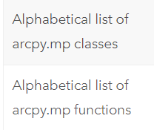
arcpy.mp functions
arcpy.mp module also has functions.
Alphabetical ‘Help’ lists of classes and functions are useful (Print them if using frequently)
Notes:
The arcpy.mp module has a set of classes and a set of functions. Looking at the online help for the mapping module, you’ll see a folder for classes (expanded in the left screen shot) and a folder for functions, (expanded in the right screen shot). The classes include a MapDocument class, a DataFrame Class, a Layer class, and many others. The functions are grouped into two categories: Functions for exporting and printing the map (most of these are for exporting. you can’t see the entire list here, but there is also a PrintMap function) and then the other category if for managing documents and layers.
Notice the alphabetical “help” lists of classes and functions in the left image. These are useful to print so that you can reference them while working with the mapping module.
https://pro.arcgis.com/en/pro-app/latest/arcpy/mapping/alphabeticallistoffunctions.htm

Slide 19
Project -> Map -> Layer
import arcpy
aprx = arcpy.mp.ArcGISProject("CURRENT")
# Get a list of Map objects.
maps = aprx.listMaps()
# Get the first Map object.
myMap = maps[0]
# Get a list of Layer objects.
layers = myMap.listLayers()
# Get the first Layer object.
myLayer = layers[0]

Slide 21
Methods for manipulating layer, tables
Arcpy mp module can move, remove, and add layers.
First instantiate ArcGISProject and Map objects.
Layer manipulation methods:
addDataFromPath (data_path)
addLayer (Position choices: AUTO_ARRANGE, TOP, or BOTTOM)
insertLayer (Relative to another layer's position)
moveLayer (Relative to another layer's position)
removeLayer

Slide 22
Methods for manipulating layer, tables
Arcpy mp module can move, remove, and add layers.
First instantiate ArcGISProject and Map objects.
Map methods for manipulating layers:
moveLayer--Relative to another layer's position
removeLayer
addLayer
addLayerToGroup
addLayer --Position choices: AUTO_ARRANGE, TOP, or BOTTOM
insertLayer--Relative to another layer's position
addTable
addTableToGroup
addDataFromPath (data_path)
addBasemap (basemap_name)
Operate on Layer or LayerFile
Operate on Table objects
No objects needed

Slide 23
Adding, moving, and removing layers
# Add a layer.
schools = "C:/data/Schools.shp"
myMap.addDataFromPath(schools)
# Remove all layers whose names contain 'park'.
for lay in myMap.listLayers("*park*"):
myMap.removeLayer(lay)

Slide 24
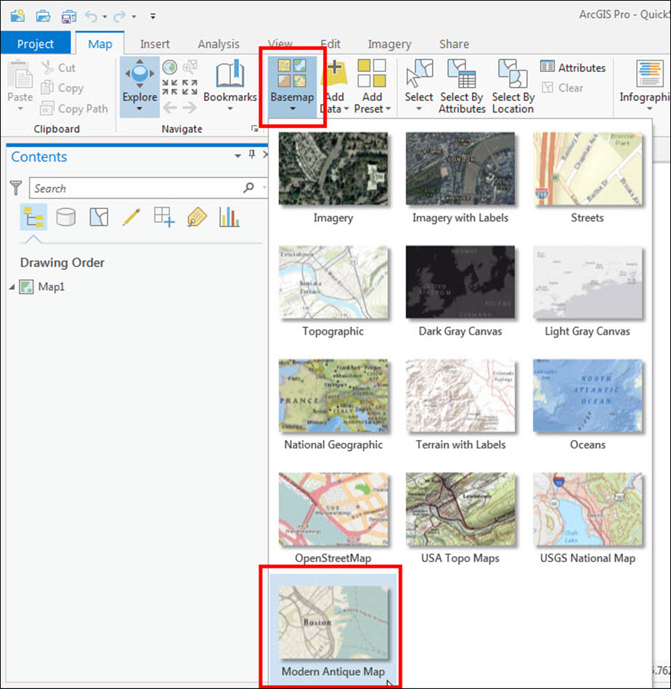
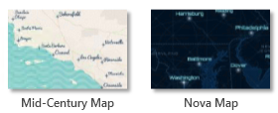
Add a basemap
# Code to get the ArcGIS Project and Map object goes here.
myMap.addBasemap("Modern Antique Map")

Slide 25

Add data from path example 1
# Code to get the ArcGIS Project and Map objects goes here.
# Add data from a path.
schools = "C:/data/Schools.shp"
myMap.addDataFromPath(schools)
# Does not use the arcpy environment workspace setting.
arcpy.env.workspace = "C:/data/
myMap.addDataFromPath("Schools.shp")
RuntimeError Traceback (most recent call last)...

Slide 26
Add data from path example 2
# Code to get the ArcGIS Project and Map objects goes here.
# Add rasters from a directory (Don't use this code!).
arcpy.env.workspace = sys.argv[1]
rasts = arcpy.ListRasters()
for rast in rasts:
myMap.addDataFromPath(rast)
RuntimeError Traceback (most recent call last)...
# Add rasters from a directory.
arcpy.env.workspace = sys.argv[1]
rasts = arcpy.ListRasters()
for rast in rasts: rastFullPath = os.path.join(arcpy.env.workspace, rast)
myMap.addDataFromPath(rastFullPath)

Slide 27
Adding and removing layers
# Code to get the ArcGIS Project and Map objects goes here.
aprx = arcpy.mp.ArcGISProject("CURRENT")
myMap = aprx.listMaps()[0]
map2 = aprx.listMaps()[1]
# Add all 'park' layers in myMap to map2.
for lay in myMap.listLayers("*park*"):
map2.addLayer(lay)
# Remove all layers whose names contain 'park'.
for lay in myMap.listLayers("*park*"):
myMap.removeLayer(lay)

Slide 28
RECALL...Project -> Map -> Layer
import arcpy
aprx = arcpy.mp.ArcGISProject("CURRENT")
# Get a list of Map objects.
maps = aprx.listMaps()[0]
# Get the first Map object.
myMap = maps[0]
# Get a list of Layer objects.
layers = myMap.listLayers()
# Get the first layer object.
myLayer = layers[0]

Slide 29
Layer properties
name, visible, dataSource, transparency, isRasterLayer, isFeatureLayer, symbology…
# Get layer's name.
myLayer.name
# Turn layer off.
myLayer.visible = False
# Set layer's transparency.
myLayer.transparency = 20
# Check if layer is a raster.
if myLayer.isRasterLayer:
print("I'm a raster.")
# Get layer's symbology object.
sym = myLayer.symbology

Slide 30
Symbology
Feature layers
Have a renderer
Types of renderers:
1. GraduatedColorsRenderer
2. GraduatedSymbolsRenderer
3. SimpleRenderer
4. UniqueValueRenderer
5. UnclassedColorRenderer
Raster layers
Use colorizers
Types of colorizers:
1. RasterClassifyColorizer
2. RasterUniqueValueColorizer
3. RasterStretchColorizer

Slide 31
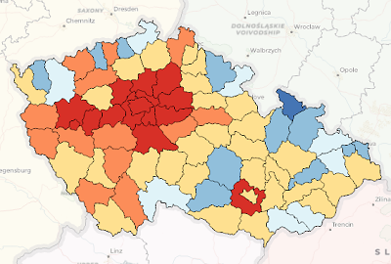
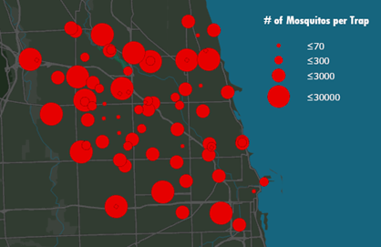
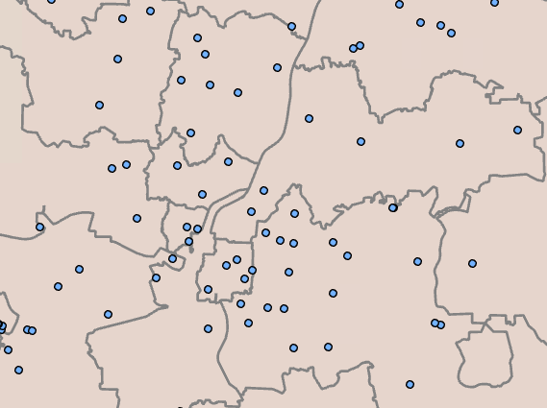
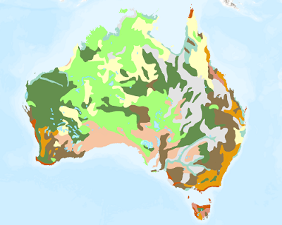
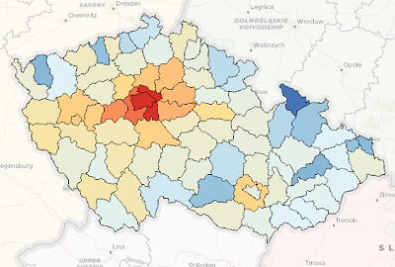
Symbology For Feature layers
1. GraduatedColorsRenderer
show a quantitative difference between mapped features by varying the symbol colors
2. GraduatedSymbolsRenderer
show a quantitative difference between mapped features by varying the symbol sizes
3. SimpleRenderer
apply the same symbol to all features in a layer
4. UniqueValueRenderer
symbolize qualitative categories of values
5. UnclassedColorsRenderer
show quantitative differences in feature values with a range of colors not broken into discrete classes
Notes:
https://pro.arcgis.com/en/pro-app/latest/help/mapping/layer-properties/symbolize-feature-layers.htm

Slide 32
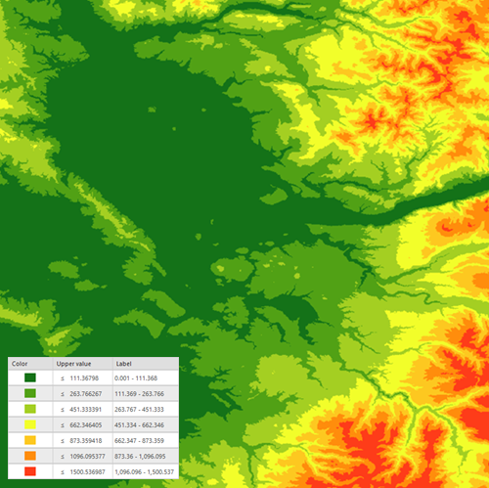
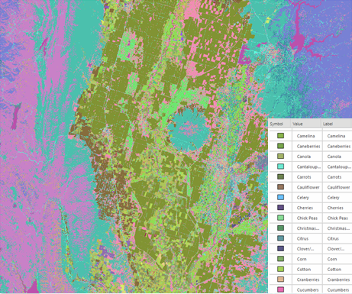
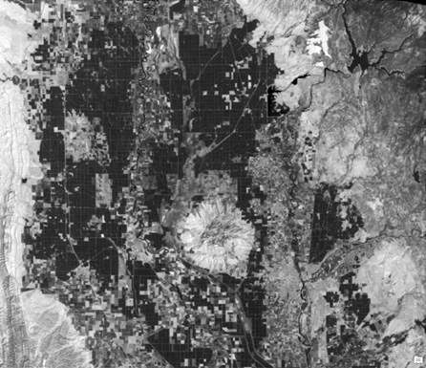
Symbology for Raster Layers
RasterClassifyColorizer
group pixels in a specified number of classes
2. RasterUniqueValueColorizer
randomly assigns a color to each value in a dataset
3. RasterStretchColorizer
define the range of values to be displayed & apply a color ramp to those values
Notes:
https://pro.arcgis.com/en/pro-app/latest/help/data/imagery/symbology-pane.htm

Slide 33
Setting a feature layer’s symbology
# Get the layer's symbology object
sym = myLayer.symbology
# Change from the default SimpleRenderer (all one color)
# to the UniqueValueRenderer
sym.updateRenderer('UniqueValueRenderer')
# Use the zip code number for color uniqueness.
sym.renderer.fields = ['ZIPNUM']
# Change the border color.
sym.renderer.symbol.outlineColor =
{'CMYK' : [255, 25, 75, 25, 100]}
# Set the layer's symbology with these changes.
myLayer.symbology = sym

Slide 34
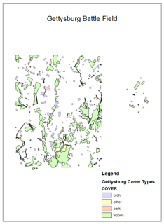


Export to PNG example
## Export the default map view to png.
import arcpy
aprx = arcpy.mp.ArcGISProject("C:/gispy/test.aprx")
# Get the first map in this project.
myMap = aprx.listMaps()[0]
myMap.defaultView.exportToPNG("C:/gispy/scratch/getty_map.png",
width=800, height=600)
del myMap
del aprx
Project object
Map object
MapView object

Slide 35
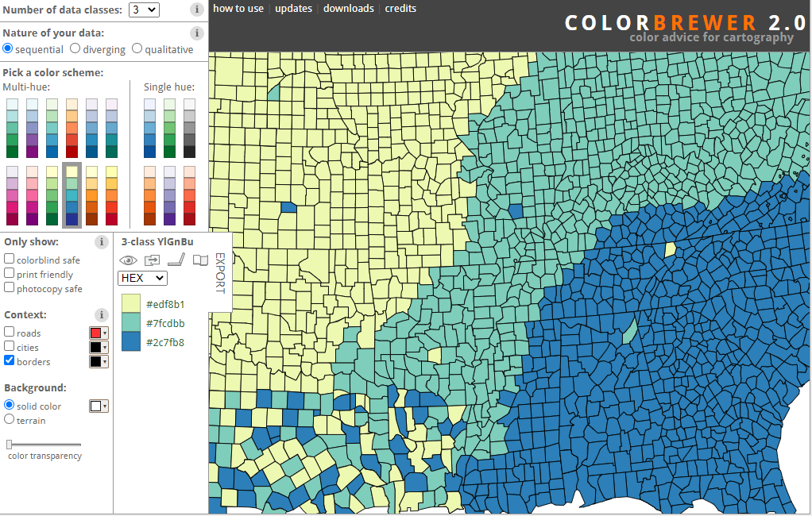
For selecting colors

Slide 36
Appendix

