Slide 1
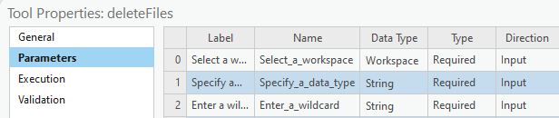
Script Tool Parameters (1)
Parameters tab
Widgets
Parameter properties
Dr. Tateosian

Slide 2
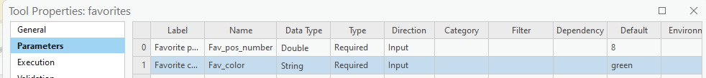
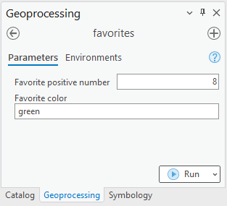
Parameter page demo
Right click on Script tool > Properties > Parameters tab
The script tool generates a widget for each parameter in the list.

Slide 3
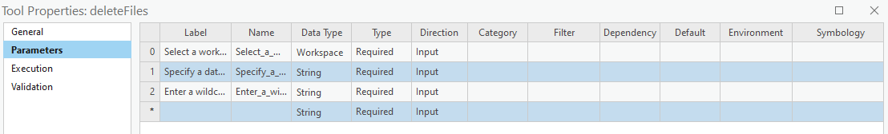
Parameter properties: Label
Label (for appearance only)
Appears on the interface.
Useful providing instructions.

Slide 4
Parameter properties: Name
Unique identifier for the parameter
Does not appear on the interface.
Cannot have spaces or special characters other than underscore.

Slide 5
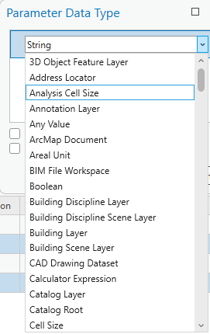
Parameter properties: Data Type
Restricts the type of the input
E.g., if you select Feature Layer, you can pick a layer from an active map or browse to a feature class.
Determines which widget appears on the tool.

Slide 6
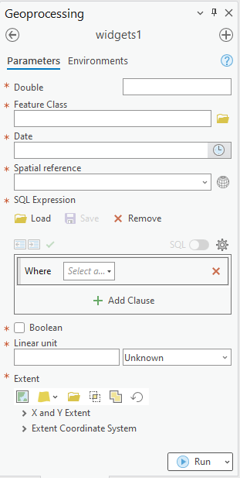
Widgets
User interface elements (e.g., text boxes, buttons, check boxes, combo boxes, and list boxes).
Help the user make input choices.
E.g., Browse to a file.
Constrains accepted input.
E.g., Restrict the file type.
Type of widget depends on the "Data Type".

Slide 7
Parameter data type examples
Target
integer
float
file geodatabase
shapefile
directory that is not a file geodatabase.
time of day
Data type for Script Tool Parameter
Long
Double
Workspace (by default the user could choose any type of workspace including local DBs, networked DBs, or just a regular folder)
Feature Class (or Shapefile if you don't want the user to have the flexibility to choose a shapefile OR a feature class)
Folder
Date (allows user to choose time, date, or both.)

Slide 8
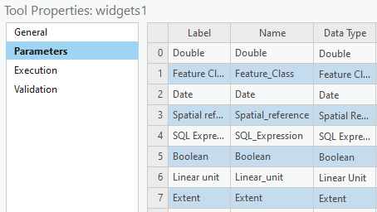
Test Drive Data Types

Slide 9

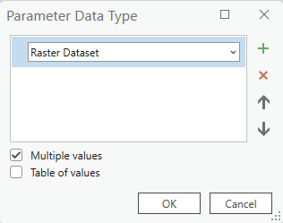
Parameter properties: Multivalue
Multivalue (checkbox)
User can select multiple items.
Most (but not all) data types have this option.
To set, select the Data Type > Click […] > Check the "Multiple values" box.
Notes:
multivalue property (checked or not)
Not all data types can have multiple values (e.g., Boolean parameters can not handle multiple values).

Slide 10
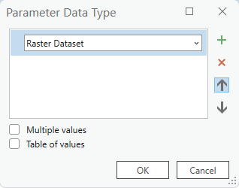


Square braces indicate Multivalue

Slide 11
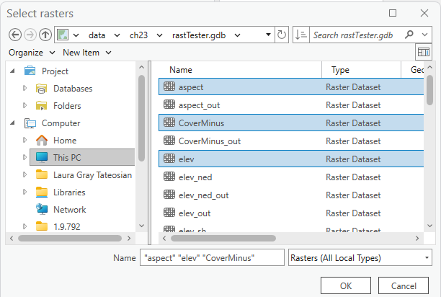
Multivalue input format
Multivalue input creates semicolon delimited string.
Value that comes into script:
C:\gispy\data\ch23\rastTester.gdb\aspect;C:\gispy\data\ch23\rastTester.gdb\CoverMinus;C:\gispy\data\ch23\rastTester.gdb\elev

Slide 12
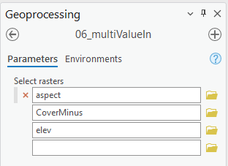
Handle multivalue input with script
Customize the Python script to handle multivalue input.
Split sys.argv[i] value on semicolon
Loop to use the values in the list.
0|
1|
2|
3|
4|
5|
6|
7|
8|
9|
10|
11|
# multiIn.py
# Purpose: Parse a semicolon delimited input string.
import reportSTargs, sys
inputString = sys.argv[1]
reportSTargs.printArc(f'Input string: {inputString}')
inputList = inputString.split(';')
for i in inputList:
reportSTargs.printArc(f'Input file: {i}')
Start Time: Friday, November 10, 20XX 4:20:01 PM
Input string: C:\gispy\data\ch23\rastTester.gdb\aspect;C:\gispy\data\ch23\rastTester.gdb\CoverMinus;C:\gispy\data\ch23\rastTester.gdb\elev
Input file: C:\gispy\data\ch23\rastTester.gdb\aspect
Input file: C:\gispy\data\ch23\rastTester.gdb\CoverMinus
Input file: C:\gispy\data\ch23\rastTester.gdb\elev
Succeeded at Friday, November 10, 20XX 4:20:01 PM (Elapsed Time: 0.32 seconds)

Slide 13
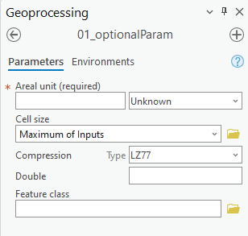
Parameter properties: Type
Type (of parameter)
Controls whether the user must enter a value.
Three choices (required, optional, or derived)
Required
Optional

Slide 14
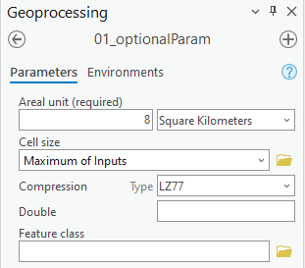
Examine what comes in
0|
1|
2|
3|
4|
5|
6|
7|
8|
9|
10|
11|
12|
13|
14|
15|
16|
# reportSTargs.py
# Purpose: Print the arguments passed into a script tool.
import arcpy, sys
def printArc(message):
'''Print message for script tool and standard output.'''
print(message)
arcpy.AddMessage(message)
def printArgs():
'''Print user arguments.'''
printArc(f"Number of arguments = {len(sys.argv)}")
for i, arg in enumerate(sys.argv):
printArc(f"Argument {i}: {arg}")
printArgs()
Argument 0: C:\gispy\sample_scripts\ch23\scripts\reportSTargs.py Argument 1: 8 SquareKilometers Argument 2: MAXOF Argument 3: LZ77 Argument 4: # Argument 5: #
Notes:
# reportSTargs.py
# Purpose: Print the arguments passed into a script tool.
# Arguments: Variable (can be used for any number of arguments)
import arcpy, sys
def printArc(message):
'''Print message for script tool and standard output.'''
print message
arcpy.AddMessage(message)
def printArgs():
'''Print user arguments.'''
printArc('Number of arguments = {0}'.format(len(sys.argv)))
for index, arg in enumerate(sys.argv):
printArc( 'Argument {0}: {1}'.format(index, arg) )
if __name__ == '__main__':
printArgs()

Slide 15
Optional parameters get values
0|
1|
2|
3|
4|
5|
6|
7|
8|
9|
10|
11|
12|
13|
14|
15|
16|
# reportSTargs.py
# Purpose: Print the arguments passed into a script tool.
import arcpy, sys
def printArc(message):
'''Print message for script tool and standard output.'''
print(message)
arcpy.AddMessage(message)
def printArgs():
'''Print user arguments.'''
printArc(f"Number of arguments = {len(sys.argv)}")
for i, arg in enumerate(sys.argv):
printArc(f"Argument {i}: {arg}")
printArgs()
Argument 0: C:\gispy\sample_scripts\ch23\scripts\reportSTargs.py Argument 1: 8 SquareKilometers Argument 2: MAXOF Argument 3: LZ77 Argument 4: # Argument 5: #
Notes:
# reportSTargs.py
# Purpose: Print the arguments passed into a script tool.
# Arguments: Variable (can be used for any number of arguments)
import arcpy, sys
def printArc(message):
'''Print message for script tool and standard output.'''
print message
arcpy.AddMessage(message)
def printArgs():
'''Print user arguments.'''
printArc('Number of arguments = {0}'.format(len(sys.argv)))
for index, arg in enumerate(sys.argv):
printArc( 'Argument {0}: {1}'.format(index, arg) )
if __name__ == '__main__':
printArgs()

Slide 16

Parameter properties: Type
Type (of parameter)
Controls whether the user must enter a value.
Three choices (required, optional, or derived)
Derived parameters don't appear in the GUI.
Derived Type is only used when the Direction property is set to Output…
Required
Optional

Slide 17
What you know so far
Topics discussed
Label vs. Name
Data type vs. Parameter Type (Required, Optional, Derived)
Direction (Input or Output)
Multivalue (checked or not)
Multivalue input (split(';'))
Widget

Slide 18
Parameter properties: Direction
Direction
Can only be set to Input or Output.
Most parameters will be Input.
Output direction can be used two ways.
Define output names.
Add output to a map (or send it to a model).
Notes:
Direction can only be set to Input or Output.
Input parameters are information the script needs to perform its tasks. E.g., a dataset or workspace to use.
Input parameters can be required or optional, but not derived.
‘Output’ direction for script tool parameters that represent output generated by the tool.
‘Output’ can be added to the map automatically.
Output examples:
--one or more datasets created by the tool.
--a modified preexisting dataset
--a Boolean value (True or False).
--numerical values resulting from script tool calculations.
Any types of results generated by standard ArcToolbox tools could be output from a custom script tool.
Like standard tools, custom script tools can be used as tools in ModelBuilder models. The output Boolean, numerical results, dataset would then be passed along to the output ovals in the models.

Slide 19

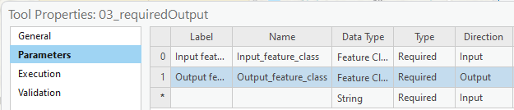
Output direction for output names
Output use
#1
Required (or Optional) Type + Output Direction
User selects a name for output created by the script.
GUI will not let user select existing file.
Output data is added to the current map.
0|
1|
2|
3|
4|
5|
6|
7|
# copier.py
# Purpose: Make a copy of argument 1 with a name specified by argument 2.
import arcpy, reportSTargs, sys
reportSTargs.printArgs()
arcpy.Copy_management(sys.argv[1], sys.argv[2])

Slide 20

Return output from Script Tool
Output use
#2
Derived Type + Output Direction
Derived Type can not be Input Direction.
User does not enter a value.
Script can return a value, like built-in tools.
Use case examples:
One or more datasets created by the tool.
A modified preexisting dataset
A Boolean value (True or False).
Numerical values resulting from script tool calculations.

Slide 21
"Return" with SetParameterAsText
Output use
#2
SetParameterAsText
The script must use this to return the parameter.
arcpy method
Takes two arguments, an index and the returned items.
Example:
arcpy.SetParameterAsText(0, output)
parameter output file
index name

Slide 22
SetParameterAsText Example 1
Call at (or near) the end of the script.
Index based on position in the parameters table.
0|
1|
2|
3|
4|
5|
6|
7|
8|
9|
10|
11|
12|
# buffer1.py
# Purpose: Buffer a file and send the result to a script tool.
import arcpy
arcpy.env.overwriteOutput = True
fileToBuffer = 'C:/gispy/data/ch23/smallDir/randpts.shp'
distance = '500 meters'
outputFile = 'C:/gispy/scratch/randptsBuffer.shp'
arcpy.Buffer_analysis(fileToBuffer, outputFile, distance)
arcpy.SetParameterAsText(0, outputFile)

Slide 23
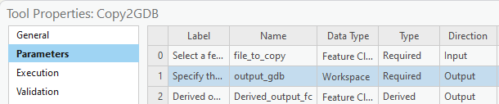
SetParameterAsText Example 2
Derived Output should be the last parameter in the parameters table.
0|
1|
2|
3|
4|
5|
6|
7|
8|
9|
10|
11|
12|
13|
14|
15|
16|
# copy_to_gdb.py
# Purpose: Copy a feature class (arg 1) into a file geodatabase (arg 2)
# Example input: C:\gispy\scratch\fires.shp C:\gispy\scratch\disasters.gdb
import arcpy, os, sys
arcpy.env.overwriteOutput = True
file_to_copy = sys.argv[1]
gdb_path = sys.argv[2]
out_folder_path = os.path.dirname(gdb_path)
gdb_name = os.path.basename(gdb_path)
copied_data = os.path.splitext(os.path.basename(file_to_copy))[0]
arcpy.conversion.FeatureClassToFeatureClass(file_to_copy,gdb_path,copied_data)
arcpy.env.workspace = gdb_path
arcpy.SetParameterAsText(2, copied_data)
Notes:
# copy_to_gdb.py
# Purpose: Copy argument 1 into a file geodatabase names as specified by argument 2.
# Example input1: C:\gispy\scratch\fires.shp C:\gispy\scratch\disasters.gdb
# Example input2: C:\gispy\scratch\getFeaturesOutput.shp C:\gispy\scratch\data.gdb
import arcpy, os, sys
arcpy.env.overwriteOutput = True
file_to_copy = sys.argv[1]
gdb_path = sys.argv[2]
out_folder_path = os.path.dirname(gdb_path)
gdb_name = os.path.basename(gdb_path)
if not arcpy.Exists(os.path.join(gdb_path)):
arcpy.management.CreateFileGDB(out_folder_path, gdb_name)
copied_data = os.path.splitext(os.path.basename(file_to_copy))[0]
arcpy.conversion.FeatureClassToFeatureClass(file_to_copy,gdb_path,copied_data)
arcpy.env.workspace = gdb_path
arcpy.SetParameterAsText(2, copied_data)

Slide 24

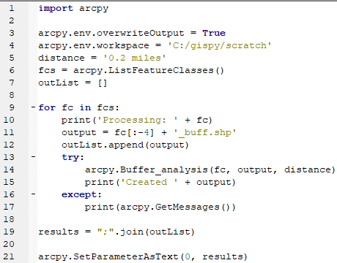
"Add multiple outputs to the map” with bug
Create a Derived, MultiValue parameter in the script tool.
In the Python script:
Collect the output names in a list
Create a semicolon delimited string from the list.
Use arcpy.SetParameterAsText
Can you spot the mistake?
Collect output names
Create delimited string
SetParameterAsText
Notes:
import arcpy
arcpy.env.overwriteOutput = True
arcpy.env.workspace = 'C:/gispy/scratch'
distance = '0.2 miles'
fcs = arcpy.ListFeatureClasses()
outList = []
for fc in fcs:
print('Processing: ' + fc)
output = fc[:-4] + '_buff.shp'
outList.append(output)
try:
arcpy.Buffer_analysis(fc, output, distance)
print('Created ' + output)
except:
print(arcpy.GetMessages())
results = ";".join(outList)
arcpy.SetParameterAsText(0, results)

Slide 25
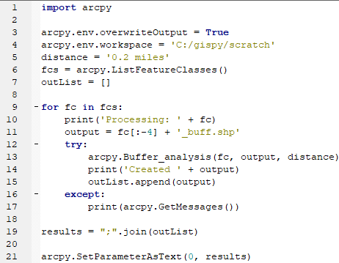
“Add multiple outputs to the map” corrected
Create a Derived, MultiValue parameter in the script tool.
In the Python script:
Collect the output names in a list
Create a semicolon delimited string from the list.
Use arcpy.SetParameterAsText
Collect output names
Create delimited string
SetParameterAsText
Notes:
import arcpy
arcpy.env.overwriteOutput = True
arcpy.env.workspace = 'C:/gispy/scratch'
distance = '0.2 miles'
fcs = arcpy.ListFeatureClasses()
outList = []
for fc in fcs:
print('Processing: ' + fc)
output = fc[:-4] + '_buff.shp'
try:
arcpy.Buffer_analysis(fc, output, distance)
print('Created ' + output)
outList.append(output)
except:
print(arcpy.GetMessages())
results = ";".join(outList)
arcpy.SetParameterAsText(0, results)

Slide 26

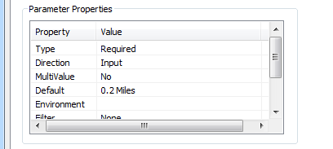
Activity– Add derived output to a map
Place some data in scratch and test the script as is.
Modify script to take 2 arguments
Create script tool with 3 parameters
Two input
Folder type for the workspace parameter.
Linear Unit for the buffer distance.
One output to be added to map 3) A derived output multivalue Feature Class
Set input default values, C:/gispy/scratch and 0.2 miles
Test the script tool in ArcGIS Pro.

Slide 27
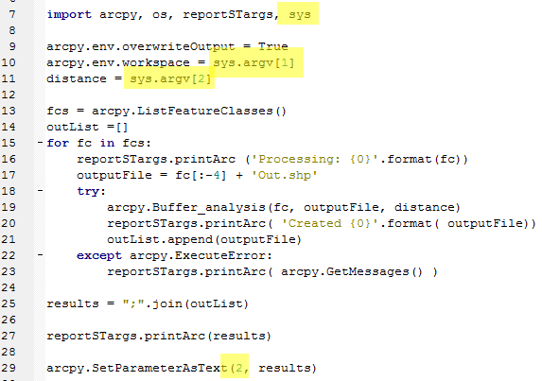
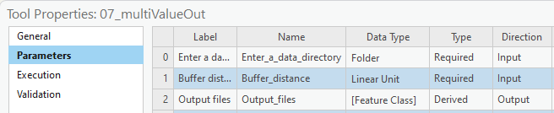
Add derived output to map -- followup
Notes:
# bufferAll.py
# Purpose: Buffer all the feature classes in an input folder by the input distance and
# send the output file names to script tool.
# Arguments: working_directory linear_unit
# Sample input: C:/gispy/data/ch23/smallDir "0.2 miles"
import arcpy, reportSTargs, sys
arcpy.env.overwriteOutput = True
arcpy.env.workspace = sys.argv[1]
distance = sys.argv[2]
fcs = arcpy.ListFeatureClasses()
outList = []
for fc in fcs:
reportSTargs.printArc('Processing: {0}'.format(fc))
outputFile = 'C:/gispy/scratch/' + fc[:-4] + 'Out.shp'
try:
arcpy.Buffer_analysis(fc, outputFile, distance)
reportSTargs.printArc('Created {0}'.format(outputFile))
outList.append(outputFile)
except arcpy.ExecuteError:
reportSTargs.printArc(arcpy.GetMessages())
results = ";".join(outList)
reportSTargs.printArc(results)
arcpy.SetParameterAsText(2, results)

Slide 28
Setting script tool parameters
Property | Description
✓ Type | (Required, Optional, or Derived). Derived: user does not enter a value for the parameter. Derived types are always output parameters.
✓ Direction | (Input or Output). If Type is Derived, direction is always set to Output.
✓ Multivalue | Yes, if you want to accept a list of values.
Default or Schema | The default value for the parameter. When the parameter data type is either feature set or record set, Default is replaced with Schema.
Environment | To set the default value of a parameter to an environment setting.
Filter | Restrict the values to be entered. 6 types of filters. Filter type depends on the data type.
Obtained from | For derived output parameters, ‘Obtained from’ can be set to the parameter containing the definition of the output. For input parameters, ‘Obtained from’ is set to the parameter containing the information needed for input.
Symbology | Use a layer file (.lyrx) to set output symbology.

Slide 29
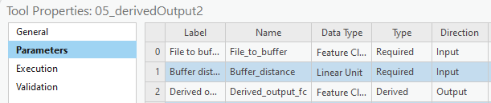
SetParameterAsText Example 2
Conventionally, Derived Output is the last parameter in the parameters table.
0|
1|
2|
3|
4|
5|
6|
7|
8|
9|
10|
11|
12|
13|
14|
15|
# buffer2.py
# Purpose: Buffer an input file by an input distance
# and send the result to a script tool.
import arcpy, os, sys
arcpy.env.overwriteOutput = True
fileToBuffer = sys.argv[1]
distance = sys.argv[2]
arcpy.env.workspace = os.path.dirname(fileToBuffer)
outputFile = 'C:/gispy/scratch/Buff'
arcpy.Buffer_analysis(fileToBuffer, outputFile, distance)
arcpy.SetParameterAsText(2, outputFile)
Notes:
# copy_to_gdb.py
# Purpose: Copy argument 1 into a file geodatabase names as specified by argument 2.
import arcpy, os, sys
arcpy.env.overwriteOutput = True
file_to_copy = sys.argv[1]
gdb_path = sys.argv[2]
out_folder_path = os.path.dirname(gdb_path)
gdb_name = os.path.basename(gdb_path)
if not arcpy.Exists(os.path.join(gdb_path)):
arcpy.management.CreateFileGDB(out_folder_path, gdb_name)
copied_data = os.path.splitext(os.path.basename(file_to_copy))[0]
arcpy.conversion.FeatureClassToFeatureClass(file_to_copy,gdb_path,copied_data)
arcpy.env.workspace = gdb_path
arcpy.SetParameterAsText(2, copied_data)

Slide 30
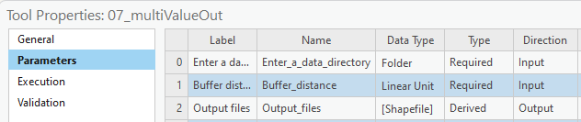

Slide 31
Summing up
Topics discussed
Label vs. Name
Data type vs. Parameter Type (Required, Optional, Derived)
Direction (Input or Output)
Required output—for getting output name & displaying on map after run
Derived output—for setting output name in script or modifying existing data; & displaying on map after run
Multivalue (checked or not)
Multivalue input (split(';')) & multivalue output (';'.join(theList))
Widget

Slide 32
Parameter FAQ
How can I remove a parameter? A: Right click on that row in the table and select delete.
I want to for the user to choose an integer. What data type to use? A: Long
I want to for the user to choose a float. What data type to use? A: Double
I want to force the user to choose a file geodatabase. What data type to use? A: Workspace + plus use a filter & check "local database"
I want to the user to choose a directory, but not a file geodatabase directory. What data type to use? A: Folder
Notes:
https://pro.arcgis.com/en/pro-app/latest/arcpy/geoprocessing_and_python/defining-parameter-data-types-in-a-python-toolbox.htm

Slide 33
Script tool parameter properties
Property | Description
Type | Required, Optional, or Derived.
Direction | Input or Output.
Multivalue | Yes, if you want to accept a list of values.
Default or Schema | The default value for the parameter. When the parameter data type is either feature set or record set, Default is replaced with Schema.
Environment | If the default value for the parameter is to come from an environment setting, this property contains the name of the environment setting.
Filter | If you want only certain values to be entered, use this. There are 6 types of filters. Filter type depends on the data type.
Obtained from | For derived parameters. For derived output parameters, Obtained from can be set to the parameter containing the definition of the output. For input parameters, Obtained from is set to the parameter containing the information needed for input.
Symbology | Use a layer file (.lyrx) to set output symbology.

Slide 34
Script tool parameter properties
Property | Description
Type | Required, Optional, or Derived.
Direction | Input or Output.
Multivalue | Yes, if you want to accept a list of values.
Default or Schema | The default value for the parameter. When the parameter data type is either feature set or record set, Default is replaced with Schema.
Environment | If the default value for the parameter is to come from an environment setting, this property contains the name of the environment setting.
Filter | If you want only certain values to be entered, use this. There are 6 types of filters. Filter type depends on the data type.
Obtained from | For derived parameters. For derived output parameters, Obtained from can be set to the parameter containing the definition of the output. For input parameters, Obtained from is set to the parameter containing the information needed for input.
Symbology | Use a layer file (.lyrx) to set output symbology.

Slide 35

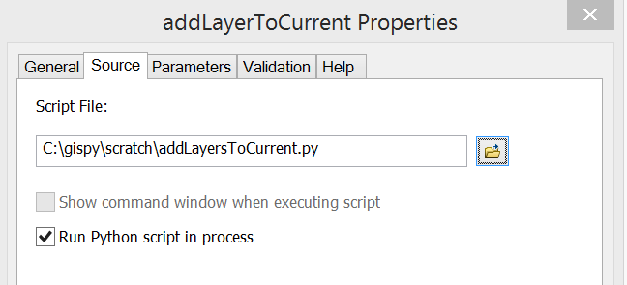
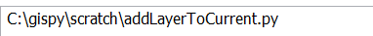
Is this like arcpy.mapping.AddLayer?
Derived Output parameter + SetParameterAsText for adding data to the current map ==
AddLayer mapping module method with MapDocument object set to 'CURRENT' in a script that is being run by a Script Tool in an open map document.
# addLayerToCurrent.py
# Purpose: Add a data layer to the first data from of the current map.
# Input: No arguments required.
# Note: Run this script from a Script Tool in an open map document.
import arcpy
fileName = 'C:/gispy/scratch/USstates/MA.shp'
# Instantiate MapDocument and DataFrame objects.
mxd = arcpy.mapping.MapDocument('CURRENT')
dfs = arcpy.mapping.ListDataFrames(mxd)
# Get the first data frame.
df = dfs[0]
# Instantiate a Layer object.
layerObj = arcpy.mapping.Layer(fileName)
# Add the new layer to the map.
arcpy.mapping.AddLayer(df, layerObj)
# Delete the MapDocument object to release the map.
del mxd

