Slide 1
Appendix I

Slide 2
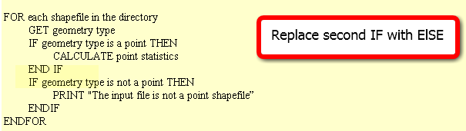
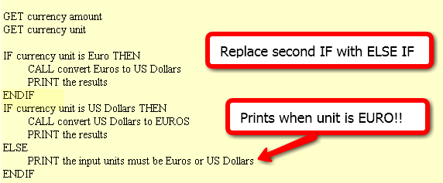
In class – Issues with form! FIX IT
Point statistics
2. Currency conversion
3. Grader
IF average < 60
NULL
ELSE
DO GivePassingGrade
ENDIF

Slide 3
FIX IT
Point statistics
2. Currency conversion
3. It is considered poor form to have a 1-sided IF stmt where the action is on the 'no' or ELSE side. This could (and should) be rewritten to eliminate the NULL 'yes' part. To do that, we change the < to its opposite: >= as follows :
IF average >= 60
DO GivePassingGrade
ENDIF

Slide 4
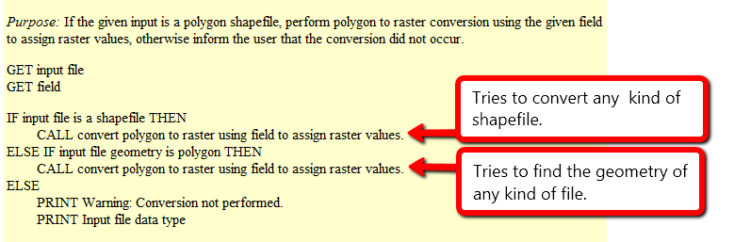
Polygon to raster
Purpose: If the given input is a polygon shapefile, perform polygon to raster conversion using the given field to assign raster values, otherwise inform the user that the conversion did not occur.
What will happen if the input file is…
a polygon shapefile?
convert the data to raster (success)
a point shapefile?
attempt to convert the data to raster, but will fail, since it’s not polygon input but it is a shapefile
a raster file?
attempt to check the geometry of the inputfile and fail, since raster files don’t have a geometry
When does it give a warning?
never

Slide 5
Polygon to raster pseudocode corrected
Instead of else if, use a compound conditional
IF input file is a shapefile AND input file geometry is polygon THEN CALL convert polygon to raster using field to assign raster values.
ELSE PRINT Warning: Conversion not performed. PRINT Input file data type
Moral: TEST ALL CONDITIONS

Slide 6



Distance converter example
Convert miles to km or km to miles and handle user input of 2, 1, or 0 arguments:
Arguments: 50 miles
>>> 50 miles is equivalent to 80.0 kilometers.
Arguments: 100
>>> Warning: No distance unit provided. Assuming input is in miles.
100.0 miles is equivalent to 160.0 kilometers.
Arguments:
>>> Usage: <numeric_distance> <distance_unit(miles or km)>

Slide 7
Distance Conversion Pseudocode
GET numeric dist from args
GET unit from args
IF unit is miles THEN COMPUTE km PRINT results
ELSE COMPUTE miles PRINT results
ENDIF
Add to the pseudocode to handle case of 'no user arguments'.
Add pseudocode to part 1 to handle the '1 argument' case.

Slide 8
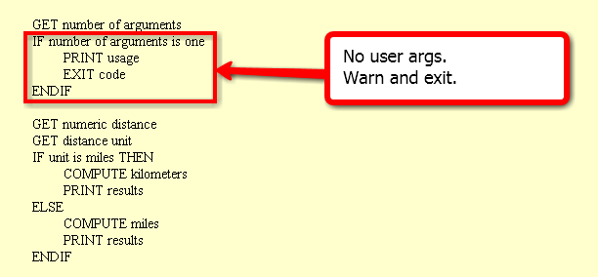
Handle no user arguments case

Slide 9
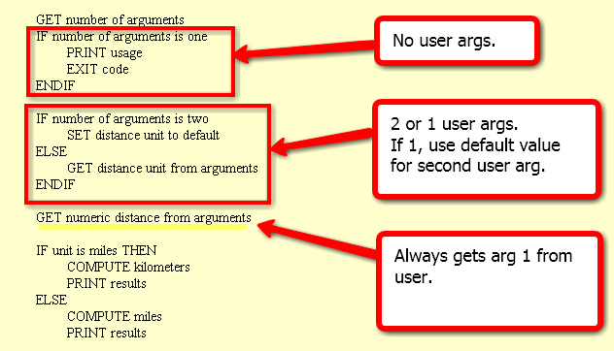
Distance conversion pseudocode
Related code given in examples 9.12 and 9.13 in the book.

Slide 10
Buffer_clip pseudocode
GET number of arguments
IF number of args < 5
PRINT usage EXIT code
ENDIF
SET fire damage
SET park
SET buffer distance
SET workspace
GET number of arguments
IF number of arguments < 4 PRINT usage EXIT code
IF number of args is 4
PRINT warning SET workspace to default
ELSE
SET workspace to last arg
ENDIF
SET fire damage
SET park
SET buffer distance
All or nothing.
How could we make
the last argument (the workspace) optional?

Slide 11
Appendix II

Slide 12
Creating a Describe object
import arcpy
# Set the data element
study_data = 'C:/gispy/data/ch09/trails.shp'
# Call Describe method
desc_obj = arcpy.Describe(study_data)
print(desc_obj)
<geoprocessing describe data object object at 0x0092D2D0>
object.method(arg1)
Describe object
data element to be described

Slide 13
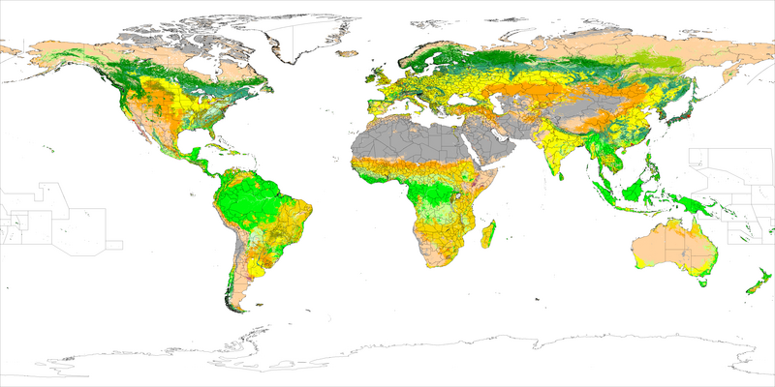
Decision-making in GIS workflows
In environmental monitoring and management various GIS data types (e.g., shapefiles, feature classes, rasters) are used to analyze land cover, pollution levels, or natural resource management.
Notes:
In most GIS applications, multiple different types of GIS data are used in concert together to explore complex questions.

Slide 14
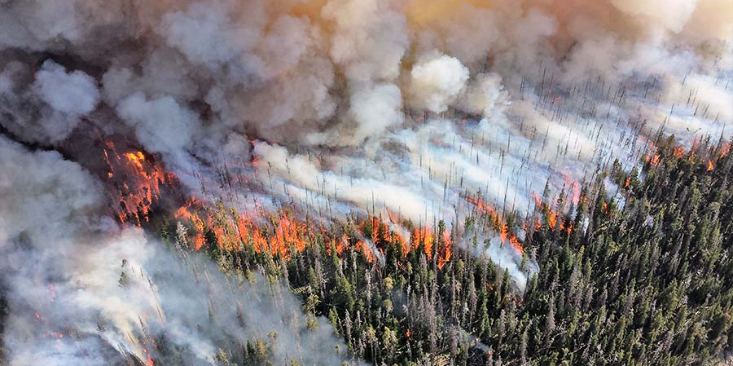
Scenario: Wildfire Risk Assessment
A government agency is assessing wildfire risk across a large region.
They receive mixed data types such as:
Point data Locations of fire incidents or weather stations.
Line data Roads and utility lines.
Polygon data Vegetation or land cover classifications.
Raster data Satellite imagery or Digital Elevation Models (DEMs).
Notes:
For example, to conduct wildfire risk assessment, a government agency may build a tool to process
point datasets of fire incidents,
polyline datasets of utility lines,
polygons datasets of vegetation,
tiffs of satellite imagery,
and
ESRI GRID files of elevation models.

Slide 15







Scenario: Wildfire Risk Assessment
A government agency is assessing wildfire risk across a large region.
They receive mixed data types such as:
Point data Locations of fire incidents or weather stations.
Line data Roads and utility lines.
Polygon data Vegetation or land cover classifications.
Raster data Satellite imagery or Digital Elevation Models (DEMs).
Notes:
Notice that we're talking about 2 different types of data (vector and raster). A dataset's datatype is something we can find out with Python.

Slide 16
Scenario: Wildfire Risk Assessment
A government agency is assessing wildfire risk across a large region.
They receive mixed data types such as:
Point data Locations of fire incidents or weather stations.
Line data Roads and utility lines.
Polygon data Vegetation or land cover classifications.
Raster data Satellite imagery or Digital Elevation Models (DEMs).
Notes:
Even within those two different data types, we're breaking it down further.
We're distinguishing between the shape types for the vector data
And we're distinguishing between the formats for the rasters.

Slide 17
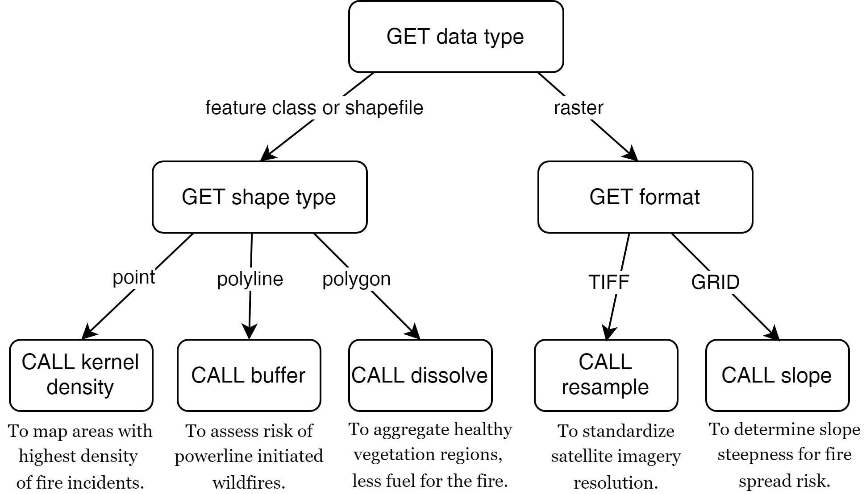
Branching workflow
Notes:
To be able to allow the user to pass in ANY of these datasets as input, the workflow might start by getting the data type.

Slide 18
Branching workflow
Notes:
Then if the datatype is "feature class" or "shapefile", it would need to find out what type of geometry the data is stored in. That is, what type of shapes does it have?

Slide 19
Branching workflow
Notes:
Is it points? polylines? polygons? For each shape type, we want to call a different tool.

Slide 20
Branching workflow
Notes:
If the shapes are points, the workflow calls the kernel density tool to map dense areas of fire incidents.
If the shapes are lines, the workflow buffers these to map the increased risk of fires starting near the powerlines.
If the shapes are polygons, the workflow will call the dissolve tool to aggregate similar vegetative coverings to larger regions to help identify unhealthy areas that fuel the fire.

Slide 21
Branching workflow
Notes:
On the other hand, if the data type is raster (instead of feature class or shapefile),
the workflow would get the dataset's format. Examples of raster formats include GIF, PNG, PDF, TIFF, ESRI GRID and many others.

Slide 22
Branching workflow
Why not
the shape
type?
Notes:
But wait...Why can't we get the shape type of a raster?

Slide 23
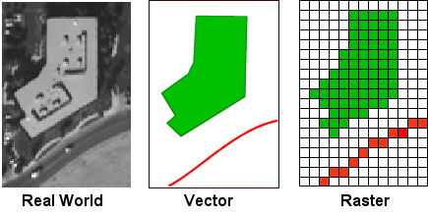
Branching workflow
Why not
the shape
type?
Notes:
The answer is, that rasters, unlike feature classes, are not made of vector geometries. Rasters are stored as a grid of cells, so instead of storing polygons, points, and lines, they store a grid of values. In other words, they don't have a shape type because that's not how they store data.

Slide 24
Branching workflow
Notes:
Coming back to our workflow, if the raster format is TIFF, the workflow resamples the raster to create a consistent cell size across rasters.
Finally, if the raster is an ESRI GRID raster, the workflow calls the slope tool to locate steep areas. Steep slopes tend to make fire spreads more quickly.
Note that this is a simplified workflow. For example, just because a raster is an ESRI GRID, doesn't necessarily mean it's a DEM. But we are making assumptions like this for illustration purposes
In this scenario,
Summary of overall workflow:
Input Data Type Identification: The script first determines the type of input data (feature class, shapefile, or raster) and processes it accordingly.
If the input data is Feature Class or Shapefile:
Point Data: If the data is point-based (e.g., fire incidents), the script could call a tool like Kernel Density or Point Density to map areas with the highest density of fire incidents. This helps identify hotspots for further risk management.
Line Data: If the data contains utility lines or roads, a tool like Buffer can be applied to assess areas at risk of powerline-initiated wildfires (e.g., creating a buffer zone around power lines to map high-risk areas).
Polygon Data: For vegetation data, tools like Dissolve can aggregate different vegetation types into larger regions, or the Intersect tool can be used to combine vegetation data with known fire history polygons to identify specific vegetation types that have burned frequently.
If the input is Raster Data:
Satellite Imagery (TIFF): For satellite images, you could use Resample to standardize the resolution across datasets before running analyses like vegetation health monitoring (using NDVI). This is critical for assessing the amount of healthy vegetation, which in turn affects wildfire fuel levels.
Digital Elevation Models (DEMs - GRID): Using the Slope tool, you can generate slope maps to assess terrain steepness. Steep slopes can contribute to the spread of wildfires, and these areas might require special management practices.
Combining Results:
After running individual processes based on data type, the results can be combined (e.g., raster layers and vector layers can be overlaid) to create a comprehensive wildfire risk map.
The workflow could apply additional spatial analysis, such as Weighted Overlay, to combine factors like vegetation health, slope, proximity to power lines, and fire incident density to generate a final wildfire risk assessment map.
Benefits of this Workflow:
Automated Processing: Different datasets arrive in varied formats, and this workflow allows for seamless automation of the correct tool application based on data type. This reduces manual work and ensures consistency in the analysis.
Scalability: The workflow can handle vast datasets and automate processes for different regions or time periods, which is crucial in environmental management where data arrives continuously.
Data Integrity: By checking the format and characteristics of each dataset, the workflow ensures that the right tools are applied, reducing the risk of errors that might arise from processing the wrong data type.
This kind of structured, automated workflow is particularly valuable in agencies that manage large, mixed datasets for disaster response, land management, or resource monitoring.

Slide 25

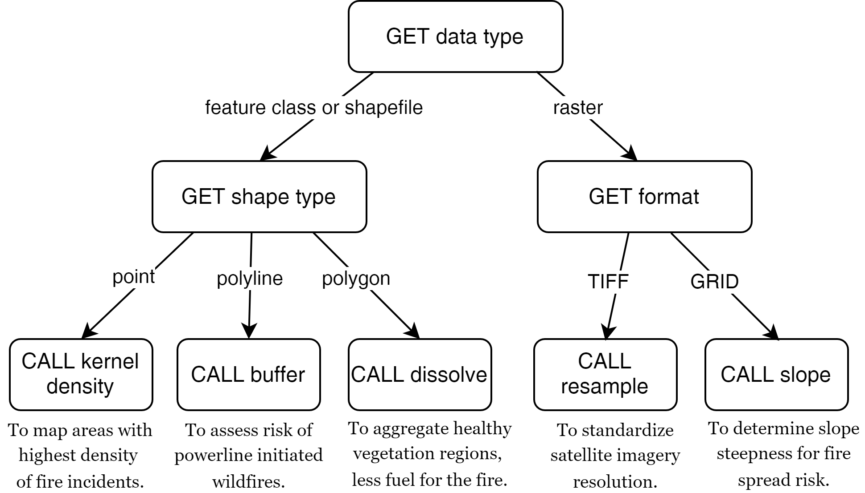
Branches
Notes:
Nevertheless, to build this workflow in Python, you would need to use conditions and branching.
And you'd need to use arcpy to call tools.

Slide 26
How can Python do this?
How?
How?
How?
Notes:
But how do you get information about a dataset's type using Python?

Slide 27
arcpy Describe objects can get this information
How?
How?
How?
arcpy Describe objects can always provide the data type.
But other properties are dynamic.
Depending on the data type, the Describe object could also have a shape type or a format
Notes:
arcpy Describe objects can ALWAYS provide the data type.
But other Describe object properties are DYNAMIC.

Slide 28
arcpy Describe objects can get this information
How?
How?
How?
arcpy Describe objects can always provide the data type.
But other properties are dynamic.
Depending on the data type, the Describe object could also have a shape type or a format
Notes:
Remember how rasters don't have a shape type? Instead they have a format. But shapefiles do not have a format property.
The properties that a describe object has depend on the data type!

Slide 29
Buffer_clip… avoid argv index error
Check the list length before indexing it, give feedback, and exit if necessary
use try/except (discuss later)
import sys
listLength = len(sys.argv) # count the number of arguments
if listLength < 5:
print 'Usage: <shapefile to buffer>, <buffer distance>, <shapefile to \ clip>, <the workspace >' # explain the problem to the user
sys.exit(0) # exit the program.
# buffer_clip.py arguments
fireDamage = sys.argv[1]
park = sys.argv[2]
bufferDist = sys.argv[3]
arcpy.env.workspace = sys.argv[4]
# Buffer and clip code below here…

Slide 30
Using if/elif/else
Use if alone when you only want do y if x is true, and you want to continue with the rest of the script in either case.
…
if field_name not in fields: arcpy.addField(filename, field_name)
# Update field values
Use elif to check another conditional statement. Follows if or elif block.
Use else to enact a default action. If none of the previous conditions are true, do what I say. Follows if or elif block.
if shapeType == ‘polygon’:
print 'Shape is polygon'
elif shapeType == ‘line’:
print 'Shape is line'
else:
print 'Shape is not line or polygon'

