Slide 1
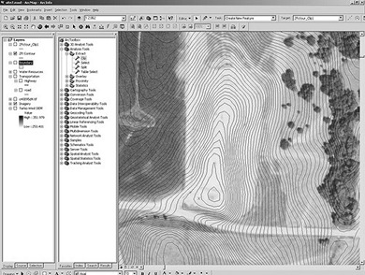
The arcpy mapping module
What mapping can do in Python
  automate map publication
  manage existing map documents
Map doc structure →mapping classes
  MapDocument classes
  Data Frame classes
  Layer classes
Manipulate layers
Modify map surround elements
Modify layer symbology
Dr. Tateosian
Notes:
This lesson returns to arcpy functionality to discuss the mapping module capabilities. arcpy can automate map publication and manage existing map documents. The mapping module has Python classes that mimic the organization of arcmap. Keep in mind our recent discussion of user-defined classes. The terms property and method will reappear as we go over these mapping classes. In this lecture, you will also see how to manipulate (add, remove, or move) map layers, how to modify map surrounds, such as the title and north arrow, and finally, how to modify the symbology of map layers.

Slide 2
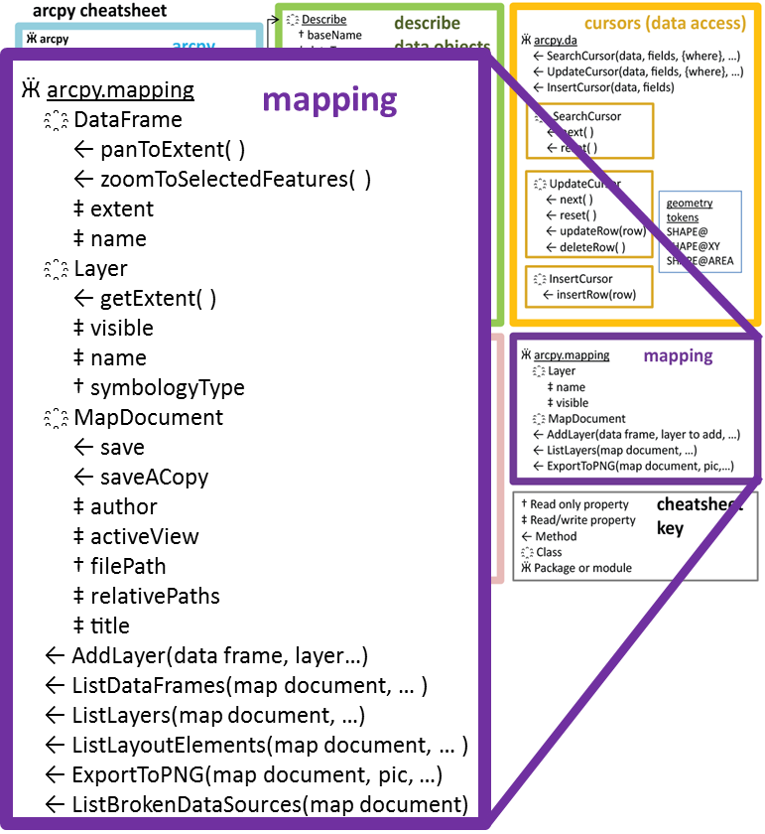
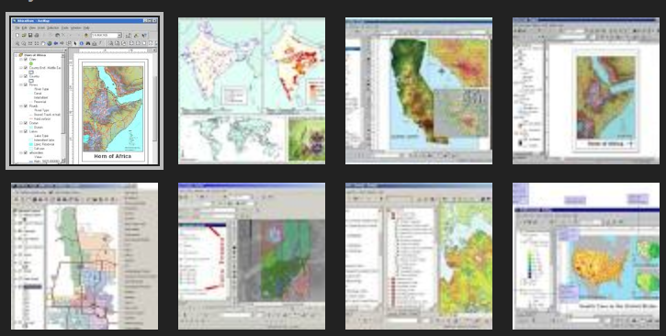
arcpy mapping module
Add layers
Export to PDF
List the layers
Zoom!
Get the extent
Move legends
Change titles
List the data frames
And more…
Notes:
Taking a look at the ‘arcpy cheatsheet’ once more, there is a purple box on the right side of the sheet for the mapping module. As I mentioned, the mapping module allows you to modify existing map documents. It can also get the extent, take a screen shot of what’s on the map, add layers to the map, rearrange layers, zoom, list information about the map, such as the data frames and layers and there’s also a way to automate checking for broken links in maps. To do these things, the mapping module uses several classes, so, again, that should tie into what you already know about classes.

Slide 3
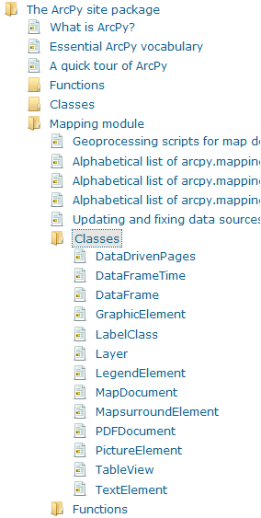
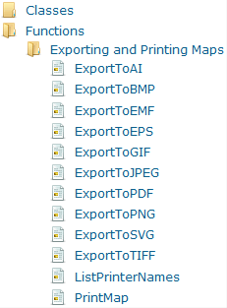
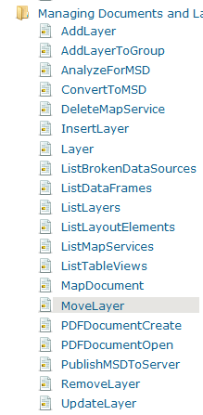
arcpy mapping classes and functions
Mapping module has classes and functions
Classes: MapDocument, DataFrame, Layer, and more
Two function categories
  Exporting and printing
  Managing Documents and layers
Alphabetical ‘Help’ lists of classes and functions are useful (print them if using a lot)
Notes:
The mapping module has a set of classes and a set of functions. Looking at the online help for the mapping module, you’ll see a folder for classes (expanded in the left screen shot) and a folder for functions, (expanded in the right screen shot). The classes include a MapDocument class, a DataFrame Class, a Layer class, and many others. The functions are grouped into two categories: Functions for exporting and printing the map (most of these are for exporting. you can’t see the entire list here, but there is also a PrintMap function) and then the other category if for managing documents and layers.
Notice the alphabetical “help” lists of classes and functions in the left image. These are useful to print so that you can reference them while working with the mapping module.

Slide 4
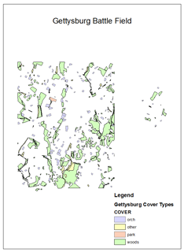
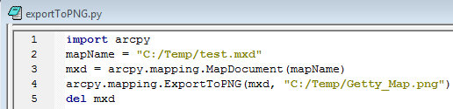
Export to PNG example
Syntax:
  arcpy.mapping.functionName(…)
  arcpy.mapping.ExportToPNG(…)
Arguments:
  MapDocument object, output file name
  Line 3 creates the MapDocument object

Slide 5
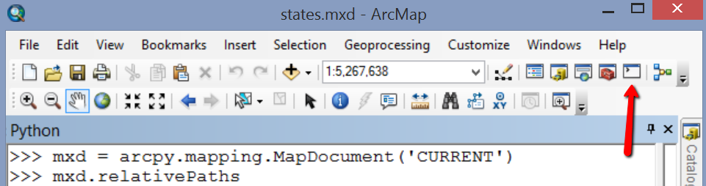
MapDocument object
Need this for most arcpy mapping scripts.
Required argument for many function.
import arcpy
mapName = "C:/gispy/scratch/ch24/maps/"
mxd = arcpy.mapping.MapDocument(mapName)
MapDocument MapDocument object
object constructor
In class – Explore MapDocument objects

Slide 6
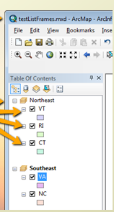
In Class - Exploring MapDocument follow-up 1
#1. What is mxd?
>>> mxd
<MapDocument object at 0x146d4c90[0x146d4b80]>
#2. What does mxd.relativePaths mean?
>>> mxd.relativePaths
False
# Meaning: Does the map use a relative path to the data layers?
# 3. How can you change mxd.filePath from a Python script?
>>> mxd.filePath
u'C:\\gispy\\data\\ch24\\maps\\states.mxd'
>>> mxd.filePath = 'C:\\gispy\\data\\ch24\\maps\\US.mxd'
NameError: The attribute 'filePath' is not supported on this instance of MapDocument.
#You can’t!
# 4. How do you get or change the author of the map from a Python script?
>>> mxd.author
u''
>>> mxd.author = "Me"
>>> mxd.author
u'Me'
# 5. How can you force the map to refresh to show changes you've made in the current session?
>>> mxd.title
u'Hey hey'
>>> mxd.title = 'Eastern US'
>>> arcpy.RefreshActiveView( )

Slide 7
In Class - Exploring MapDocument follow-up 2
#6. In the PythonWin IDE, what does/doesn't work:
>>> mxd1 = arcpy.mapping.MapDocument('CURRENT') # Throws RuntimeError. Guess why?
RuntimeError: Object: CreateObject cannot open map document
>>> arcpy.env.workspace = "C:/gispy/scratch/ch24/maps/“
>>> mapName = 'states.mxd‘
>>> mxd2 = arcpy.mapping.MapDocument(mapName) # Throws AssertionError. Guess why?
AssertionError: Invalid MXD filename
>>> mapName = "C:/gispy/scratch/ch24/maps/states.mxd"
>>> mxd3 = arcpy.mapping.MapDocument(mapName) # Works!
>>> mxd3.save() # fails. More on next slide.
#7. What does os.startfile do?
import os
os.startfile('C:/gispy/scratch/ch24/maps/landCover.mxd')
# Launches ArcMap with that map open.
#8. a. Where can you find a list of all the MapDocument properties and methods.
Online help for arcpy mapdocument class
b. Which properties can be modified from a Python script?
Some say read-only other read/write—try to change them and see what happens.

Slide 8
Saving MapDocument methods
>>> mxd
<MapDocument object at 0x146d4c90[0x146d4b80]>
>>> mxd.save()
Traceback (most recent call last):
File "<interactive input>", line 1, in <module>
File "C:\Program Files (x86)\ArcGIS\Desktop10.0\arcpy\arcpy\utils.py", line 179, in fn_
return fn(*args, **kw)
File "C:\Program Files (x86)\ArcGIS\Desktop10.0\arcpy\arcpy\_mapping.py", line 617, in save
return convertArcObjectToPythonObject(self._arc_object.save(*gp_fixargs((), True)))
IOError: MapDocObject: Unable to save. Check to make sure you have write access to the specified file and that there is enough space on the storage device to hold your document.
This error occurred because I tried to save the map with Python while it was open. Instead I can save a copy.
>>> copyName = mapName[:-4] + "modified.mxd"
>>> mxd.saveACopy(copyName)
Then I can make changes to that map and save it because it’s not open in ArcMap.
>>> mxd2 = arcpy.mapping.MapDocument(copyName)
>>> mxd2.title = "Foo2“
>>> mxd2.save()

Slide 9
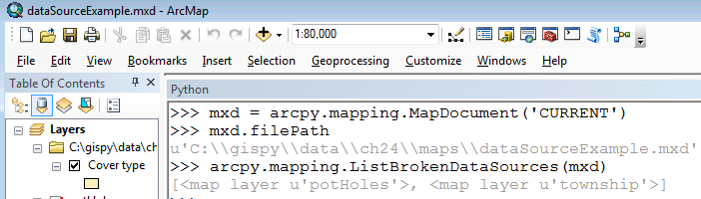
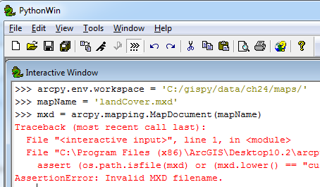
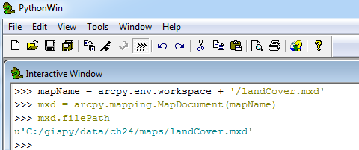
Map name vs. ‘CURRENT’ map
'CURRENT' only works for code running inside ArcMap– in the Scripting window or in a Script Tool run there.
>>> mxd = arcpy.mapping.MapDocument('CURRENT')
RuntimeError: Object: CreateObject cannot open map document
Outside of ArcMap, you must use the full path file name of the map

Slide 10
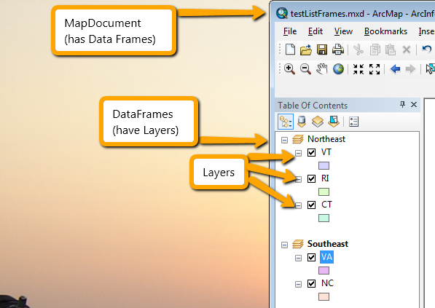
Map hierarchy

Slide 11
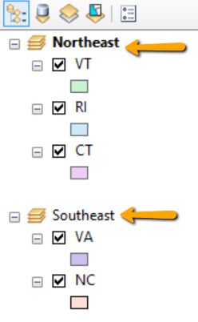
DataFrame object
The ListDataFrames method lists DataFrame objects
>>> mapName = "C:/gispy/scratch/ch24/maps/states.mxd"
>>> mxd = arcpy.mapping.MapDocument(mapName)
>>> # Get a list of data frame objects.
>>> dfs = arcpy.mapping.ListDataFrames(mxd)
>>> # Get the first data frame.
>>> df = dfs[0]
>>> df
<DataFrame object at 0x147278d0[0x14712cf0]>
>>> df.name
u'Northeast‘
>>> df2 = dfs[1]
>>> ext = df2.extent
>>> ext.Ymin
29.99437527717719
>>> arcpy.SelectLayerByAttribute_management('VA')
>>> df2.zoomToSelectedFeatures( )

Slide 12
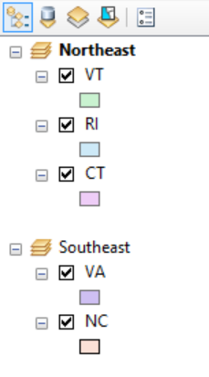
Layer object
import arcpy
mapName = "C:/gispy/scratch/ch24/maps/states.mxd"
mxd = arcpy.mapping.MapDocument(mapName)
# Get a list of data frame objects.
dfs = arcpy.mapping.ListDataFrames(mxd)
# Get the first data frame.
df = dfs[0]
# Get a list of layer objects in this data frame.
layers = arcpy.mapping.ListLayers(mxd, "*", df)
for layer in layers:
# Print the name of the layer.
print layer.name
In class – Exploring DataFrame and Layer objects
>>> VT
RI
CT

Slide 13
In class - Explore DataFrame & Layer objects:
How can you list all layers?
>>> layers = arcpy.mapping.ListLayers(mxd)
>>> for myLayer in layers:
... print myLayer.name
How can you use Python to zoom?
  >>> arcpy.SelectLayerByAttribute_management('VA')
  >>> df.zoomToSelectedFeatures( )
  OR
  >>> e = myLayer.getExtent( )
  >>> df.extent = e
How could you get the 5th layer in the 3rd dataframe?
  >>> dfs = arcpy.mapping.ListDataFrames(mxd)
  >>> df = dfs[2]
  >>> layers = arcpy.mapping.ListLayers(mxd, "*", df)
  >>> myLayer = layers[4]
Where can you find a complete list of layer properties and methods?
Search online for arcpy Layer class

Slide 14
Methods for manipulating layers
Arcpy mapping module can move, remove, and add layers.
First instantiate MapDocument and DataFrame objects.
Layer manipulation methods:
  AddLayer (TOP or BOTTOM)
  InsertLayer (Relative position)
  MoveLayer (Relative position)
  RemoveLayer
  UpdateLayer (setting symbology)

Slide 15
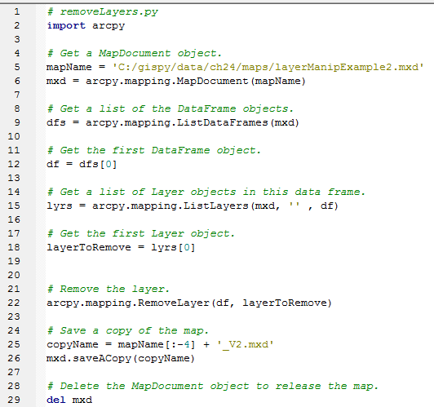
Removing a layer

Slide 16
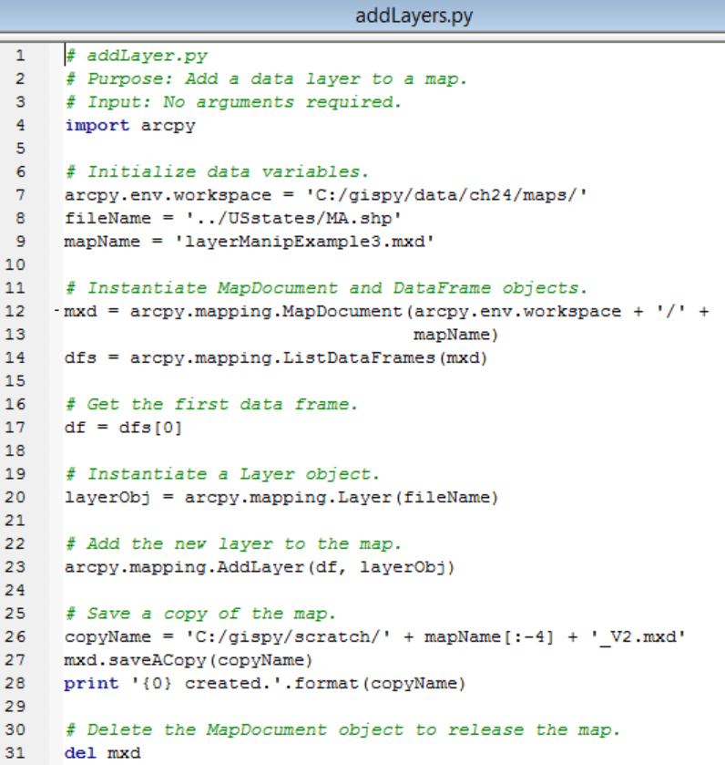
Adding a feature layer
Notes:
import arcpy
#Initialize data variables
arcpy.env.workspace = 'C:/gispy/data/ch24/maps/'
fileName = '../USstates/MA.shp'
mapName = 'layerManipExample3.mxd‘
#Instantiate mapDocument, dataFrame, and Layer objects.
mxd = arcpy.mapping.MapDocument(mapName)
dfs = arcpy.mapping.ListDataFrames(mxd)
#get the first data frame
df = dfs[0]
addLayer = arcpy.mapping.Layer(fileName)
#Add the new layer to the map
arcpy.mapping.AddLayer(df, addLayer)
#Save a copy of the map.
copyName = mapName[:-4] + "2.mxd"
mxd.saveACopy(copyName)
#Delete the mapDocument object to release the map.
del mxd

Slide 17
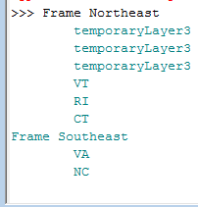
In class – list feature layers
Add a raster to the state.mxd by hand.
Add code to print the name of the data frames & feature type layers in a map (not the raster layers) as shown:
Hint1: Need nested looping to loop through the data frames and the layers.
Hint2: layer objects have an isFeatureLayer property

Slide 18
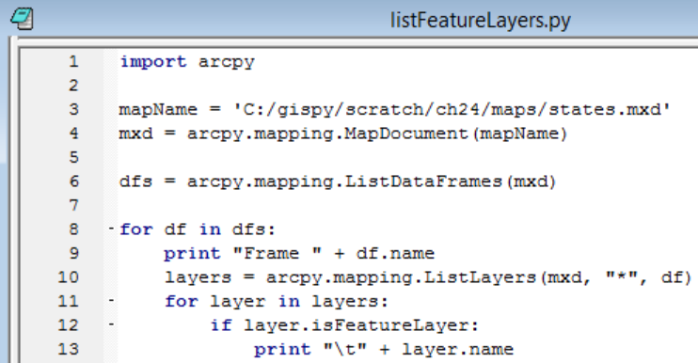
listFeatureLayers

Slide 19
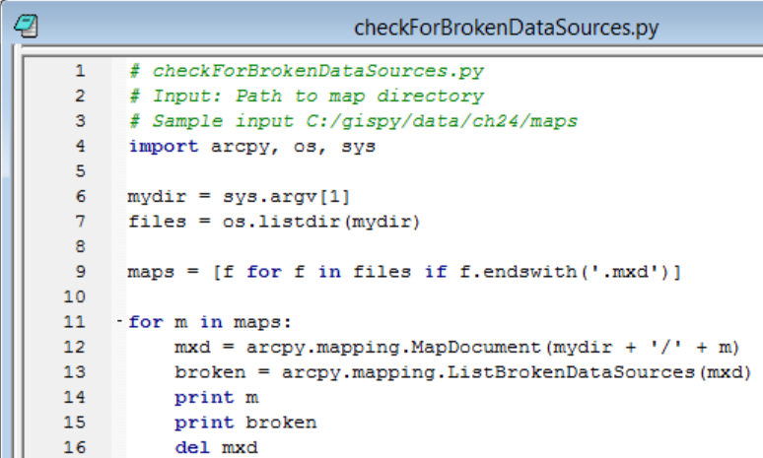
ListBrokenDataSources

Slide 20
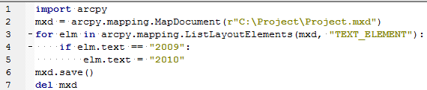
Managing layout elements
arcpy CAN’T create new elements!
For projects where you want to modify layout elements, use an existing map as a template map to modify.
Template map elements can be ‘hidden’ outside the initial viewing box.
Getting a layout element to modify its properties, often need to know the element name.
When you add an element to a map document, it gets a name.
However, for some elements, the default name is an empty string (e.g., text elements).
Use meaningful names for each element in the template map.
Layout Workflow
GET map document object
GET layout element(s) of interest
MODIFY layout element property
SAVE the map
DELETE the map document object
2009

Slide 21
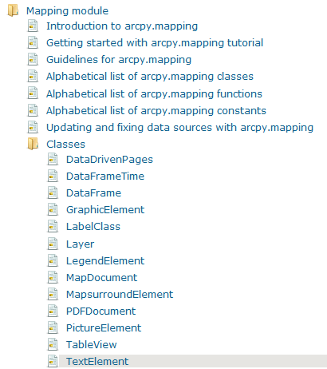
List layout elements
ListLayoutElements (map_document, {element_type}, {wildcard})
element types:
Element type is optional but will not accept a place holder;
must use a legitimate element type if you want to use a wildcard
List all layout elements objects:
elems = arcpy.mapping.ListLayoutElements(mxd)
pics = arcpy.mapping.ListLayoutElements(mxd,'PICTURE_ELEMENT')
horseLabels = arcpy.mapping.ListLayoutElements(mxd,'TEXT_ELEMENT','HOR*')
'DATAFRAME_ELEMENT‘
'GRAPHIC_ELEMENT'
'LEGEND_ELEMENT‘
'MAPSURROUND_ELEMENT‘
'PICTURE_ELEMENT‘
'TEXT_ELEMENT'

Slide 22
Explain what the code does…
Part 1:
>>> mxd = arcpy.mapping.MapDocument('CURRENT')
>>> arrow = arcpy.mapping.ListLayoutElements(mxd,'MAPSURROUND_ELEMENT','*Arrow*')[0]
>>> arrow.name
u'North Arrow'
Part 2:
>>> mxd = arcpy.mapping.MapDocument('CURRENT')
>>> elems = arcpy.mapping.ListLayoutElements(mxd)
>>> for e in elems:
... print e.name
Text Box
North Arrow
Legend
Title
Layers
>>> for e in elems:
... if 'Title' in e.name:
... title = e
>>> dfs = arcpy.mapping.ListDataFrames(mxd)
>>> df = dfs[0]
>>> title.elementPositionX = df.elementPositionX + (df.elementWidth*0.5) - (title.elementWidth*0.5)
>>> arcpy.RefreshActiveView( )
>>> title.elementPositionY = df.elementPositionY + df.elementHeight - title.elementHeight

Slide 23
Explain what the code does…
# Print the name of the north arrow.
Part 1:
>>> mxd = arcpy.mapping.MapDocument('CURRENT')
>>> arrow = arcpy.mapping.ListLayoutElements(mxd,'MAPSURROUND_ELEMENT','*Arrow*')[0]
>>> arrow.name
u'North Arrow'
Part 2:
>>> mxd = arcpy.mapping.MapDocument('CURRENT')
>>> elems = arcpy.mapping.ListLayoutElements(mxd)
>>> for e in elems:
... print e.name
Text Box
North Arrow
Legend
Title
Layers
>>> for e in elems:
... if 'Title' in e.name:
... title = e
>>> dfs = arcpy.mapping.ListDataFrames(mxd)
>>> df = dfs[0]
>>> title.elementPositionX = df.elementPositionX + (df.elementWidth*0.5) - (title.elementWidth*0.5)
>>> arcpy.RefreshActiveView( )
>>> title.elementPositionY = df.elementPositionY + df.elementHeight - title.elementHeight
# Print the names of all the elements.
# Get the element named Title.
# Move the Title to the
# center (top) of the first data frame

Slide 24
Layer symbologyType
Layer objects have a ‘symbologyType’ property
>>> layer1.symbologyType
u'OTHER'
>>> layer2.symbologyType
u'GRADUATED_COLORS'
Depending on its symbologyType, a Layer object can have a 'symbology' class.
If the symbologyType is ‘OTHER’, the layer has no ‘symbology’ property.
>>> layer1.symbology
NameError: The attribute 'symbology' is not supported on this instance of Layer.
>>> layer2.symbology
<GraduatedSymbolsSymbology object at 0x192a6[0x22026b0]>
Python can not change a layer’s symbologyType with an assignment statement.
>>> layer1.symbologyType = 'GRADUATED_COLORS'
RuntimeError: LayerObject: Set attribute symbologyType does not exist
‘.lyr' files (Layer Files) can store symbology for a dataset.
Add a Layer file data to a map and it uses the stored symbologyType;
Otherwise, the default symbologyType is 'OTHER'.
symbologyType values
'GRADUATED_COLORS'
'GRADUATED_SYMBOLS'
'UNIQUE_VALUES'
'RASTER_CLASSIFIED'
'OTHER'

Slide 25
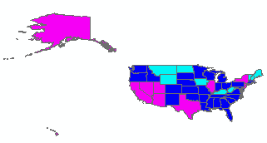
Modify symbology
symbologyType can be modified using a pre-prepared ‘.lyr' file.
>>> srcLay = "C:/gispy/data/ch24/symbolTraining/gradColorsNE.lyr'
>>> srcLayObj = arcpy.mapping.Layer(srcLay)
>>> arcpy.mapping.UpdateLayer(df, layerToModify, srcLayObj)
>>> layerToModify.symbologyType
u'GRADUATED_COLORS'
Graduated color symbology properties can be modified
Change the value field for calculating the colors & number of color classes:
>>> layerToModify.symbology.valueField
u'Category'
>>> layerToModify.symbology.valueField = 'AVE_FAM_SZ'
>>> arcpy.RefreshActiveView()
>>> layerToModify.symbology.numClasses
5
>>> layerToModify.symbology.numClasses = 3

Slide 26
Summing up
Topics discussed
    MapDocument, DataFrame, Layer objects
      Map name or 'CURRENT' map
      Check map properties
      List map objects
      Save map documents
      Move, remove, and add layers
    Modify layout element properties
    Modify symbology
Up next
    HTML
Additional topics
    arcpy package organization
    data driven pages

Slide 27
Appendix

Slide 28
Additional Explore DataFrame & Layer objects examples
>>> df
<DataFrame object at 0x147278d0[0x14712cf0]>
>>> df.name
u'Northeast'
>>> df.description
u''
>>> df.description = "My very cool data frame"
>>> df.description
u'My very cool data frame'
>>> df.displayUnits
u'DecimalDegrees'
>>> layer.isFeatureLayer
True
>>> layer.isRasterLayer
False
>>> e = layer.getExtent()
>>> e
<Extent object at 0x146d41d0[0x1472a9e0]>
>>> e.XMax
-75.45046915555109
>>> layer.dataSource
u'C:\\Temp\\NC.shp'

Slide 29
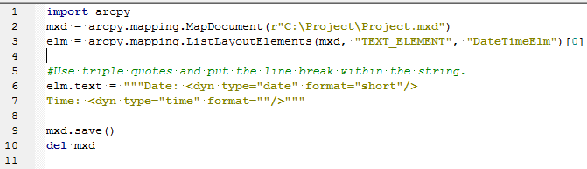
Dynamic text string
Text placed on a map layout that changes dynamically based on the current properties of the map document, data frame, and Data Driven Page
    A user name
    The date a map document was saved
    The file path for the map document
    The page numbers …
Text Element example date/time
  Update a static 9.3 map document date/time text element string
  Uses dynamic text strings.

Slide 30
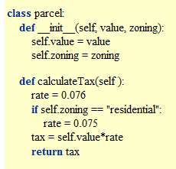
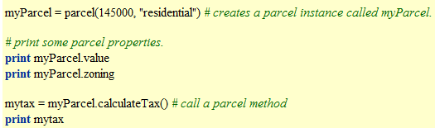
In class - review user-defined classes
create a parcel object named myParcel with value 145000 & residential zoning.
print the parcel value and zoning for myParcel
print the tax for myParcel.
class Human:
def __init__(self):
self.shorts =“ugly yellow”
self.heartRate = 60
def fallInLove(self):
self.heartRate = 120
print ‘I love GIS’
create an instance of a human object named ken.
print ken’s shorts property.
call ken’s fallInLove method
Notes:
ken = human( ) # Create a human object called ken
print ken
print ken.shorts
ken.fallInLove( )

Slide 31
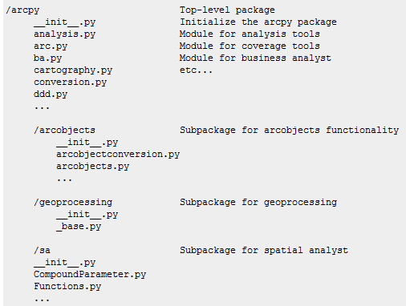
Python packages
Python module
  - a single Python script (.py file) containing tightly related definitions and statements.
Python package
  - a special way of structuring a set of related Python modules.
  - a directory containing modules and sometimes subpackages, which also contain modules.
A module name __init__.py tells Python that the directory contains a package.
Module B within package A can be accessed using the dotted name notation, A.B
Example: arcpy.ddd

Slide 32
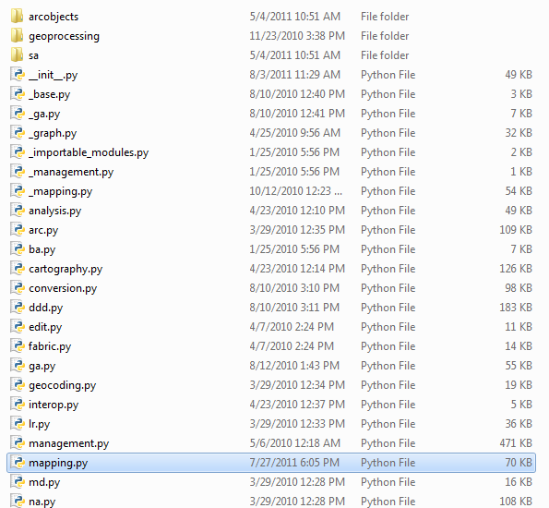
Arcpy package
Search under the ArcGIS install for the arcpy directory
Module B within package A can be accessed using the dotted name notation, A.B
Example: arcpy.mapping

Slide 33
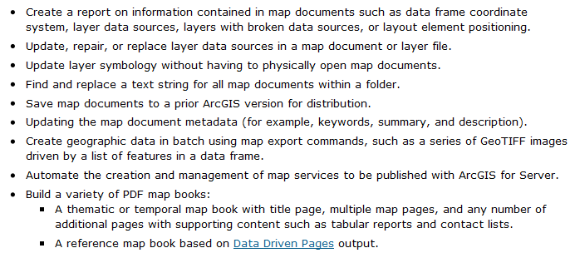
What is arcpy.mapping for?
Examples of things you can do with arcpy.mapping…
Before ArcGIS 10 items things were done with ArcObjects
ArcObjects --a very difficult programming environment to learn for the average GIS professional.
Arcpy.mapping is a courser-grained object model, meaning that the functions are designed in a way that a single arcpy.mapping function can replace many lines of ArcObjects code

