Slide 1
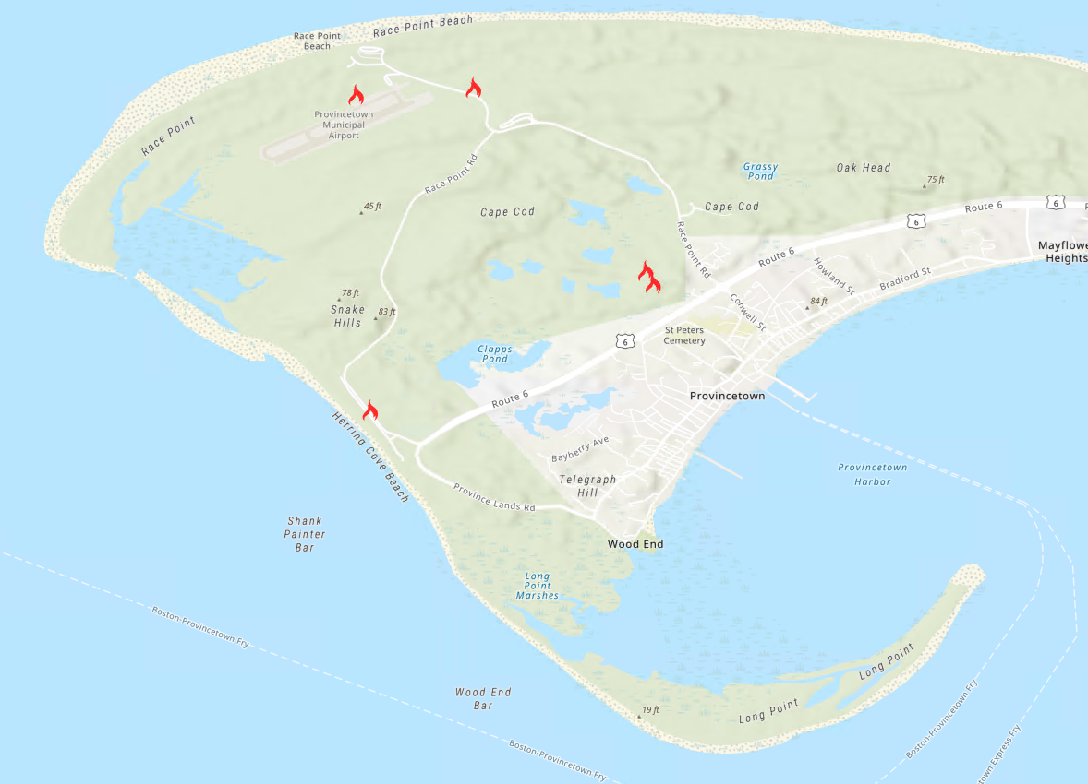
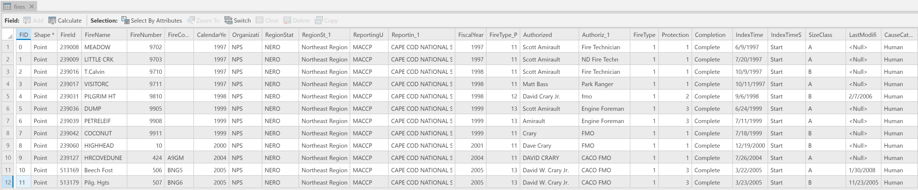
Notes:
The national parks along the US east coast work together to keep records of any locations where wildfires have started in the parks. This map shows a few of the fire ignitions in Cape Cod National Seashore. Below the map is part of the attribute table of the fires shapefile. If you are working with this data, you may want to compare the causes of fires that occurred 20 years ago and to those that occurred last year, or you may want to make the Authorized name field more consistent. Here David Crary is referred to at least five distinct ways. Or you may get reports of new fires and need to add new records to the table. arcpy cursors can be used for all of these tasks.

Slide 2
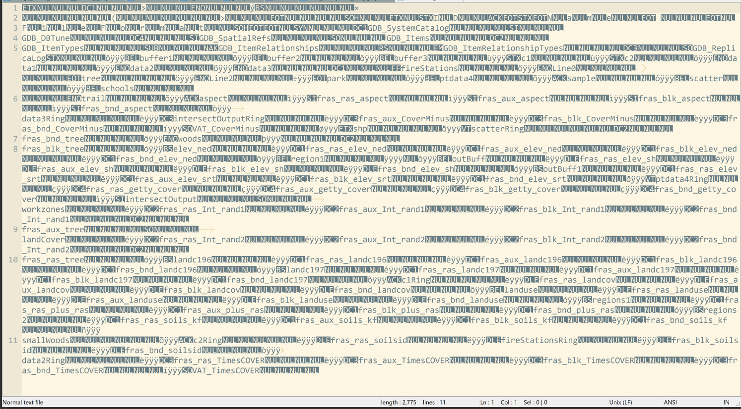
arcpy cursors for GIS data
Notes:
For some tabular manipulation tasks, you can just skip the coding and work in Excel to work with the data. But this doesn't always work for two reasons.
1) If you need to repeat the process on many files or very large files, the manual approach becomes error prone and impractical.
2) Many GIS data formats do not even enable this type of access, because they are binary encodings. This is what it might look like if you try to open a shapefile in Notepad, because shapefiles are binary.

Slide 3
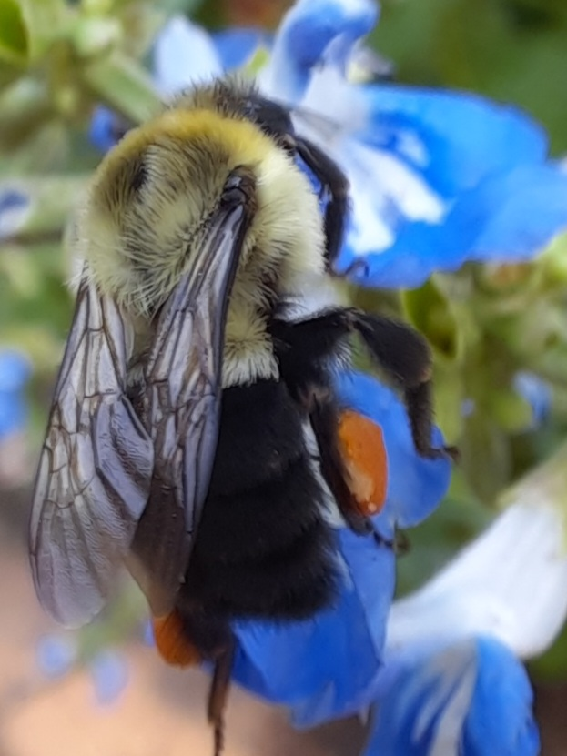
Cursors --------------- Read/write GIS attribute table rows
Center for Geospatial Analytics
North Carolina State University
Dr. Tateosian

Slide 4
Objectives
Traverse & modify GIS tables
Access geometric properties
Manage locks
Filter GIS records

Slide 5
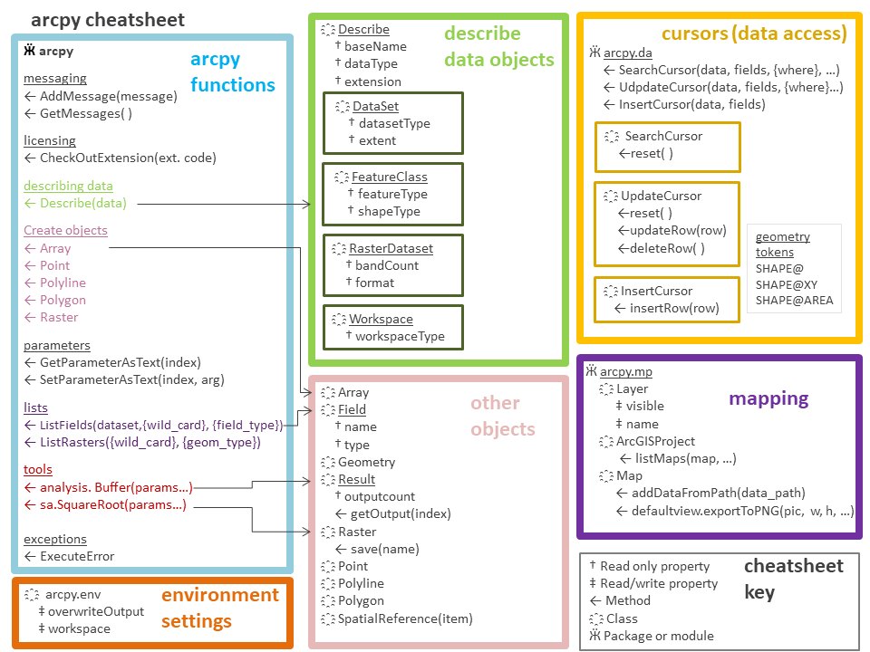
cursors (data access)
Ӝ arcpy.da
← SearchCursor(data, fields, {where_clause}, …)
← UdpdateCursor(data, fields, {where_clause}…)
← InsertCursor(data, fields)
҈ SearchCursor
† fields ← reset( )
geometry tokens
SHAPE@
SHAPE@XY
SHAPE@AREA
SHAPE@LENGTH
SHAPE@JSON
SHAPE@WKB
SHAPE@WKT
SHAPE@X
SHAPE@Y
SHAPE@Z
SHAPE@M
…
҈ UpdateCursor
† fields ← deleteRow( ) ← reset( )
← updateRow(row)
list or tuple
҈ InsertCursor
† fields
← insertRow(row)
list or tuple

Slide 6
field names
FID | Shape | Bee _farm | Honey_yield
0 | Point | BeeWell | 1056
1 | Point | Buzzy Dell | 640
2 | Point | PollenNation | 88000
rows

Slide 7
3 types of cursors

Slide 8
SearchCursor
UpdateCursor
InsertCursor

Slide 9
SearchCursor: read rows (no changes)
UpdateCursor
InsertCursor

Slide 10
SearchCursor: read rows (no changes)
UpdateCursor: modify or delete rows
InsertCursor

Slide 11
SearchCursor: read rows (no changes)
UpdateCursor: modify or delete rows
InsertCursor: add rows

Slide 12
SearchCursor
UpdateCursor
InsertCursor

Slide 13
Parameters
SearchCursor
UpdateCursor
InsertCursor
required
{optional}
in_table
field_names
{where_clause} {spatial_reference} {explode_to_points}
{sql_clause}
{datum_transformation}
in_table
field_names
{where_clause} {spatial_reference} {explode_to_points}
{sql_clause}
{datum_transformation}
in_table
field_names
{datum_transformation}

Slide 14
Parameters
SearchCursor
UpdateCursor
InsertCursor
in_table field_names
{where_clause} {spatial_reference} {explode_to_points}
{sql_clause}
{datum_transformation}
same
in_table field_names
{where_clause} {spatial_reference} {explode_to_points}
{sql_clause}
{datum_transformation}
in_table
field_names
{datum_transformation}

Slide 15
Data access cursor methods
Search: read rows (no changes)
Update: modify or delete rows
Insert: add rows
arcpy.da.SearchCursor(in_table, field_names, {where_clause}, {spatial_reference}, {explode_to_points}, {sql_clause}, {datum_transformation})
arcpy.da.UpdateCursor(in_table, field_names, {where_clause}, {spatial_reference}, {explode_to_points}, {sql_clause}, {datum_transformation})
arcpy.da.InsertCursor(in_table, field_names, {datum_transformation})

Slide 16
rc = arcpy.da.<type>Cursor(in_table, field_names)
Cursor object

Slide 17
rc = arcpy.da.<type>Cursor(in_table, field_names)
data access module

Slide 18
rc = arcpy.da.<type>Cursor(in_table, field_names)
Search
Update
Insert

Slide 19
rc = arcpy.da.<type>Cursor(in_table, field_names)
required arguments
Search
Update
Insert
Notes:
I’ll introduce cursors by first using examples from the simplest one.

Slide 20
rc = arcpy.da.<type>Cursor(in_table, field_names)
Search
Update
Insert

Slide 21
rc = arcpy.da.<type>Cursor(in_table, field_names)
sc = arcpy.da.SearchCursor("beefarm.shp",
["FID", "BeeProduct"])

Slide 22
rc = arcpy.da.<type>Cursor(in_table, field_names)
sc = arcpy.da.SearchCursor(
in_table="beefarm.shp",
field_names=["FID", "BeeProduct"])

Slide 23
Three cursor types
Search: read rows (no changes)
Update: modify or delete rows
Insert: add rows
arcpy.da.SearchCursor(in_table, field_names, {where_clause}, {spatial_reference}, {explode_to_points}, {sql_clause}, {datum_transformation})
arcpy.da.UpdateCursor(in_table, field_names, {where_clause}, {spatial_reference}, {explode_to_points}, {sql_clause}, {datum_transformation})
arcpy.da.InsertCursor(in_table, field_names, {datum_transformation})

Slide 25
Notes:
Once you have that cursor object, what can you do with it? We return to the fires at Cape Cod National Seashore to look at some examples.

Slide 26
Notes:
These examples will use the fires attribute table.

Slide 27
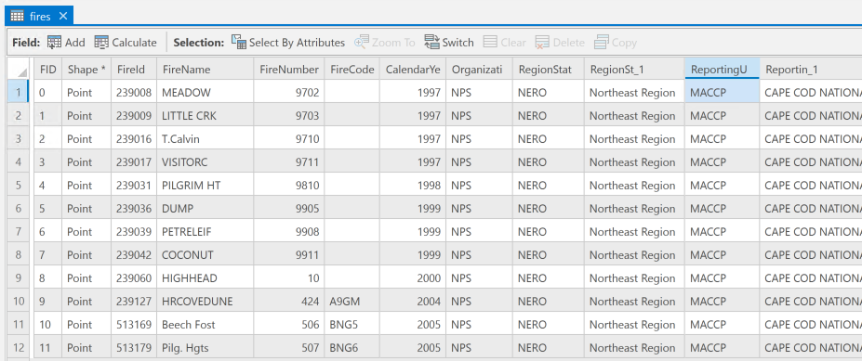
# Get a SearchCursor object.
import arcpy
arcpy.env.workspace = "C:/gispy/data/ch02"
data = "fires.shp"

Slide 28
# Get a SearchCursor object.
import arcpy
arcpy.env.workspace = "C:/gispy/data/ch02"
data = "fires.shp"
fields = [ "FIREID", "FIRENAME" ]

Slide 29
# Get a SearchCursor object.
import arcpy
arcpy.env.workspace = "C:/gispy/data/ch02"
data = "fires.shp"
fields = [ "FIREID", "FIRENAME" ]
sc = arcpy.da.SearchCursor(in_table=data,
field_names=field)
Cursor object

Slide 30
Got the Cursor object. Now what?

Slide 31
Cursor objects are iterators

Slide 32
Iteration terms
To iterate – perform something over and over
An iterable object contains a countable number of values. E.g., lists, tuples, strings.
You can traverse iterable objects with FOR-loops.
A Python iterator is an object that can be iterated upon. You can traverse through all the values using a FOR-loop. But you can also use next().
You can get iterators from iterable objects like lists.
>>> mylist = ["apple", "banana", "cherry"]
>>> myit = iter(mylist)
>>> type(myit)
<class 'list_iterator'>
Then you can use the built-in next() function to return the next item.
>>> a = next(myit)
>>> print(a)
apple
>>> b = next(myit)
>>> print(b)
banana

Slide 33
Cursor objects are iterators
Meaning you can traverse them with next or with a FOR-loop

Slide 34
# Get a SearchCursor object.
import arcpy
arcpy.env.workspace = "C:/gispy/data/ch02"
data = "fires.shp"
fields = [ "FIREID", "FIRENAME" ]
sc = arcpy.da.SearchCursor(in_table=data,
field_names=fields)
# Advance the cursor to row 1.
row = next(sc)

Slide 35
# Get a SearchCursor object.
import arcpy
arcpy.env.workspace = "C:/gispy/data/ch02"
data = "fires.shp"
fields = [ "FIREID", "FIRENAME" ]
sc = arcpy.da.SearchCursor(in_table=data,
field_names=fields)
# Advance the cursor to row 1.
row = next(sc)
print(f"row = {row}")
print(f"row type = {type(row)}")
print(f"row[0] = {row[0]}")
print(f"row[1] = {row[1]}")

Slide 36
# Get a SearchCursor object.
import arcpy
arcpy.env.workspace = "C:/gispy/data/ch02"
data = "fires.shp"
fields = [ "FIREID", "FIRENAME" ]
sc = arcpy.da.SearchCursor(in_table=data,
field_names=fields)
# Advance the cursor to row 1.
row = next(sc)
print(f"row = {row}")
print(f"row type = {type(row)}")
print(f"row[0] = {row[0]}")
print(f"row[1] = {row[1]}")
row = (239008, 'MEADOW')
row type = <class 'tuple'>
row[0] = 239008
row[1] = MEADOW

Slide 37
# Get a SearchCursor object.
import arcpy
arcpy.env.workspace = "C:/gispy/data/ch02"
data = "fires.shp"
fields = [ "FIREID", "FIRENAME" ]
sc = arcpy.da.SearchCursor(in_table=data,
field_names=fields)
# Advance the cursor to row 1.
row = next(sc)
print(f"row = {row}")
print(f"row type = {type(row)}")
print(f"row[0] = {row[0]}")
print(f"row[1] = {row[1]}")
row = (239008, 'MEADOW')
row type = <class 'tuple'>
row[0] = 239008
row[1] = MEADOW

Slide 38
# Get a SearchCursor object.
import arcpy
arcpy.env.workspace = "C:/gispy/data/ch02"
data = "fires.shp"
fields = [ "FIREID", "FIRENAME" ]
sc = arcpy.da.SearchCursor(in_table=data,
field_names=fields) # Advance the cursor to row 1.
row1 = next(sc)
# Advance the cursor to row 2.
row2 = next(sc)
# Advance the cursor to row 3.
row3 = next(sc)
# Advance the cursor to row 4.
row4 = next(sc)

Slide 39

# Get a SearchCursor object.
import arcpy
arcpy.env.workspace = "C:/gispy/data/ch02"
data = "fires.shp"
fields = [ "FIREID", "FIRENAME" ]
sc = arcpy.da.SearchCursor(in_table=data,
field_names=fields) # Advance the cursor to row 1.
row1 = next(sc)
# Advance the cursor to row 2.
row2 = next(sc)
# Advance the cursor to row 3.
row3 = next(sc)
# Advance the cursor to row 4.
row4 = next(sc)

Slide 40
# Get a SearchCursor object.
import arcpy
arcpy.env.workspace = "C:/gispy/data/ch02"
data = "fires.shp"
fields = [ "FIREID", "FIRENAME" ]
sc = arcpy.da.SearchCursor(in_table=data,
field_names=fields) # Iterate through each row.
for row in sc:
print(f"{row}")

Slide 42
About field_names...
rc = arcpy.da.<type>Cursor(in_table, field_names)

Slide 43
rc = arcpy.da.<type>Cursor(in_table, field_names)
You can get all fields by using a placeholder.
field_names = ["*"]
Notes:
For large datasets, it’s better to specify on the fields you’re using.

Slide 44
# Get a SearchCursor object.
import arcpy
arcpy.env.workspace = "C:/gispy/data/ch02"
data = "fires.shp"
fields = ["*"]
sc = arcpy.da.SearchCursor(in_table=data,
field_names=fields)
# Get the first row.
row = next(sc)
print(f"Row has {len(row)} items.")
for num, item in enumerate(row):
print(f"Row[{num}]: {item}")
Row has 74 items.
Row[0]: 0
Row[1]: (-70.0806,42.0519)
Row[2]: 239008
Row[3]: NPS
Row[4]: NERO
Row[5]: Northeast Region
Row[6]: MACCP
Row[7]: CAPE COD NATIONAL SEASHORE
Row[8]: 1997
...

Slide 45
# Get a SearchCursor object.
import arcpy
arcpy.env.workspace = "C:/gispy/data/ch02"
data = "fires.shp"
fields = [ "FIREID", "FIRENAME" ]
sc = arcpy.da.SearchCursor(in_table=data,
field_names=fields) # Iterate through each row.
for row in sc:
print(row)
(239008, 'MEADOW')
(239009, 'LITTLE CRK')
(239016, 'T.Calvin')
(239017, 'VISITORC')
(239031, 'PILGRIM HT')
(239036, 'DUMP')
(239039, 'PETRELEIF')
(239042, 'COCONUT')
(239060, 'HIGHHEAD')
(239127, 'HRCOVEDUNE')
(513169, 'Beech Fost')
(513179, 'Pilg. Hgts')

Slide 46
# Get a SearchCursor object.
import arcpy
arcpy.env.workspace = "C:/gispy/data/ch02"
data = "fires.shp"
fields = [ "FIREID", "FIRENAME" ]
sc = arcpy.da.SearchCursor(in_table=data,
field_names=fields) # Iterate through each row.
for row in sc:
print(f"Fire name = {??}")
Fire name = MEADOW
Fire name = LITTLE CRK Fire name = T.Calvin
Fire name = VISITORC
Fire name = PILGRIM HT Fire name = DUMP
Fire name = PETRELEIF Fire name = COCONUT
Fire name = HIGHHEAD
Fire name = HRCOVEDUNE
Fire name = Beech Fost Fire name = Pilg. Hgts

Slide 47
# Get a SearchCursor object.
import arcpy
arcpy.env.workspace = "C:/gispy/data/ch02"
data = "fires.shp"
fields = [ "FIREID", "FIRENAME" ]
sc = arcpy.da.SearchCursor(in_table=data,
field_names=fields) # Iterate through each row.
for row in sc:
print(f"Fire name = {row[1]}")
Fire name = MEADOW
Fire name = LITTLE CRK Fire name = T.Calvin
Fire name = VISITORC
Fire name = PILGRIM HT Fire name = DUMP
Fire name = PETRELEIF Fire name = COCONUT
Fire name = HIGHHEAD
Fire name = HRCOVEDUNE
Fire name = Beech Fost Fire name = Pilg. Hgts

Slide 48
# Get a SearchCursor object.
import arcpy
arcpy.env.workspace = "C:/gispy/data/ch02"
data = "fires.shp"
fields = ["FIRENAME", "FIREID"]
sc = arcpy.da.SearchCursor(in_table=data,
field_names=fields) # Iterate through each row.
for row in sc:
print(f"Fire name = {??}")
Fire name = MEADOW
Fire name = LITTLE CRK Fire name = T.Calvin
Fire name = VISITORC
Fire name = PILGRIM HT Fire name = DUMP
Fire name = PETRELEIF Fire name = COCONUT
Fire name = HIGHHEAD
Fire name = HRCOVEDUNE
Fire name = Beech Fost Fire name = Pilg. Hgts

Slide 49
# Get a SearchCursor object.
import arcpy
arcpy.env.workspace = "C:/gispy/data/ch02"
data = "fires.shp"
fields = ["FIRENAME", "FIREID"]
sc = arcpy.da.SearchCursor(in_table=data,
field_names=fields) # Iterate through each row.
for row in sc:
print(f"Fire name = {row[0]}")
Fire name = MEADOW
Fire name = LITTLE CRK Fire name = T.Calvin
Fire name = VISITORC
Fire name = PILGRIM HT Fire name = DUMP
Fire name = PETRELEIF Fire name = COCONUT
Fire name = HIGHHEAD
Fire name = HRCOVEDUNE
Fire name = Beech Fost Fire name = Pilg. Hgts

Slide 50
# Get a SearchCursor object.
import arcpy
arcpy.env.workspace = "C:/gispy/data/ch02"
data = "fires.shp"
fields = ["FIRENAME", "FIREID"]
Field names can be provided in any order.

Slide 51
# Get a SearchCursor object.
import arcpy
arcpy.env.workspace = "C:/gispy/data/ch02"
data = "fires.shp"
fields = ["FIRENAME", "FIREID"]
sc = arcpy.da.SearchCursor(in_table=data,
field_names=fields)
The cursor’s order for the fields depends on the field_names list, not the order in the data table.

Slide 52
# Get a SearchCursor object.
import arcpy
arcpy.env.workspace = "C:/gispy/data/ch02"
data = "fires.shp"
fields = ["FIRENAME", "FIREID"]
sc = arcpy.da.SearchCursor(in_table=data,
field_names=fields)
# Iterate through each row.
for row in sc:
print(f"{row}")
('MEADOW', 239008)
('LITTLE CRK', 239009)
('T.Calvin', 239016)
('VISITORC', 239017)
('PILGRIM HT', 239031)
('DUMP', 239036)
('PETRELEIF', 239039)
('COCONUT', 239042)
('HIGHHEAD', 239060)
('HRCOVEDUNE', 239127)
('Beech Fost', 513169)
('Pilg. Hgts', 513179)
The cursor’s tuple order matches the field_names list.

Slide 53
3rd
2nd
1st
# Get a SearchCursor object.
import arcpy
arcpy.env.workspace = "C:/gispy/data/ch02"
data = "fires.shp"
fields = ["CALENDARYE", "FIRENAME", "FIREID"]
sc = arcpy.da.SearchCursor(in_table=data,
field_names=fields) # Iterate through each row.
for row in sc:
print(f"{row}")

Slide 54
3rd
2nd
1st
# Get a SearchCursor object.
import arcpy
arcpy.env.workspace = "C:/gispy/data/ch02"
data = "fires.shp"
fields = ["CALENDARYE", "FIRENAME", "FIREID"]
sc = arcpy.da.SearchCursor(in_table=data,
field_names=fields) # Iterate through each row.
for row in sc:
print(f"{row}")
(1997, 'MEADOW', 239008)
(1997, 'LITTLE CRK', 239009)
(1997, 'T.Calvin', 239016)
(1997, 'VISITORC', 239017)
(1998, 'PILGRIM HT', 239031)
(1999, 'DUMP', 239036)
(1999, 'PETRELEIF', 239039)
(1999, 'COCONUT', 239042)
(2000, 'HIGHHEAD', 239060)
(2004, 'HRCOVEDUNE', 239127)
(2005, 'Beech Fost', 513169)
(2005, 'Pilg. Hgts', 513179)

Slide 56
Activity: search_cursors.ipynb
Notes:
https://lgtateos.github.io/gis540/notebooks/search_cursors.ipynb

Slide 57
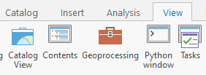

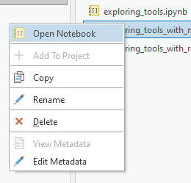
Open a Python Notebook in ArcGIS Pro
Open a Catalog View.
Paste the notebook’s directory in the Catalog address bar.
Right-click the notebook.
Select Open Notebook.

Slide 58
Open a Python Notebook in ArcGIS Pro
Open a Catalog View.
Paste the notebook’s directory in the Catalog address bar.
Right-click the notebook.
Select Open Notebook.
Try search_cursors.ipynb

Slide 59
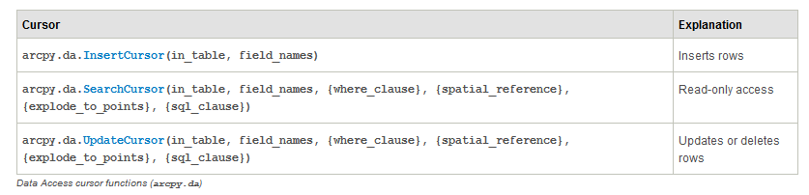
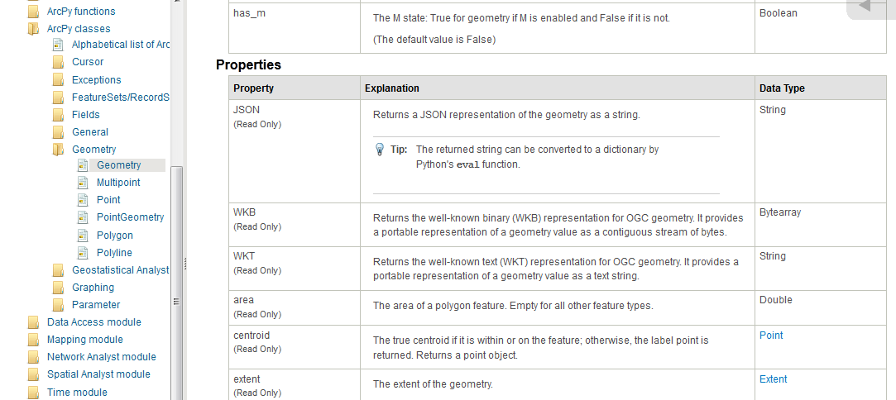
In class - Exploring cursor objects (Part 1)

Slide 60


In class follow-up
What data type is row?
sc.reset()?
Area of a polygon?
del sc
sc = arcpy.da.SearchCursor(fc, "*","COVER = 'orch'") ??
<> in a where_clause
FID is 22. RECNO = ?
If you have a row tuple, how can you find the value of the COVER field for that row?
Notes:
What is row? a tuple
sc.reset( ) resets the pointer to the beginning of the list.
Area of a polygon?
fieldNames = ["SHAPE@"]
sc = arcpy.da.SearchCursor(fc, fieldNames)
for row in sc: print row[0].area
del sc: keyword del deletes the object it’s used on. del sc deleted the search cursor we were using. So sc.next() threw an error.
--------------- Upcoming slides will address the rest
5. sc = arcpy.da.SearchCursor(fc, "*","COVER = 'orch'") only select rows with COVER type orch (stands for orchard)
6. <> is SQL for ‘not equal to’
sc = arcpy.da.SearchCursor(fc, "*", "COVER <> 'woods'") selects the non-woods cover type rows.
7. row FID is 22 --> row RECNO is 23
sc = arcpy.da.SearchCursor(fc, "*", "FID = 22")
row = sc.next()
print row[0]
print row[3]
8. If you have a row tuple, how can you find the value of the COVER field for that row?
That depends on how you created your search cursor.
Examples:
sc = arcpy.da.SearchCursor(fc, "*")
row = sc.next()
row[2]
sc = arcpy.da.SearchCursor(fc, [“COVER"])
row = sc.next()
row[0]

Slide 61
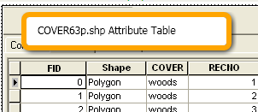
Accessing fields
If you have a row tuple, what will be the index for the COVER field?
Depends on how you created the search cursor!
fc = "C:/gispy/park/COVER63p.shp"
sc = arcpy.da.SearchCursor(fc, "*")
row = next(sc)
row[2]
del sc
sc = arcpy.da.SearchCursor(fc, ["RECNO", "COVER"])
row = next(sc)
row[1]
del sc
fieldNames = ["RECNO", "COVER"]
sc = arcpy.da.SearchCursor(fc, fieldNames, query)
covIndex = fieldNames.index("COVER")
row = next(sc)
print row[covIndex]
del sc

Slide 62
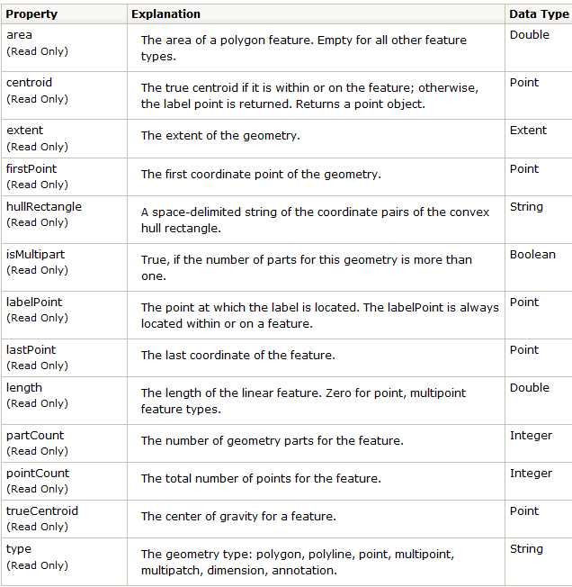
Geometry Object
import arcpy
sc = arcpy.da.SearchCursor("C:/gispy/scratch/park.shp", "SHAPE@")
row = next(sc)
del sc
row[0].type
"polygon"
row[0].area
600937.092
Geometry objects properties*
*Not all shown here. For a complete list, search online for: Geometry object arcpy

Slide 63
Required parameters
search: read rows (no changes)
update: modify or delete rows
insert: add rows
SearchCursor (in_table, field_names, {where_clause}, {spatial_reference}, {explode_to_points}, {sql_clause}, {datum_transformation})
UpdateCursor (in_table, field_names, {where_clause}, {spatial_reference}, {explode_to_points}, {sql_clause}, {datum_transformation})
InsertCursor (in_table, field_names, {datum_transformation})

Slide 64
Optional parameters
search: read rows (no changes)
update: modify or delete rows
insert: add rows
SearchCursor (in_table, field_names, {where_clause}, {spatial_reference}, {explode_to_points}, {sql_clause}, {datum_transformation})
UpdateCursor (in_table, field_names, {where_clause}, {spatial_reference}, {explode_to_points}, {sql_clause}, {datum_transformation})
InsertCursor (in_table, field_names, {datum_transformation})

Slide 65
where_clause
search: read rows (no changes)
update: modify or delete rows
insert: add rows
SearchCursor (in_table, field_names, {where_clause}, {spatial_reference}, {explode_to_points}, {sql_clause}, {datum_transformation})
UpdateCursor (in_table, field_names, {where_clause}, {spatial_reference}, {explode_to_points}, {sql_clause}, {datum_transformation})
InsertCursor (in_table, field_names, {datum_transformation})

Slide 66
where_clause for filtering records
import arcpy
arcpy.env.workspace = "C:/gispy/data/ch02"
data = "fires.shp“
# Specify a condition with SQL in a Python string.
query = "FID > 50"
sc = arcpy.da.SearchCursor(
in_table = "C:/gispy/scratch/park.shp", field_names = ['FID'],
where_clause = query)
row = next(sc)
print(f"row = {row[0]}")
row = 51

Slide 67
where_clause for filtering records
SQL statement as a Python string
"FIREID > 50"
"FIRENAME = 'Meadow'"
"COVER <> 'woods'" "WATERBODY LIKE 'Lake%'"
"UPPER(AUTHOR) = 'ROWLING'"
"NAME = 'woods' OR NAME = 'forest'"
Use as where_clause parameter
>>> query = "FID > 50"
>>> sc = arcpy.da.SearchCursor("C:/gispy/scratch/park.shp", ['FID'], query)
>>> row = next(sc)
>>> row[0]
51
For where_clause documentation, search online for: ArcGIS SQL reference

Slide 68
where_clause and quotation marks
"FIREID > 50"
"FIRENAME = 'Meadow'"
"COVER <> 'woods'"
"WATERBODY LIKE 'Lake%'"
"UPPER(AUTHOR) = 'ROWLING'"
"NAME = 'woods' OR NAME = 'forest'"

Slide 69
where_clause and quotation marks
"FIREID > 50"
"FIRENAME = 'Meadow'"
"COVER <> 'woods'"
"WATERBODY LIKE 'Lake%'"
"UPPER(AUTHOR) = 'ROWLING'"
"NAME = 'woods' OR NAME = 'forest'"
only outer quotes

Slide 70
where_clause and quotation marks
"FIREID > 50"
field name

Slide 71
where_clause and quotation marks
"FIREID > 50"
field name
numerical value

Slide 72
where_clause and quotation marks
"FIREID > 50"
only outer quotes
field name
numerical value

Slide 73
where_clause and quotation marks
"FIREID > 50"
"FIRENAME = 'Meadow'"
only outer quotes
field name

Slide 74
where_clause and quotation marks
"FIREID > 50"
"FIRENAME = 'Meadow'"
only outer quotes
field name
text value

Slide 75
where_clause and quotation marks
"FIREID > 50"
"FIRENAME = 'Meadow'"
only outer quotes
outer quotes and
single inner quotes
around the value
field name
text value

Slide 76
where_clause and quotation marks
"FIREID > 50"
"FIRENAME = 'Meadow'"
only outer quotes
outer quotes and
single inner quotes
around the value
field name
text value
Whenever the value being compared is text, use inner quotes.

Slide 77
where_clause and quotation marks
"FIREID > 50"
"FIRENAME = 'Meadow'"
"COVER <> 'woods'"
"WATERBODY LIKE 'Lake%'"
"UPPER(AUTHOR) = 'ROWLING'"
"NAME = 'woods' OR NAME = 'forest'"
only outer quotes
outer quotes and
single inner quotes
around the value

Slide 78
where_clause with variable
>>> fs = arcpy.ListFields("C:/COVER63p.shp")
>>> f = fs[0]
>>> f.name
'FID'
>>> query = f"{f.name} > 200"
sc = arcpy.da.SearchCursor("C:/COVER63p.shp", [f.name], query)
>>> row = sc.next()
>>> row[0]
201

Slide 79

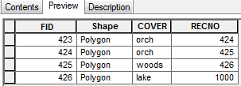
In class - Exploring cursor objects (Part 2)

Slide 80
Updating rows
# DON’T DO THIS!
import arcpy
arcpy.env.workspace = "C:/gispy/scratch/"
fc = "park.shp"
# Get an update cursor.
uc = arcpy.da.UpdateCursor(fc, "*")
# Update lake rows.
for row in uc:
if row[2] == "lake":
row[3] = 1000
del uc
before
after
NO changes are made to the data attribute table.

Slide 81
Updating rows with updateRow
NO changes are made to the data attribute table, until they are
committed with the updateRow method.
# DO THIS.
import arcpy
arcpy.env.workspace = "C:/gispy/scratch/"
fc = "park.shp"
# Get an update cursor.
uc = arcpy.da.UpdateCursor(fc, "*")
# Update lake rows.
for row in uc:
if row[2] == "lake":
row[3] = 1000
uc.updateRow(row)
del uc
before
after
Notes:
NO changes are made to the data attribute table until the change is committed with the updateRow method.

Slide 82
Deleting a row
import arcpy
arcpy.env.workspace = "C:/gispy/scratch/"
fc = "park.shp"
uc = arcpy.da.UpdateCursor(in_table=fc, field_names=["*"])
# Get first row.
row = next(uc)
# Delete the row.
uc.deleteRow()
del uc
Notes:
import arcpy
arcpy.env.overwriteOutput = True
arcpy.env.workspace = "C:/gispy/scratch/"
fc = "park.shp"
arcpy.management.Copy(fc, "foo.shp")
count1 = arcpy.management.GetCount("foo.shp")
print(f"count1={count1}")
uc = arcpy.da.UpdateCursor(in_table="foo.shp", field_names=["*"])
# Get first row.
row = next(uc)
# Delete the row.
uc.deleteRow()
count2 = arcpy.management.GetCount("foo.shp")
print(f"count2={count2}")
del uc
count3 = arcpy.management.GetCount("foo.shp")
print(f"count3={count3}")

Slide 83
Deleting a row
import arcpy
arcpy.env.workspace = "C:/gispy/scratch/"
fc = "park.shp"
uc = arcpy.da.UpdateCursor(in_table=fc, field_names=["*"])
# Get first row.
row = next(uc)
# Delete the row.
uc.deleteRow()
del uc
deleteRow, like updateRow is an UpdateCursor method.
Notes:
import arcpy
arcpy.env.overwriteOutput = True
arcpy.env.workspace = "C:/gispy/scratch/"
fc = "park.shp"
arcpy.management.Copy(fc, "foo.shp")
count1 = arcpy.management.GetCount("foo.shp")
print(f"count1={count1}")
uc = arcpy.da.UpdateCursor(in_table="foo.shp", field_names=["*"])
# Get first row.
row = next(uc)
# Delete the row.
uc.deleteRow()
count2 = arcpy.management.GetCount("foo.shp")
print(f"count2={count2}")
del uc
count3 = arcpy.management.GetCount("foo.shp")
print(f"count3={count3}")

Slide 84
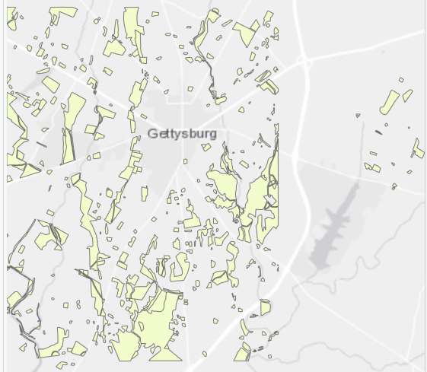
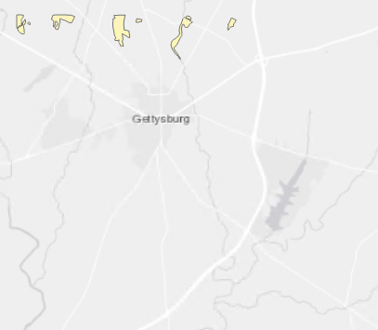
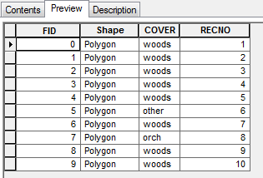
Deleting rows
before
import arcpy
arcpy.env.workspace = "C:/gispy/scratch/"
fc = "park.shp"
# Get only the rows to delete.
uc = arcpy.da.UpdateCursor(
in_table=fc,
field_names=["*"],
where_clause="RECNO > 10")
for row in uc:
uc.deleteRow()
del uc
after

Slide 85
Delete row & check the count
import arcpy
arcpy.env.workspace = "C:/gispy/scratch/"
fc = "park.shp"
# How many records are there at first? count1 = arcpy.management.GetCount(fc)
print(f"count1={count1}")
uc = arcpy.da.UpdateCursor(in_table=fc, field_names=["*"])
row = next(uc)
# Delete the row.
uc.deleteRow()
# Now how many rows are there?
count2 = arcpy.management.GetCount(fc)
print(f"count2={count2}")
del uc
# How about now? count3 = arcpy.management.GetCount(fc)
print(f"count3={count3}")
Notes:
import arcpy
arcpy.env.overwriteOutput = True
arcpy.env.workspace = "C:/gispy/scratch/"
fc = "park.shp"
arcpy.management.Copy(fc, "foo.shp")
count1 = arcpy.management.GetCount("foo.shp")
print(f"count1={count1}")
uc = arcpy.da.UpdateCursor(in_table="foo.shp", field_names=["*"])
# Get first row.
row = next(uc)
# Delete the row.
uc.deleteRow()
count2 = arcpy.management.GetCount("foo.shp")
print(f"count2={count2}")
del uc
count3 = arcpy.management.GetCount("foo.shp")
print(f"count3={count3}")

Slide 86
Delete row & check the count
import arcpy
arcpy.env.workspace = "C:/gispy/scratch/"
fc = "park.shp"
# How many records are there at first? count1 = arcpy.management.GetCount(fc)
print(f"count1={count1}")
uc = arcpy.da.UpdateCursor(in_table=fc, field_names=["*"])
row = next(uc)
# Delete the row.
uc.deleteRow()
# Now how many rows are there?
count2 = arcpy.management.GetCount(fc)
print(f"count2={count2}")
del uc
# How about now? count3 = arcpy.management.GetCount(fc)
print(f"count3={count3}")
count1=426
count2=426
count3=425
Notes:
import arcpy
arcpy.env.overwriteOutput = True
arcpy.env.workspace = "C:/gispy/scratch/"
fc = "park.shp"
arcpy.management.Copy(fc, "foo.shp")
count1 = arcpy.management.GetCount("foo.shp")
print(f"count1={count1}")
uc = arcpy.da.UpdateCursor(in_table="foo.shp", field_names=["*"])
# Get first row.
row = next(uc)
# Delete the row.
uc.deleteRow()
count2 = arcpy.management.GetCount("foo.shp")
print(f"count2={count2}")
del uc
count3 = arcpy.management.GetCount("foo.shp")
print(f"count3={count3}")

Slide 87
Delete row & check the count
import arcpy
arcpy.env.workspace = "C:/gispy/scratch/"
fc = "park.shp"
# How many records are there at first? count1 = arcpy.management.GetCount(fc)
print(f"count1={count1}")
uc = arcpy.da.UpdateCursor(in_table=fc, field_names=["*"])
row = next(uc)
# Delete the row.
uc.deleteRow()
# Now how many rows are there?
count2 = arcpy.management.GetCount(fc)
print(f"count2={count2}")
del uc
# How about now? count3 = arcpy.management.GetCount(fc)
print(f"count3={count3}")
The update is only committed after the cursor object is destroyed.
count1=426
count2=426
count3=425
Notes:
import arcpy
arcpy.env.overwriteOutput = True
arcpy.env.workspace = "C:/gispy/scratch/"
fc = "park.shp"
arcpy.management.Copy(fc, "foo.shp")
count1 = arcpy.management.GetCount("foo.shp")
print(f"count1={count1}")
uc = arcpy.da.UpdateCursor(in_table="foo.shp", field_names=["*"])
# Get first row.
row = next(uc)
# Delete the row.
uc.deleteRow()
count2 = arcpy.management.GetCount("foo.shp")
print(f"count2={count2}")
del uc
count3 = arcpy.management.GetCount("foo.shp")
print(f"count3={count3}")

Slide 88
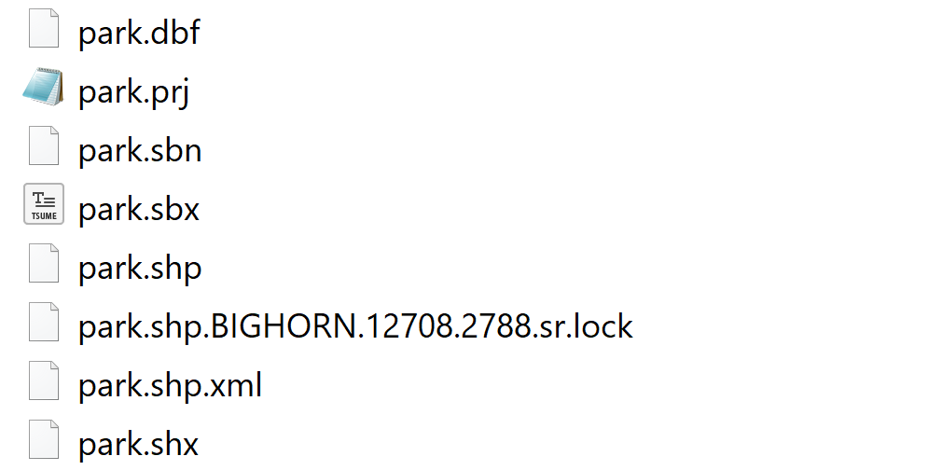
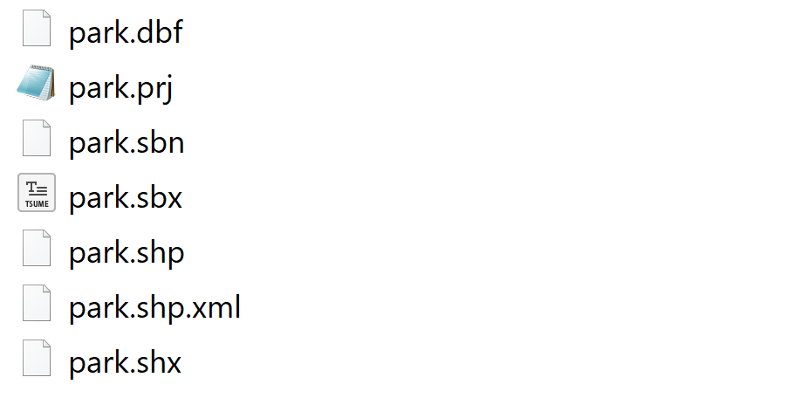
Deleting the cursor object
fc = " C:/gispy/scratch/park.shp"
cursor = arcpy.da.InsertCursor(fc, "*")
del cursor

Slide 89
Deleting the cursor object
fc = " C:/gispy/scratch/park.shp"
cursor = arcpy.da.InsertCursor(fc, "*")
del cursor
All cursor types lock the data.

Slide 90
deleteRow versus del
# Delete a row in the attribute table.
uc.deleteRow()
# Delete cursor objects to avoid locking issues.
del uc
Deletes GIS tabular data records
It’s an arcpy UpdateCursor method.
It is defined by the arcpy package.
Deletes the Python object created during code execution.
del is a Python keyword
It is not defined by the arcpy package.
All pending changes to the data (caused by an update or insert cursor) are committed and all locks on the dataset are removed.
Always delete arcpy cursors.

Slide 91
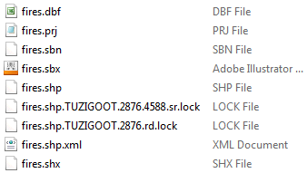
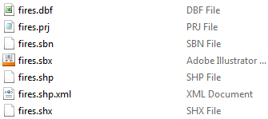
Using with … as
import arcpy
fc = "C:/Temp/fires.shp"
sc = arcpy.da.SearchCursor (fc, ["FID"])
for row in sc:
print(row[150])
del sc
Traceback (most recent call last):
File "c:/gispy/scratch/proTest.py", line 5, in <module>
print(row[150])
IndexError: tuple index out of range
import arcpy
fc = "C:/Temp/fires.shp"
with arcpy.da.SearchCursor(fc, ["FID"]) as sc:
for row in sc:
print(row[150])
del sc
Locks still not always released—e.g., In a Jupyter Notebook run from VS Code.
Restart VS Code to unlock.

Slide 92
Error handling with cursors
Create the cursor
try:
Use the cursor
except:
print the traceback
finally:
delete the cursor
finally is a Python keyword. b
finally block is always executed, regardless of whether an exception is thrown.

Slide 93
Error handling and removing locks
import arcpy, traceback
arcpy.env.workspace = "C:/gispy/scratch/"
fc = "park.shp"
sc = arcpy.da.SearchCursor(in_table=fc, field_names=["FID"])
try:
for row in sc:
print(row_bogus)
except:
# Add a specific message for locating the issue.
print(f"An error occurred when trying to read {fc}")
# Print the exception.
traceback.print_exc()
finally:
del sc
Locks still not always released—e.g., In a Jupyter Notebook run from VS Code.
Restart VS Code to unlock.

Slide 94
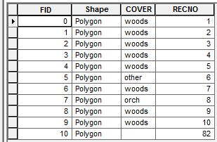
Insert cursor
before
Create a list or tuple with row values.*
Create InsertCursor.
Insert the new row.
import arcpy
arcpy.env.workspace = "C:/gispy/"
fc = "park.shp"
# Get an insert cursor.
ic = arcpy.da.InsertCursor(
in_table=fc,
field_names=["RECNO"])
row_list = [82] # Insert new row.
ic.insertRow(row_list)
del ic
after
Notes:
A list or tuple of values.

Slide 95
Insert cursor
before
Create a list or tuple with row values.*
Create InsertCursor.
Insert the new row.
import arcpy
arcpy.env.workspace = "C:/gispy/scratch"
fc = "park.shp"
# Get an insert cursor.
ic = arcpy.da.InsertCursor(
in_table=fc,
field_names=["RECNO"])
row_list = [82] # Insert new row.
ic.insertRow(row_list)
del ic
after
* The order of values must be in the same order as specified when creating the cursor.
Notes:
A list or tuple of values.

Slide 96
Insert cursor
before
Create a list or tuple with row values.*
Create InsertCursor.
Insert the new row.
import arcpy
arcpy.env.workspace = "C:/gispy/scratch"
fc = "park.shp"
# Get an insert cursor.
ic = arcpy.da.InsertCursor(
in_table=fc,
field_names=["RECNO"])
row_list = [82] # Insert new row.
ic.insertRow(row_list)
del ic
after
New row in table
Polygon geometry is not defined.
No Polygon will be displayed.
Notes:
A list or tuple of values.

Slide 97
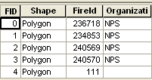
To set the Shape field
Need to create a Geometry object
Point, Multipoint, Polyline, or Polygon
hospital_point = arcpy.Point(-70.1, 42.07)
temp_array = arcpy.Array([arcpy.Point(459111.66, 5010433.12),
arcpy.Point(472516.38, 5001431.08),
arcpy.Point(477710.81, 4986587.10)])
rail_polyline = arcpy.Polyline(temp_array)

Slide 98
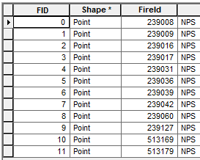
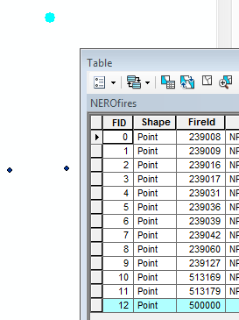
Inserting a point
before
import arcpy
arcpy.env.workspace = "C:/gispy/scratch"
fc = "fires.shp"
ic = arcpy.da.InsertCursor(
in_table=fc,
field_names=["FIREID", "SHAPE@"])
# Create Point object.
the_point = arcpy.Point(-70.10, 42.07)
# Put the row FIREID and Point in a list.
the_row = [500000, the_point]
# Insert the new row.
ic.insertRow(the_row)
del ic
after
New point
and
row in table
Notes:
The order of values must be in the same order as specified when creating the cursor.

Slide 99
Summing up
Topics discussed
search and update cursors
geometry object
where clauses
deleting cursors
The with keyword
handling exceptions with try/except/finally

Slide 100
Appendix

Slide 101
RuntimeError you might encounter
Simple code that throws an error on line 5
1| import arcpy
2| 3| arcpy.env.workspace = r"C:\theDatabase.gdb\" 4| uc = arcpy.da.UpdateCursor("imgPoints", "*")
5| for entry in uc:
6| print(entry)
7| del uc
Error: Unhandled exception while debugging... Traceback (most recent call last): File "C:\theScript.py", line 5, in <module> for entry in uc: RuntimeError: Objects in this class cannot be updated outside an edit session
"imgPoints" was created using the GeoTagged Photos To Points (Data Management) tool.
The photo points are in a relationship class with the photos.

Slide 102
Edit session example
arcpy.env.workspace = r"C:\theDatabase.gdb")
with arcpy.da.Editor(arcpy.env.workspace) as edit:
uc = arcpy.da.UpdateCursor("imgPoints", "*")
for entry in uc:
print(entry)
del uc

Slide 103
When is an edit session needed?
From the UpdateCursor help:
Some of the dataset types that can only be edited within an edit session:
Feature classes participating in a topology
Feature classes participating in a geometric network
Feature classes participating in a network dataset
Versioned datasets in enterprise geodatabases
Some object and feature classes with class extensions
Opening simultaneous insert or update operations on the same workspace using different cursors requires the start of an edit session.

Slide 104
Edit session
When you're trying to update an attribute table and you see this error:
RuntimeError: Objects in this class cannot be updated outside an edit session
Try wrapping your cursor code in an edit session. That will involve adding a line of code like this...
with arcpy.da.Editor(workspacePath) as edit:

Slide 105
Summing up
Topics discussed
search and update cursors
geometry object
where clauses
deleting cursors
The with keyword
handling exceptions with try/except
Up next
Python dictionaries
Additional topics
Insert cursors
the SpatialReference object

Slide 106
More looping
# Delete in a loop
fc = "C:/Temp/COVER63p.shp"
uc = arcpy.da.UpdateCursor(fc, ["*"], "RECNO > 10")
for row in uc:
uc.deleteRow( )
del uc
# Enumerate with cursors
sc = arcpy.da.SearchCursor(fc, "*")
for i, row in enumerate(uc):
if i < 5:
print row[0]
del sc

Slide 107
Find 7 mistakes
Goal: Add 15 to the length field for rows that have a typeID of 'regular'.
import arcpy
# Get an update cursor.
uc = arcpy.da.updatecursor("myfile.shp", ['typeID', 'length'])
for row in uc
# Find the rows with typeID "regular".
if row[3] = "regular":
# Add 15 to the length.
row[1] = row[1] + 15
Notes:
updatecursor should be UpdateCursor
need to specify the workspace or give the full path file name.
missing colon on the FOR-loop line.
single = should be double ==
row[3] should be row[0]
missing uc.updateRow(row)
missing del uc

Slide 108
Update a field based on another field
Purpose: Add 15 to the length field for rows that have a typeID of 'regular'.
import arcpy
arcpy.env.workspace = "C:/Temp"
# Get an update cursor.
uc = arcpy.da.UpdateCursor("myfile.shp", ['typeID', 'length'])
for row in uc:
# Find the rows with typeID "regular".
if row[0] == "regular":
# Add 15 to the length.
row[1] = row[1] + 15
uc.updateRow(row)
del uc

Slide 109
Update a field based on another field
Purpose: Add 15 to the length field for rows that have a typeID of 'regular’.
import arcpy, traceback
# Get an update cursor.
arcpy.env.workspace = "C:/Temp"
uc = arcpy.da.UpdateCursor(in_table="myfile.shp",
field_names=["typeID", "length"])
try:
for row in uc:
# Find the rows with typeID "regular".
if row[0] == "regular":
# Add 15 to the length.
row[1] = row[1] + 15
uc.updateRow(row)
except:
traceback.print_exception()
finally:
del uc
Notes:
Same as previous, but with error handling and keyword arguments.

Slide 110
Spatial Reference object
The coordinate system, tolerance, and resolution used to store a spatial dataset.
prjFile = “C:/Program Files/ArcGIS/Desktop10.0/Coordinate Systems/Projected Coordinate Systems" + \ "/Continental/North America/USA Contiguous Equidistant Conic.prj"
# Create a spatial reference object using a projection file
sr = arcpy.SpatialReference(prjFile)

