Slide 1

Data structures: lists and tuples
String Methods
The list data type
List operations and methods
The tuple data type
Tuple operations and methods
Dr. Tateosian

Slide 2
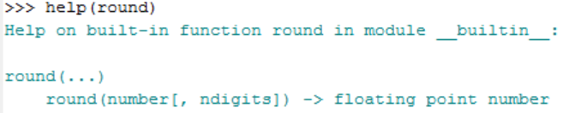
Terminology Review
Name the data type of each of the variables a through g
a = 5890000000000
  b = 6.58900000000001
  c = 89j
  d = True
  e = "589"
  f = "ape" in "apricot"
  g = len
Use any of the following terms that apply to describe the code snippet on lines 1-3: string literal, indexing, concatenation, slicing, assignment statement, finding the length of, string variable, calling a function, and checking for membership in.
Line 1| fruit = "apricot"
Line 2| river = fruit[2:4] + fruit[5]
Line 3| print(river in fruit)
Use these function-related terms, calling a function, passing an argument, parameter, return value, and signature, in sentences to describe what you see below:
Notes:
Name the data type of each of the variables a through g
a = 5890000000000
a is an integer number
b = 6.58900000000001
b is a float number
c = 89j
c is a complex number
d = True
d is a Boolean
e = "589"
e is a String
f = "ape" in "apricot"
Boolean
g = len
g has been assigned a built-in function
Use any of the following terms that apply to describe the code snippet string literal, indexing, concatenation, slicing, assignment statement, finding the length of, string variable, calling a function, and checking from membership in.
Line 1 | fruit = "apricot"
Line 2 | river = fruit[2:4] + fruit[5]
Line 3 | print(river in fruit)
Lines 1 and 2 are assignment statements.
Line 1 has a string literal ("apricot") and a string variable (fruit).
Line 2 uses has slicing fruit[2:4], indexing fruit[5], and concatenation fruit[2:4] + fruit[5].
Line 3 checks for membership in.
The terms finding the length of and calling a function do not apply in this code.
By the way, what does (fruit[2:4] + fruit[5]) give you?
3. Use these function-related terms, calling, passing an argument, parameter, return value, and signature, in sentences to describe what you see below:
>>> help(round)
Help on built-in function round in module __builtin__:
round(...)
round(number[, ndigits]) -> floating point number
Answers
This code calls the help function.
The round function is passed as an argument into the help function.
The round function requires one parameter, a number. Optionally, a second parameter, the number of digits (ndigits), can be used.
The return value of the round function is a floating point number.
The signature of the round number is round(number[, ndigits])

Slide 3
Lists []
a flexible a container of a sequence of objects.
use square braces, surrounding comma separated items.
>>> vec = [2, 4, 6, 8] # I’m a list.
store any mixture of data types in a list (numbers, strings, Booleans, lists, etc.
>>> mylist = ["Wake", 27695, "NC"] # Me too.
don’t need to decide ahead of time how many elements will be in the list. Grows dynamically as needed.
can be empty; create an empty list:
mylist = [ ]
many functions return lists
>>> fcs = arcpy.ListFeatureClasses()
>>> print(fcs)
['data1.shp', 'park.shp', 'USA.shp']
>>> theTime = "11:50:22.040000"
>>> timeList = time.split(":")
>>> print(timeList)
['11', '50', '22.040000']
Notes:
#List comprehension
>>> vec = [2, 4, 6]
>>> [3*x for x in vec]
[6, 12, 18]
#Checking for membership
>>> 12 in vec
True

Slide 4
Common list operations
indexing | >>> myList = ["fee","fi","fo","fum","I"] >>> myList[3] 'fum'
concatenation | >>> vec = [2, 4, 6] >>> fcs = ["roads", "cities", "states"] >>> vec + fcs [2, 4, 6, "roads", "cities", "states"]
slicing | >>> myAlpha = ["a","b","c","d","e"] >>> myAlpha[1:4] ['b', 'c', 'd']
Finding length | >>> len(myAlpha) 5
Checking for membership in | 'roads' in myAlpha False

Slide 5
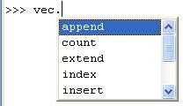
List Methods
Functions associated with lists.
Link to list method documentation
append, extend, count, index, pop, insert, remove, reverse, sort
>>> vec = [2,4,6]
>>> vec.reverse()
>>> vec
[6, 4, 2]
>>> vec.append(55)
>>> vec
[6, 4, 2, 55]
>>> vec.insert(3, “GIS”)
>>> vec
[6, 4, 2, "GIS", 55]
object.method(argument 1, argument 2, …)
no arguments
object method
one argument
two arguments

Slide 6
More list method examples
>>> myList = ["GIS", 540, "GIS" , 530, 550, "GIS"]
>>> myList.extend(["a","b","c"])
>>> myList
["GIS", 540, "GIS", 530, 550, "GIS", "a", "b", "c"]
>>> myList.index("GIS")
0
>>> myList.pop()
'c'
>>> myList
['GIS', 540, 'GIS', 530, 550, 'GIS', 'a', 'b']
>>> myList.count('GIS')
3
>>> myList.count(5)
0

Slide 7
Comparing string and list methods
Watch what lower does…
>>> myStr = "GISSISSII"
>>> myStr.lower()
'gississii'
>>> myStr.islower()
False
>>> myStr
'GISSISSII'
Watch what remove does…
>>> myList =["GIS", 540, "GIS", 530, 550, "GIS"]
>>> myList.remove("GIS")
>>> myList
[540, 'GIS', 530, 550, 'GIS']
>>> myList.count("GIS")
2
>>> print(myList.sort())
None
>>> myList
[530, 540, 550, 'GIS', 'GIS']
String methods never alter the original string itself.
They only ever return a value.
List methods often alter the original list itself.
  append, extend, pop, insert, remove, reverse, and sort alter the original list.
  Only count and index don’t alter the list.
Most list methods return None.
  Only count, pop, and index return a value other than None.

Slide 8
IN PLACE vs returning the result
IN PLACE methods change the original variable
  >>> vec = ["b","a","c"]
  >>> vec.sort()
  >>> vec
  ['a', 'b', 'c']
  >>> print(vec.sort())
  None
Return the results: Methods are not IN PLACE, perform the action but…
  They do not change the original variable
    >>> myStr = "GIS"
    >>> myStr.replace("IS", "oose" )
    'Goose'
    >>> myStr
    'GIS'
  To keep results must assign to a variable
  >>> newStr = myStr.replace("IS", "oose" )
    >>> newStr
    'Goose'
List methods are IN PLACE. String methods are not.

Slide 9
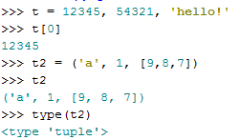
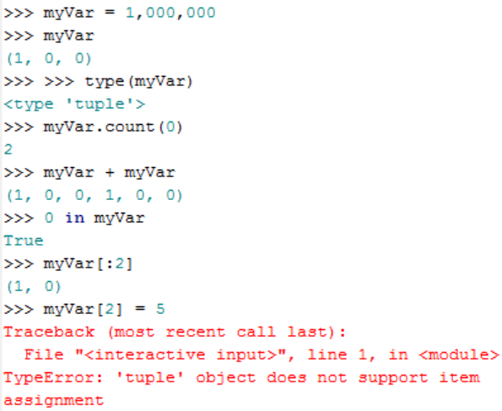
Tuples
Another built-in Python sequence data type
Objects values separated by commas but surrounded by round brackets (parentheses)
Tuple methods
  count, index
Operations include indexing, concatenation, finding length, membership in.
Reassigning indexed items, e.g., myVar[2] = 5 is not allowed.
Create am empty tuple
t = ()
Examples of usage:
  Read-only data.
  (x, y) coordinate pairs
  employee records from a database

Slide 10
Mutable vs immutable (changeable or not)
Mutable objects: individual elements of a mutable object are changeable one created
…and those of an immutable object are not.
Lists are mutable
>>> mylist = ["a","b","c"]
>>> mylist[0] = "z"
>>> mylist
['z', 'b', 'c']
But strings and tuples aren't.
>>> mystr = "abc"
>>> mystr[0] = "z"
TypeError: 'str' object does not support item assignment
>>> myTuple = (1, 2, 3)
>>> myTuple[2] = 5
TypeError: 'tuple' object does not support item assignment

Slide 11
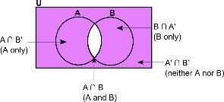
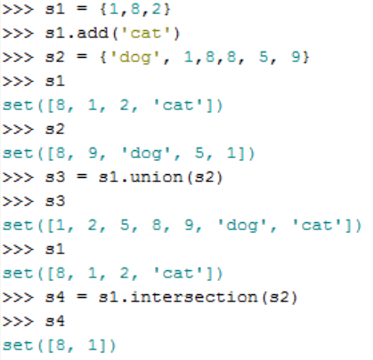
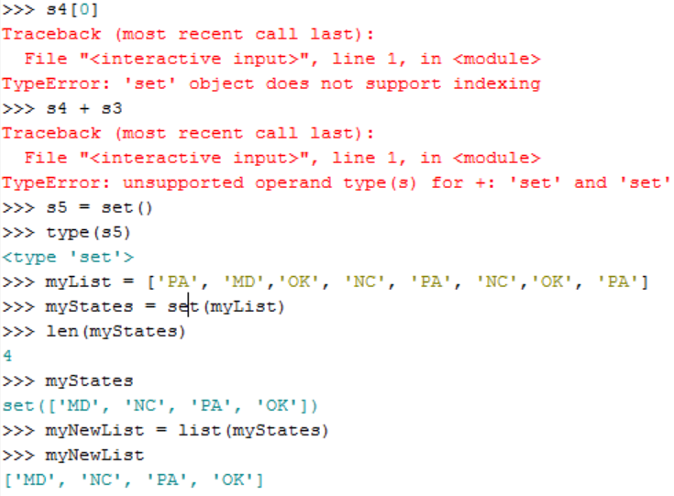
Sets
Another built-in Python sequence data type
Unordered collection of unique items.
Set methods
issubset, issuperset, union, intersection, difference, symmetric_difference, add, update, discard,remove, pop, … (and more)
Creating a set
  An empty set:
  mySet1 = set()
  With known items:
  mySet2 = {"a", 1, 4j}
  Form a set by casting from a list:
  mySet3 = set(myList)
Set operations include finding length, membership in and not a member of.
  >>> len(mySet2)
  3
  >>> 1 in mySet2
  True
  >>> 2 not in mySet2
  True
NO indexing or concatenation.
Example of usage:
  Get the set unique elements in a list.

Slide 12
HANDS ON! convertLat.py:
Goal Code to convert degrees, minutes, seconds to decimal degrees.
Hints Write one or more line of code for each double-hash (##) comment.
Example lat = "30d-15m-50s"
Assumptions
  lat is for latitude North
  dash (-) is used to separate degrees, minutes, and seconds.
  degrees value is followed by d, minutes value is followed by m, seconds value is followed by s
Caution don’t assume lat will always have 2-digit numbers for deg, min, sec.
How
Use the split method, indexing, the rstrip method, casting, math operations, and the format method.
Code examples
>>> path = "C:/Temp/buffer/output.shp"
>>> p = path.split("/")
>>> print(p)
['C:', 'Temp', 'buffer', 'output.shp']
>>> path.rstrip(".shp")
'C:/Temp/buffer/output'
Notes:
['C:', 'Temp', 'buffer', 'output.shp'] # split output is a list

Slide 13
Summing up
Topics discussed
    Additional strings methods
    List data type
    List indexing, slicing, concatenation, len, in keyword
    Calling list methods (object.method format again)
    String vs. list methods
    In place (list) versus return value (string) methods
    Tuples operations and methods
    A use for the Set data type
Up next
    calling geoprocessing tools
Additional topics
    dictionaries
    file objects
    user defined objects

Slide 14
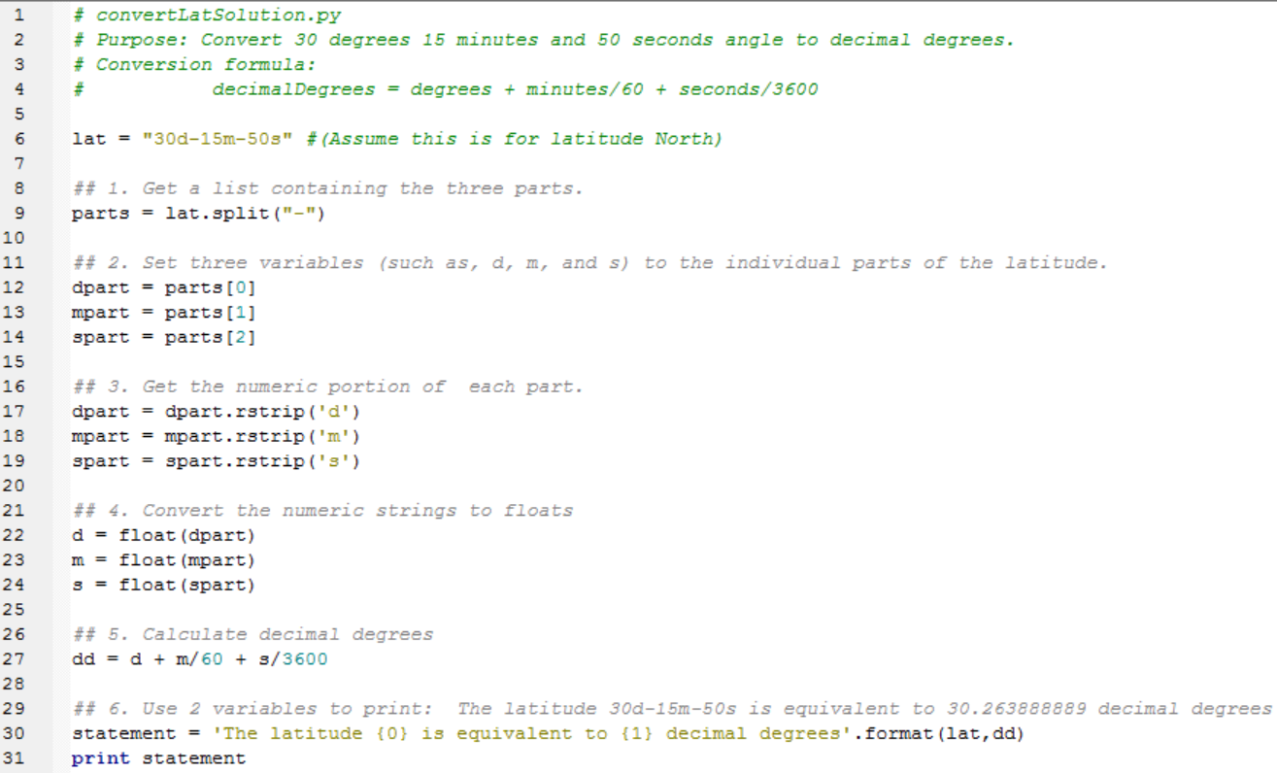
convertLatSolution.py
( )
Notes:
# convertLat3.py
# Purpose: Read a file containing latitudes and convert from
# decimal-minute-second format to decimal degrees.
# Usage: csv_file_with_latitude_in_second_column
# Example: C:/gispy/scratch/lats2.csv
import sys
# Get the file path from the user.
theFilePath = sys.argv[1]
# Open the latitude file for reading.
inf = open(theFilePath, 'r')
for row in inf:
## 1. Get a list containing the three parts.
rowParts = row.split(',')
dmsLat = rowParts[1]
dmsLat = dmsLat.rstrip()
dmsLatParts = dmsLat.split("-")
## 2. Set three variables (such as, d, m, and s) to the individual parts of the latitude.
deg = dmsLatParts[0]
min = dmsLatParts[1]
sec = dmsLatParts[2]
## 3. Get the numeric portion of each part.
deg = deg.replace('d','')
min = min.replace('m','')
sec = sec.replace('s','')
## 4. Convert the numeric strings to floats
deg = float(deg)
min = float(min)
sec = float(sec)
## 5. Calculate decimal degrees
dd = deg + min/60 + sec/3600
## 6. Use 2 variables to print: The 30d-15m-50s is equivalent to 30.263888889 decimal degrees
print("The latitude {0} is equivalent to {1:.4f} decimal degrees".format(dmsLat, dd))
inf.close()

