Slide 1


Data structures: numbers and strings
Numerical data types
Strings data type
String operations
String methods
Formatting strings
Dr. Tateosian

Slide 2
Built-in data types
numbers
  int x = 5
  float x = 5.0
  complex x = 3+4j
  long x = 30000000510
sequences
  string x = “Ken”
  tuple x = ( 8, “sky”, blue )
  list x = [ name, “rule”, 2]
  dictionary x = { 13 : “Joe”, 58 : “Ida”}
file x = open( “data.txt”, ‘r’)
specialized data types such as dates and times, fixed-type arrays, heap queues, synchronized queues, and sets.

Slide 3
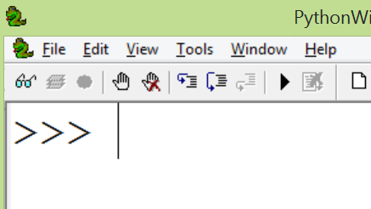
Each data type has…
a set of possible values
    Integers: [-2147483647, 2147483647]
allowable operations (with the same type)
other properties like mutability or immutability
>>> a = 5
>>> b = 6
>>> a + b #Addition operation
11
>>> b**2
36
>>> c = '5'
>>> d = '6'
>>> c + d #Concatenation operation
'56'
>>> d**2
TypeError: unsupported operand type(s) for ** or pow(): 'str' and 'int‘

Slide 4
Numeric data types
Tip Commas are not allowed in Python numbers
e.g., 1,000,000 is not valid
Numerical data types Examples .
  integers ('int') 5 -53336 0
  floating points ('float') 5.002 -0.4 0.0
  complex ('complex') 5j 3 - 6j 0j
  long (‘long') Same as plain integers, but with wider range
Mathematical operations
  Operation Operator Example
  Addition + 7 + 2 = 9
  Subtraction - 7 - 2 = 5
  Multiplication * 7 * 2 = 14
  Division / 7 / 2 = 3
  Exponentiation ** 7**2 = 9
  Modulus division % 7 % 2 = 1
Dynamic typing
  If the value has a decimal, the var’s type is float
float versus integer division
  Caution: integer division truncates
# Example
>>> a = 7
>>> type(a)
<type 'int'>
>>> b = 7.0
>>> type(b)
<type 'float'>
>>> b / 2
3.5000005000000001
>>> a / 2
3
Notes:
-----------------------------------------------------------
DEMO6: NUMBERS
**************
>>> iNum = 7
>>> type(iNum)
<type 'int'>
>>> fNum = 7.0
>>> type(fNum)
<type 'float'>
>>> iNum == fNum
1
>>> fNum = 7.000001
>>> iNum == fNum
0
>>> fNum < iNum
0
>>> fNum > iNum
1
>>> int(fNum) == iNum
1
>>> float(iNum)
7.0
>>> float(iNum) == fNum
0
>>> fNum / 2
3.5000005000000001
>>> iNum / 2
3
>>> iNum / 2.
3.5
>>> divmod(iNum, 2)
(3, 1)
>>> round(fNum / 2) # rounds to the nearest int
4.0
>>> # if you always want to round down:
>>> from math import floor
>>> floor(40.9)
40.0
>>> # the same can be done with:
>>> int(40.9)
40
>>> 3**2
9
>>> 4**0.5
2.0
>>> 1 + 2
3
>>> 1 + 2 +
SyntaxError: invalid syntax
>>> 1 + 2 + \
3
6
-------------------------------------------------------
>>> # other goodies
>>> 1/2
0
>>> # int / int -> int
>>> # and rounds down
>>> # to make it more "natural":
>>> from __future__ import division
>>> 1/2
0.5
>>> # to get int / int -> int:
>>> 1//2
0
>>> # also with '//' we get float/float -> int:
>>> 1.0//2.0
0.0
>>> 0xA
10
>>> # with zero x leading indicates hexadecimals
>>> # Python handles large numbers
>>> 111111111111111111111
111111111111111111111L

Slide 5

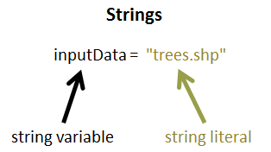
Strings
string: A data type for storing sequences of characters
string literal: A sequence of characters surrounded by quotations marks
string variable: A variable with a string literal value
The difference between these two terms is important, but both of these items are sometimes referred to simply as 'strings'.

Slide 6
String variable vs. string literal
output = "C:/data/clipped.shp"
Printing a string variable prints the value.
Printing a string literal prints that string literally.
Once you set your string variable, don’t use quotes around that name.
Use the variable name without quotation marks to reference the value.
>>> print output
C:/data/clipped.shp
>>> print "output"
output

Slide 7
Creating string literals
    >>> 'I am a string'
    'I am a string'
    >>> "so am I"
    'so am I'
    >>> "Do not do this'
    SyntaxError
    >>> 'Don't do this either'
    SyntaxError
    >>> "Do this. I'd some eggs"
    "Do this. I'd some eggs"
    >>> "123 like *me* &#%"
    '123 like *me* &#%'
  >>> letters = 'a b c
  SyntaxError
  alphabet = """a b c
    d e f"""
    >>> print alphabet
    a b c
    d e f
Can use single, double, or triple quotation marks.
Opening and closing quotes match.
Embedded quotation marks must be different from outer ones.
Strings can contain numbers and special characters.
Start and end quotes must be on the same line, except if triple quotes or a line continuation character is used.

Slide 8
Backslash character in strings
line continuation
escape sequences
file paths
>>> print "C:\national_data"
Escape sequence examples
\b backspace
\n new line
\t tab
\\ \

Slide 9
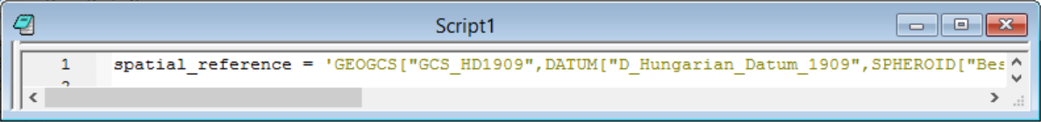
Line continuation character (\)
>>> spatial_reference = 'GEOGCS["GCS_HD1909",DATUM["D_Hungarian_Datum_1909",
SPHEROID["Bessel_1841",6377397.155,299.1528128]],
PRIMEM["Greenwich",0.0],UNIT["Degree",0.0174532925199433]]‘
To avoid scrolling, use line width < 90 characters (roughly)
>>> # Find the number of characters in the spatial_reference string
>>> len(spatial_reference)
158
A string must
  start and end a single line OR
  use a line continuation character ( \) at the end of a line of code OR
  use triple quotes
syntax error
(script won’t run)
Line
continuation
characters

Slide 10
Line continuation versus triple quote
A backslash embedded in a string at the end of a line, allows a string to be written on more than one line.
Triple quotes allows a string to be written on more than one line.
Line continuation | Triple quotes
lettersLC = 'a b c \ d e f \ g h i' >>> print lettersLC a b c d e f g h i | lettersTQ = '''a b c d e f g h i''' >>> print lettersTQ a b c d e f g h i
Preserves single line spacing | Printed on separate lines.

Slide 11
Escape character (\)
Backslash in a string literal, when followed immediately by a character, signifies that what is to follow takes an alternative interpretation. ‘\n’ is an escape sequence.
>>> print "C:\national_data"
C:
ational_data
# Use / or \\ or r
>>> print "C:/national_data" # preferred
C:/national_data
>>> print "C:\\national_data"
C:\national_data
>>> print r"C:\national_data" # raw string
C:\national_data
Escape sequence examples
\b backspace
\n new line
\t tab
\\ \
new line escape sequence

Slide 12
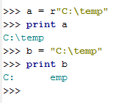
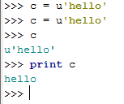

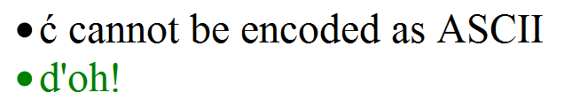
r or u before string literal
What does that little r mean?
  a is a raw string literal
  b is a string literal
  In a raw string literal,
  -a backslash, \, is taken as meaning "just a backslash
  -there are no "escape sequences" to represent newlines, tabs, backspaces, form-feeds, and so on.
What does that little u mean?
  c is a unicode string.
  --In Python 2.* most strings are ASCII
  --ASCII – created in 1963 as the American Standard Code for Information Interchange; each character is one byte; 128 possible characters.
  --Unicode demystified: http://farmdev.com/talks/unicode/
Unicode to the rescue!

Slide 13
Common string operations
indexing (zero-based) | >>> x = “abcde” >>> x[3] ‘d’
concatenation (from Latin com: together + catena: chain) | >>> y = “soup” >>> x + y ‘abcdesoup’
slicing | >>> x[1:4] ‘bcd’
Finding length | >>> len(x) 5
Checking for membership in | >>> ‘abc’ in y False

Slide 14
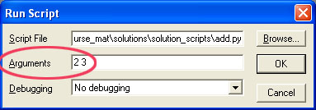


Casting (type conversion)
Recall add.py
print int(sys.argv[1]) + int(sys.argv[2])
5
Casting
  converts a variable value from one type to another (if possible)
Built-in functions: int(x), float(x), str(x), list(x)…
Measurement units for geospatial tools like buffering, near feature, etc.
>>> num = 3.8
>>> unit = "miles"
>>> buff_dist = num + unit
TypeError: unsupported operand type(s) for +: 'int' and 'str'
>>> buff_dist = str(num) + " " + unit
'3.8 miles'
String to integer | Number to string | String to float | When it’s not possible?
>>> val = "6" >>> int(val) 6 | >>> num = 3.8 >>> str(num) '3.8' | >>> val = "-6.25" >>> float(val) -6.25 | >>> val = “foo" >>> int(val) ValueError: invalid literal for int() with base 10: 'foo'
Recall ‘Simple buffer’ example:
arcpy.Buffer_analysis('park.shp', 'C:/gispy/scratch/parkBuffer.shp', '0.25 miles', 'OUTSIDE_ONLY', 'ROUND', 'ALL')
# Purpose: Buffer a park varying buffer distances from 1 to 5 miles.
inName = 'park.shp'
for num in range(1, 6):
# Set the buffer distance based on num ('1 miles', '2 miles', ...).
distance = num + ' ' + 'miles'
# Set the output name based on num ('buffer1.shp', 'buffer2.shp', ...)
outName = outDir + 'buffer{0}.shp'.format(num)
arcpy.Buffer_analysis(inName, outName, distance)
print '{0}{1} created.'.format(outDir, outName)

Slide 15
String methods
Functions associated with strings
Examples: capitalize, upper, lower, count, find, replace, endswith, join, format, startswith,…
String method documentation
>>> bird = 'Parrot'
>>> lowerBird = bird.lower( )
>>> lowerBird
‘parrot’
>>> food = bird.replace('P','C')
>>> food
‘Carrot’
>>> state = 'Mississippi'
>>> state.count('s')
4
object.method(argument 1, argument 2, …)
no arguments
object method
two arguments
one argument

Slide 16
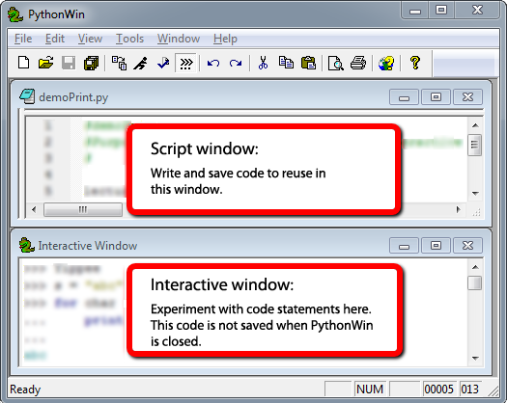
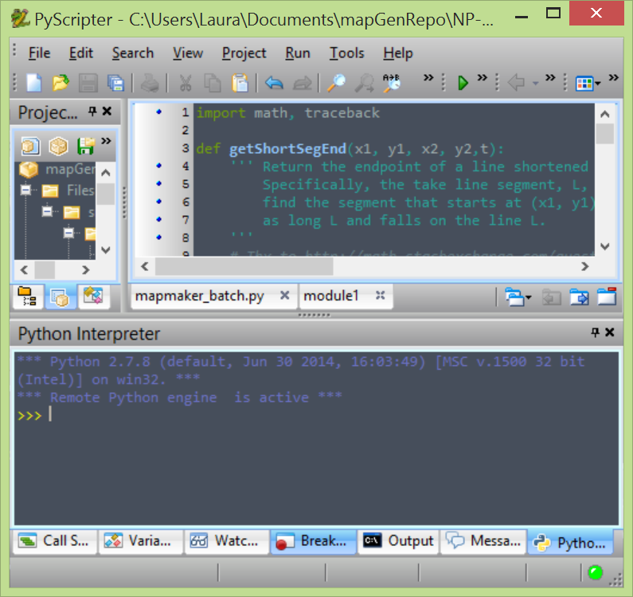
Script vs. Interactive windows
Script Window
  Write code.
  Save code.
  Run code. (Code is not evaluated as soon as you click ‘Enter’)
  Close PythonWin and work is saved.
The interactive environment:
  User types a line of code in the interactive window (for example, 'print "Hello"').
  The user presses 'Enter' to indicate that the line of code is complete.
  The single line of code is run.
  Close PythonWin and all work is lost.
“Python Interpreter” window is interactive window in PyScripter and other IDEs.

Slide 17
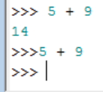
Tips for the interactive window
Interactive window command prompt: >>>
    Must be a space between prompt and code
    Hitting Return takes you to the right spot.
    Don’t space or backspace before typing.
If a command doesn’t work, hit Return key (or Enter key), then retype it.
In the interactive window you can print variable value with or without ‘print’.
  >>> print inputFile
  trees.shp
  >>> inputFile
  'trees.shp‘
IDE session --when you open the IDE, a session starts; when you close the IDE the current session ends. If you open it again, a new ‘session’ starts.
IDEs stores current session command history.
To access previous commands, in PythonWin: Ctrl+ uparrow
in PyScripter: uparrow
Heed Window Focus (the active window)!
  Shift focus to the script window before saving a script (else you might unintentionally save interactive window contents).
A variable assigned a value during the current session keeps that value until it is assigned another value (demo: x = 5)
Within a script, this will not print anything.
Notes:
>>> print FID
>>> FID
>>> 145
>>> print fid

Slide 18
Exercise: Explore string operations
Try each statement in the interactive window & answer the questions.
x = "GIS"
x[0]
x[3]
"s" in x
len(x)
y = "rules"
x = x + y
len(x)
"s" in x
x[0:2]
x[:2]
x[2]
x[1:3]
x[-4:0]
x[:-4]
x
x[3]
print x,y
print x+y
numStr = "742"
numStr.zfill(8)
1. Why does x[3] give an error the 1st time but not the 2nd time?
2. What does Python keyword in do? Does case matter?
3. How could you change the statement x = x+y to print “GIS rules”?
4. What’s the difference between x[:2], x[0:2], and x[2]?
5. What does x[:-4]do?
6. Does x.lower()change the value of x? If so, how?
7. What's the difference between the output of print x,y and print x+y?

Slide 19
‘Explore string operations’ Q & A
x = "GIS"
x[0]
x[3]
"s" in x
len(x)
y = "rules"
x = x + y
len(x)
"s" in x
x[0:2]
x[:2]
x[2]
x[:-4]
x[3]
x
print x,y
print x+y
numStr = "742"
numStr.zfill(8)
1. Why does x[3] give an error the 1st time but not the 2nd time?
There’s no 4th character the first time (but there is the second).
2. What does Python keyword in do? Does case matter?
Checks for membership in. Yes, it’s case sensitive.
3. How could you change the statement x = x+y to print “GIS rules”?
x = x + " " + y
4. What’s the difference between x[:2], x[0:2], and x[2]?
x[:2] slices (returns the first 2 characters). x[0:2] does the same.
x[2] indexes (returns the 3rd character).
5. What does x[:-4] do?
Removes the last 4 characters. If there aren’t 4 character, it returns an empty string.
6. Does x.lower()change the value of x? If so, how?
No! It returns an all lowercase version of x, but x itself is unchanged.
7. What's the difference between the output of print x,y and print x+y?
The comma inserts a space.

Slide 20
‘Explore string ops’ take home messages
Indexing is zero-based.
Indexing throws an ‘IndexError’ exception if the index is greater than n-1, n = length_of_string.
Indexing & slicing look alike; but slicing uses a colon and (optionally) both start & end indices.
Spaces must be inserted explicitly in concatenation.
String methods do NOT alter the string itself. Instead, they ‘return’ the value.
If you are not sure what a method does, try an example in the interactive window and/or look at the string method documentation.

Slide 21


Print strings and numbers
Three methods:
  commas
  concatenation
  string formatting

Slide 22
String ‘format’ method
Combine data types in a string using
  casting and concatenation OR string formatting
Curly braces with numbers inside are place holders in a string literal.
Place things to insert into the string comma separated inside the parentheses
>>> x = 5.3398
>>> unit = 'miles'
>>> inFile = 'trees.shp'
>>> print 'File {0} was buffered with a {1:.2f} {2} buffer.'.format( inFile, x, unit)
File trees.shp was buffered with a 5.34 miles buffer.
>>> a = [1,2,3]
>>> b = 'GIS'
>>> myStr = '{0} is as easy as {1}'.format(b, a)
>>> myStr
'GIS is as easy as [1, 2, 3]'
num = 3.8
unit = "km"
buff_dist = str(num) + " " + unit
num = 3.8
unit = "km"
buff_dist = "{0} {1}".format(num,unit)
{1:.2f} returns two decimal places of a float
Notes:
DEMO7: STRINGS
*********************
>>> first_name = "Laura"
>>> last_name = "Tateosian"
>>> print first_name,last_name
Laura Tateosian
>>> mycat = "Jack“
>>> print mycat[0]
J
>>> print mycat[4]
Traceback (most recent call last): File "<interactive input>", line 1, in ?
IndexError: string index out of range
-----------------------------------------------------------
>>> # you can directly index any sequence which is returned by a function
>>> firstInitial = raw_input("Enter your name ")[0]
Enter your name Laura
>>> firstInitial
‘L'
print “””These triple quotations will preserve the
line breaks”””
print “otherwise you have to
hardcode line breaks”
print “You can do that with the \n carriage return special sequence”
>>> w1 = ‘dough’
>>> w2 = "nut”
>>> breakfast = w1+ w2
>>> print breakfast
doughnut
print “I wish I had a “ + breakfast + “I want a “ + breakfast
>>> w1 = “V”
>>> w2 = 8 #not a string
>>> breakfast = w1+ w2
>>> print breakfast
Typeerror
>>> myst = "candycane"
>>> myst[0:5]
'candy‘
>>> lastname = "Dangermond“
>>> mycat = mycat + lastname
>>> print mycatJackDangermond
#filename as string
------------------------------------------------------------
#Three ways that work:
>>>mydir = “c:/nr536“
>>>mydir = “c:\\nr536“
>>>mydir = r“c:\nr536“ #raw input mode does not convert \n to newline
#One that won’t work:
mydir = “c:\nr536“
>>> mydir ="c:\nr536“
>>> print mydir
c:
r536
-----------------------------------------------------------
>>> # string methods
>>> shapefile = "roads.shp"
>>> len(shapefile)
9
>>> from string import *
>>> capitalize(shapefile)
'Roads.shp'
>>> uppered = upper(shapefile)
>>> uppered
'ROADS.SHP'
>>> lowered = lower(uppered)
>>> lowered
'roads.shp'
>>> count(shapefile, "s")
2
>>> "shp" in shapefile
True
>>> find(shapefile, "shp")
6
>>> replace(shapefile, "roads", "rivers")
'rivers.shp'
>>> index(shapefile, ".")
5
>>> strg = "This is string"
>>> strg.endswith("ing")
True
>>> strg.endswith("ing", -2)
False
>>> space = " "
>>> space.isspace()
True
>>> not_space = "aaa"
>>> not_space.isspace()
False
-----------------------------------------------------------
#String Formatting
>>> print "%s is fabulous in %d and the temperature is %f degrees!" %("Raleigh, NC", 2007, 71.54)
Raleigh, NC is fabulous in 2007 and the temperature is 71.540000 degrees!
>>>print "%s is fabulous in %d and the temperature is %.2f degrees!" %("Raleigh, NC", 2007, 71.54)
Raleigh, NC is fabulous in 2007 and the temperature is 71.54 degrees!

Slide 23
Summing up
Topics discussed
    Data types: integers, float, strings
    Integer division
    String literal versus string variable
    String and list indexing, slicing, concatenation, len, ‘in’ keyword
    String line continuation, escape sequences, raw & unary strings
    String formatting
Up next
    Lists and tuples
Appendix topics
    Commas vs concatenation
    Old school style formatting
    Escaping quotation marks

Slide 24
Appendix

Slide 25
Appendix: Commas versus concatenation
>>> fcName = "park"
>>> count = 1
>>> print "Clip file:", fcName, count, ".shp"
Clip file: park 1 .shp
>>> print "Clip file:" + fcName + count, ".shp"
Typeerror
>>> print "Clip file:" + fcName + str(count) + ".shp"
Clip file:park1.shp
>>> print "Clip file:", fcName + str(count) + ".shp"
Clip file: park1.shp

Slide 26
Appendix: Old school string formatting
Mixing elements (heterogeneous content)
% - conversion specifier
“…%format….” % (what_to_format)
String templates (Template)
>>> x = 5
>>> unit = “miles”
>>> inFile = “trees.shp”
>>> print “File %s was buffered with a %d %s buffer.” % ( inFile, x, unit)
File trees.shp was buffered with a 5 miles buffer.
%d integer
%s string
%f float
%.2f two digits float
Notes:
DEMO7: STRINGS
*********************
>>> first_name = “Jack"
>>> last_name = “BeQuick"
>>> print first_name,last_name
Jack BeQuick
>>> mycat = "Jack“
>>> print mycat[0]
J
>>> print mycat[4]
Traceback (most recent call last): File "<interactive input>", line 1, in ?
IndexError: string index out of range
-----------------------------------------------------------
>>> # you can directly index any sequence which is returned by a function
>>> firstInitial = raw_input("Enter your name ")[0]
Enter your name Jack
>>> firstInitial
‘J’
print “””These triple quotations will preserve the
line breaks”””
print “otherwise you have to
hardcode line breaks”
print “You can do that with the \n carriage return special sequence”
>>> w1 = ‘dough’
>>> w2 = "nut”
>>> breakfast = w1+ w2
>>> print breakfast
doughnut
print “I wish I had a “ + breakfast + “I want a “ + breakfast
>>> w1 = “V”
>>> w2 = 8 #not a string
>>> breakfast = w1+ w2
>>> print breakfast
Typeerror
>>> myst = "candycane"
>>> myst[0:5]
'candy‘
>>> lastname = "Dangermond“
>>> mycat = mycat + lastname
>>> print mycatJackDangermond
#filename as string
------------------------------------------------------------
#Three ways that work:
>>>mydir = “c:/nr536“
>>>mydir = “c:\\nr536“
>>>mydir = r“c:\nr536“ #raw input mode does not convert \n to newline
#One that won’t work:
mydir = “c:\nr536“
>>> mydir ="c:\nr536“
>>> print mydir
c:
r536
-----------------------------------------------------------
>>> # string methods
>>> shapefile = "roads.shp"
>>> len(shapefile)
9
>>> from string import *
>>> capitalize(shapefile)
'Roads.shp'
>>> uppered = upper(shapefile)
>>> uppered
'ROADS.SHP'
>>> lowered = lower(uppered)
>>> lowered
'roads.shp'
>>> count(shapefile, "s")
2
>>> "shp" in shapefile
True
>>> find(shapefile, "shp")
6
>>> replace(shapefile, "roads", "rivers")
'rivers.shp'
>>> index(shapefile, ".")
5
>>> strg = "This is string"
>>> strg.endswith("ing")
True
>>> strg.endswith("ing", -2)
False
>>> space = " "
>>> space.isspace()
True
>>> not_space = "aaa"
>>> not_space.isspace()
False
-----------------------------------------------------------
#String Formatting
>>> print "%s is fabulous in %d and the temperature is %f degrees!" %("Raleigh, NC", 2007, 71.54)
Raleigh, NC is fabulous in 2007 and the temperature is 71.540000 degrees!
>>>print "%s is fabulous in %d and the temperature is %.2f degrees!" %("Raleigh, NC", 2007, 71.54)
Raleigh, NC is fabulous in 2007 and the temperature is 71.54 degrees!

Slide 27
Appendix: More old-school examples
“…%format….” % (what_to_format)
num_parsels = 500
my_polygon = “RTP”
sentence = “%d parcels intersect with %s” %(num_parsels,my_polygon)
print sentence
>>> 500 parcels intersect with RTP
print num_parsels, “parcels intersect with”,my_polygon
>>> 500 parcels intersect with RTP
sentence = num_parsels, “parcels intersect with”,my_polygon
print sentence
>>>(5, 'parcels intersect with', 'selected region')
%d integer
%s string
Notes:
DEMO7: STRINGS
*********************
>>> first_name = “Jack"
>>> last_name = “BeQuick"
>>> print first_name,last_name
Jack BeQuick
>>> mycat = "Jack“
>>> print mycat[0]
J
>>> print mycat[4]
Traceback (most recent call last): File "<interactive input>", line 1, in ?
IndexError: string index out of range
-----------------------------------------------------------
>>> # you can directly index any sequence which is returned by a function
>>> firstInitial = raw_input("Enter your name ")[0]
Enter your name Laura
>>> firstInitial
‘L'
print “””These triple quotations will preserve the
line breaks”””
print “otherwise you have to
hardcode line breaks”
print “You can do that with the \n carriage return special sequence”
>>> w1 = ‘dough’
>>> w2 = "nut”
>>> breakfast = w1+ w2
>>> print breakfast
doughnut
print “I wish I had a “ + breakfast + “I want a “ + breakfast
>>> w1 = “V”
>>> w2 = 8 #not a string
>>> breakfast = w1+ w2
>>> print breakfast
Typeerror
>>> myst = "candycane"
>>> myst[0:5]
'candy‘
>>> lastname = "Dangermond“
>>> mycat = mycat + lastname
>>> print mycatJackDangermond
#filename as string
------------------------------------------------------------
#Three ways that work:
>>>mydir = “c:/nr536“
>>>mydir = “c:\\nr536“
>>>mydir = r“c:\nr536“ #raw input mode does not convert \n to newline
#One that won’t work:
mydir = “c:\nr536“
>>> mydir ="c:\nr536“
>>> print mydir
c:
r536
-----------------------------------------------------------
>>> # string methods
>>> shapefile = "roads.shp"
>>> len(shapefile)
9
>>> from string import *
>>> capitalize(shapefile)
'Roads.shp'
>>> uppered = upper(shapefile)
>>> uppered
'ROADS.SHP'
>>> lowered = lower(uppered)
>>> lowered
'roads.shp'
>>> count(shapefile, "s")
2
>>> "shp" in shapefile
True
>>> find(shapefile, "shp")
6
>>> replace(shapefile, "roads", "rivers")
'rivers.shp'
>>> index(shapefile, ".")
5
>>> strg = "This is string"
>>> strg.endswith("ing")
True
>>> strg.endswith("ing", -2)
False
>>> space = " "
>>> space.isspace()
True
>>> not_space = "aaa"
>>> not_space.isspace()
False
-----------------------------------------------------------
#String Formatting
>>> print "%s is fabulous in %d and the temperature is %f degrees!" %("Raleigh, NC", 2007, 71.54)
Raleigh, NC is fabulous in 2007 and the temperature is 71.540000 degrees!
>>>print "%s is fabulous in %d and the temperature is %.2f degrees!" %("Raleigh, NC", 2007, 71.54)
Raleigh, NC is fabulous in 2007 and the temperature is 71.54 degrees!

Slide 28
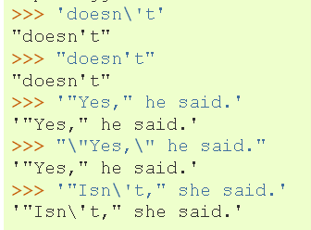
Appendix: Escaping the quotation marks
String ends where it finds the first matching quote.
  >>> 'doesn't'
  'doesn't'
  ^
  Traceback ( File "<interactive input>", line 1 'doesn't'
  SyntaxError: invalid syntax
Use \ or combination of ' and " to make a string which contains quotes.
Escape from the inside quotation mark with a backslash with an escape sequence \' or \"
>>> 'doesn\'t'
"doesn't"
How would you would fix this one?
  >>> "He said, "I love GIS""
Notes:
Fix the last one as follows
>>> "He said, \"I love GIS\""

Slide 29
Appendix: Operations
int
>>> x = 1 # What type is x?
How can I make x a float?
x = 1.0 or x = float(x) #This casts x to a float
What is kind of statement is x = 1?
An assignment statement
What kind of statement is x == 1?
A conditional statement
x = y #What result does this yield?
If y is defined, it sets x equal to y. If not, it throws an exception.

