Slide 1

Fetching and uncompressing files
Fetch HTML
Text vs. binary
Fetch binary web content
Expand files
WakeGov data download
Dr. Tateosian
Notes:
Thanks to drupal for the picture
https://drupal.org/files/project-images/blog-358561.jpeg

Slide 2

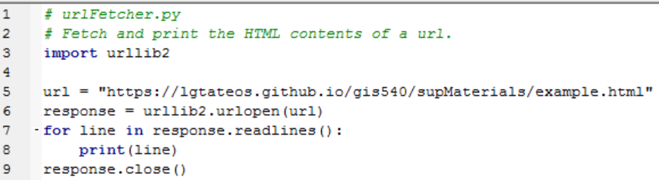
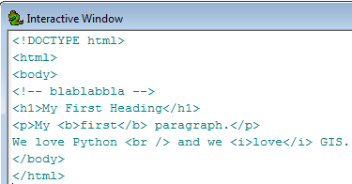
Fetching HTML
urllib2
  Built-in module for fetching web page
  content
  urlopen function returns a file object open for reading (similar to myfile = open(‘data.txt’, ‘r’) )
Notes:
# urlFetcher.py
# Fetch and print the HTML contents of a url.
import urllib2
url = "https://lgtateos.github.io/gis540/supMaterials/example.html"
response = urllib2.urlopen(url)
for line in response.readlines():
print(line)
response.close()

Slide 3
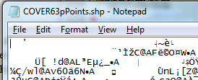
Binary vs. ASCII text files
Two general types of files:
  A text file is readable in Notepad. Text files are also called ASCII files. (Examples: .html, .py, .txt)
  A binary file will not make any sense if you read it in Notepad; it consists mostly of unprintable characters. (Examples: .exe, .zip, .shp)
Different apps. call for different formats. Need to know which type of file when using urllib2 to fetch files.
FTP urls often points to binary files
FTP = file transfer protocol, a network protocol for transferring files from a host machine to another machine.

Slide 4
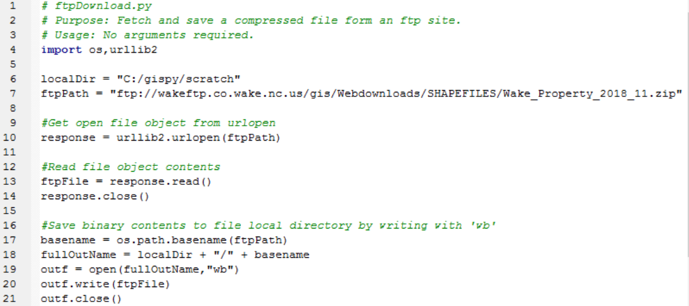
Fetching binary files
Fetch with Python
Use urllib2 to fetch the file
Read the binary file contents
Write the file to disk.
Notes:
import os,urllib2
localDir = "C:/gispy/scratch"
ftpPath = "ftp://wakeftp.co.wake.nc.us/gis/Webdownloads/SHAPEFILES/Wake_Property_2018_11.zip"
#Get open file object from urlopen
response = urllib2.urlopen(ftpPath)
#Read file object contents
ftpFile = response.read()
response.close()
#Save binary contents to file local directory by writing with 'wb'
basename = os.path.basename(ftpPath)
fullOutName = localDir + "/" + basename
outf = open(fullOutName,"wb")
outf.write(ftpFile)
outf.close()

Slide 5
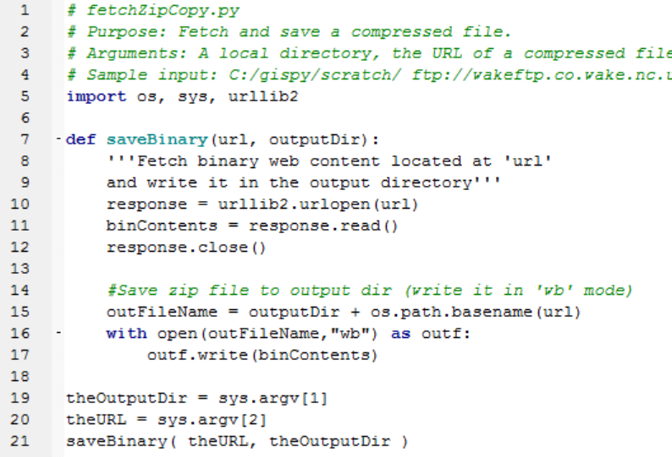
Fetching compressed data
User-defined ‘saveBinary’ function
Notes:
# fetchZipCopy.py
# Purpose: Fetch and save a compressed file.
# Arguments: A local directory, the URL of a compressed file
# Sample input: C:/gispy/scratch/ ftp://wakeftp.co.wake.nc.us/gis/Webdownloads/SHAPEFILES/Wake_Property_2018_11.zip
import os, sys, urllib2
def saveBinary(url, outputDir):
'''Fetch binary web content located at 'url'
and write it in the output directory'''
response = urllib2.urlopen(url)
binContents = response.read()
response.close()
#Save zip file to output dir (write it in 'wb' mode)
outFileName = outputDir + os.path.basename(url)
with open(outFileName,"wb") as outf:
outf.write(binContents)
theoOutputDir = sys.argv[1]
theURL = sys.argv[2]
saveBinary( theURL, theOutputDir )

Slide 6
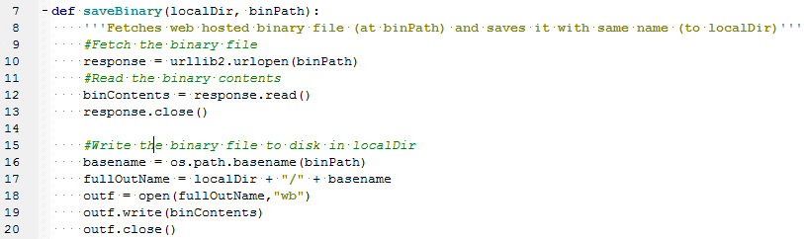

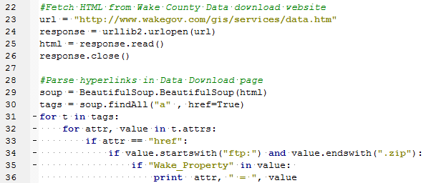
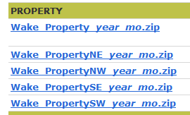
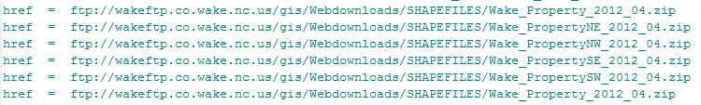
Wake County Data Download
Notes:
http://www.wakegov.com/gis/services/Pages/data.aspx
#wakeURL_solution.py
import os,urllib2, sys, zipfile, traceback
sys.path.append("C:/gispy/scratch") #Make sure path is appended to import local module
import BeautifulSoup
def fetchBinary(localDir, binPath):
'''Fetches web hosted binary file (at binPath) and saves it with same name (to localDir)'''
#Fetch the binary file
response = urllib2.urlopen(binPath)
#Read the binary contents
binContents = response.read()
response.close()
#Write the binary file to disk in localDir
basename = os.path.basename(binPath)
outf = open(localDir + "/" + basename,"wb")
outf.write(binContents)
outf.close()
def unzip(zip,dest):
'''Unzip a compressed file (zip) into the destination directory (dest).'''
print "Unzipping", zip, "to", dest
#Get a zipfile object
zip = zipfile.ZipFile(zip, 'r')
if not os.path.exists(dest):
os.makedirs(dest)
#Get a list of files in the archive
zipList = zip.namelist()
for filename in zipList:
#Get the binary file contents and print the byte count in the current file
binContents = zip.read(filename)
print ' Unzipping file:', filename, 'with', len(binContents), 'bytes..'
#Write the binary file to disk
outf = open(dest + filename, 'wb')
outf.write(binContents)
outf.close()
zip.close
print "Extraction complete."
#Fetch HTML from Wake County Data download website
url = "http://www.wakegov.com/gis/services/data.htm"
response = urllib2.urlopen(url)
html = response.read()
response.close()
#Parse hyperlinks in Data Download page
soup = BeautifulSoup.BeautifulSoup(html)
workingDir= "C:/gispy/scratch/"
tags = soup.findAll("a" , href=True)
#Loop through the links in the html
for t in tags:
#Loop through the attributes in the current link
for attr, value in t.attrs:
#Find the link destination attribute
if attr == "href":
#Find the ftp zipfile link destinations
if value.startswith("ftp:") and value.endswith(".zip"):
#Find the links relating to Wake_Streets
if "Wake_Property" in value:
print attr, " = ", value

Slide 7
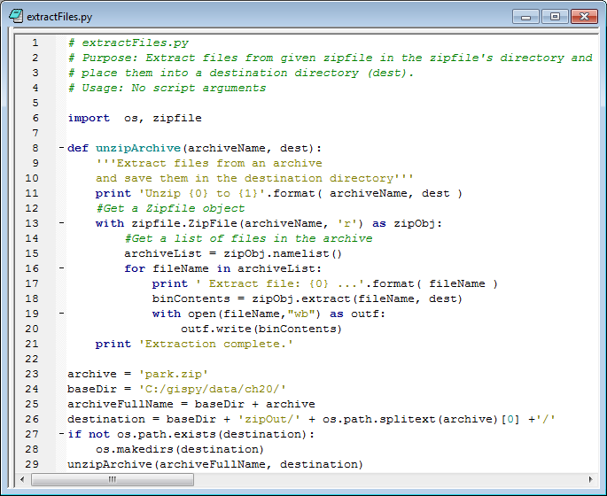
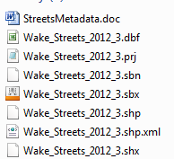
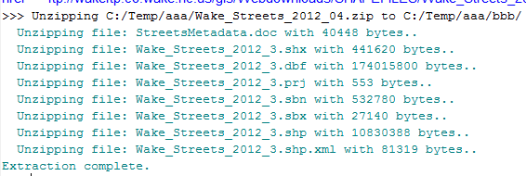
Expanding compressed data
Import zipfile (built-in Python module).
Get zipfile object for given compressed file (e.g., Wake_Streets.zip)
Get the list of files in the zip object -- zip.namelist()
For each file in list,
  Extract the binary contents -- zipObject.Extract(fileName, dest)
Notes:
# extractFiles.py
import os, zipfile
def unzipArchive(archiveName, dest):
'''Extract files from an archive
and extract them in the destination directory'''
print 'Unzip {0} to {1}'.format( archiveName, dest )
#Get a Zipfile object
with zipfile.ZipFile(archiveName, 'r') as zipObj:
#Get a list of files in the archive
archiveList = zipObj.namelist()
for fileName in archiveList:
print ' Extract file: {0} ...'.format( fileName )
binContents = zipObj.extract(fileName, dest)
print 'Extraction complete.'
archive = 'Wake_Streets_2012_04.zip'
baseDir = 'C:/gispy/scratch/'
archiveFullName = baseDir + archive
destination = baseDir + 'zipOut/' + os.path.splitext(archive)[0] +'/'
if not os.path.exists(destination):
os.makedirs(destination)
unzipArchive(archiveFullName, destination)

Slide 8
Fetch and extract workflow
FETCH the data download page.
CREATE a soup object.
GET a list of the links in the data download page.
FOR each link:
IF the link references a Zip file:
CALL fetchZip to fetch the Zip file, saving it locally.
CALL unzipArchive to extract the compressed files.

Slide 9
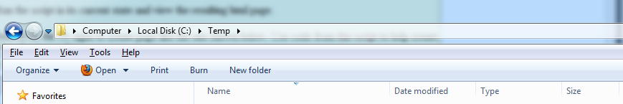
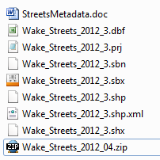
In class - wakeURL.py
1. Save BeautifulSoup.py and wakeURL.py in C:/gispy/scratch
2. Add code to import some built-in modules and BeautifulSoup.
3. Run the script in its current state and view the resulting print statements.
4. Search for the ### signs and add code there to make procedures work and then to call them.
Notes:
import os,urllib2, BeautifulSoup
def saveFTP(localDir, ftpPath):
response = urllib2.urlopen(ftpPath)
ftpFile = response.read()
response.close()
basename = os.path.basename(ftpPath)
fullOutName = localDir + "/" + basename
outf = open(fullOutName,"wb")
outf.write(ftpFile)
outf.close()
url = "http://www.wakegov.com/gis/services/Pages/data.aspx"
response = urllib2.urlopen(url)
html = response.read()
response.close()
soup = BeautifulSoup.BeautifulSoup(html)
references = soup.findAll("a" , href=True)
for link in references:
linkRef = link['href']
if linkRef.startswith("ftp:") and linkRef.endswith(".zip"):
if "Wake_Property" in linkRef:
print link['href']
saveFTP("C:/gispy/scratch", linkRef)

Slide 10
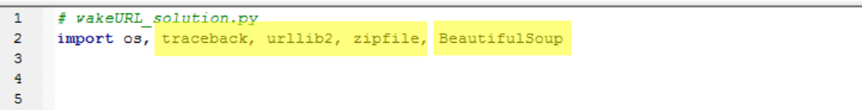

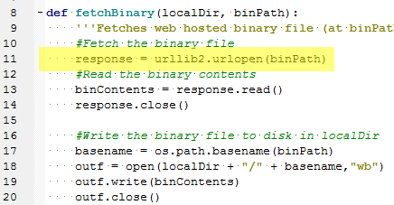
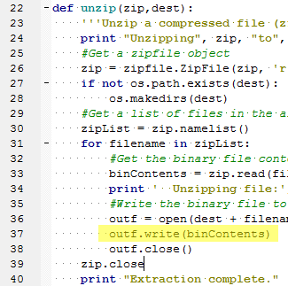
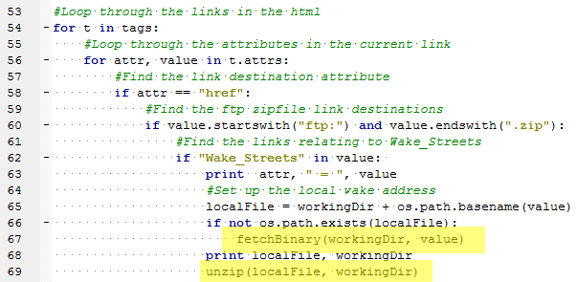
wakeURL followup
Notes:
#wakeURL_solution.py
import os, traceback, urllib2, zipfile, BeautifulSoup
def fetchBinary(localDir, binPath):
'''Fetches web hosted binary file (at binPath) and saves it with same name (to localDir)'''
#Fetch the binary file
response = urllib2.urlopen(binPath)
#Read the binary contents
binContents = response.read()
response.close()
#Write the binary file to disk in localDir
basename = os.path.basename(binPath)
fullOutName = localDir + "/" + basename
outf = open(fullOutName,"wb")
outf.write(binContents)
outf.close()
def unzip(zip,dest):
'''Unzip a compressed file (zip) into the destination directory (dest).'''
print "Unzipping", zip, "to", dest
zip = zipfile.ZipFile(zip, 'r')
if not os.path.exists(dest):
os.makedirs(dest)
for filename in zip.namelist():
try:
bytes = zip.read(filename)
print ' Unzipping file:', filename, 'with', len(bytes), 'bytes..'
fullname = dest + filename
file(fullname, 'wb').write(zip.read(filename))
except:
print "Unzip failed for", filename
traceback.print_exc( )
zip.close
print "Extraction complete."
#Fetch HTML from Wake County Data download website
url = "hhttp://www.wakegov.com/gis/services/Pages/data.aspx"
response = urllib2.urlopen(url)
html = response.read()
response.close()
#Parse hyperlinks in Data Download page
soup = BeautifulSoup.BeautifulSoup(html)
workingDir= "C:/gispy/scratch/"
tags = soup.findAll("a" , href=True)
for t in tags:
for attr, value in t.attrs:
if attr == "href":
if value.startswith("ftp:") and value.endswith(".zip"):
if "Wake_Streets" in value:
print attr, " = ", value
fetchBinary(workingDir, value)
unzip(workingDir + os.path.basename(value), workingDir)

Slide 11

Summing up
Topics discussed
    Fetch HTML
    Text vs. binary
    Fetch binary web content
    Expand compressed files
    WakeGov data download
Notes:
thanks to dogbehavioronline.com for the pic
http://www.dogbehavioronline.com/how-to-train-a-dog-to-fetch/
and we saw how to use the zipfile module to unzip or uncompress files with Python. We combined all of these things in the last in-class exercise, the WakeGov data download example. As an extra challenge, see if you can modify this exercise to download all the street and highway data from this page. The topics in this lecture, enable you to programmatically use data warehouses with exposed links, since you now know how to extract the online data for local use.

