Slide 1


Batch processing with arcpy 'List' methods
Review dot notation, FOR-loops, & geoprocessing methods
Define batch processing
List data in a workspace
Batch geoprocess
Dr. Tateosian
Notes:
I Love Lucy gif, Thanks: https://bendyworks.com/blog/transducers-clojures-next-big-idea

Slide 2
Use split, join, rstrip, index, & startswith to…
1. Break this comma delimited string into a list, rList
>>> record = 'ID, name, latitude, longitude\t\n'
2. Join rList into a semicolon separated string, semicolonRecord
>>> rList = ['ID', 'name', 'latitude', 'longitude\t\n']
Strip the white space from the right side of record
>>> record = 'ID, name, latitude, longitude\t\n'
Find the index of the first instance of 'foo' in myList
>>> myList = ['a', 2, 'foo', 'bla', 'foo']
Check if fileName starts with substring poly. Store answer in a variable named isPolygon
>>> fileName = 'tree_poly'
Notes:
Almost any Python program uses the string and list data types and their methods.
To call these methods you need to use dot notation: object-dot-method (Example: myString.upper() )
For each question on this slide write a line of code that uses a string or list method and dot notation.
The title of the slide provides the names of the methods you need to use in the same order that you need to use them.
Note that #2 is probably the trickiest one…. “join” is a string method and the object needs to be the string separator– the semicolon, as a string literal!

Slide 3
Use split, join, rstrip, index, & startswith to…
1. Break this comma delimited string into a list, rList
>>> record = 'ID, name, latitude, longitude\t\n'
rList = record.split(',')
  >>> rList
  ['ID', ' name', ' latitude', ' longitude\t\n']
2. Join rList into a semicolon separated string, semicolonRecord.
>>> rList = ['ID', 'name', 'latitude', 'longitude\t\n']
semicolonRecord = ';'.join(rList)
>>> semicolonRecord
'ID;name;latitude;longitude\t\n'
Strip the white space from the right side of record
>>> record = 'ID, name, latitude, longitude\t\n'
>>> record.rstrip( )
'ID, name, latitude, longitude'
Find the index of the first instance of 'foo' in myList
>>> myList = ['a', 2, 'foo', 'bla', 'foo']
>>> myList.index('foo')
2
Check if fileName starts with substring poly. Store answer in a variable named isPolygon
>>> fileName = 'tree_poly'
>>> isPolygon = fileName.startswith('poly')
>>> isPolygon
False

Slide 4
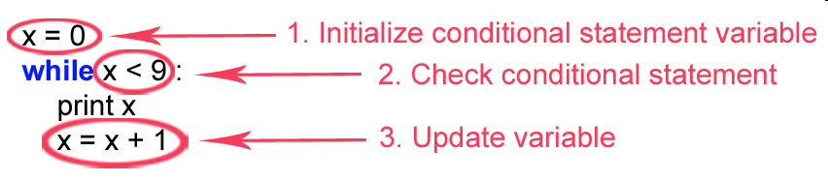
Use a loop to print 2, 4, 6, 8, 10
Use a WHILE-loop
Use a FOR-loop
  x = 2
  while x <= 10:
  print(x)
  x = x + 2
for x in range(2, 11, 2):
print(x)

Slide 5
Use a loop to print 100, 75, 50, 25, 0
Use a WHILE-loop
Use a FOR-loop
  x = 100
  while x >= 0:
  print(x)
  x = x - 25
for x in range(100, -1, -25):
print(x)
Notes:
Here’s a slightly more challenging one, since we haven’t yet done a count down.
Write some code to use a WHILE-loop and then a FOR-loop to print 100, 75, 50, 25, and 0.
For the WHILE-loop, keep in mind that you want to start with 100 and go down to 0 by steps of 25.
That means the initial value of the looping variable should be higher than the final value.
In the case of the FOR-loop, you’ll need to do 3 steps because the range function is not designed to count down.
1) Use the range function to get the list in the opposite order.
2) Then use a list method that reverses the order of the list.
3) Finally, print the values in a FOR-loop.

Slide 6
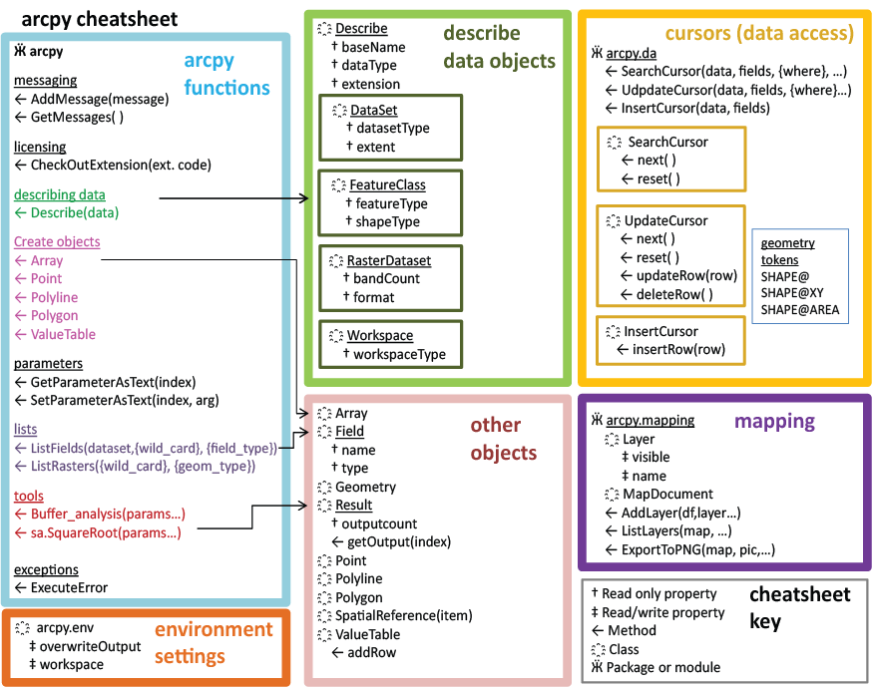
Review: arcpy properties & methods
Set the geoprocessing workspace to C:/data.mdb
  import arcpy
arcpy.env.workspace = 'C:/data.mdb'
Get the data type of myfile
myfile = 'rduForest'
dsc = arcpy.Describe(myfile)
type = dsc.dataType
Call the ArcToolbox clip (analysis) tool
input = 'rivers.shp'
clipfile = 'cityLimits.shp'
output = 'studyRegion.shp'
arcpy.Clip_analysis(input, clipfile, output)
Notes:
The 'import' statement tells Python to point to the arcpy module.
Use ArcToolbox tools with Geoprocessor like any other objects.
System toolboxes are available by default
Any tool from a referenced toolbox can be called as a method.
If pathname has spaces, use r or forward slash
Environment settings are properties.
Always suffix the tool with the toolbox alias.
Must also check out the correct license:
# Check out any necessary licenses
arcpy.CheckOutExtension('spatial')
#To get a complete list of environment variables,
for envVar in arcpy.ListEnvironments():
print envVar
>>> Results will be something like this:
>>> newPrecision
XYResolution
XYDomain
scratchWorkspace
MTolerance
compression
coincidentPoints
randomGenerator
outputCoordinateSystem
rasterStatistics
ZDomain
projectCompare
cartographicCoordinateSystem
configKeyword
outputZFlag
qualifiedFieldNames
tileSizepyramid
referenceScale
extent
XYTolerance
MDomain
spatialGrid1
cellSize
outputZValue
outputMFlag
geographicTransformations
spatialGrid2
ZResolution
mask
spatialGrid3
workspace
MResolution
derivedPrecision
ZTolerance

Slide 7
What is batch processing?
Batch processing
  Grouping sequential steps together to be run on a set (or batch) of items.
Examples:
  Trim toenails, clean ears, give rabies shot to each puppy in the batch.
  Rename every file in a directory to include the modification date.
  Run land cover analysis on each one of a set regions.
  Update the temperature value for each record that in a dataset.
Batch
  set of puppies, directories, set of files, set of data records, set of data columns, etc.
Steps to be repeated
  grooming, geoprocessing, moving, updating, deleting, etc.
Pseudocode: REPETITION (FOR…END FOR, WHILE…END WHILE)
Notes:
We can repeat individual steps (or loop) with FOR-loops and WHILE-loops. One of the main reasons to write a script is because you want to do batch processing.
Batch processing is the grouping together of sequential steps to be run on a set or batch of items.
For example, when your dog has octuplets and you take them to the vet, for each puppy in the batch, she will trim his toenails, clean his ears,…
That’s puppies, but there’s a lot of batch processing in working with data too. You want to rename every file in a directory to include the date they were modified. Or you want to run land cover analysis on each one of a set of remotely sensed data files. Or you want to update the temperature value for each record that in a dataset. These are just a few examples of batch processing.
Batch processing is when you're doing the same step or set of steps on a batch of items.
The items could be puppies, directories, files, records, columns, or other things.
This is exactly what we were talking about when we discussed REPETITION in the pseudocode lecture.

Slide 8
Batch processing pseudocode example
copy raster1 to backup folder
rename raster1
reclassify raster1
copy raster2 to backup folder
rename raster2
reclassify raster2
copy raster3 to backup folder
rename raster3
reclassify raster3
copy raster4 to backup folder
rename raster4
reclassify raster4
copy raster5 to backup folder
rename raster5
reclassify raster5
…
GET a list of the rasters in the workspace.
FOR each raster in list
copy raster to backup folder
rename raster
reclassify raster
ENDFOR
Use batch processing
instead!
Notes:
Suppose you want to rename and reclassify each raster in a workspace, but you want to make a backup copy before doing so.
If you could somehow get a list of all the raster files in the workspace, then you could just repeat the same three sequential steps for each one of them:
copy, rename, reclassify, copy, rename, reclassify,…
If you know you only have 2 or 3 rasters, it might be just as fast to do this by hand as to write a script to do this. But if you have 5 or 10 or 100 if you’re going to have to do this again for several projects, it really pays off to script it.
But in order to be worthwhile, your script shouldn’t look like the steps on the right. That approach will be cumbersome quickly if you need to modify the reclassification parameters or if, you need to run it on 50, rather than 5 files.
Instead, use batch processing, like the pseudocode on the left. Batch processing pseudocode always uses at least one of the key terms FOR or WHILE.

Slide 9
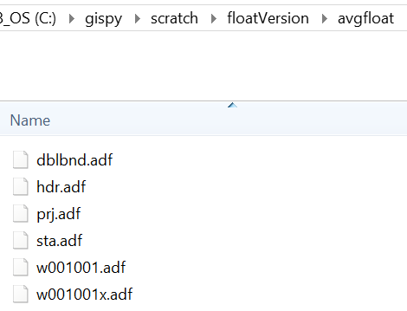

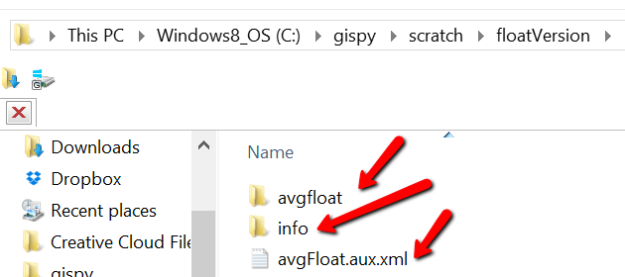
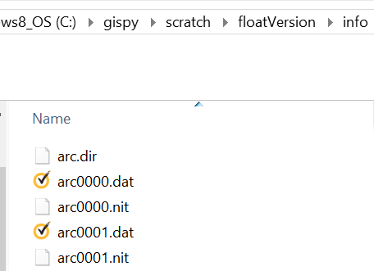
If only we could get a list of files in the workspace
why not os.listdir?
Two examples where os.listdir does not work:
  ESRI Grid Rasters, ArcGIS File Geodatabases (.gdb files)
ArcCatalog
Windows Explorer
Notes:
Remember how we said “if we could some how get a list of all the raster file in the workspace…” we could do this batch processing?
You might think, we already have that: os.listdir. Good thinking! But unfortunately it doesn’t play with proprietary data types the way we’d like it to.
For example, when you look at an ESRI grid raster in ArcCatalog, you see one file. But if you look at it in Windows Explorer, you see two directories and a whole bunch of files. Unfortunately, os.listdir interpret the proprietary file format like ArcCatalog does.
Another example where os.listdir doesn’t work as desired is listing data in file geodatabases. It doesn’t see a list of feature classes and rasters, just some strange binary files. Can you think of other examples where it won’t work?
This lesson focuses on the arcpy methods like this that are designed to overcome this issue.

Slide 10
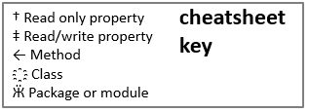
arcpy overview
Each part of the diagram has related functionality
  arcpy functions
  Describe objects
  Enumeration objects
  Cursor objects
  Other objects
  Mapping
Describe
Cursors
arcpy
functions
Enumerations
Other
Objects
Mapping
Need to import arcpy to access these properties & methods.
Notes:
We know that
… arcpy methods and properties allow you to access toolbox tools, set environment properties, get messages from tool runs, as well as other things.
We also know that
... Describe objects allow you to get information about the datasets you're dealing with, such as what Shapetype your feature class has or what the name of the OID field is.
Now we’re going to look at Enumerations methods, which allow you to perform batch processing. They return Python lists of feature class names, raster names, field objects, or other relevant items.
Later, we’ll discuss Cursor objects that allow you to process individual records in the data.
We’ll also see that other objects can be created. They will have the properties and/or methods specified in the pink box depending on which type of object they are. One example we will encounter shortly is Field objects.
Quite a bit later in the course we’ll also discuss the mapping module and a little bit about how to write your own classes. But for now, we’ll focus on those enumeration methods.

Slide 11
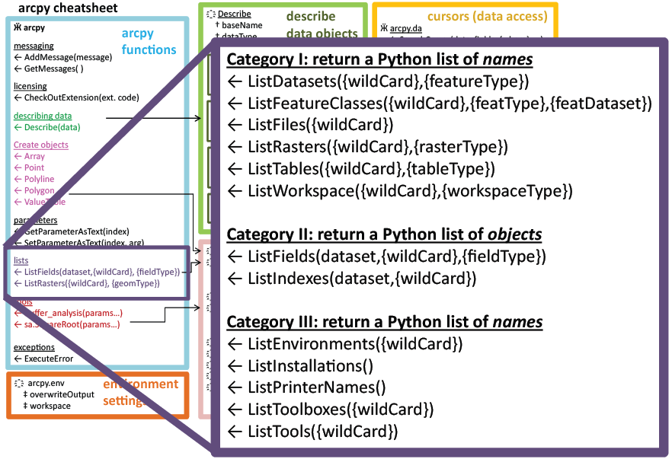
Enumeration Methods
arcpy method names that start with ‘List'
Returns a Python list
Items in list are strings or field objects or index objects, depending on method called.
Set the workspace before calling an arcpy ‘List' method
>>> arcpy.env.workspace = 'C:/studyData'
>>> fcList = arcpy.ListFeatureClasses()
>>> print(fcList)
['birdFeeders.shp', 'trails.shp']

Slide 12
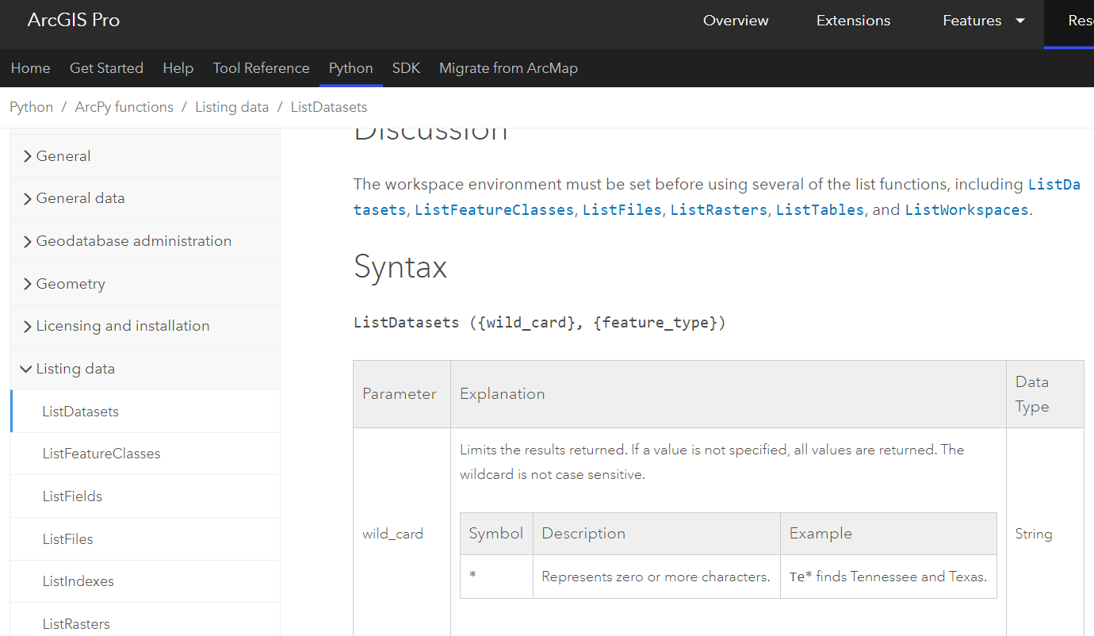
Enumeration Methods Help
ArcGIS Resources (online help)
https://pro.arcgis.com/en/pro-app/latest/arcpy/functions/listdatasets.htm
Search for 'ListDatasets arcpy'

Slide 13
Simple looping examples with arcpy.List…
The arcpy workspace must be set first.
Print the feature classes in the workspace.
import arcpy
arcpy.env.workspace = 'C:/Temp'
fcs = arcpy.ListFeatureClasses()
for f in fcs:
print(f)
print('All done.')

Slide 14
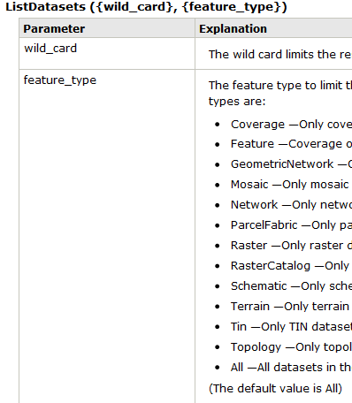
Batch geoprocessing example
Fill in the blanks so that the script uses an ArcToolbox tool to delete each dataset in the C:/Temp directory (hint: use this)
import arcpy
arcpy.env.workspace = 'C:/Temp'
dsets = arcpy.ListDatasets()
for d in dsets:
print("All datasets deleted. \
I hope that wasn't a mistake.")
arcpy.Delete_management(d)

Slide 15
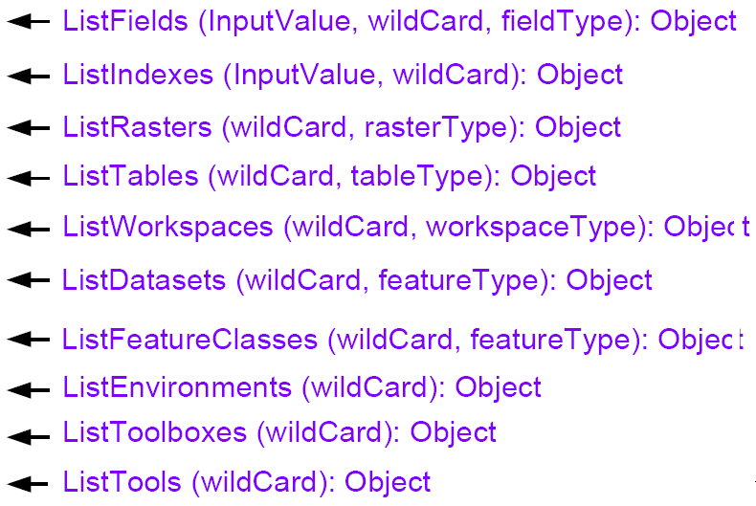
arcpy 'List' method parameters
wildCard parameter (optional)
    search for substrings in names
    only list files containing those substrings
    use '*' as a placeholder
featureType (optional)
    only list files of that Feature type
import arcpy
# Set the workspace.
arcpy.env.workspace = 'C:/Data'
# 1. List all of the feature classes
fcs1 = arcpy.ListFeatureClasses( )
# 2. List all of the feature classes that contain the string elev
fcs2 = arcpy.ListFeatureClasses('*elev*')
# 3. List all polygon feature classes that start with veg
fcs3 = arcpy.ListFeatureClasses('veg*', 'Polygon')
# 4. List all polygon feature classes
fcs4 = arcpy.ListFeatureClasses('*', 'Polygon')
Notes:
The examples we have seen so far have used the List enumeration methods with empty parentheses. In other words, we did not specify any arguments when calling these methods.
But in fact, most of these methods have two optional parameters, a wild card and a type.
To get familiar with how the wildcard and type parameters can be used to restrict the list that is returned, let’s first look at the example of ListFeatureClasses, which has optional wildcard and featureType parameters.

Slide 16
Types
Function | Types (The default value is ALL)
ListDatasets({wild_card}, {feature_type}) | Coverage, Feature, GeometricNetwork, Mosaic, Network, ParcelFabric, Raster, RasterCatalog, Schematic, Terrain, Tin, Topology, ALL
ListFeatureClasses({wild_card}, {feature_type}) | Annotation, ARC, Dimension, Edge, Junction, Label, Line, Multipatch, Node, Point, Polygon, Polyline, Region, Route, Tic, ALL
ListFields(dataset,{wild_card}, {field_type}) | Date, Double, Geometry, GUID, Integer, OID, Raster, Single, SmallInteger, Single, ALL
ListRasters({wild_card}, {raster_type}) | BMP, GIF, GRID, IMG, JP2, JPG, PNG, TIFF, ALL
ListTables({wild_card}, {table_type}) | dBASE, INFO, ALL ALL→All stand-alone tables, including geodatabase tables, are returned.
ListWorkSpaces({wild_card}, {workspace_type}) | Access, Coverage, FileGDB, Folder, SDE, ALL
Use online help for complete details.

Slide 17
In class: rewrite using arcpy not os.listdir
# Print each shapefile in C:/Temp. Assume this
# directory only contains shapefiles and rasters.
import os
path = 'C:/Temp'
files = os.listdir(path)
for f in files:
if f.endswith('.shp'):
print(f)
import arcpy
arcpy.env.workspace = 'C:/Temp'
files = arcpy.ListFeatureClasses()
for f in files:
print(f)

Slide 18
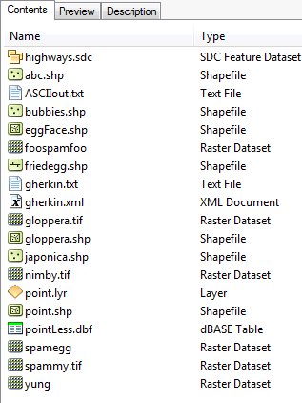
Enumeration wildcards
    import arcpy
    # Set the workspace.
    arcpy.env.workspace = 'C:/dater'
    L1 = arcpy.ListFeatureClasses('point')
    L2 = arcpy.ListRasters('*g*')
    L3 = arcpy.ListFeatureClasses('egg*','line')
    L4 = arcpy.ListRasters('*', 'TIF')
    Which files will be in each list?
Notes:
import arcpy
# Set the workspace.
arcpy.env.workspace = 'C:/Temp'
L1 = arcpy.ListFeatureClasses('point')
L2 = arcpy.ListRasters('*spam*')
L3 = arcpy.ListFeatureClasses('egg*', 'line')
L4 = arcpy.ListRasters('*', 'TIF')
For each list, give an example of a file name that would be contained in the list.
Give an example of a file that would be contained in two of the lists, if possible.
Which of these lists contains all the point shapefiles in the workspace?
1. L1 would only list a feature class named 'point'.
L2 is a list the rasters in C:/Temp that contain the substring 'spam', such as spamBla.jpg
L3 is a list of all the feature classes in C:/Temp whose names start with egg and are line shape types.
L4 is a list of all the bitmap rasters in C:/Temp, such as bla.bmp.
2. 'spam.tif' and 'blaSpam.tif' would appear in both L2 and L4. No other lists pairs of lists could have common items.
3. None, unless there is only one Point type shapefile named 'point.shp'

Slide 19
Enumeration wildcards
    import arcpy
    # Set the workspace.
    arcpy.env.workspace = 'C:/dater'
    L1 = arcpy.ListFeatureClasses('point')
    [ ]
    L2 = arcpy.ListRasters('*g*')
    [u'gloppera.tif', u'spamegg', u'yung']
    L3 = arcpy.ListFeatureClasses('egg*', 'line')
    [ ]
    L4 = arcpy.ListRasters('*', 'TIF')
    [u'gloppera.tif', u'nimby.tif', u'spammy.tif']
Notes:
import arcpy
# Set the workspace.
arcpy.env.workspace = 'C:/Temp'
L1 = arcpy.ListFeatureClasses('point')
L2 = arcpy.ListRasters('*spam*')
L3 = arcpy.ListFeatureClasses('egg*', 'line')
L4 = arcpy.ListRasters('*', 'TIF')
For each list, give an example of a file name that would be contained in the list.
Give an example of a file that would be contained in two of the lists, if possible.
Which of these lists contains all the point shapefiles in the workspace?
1. L1 would only list a feature class named 'point'.
L2 is a list the rasters in C:/Temp that contain the substring 'spam', such as spamBla.jpg
L3 is a list of all the feature classes in C:/Temp whose names start with egg and are line shape types.
L4 is a list of all the bitmap rasters in C:/Temp, such as bla.bmp.
2. 'spam.tif' and 'blaSpam.tif' would appear in both L2 and L4. No other lists pairs of lists could have common items.
3. None, unless there is only one Point type shapefile named 'point.shp'

Slide 20
Summing up arcpy 'List' methods
Topics discussed
    Batch processing
      grouping sequential steps to perform on a set of items
    The clue is in the name
      ListDataSets, ListFeatureClasses, ListFields, ListRasters, ListTables, ListWorkspaces
    Must set arcpy.env.workspace first
    Can specify type and/or use wild cards (*)
Up next
    More FOR-loop examples
    Why listing fields is different

Slide 21


Batch processing with arcpy 'List' methods part II
Some common mistakes in batch processing
Additional batch processing examples
ListFields method
Stepping through code with the debugger
Dr. Tateosian
Notes:
I Love Lucy gif, Thanks: https://bendyworks.com/blog/transducers-clojures-next-big-idea

Slide 22
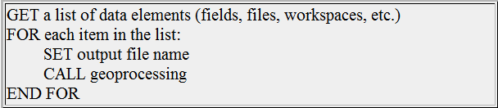
Batch geoprocessing with arcpy.List…
List the files, then perform geoprocessing on each file
Place geoprocessing command(s) inside a FOR loop through the input datasets.
Update output file names, or else…!
Pattern to follow
What's wrong with the following script?
  # Buffer all of the line feature classes in
  # C:/gispy/data/ch11.
  import arcpy
  arcpy.env.workspace = 'C:/gispy/data/ch11'
  fcs = arcpy.ListFeatureClasses('*', 'Line')
  for fc in fcs:
  arcpy.Buffer_analysis(fc, 'out.shp', '500 meters')

Slide 23
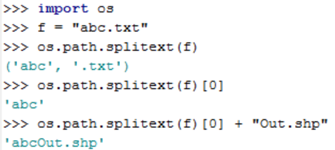
Update output based on input name
  # Buffer each line feature class in C:/Temp.
  import arcpy
  arcpy.env.workspace = 'C:/gispy/data/ch11'
  fcs = arcpy.ListFeatureClasses ('*', 'Line')
  outputDir = 'C:/gispy/data/ch11/outputDr/'
  for fc in fcs:
  # Insert ‘Out' into output name.
  basename = os.path.splitext(fc)[0]
  output = outputDir + basename + 'Out.shp'
  # Buffer input file by 500 meters. arcpy.Buffer_analysis(fc, output, '500 meters')
Input
paths.shp
rivers.shp
trails.shp
Output
pathsOut.shp
riversOut.shp
trailsOut.shp
Note…

Slide 24
In-class exercise: List and copy
Goal: Make a copy in a gdb of the point files whose names start with s
Steps:
List all the point feature classes in C:/gispy/data/ch11/tester.gdb whose names start with 's'
Create a new file geodatabase: arcpy.CreateFileGDB_management('C:/gispy/scratch/',
'out.gdb')
Copy the listed feature classes from C:/gispy/data/ch11/tester.gdb and copy them to C:/gispy/scratch/out.gdb.
Use these tips:
  Template: Copy_management (in_data, out_data, {data_type})
  The output data must be a dynamic name that changes each time you loop.
  The destination needs to have a slash between the wksp and filename.
  destination = destWorkspace + '/' + fc

Slide 25
List and copy solution
  # copyEses.py
  # Copy feature classes from gdb to gdb.
  import arcpy
  arcpy.env.workspace = 'C:/gispy/data/ch11/tester.gdb'
  fcs = arcpy.ListFeatureClasses('s*','POINT') #Step 1
  res = arcpy.CreateFileGDB_management(
  'C:/gispy/scratch', 'out.gdb') #Step 2
  destWorkspace = res.getOutput(0)
  for fc in fcs:
  # Create output name with destination path
  destination = destWorkspace + '/' + fc
  # Copy the features to C:/gispy/scratch/out.gdb
    arcpy.Copy_management(fc, destination) #Step 3

Slide 26
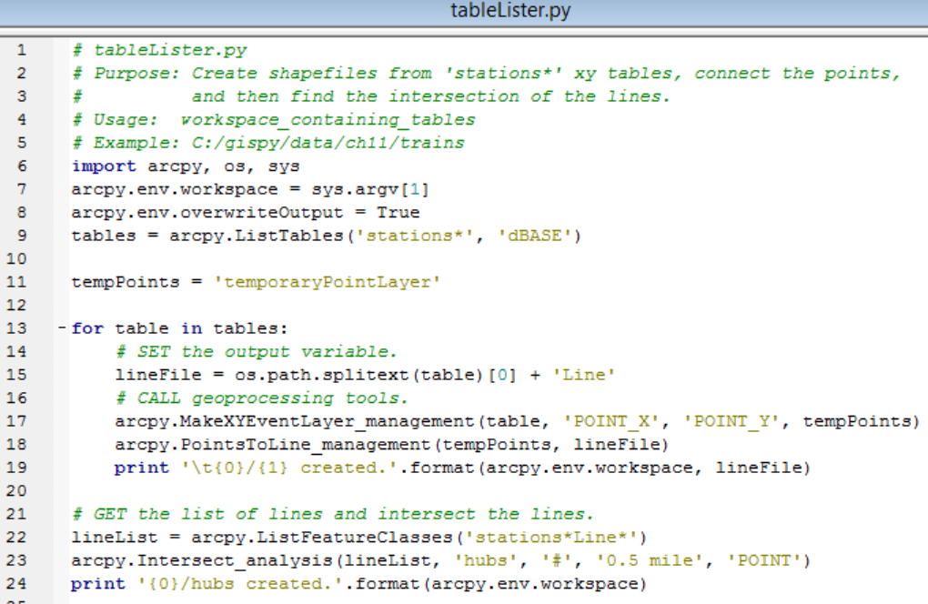

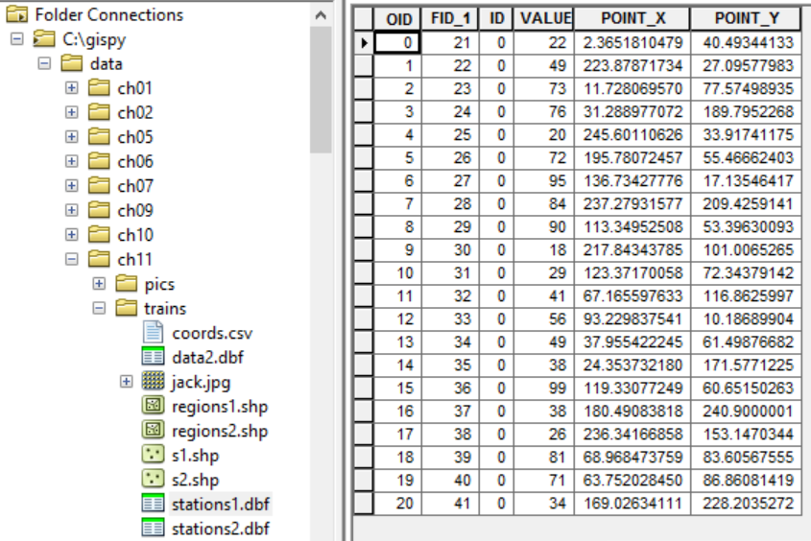
Multiple step batch processing

Slide 27
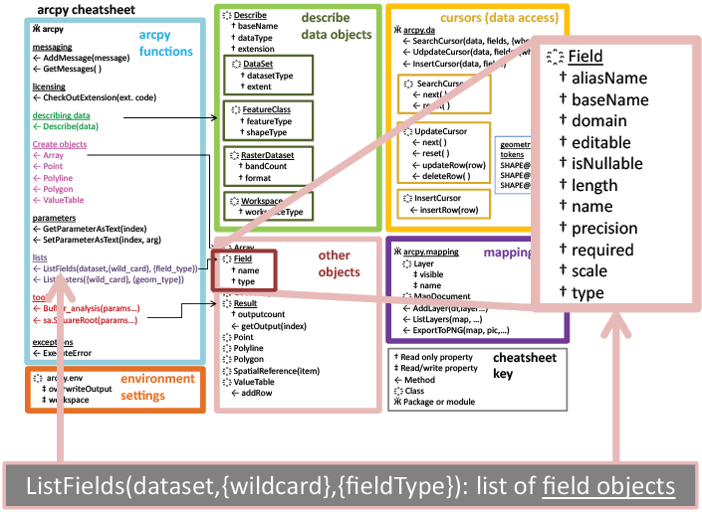
The two differences when listing fields
2
1
ListFields and ListIndexes require dataset (a data file)

Slide 28
Exercise - Exploring Field objects
Which one of these statements tells you how many fields the attribute table has?
Name four field properties.
How can you find the name of the 3rd field?
import arcpy
fc = "C:/gispy/data/ch10/park.shp"
fs = arcpy.ListFields(fc)
f = fs[0]
f
f.name
f.type
f.length
f = fs[1]
f.name
f.isNullable
len(fs)

Slide 29
Exercise - Exploring Field objects
Which one of these statements tells you how many fields the attribute table has?
len(fs)
Name four field properties.
name, type, length,isNullable
How can you find the name of the 3rd field?
f = fs[2]
print f.name
Which one of these statements tells you how many fields the attribute table has?
Name four field properties.
How can you find the name of the 3rd field?
import arcpy
fc = "C:/gispy/data/ch10/park.shp"
fs = arcpy.ListFields(fc)
f = fs[0]
f
f.name
f.type
f.length
f = fs[1]
f.name
f.isNullable
len(fs)

Slide 30
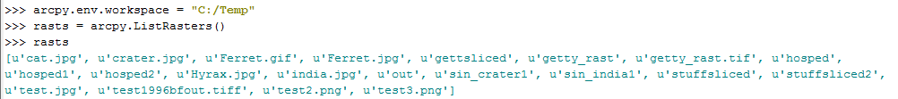
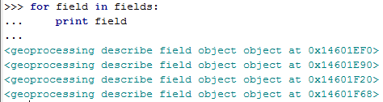
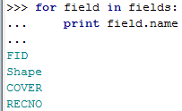
Field Objects vs. Field Names
arcpy.ListFields returns a list of field objects!
unlike ListRasters and others, these are NOT string names!!
Often you want field name not field object.
instead

Slide 31

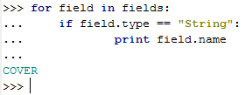
Exercise - Looping through fields
# print all the attribute names
import arcpy
fc = 'C:/gispy/data/Ch11/park.shp'
fields = arcpy.ListFields( fc )
for field in fields:
print field.name
#print the field names for String type data fields
import arcpy
fc = 'C:/gispy/data/Ch11/park.shp'
fields = arcpy.ListFields( fc )
for field in fields:
if field.type == 'String':
print field.name
# print all the attribute types
# print all the attribute types
import arcpy
fc = 'C:/gispy/data/Ch11/park.shp'
fields = arcpy.ListFields( fc )
for field in fields:
print field.type

Slide 32
In class - check4Field.py
Check if C:/gispy/data/Ch11/park.shp has a field named 'COVER'.
# check4Field.py
import arcpy
fc = 'C:/gispy/data/Ch11/park.shp'
…
Result:

Slide 33
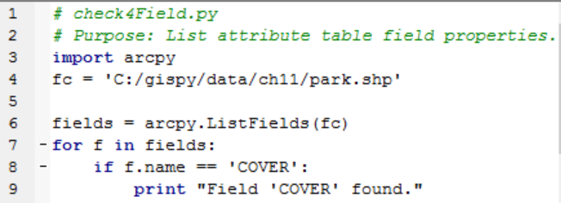
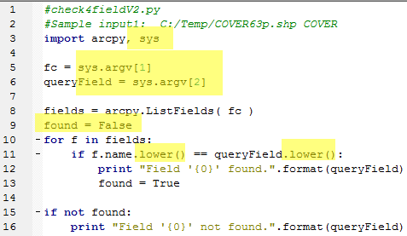
check4Field.py solutions
Modify check4Field.py to check if C:/gispy/data/ch11//park.shp has a field named 'COVER'
------V2 below------------------------
Notes:
#version 1
import arcpy
fc = 'C:/Temp/COVER63p.shp'
fields = arcpy.ListFields( fc )
for f in fields:
if f.name == 'COVER':
print "Field 'COVER' found.“
# OR --------------------
#version 2
import arcpy
fc = 'C:/Temp/COVER63p.shp'
fields = arcpy.ListFields( fc )
names = []
for f in fields:
names.append(f.name)
print 'Attribute names:', names
if 'COVER' in names:
print "Field 'COVER' found."

Slide 34
Debug: Step Through Code

Slide 35
Summing up
Topics discussed
    Listing enumeration methods
    Using wildcard and type to get subset of items
    Dynamic output names
    Listing fields
Up next
    Debugging
Additional topics
    Administrative 'List' methods
    Listing indexes

Slide 36
Appendix

Slide 37
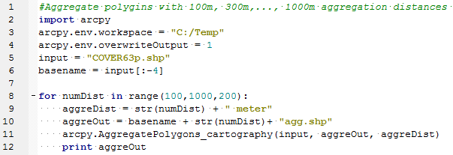
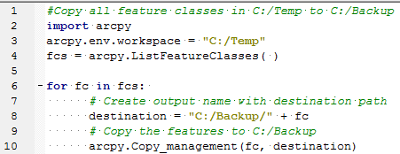
Updating output names
Why update?
  if output name is not updated, only one file created (overwritten n times, where n is the number of times looped)
When update?
  inside the loop before the analysis
Identify the output variable, and how it's updated in these examples:
What makes it unique?
numDist –the looping variable
What makes it unique?
fc – the looping variable

Slide 38
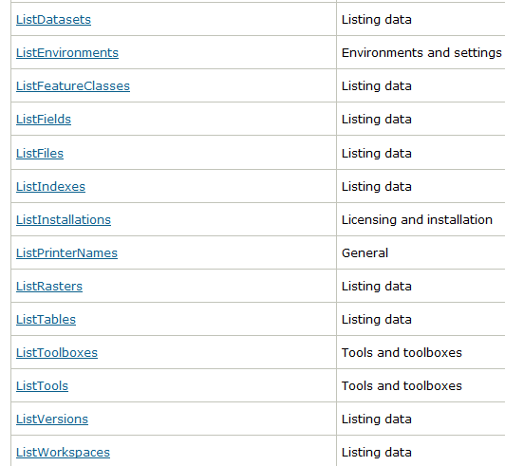
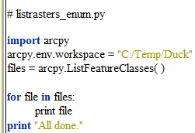
Exercise -- listrasters_enum.py
Currently the code prints the names of all feature classes in 'C:/Temp/Duck'
Write code to print a list of the raster datasets in:
'C:/Temp/ncrast_geodatabase/ncrast.mdb'.
Then modify the code to list only the rasters whose names start with 'land'

Slide 39
listrasters_enum.py
import arcpy
arcpy.env.workspace = 'C:/Temp/ncrast_geodatabase/ncrast.mdb'
rasts = arcpy.ListRasters('land*' )
for c in rasts:
print c
print 'All done.'

Slide 40
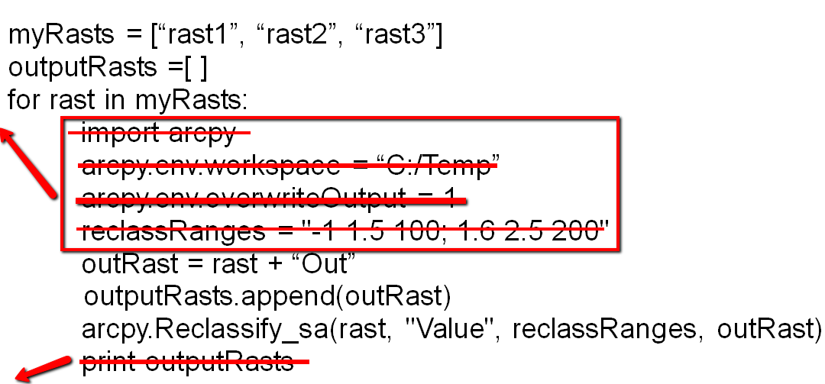
1. myList.append(4)
2. mystr = myList[2]
3. for f in fileNames:
if f.endswith('.xls'):
print f
4.

