Slide 1

Fetching and uncompressingfiles
Fetch HTML
Text vs. binary
Fetch binary web content
Dr. Tateosian

Slide 2

Fetching web content
requests module for fetching web content
get method returns a response object
responses can be written locally or parsed
import requests
url = "www.google.com"
response = requests.get(url)
Notes:
Python 3 (better for quick and easy fetches)
# urlFetcher.py
# Fetch and print the HTML contents of a url.
import requests
url = "https://lgtateos.github.io/gis540/supMaterials/example.html"
response = requests.get(url)
for line in response.text.splitlines():
print(line)
response.close()
Python 3 (better for very large files)
# urlFetcher.py
# Fetch and print the HTML contents of a url.
import urllib
url = "https://lgtateos.github.io/gis540/supMaterials/example.html"
response = urllib.request.urlopen(url)
for line in response.readlines():
print(line)
response.close()
Python 2
# urlFetcher.py
# Fetch and print the HTML contents of a url.
import urllib2
url = "https://lgtateos.github.io/gis540/supMaterials/example.html"
response = urllib2.urlopen(url)
for line in response.readlines():
print(line)
response.close()

Slide 3
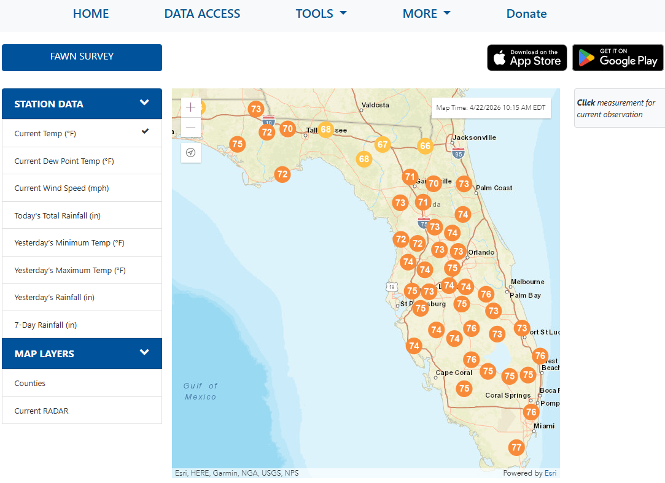
Web hosted data example
Notes:
https://fawn.ifas.ufl.edu/data/
import requests, os
# Hard-coded URL for the 2026 CSV
csv_url = "https://fawn.ifas.ufl.edu/data/fawnpub/daily_summaries/BY_YEAR/2025_daily.csv"
csv_url = "https://lulctimeseries.blob.core.windows.net/lulctimeseriesv003/lc2024/53U_20240101-20241231.tif"
outputDir = "C:/gispy/scratch/"
outputName = outputDir + os.path.basename(csv_url)
outputName = os.path.join(outputDir, os.path.basename(csv_url))
# Fetch and write
response = requests.get(csv_url)
with open(outputName, "wb") as f:
f.write(response.content)
print(f"{os.path.basename(csv_url)} downloaded successfully to {outputDir}.")

Slide 4
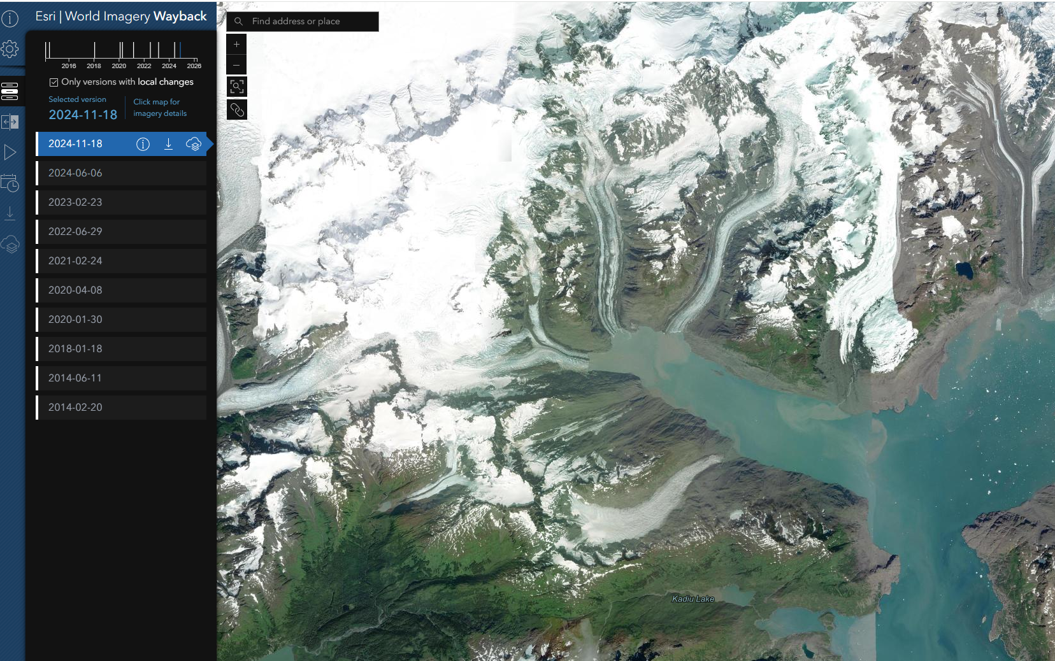
Web hosted data example
Notes:
https://livingatlas.arcgis.com/landcoverexplorer/#mapCenter=-147.06500%2C61.16000%2C11.00&mode=step&timeExtent=2017%2C2022&year=2022&downloadMode=true
import requests, os
# Hard-coded URL for the 2026 CSV
csv_url = "https://fawn.ifas.ufl.edu/data/fawnpub/daily_summaries/BY_YEAR/2025_daily.csv"
csv_url = "https://lulctimeseries.blob.core.windows.net/lulctimeseriesv003/lc2024/53U_20240101-20241231.tif"
outputDir = "C:/gispy/scratch/"
outputName = outputDir + os.path.basename(csv_url)
outputName = os.path.join(outputDir, os.path.basename(csv_url))
# Fetch and write
response = requests.get(csv_url)
with open(outputName, "wb") as f:
f.write(response.content)
print(f"{os.path.basename(csv_url)} downloaded successfully to {outputDir}.")

Slide 5
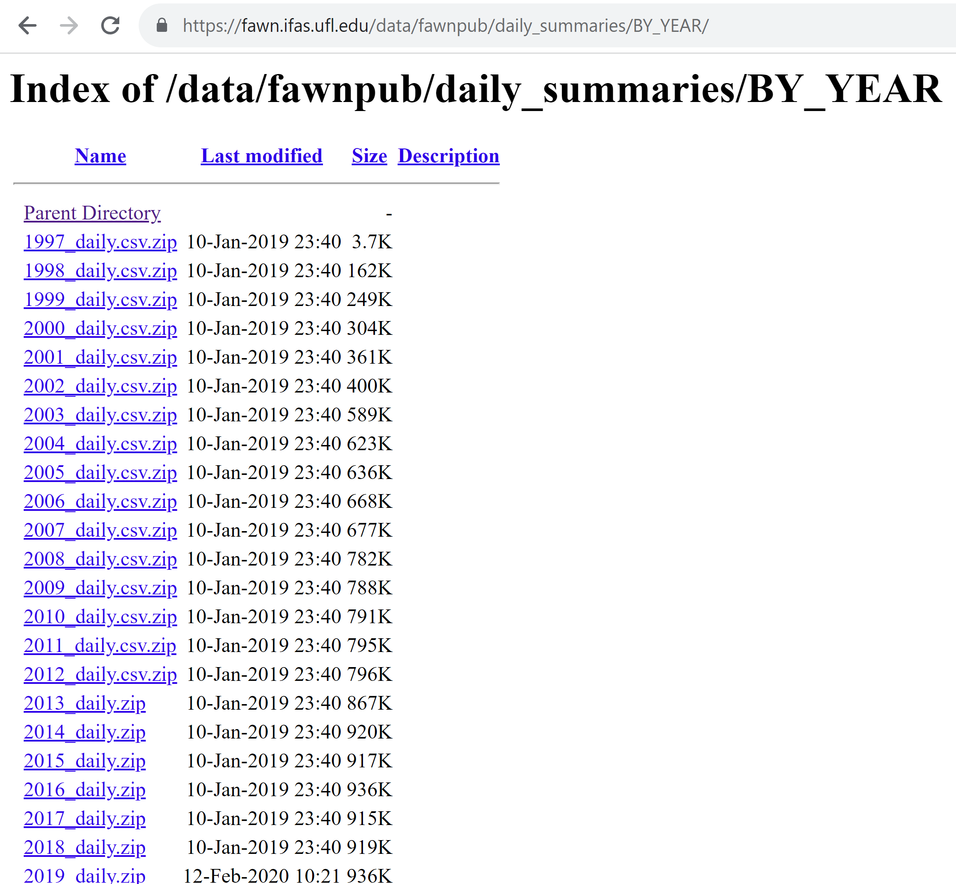
Fetching and writing a data file
import requests, os
# Hard-coded URL for the 2026 CSV
csv_url = "https://fawn.ifas.ufl.edu/data/fawnpub/daily_summaries/BY_YEAR/2026_daily.csv"
outputDir = "C:/gispy/scratch/ "
# Fetch the dataset
response = requests.get(csv_url)
outputName = os.path.join(outputDir, os.path.basename(csv_url))
# Write the dataset locally
with open(outputName, "wb") as f:
f.write(response.content)
print(f"{os.path.basename(csv_url)} downloaded to {outputDir}.")
FAWN data hosting webpage
Notes:
import requests, os
# Hard-coded URL for the 2026 CSV
csv_url = "https://fawn.ifas.ufl.edu/data/fawnpub/daily_summaries/BY_YEAR/2026_daily.csv"
outputDir = "C:/gispy/scratch/ "
outputName = os.path.join(outputDir, os.path.basename(csv_url))
# Fetch and write
response = requests.get(csv_url)
with open(outputName, "wb") as f:
f.write(response.content)
print(f"{os.path.basename(csv_url)} downloaded successfully to {outputDir}.")

Slide 6

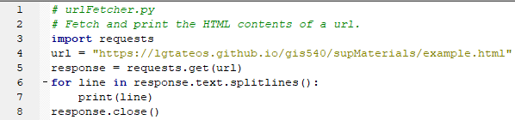
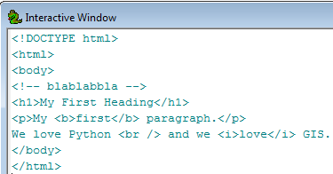
Fetching HTML
requests
Module for fetching web page content
get method returns a response object
with a text property
Python output
Split the text contents based on \n
Notes:
Python 3 (better for quick and easy fetches)
# urlFetcher.py
# Fetch and print the HTML contents of a url.
import requests
url = "https://lgtateos.github.io/gis540/supMaterials/example.html"
response = requests.get(url)
for line in response.text.splitlines():
print(line)
response.close()
Python 3 (better for very large files)
# urlFetcher.py
# Fetch and print the HTML contents of a url.
import urllib
url = "https://lgtateos.github.io/gis540/supMaterials/example.html"
response = urllib.request.urlopen(url)
for line in response.readlines():
print(line)
response.close()
Python 2
# urlFetcher.py
# Fetch and print the HTML contents of a url.
import urllib2
url = "https://lgtateos.github.io/gis540/supMaterials/example.html"
response = urllib2.urlopen(url)
for line in response.readlines():
print(line)
response.close()

Slide 7
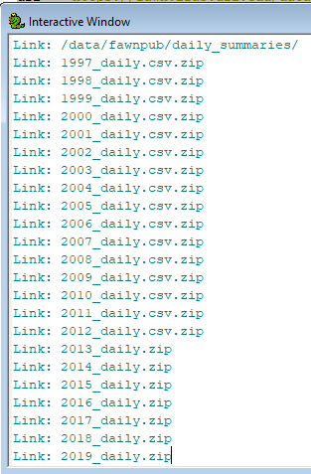
Application: Fetch HTML with data links
FAWN data hosting webpage
# listWeatherData.py
# Purpose: Read and print the links in an HTML data page.
import bs4
import requests
import sys
# Fetch the HTML file contents.
url = "https://fawn.ifas.ufl.edu/data/fawnpub/daily_summaries/BY_YEAR/"
response = requests.get(url)
contents = response.text
response.close()
print(contents)
Python output
Notes:
# listWeatherData.py
# Purpose: Read and print the links in an HTML data page.
import bs4
import requests
import sys
# Fetch the HTML file contents.
url = "https://fawn.ifas.ufl.edu/data/fawnpub/daily_summaries/BY_YEAR/"
response = requests.get(url)
contents = response.text
response.close()
# Create a soup object from the HTML contents.
soup = bs4.BeautifulSoup(contents)
# Find all the hyperlinks in the page.
linkTags = soup.findAll("a")
# Print each hyperlink reference.
for linkTag in linkTags:
print(f"Link: {linkTag['href']}")

Slide 8
Parse html with BeautifulSoup (bs4)
# listWeatherData.py
# Purpose: Read and print the links in an HTML data page.
import bs4
import requests
import sys
# Fetch the HTML file contents.
url = "https://fawn.ifas.ufl.edu/data/fawnpub/daily_summaries/BY_YEAR/"
response = requests.get(url)
contents = response.text
response.close()
# Create a soup object from the HTML contents.
soup = bs4.BeautifulSoup(contents)
# Find all the hyperlinks in the page.
linkTags = soup.findAll("a")
# Print each hyperlink reference.
for linkTag in linkTags:
print(f"Link: {linkTag['href']}")
FAWN data hosting webpage
Python output
Notes:
# listWeatherData.py
# Purpose: Read links in an HTML data page and download the CSV datasets.
import bs4
import requests
import sys
import os
outputDir = "C:/gispy/scratch/"
# Fetch the HTML file contents.
url = "https://fawn.ifas.ufl.edu/data/fawnpub/daily_summaries/BY_YEAR/"
response = requests.get(url)
contents = response.text
response.close()
# Create a soup object from the HTML contents.
soup = bs4.BeautifulSoup(contents)
# Find all the hyperlinks in the page.
linkTags = soup.findAll("a")
# Get each linked csv.
for linkTag in linkTags:
theLink = linkTag['href']
if theLink.endswith(".csv"):
print(f"Link: {linkTag['href']}")
## Fetch and write
full_link = url + theLink
outputName = os.path.join(outputDir, os.path.basename(theLink))
response = requests.get(full_link)
with open(outputName, "wb") as f:
f.write(response.content)
print(f"{os.path.basename(theLink)} downloaded successfully to {outputDir}.")

Slide 9
Download the linked csv's
# listWeatherData.py
# Purpose: Read links in an HTML data page and download the CSV datasets.
import bs4
import requests
import sys, os
# Fetch the HTML file contents.
url = "https://fawn.ifas.ufl.edu/data/fawnpub/daily_summaries/BY_YEAR/"
response = requests.get(url)
contents = response.text
response.close()
# Create a soup object from the HTML contents.
soup = bs4.BeautifulSoup(contents)
# Find all the hyperlinks in the page.
linkTags = soup.findAll("a")
# Get each linked csv.
for linkTag in linkTags:
theLink = linkTag['href']
if theLink.endswith(".csv"):
print(f"Link: {linkTag['href']}")
# Fetch and write
full_link = url + theLink
outputName = os.path.join(outputDir, os.path.basename(theLink))
response = requests.get(full_link)
with open(outputName, "wb") as f:
f.write(response.content)
print(f"{os.path.basename(theLink)} downloaded successfully to {outputDir}.")
FAWN data hosting webpage
Python output
Notes:
# listWeatherData.py
# Purpose: Read and print the links in an HTML data page.
import bs4
import requests
import sys
# Fetch the HTML file contents.
url = "https://fawn.ifas.ufl.edu/data/fawnpub/daily_summaries/BY_YEAR/"
response = requests.get(url)
contents = response.text
response.close()
# Create a soup object from the HTML contents.
soup = bs4.BeautifulSoup(contents)
# Find all the hyperlinks in the page.
linkTags = soup.findAll("a")
# Print each hyperlink reference.
for linkTag in linkTags:
print(f"Link: {linkTag['href']}")

Slide 10
Uncompress a file
# unzip_file.py
# Purpose: Uncompress a zipfile.
import zipfile
import os
# Specify the compressed file and destination directory.
zipPath = r"C:\gispy\data\ch20\getty.zip"
outputDir = "C:/gispy/scratch/"
# Extract the zip contents and write it to the output directory.
print(f"Extracting to {outputDir}...")
with zipfile.ZipFile(zipPath, 'r') as zip_ref:
zip_ref.extractall(outputDir)
print(f"{os.path.basename(zipPath)} unzipped in {outputDir}")
Notes:
# unzip_file.py
# Purpose: Uncompress a zipfile.
import zipfile
import os
# Specify the compressed file and destination directory.
zipPath = r"C:\gispy\data\ch20\getty.zip"
outputDir = "C:/gispy/scratch/"
# Extract the zip contents and write it to the output directory.
print(f"Extracting to {outputDir}...")
with zipfile.ZipFile(zipPath, 'r') as zip_ref:
zip_ref.extractall(outputDir)
print(f"{os.path.basename(zipPath)} unzipped in {outputDir}")

Slide 11
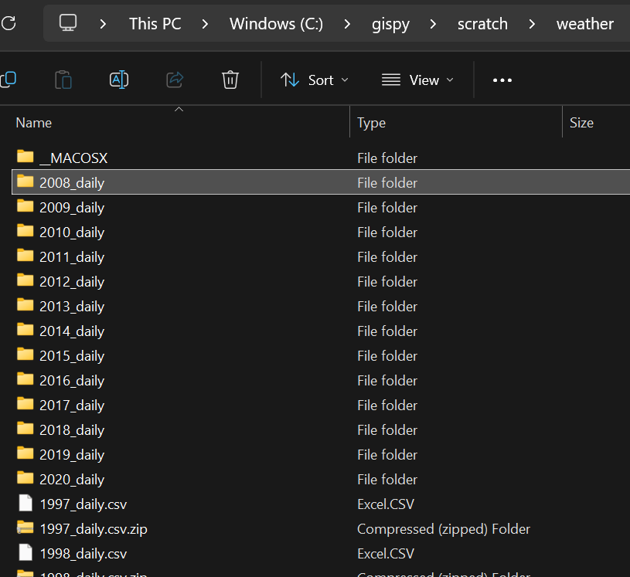
Uncompress the zipfiles
# parse_fetch_unzip_weatherdata.py
# Purpose: Download and extract the linked csv's
import bs4, os, requests, sys, zipfile
# Fetch the HTML file contents.
url = "https://fawn.ifas.ufl.edu/data/fawnpub/daily_summaries/BY_YEAR/"
response = requests.get(url)
contents = response.text
response.close()
# Create a soup object from the HTML contents.
soup = bs4.BeautifulSoup(contents)
# Find all the hyperlinks in the page.
linkTags = soup.findAll("a")
# Get each linked csv.
for linkTag in linkTags:
theLink = linkTag['href']
if theLink.endswith(".csv") or theLink.endswith(".zip") :
print(f"Link: {linkTag['href']}")
# Fetch and write
full_link = url + theLink
outputName = os.path.join(outputDir, os.path.basename(theLink))
response = requests.get(full_link)
with open(outputName, "wb") as f:
f.write(response.content)
# Uncompress the zipfiles.
with zipfile.ZipFile(zipPath, 'r') as zip_ref:
zip_ref.extractall(outputDir)
print(f"Downloaded and uncompressed zip files to {outputDir}")
FAWN data hosting webpage
Directory output
Notes:
# parse_fetch_unzip_weatherdata.py
# Purpose: Read links in an HTML data page and download the CSV datasets.
import bs4, os, requests, sys, zipfile
outputDir = "C:/gispy/scratch/weather"
if not os.path.exists(outputDir):
os.makedirs(outputDir)
# Fetch the HTML file contents.
url = "https://fawn.ifas.ufl.edu/data/fawnpub/daily_summaries/BY_YEAR/"
response = requests.get(url)
contents = response.text
response.close()
# Create a soup object from the HTML contents.
soup = bs4.BeautifulSoup(contents)
# Find all the hyperlinks in the page.
linkTags = soup.findAll("a")
# Get each linked csv.
for linkTag in linkTags:
theLink = linkTag['href']
if theLink.endswith(".zip"):
print(f"Link: {linkTag['href']}")
## Fetch and write
full_link = url + theLink
zipPath = os.path.join(outputDir, os.path.basename(theLink))
response = requests.get(full_link)
with open(zipPath, "wb") as f:
f.write(response.content)
print(f"{os.path.basename(theLink)} downloaded successfully to {outputDir}.")
print(f"Extracting to {outputDir}...")
with zipfile.ZipFile(zipPath, 'r') as zip_ref:
zip_ref.extractall(outputDir)
print(f"Downloaded and uncompressed zip files to {outputDir}")

Slide 12

Summing up: Topics discussed
Fetch web content (html, files)
Parse html with beautiful soup (soup.findAll("a"))
Write the fetched file locally ("wb")
Expand compressed files
Notes:
thanks to dogbehavioronline.com for the pic
http://www.dogbehavioronline.com/how-to-train-a-dog-to-fetch/
and we saw how to use the zipfile module to unzip or uncompress files with Python. We combined all of these things in the last in-class exercise, the WakeGov data download example. As an extra challenge, see if you can modify this exercise to download all the street and highway data from this page. The topics in this lecture, enable you to programmatically use data warehouses with exposed links, since you now know how to extract the online data for local use.

