Slide 1
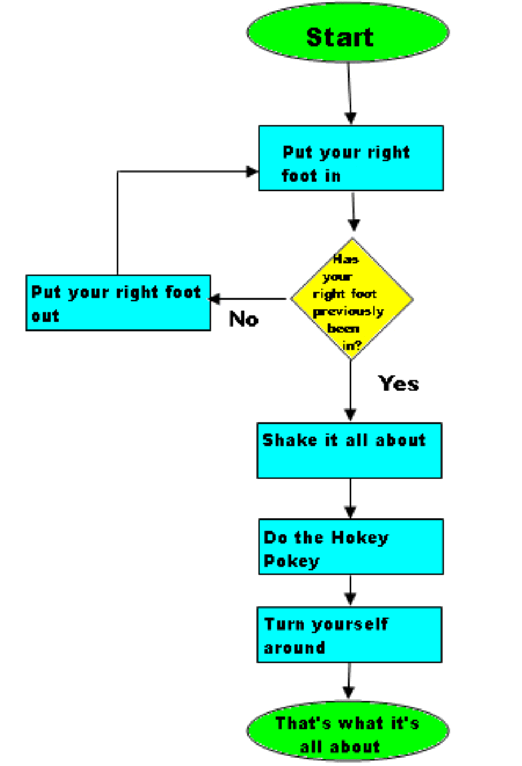
Decision making & with Describe object
Dr. Tateosian
Notes:
myList.append( 4 )
mystr.endswith('shp')
arcpy.env.overwriteOutput = 1
arcpy.compact_management(filename)
rc = arcpy.AverageNearestNeighbor_stats('C://points.shp', 'Euclidean Distance') a. print rc.outputcount b. print rc.getOutput(0)

Slide 2
Outline
Conditional statements
Decision-making syntax
Boolean Expressions
Logical operators
Comparison operators
Describing ArcGIS data

Slide 3
Branching workflow example
kml preparation tool. Different for vector/raster/other datatypes. Different for points/lines/polygon. Different for TIFs and other formats.
How can I determine what type of data I have?
GET data type
feature class
shapefile
raster
other
PRINT
'warning, knuckle head'
GET shape type
GET format
point
line
polygon
other
TIF
other
CALL point
to kml
CALL line
to kml
CALL polygon
to kml
CALL layer
to kml
CALL
convert to TIFF

Slide 4
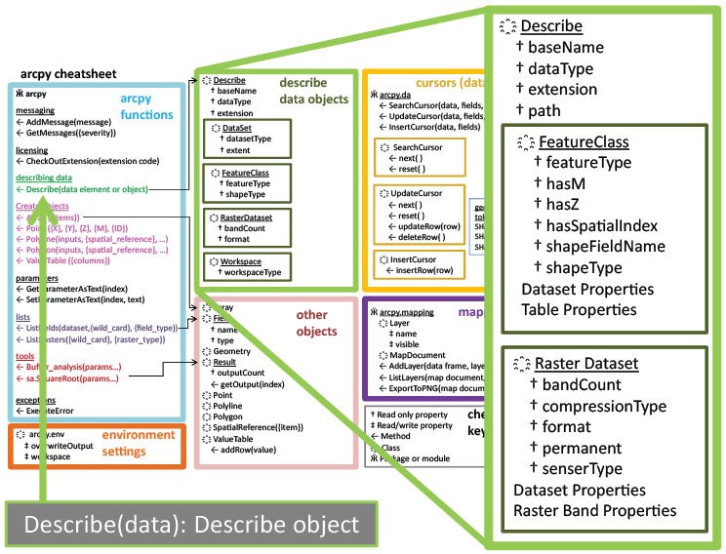
Describe Object
desc = arcpy.Describe(rastfile)

Slide 5
Creating a describe object
>>> # Create geoprocessing objects >>> import arcpy
>>> # Set the data element >>> rastfile = 'C:/gispy/data/ch09/jack.jpg'
>>> # Call describe method >>> dsc = arcpy.Describe(rastfile)
>>> print(dsc ) <geoprocessing describe data object object at 0x0092D2D0>
object.method(arg1,arg2, …)
describe object
data element to be described

Slide 6
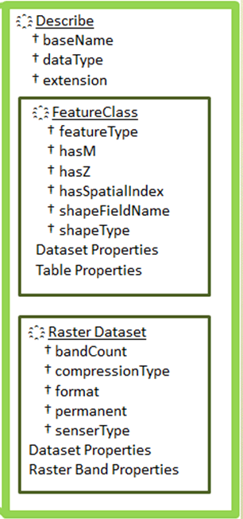
Using a describe object
>>> import arcpy >>> rastfile = 'C:/gispy/data/ch09/jack.jpg' >>> dsc = arcpy.Describe(rastfile) >>> print(dsc.dataType) 'RasterDataset'
>>> print(dsc.format) 'JFIF'
See note view for demo
Notes:
>>> import arcpy
>>> file = 'park.shp'
>>> dsc = arcpy.Describe(file)
>>> dsc.Format
Traceback (most recent call last): File "<interactive input>", line 1, in ?
RuntimeError: describe method: Format does not exist
>>> dsc.ShapeType
u'Polygon‘
>>> dsc.HasOID
True
>>> dsc.DatasetType
‘Shapefile'

Slide 7
Selection Syntax
Convert the pseudocode to Python
Python conditional keywords: if, elif, else
Use a describe object to get the shapeType
Python
import arcpy
mydata = "C:/Temp/data.shp"
dsc = arcpy.Describe(mydata)
shapeType = dsc.shapeType
if shapeType == "Polygon":
print("Shape is polygon")
elif shapeType == "Polyline":
print("Shape is line")
else:
print("Shape is not line or polygon")
Pseudocode
GET shapefile
GET shape type
IF shape type is Polygon THEN PRINT shape is polygon
ELSE IF shape type is Polyline THEN PRINT shape is line
ELSE
PRINT shape isn’t line or polygon ENDIF

Slide 8
Using describe with caution
Previous slide
import arcpy
mydata = "C:/Temp/data.shp"
dsc = arcpy.Describe(mydata)
shapeType = dsc.ShapeType
if shapeType == "Polygon":
print("Shape is polygon")
elif shapeType == "Polyline":
print("Shape is line")
else:
print("Shape is not \
line or polygon")
More cautiously
import arcpy
mydata = "C:/Temp/data.shp"
dsc = arcpy.Describe(mydata)
if dsc.dataType == "ShapeFile":
shapeType = dsc.ShapeType
if shapeType == "polygon":
print("Shape is polygon")
elif shapeType == "Polyline":
print("Shape is line")
else:
print("Shape is not \
line or polygon")

Slide 9
Summing up
Topics discussed
Conditional statements
Decision-making syntax
Boolean Expressions
Logical operators
Comparison operators
Describing ArcGIS data
Coming up
Looping
Additional topics
Tools that make selections
Select by attributes
Compound vs. nested conditions
Testing conditions
Using os module to check for files

Slide 10
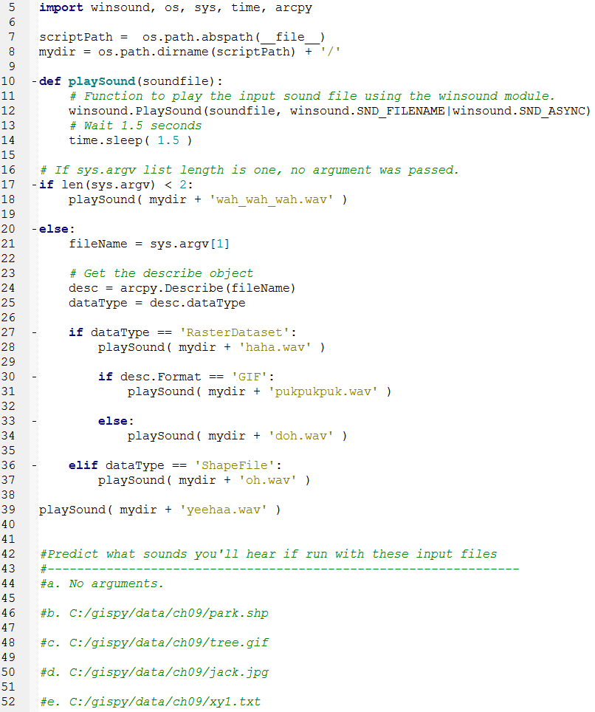
In class – conditionalSound.py

Slide 11
Appendix I

Slide 12
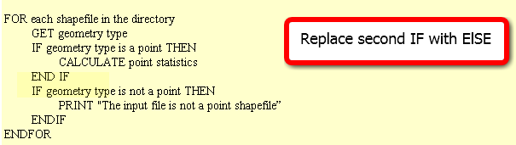
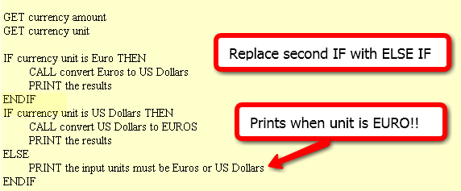
In class – Poor form! FIX IT
Point statistics
2. Currency conversion
3. Grader
IF average < 60
NULL
ELSE
DO GivePassingGrade
ENDIF

Slide 13
FIX IT
Point statistics
2. Currency conversion
3. It is considered poor form to have a 1-sided IF stmt where the action is on the 'no' or ELSE side. This could (and should) be rewritten to eliminate the NULL 'yes' part. To do that, we change the < to its opposite: >= as follows :
IF average >= 60
DO GivePassingGrade
ENDIF

Slide 14
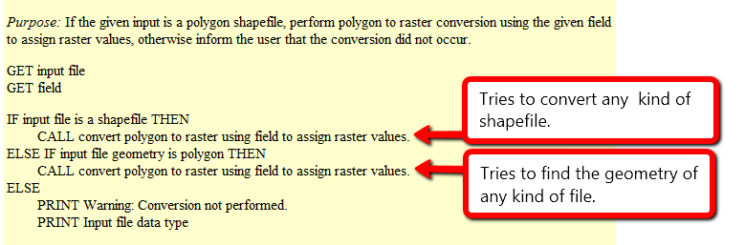
Polygon to raster
Purpose: If the given input is a polygon shapefile, perform polygon to raster conversion using the given field to assign raster values, otherwise inform the user that the conversion did not occur.
What will happen if the input file is…
a polygon shapefile?
convert the data to raster (success)
a point shapefile?
attempt to convert the data to raster, but will fail, since it’s not polygon input but it is a shapefile
a raster file?
attempt to check the geometry of the inputfile and fail, since raster files don’t have a geometry
When does it give a warning?
never

Slide 15
Polygon to raster pseudocode corrected
Instead of else if, use a compound conditional
IF input file is a shapefile AND input file geometry is polygon THEN CALL convert polygon to raster using field to assign raster values.
ELSE PRINT Warning: Conversion not performed. PRINT Input file data type
Moral: TEST ALL CONDITIONS

Slide 16



Distance converter example
Convert miles to km or km to miles and handle user input of 2, 1, or 0 arguments:
Arguments: 50 miles
>>> 50 miles is equivalent to 80.0 kilometers.
Arguments: 100
>>> Warning: No distance unit provided. Assuming input is in miles.
100.0 miles is equivalent to 160.0 kilometers.
Arguments:
>>> Usage: <numeric_distance> <distance_unit(miles or km)>

Slide 17
Distance Conversion Pseudocode
GET numeric dist from args
GET unit from args
IF unit is miles THEN COMPUTE km PRINT results
ELSE COMPUTE miles PRINT results
ENDIF
Add to the pseudocode to handle case of 'no user arguments'.
Add pseudocode to part 1 to handle the '1 argument' case.

Slide 18
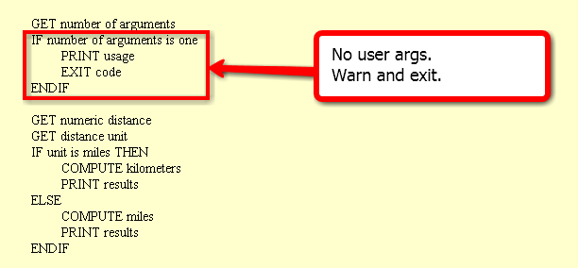
Handle no user arguments case

Slide 19
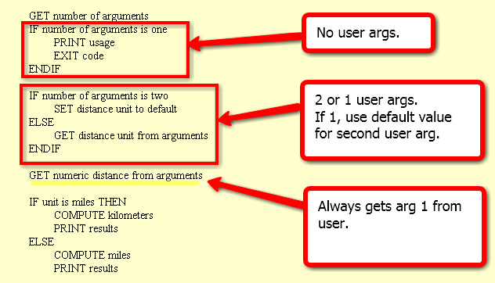
Distance conversion pseudocode
Related code given in examples 9.12 and 9.13 in the book.

Slide 20
Buffer_clip pseudocode
GET number of arguments
IF number of args < 5
PRINT usage EXIT code
ENDIF
SET fire damage
SET park
SET buffer distance
SET workspace
GET number of arguments
IF number of arguments < 4 PRINT usage EXIT code
IF number of args is 4
PRINT warning SET workspace to default
ELSE
SET workspace to last arg
ENDIF
SET fire damage
SET park
SET buffer distance
All or nothing.
How could we make
the last argument (the workspace) optional?

Slide 21
Appendix II

Slide 22
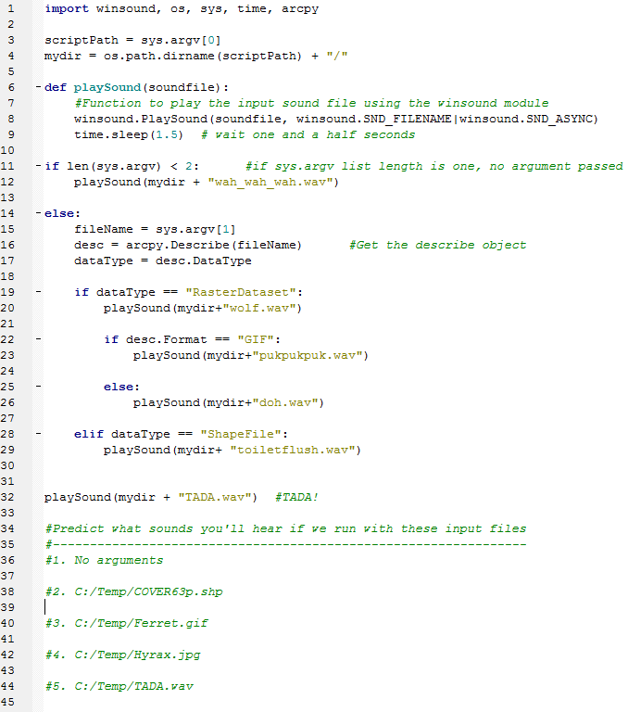
In class – conditionalSound.py (orig)

Slide 23
Buffer_clip… avoid argv index error
Check the list length before indexing it, give feedback, and exit if necessary
use try/except (discuss later)
import sys
listLength = len(sys.argv) # count the number of arguments
if listLength < 5:
print 'Usage: <shapefile to buffer>, <buffer distance>, <shapefile to \ clip>, <the workspace >' # explain the problem to the user
sys.exit(0) # exit the program.
# buffer_clip.py arguments
fireDamage = sys.argv[1]
park = sys.argv[2]
bufferDist = sys.argv[3]
arcpy.env.workspace = sys.argv[4]
# Buffer and clip code below here…

Slide 24
Using if/elif/else
Use if alone when you only want do y if x is true, and you want to continue with the rest of the script in either case.
…
if field_name not in fields: arcpy.addField(filename, field_name)
# Update field values
Use elif to check another conditional statement. Follows if or elif block.
Use else to enact a default action. If none of the previous conditions are true, do what I say. Follows if or elif block.
if shapeType == ‘polygon’:
print 'Shape is polygon'
elif shapeType == ‘line’:
print 'Shape is line'
else:
print 'Shape is not line or polygon'

Slide 25
Ways not to use if, elif
Instead should be
if x == 1:
#do stuff
if x == 2:
#do special stuff
if x == 3:
#do very weird thing
if x == 1:
#do stuff with a
elif x == 2:
#do stuff with b
elif x == 3:
#do stuff with c
elif x == 4:
#do stuff with d
elif x == 5:
#do stuff with e
elif x == 6:
#do stuff with f
…
if x == 1:
#do stuff
elif x == 2
#do special stuff
elif x == 3
#do very weird thing
Don’t use repeated if to check mutually exclusive conditions.
Don’t use a large number of ‘elif’ conditions when consistently testing the same variable’s value and performing the same operation inside.
There are better ways to do this.
Instead should be
using Python
built-in data structure
called a dictionary.
--Dictionaries will be
discussed in a
later lecture.

Slide 26
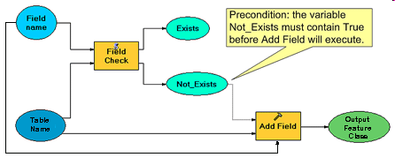
Condition with ‘not’ keyword
Pseudocode
IF field name does not exist THEN CALL Add field ENDIF
CALCULATE FIELD
conditional
statement
Python code
fileName = 'C:/data.shp'
fieldName = 'slope'
fields =['FID', 'rise', 'run']
if fieldName not in fields: arcpy.addField(fileName, fieldName)
print 'New field created.'
arcpy.CalculateField(fileName, fieldName, \ '[rise] / [run]‘)
colon
indent entire if code block (code block = set of related code)
Notes:
#Complete example of code.
import arcpy
fileName = 'C:/Temp/COVER63p.shp'
fieldName = 'Square'
fieldObjs = arcpy.listFields(filename) #we haven’t gone over this yet.
fields=[]
for f in fieldObjs: #we haven’t gone over ‘for’ loops yet.
fields.append(f.name)
if fieldName not in fields:
arcpy.addField(fileName, fieldName)
print 'New field created.'
arcpy.CalculateField(fileName, fieldName, \
'[RECNO]*[RECNO]')
#another way to get the field name list is to use list comprehension:
fields = [f.name for f in fieldObjs]

