Slide 1
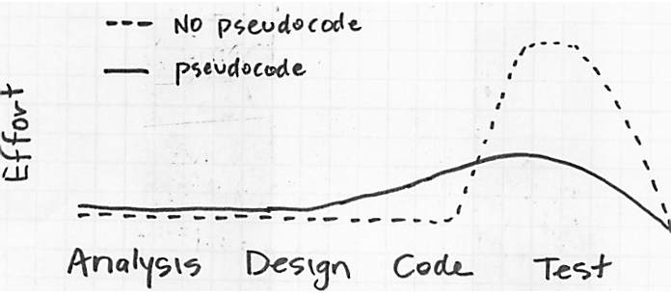
Controlling Flow (Pseudocode)
Workflow visualization (Modelbuilder)
3 main structural components
Pseudocode keywords
Sequences
Selection
Functions
Repetition
Combining selection & repetition
Dr. Tateosian

Slide 2
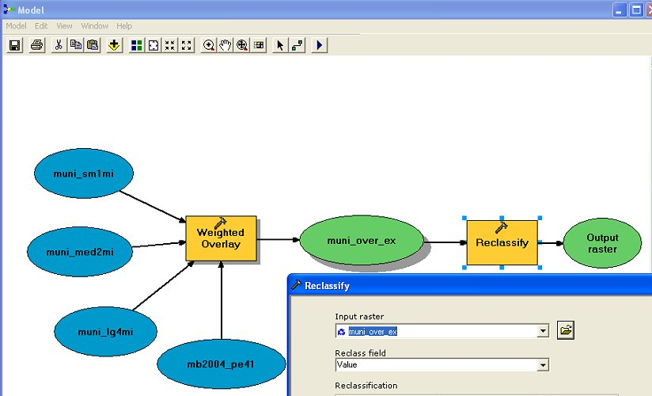
Modelbuilder Model as pseudocode
SET input to muni_sm1mi, muni_med2mi, munilg4mi, and mb2004_pe41
SET output name to muni_over_ex
CALL weighted overlay
SET input to muni_over_ex
SET output to Output raster
CALL reclassify on muni_over_ex
Notes:
Modelbuilder provides a way to visualize the process flow. Pseudocode helps to organize these as a series of steps.

Slide 3
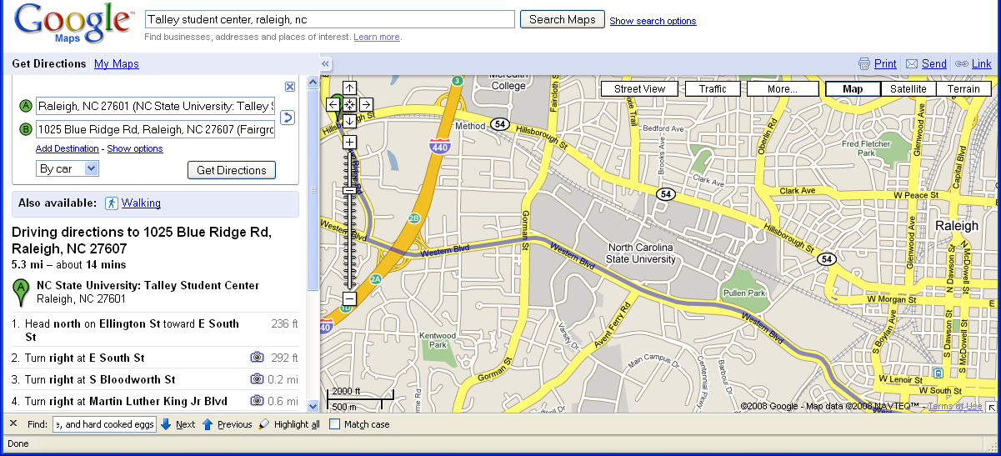
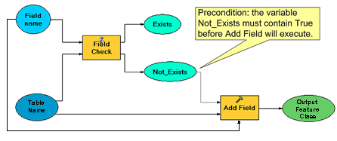


Structural components
Sequences
Selection (a.k.a. decision-making, a.k.a. branching)
Repetition (a.k.a. looping)
Lasagna
1 box Lasagna noodles
cheese sauce
2 eggs,1 C ric cheese,
2 C moza,1 C parm
tomato sauce
Instructions: Cook noodles. Mix cheese
sauce. Layer tom. sauce in 9x12pan. Layer noodles. Layer cheese sauce. Repeat 2 times…

Slide 4
Pseudocode keywords
Selection: IF...THEN, ELSEIF, ELSE,... ENDIF
Repetition: WHILE...ENDWHILE, FOR...ENDFOR
Other:
Input: READ, OBTAIN, GET
Output: PRINT, DISPLAY, SHOW
Compute: COMPUTE, CALCULATE, DETERMINE
Initialize: SET, INIT
Add one: INCREMENT, BUMP
Subtract one: DECREMENT
Functions: CALL, PROC, ENDPROC, RETURN

Slide 5
Sequences Examples
“GIS is part of scripting language and I want learn anything that goes along with GIS. Perhaps, as a beginner buffering, clipping, and extraction, classification of raster data.“
GET shapefile
CALL Buffer
CALL Clip
CALL Extract
GET Raster file
CALL Raster classification
“On a monthly basis, I download the tax data from the Tax Department database, convert it to a table readable in ArcGIS, and join it to the Parcel Data layer via a sql join.”
CALL DOWNLOAD tax data from Tax Department database
CALL CONVERT to dBase table
CALL JOIN dBase to Parcel Data

Slide 6
Selection examples
Selection: IF...THEN, ELSEIF, ELSE,... ENDIF
“I want to add a new field to the table for zipcodes, but sometimes that field may be there already”
    GET table name
    GET field name
    IF field exists THEN
    do nothing
    ELSE
    CALL add field
    ENDIF
Check if a tree has been recorded in the database. If it hasn’t, add this point.
Get database name
Get tree record
IF tree record is not in the database THEN
ADD tree record to the database
END IF
# BETTER!
GET table name
GET field name
IF field does not exist THEN
CALL add field
ENDIF

Slide 7
Pseudocode for a branching model
Pseudocode
keywords
SET table name
SET field name
field_exists = CALL field check
IF field_exists is true THEN
do nothing
ELSE
CALL add field
ENDIF
Unnecessary
details omitted
Indentation &
dedentation for related code blocks

Slide 8
Function example
Pseudocode keywords: FUNC, ENDFUNC, CALL, RETURN
Write and call a function that finds the orientation of highways based on their number.
FUNC findOrientation( highway number)
IF highway number is even
orientation = EW
ELSE
orientation = NS
ENDIF
RETURN orientation
ENDFUNC
myOrientation = CALL findOrientation(50)
PRINT myOrientation

Slide 9
Repetition example 1
Pseudocode keywords: FOR...ENDFOR
Goal: reproject each shapefile in a list to NAD83.
GET list of shapefiles
SET the coordinate system to NAD83
FOR each file in the list
SET output project file name
CALL the project tool
ENDFOR
Notes:
##Automate the conversion of multiple files into a particular coordinate system.
GET the list of shapefiles
SET the desired coordinate system
FOR each file in the list
CALL project file to desired coordinate system
ENDFOR
## Convert multiple files from ASCII to raster format GET the list of Excel files
GET a list the files in the directory
FOR each file in list
IF the file is ASCII format
CALL Convert from ASCII to Raster
ENDIF
ENDFOR
##Reformat Excel data files, plot xy data, then add to ArcGIS
GET the list of Excel files
SET the x and y coordinate fields
FOR each file in list
CALL Reformat Excel data
CALL make xy event layer
CALL add layer to ArcMap
ENDFOR
##Version 2 Reformat Excel data files, plot xy data, then add to ArcGIS (more detailed)
GET the list of Excel files
SET the x and y coordinate fields
FOR each file in list
CALL Remove unnecessary header rows from Excel file
FOR each field in Excel file
CALL Replace hyphens with underscores
ENDFOR
CALL make xy event layer
CALL add layer to ArcMap
ENDFOR

Slide 10
Repetition example 2
Pseudocode keywords: WHILE, ENDWHILE
  Often used for counting (as in the example below)
  Needs to be used when the number of times to loop is not known ahead of time.
Example Goal: Model various gypsy moth spread scenarios. Buffers for the next 100 years every 5 years
Model calculates buffer based on the year and spread rate
# What’s missing here?
SET year 2010
SET spread rate
WHILE year less than 2110
CALCULATE buffer dist. based on yr & spread rate
SET output buffer name
CALL buffer on input shapefile
SET year to year + 5
ENDWHILE

Slide 11
Combining selection and repetition
“I work with a dataset for the City of Raleigh that contains all of the trees that have been inventoried in the city’s right of way and some of the data has not been properly checked back into the system. From time to time we update and include those un-included points.”
GET database name
GET external table
FOR EACH tree record
IF tree record is not in the database THEN
ADD tree record to the database
END IF
ENDFOR
Convert the ASCII files in a directory to raster format (the directory contains non- ASCII format files too.)
GET a list of the files in the directory
FOR each file in list
IF the file is ASCII format THEN
SET output raster name
CALL Convert from ASCII to Raster
ENDIF
ENDFOR
Notes:
## Convert multiple files from ASCII to raster format GET the list of Excel files
GET a list the files in the directory
FOR each file in list
IF the file is ASCII format
CALL Convert from ASCII to Raster
ENDIF
ENDFOR

Slide 12
Framing the loop
I have a large number of tables in an MSAccess .mdb. I want to convert each table to an XY layer, then save as shape files in another folder. Then I want to merge all the shapefiles into one shapefile.
get the looping objects, state what you’re looping on, determine what goes inside the loop (what’s repeated?)
  GET a list of the tables in the mdb
  CALL Create output folder
  FOR each table in the list
  CALL Make XY Layer
  CALL Save layer as shapefile in output folder
  ENDFOR
  CALL Merge shapefiles in output folder.
  GET a list of the tables in the mdb
  CALL Create output folder
  FOR each table in the list:
  CALL Make XY Layer
  CALL Save layer as shapefile in output folder
  CALL Merge shapefiles in output folder.
  ENDFOR
  #Can you find the mistake in this pseudocode?
Notes:
gp.MakeTableView_management (fc, "fctv")
gp.MakeXYEventLayer_management ("fctv", "LON", "LAT", "fcxy", projection) gp.SavetoLayerFile_management ("fcxy", "fxlay")
gp.FeatureClasstoShapefile_conversion ("fclay", outfolder + "/" + fc + ".shp")

Slide 13
In class - Convert to pseudocode
I have weekly dumping data of dredged material in dbf files for one year and want to make a raster for each week and a combined raster for the entire year. These steps need to be taken:
- make xy event layer from dbf file
- clip with disposal site s1
- convert the shape file to a raster
- sum of all the rasters in the folder with weighted sum (weight = 1)

Slide 14
In class - Convert to pseudocode solution
GET a list of the weekly dbf files
FOR each dbf in list
CALL make xy event layer
CALL clip on disposal site s1
CALL shape file to a raster conversion
ENDFOR
CALL weighted sum on all the output rasters

Slide 15
Nested Repetition Example
Repetition can also be nested.
Goal: Model various gypsy moth spread scenarios using 5 different spread models to generate multiple buffers representing spread over year 10 years (2010-2020).
GET input shapefile
FOR each projection year
FOR each spread model
CALCULATE buffer based on year & spread model
SET output buff. name based on year & spread model
CALL buffer on input shapefile
ENDFOR
ENDFOR

Slide 16
Use while loop for year repetition
…over year 2010-2020, using 5 different spread models
GET input shapefile
FOR each projection year
FOR each spread model
CALCULATE buffer based on year & spread model
SET output buff. name based on year & spread model
CALL buffer on input shapefile
ENDFOR
ENDFOR
GET input shapefile
SET year to 2010
WHILE year is less than 2021
FOR each spread model
CALCULATE buffer based on year & spread model
SET output buff. name based on year & spread model
CALL buffer on input shapefile
ENDFOR
SET year to year + 1
ENDWHILE

Slide 17
More nested looping
I work with a data set for the City of Raleigh that contains all of the trees that have been inventoried in the cities right of way and some of the data has not been properly checked back into the system. From time to time we manually update and add those missing points. The raw data is recorded in a set of spread sheets. I want to automate going through the spread sheet files, comparing each record to the database and then adding missing points to the database.
GET tree inventory dataset
GET list of spread sheets
FOR each spread sheet in the list
FOR EACH tree record in the current spread sheet
IF tree record is not in the database THEN
ADD tree record to the database
ENDIF
ENDFOR
ENDFOR

Slide 18
Summing up
Topics discussed
    Workflow visualization (Modelbuilder)
    3 main structural components
    Pseudocode keywords
    Sequences
    Selection
    Functions
    Repetition
    Combining selection & repetition
    Prose -> pseudocode
    Converting a FOR loop to a WHILE loop
    Nested looping
Up next
    Decision-making (a.k.a. selection or branching)

