Slide 1

ToolValidator
Dr. Tateosian
Internal validation
ToolValidator class methods
Enable/disable parameters
Updating parameters
Debugging the ToolValidator class

Slide 2
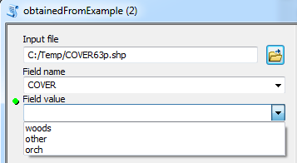
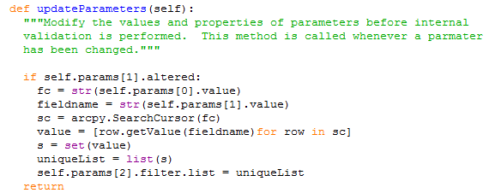
One cool way to use ToolValidator
Populate GUI dynamically
Notes:
import arcpy
fc = "C:/temp/COVER63p.shp"
fieldname = "COVER"
sc = arcpy.SearchCursor(fc)
##valueList = [row.getValue(fieldname)for row in sc]
valueList = []
for row in sc:
valueList.append(row.getValue(fieldname))
del sc
uniqueValueSet = set(valueList)
uniqueValueList = list(uniqueValueSet)
print uniqueValueList
def updateParameters(self):
"""Modify the values and properties of parameters before internal
validation is performed. This method is called whenever a parmater
has been changed."""
if self.params[1].altered:
fc = str(self.params[0].value)
fieldname = str(self.params[1].value)
sc = arcpy.SearchCursor(fc)
value = [row.getValue(fieldname)for row in sc]
s = set(value)
uniqueList = list(s)
self.params[2].filter.list = uniqueList
return

Slide 3
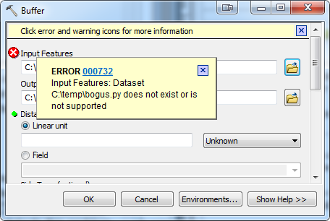
Supervise user input
Internal validation
  --built-in checks
  --automatically parameters
    Are all required inputs filled in?
    Does the input dataset exist?
    Is the input a raster when it's supposed to be raster?
    And more…
ToolValidator class
  Custom checks, custom behavior
Notes:
Script tool internal validation
If a parameter is required, check if it's empty (nothing entered yet) and, if so, post the "Value is required" message to the tool dialog box (using a green dot instead of a red x).
Check that the value the user entered is of the right type
Check filter membership
Check existence of input datasets.
Generate a default catalog path for output datasets.
Check existence of output datasets against the overwriteOutput environment setting. If the dataset exists and overwriteOutput is false, an error is produced; otherwise, a warning is produced.
If the parameter is a Field data type, check that the field exists in the associated table.
Check that the output dataset isn't the same as the input dataset (unless the output is derived, like Add Field).
For parameters containing linear and areal unit data types, set their default values by examining the corresponding values in ArcMap (if running from ArcMap).
If the output is a coverage, grid, or INFO table, check the 13-character file name limit for these datasets.

Slide 4
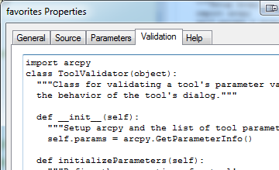
ToolValidator Class
Right click onScript Tool > Properties >
Validation tab.
class ToolValidator:
""“..."""
def __init__(self):
""“..."""
import arcpy
self.params = arcpy.GetParameterInfo()
def initializeParameters(self):
""“…."""
return
def updateParameters(self):
""“…."""
return
def updateMessages(self):
""“…."""
return

Slide 5
Things can do with ToolValidator?
Functionality beyond ‘Parameters’ tab
Build more agile GUIs
Reproducibility (copy & paste script to use for other tools)
Functionality:
  Enable/disable
    Example:
    If user selects a point feature class in the 1st parameter, display GREEN, EGGS, and HAM in 2nd parameter.
    If user selects a polygon feature class, display list SPAM, and ULTRASPAM in 2nd parameter.
  Update a parameter filter
  Provide default values
  Customize warnings & error messages
  Use parameter categories
  Update output data description (for ModelBuilder)

Slide 6
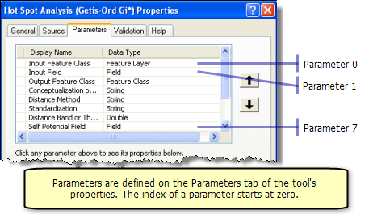
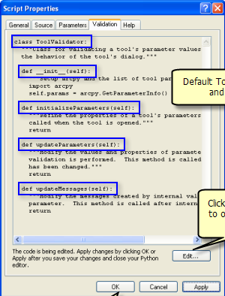
ToolValidator
Parameter tab to set parameters
ToolValidator tab to set parameters
  class ToolValidator:
  """Class for validating a tool's parameter values and controlling
  the behavior of the tool's dialog."""
  def __init__(self):
  """Setup arcpy and the list of tool parameters."""
  import arcpy
  self.params = arcpy.GetParameterInfo()

Slide 7
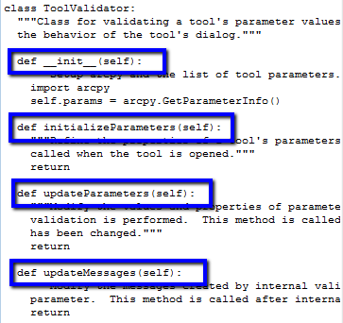
Tool validator methods
Method | Description
__init__ | Initializes the ToolValidator class. Perform import and initialize the object (self) properties.
initializeParameters | Called once when the tool dialog box first opens
updateParameters | Called each time the user changes a parameter. After returning from updateParameters, geoprocessing calls its internal validation routine.
updateMessages | Called after returning from the internal validation routine. You can change the messages created from internal validation.

Slide 8
Tool parameters
class ToolValidator:
def __init__(self):
"""Setup arcpy and the list of tool parameters."""
import arcpy
self.params = arcpy.GetParameterInfo()
Selected Properties | Read/Write | Value(s) | Description
name | Read only | String | Parameter name as defined on Parameters tab
direction | Read only | String: "Input", "Output" | Input/Output direction defined on Parameters tab
datatype | Read only | String | Data type as defined on Parameters tab.
parameterType | Read only | String: "Required", "Optional", "Derived" | Type as defined on the Parameters tab .
parameterDependencies | Read/write | Python List | A list of indexes of each dependent parameter.
value | Read/write | Value object | The value of the parameter.
enabled | Read/write | Boolean | False if the parameter is dimmed (unavailable).
altered | Read only | Boolean | True if the user has modified the value.
hasBeenValidated | Read only | Boolean | True if the internal validation routine has checked the parameter.
category | Read/write | String | The category of the parameter.
filter | Read only | GP Filter object | The filter to apply to values in the parameter.
symbology | Read/write | String | The pathname to a layer file (.lyr) used for drawing the output.
Notes:
For a complete list of properties:
http://help.arcgis.com/en/arcgisdesktop/10.0/help/index.html#/Programming_a_ToolValidator_class/00150000000v000000/

Slide 9
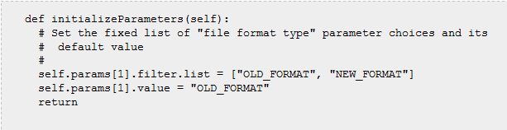
initializeParameters
__init__ class sets self.params to the list of parameters
      class ToolValidator:
      def __init__(self):
      """Setup arcpy and the list of tool parameters."""
      import arcpy
      self.params = arcpy.GetParameterInfo()
self.params is a Python list. To set or get use index
    self.params[1].filter.list = [“a”,”b”]
    self.params[1].value = “a”
Set in initializeParameters or updateParameters methods

Slide 10
Parameter props/methods
object.property and object.method
if self.params[0].altered:
self.params[0].setErrorMessage(“NO!!!")
object.property.property
    self.params[1].filter.list = [“Spam”,”Eggs”]
    other useful properties
    self.params[1].value = “Spam”
if self.params[0].enabled:
self.params[0].setErrorMessage(“WOOPEE!!!")

Slide 11
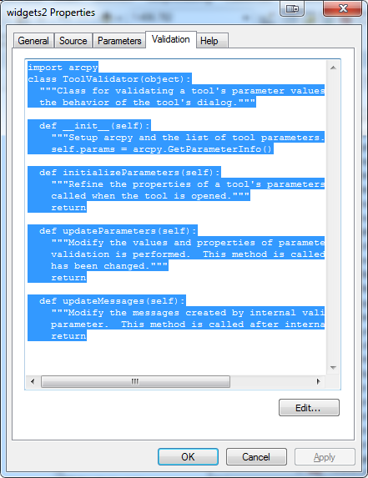
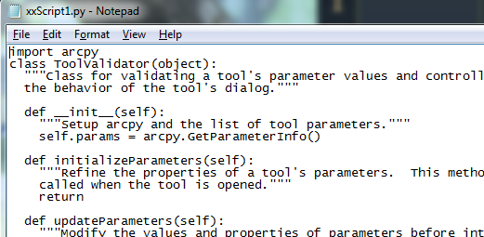
How to modify ToolValidator class
Right click, select Script Tool properties.
Validation tab.
Edit… (This Notepad launches).
Modify in Notepad
and File > SAVE.
Close Notepad window.
Click OK on Validation tab.

Slide 12
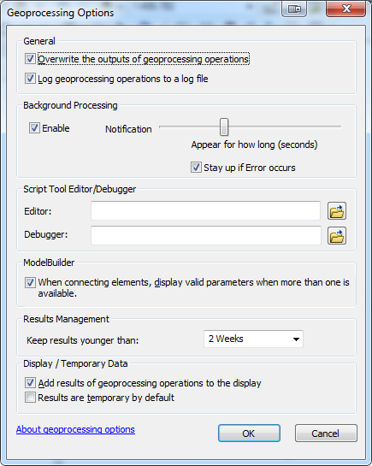
Script tool editor
ArcMap > Geoprocessing menu >
Geoprocessing options >
Editor > Browse to IDE
Default may be notepad.exe – okay, but no syntax checking

Slide 13
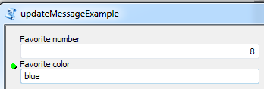
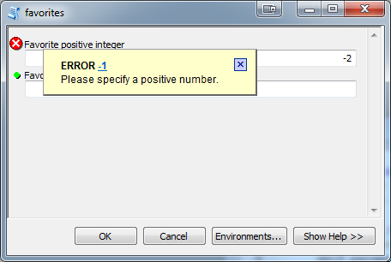
In class - updateMessage
1. Create a script tool (no need to point to an actual script--this is just an empty shell). Set up 2 parameters:
Favorite number, a required input with datatype long.
Favorite color a required input with datatype string.
2. Modify updateMessages method in the ToolValidator so that if the user enters a negative number in the 1st param., the tool gives an error and tells the users to enter a positive number.
Notes:
def updateMessages(self):
"""Modify the messages created by internal validation for each tool
parameter. This method is called after internal validation."""
if self.params[0].altered:
if self.params[0].value < 0:
self.params[0].setErrorMessage("Please use a positive number")
return

Slide 14

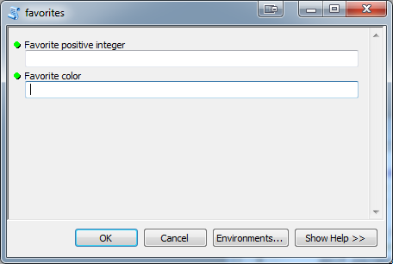
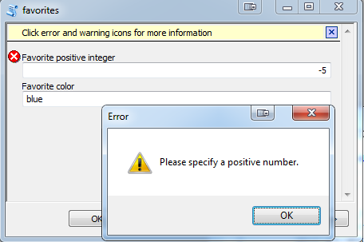
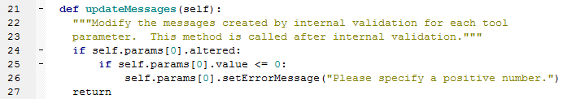
updateMessage followup
Notes:
def updateMessages(self):
"""Modify the messages created by internal validation for each tool
parameter. This method is called after internal validation."""
if self.params[0].altered:
if float(self.params[0].value) < 0:
self.params[0].setErrorMessage("Please use a positive number")
return

Slide 15
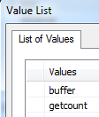
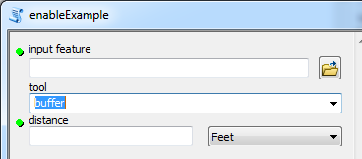
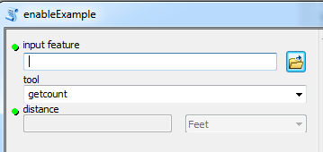
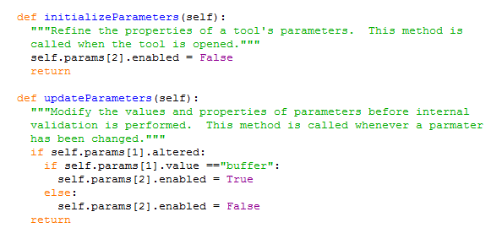
Enable/disable parameters example
Script tool either buffers or gets count for the input file.
Parameter 0 is the input file
Parameter 1 has two values: getcount or buffer
Parameter 2 gets the buffer distance
If parameter 1 is buffer: get a buffer distance; else disable this parameter (#2).
Notes:
class ToolValidator:
"""Class for validating a tool's parameter values and controlling
the behavior of the tool's dialog."""
def __init__(self):
"""Setup arcpy and the list of tool parameters."""
import arcpy
self.params = arcpy.GetParameterInfo()
def initializeParameters(self):
"""Refine the properties of a tool's parameters. This method is
called when the tool is opened."""
self.params[2].enabled = False
return
def updateParameters(self):
"""Modify the values and properties of parameters before internal
validation is performed. This method is called whenever a parmater
has been changed."""
if self.params[1].altered:
if self.params[1].value =="buffer":
self.params[2].enabled = True
else:
self.params[2].enabled = False
return
def updateMessages(self):
"""Modify the messages created by internal validation for each tool
parameter. This method is called after internal validation."""
return

Slide 16
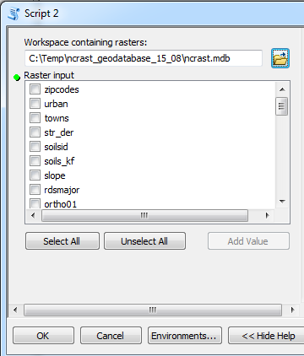
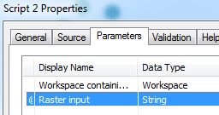
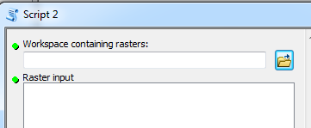
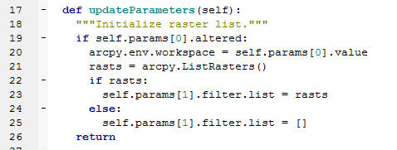
Updating parameters
Notes:
class ToolValidator:
"""Class for validating a tool's parameter values and controlling
the behavior of the tool's dialog."""
def __init__(self):
"""Setup arcpy and the list of tool parameters."""
import arcpy
self.params = arcpy.GetParameterInfo()
def initializeParameters(self):
"""Refine the properties of a tool's parameters. This method is
called when the tool is opened."""
return
def updateParameters(self):
"""Modify the values and properties of parameters before internal
validation is performed. This method is called whenever a parmater
has been changed."""
if self.params[0].altered:
arcpy.env.workspace = str(self.params[0].value)
rasts = arcpy.ListRasters()
self.params[1].filter.list = rasts
return
def updateMessages(self):
"""Modify the messages created by internal validation for each tool
parameter. This method is called after internal validation."""
return

Slide 17
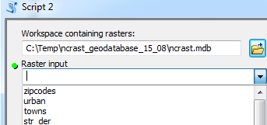
Updating parameters
parameter properties:
  Line 19: altered -- returns true or false
  Line 23: filter.list – A python list of choices available to user.
  Multivalue yes, gives a set of check boxes.
  Multivalue no, gives a combobox
Notes:
class ToolValidator:
"""Class for validating a tool's parameter values and controlling
the behavior of the tool's dialog."""
def __init__(self):
"""Setup arcpy and the list of tool parameters."""
import arcpy
self.params = arcpy.GetParameterInfo()
def initializeParameters(self):
"""Refine the properties of a tool's parameters. This method is
called when the tool is opened."""
return
def updateParameters(self):
"""Modify the values and properties of parameters before internal
validation is performed. This method is called whenever a parmater
has been changed."""
if self.params[0].altered:
arcpy.env.workspace = str(self.params[0].value)
rasts = arcpy.ListRasters()
self.params[1].filter.list = rasts
return
def updateMessages(self):
"""Modify the messages created by internal validation for each tool
parameter. This method is called after internal validation."""
return

Slide 18
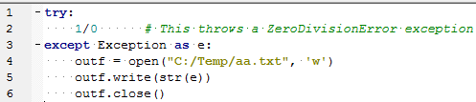

Debugging the tool validator
Print exceptions to a file.
e gets an exception object.
cast it to string and it gives the descriptive error.
Blow by blow:
  Line 4: open text file
  Line 5: write exception
  Line 6: close file
Notes:
try:
1/0 # This throws a ZeroDivisionError exception
except Exception, e:
outf = open("C:/Temp/aa.txt", 'w')
outf.write(str(e))
outf.close()

Slide 19
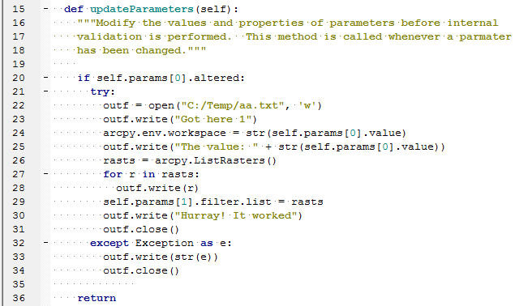
Tool validator debugging example
Remember: always close the file.
Notes:
class ToolValidator:
"""Class for validating a tool's parameter values and controlling
the behavior of the tool's dialog."""
def __init__(self):
"""Setup arcpy and the list of tool parameters."""
import arcpy
self.params = arcpy.GetParameterInfo()
def initializeParameters(self):
"""Refine the properties of a tool's parameters. This method is
called when the tool is opened."""
return
def updateParameters(self):
"""Modify the values and properties of parameters before internal
validation is performed. This method is called whenever a parmater
has been changed."""
if self.params[0].altered:
try:
outf = open("C:/Temp/aa.txt", 'w')
outf.write("Got here 1")
arcpy.env.workspace = str(self.params[0].value)
outf.write("The value: " + str(self.params[0].value))
rasts = arcpy.ListRasters()
for r in rasts:
outf.write(r)
self.params[1].filter.list = rasts
outf.write("Hurray! It worked")
outf.close()
except Exception as e:
outf.write(str(e))
outf.close()
return
def updateMessages(self):
"""Modify the messages created by internal validation for each tool
parameter. This method is called after internal validation."""
return

Slide 20
In class - getUniqueValues.py
Complete a script to get a list of unique values for a field in a GIS table.
Create a script tool (no need to point to an actual script). Set up 3 parameters.
Modify updateParameters in ToolValidator class so that the 3rd parameter is updated to a unique list of values in the selected field for the selected feature class.

Slide 21
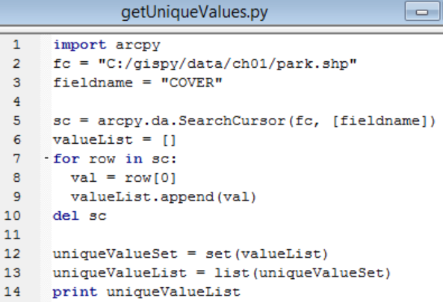


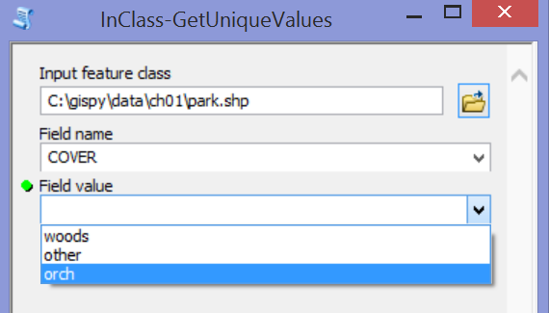
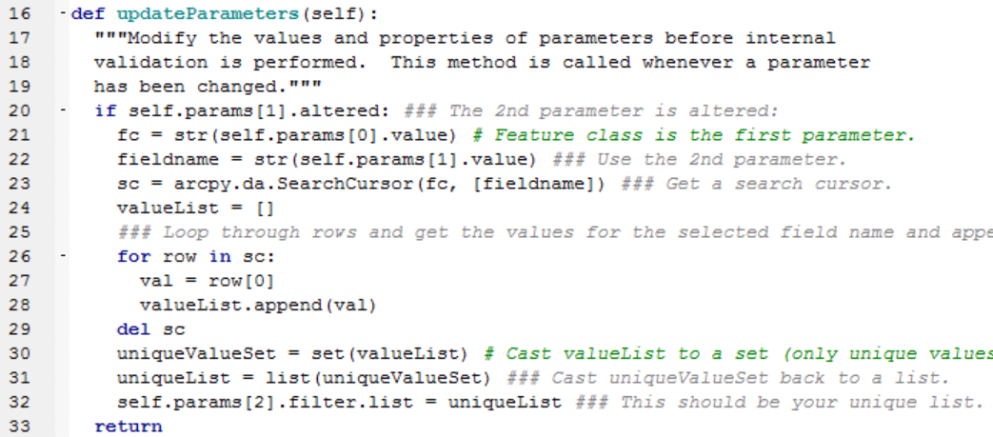

getUniqueValues followup
Notes:
import arcpy
fc = "C:/gispy/data/ch01/park.shp"
fieldname = "COVER"
sc = arcpy.da.SearchCursor(fc, [fieldname])
valueList = []
for row in sc:
val = row[0]
valueList.append(val)
del sc
uniqueValueSet = set(valueList)
uniqueValueList = list(uniqueValueSet)
print uniqueValueList
def updateParameters(self):
"""Modify the values and properties of parameters before internal
validation is performed. This method is called whenever a parameter
has been changed."""
if self.params[1].altered: ### The 2nd parameter is altered:
fc = str(self.params[0].value) # Feature class is the first parameter.
fieldname = str(self.params[1].value) ### Use the 2nd parameter.
sc = arcpy.da.SearchCursor(fc, [fieldname]) ### Get a search cursor.
valueList = []
### Loop through rows and get the values for the selected field name and append to valuelist.
for row in sc:
val = row[0]
valueList.append(val)
del sc
uniqueValueSet = set(valueList) # Cast valueList to a set (only unique values retained).
uniqueList = list(uniqueValueSet) ### Cast uniqueValueSet back to a list.
self.params[2].filter.list = uniqueList ### This should be your unique list.
return
##valueList = [row[0] for row in sc]

Slide 22
Summing up
Topics discussed
    Internal validation
    ToolValidator class methods
    Enable/disable parameters
    Updating parameters
    Debugging the ToolValidator class
Notes:
This video showed how the ToolValidator enables you to go beyond the Internal Validation. With the ToolValidator class, you can create custom warnings and errors and initialize and update parameters dynamically.
In one example, we restricted the user to only input positive numbers. You could use a similar technique to make sure a string doesn’t contain any special characters or to require a file name to contain a particular substring, or you could force the user to only select even numbers.
We also used the ToolValidator class to find the values of a field in a dataset selected by the user in another input parameter. You could use a similar technique to find the range of numerical values in a selected field. You’d again use a search cursor to collect the values, then you could use the built-in min and max functions to find the minimum and maximum values. Likewise, you could find the date span in a dataset by using the search cursor with the datetime module. These examples use search cursors, but standard file i/o could be used for a dataset that is not yet GIS ready, so that you could provide a list of field names, since the obtained from property would be able to do it.
With ideas like these, the ToolValidator Class can create much more powerful “smarter” dynamic graphical user interface.

Slide 23
Appendix

Slide 24
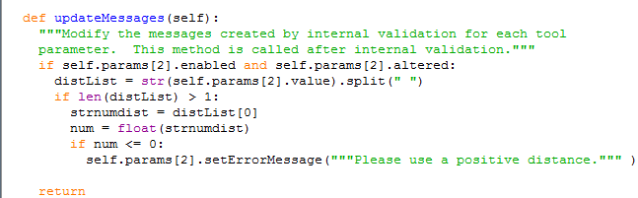
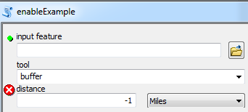
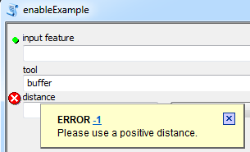
updateMessages Example 2

