Slide 1
Background concepts
Conditional statements
Decision-making syntax
Boolean Expressions
Logical operators
Comparison operators
New concepts
arcpy Describe object
GIS data types and other data properties

Slide 2

Decision making with Describe objects
Dr. Tateosian
Photo credit: Credit James Wheeler
Notes:
In this video, we’re going to explore the ArcPy Describe object and how it can enhance decision-making in GIS workflows.

Slide 3
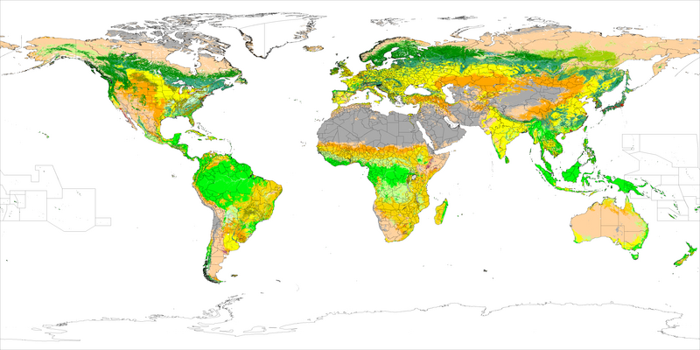
What is the Arcpy Describe Object?
Allows us to extract information about various data elements in GIS, such as feature classes, rasters, tables, or workspaces.
C:/gipsy/scratch
Feature class
Polygon
No M value
No z value
Notes:
Let’s start by answering the question: what exactly is the Describe object? In simple terms, the Describe object allows us to extract information about various data elements in GIS, such as feature classes, rasters, tables, or workspaces. By accessing the metadata, we can learn about the structure and properties of datasets—think of it as a sneak peek behind the scenes of your GIS data.

Slide 4
Why Describe?
Getting information about the geometry type, format, spatial reference, data extent can help you to…
Choose appropriate analysis methods,
Ensure data compatibility,
Automate processes by dynamically adapting to different datasets

Slide 5

Practical example 1: Choose analytic method
Determine if a dataset has points before calculating distance.
Notes:
Suppose you are working on a project that calculates the distances between charging stations. Before driving in the wrong direction, you can use the Describe object to check if your dataset is composed of points, lines, or polygons. If the shape type is 'polygon' or 'polyline', distance calculations might not be appropriate, and you’ll need to adjust your approach. This is where Describe helps in making informed choices.

Slide 6
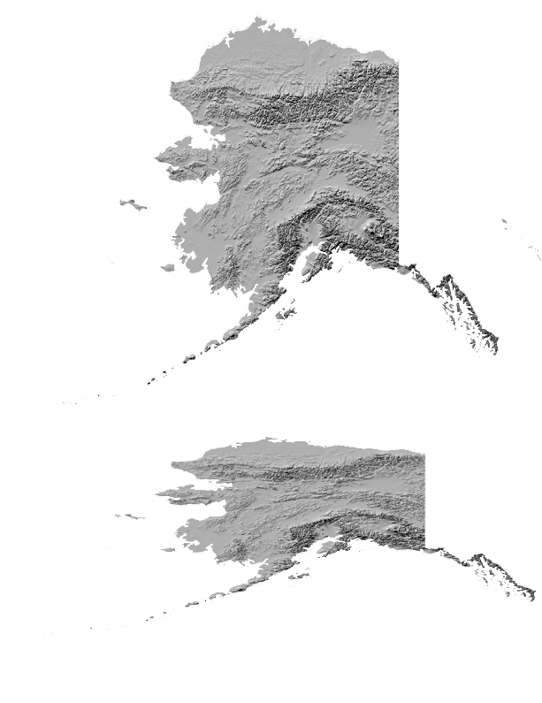
Practical example 2: Validate data compatibility
Determine if a datasets have the same projection before performing overlay operations.
Notes:
Or suppose you are performing some overlay operations with multiple datasets. They need to share the same spatial reference. The Describe object allows you to check and compare the coordinate systems of your layers so you can ensure that the data aligns perfectly.

Slide 7
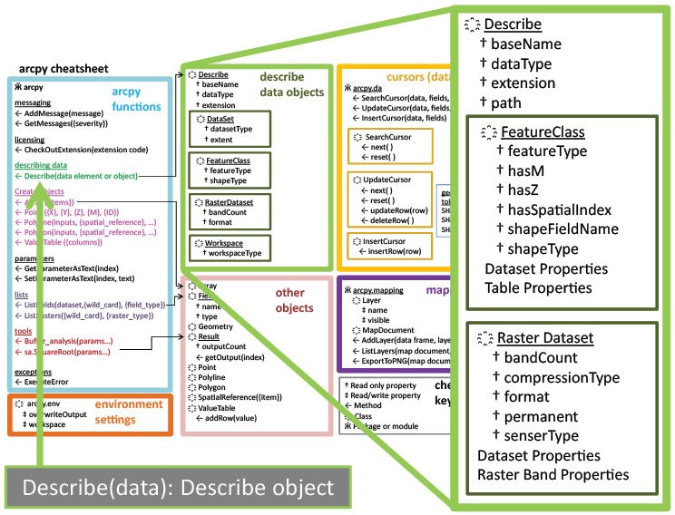
Describe Object
desc = arcpy.Describe("C:/gispy/data/ch09/getty_rast")
Describe object
Data element to be described
Notes:
The Describe method is in the left column of the cheatsheet, and the object it returns is represented by the green box.
You create a describe object for a dataset by passing it in as an argument.

Slide 8

Simple example 1: Identify geometry type
import arcpy
# Define the path to your dataset
fc = "C:/gispy/data/ch09/trails.shp"
# Get the Describe object
desc = arcpy.Describe(fc)
# Print the geometry type
print(f"Geometry type: {desc.shapeType}")
Geometry type: Polyline
Notes:
Let’s start with a simple but essential task: identifying the geometry type of a dataset. Knowing whether you’re dealing with points, lines, or polygons is critical for choosing the right analysis tools.
Here’s a Python example using the Describe object to find out whether our dataset contains points, lines, or polygons.
We can use this to determine how to proceed with spatial analysis, depending on the shape type of the dataset.

Slide 9
Simple example 2: Check the spatial reference
import arcpy
fc = "C:/gispy/data/ch09/trails.shp"
desc = arcpy.Describe(fc)
# Get spatial reference
spatial_ref = desc.spatialReference
# Print spatial reference details
print(f"Spatial Reference: {spatial_ref.name}")
print(f"Type: {spatial_ref.type}")
print(f"EPSG Code: {spatial_ref.factoryCode}")
Spatial Reference: 'North_America_Albers_Equal_Area_Conic'
Type: 'Projected'
EPSG Code: 102008

Slide 10
Real-world application: Clip analysis
import arcpy
arcpy.env.workspace = "C:/gispy/scratch"
input_fc = "input_dataset.shp"
clip_fc = "clip_dataset.shp"
# Get the spatial reference names of both datasets.
desc_input = arcpy.Describe(input_fc)
desc_clip = arcpy.Describe(clip_fc)
sr_input = desc_input.spatialReference.name
sr_clip = desc_clip.spatialReference.name
# Compare the spatial reference names.
if sr_input != sr_clip:
# Reproject the clip dataset to match the input dataset's spatial ref.
reprojected_clip = "reprojected_clip.shp"
arcpy.management.Project(clip_fc,
reprojected_clip,
desc_input.spatialReference)
clip_fc = reprojected_clip # Use the reprojected clip dataset
# Perform the Clip operation
output_fc = "clipped_output.shp"
arcpy.analysis.Clip(input_fc, clip_fc, output_fc)
print(f"{arcpy.env.workspace}/{output_fc} created.")

Slide 11
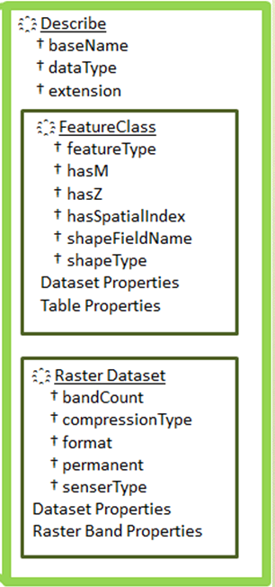











Available properties depend on data type
>>> import arcpy
>>> cat_pic = 'C:/gispy/data/ch09/jack.jpg'
>>> desc1 = arcpy.Describe(cat_pic)
>>> desc1.dataType 'RasterDataset'
>>> desc1.format 'JFIF'
>>> battlefield = 'C:/gispy/data/ch11/tester.gdb/park'
>>> desc2 = arcpy.Describe(battlefield)
>>> desc2.format
Traceback ...
RuntimeError: describe method: Format does not exist
>>> desc2.dataType
'FeatureClass'
>>> desc2.shapeType
'Polygon'
>>> desc2.hasZ
False
Notes:
>>> import arcpy
>>> myfile = 'C:/gispy/data/ch09/park.shp'
>>> desc2 = arcpy.Describe(myfile)
>>> desc2.format
Traceback (most recent call last): File "<interactive input>", line 1, in ?
RuntimeError: describe method: Format does not exist
>>> desc2.shapeType
'Polygon‘
>>> desc2.HasOID
True
>>> desc2.dataType
‘Shapefile'

Slide 12


Several properties are always available
>>> import arcpy
>>> cat_pic = 'C:/gispy/data/ch09/jack.jpg'
>>> desc1 = arcpy.Describe(cat_pic)
>>> desc1.dataType
All datasets have a baseName,
datatype, extension, path,
and other properties

Slide 13
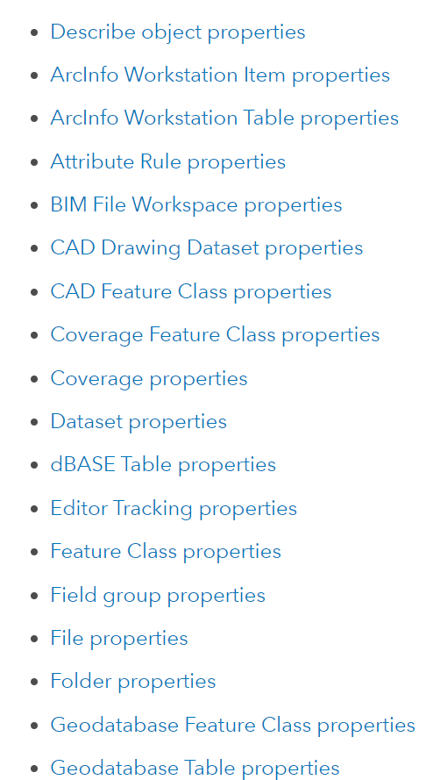
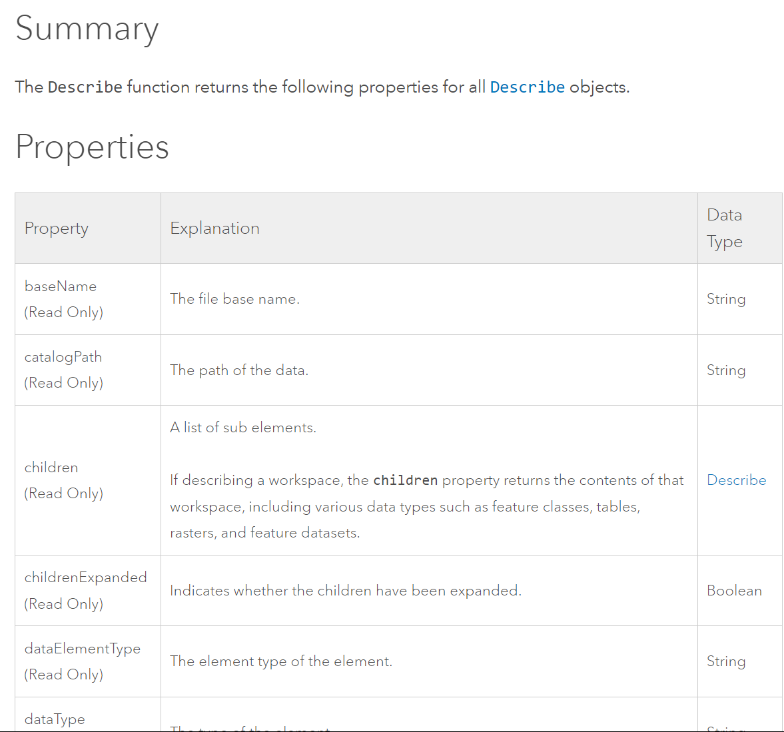



How to tell what properties are available?
Describe object online help
In a web search engine (such as Google), search for arcpy describe object
Notes:
You maybe wondering how to tell what properties are available.
You can search online for "arcpy describe object"
There you'll find a list of the properties that are common to all datasets.
There's a link from the summary page to a page that contains a list of all the datatypes.
You can click on any one of these to see its properties. For example if we click on the feature class properties

Slide 14
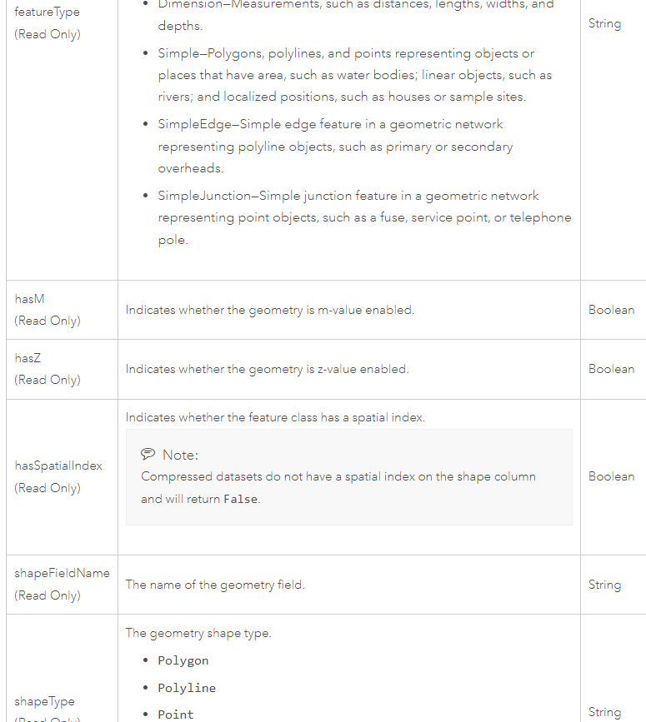
Feature class properties
Notes:
… we see a table of feature class properties.

Slide 15
Selection Syntax
Convert the pseudocode to Python
Python conditional keywords: if, elif, else
Use a Describe object to get the shapeType
Pseudocode
GET shapefile from user
GET shape type (Hint: Use 2 Python lines)
IF shape type is Polygon THEN PRINT shape is polygon
ELSE IF shape type is Polyline THEN PRINT shape is polyline
ELSE
PRINT shape is not polyline or polygon ENDIF
Python code
import arcpy, sys
mydata = sys.argv[1]
dsc = arcpy.Describe(mydata)
shapeType = dsc.shapeType
if shapeType == "Polygon":
print("Shape is polygon")
elif shapeType == "Polyline":
print("Shape is polyline")
else:
print("Shape is not polyline \
or polygon")

Slide 16
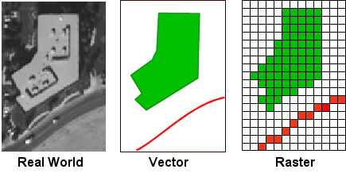
arcpy Describe objects can get this information
arcpy Describe objects can always provide dataType.
But other properties are dynamic.
Depending on the data type, the Describe object could also have a shape type or a format
Notes:
Remember how rasters don't have a shape type? Instead they have a format. But shapefiles do not have a format property.
The properties that a describe object has depend on the data type!

Slide 17
Using Describe properties with caution
Previous slide
import arcpy, sys
mydata = sys.argv[1]
dsc = arcpy.Describe(mydata)
shapeType = dsc.ShapeType
if shapeType == "Polygon":
print("Shape is polygon")
elif shapeType == "Polyline":
print("Shape is line")
else:
print("Shape is not \ polyline or polygon")
More cautiously
import arcpy, sys
mydata = sys.argv[1]
dsc = arcpy.Describe(mydata)
if dsc.dataType == "ShapeFile":
shapeType = dsc.ShapeType
if shapeType == "polygon":
print("Shape is polygon")
elif shapeType == "Polyline":
print("Shape is line")
else:
print("Shape is not \
polyline or polygon")

Slide 18
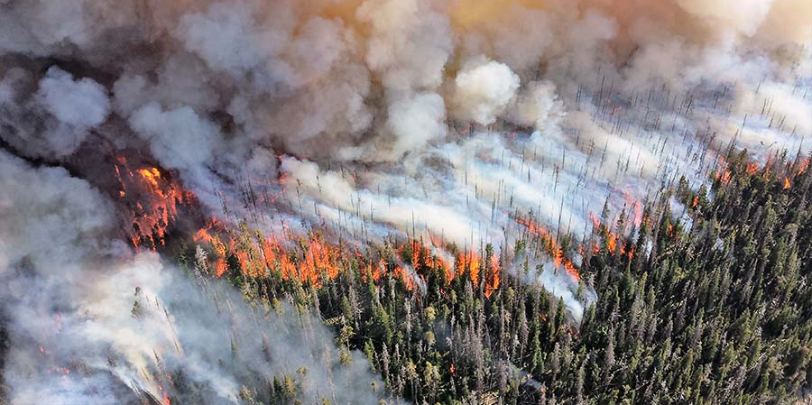
Scenario: Wildfire Risk Assessment
A government agency is assessing wildfire risk across a large region.
They receive mixed data types such as:
Point data Locations of fire incidents or weather stations.
Line data Roads and utility lines.
Polygon data Vegetation or land cover classifications.
Raster data Satellite imagery or Digital Elevation Models (DEMs).
Notes:
In most GIS applications, multiple different types of GIS data are used in concert together to explore complex questions.
For example, to conduct wildfire risk assessment, a government agency may build a tool to process
point datasets of fire incidents,
polyline datasets of utility lines,
polygons datasets of vegetation,
tiffs of satellite imagery,
and
ESRI GRID files of elevation models.

Slide 19







Scenario: Wildfire Risk Assessment
A government agency is assessing wildfire risk across a large region.
They receive mixed data types such as:
Point data Locations of fire incidents or weather stations.
Line data Roads and utility lines.
Polygon data Vegetation or land cover classifications.
Raster data Satellite imagery or Digital Elevation Models (DEMs).
Notes:
Notice that we're talking about 2 different types of data (vector and raster). A dataset's datatype is something we can find out with Python.

Slide 20
Scenario: Wildfire Risk Assessment
A government agency is assessing wildfire risk across a large region.
They receive mixed data types such as:
Point data Locations of fire incidents or weather stations.
Line data Roads and utility lines.
Polygon data Vegetation or land cover classifications.
Raster data Satellite imagery or Digital Elevation Models (DEMs).
Notes:
Even within those two different data types, we're breaking it down further.
We're distinguishing between the shape types for the vector data
And we're distinguishing between the formats for the rasters.

Slide 21

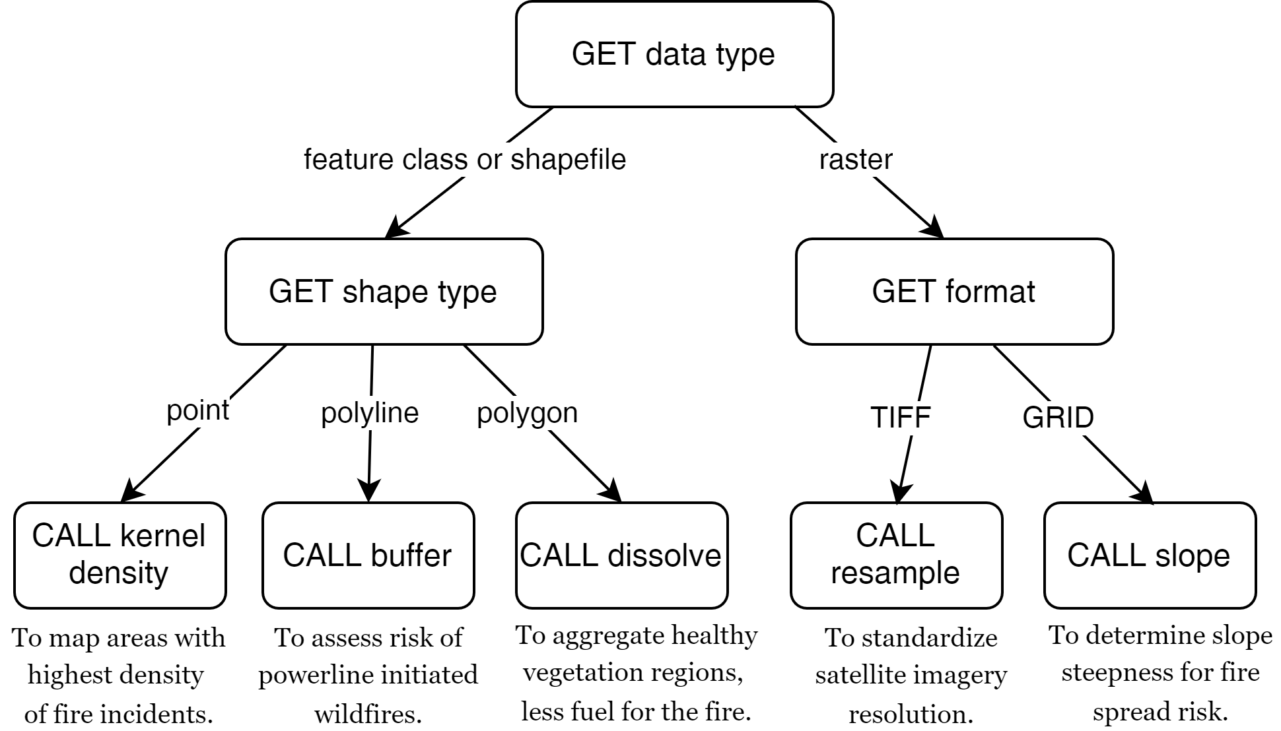









Wildfire risk assessment example
import arcpy, sys
input_data = sys.argv[1]
output_data = sys.argv[2]
# Describe the dataset
desc = arcpy.Describe(input_data)
data_type = desc.dataType
# If it's a feature class or shapefile dataset
if data_type in ['FeatureClass', 'Shapefile']:
shape_type = desc.shapeType
if shape_type == 'Point':
arcpy.analysis.PointDensity(input_data, output_data)
elif shape_type == 'Polyline':
arcpy.analysis.Buffer(input_data, output_data, "0.5 kilometers")
elif shape_type == 'Polygon':
arcpy.management.Dissolve(input_data, output_data)
# If it's a raster dataset...
elif data_type == 'RasterDataset':
format = desc.format
if format == 'TIFF':
arcpy.management.Resample(input_data, output_data, ...)
elif format == 'GRID':
arcpy.sa.Slope(input_data, output_data)
Notes:
On the right we have the workflow diagram for this scenario. The corresponding code is on the left. The circled number show where the workflow diagram pieces appear in the code.

Slide 22
Raster preparation tool
Different procedure for vector/raster/other datatypes.
Different for points/lines/polygon.
Different for TIFs and other formats.
GET data type
feature class
shapefile
raster
other
PRINT
'warning, knuckle head'
GET shape type
GET format
point
line
polygon
other
TIF
other
CALL point
to rast
CALL line
to rast
CALL polygon
to rast
PRINT
Not used
CALL
convert to TIFF

Slide 23
Raster preparation tool
Different procedure for vector/raster/other datatypes.
Different for points/lines/polygon.
Different for TIFs and other formats.
GET data type
feature class
shapefile
raster
other
PRINT
'warning, knuckle head'
GET shape type
GET format
point
line
polygon
other
TIF
other
CALL point
to rast
CALL line
to rast
CALL polygon
to rast
PRINT
Not used
CALL
convert to TIFF

Slide 24
Raster preparation tool
Different procedure for vector/raster/other datatypes.
Different for points/lines/polygon.
Different for TIFs and other formats.
GET data type
feature class
shapefile
raster
other
PRINT
'warning, knuckle head'
GET shape type
GET format
point
line
polygon
other
TIF
other
CALL point
to rast
CALL line
to rast
CALL polygon
to rast
PRINT
Not used
CALL
convert to TIFF

Slide 25
Raster preparation tool
Different procedure for vector/raster/other datatypes.
Different for points/lines/polygon.
Different for TIFs and other formats.
GET data type
feature class
shapefile
raster
other
PRINT
'warning, knuckle head'
GET shape type
GET format
point
line
polygon
other
TIF
other
CALL point
to rast
CALL line
to rast
CALL polygon
to rast
PRINT
Not used
CALL
convert to TIFF

Slide 26

Summing up
How to Describe data with arcpy
Describe properties are dynamic
Use this within branching conditions.

Slide 27
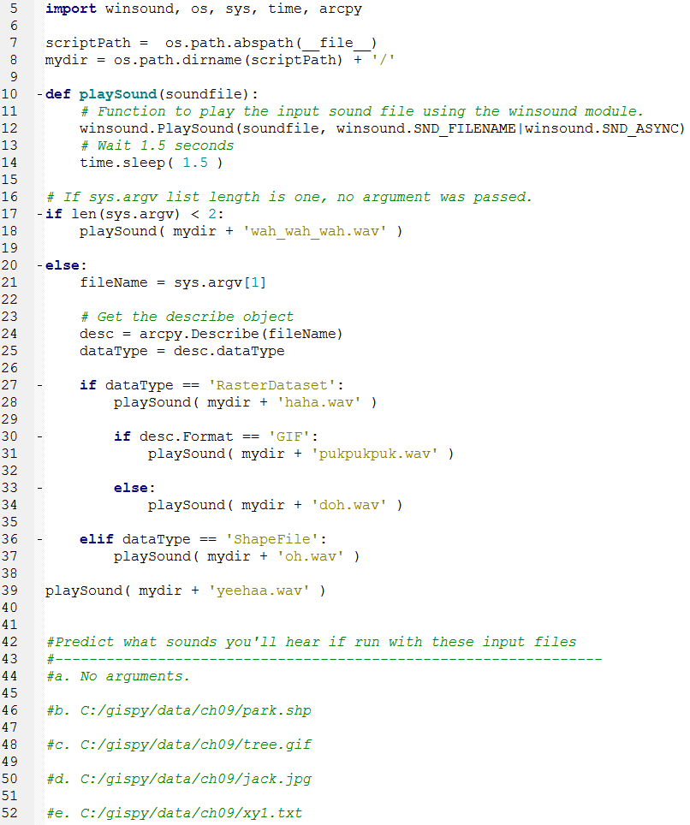
In class – conditionalSound.py

