Slide 1

Python dictionaries
What are they?
Syntax
Methods
Operations
Looping
Dr. Tateosian

Slide 2

Review – write a line of code for each
Create an empty Python list named mylist.
Append 8 and 5 to your new list.
Set x to the second item in your list by using list indexing.
Check if 3 is in your list.
Loop through your list and print each item.
Notes:
Create an empty Python list named mylist. mylist = [ ]
Append 8 and 5 to your new list. mylist.append(8) mylist.append(5)
--or– mylist.extend([8, 5])
Set x to the second item in your list by using list indexing. x = mylist[1]
Check if 3 is in your list. 3 in mylist
Loop through your list and print each item. for item in mylist:
print(item)

Slide 3
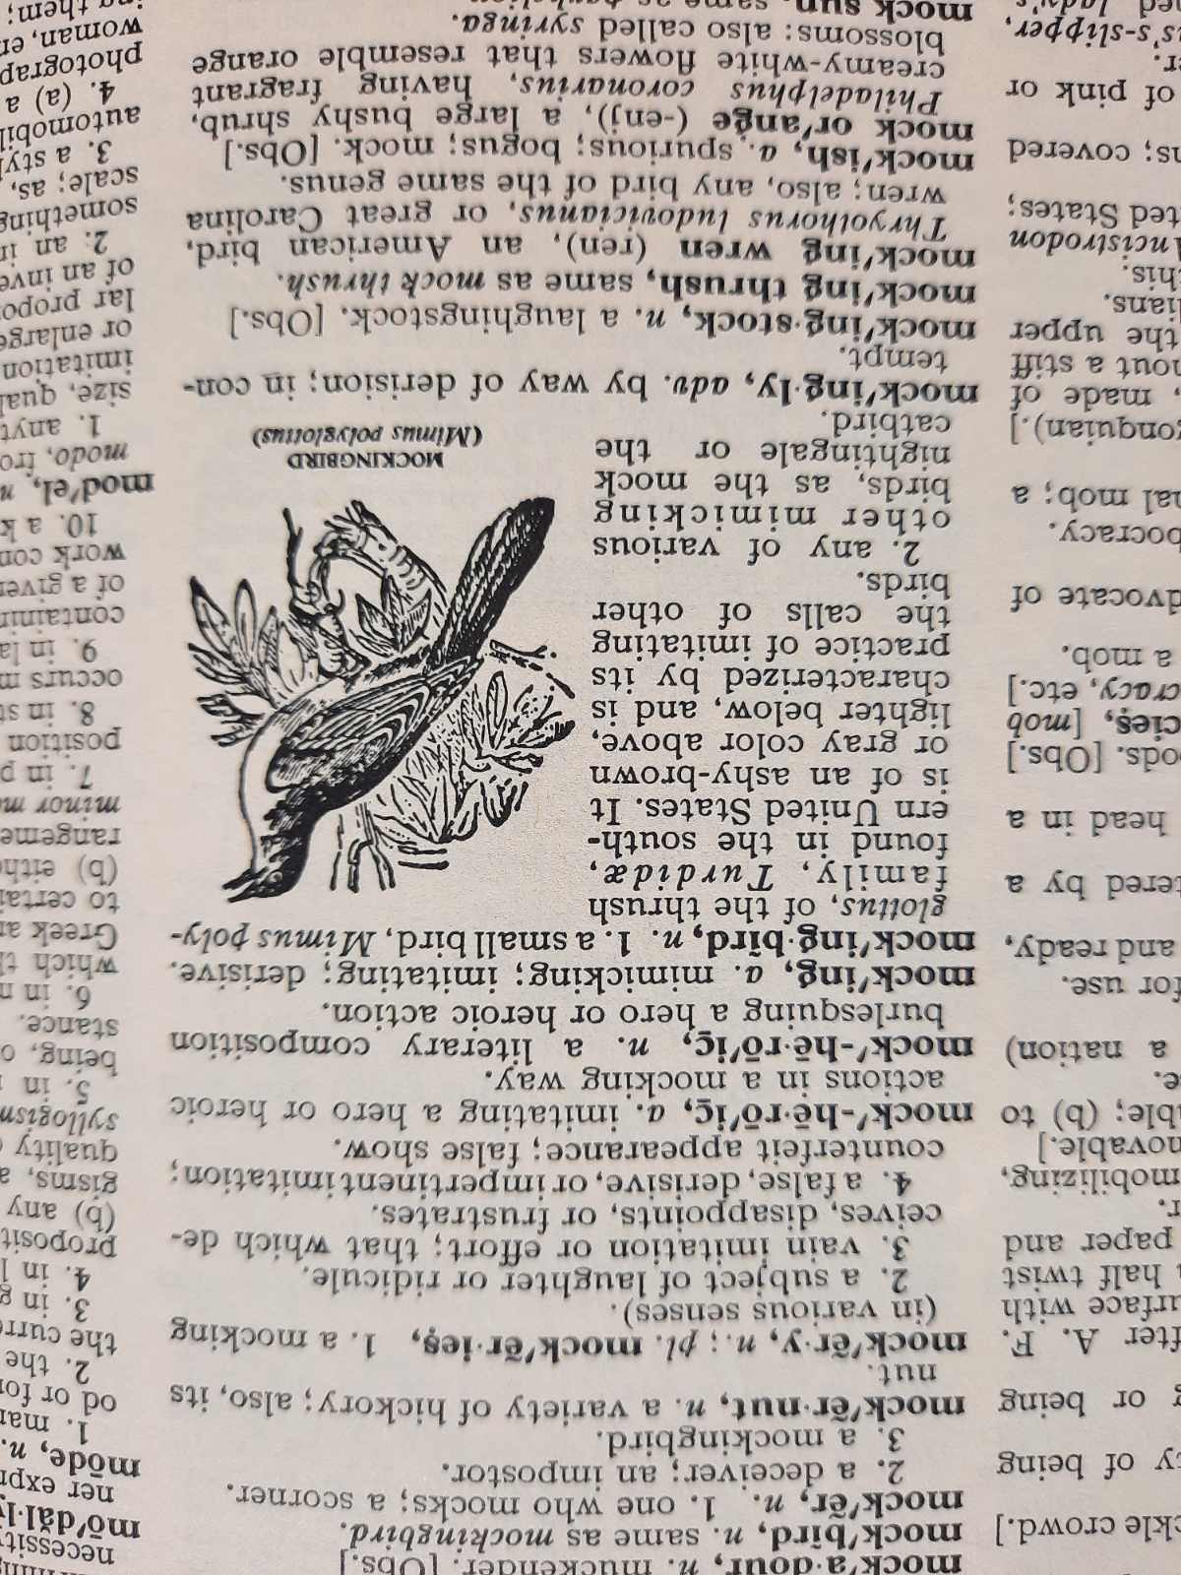
Background
Describe Webster's dictionary
a book alphabetically listing the words and their meanings
Geospatial data can be extensive and complex
Native Python data types?
strings, lists, …
and dictionaries
Notes:
Geospatial data can be extensive and complex, involving numerous attributes and spatial information. Dictionaries offer efficient data storage and retrieval, allowing you to associate attributes and spatial data with feature IDs, making it easier to access, manipulate, and analyze this information.

Slide 4
Ways not to use if, elif
Instead should be
if x == 1:
#do stuff
if x == 2:
#do special stuff
if x == 3:
#do very weird thing
if x == 1:
#do stuff with a
elif x == 2:
#do stuff with b
elif x == 3:
#do stuff with c
elif x == 4:
#do stuff with d
elif x == 5:
#do stuff with e
elif x == 6:
#do stuff with f
…
if x == 1:
#do stuff
elif x == 2
#do special stuff
elif x == 3
#do very weird thing
Don’t use repeated if to check mutually exclusive conditions.
Don’t use a large number of ‘elif’ conditions when consistently testing the same variable’s value and performing the same operation inside.
Instead should be
using Python
dictionary.

Slide 5
Dictionaries
Built-in data type, like strings, tuples, & lists.
A collection of items like lists, but…
Each item is a pair: key:value
myFeature = {'name': 'Lake', 'area': 1000, 'depth': 20}
Each key is unique, like an FID.
Used to store a value with some key and extract the value given the key

Slide 6

First, review list syntax
Create a list
--create an empty list:
mylist = []
--a list containing 1,2, and ‘bla’
mylist = [1,2,’bla’]
Add ‘foo’ to an existing list
mylist.append(‘foo’)
Remove an instance of ‘bla’ from the list
mylist.remove(‘bla’)
Get the third item in the list
x = mylist[2]
Check if 3 is in the list
3 in mylist
What’s the name for this
type of action?
indexing

Slide 7
Create a dictionary
Create an empty dictionary.
>>> myD = {}
>>> myD
{}
Create a dictionary with items "color":"gray" and "fill":False.
>>> mountain = {'color': 'gray', 'fill': False}
>>> mountain
{'color': 'gray', 'fill': False}
items

Slide 8
Modify a dictionary*
>>> mountain = {'color': 'gray', 'fill': False}
Add the item "outline":"solid" to mountain (an existing dictionary).
>>> mountain["outline"] = "solid"
>>> mountain
{'color': 'gray', 'fill': False, 'outline': 'solid'}
Modify the color value to blue.
>>> mountain["color"] = "blue"
>>> mountain
{'color': 'blue', 'fill': False, 'outline': 'solid'}
*You can also remove items.

Slide 9
Add item vs . Modify item
>>> mountain = {'color': 'gray', 'fill': False}
Add an item.
>>> mountain["outline"] = "solid"
>>> mountain
{'color': 'gray', 'fill': False, 'outline': 'solid'}
Modify that item.
>>> mountain["outline"] = "dash"
>>> mountain
{'color': 'gray', 'fill': False, 'outline': 'dash'}
Notes:
Adding and modifying look the same!

Slide 10
Add item vs. modify existing item
Dictionary items can be added in 2 ways:
when the dictionary is created:
>>> myD = {0:'woods', 5:'park', 'foo':'orch'}
>>> myD
{0: 'woods', 5: 'park‘, 'foo': 'orch‘}
individually after the dictionary has already been created:
>>> myD[10] = 'lake' # access-by-key syntax
>>> myD
{0: 'woods', 10: 'lake', 'foo': 'orch', 5: 'park'}
Modifying items looks just like #2. Only difference is using a key that is already in the dictionary
>>> myD[5] = 'hurray!' # access-by-key syntax
>>> myD
{0: 'woods', 10: 'lake', 'foo': 'orch', 5: 'hurray!'}

Slide 11


Access-by-key
Get the value of the item which has key 5
>>> myD = {0:"woods", 5:"park", "foo":"orch"}
>>> val1 = myD[5]
>>> val1
'park'
Get the value of the item which has key “foo”
>>> val2 = myD[“foo”]
>>> val2
'orch'
What will val3 be?
>>> val3 = myD[2]
There are 3 items in the dictionary… with zero-based indexing, why doesn't this give the 3rd item?
(use access-by-key syntax)
# Looks like indexing but it’s NOT
5:"park“ is NOT necessarily the 6th item!

Slide 12
Check for membership in
Check if soils has an item with a key of 5.
>>> 5 in soils
True
Check if soils has an item with a key of 'Fill'.
>>> 'Fill' in soils
False
Check if soils does not have an item with a key of 4.
>>> 4 not in soils
True
>>> soils = {0:'Fill', 2:'Clay', 5:'Other'}

Slide 13
Dictionary operations
Operation | Explanation
len(d) | Returns the number of items, i.e. the number of (key,value) pairs.
del d[k] | Deletes the key, k, together with its value.
k in d | True, if a key, k, exists in the dictionary d.
k not in d | True, if a key, k, doesn't exist in the dictionary d.
>>> myD = {0:'woods', 5:'park', 'foo':'orch'}
>>> len(myD)
3
>>> 5 in myD
True
>>> del myD[5]
>>> myD
{0: 'woods', 'foo': 'orch'}
>>> 5 not in myD
True
>>> len(myD)
2
# Again…not indexing!
For dictionaries always remember to use a KEY in the square braces, not an index.

Slide 14
Dictionary methods
object.method()
Dictionaries methods: clear, copy, fromkeys, get, items, keys, pop, popitem, setdefault, update, values
>>> myD = {0:"woods", 5:"park", "foo":"orch"}
>>> myD.keys()
dict_keys([0, 5, 'foo'])
>>> myD.pop("foo")
'orch’
>>> myD
{0: 'woods', 5: 'park'}

Slide 15
Dictionary methods
object.method()
Dictionaries methods: clear, copy, fromkeys, get, items, keys, pop, popitem, setdefault, update, values
>>> myD = {0:"woods", 5:"park", "foo":"orch"}
>>> myD.keys()
dict_keys([0, 5, 'foo'])
>>> myD.pop("foo")
'orch’
>>> myD
{0: 'woods', 5: 'park'}

Slide 16
Dictionary methods
object.method()
Dictionaries methods: clear, copy, fromkeys, get, items, keys, pop, popitem, setdefault, update, values
>>> myD = {0:"woods", 5:"park", "foo":"orch"}
>>> myD.keys()
dict_keys([0, 5, 'foo'])
>>> myD.pop("foo")
'orch'
>>> myD
{0: 'woods', 5: 'park'}

Slide 17
Dictionary views
object.method()
Dictionaries methods that return views: keys, values, items
>>> myD = {0:'woods', 5:'park', 'foo':'orch'}
>>> myD.keys() # keys() returns a view of the keys in the dictionary.
dict_keys([0, 5, 'foo’])
>>> myD.values() # values() returns a view of the values in the dictionary.
dict_values(['woods', 'park', 'orch’])
>>> myD.items()# items() returns a view of the items (the key-value pairs) in the dictionary.
dict_items([(0, 'woods'), (5, 'park'), ('foo', 'orch')])
In Python 2.*, keys(), values(), and items() return lists.
In Python 3.*, keys(), values(), and items() return view objects
Views stay synchronized with the dictionary.
Making a view is more efficient than creating a new list whenever these methods are called.

Slide 18
Get list from dict view
object.method()
To get a list of dictionaries keys, values, or items, cast to list
>>> myD = {0:'woods', 5:'park', 'foo':'orch'}
>>> myD.keys() # keys() returns a view of the keys in the dictionary.
dict_keys([0, 5, 'foo'])
>>> list(myD.keys()) # Returns a list of keys.
[0, 5, 'foo']
>>> list(myD.values()) # Returns a list of values.
['woods', 'park', 'orch']
>>> list(myD.items())# Returns a list of items as key-value tuples.
[(0, 'woods'), (5, 'park'), ('foo', 'orch')]

Slide 19
Iterating over keys or values
If you loop over the dictionary, it returns the keys.
>>> myD = {0:'woods', 5:'park', 'foo':'orch'}
>>> for key in myD:
... print(key)
...
0
5
foo
To loop over the values, use the values method.
>>> for value in myD.values():
... print(value)
...
woods
park
orch

Slide 20
Iterating over dictionary items
To loop over the items, use the items method and two iterating variables.
>>> myD = {0:'woods', 5:'park', 'foo':'orch'}
>>> for key, value in myD.items():
... print(f"The key is {key} and the value is {value}.")
...
The key is 0 and the value is woods.
The key is 5 and the value is park.
The key is foo and the value is orch.

Slide 21
In class – Explore dictionaries
Type statements from the in-class page in the Interactive Window and answer the questions.
What does myD2 = {} do?
Explain the difference between what happened when you typed myD[1] = "other" and when you typed myD[3] = "lake".
Explain the difference between myList[2] and myD[2].
Write a line of code to add an item with key "London" and value "Heathrow" into myD.
Write a line of code to add an item with key "beer" and value ["Bass", "Corona", "Dunkle"] to myD.
Write a line of code to append "Pale Ale" list whose key is "beer".
Set the value of x to "5 hrs". Write a line of code to add an item with key "sleep" and value a list containing one item, x. (solutions in note view)
Notes:
Creates an empty dictionary named myD2.
Before these commands, the dictionary looked like this myD = {0:"woods", 1:"park", 5:"orch"}
myD[1] = "other" modified the item which has key 1 myD[3] = "lake” added a new item to the dictionary.
myList[2] is indexing into a list. It returns the 3rd item in the list. myD[2] returns the value of the dictionary item with key of 2. But this dictionary doesn’t have one, so it returns an error.
myD[“London”] = “Heathrow”
myD[“beer”] = ["Bass", "Corona", "Dunkle"]
myD[“beer”].append(“Pale Ale”)
x = “5 hrs” myD[“sleep”] = [x]

Slide 22
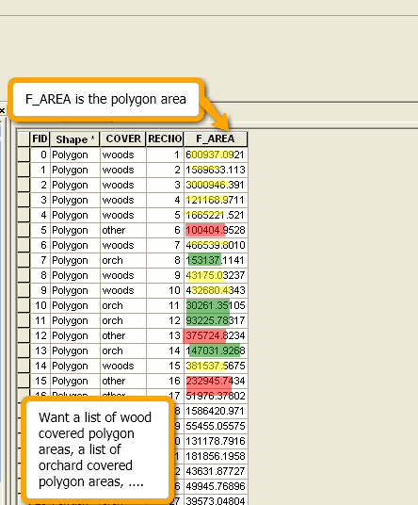
Dictionaries and attribute tables
Good data type for storing info. from GIS attribute tables.
Simple example - collect FID:COVER items
sc = arcpy.da.SearchCursor('park.shp', ['FID', 'COVER'])
myD = {}
for row in sc: ID = row[0] coverType = row[1]
myD[ID] = coverType
del sc

Slide 23
Conditional statement for dictionary creation
In the previous example keys guaranteed to be unique (because FID is unique)
If key values from input to dictionary is not guaranteed to be unique, must use a conditional statement for cases “key in dictionary” and “key not in dictionary”
In this way, the code can do something different for these 2 cases. --For example, create a new dictionary entry and initialize the value to 1
or add 1 to the existing value for that item.
Frequency example below:
Collects the frequency of cover types in a dictionary
Each item is coverType:frequency
sc = arcpy.da.SearchCursor('park.shp', ['COVER'])
myD = {}
for row in sc:
key = row[0]
if key in myD:
myD[key] = myD[key] + 1
else: myD[key] = 1
del sc
>>> print(myD)
{'woods':9, 'orch':4, 'other':3}
Notes:
>>> print(myD)
{“woods”:9, “orch”:3,”other:3}

Slide 24
Python lists in dictionaries
dictionary values can be any Python data type
numbers, strings, lists, dictionaries…
Example below:
A dictionary to store COVER types and their areas.
Each item is coverType:listOfAreas
myD = {
'woods': [600937, 1589633,…]
'orch': [153137.114187, …]
'other': [100404, 375724, …]
'park': …
}
myD could be used to calculate statistics about the areas associated with cover types. (mean, std dev, variance, etc.)
To create myD, use conditional statements…

Slide 25
Using lists as dictionary values
To create a dictionary from an attribute table and collect lists of multiple items from one field based on another field, use lists and conditional statements…
If the key is already in the table, append the value to the list.
If not, create a new list by surrounding the value with square braces and assigning this to the dictionary item with that key.
# If the key is already in the list, append.
if key in myD: myD[key].append(value) else: # Otherwise create a new list
myD[key] = [value]

Slide 26
Example using lists in a dictionary
Create a dictionary to store COVER types & their
areas. Each item is coverType:listOfAreas
import arcpy
arcpy.env.workspace = 'C:/Temp'
fields = ['COVER', 'F_AREA']
myD = { }
sc = arcpy.da.SearchCursor('park.shp', fields)
for row in sc:
cover = row[0]
area = row[1]
if cover in myD: # if this cover type is already a key in the dictionary,
# append its list of polygon areas
myD[cover].append(area) else:
# else, create a new list by putting the polygon area in square
# braces & assigning it to the dict. with the COVER key.
myD[cover] = [area]
del sc
>>> print(myD)
{'woods': [600937, 1589633,…]
'orch': [153137.114187, …]
'other': [100404, 375724, …]
'park': … }

Slide 27
Summing up
Topics discussed
built-in dictionaries
Access by key, not by index.
Update/add/delete dictionary items
Listing keys, values, items
dictionaries with looping
Using dictionaries with arcpy cursors
Up next
Reading & writing text files
Additional topics
Dictionaries vs. elif

Slide 28
Appendix

Slide 29
In class – on a piece of paper…
Create a dictionary where the keys are 3 classmates and the values are their favorite beverage.
Iterate through the keys in the dictionary, printing them
Iterate through the keys in the dictionary, printing the key and the value
bevD = {“Tim”:“Sambucus”, “Paul”:“Red Bull”, “Rahul”:”vodka”}
#One solution
for person in bevD:
print(person)
for person in bevD:
print(person, bevD[person])
#Another solution
for person in bevD.keys():
print(person)
for person, drink in bevD.items():
print(person, drink)

Slide 30
DrinkDict.py
Create a dictionary where drinks are the key and a list of people who favor that drink are the value, by completing the code in the given script. The existing code uses the built-in raw_input function to prompt you for 10 people's names and favorite drinks. Example output:
{ ‘tea’: [’Lani‘, ’Josh‘], ’water‘: [’Stew‘, ‘Mike’], 'beer': [’Ginger', ’Steph', ’Latonia', ’Brendan'], 'sweet tea': [’Brian', ’Steph']
}
myD={}
for i in range(10):
name = raw_input("Name:")
drink = raw_input(name +"'s fav. drink:")
# insert dictionary code here.

Slide 31
DrinkDict.py solution
d={}
for i in range(10):
name = raw_input("Name:")
drink = raw_input(name +"'s fav. drink:")
if drink in d:
d[drink].append(name)
else:
d[drink] = [name]

Slide 32
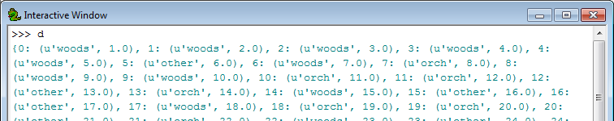
In class - table2dict.py
Create a search cursor for shapefiles.
Build a dictionary with FID as the key and a tuple of the non-shape fields as the value.
Dictionary item format is uniqueID: (field1,field2, …)
Example input ‘COVER63p.shp’ has output:

Slide 33
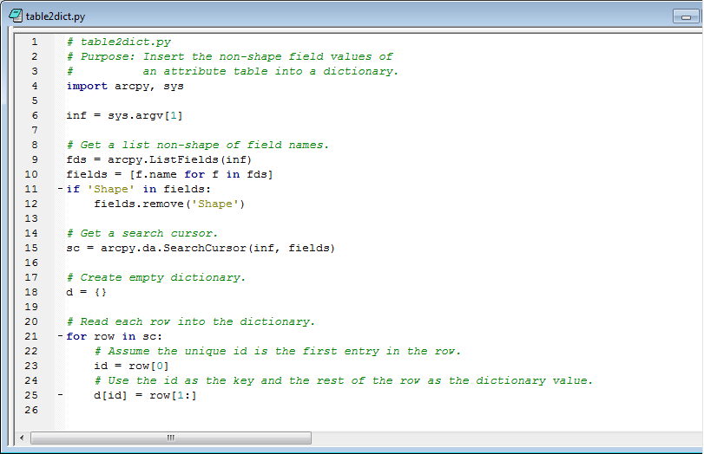
table2dict.py

