Slide 1

Repetition with
WHILE-loops
&
FOR-loops
Review Booleans and code structural components
WHILE-loop and FOR-loop syntax
The range function
The os.listdir method
Dr. Tateosian

Slide 2
Review– Conditions and Booleans
logical operators: and, what else?…
comparison operators: <, > , <=, …what else?
Which of the following are ‘True’ expressions in Python?
  False
  [False, False, False]
  5-11/2
  “None”
  “[]”
  []
  None
Which strings, lists, dictionaries, and tuples are evaluated as False?
Notes:
and, or, not
<, >, <=, >=, !=, ==
b, d, and e are evaluated by Python as True
Only empty strings, lists, dictionaries, and tuples are False.

Slide 3
Reviewing pseudocode keywords
Match the pseudocode words with the structural component
Sequences
Selection
Repetition
Procedures
ENDPROC
DECREMENT
READ
CALCULATE
ELSEIF
ENDWHILE
IF
INCREMENT
DISPLAY
GET
OBTAIN
SHOW
CALL
THEN
BUMP
FOR
DETERMINE
COMPUTE
SET
PRINT
INIT
RETURN
PROC
WHILE
ELSE
ENDFOR
ENDIF
Notes:
See table 8.2 in the book. Any keywords that are not listed under categories 2-4 would fall into category 1.
# Randomly shuffle a list
import random
keywords = ['IF', 'THEN', 'ELSEIF', 'ELSE', 'ENDIF', 'WHILE', 'ENDWHILE', 'FOR', 'ENDFOR', 'READ', 'OBTAIN', 'GET', 'PRINT', 'DISPLAY', 'SHOW', 'COMPUTE', 'CALCULATE', 'DETERMINE', 'SET', 'INIT', 'INCREMENT', 'BUMP', 'DECREMENT', 'CALL', 'PROC', 'ENDPROC', 'RETURN']
random.shuffle(keywords)
for i in keywords:
print i

Slide 4
Python WHILE-loop syntax
Used for repetitive tasks:
clip file 1
clip file 2
clip file 3
…_x001a_
# WHILE-loop example
  x = 0
  while x < 9:
  print x
  x = x + 1
Use of colons and indentation required.

Slide 5
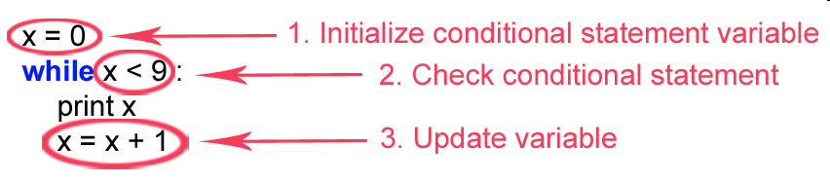
Key Looping Components
  x = 0
  while x < 9:
  print x
  x = x + 1
Syntax: colons and indentation.

Slide 6
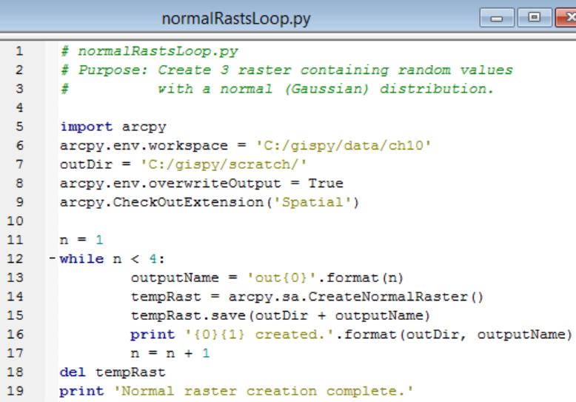
Using a WHILE-loop for geoprocessing

Slide 7
Python FOR-loop
FOR-loop does something for every value in a list.
myfiles = ["data1.shp", "data2.shp","data3.shp","data4.shp"]
for theFile in myfiles:
print theFile
>>> data1.shp
data2.shp
data3.shp
data4.shp
A variable that gets set to each element in the list.
Use any name (that’s not already being used)

Slide 8
Loop formats
WHILE-loop
initialize variable
while expression:
  code statement(s)
  update variable
FOR-loop
for iteratingVar in sequence:
code statement(s)

Slide 9
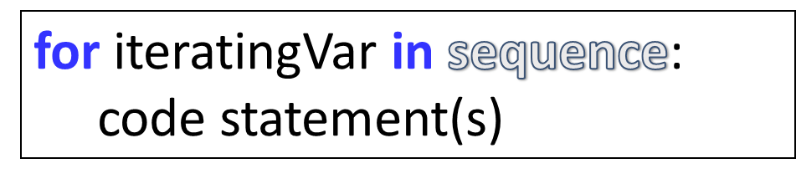
FOR-loops consume sequences
Sequences we have discussed:
  lists ["data1.shp", "data2.shp","data3.shp"]
  strings "data1.shp"
  tuples ("72.5", "-16", "2”)
Sequences are indexable data types.
FOR-loops iterate over any indexable type of data object.
  myString = “GIS rules”
  for letter in myString:
  print letter
>>> G
I
S
r
u
l
e
s

Slide 10
FOR-loop cursor
myfiles = ["data1.shp", "data2.shp","data3.shp","data4.shp”]
for currentFile in myfiles:
print currentFile
["data1.shp", "data2.shp", "data3.shp", "data4.shp"]
currentFile
["data1.shp", "data2.shp", "data3.shp", "data4.shp"]
currentFile
["data1.shp", "data2.shp", "data3.shp", "data4.shp"]
currentFile
["data1.shp", "data2.shp", "data3.shp", "data4.shp"]
currentFile

Slide 11
Practice WHILE & FOR loop syntax
1. Replace this FOR-loop with a WHILE-loop.
nums = [5,10,15,20]
for x in nums:
print x
2. Replace this WHILE-loop with a FOR-loop.
  x = 0
  while x < 9:
  print x
  x = x + 1

Slide 12

Practice WHILE & FOR loop syntax
1. Replace this FOR-loop with a WHILE-loop.
nums = [5,10,15,20]
for x in nums:
print x
  x = 5
  while x <= 20:
  print x
  x = x + 5
2. Replace this WHILE-loop with a FOR-loop.
  x = 0
  while x < 9:
  print x
  x = x + 1
nums = [0,1,2,3,4,5,6,7,8]
for x in nums:
print x

Slide 13
Generate a range of numbers
Use the range function
    Built-in Python function.
    Takes 1, 2, or 3 numbers as input.
    Returns an iterator, which can be cast to a list of numbers,
>>> list(range(6))
[0, 1, 2, 3, 4, 5]
>>> list(range(-10,10 ))
[-10, -9, -8, -7, -6, -5, -4, -3, -2, -1, 0, 1, 2, 3, 4, 5, 6, 7, 8, 9]
>>> list(range(0,100,10))
[0, 10, 20, 30, 40, 50, 60, 70, 80, 90]

Slide 14
Try this…
Here’s the FOR-loop from previous slide:
nums = [0,1,2,3,4,5,6,7,8]
for x in nums:
print x
Replace:
nums = [0,1,2,3,4,5,6,7,8]
nums = range(9)

Slide 15
Replace this while loop with a for loop
  x = 0
  while x < 9:
  print x
  x = x + 1
for x in range(9):
print(x)
In the FOR-loop, the conditional statement variable is
initialized (Step 1) and updated (Step 3) automatically

Slide 16
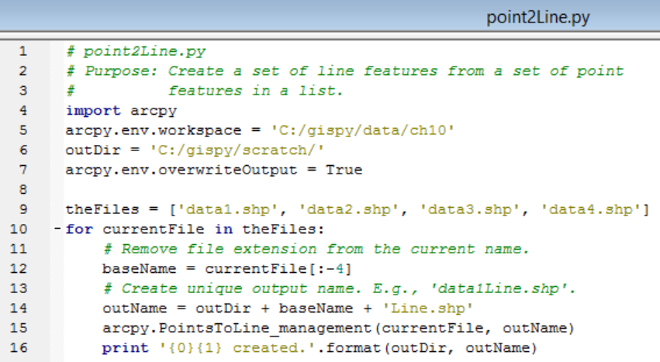
Using a FOR-loop for geoprocessing (a static file list)

Slide 17
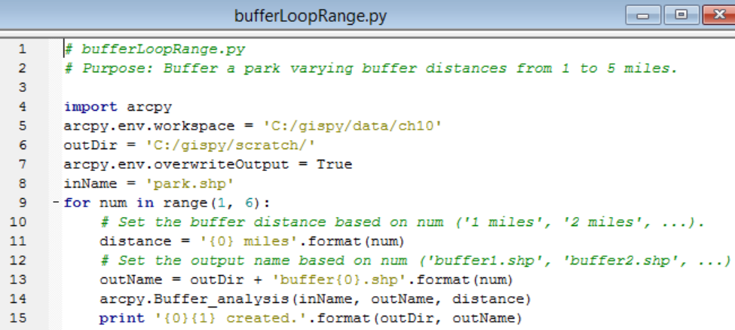
Using a FOR-loop for geoprocessing (with range)

Slide 18
The os module ‘listdir’ function
os.listdir returns a list of files in the given directory
>>> import os
>>> path = "C:/Temp/Duck"
>>> os.listdir(path)
['3.dbf', '3.prj', '3.sbn', '3.sbx', '3.shp', '3.shp.xml', '3.shx', 'aggrastout‘,…]
Does it work for file geodatabases?
  That depends on what you mean by ‘work’
>>> path = "C:/gispy/data/ch10/county.gdb”
>>> os.listdir(path)
['a00000001.freelist', 'a00000001.gdbindexes', 'a00000001.gdbtable', 'a00000001.gdbtablx', …]
Does it list files in subdirectories?
  No, but… The os.walk function does.

Slide 19
In class – List and loop --emoticons :)
Use os.listdir to list the files in a directory specified by the user (e.g., C:/gispy/data/ch10
Loop through the list.
Print the files as you loop.
Use conditional statements to check for files that end with shp, txt, or dbf.
Print name and emoticons for depending on file type.
    shp files (print name and :])
    txt files (name and print :[)
    dbf files (print name and :o)
*For an extra challenge, also print the position of the file in the list.
    Sample output:
      3.dbf :o
      3.shp :]
      brillag.txt :[
      gyre.txt :[
      tater.dbf :o
      tater.shp :]
    2 3.dbf :o
    4 3.shp :]
    5 brillag.txt :[
    8 gyre.txt :[
    12 tater.dbf :o
    13 tater.shp :]
**For another extra challenge, set the directory based on the script’s location (not use input).

Slide 20
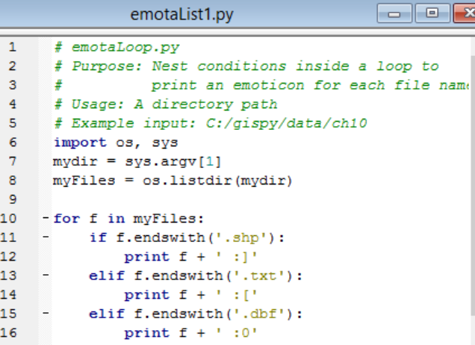
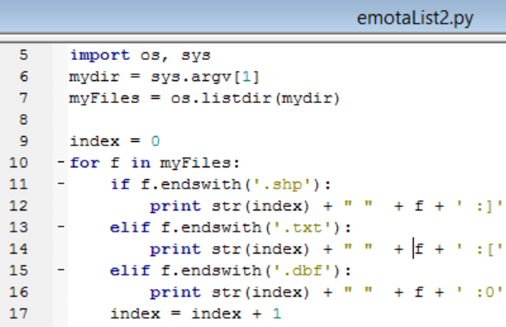
Emoting emotaList solutions
Notes:
Run the first one on C:/gispy/data/ch10
data.txt :[
data1.dbf :0
data1.shp :]
data2.dbf :0
data2.shp :]
data3.dbf :0
data3.shp :]
data4.dbf :0
data4.shp :]
park.dbf :0
park.shp :]
parkLines.dbf :0
parkLines.shp :]
xy1.txt :[
xy_current.txt :[
Run the second one on C:/gispy/data/ch10:
2 data.txt :[
4 data1.dbf :0
5 data1.shp :]
8 data2.dbf :0
9 data2.shp :]
12 data3.dbf :0
13 data3.shp :]
16 data4.dbf :0
17 data4.shp :]
22 park.dbf :0
26 park.shp :]
29 parkLines.dbf :0
33 parkLines.shp :]
38 xy1.txt :[
40 xy_current.txt :[

Slide 21
Nested repetition planner example
Weekly planner
Week 1
M:
T:
W:
R:
F:
Week 2
M:
T:
W:
R:
F:
Week 3
M:
T:
W:
R:
F:
Week 4
M:
T:
W:
R:
F:
Write pseudocode to print this workday planner

Slide 22
Nested repetition planner example
Weekly planner
Week 1
M:
T:
W:
R:
F:
Week 2
M:
T:
W:
R:
F:
Week 3
M:
T:
W:
R:
F:
Week 4
M:
T:
W:
R:
F:
Write pseudocode to print this workday planner
FOR each week of the month
PRINT the week number
FOR each work day of the week
PRINT the first letter of the day, indented
ENDFOR
ENDFOR
Rewrite the pseudocode as Python code.

Slide 23
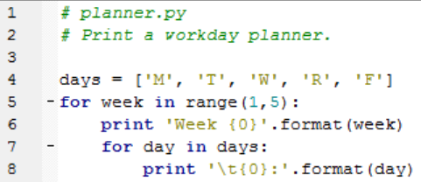
Nested repetition planner example
Weekly planner
Week 1
M:
T:
W:
R:
F:
Week 2
M:
T:
W:
R:
F:
Week 3
M:
T:
W:
R:
F:
Week 4
M:
T:
W:
R:
F:
Write pseudocode to print this workday planner
FOR each week of the month
PRINT the week number
FOR each work day of the week
PRINT the first letter of the day, indented
ENDFOR
ENDFOR
Rewrite the pseudocode as Python code.

Slide 24
Summing up
Topics discussed
    Review Booleans and code structural components
    WHILE and FOR loop syntax (while, for, and in keywords)
    The range function
    The os.listdir method
Up next
    Batch geoprocessing
Related topics that will be covered in another lecture
    list comprehension
    The built-in enumerate function
    The os.walk method
    The built-in zip function

Slide 25
Appendix

Slide 26
Additional challenge #1 Separate odd/even
Iterate through every integer in a list to separate out even and odd numbers. (Assume the list only contains integers)
Example list:
my_list = [1, 2, 3, 4, 5, 6, 7, 100, 110, 21, 33, 32, 2, 4]
Notes:
my_list = [1, 2, 3, 4, 5, 6, 7, 100, 110, 21, 33, 32, 2, 4]even = []
not_even = []
for i in my_list:
outlier.append(i)
if i%2 == 0:
even.append(i)
else:
not_even.append(i)print('Even numbers', even)
print('Odd numbers', not_even)
print('outliers', outlier)

Slide 27
Additional challenge #1 Separate odd/even
Iterate through every integer in a list to separate out even and odd numbers. (Assume the list only contains integers)
Example list:
my_list = [1, 2, 3, 4, 5, 6, 7, 100, 110, 21, 33, 32, 2, 4]
Steps?
Create two empty lists (evens and odd).
Loop through the number list.
Check for even-ness (hint, think about the mod operator)
Append to even list or odd list
Print the even numbers list
Print the odd numbers list
Write a pseudocode solution.
Notes:
my_list = [1, 2, 3, 4, 5, 6, 7, 100, 110, 21, 33, 32, 2, 4]even = []
not_even = []
for i in my_list:
outlier.append(i)
if i%2 == 0:
even.append(i)
else:
not_even.append(i)print('Even numbers', even)
print('Odd numbers', not_even)
print('outliers', outlier)

Slide 28
Additional challenge #1 Separate odd/even
Iterate through every integer in a list to separate out even and odd numbers. (Assume the list only contains integers)
GET my_list, a list of integers.
SET two empty lists (evens and odd).
FOR each number in my_list
IF even THEN
ADD to even list
ELSE
ADD number to the odd list
ENDIF
ENDFOR
PRINT the even list
PRINT the odd list
Write a PYTHON solution.
Notes:
my_list = [1, 2, 3, 4, 5, 6, 7, 100, 110, 21, 33, 32, 2, 4]even = []
not_even = []
for i in my_list:
outlier.append(i)
if i%2 == 0:
even.append(i)
else:
not_even.append(i)print('Even numbers', even)
print('Odd numbers', not_even)
print('outliers', outlier)

Slide 29
Challenge #1
# Purpose: Iterate through every integer in a list to separate out even and odd numbers.
# (Assume the list only contains integers)
my_list = [1, 2, 3, 4, 5, 6, 7, 100, 110, 21, 33, 32, 2, 4]
even = []
not_even = []
for i in my_list:
if i%2 == 0:
even.append(i)
else:
not_even.append(i)
print('Even numbers', even)
print('Odd numbers', not_even)

Slide 30
Challenge #2
Find the sum of all the numbers in a list of numbers.
Example list:
my_list = [1, 2, 3, 4, 5, 6, 7, 100, 110, 21, 33, 32, 2, 4]
Initialize a total_sum variable.
Loop through the list.
Add the number to the total_sum
Print the results
Write a pseudocode solution.

Slide 31
Challenge #2
# Find the sum of all the numbers in a list of numbers.
total_sum = 0
for i in my_list:
total_sum = i + total_sum
print(f"Sum of the numbers in the list: {total_sum}")

Slide 32
Additional challenge #1 Separate odd/even
Iterate through every number in a list to separate out even and odd numbers. Identify possible outlier values as well.
Example list:
my_list = [1, 2, 3, 4, 5, 6, 7, 100, 110, 21, 33, 32, 2, 4]

Slide 33
Break points and looping
pig_latin.py demo

Slide 34
Using index and value
fileList = [‘a.dbf', ‘b.jpg', ‘c.txt‘]
index = 0
for file in fileList:
print index, file
index = index + 1
Works, but there’s an easier way.

Slide 35
Enumerate
Built-in function
enumerate(mylist)
Returns an enumerate object
Use in a for loop to get both the index and the value in a list
seasons = ['Spring', 'Summer', 'Fall', 'Winter']
for i, season in enumerate(seasons):
print i, season
#Output
0 Spring
1 Summer
2 Fall
3 Winter

Slide 36
Enumerate index and value
fileList = [‘a.dbf', ‘b.jpg', ‘c.txt‘]
index = 0
for file in fileList:
print index, fileList[index]
index = index + 1
Replace with for loop and enumerate:
for index, filename in enumerate(fileList):
print index, filename

