Slide 1
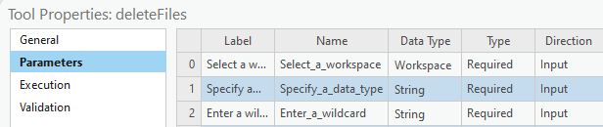
Script Tool Parameters (1)
Parameter property tab
Widgets
Properties
Type
Direction
Multivalue (input & output)
Dr. Tateosian

Slide 2
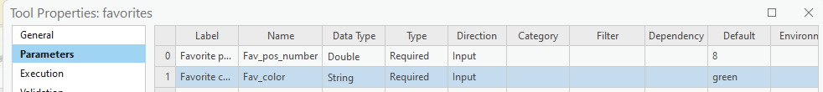
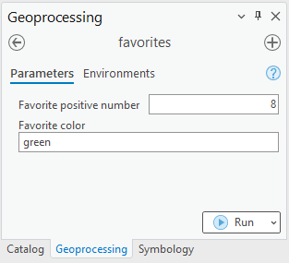
Parameter page demo
Right click on Script tool > Properties > Parameters tab
The script tool generates a widget for each parameter in the list.

Slide 3
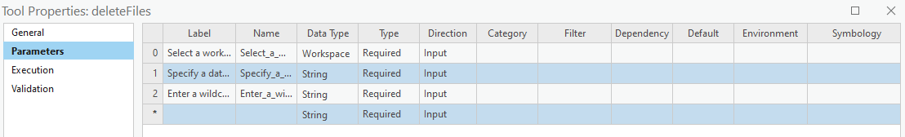
Parameter properties: Label
Label (for appearance only)
Appears on the interface.
Useful providing instructions.

Slide 4
Parameter properties: Name
Unique identifier for the parameter
Does not appear on the interface.
Cannot have spaces or special characters other than underscore.

Slide 5
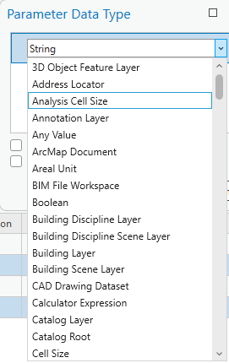
Parameter properties: Data Type
Restricts the type of the input
E.g., if you select Feature Layer, you can pick a layer from an active map or browse to a feature class.
Determines which widget appears on the tool.

Slide 6
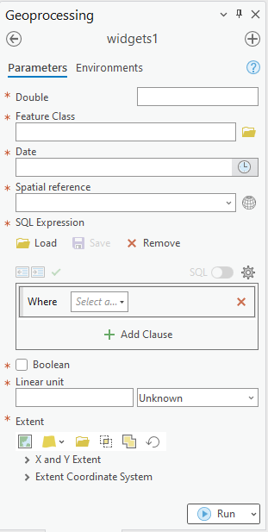
Widgets
User interface elements (e.g., text boxes, buttons, check boxes, combo boxes, and list boxes).
Help the user make input choices.
E.g., Browse to a file.
Constrains accepted input.
E.g., Restrict the file type.
Type of widget depends on the "Data Type".

Slide 7
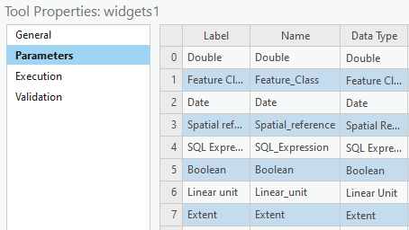
Test Drive Data Types

Slide 8
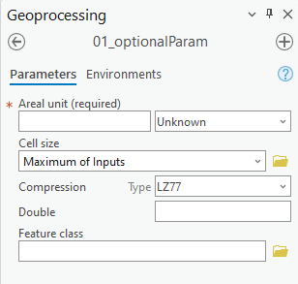
Parameter properties: Type
Type (of parameter)
Controls whether the user must enter a value.
Three choices (required, optional, or derived)
Required
Optional

Slide 9
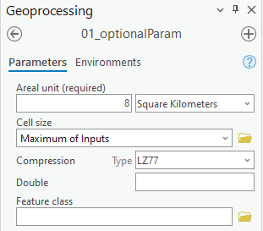
Examine what comes in
0|
1|
2|
3|
4|
5|
6|
7|
8|
9|
10|
11|
12|
13|
14|
15|
16|
# reportSTargs.py
# Purpose: Print the arguments passed into a script tool.
import arcpy, sys
def printArc(message):
'''Print message for script tool and standard output.'''
print(message)
arcpy.AddMessage(message)
def printArgs():
'''Print user arguments.'''
printArc(f"Number of arguments = {len(sys.argv)}")
for i, arg in enumerate(sys.argv):
printArc(f"Argument {i}: {arg}")
printArgs()
Argument 0: C:\gispy\sample_scripts\ch23\scripts\reportSTargs.py Argument 1: 8 SquareKilometers Argument 2: MAXOF Argument 3: LZ77 Argument 4: # Argument 5: #
Notes:
# reportSTargs.py
# Purpose: Print the arguments passed into a script tool.
# Arguments: Variable (can be used for any number of arguments)
import arcpy, sys
def printArc(message):
'''Print message for script tool and standard output.'''
print message
arcpy.AddMessage(message)
def printArgs():
'''Print user arguments.'''
printArc('Number of arguments = {0}'.format(len(sys.argv)))
for index, arg in enumerate(sys.argv):
printArc( 'Argument {0}: {1}'.format(index, arg) )
if __name__ == '__main__':
printArgs()

Slide 10
Optional parameters get values
# reportSTargs.py
# Purpose: Print the arguments passed into a script tool.
import arcpy, sys
def printArc(message):
'''Print message for script tool and standard output.'''
print(message)
arcpy.AddMessage(message)
def printArgs():
'''Print user arguments.'''
printArc(f"Number of arguments = {len(sys.argv)}")
for i, arg in enumerate(sys.argv):
printArc(f"Argument {i}: {arg}")
printArgs()
Type can be:
Required
Optional
Derived
‘Derived’ is closely related to the ‘Direction’ property…
Argument 0: C:\gispy\sample_scripts\ch23\scripts\reportSTargs.py Argument 1: 8 SquareKilometers Argument 2: MAXOF Argument 3: LZ77 Argument 4: # Argument 5: #
Notes:
# reportSTargs.py
# Purpose: Print the arguments passed into a script tool.
# Arguments: Variable (can be used for any number of arguments)
import arcpy, sys
def printArc(message):
'''Print message for script tool and standard output.'''
print message
arcpy.AddMessage(message)
def printArgs():
'''Print user arguments.'''
printArc('Number of arguments = {0}'.format(len(sys.argv)))
for index, arg in enumerate(sys.argv):
printArc( 'Argument {0}: {1}'.format(index, arg) )
if __name__ == '__main__':
printArgs()

Slide 11
Script tool parameter properties
Property | Description
Type | Required, Optional, or Derived.
Direction | Input or Output.
Multivalue | Yes, if you want to accept a list of values.
Default or Schema | The default value for the parameter. When the parameter data type is either feature set or record set, Default is replaced with Schema.
Environment | If the default value for the parameter is to come from an environment setting, this property contains the name of the environment setting.
Filter | If you want only certain values to be entered, use this. There are 6 types of filters. Filter type depends on the data type.
Obtained from | For derived parameters. For derived output parameters, Obtained from can be set to the parameter containing the definition of the output. For input parameters, Obtained from is set to the parameter containing the information needed for input.
Symbology | Use a layer file (.lyrx) to set output symbology.

Slide 12
Script tool parameter properties
Property | Description
Type | Required, Optional, or Derived.
Direction | Input or Output.
Multivalue | Yes, if you want to accept a list of values.
Default or Schema | The default value for the parameter. When the parameter data type is either feature set or record set, Default is replaced with Schema.
Environment | If the default value for the parameter is to come from an environment setting, this property contains the name of the environment setting.
Filter | If you want only certain values to be entered, use this. There are 6 types of filters. Filter type depends on the data type.
Obtained from | For derived parameters. For derived output parameters, Obtained from can be set to the parameter containing the definition of the output. For input parameters, Obtained from is set to the parameter containing the information needed for input.
Symbology | Use a layer file (.lyrx) to set output symbology.

Slide 13
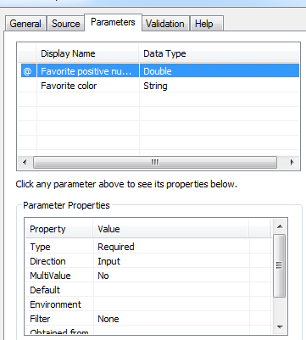
Direction: Input or Output
Default direction is ‘Input’
Input parameters are information the script needs to perform its tasks. E.g., a dataset or workspace to use.
Input parameters can be required or optional, but not derived.
‘Output’ direction for script tool parameters that represent output generated by the tool.
‘Output’ can be added to the map automatically.
Output examples:
--one or more datasets created by the tool.
--a modified preexisting dataset
--a Boolean value (True or False).
--numerical values resulting from script tool calculations.
Any types of results generated by standard ArcToolbox tools could be output from a custom script tool.
Like standard tools, custom script tools can be used as tools in ModelBuilder models. The output Boolean, numerical results, dataset would then be passed along to the output ovals in the models.

Slide 14
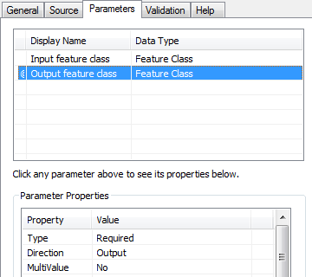
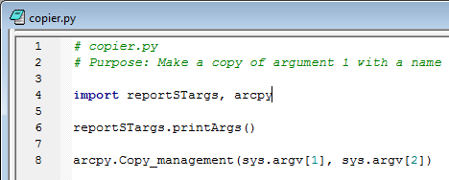
Required Output
‘Required' Type with ‘Output' direction
Used for output that is created by the script, not for modifications to existing data.
If user tries to select an existing dataset, the GUI will raise an error.
Allows the user to select the location and name of the output.
If the output is a modification of existing data or if the script itself determines the output name and location, the parameter Type should be a ‘Derived‘.

Slide 15
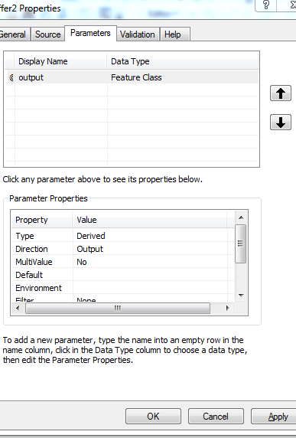
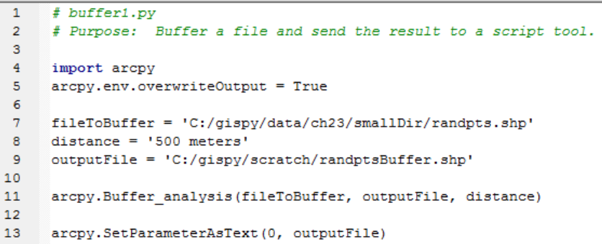
Derived Output
Derived
User does not enter a value for the parameter.
Derived types are always output parameters. (Direction automatically changes when you select derived)
In the script, use arcpy.SetParameterAsText
For example: arcpy.SetParameterAsText(0, output)
parameter output file
index name

Slide 16

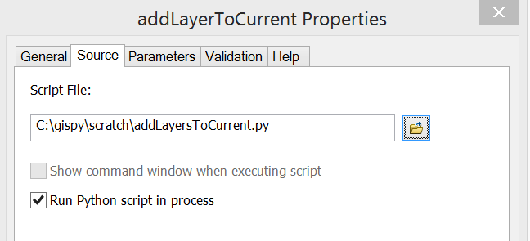
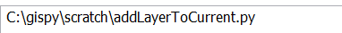
Is this like arcpy.mapping.AddLayer?
Derived Output parameter + SetParameterAsText for adding data to the current map ==
AddLayer mapping module method with MapDocument object set to 'CURRENT' in a script that is being run by a Script Tool in an open map document.
# addLayerToCurrent.py
# Purpose: Add a data layer to the first data from of the current map.
# Input: No arguments required.
# Note: Run this script from a Script Tool in an open map document.
import arcpy
fileName = 'C:/gispy/scratch/USstates/MA.shp'
# Instantiate MapDocument and DataFrame objects.
mxd = arcpy.mapping.MapDocument('CURRENT')
dfs = arcpy.mapping.ListDataFrames(mxd)
# Get the first data frame.
df = dfs[0]
# Instantiate a Layer object.
layerObj = arcpy.mapping.Layer(fileName)
# Add the new layer to the map.
arcpy.mapping.AddLayer(df, layerObj)
# Delete the MapDocument object to release the map.
del mxd

Slide 17
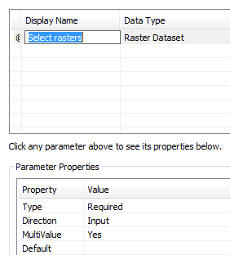
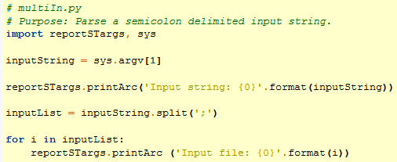
Multivalue
multivalue property can be yes or no
Not all data types can have multiple values (e.g., Boolean parameters can not handle multiple values).
When set to ‘yes’ for an input parameter, the parameter will accept a list of values.
Input as semicolon separated string names
Input string: C:\gispy\data\ch23\rastTester.gdb\aspect;C:\gispy\data\ch23\rastTester.gdb\elev;C:\gispy\data\ch23\rastTester.gdb\landcov

Slide 18
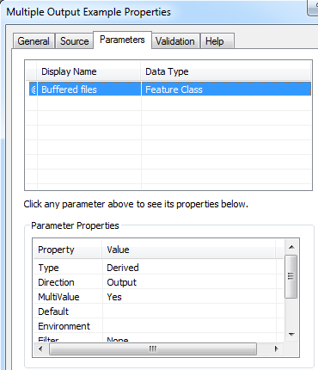
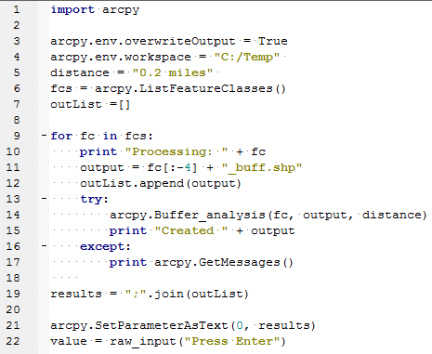
Original “Add multiple outputs to the map” slide
Create a Derived, MultiValue parameter in the script tool.
In the Python script:
Collect the output names in a list
Create a semicolon delimited string from the list.
Use arcpy.SetParameterAsText
Can you spot the mistake?
Collect output names
Create delimited string
SetParameterAsText

Slide 19
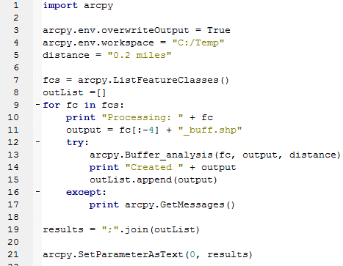
Corrected “Add multiple outputs to the map” slide
Create a Derived, MultiValue parameter in the script tool.
In the Python script:
Collect the output names in a list
Create a semicolon delimited string from the list.
Use arcpy.SetParameterAsText
Collect output names
Create delimited string
SetParameterAsText

Slide 20
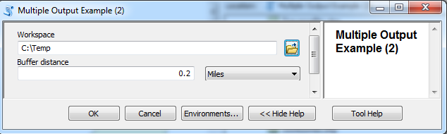
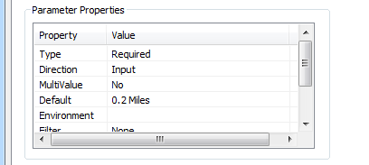
In class – Add derived output to a map
Place some data in scratch and test the script as is.
Modify script to take 2 arguments
Create script tool with 3 parameters
Two input
Folder type for the workspace parameter.
Linear Unit for the buffer distance.
One output to be added to map 3) An derived output multivalue Feature Class
Set input default values, C:/gispy/scratch and 0.2 miles
Test the script tool in ArcMap.

Slide 21
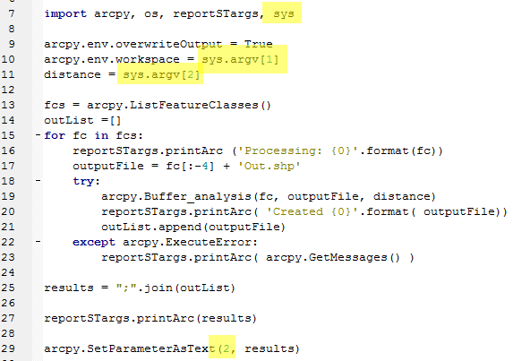
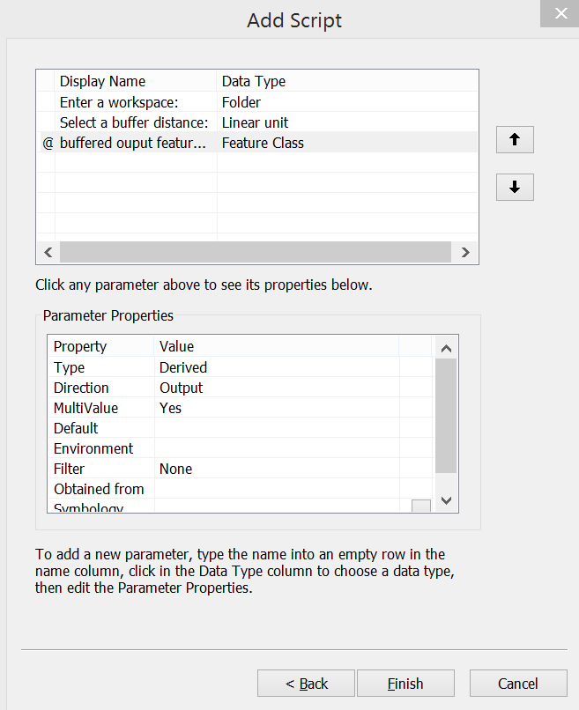
Add derived output to map -- followup

Slide 22
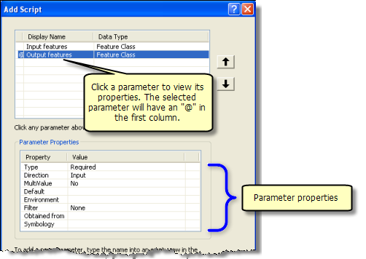
Setting script tool parameters
Property | Description
✓ Type | (Required, Optional, or Derived). Derived: user does not enter a value for the parameter. Derived types are always output parameters.
✓ Direction | (Input or Output). If Type is Derived, direction is always set to Output.
✓ Multivalue | Yes, if you want to accept a list of values.
Default or Schema | The default value for the parameter. When the parameter data type is either feature set or record set, Default is replaced with Schema.
Environment | To set the default value of a parameter to an environment setting.
Filter | Restrict the values to be entered. 6 types of filters. Filter type depends on the data type.
Obtained from | For derived output parameters, ‘Obtained from’ can be set to the parameter containing the definition of the output. For input parameters, ‘Obtained from’ is set to the parameter containing the information needed for input.
Symbology | Use a layer file (.lyr) to set output symbology.

Slide 23
Summing up
Topics discussed
Widgets
Type (Required, Optional, Derived)
Direction (Input or Output)
Required output—for getting output name & displaying on map after run
Derived output—for setting output name in script or modifying existing data; & displaying on map after run
Multivalue (Yes or No)
Multivalue input & multivalue output (split or join ‘;’)

