Slide 1
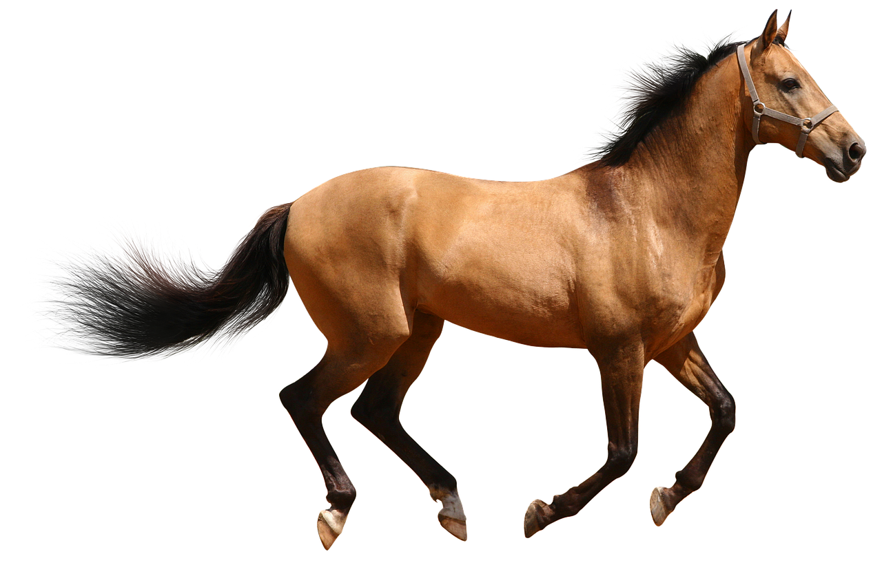
User-defined classes
class
  Motivation
  Syntax
  Terminology
  Use in u.d. module
horse
methods
graze()
walk()
trot()
canter()
whinny()
jump()
attributes
gender
maneColor
furColor
height
breed
Dr. Tateosian
Notes:
This video introduces user-defined classes, including the motivation for employing them, some syntax and terminology, and classes in user-defined modules.
On first exposure, the concepts of object oriented programming may all seem a bit peculiar, but keep in mind that you've been working with objects (arcpy objects, list objects, and so forth all through this course). Classes are just a way for you to define a blueprint for your own types of objects.
As you study classes, think in terms of the types of objects you are dealing with in your own research. For example, if you are working with data pertaining to wild horse populations, you might create a horse class. The class you create can encapsulate the attributes that horses have and the actions they are capable of taking. A horse has a gender, color, and height, and they are capable of grazing, trotting, and so forth.
Python is an object-oriented programming language. As a new programmer, you never really understand that until you have the opportunity to create your own classes, which allows you to create objects. Though the utility of user-defined classes may not be obvious to you immediately, learning the basics for creating your own classes will doubtless deepen your understanding of the objects that you use all the time, the ones defined by others.

Slide 2
OOP vs. Procedural
Object-oriented programming
  classes are a main component of OOP
procedural programming
  build code with a set of variables, procedures
procedural example next slide:
  Example data:
    parcels which have: ID's, man-made structures, zoning, property value, taxes, more…

Slide 3
Parcel example (procedural approach)
>>> parcelList = [ 1, 2, 5, 10, 15]
# How to add/remove parcels?
>>> def addParcel(parcel):
parcelList.append(parcel)
>>> def removeParcel(parcel):
parcelList.remove(parcel)
# How to keep track of man-made structures on each parcel?
>>> parcelStructures = {}
>>> for parcel in parcelList:
parcelStructures[parcel] = []
>>> def addStructure(parcel, structure):
parcelStructures[parcel].append(structure)
>>> def changeStructure(parcel, oldStructure, newStructure):
position = parcelStructures[parcel].index[oldStructure]
parcelStructures[parcel][position] = newStructure
# What about other parcel attributes, like zoning, property value, taxes, etc.
>>> parcelZoning = {}
>>> …
{1: 'residential', 2: 'industrial', 5: 'commercial', …
# Need related functions for each additional variable.
# Difficult to keep track of which functions need which vars. and how everything relates.
Data: parcels which have ID's, man-made structures, zoning, property value, taxes, more…
---We'll revisit this example
with an object-oriented
approach in an upcoming
slide…but first, what's an object?

Slide 4
Remember the describe object?
>>> # Create geoprocessing objects
>>> import arcpy
>>> # Set the data element
>>> rastfile = "C:/Temp/raster1"
>>> # Call arcpy describe method to create return a describe object
>>> dsc = arcpy.Describe(rastfile)
>>> print (dsc)
<geoprocessing describe data object object at 0x0092D2D0>
describe object
data element to be described

Slide 5
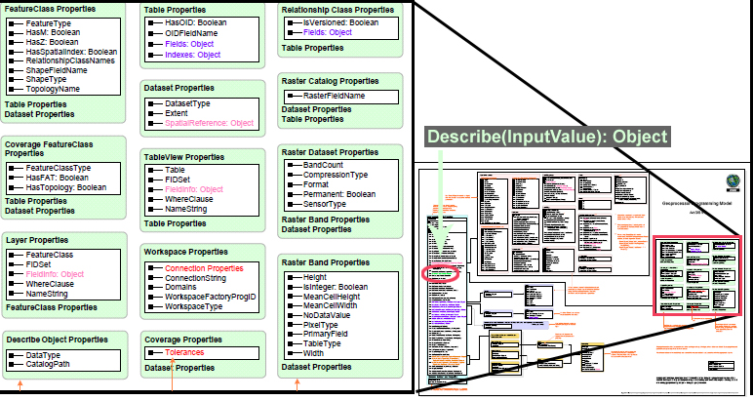
Describe object has properties…
desc = arcpy.Describe(rastfile) # create the describe object
print desc.CatalogPath # use a describe object property

Slide 6
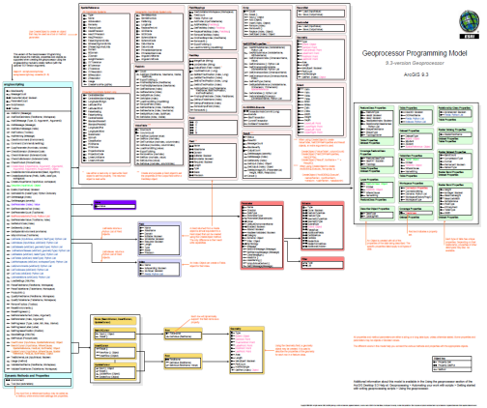
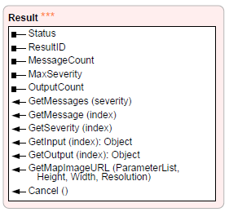
Remember the results object?
Assignment statement to store the results
  >>> res = arcpy.AverageNearestNeighbor_stats("C://points.shp", \
  "Euclidean Distance")
Results objects have properties and methods
  >>> res.outputCount # a property
  6 # the number of outputs
  >>> res.getOutput(0) # a method
  '0.64632' # nearest neighbor index
  >>> res.getOutput(1)
  '-4.27929' # z score
  >>> res.getOutput(2)
  '0.000019' #p-value

Slide 7
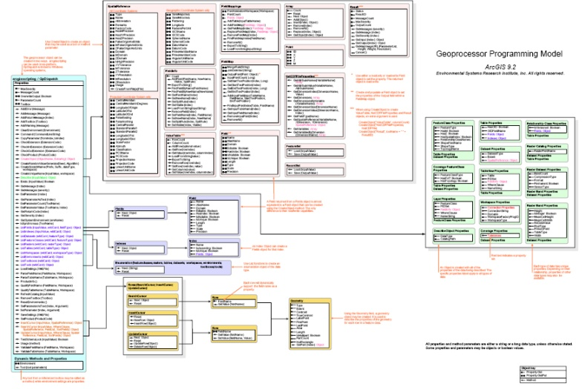
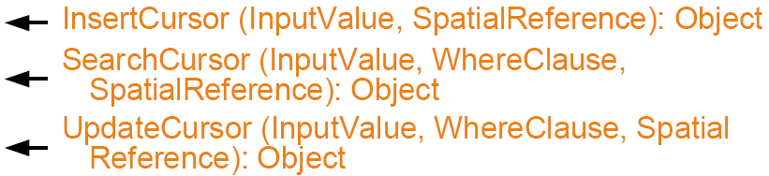
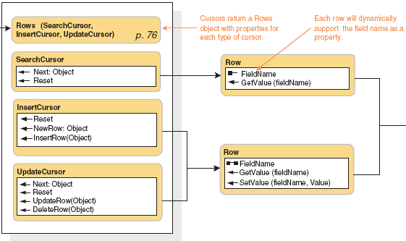
Remember cursor object?
These 3 arcpy methods return cursor objects:
These objects have methods.
The methods depend on the type of cursor.
E.g., InsertCursor objects have an InsertRow method,
but SearchCursor objects don't._x0013_
Cursor objects don't have any properties.

Slide 8
Objects and classes
Object:
  collection of data and functions that operate on that data
  data types in Python are built-in objects (integers, strings, lists, dictionaries…)
  when we import arcpy, we can use additional objects (results object, describe object, cursor objects, geometry objects…)
Class:
  a blueprint for a collection of objects with identical characteristics
  allows you to create user-defined objects
  provides encapsulation - a method of grouping together logically related things.

Slide 9
arcpy objects
arcpy objects we have used: describe, result, field, describe, search cursor, geometry
object.property format:
  print dsc.dataType # assuming dsc is a describe object. print res.outputCount # assuming res is a results object.
    print myfield.name # assuming myfield is a field object.
    # cursor objects don't have any properties—only methods.
object.method format:
    # describe objects don't have any methods—only properties.
    res.getOutput(0)
    # field objects don't have any methods – only properties.
    sc.next()

Slide 10
Object-oriented programming
Some main concepts in the OOP approach (as opposed to the procedural programming approach)
  The program is a collection of cooperating objects (not a list of instructions to the computer)
  Objects represent real world entities or abstract concepts (e.g. parcel lot, census tract, resident, watershed, weather)
  Objects have associated data – attributes - and may perform actions through functions –methods
  The program is built from bottom-up by using those objects as building blocks and defining interrelationships between them

Slide 11














Thinking in terms of objects
parcel lot, census tract, resident, watershed, playground, soil sample, weather
attributes & actions

Slide 12
Exercise Thinking OOP
Plan the OOP components for a script that would support daily air traffic analysis of airlines and their flights. The script will use Airline, Flight, and Seat objects. Identify properties and methods for each of these objects based on the following description:
Each airline name is stored along with a set of numbered flights. The origin and destination airports of each flight are stored and can be used to estimate the length of flight paths. Flight departure and arrival times are stored, so that the flight duration can be derived. Each flight has a set of seats organized in rows and columns. Each seat has a fare rate and a status (occupied or vacant) which can be modified when a new reservation is made. The class (first, business, or economy) can be determined based on the row. Flights can be added and removed. The capacity, the load factor, and the total fare for a flight can be calculated. The total number of flights for each airline for a day can also be derived.
Airline properties (2):
Flight properties (5):
Seat properties (4):
Airline methods (3):
Flight methods (5):
Seat methods (2):

Slide 13
Exercise ---Thinking in OOP
Plan the OOP components for a script that would support daily air traffic analysis of airlines and their flights. The script will use Airline, Flight, and Seat objects. Identify properties and methods for each of these objects based on the following description:
Each airline name is stored along with a set of numbered flights. The origin and destination airports of each flight are stored and can be used to estimate the length of flight paths. Flight departure and arrival times are stored, so that the flight duration can be derived. Each flight has a set of seats organized in rows and columns. Each seat has a fare rate and a status (occupied or vacant) which can be modified when a new reservation is made. The class (first, business, or economy) can be determined based on the row. Flights can be added and removed. The capacity, the load factor, and the total fare for a flight can be calculated. The total number of flights for each airline for a day can also be derived.
Airline properties (2): name, list of flights
Flight properties (5): origin, destination, departure time, arrival time, set of seats
Seat properties (4): row, column, fare rate, status
Airline methods (3): getTotalFlights, addFlight, removeFlight
Flight methods (5): getFlightDuration, getFlightPathLength, calcLoadFactor, calcTotalFare, calcCapacity
Seat methods (2): getClass, modifyStatus

Slide 14


class syntax
Use the Python keyword class
The class structure provides a block of code to group properties and procedures related to an object
class Human:
"""A simple example class"""
def __init__(self):
self.shorts ="ugly yellow"
self.heartRate = 60
def changeShorts(self, color):
self.shorts = color
print(self.shorts)

Slide 15
Defining and invoking objects
To define an object, we create a class
A class is an object template (blueprint, specification)…but it is not the object itself
To create an object we need to instantiate the class – call the class, put the necessary data into its attributes, and assign the object to a variable (so it does not "float" in the memory)

Slide 16
Using the 'Human' class
class Human:
def __init__(self):
self.shorts ="ugly yellow"
self.heartRate = 60
def fallInLove(self):
self.heartRate = 120
print('I love GIS')
ken = Human( ) # Create a Human object called ken
print(ken)
print(ken.shorts)
ken.fallInLove( )
instantiating the class – calling the class (looks just like calling a procedure), putting the necessary data into its attributes, and assigning the object to a variable
>>> <__main__.Human instance at 0x09A53288>
>>> ugly yellow
>>> I love GIS

Slide 17
Terminology
class Human:
def __init__(self):
self.shorts ="ugly yellow"
self.heartRate = 60
def fallInLove(self):
self.heartRate = 120
print('I love GIS')
ken = Human( )
print(ken)
print(ken.shorts)
ken.fallInLove( )
__init__
self
class properties
class method
instantiate the class
object instance
>>> <__main__.Human instance at 0x09A53288>
>>> ugly yellow
>>> I love GIS

Slide 18
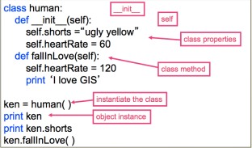
Object instance
To use the class, create an object instance:
  Call the class (like calling a procedure) & assign the object to a variable
class Human:
  def __init__(self):
  self.shorts = "ugly yellow"
  self.heartRate = 60
def fallInLove(self):
self.heartRate = 120
print('I love GIS')
ken = Human( )
print(ken)
print(ken.shorts)
ken.fallInLove( )
Defining the class
Creating & using
an object instance

Slide 19
Class method
A procedure defined inside a class is called a method
fallInLove is a Human class method
Format:
object.method(arg1,arg2, …)
ken.fallInLove( )
ken.changeShorts("blue")
Familiar notation:
getOutput is a result method
    print(res.getOutput(0))
sort is a list method
mylist.sort( )
class Human:
def __init__(self):
self.shorts = "ugly yellow"
self.heartRate = 60
def fallInLove(self):
self.heartRate = 120
print('I love GIS')
def changeShorts(self,color):
self.shorts = color
print(self.shorts)
#---------- invocation ----------
ken = Human( )
print(ken)
print(ken.shorts)
ken.fallInLove( )

Slide 20
Class properties (Attributes)
properties: variables associated with each class object.
ken is a Human class object
  ken has shorts
  ken has a heartRate
  ken's shorts are ugly yellow
  ken's heart rate is 60 first, then 120 later
chris is a Human class object
  chris has shorts
  chris has a heartRate
  chris's heart rate is 60.
  chris's shorts are ugly yellow at first, then red later.
class Human:
def __init__(self):
self.shorts ="ugly yellow"
self.heartRate = 60
def fallInLove(self):
self.heartRate = 120
print 'I love GIS'
def changeShorts(self,color):
self.shorts = color
print self.shorts
#---------- invocation ----------
ken = Human( )
print ken
print ken.shorts
ken.fallInLove( )
chris = Human()
chris.changeShorts("red")

Slide 21
__init__
Constructor method
__init__ is a special method name. (two underscores on each side)
__init__ is automatically called when you create (instantiate) an object
init (Initialize) give initial values to.
Use self.property notation and initialize class properties inside __init__
class Point:
def __init__(self, my_x, my_y):
self.x = my_x
self.y = my_y
#---------- invocation ----------
pointOne = Point(100.00, 200.00)
print (pointOne)
print (pointOne.x)
print (pointOne.y)
#Output
<__main__.Point instance at 01236104>
100.0
200.0
Notes:
pass: (empty blocks are illegal in python, does nothing, placeholder for future code)

Slide 22
self
class Parcel:
def __init__(self, value, zoning):
self.value = value
self.zoning = zoning
def calculateTax(self):
if self.zoning == "residential":
rate = 0.075
else:
rate = 0.77
return self.value*rate
#---------- invocation ----------
myParcel = Parcel(145000, "residential")
myParcel.value
myParcel.zoning
mytax = myParcel.calculateTax()
print "Value:", myParcel.value
print "Zoning:", myParcel.zoning
print "Tax:", mytax
use self the name of 1st arg. in class methods
1st arg. is the object itself, passed implicitly
myParcel = Parcel(145000, "residential") #only 2 args
self.property to refer to property inside the class
object.property outside the class
Example:
self.zoning
myParcel.zoning
>>> Value: 145000
Zoning: residential
Tax: 10875.0

Slide 23
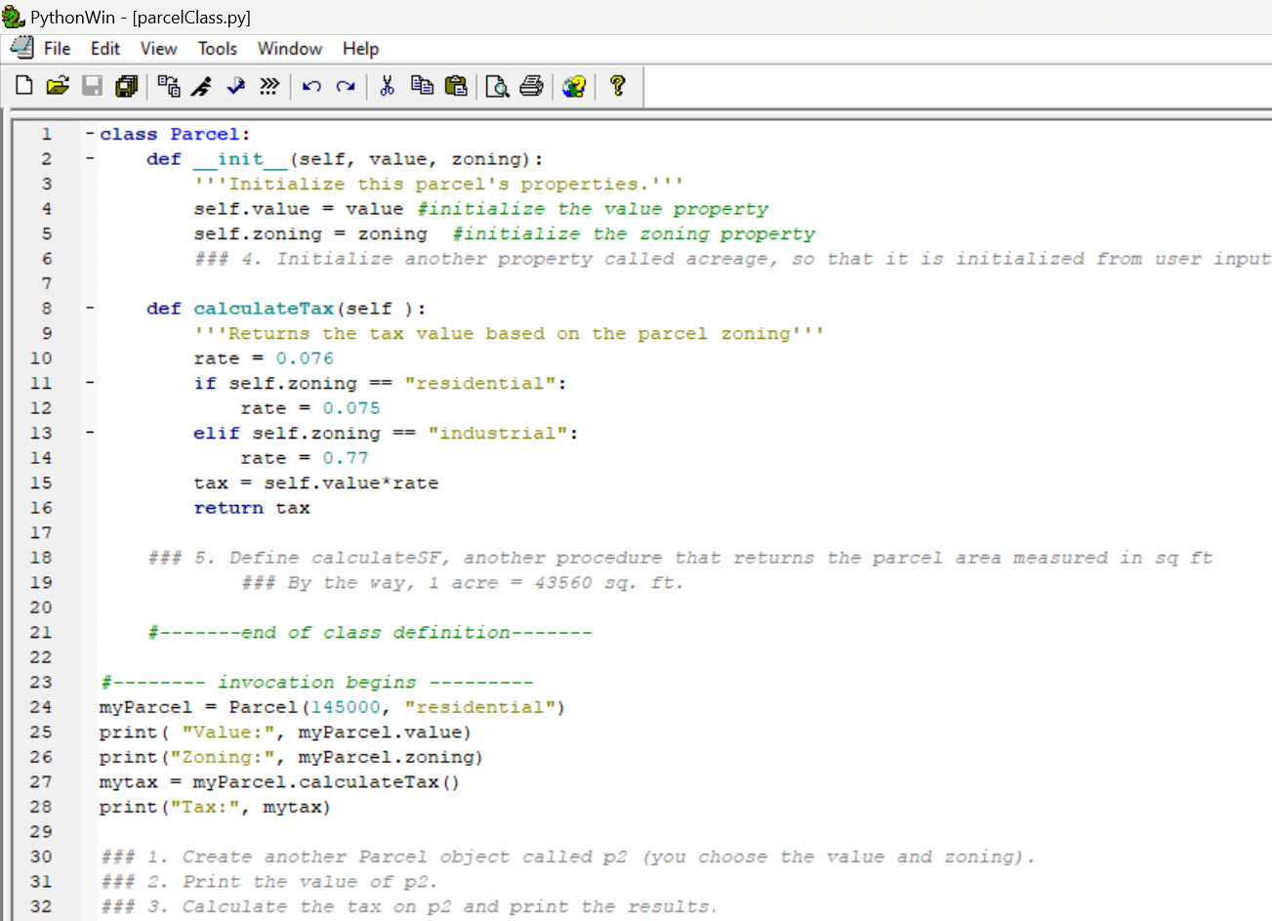
In class - parcelClass.py

Slide 24
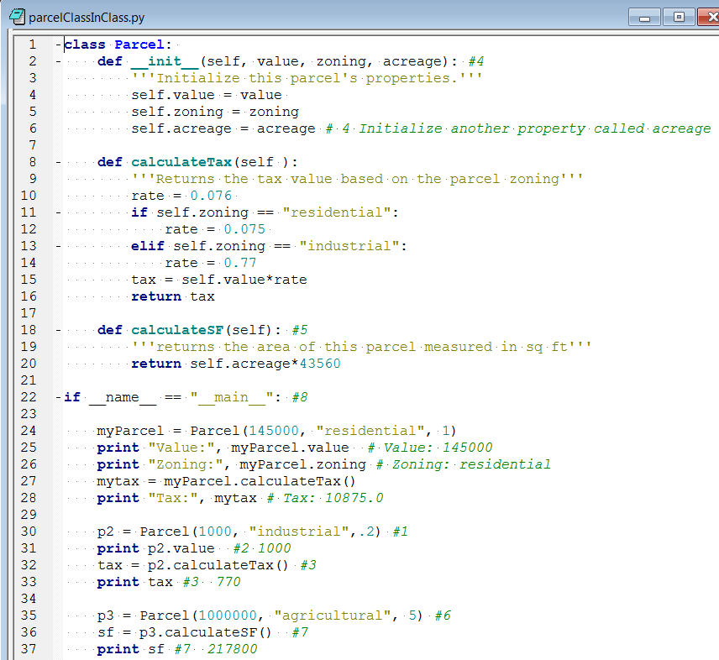
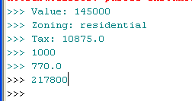
In class- parcelClass.py solution
Notes:
#8 added the conditional statement on line 22. And indented all of the code that is not inside the class definition so that it is in that conditional block. This makes it so that this script can be imported as a user-defined module and the indented code on lines 24-37 will not be run. We'll return to this and part 9 in a moment (see the "Consuming Parcel in another script" slide).

Slide 25
Some take home messages
A class is simply a user-defined compound type.
It is more complex than built-in primitives like integer, string, or list.
You can define class attributes and methods.
To create an object from a class, assign it to a variable:
p = Parcel(200, "residential")
Access object attributes and methods using dot notation: p.calculateTax()
Update attribute values using an assignment statement: p.value = 25000000

Slide 26
Classes in user-defined modules
Classes often defined in user-defined modules
Place non-class code inside if __name__ == "__main__": conditional statement.
To use a class from a separate script,
  Import it like any other user-defined module.
  Use moduleName.ClassName to create an object.
  Use the object just like before.
# urbanPlanner.py
import parcelClass
p = parcelClass.Parcel(200,"residential")
myTax = p.calculateTax( )
print("My parcel zoning: {0}".format(p.zoning))

Slide 27
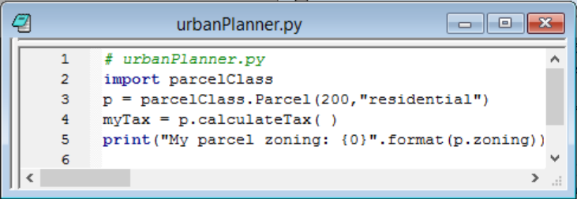
Consuming Parcel in another script
Notes:
In our in-class exercise, urbanPlanner and parcelClass reside in the same directory. That means we can simply import parcelClass without modifying the system path. Line 2 of urbanPlanner.py shows the parcelClass being imported. Then on line 3, a Parcel object is created. Notice that we say p = parcelClass.Parcel instead of simply saying p = Parcel. That's because we're calling it from another module Then on line 4, we commence using p just like we would if were had created it inside of the parcelClass.py module. So we've made our parcelClass more reusable, by placing it inside a user-defined module that can be imported without running all the test code from lines 24-37.

Slide 28
Summing up
Topics discussed
    syntax
    terminology: objects, classes, object instance, instantiate a class, method, property, self, __init__
    Using a class in another module
Upcoming
    Mapping module and Working with HTML
Additional topics
    Inheritance, polymorphism, encapsulation, abstraction…

Slide 29

Appendix

Slide 30
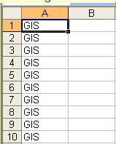
Excel example
# excel_short.py
class ExcelDocument(object):
def __init__(self, visible=False):
self.app = Dispatch("Excel.Application")
self.app.Visible = visible
self.sheet = 1
def new(self, filename=None):
self.app.Workbooks.Add(filename)
def set_value(self, cell, value=''):
self.get_range(cell).Value = value
…
# writeGIS.py
import excel_short
exObj = excel_short.ExcelDocument(True)
exObj.new( ) # Create a new Excel document
#(like clicking the new button in Excel's interface.)
exObj.set_value("A1:A10", "GIS") # Change the value of cells A1 to A10
exObj.save_as("C:/Temp/Test.xls", True) # Save the document as Text.xls
exObj.close() # Close the document
exObj.quit() # Quit the session

Slide 31
In class --callExcel
excel_lib.py # download into same directory as callExcelInClass.py, but don't modify
callExcelInClass.py # modify this one where you see ###
Do ### 1 and 2 first.
Run it to see what it does
Then try ### 3 and 4

Slide 32
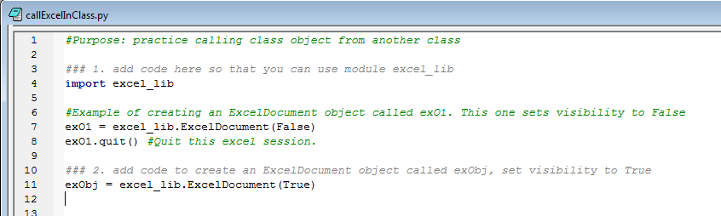
### 1 and 2

Slide 33
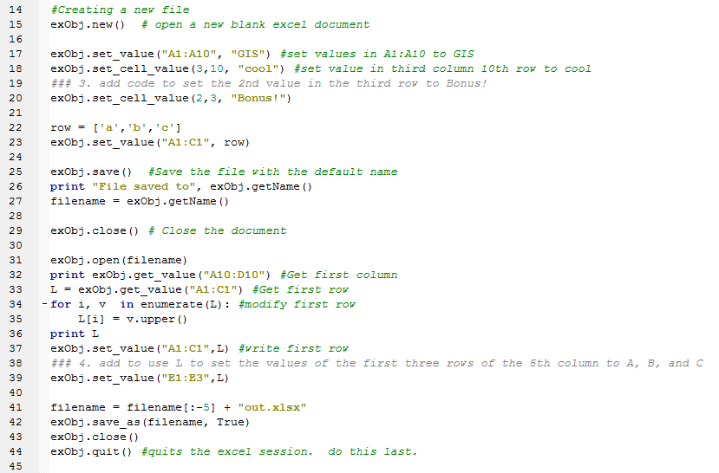
### 3 and 4

