Slide 1
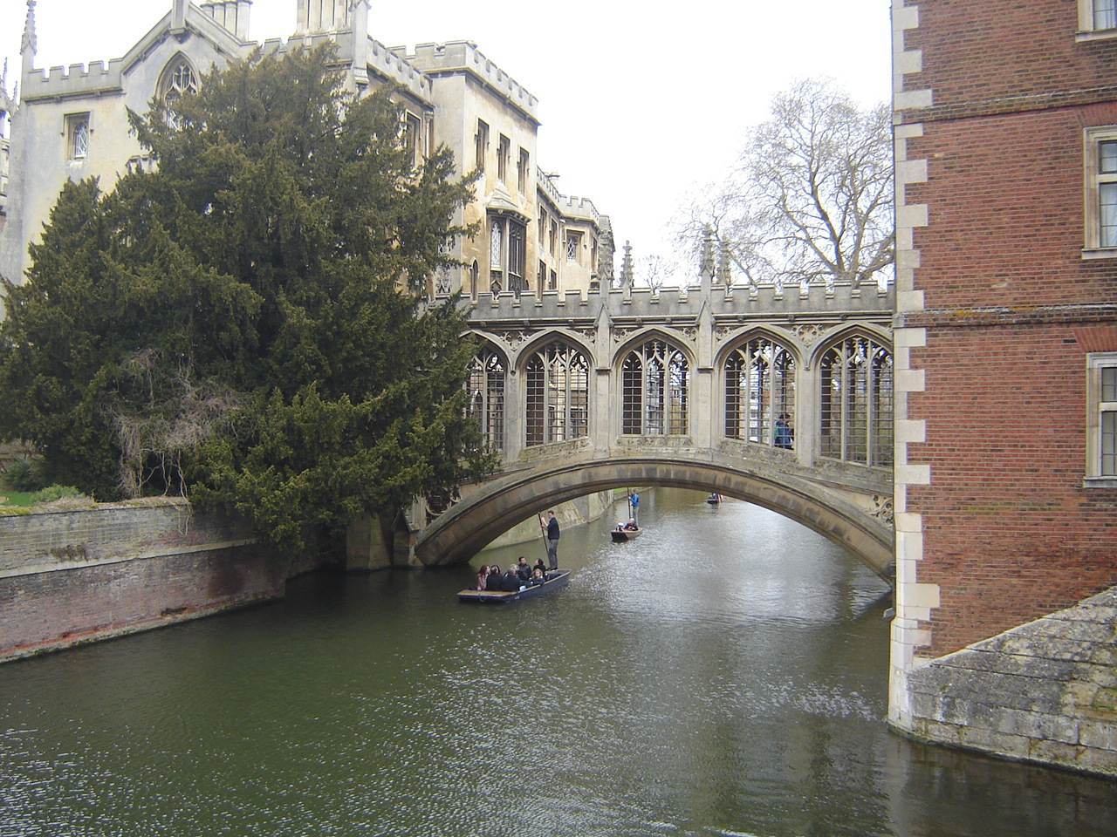
Exam II Review

Slide 2
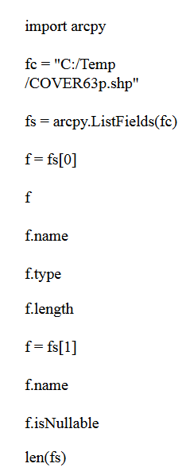
Exercise - Field objects
Which one of these statements tells you how many fields the attribute table has?
Name four field properties.
How can you find the name of the 3rd field?
Check if C:/gispy/data/Ch11/park.shp has a field named 'COVER‘ using a loop.
Check if C:/gispy/data/Ch11/park.shp has a field named 'COVER‘ using a list comprehension.
Notes:
len(fs)
name, type, length,isNullable f = fs[2]
print f.name
# Print the field names for String type data fields
import arcpy
fc = 'C:/gispy/data/Ch11/park.shp'
fields = arcpy.ListFields( fc )
for field in fields:
if field.name == ‘COVER':
print field.name + “is there”
import arcpy
fc = 'C:/gispy/data/Ch11/park.shp'
fields = arcpy.ListFields( fc )
fieldNames = [f.name for f in fields]
if field.name == ‘COVER':
print field.name + “is there”

Slide 3
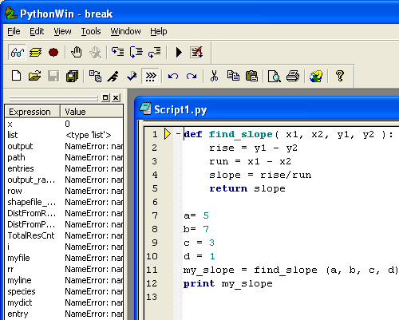
Debugging
Name and describe these debugging buttons
Explain how to get to line 2 with the debugger
What should you watch?
STOP running. (Stop debugging session)
watch toggle stepping GO
variables breakpoint (Run to first break point)
step (in) step over step out

Slide 4
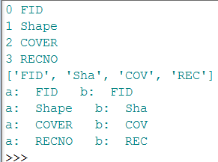
Write the output
x = ['FID', 'Shape', 'COVER', 'RECNO']
for num, thing in enumerate(x):
print num, thing
>>> y = [ i[:3] for i in x ]
print y
for a, b in zip( x, y): print "a: ", a ," b: ", b

Slide 5
Correct this script
import arcpy, sys arcpy.overwriteOutput = False arcpy.env.workspace = "C:/gispy/scratch" fcs = arcpy.ListFeatureClasses() try: for fc in fcs: buffer = fc[:-4] + "_buffer.shp" arcpy.Buffer_analysis(fc, buffer, "1 mile") print "Created: ", buffer except arcpy.ExecuteError: print arcpy.GetMessages( )

