Slide 1

Exam I Review

Slide 2
Basic Python code components
Naming & initializing variables, assignment statements
Comments
Keywords
Built-in modules
Indentation
Objects
Built-in functions, constants, exceptions,
Data structures: integers, floats, strings, lists, tuples…

Slide 3
Exercise: ‘Try me’
Download tryMe.rtf from the “In class” page.
tryMe.rtf contains code statements.
They use built-in functions
…and some generate built-in exceptions.
Type each code statement in the Interactive Window, one at a time and explain the results using the Python terms defined on these slides.
Before running each statement, predict the results.

Slide 4
‘tryMe’ take home lessons
Variable names are case-sensitive.
Python dynamically changes the data type when you assign values to a variable.
Don’t use keywords or built-ins as variable names!
>>> type(min) <type 'builtin_function_or_method'> >>> min(1, 2, 3) 1 >>> min = 5 >>> min(1, 2, 3) Traceback (most recent call last): File "<interactive input>", line 1, in <module> TypeError: 'int' object is not callable >>> type(min) <type 'int'>

Slide 5
Common string and list operations
sys.argv[1] == ?
sys.argv[2] == ?
Operation name | String example | List example
? | >>> x = sys.argv[1] >>> x[3] ? | >>> mylist = [sys.argv[1],sys.argv[2],'c','d','e'] >>> mylist[5] ?
? | >>> y = sys.argv[2] >>> x + y 'abcdesoup' | >>> mylist = sys.argv + x ?
? | >>> x[1:4] 'bcd' | >>> mylist = ['a','b','c','d','e'] >>> ? ['b', 'c', 'd']
Finding length | >>> len(x) 5 | ? (find the number of user arguments) print 'The user passed in {?} arguments.‘?
? | >>> 'ae' in y ? | 'abc' in mylist ?

Slide 6
Common string and list operations
sys.argv[1] == 'abcde'
sys.argv[2] == 'soup'
Operation name | String example | List example
indexing (zero-based) | >>> x = sys.argv[1] >>> x[3] 'd' | >>> mylist = [sys.argv[1],sys.argv[2],'c','d','e'] >>> mylist[5] IndexError
concatenation (from Latin com: together + catena: chain) | >>> y = sys.argv[2] >>> x + y 'abcdesoup' | >>> mylist = sys.argv + x TypeError
slicing | >>> x[1:4] 'bcd' | >>> mylist = ['a','b','c','d','e'] >>> mylist[1:4] ['b', 'c', 'd']
Finding length | >>> len(x) 5 | ct = len(sys.argv) - 1 print 'The user passed in {0} arguments.'.format(ct)
Checking for membership in | >>> 'ae' in y False | 'abc' in mylist False

Slide 7
Data type concepts
Data types: integers, float, strings, lists, tuples
Integer division
String literal versus string variable
String and list indexing, slicing, concatenation, len, ‘in’ keyword
String line continuation, escape sequences, raw & unary strings
In place (list) versus return value (string) methods
Formatting print statements (commas, concatenation, the string format method)
String methods: capitalize, center, count, decode, encode, endswith, expandtabs, find, index, isalnum, isalpha, isdigit, islower, isspace, istitle, isupper, join, ljust, lower, lstrip, partition, replace, rfind, rindex, rjust, rpartition, rsplit, restrip, split, splitlines , startswith, strip, swapcase , title, translate, upper, and zfill
List methods: append, extend, insert, remove, pop, index, count, sort, and reverse

Slide 8
Use split, join, rstrip, index, & startswith to…
Break this comma delimited string into a list, rList >>> record = 'ID, name, latitude, longitude\t\n'
rList = record.split(',')
2. Join rList into a semicolon separated string. >>> rList = ['ID', 'name', 'latitude', 'longitude\t\n']
semicolonRecord = ';'.join(rList)
Strip the white space from the right side of 'record' >>> record = 'ID, name, latitude, longitude\t\n'
srecord = record.rstrip( )
Get the index of the first occurrence of 'foo' in 'myList'
>>> myList = ['a', 2, 'foo', 'bla', 'foo']
fooIndex = myList.index( 'foo' )
Check if 'fileName' starts with 'poly'. Store answer in a variable named 'isPolygon'
isPolygon = fileName.startswith('poly')

Slide 9
In Class --convertLat.py:
Purpose: Convert degrees, minutes, seconds to decimal degrees.
Write one or more line of code for each double-hash (##) comment.
Use string methods 'split' and 'rstrip' to solve the problem. Here are some examples:
>>> path = "C:/Temp/buffer/output.shp“
>>> p = path.split("/")
>>> print p
['C:', 'Temp', 'buffer', 'output.shp']
>>> path.rstrip(‘.shp’)
'C:/Temp/buffer/output'
Notes:
['C:', 'Temp', 'buffer', 'output.shp'] # split output is a list

Slide 10
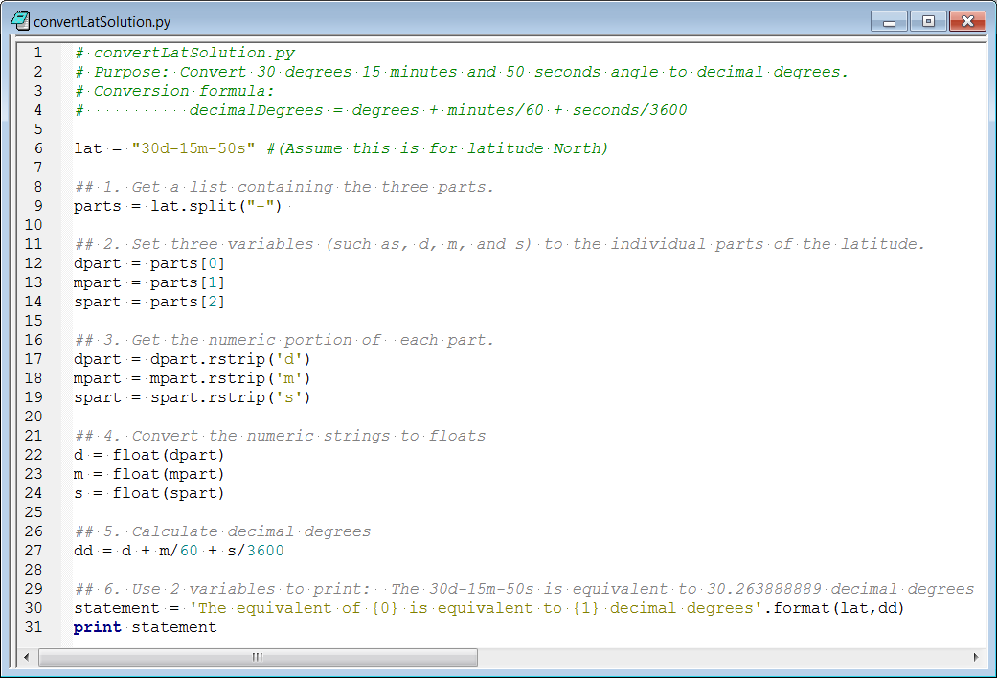
convertLatSolution.py

Slide 11
arcpy
Environments settings
Calling tools
Using tool help
Working with linear units
Calling spatial analyst tools
Raster calculator
Results objects

Slide 12
Handling file paths with os
>>> import os
>>> p = 'D:/data/DelWaterGap.shp'
>>> theDir = os.path.dirname(p)
>>> theDir
'D:/data'
>>> theName = os.path.basename(p)
>>> theName
'DelWaterGap.shp'
>>> os.path.exists(theDir + theName)
False
>>> theDir + theName
'D:/dataDelWaterGap.shp'
>>> fullPathFileName = os.path.join(theDir, theName)
>>> fullPathFileName
'D:/data\\DelWaterGap.shp'

Slide 13
Key pseudocode words
Selection: IF...THEN, ELSEIF, ELSE,... ENDIF
Repetition: WHILE...ENDWHILE, FOR...ENDFOR
Input: READ, OBTAIN, GET
Output: PRINT, DISPLAY, SHOW
Compute: COMPUTE, CALCULATE, DETERMINE
Initialize: SET, INIT
Add one: INCREMENT, BUMP
Subtract one: DECREMENT
Functions: CALL, FUNC, ENDFUNC, RETURN

Slide 14
Pseudocode
Write a temperature conversion workflow in pseudcode to convert between Celsius and Fahrenheit. The workflow should handle one numerical required argument and one optional argument (the scale, F or C). If the user gives two arguments, perform the conversion. If the user gives only one argument, a number, assume the number is given in Fahrenheit, warn the user, and perform the conversion. If the user provides no arguments, print a statement explaining how to run it.

Slide 15
Pseudocode solution
Write a temperature conversion workflow in pseudcode to convert between Celsius and Fahrenheit. The workflow should handle one numerical required argument and one optional argument (the scale, F or C). If the user gives two arguments, perform the conversion. If the user gives only one argument, a number, assume the number is given in Fahrenheit, warn the user, and perform the conversion. If the user provides no arguments, print a statement explaining how to run it.
IF there are no arguments THEN
Warn the user and inform them how to run the script
EXIT the script
ENDIF
IF there is only one user argument THEN
Warn the user that since no unit was provided, F is assumed.
SET the unit to Fahrenheit
ELSE
GET the unit from the 2nd user input
ENDIF
GET the numerical value from the first user input
IF the unit is Fahrenheit THEN
Convert to Celsius
ELSE
Convert to Fahrenheit
ENDIF
PRINT conversion results

Slide 16
Decision-making (branching)
Conditional statements
Decision-making syntax
Boolean Expressions
What’s false???
Logical operators ???
Comparison operators ???
Describing ArcGIS data
'False' in Python:
False
None
0
“”
()
[]
{}
All other numbers, strings,lists, dictionaries, tuples evaluate as True,
Which of the following are ‘True’ expressions in Python?
False
[False, False, False]
5-11/2
'None'
'[]'
[]
None
Logical operators and, or, and not
Comparison operators >, <, <=,>=
!= not equal == equal
>>> import arcpy
>>> myFile = 'C:/Temp/park.shp'
>>> dsc = arcpy.Describe(myFile)
>>> dsc.Format
Traceback (most recent call last): File "<interactive input>", line 1, in ?
AttributeError: DescribeData: Method Format does not exist
>>> dsc.ShapeType
u'Polygon‘
>>> dsc.HasOID
True
>>> dsc.DatasetType
‘Shapefile'

Slide 17
WHILE & FOR looping
WHILE and FOR loop syntax
3 important components of a WHILE-loop
The range function
os.listdir
1. Replace this FOR-loop with a WHILE-loop.
2. Replace this WHILE-loop with a FOR-loop.
nums = [5,10,15,20]
for x in nums:
print x
x = 0
while x < 9:
print x
x = x + 1

Slide 18
Exercise – listfc_os.py
Use os.listdir to list the files in a directory.
Loop through the list.
Print the files as you loop.
Use conditional statements to check for files that end with shp, txt, or dbf.
Print name and emoticons for depending on file type.
shp files (print name and :])
txt files (name and print :[)
dbf files (print name and :o)
Sample output:
3.dbf :o
3.shp :]
brillag.txt :[
gyre.txt :[
tater.dbf :o
tater.shp :]

Slide 19
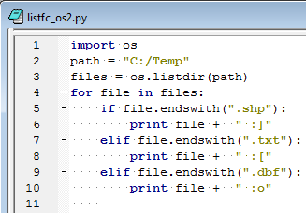
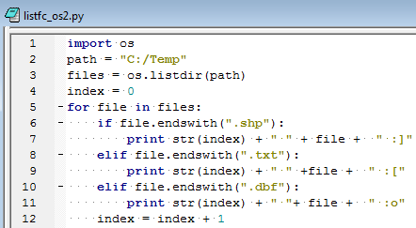
Emoting listfc_os.py solutions

Slide 20
Batch geoprocessing
Listing feature classes, rasters, other data types
Using wildcard and type to get subset of items
Dynamic output names
Listing fields
What's wrong with
the following script?
# Buffer all of the line feature classes in C:/Temp.
import arcpy
fcs = arcpy.ListFeatureClasses ('*', 'Line')
for fc in fcs:
arcpy.overwriteOutput = True
dist = sys.argv[1] + ‘meters’
arcpy.Buffer (fc, 'out.shp‘, dist)

Slide 21
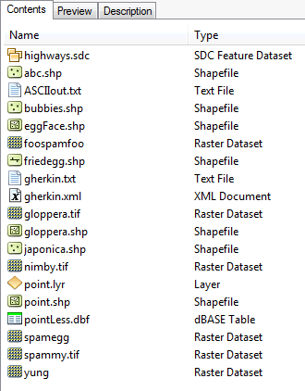
Enumeration wildcards
import arcpy
# Set the workspace.
arcpy.env.workspace = 'C:/dater'
L1 = arcpy.ListFeatureClasses('point')
L2 = arcpy.ListRasters('*spam*')
L3 = arcpy.ListFeatureClasses('egg*', 'line')
L4 = arcpy.ListRasters('*', 'TIF')
Which files will be in each list?
Notes:
import arcpy
# Set the workspace.
arcpy.env.workspace = 'C:/Temp'
L1 = arcpy.ListFeatureClasses('point')
L2 = arcpy.ListRasters('*spam*')
L3 = arcpy.ListFeatureClasses('egg*', 'line')
L4 = arcpy.ListRasters('*', 'TIF')
For each list, give an example of a file name that would be contained in the list.
Give an example of a file that would be contained in two of the lists, if possible.
Which of these lists contains all the point shapefiles in the workspace?
1. L1 would only list a feature class named 'point'.
L2 is a list the rasters in C:/Temp that contain the substring 'spam', such as spamBla.jpg
L3 is a list of all the feature classes in C:/Temp whose names start with egg and are line shape types.
L4 is a list of all the bitmap rasters in C:/Temp, such as bla.bmp.
2. 'spam.tif' and 'blaSpam.tif' would appear in both L2 and L4. No other lists pairs of lists could have common items.
3. None, unless there is only one Point type shapefile named 'point.shp'

Slide 22
Enumeration wildcards
import arcpy
# Set the workspace.
arcpy.env.workspace = 'C:/dater'
L1 = arcpy.ListFeatureClasses('point')
[ ]
L2 = arcpy.ListRasters('*spam*')
[u'foospamfoo', u'spamegg', u'spammy.tif']
L3 = arcpy.ListFeatureClasses('egg*', 'line')
[ ]
L4 = arcpy.ListRasters('*', 'TIF')
[u'gloppera.tif', u'nimby.tif', u'spammy.tif']
Notes:
import arcpy
# Set the workspace.
arcpy.env.workspace = 'C:/Temp'
L1 = arcpy.ListFeatureClasses('point')
L2 = arcpy.ListRasters('*spam*')
L3 = arcpy.ListFeatureClasses('egg*', 'line')
L4 = arcpy.ListRasters('*', 'TIF')
For each list, give an example of a file name that would be contained in the list.
Give an example of a file that would be contained in two of the lists, if possible.
Which of these lists contains all the point shapefiles in the workspace?
1. L1 would only list a feature class named 'point'.
L2 is a list the rasters in C:/Temp that contain the substring 'spam', such as spamBla.jpg
L3 is a list of all the feature classes in C:/Temp whose names start with egg and are line shape types.
L4 is a list of all the bitmap rasters in C:/Temp, such as bla.bmp.
2. 'spam.tif' and 'blaSpam.tif' would appear in both L2 and L4. No other lists pairs of lists could have common items.
3. None, unless there is only one Point type shapefile named 'point.shp'

Slide 23
Exercise: List and copy
Goals:
List all the point feature classes in C:/Temp/tester.gdb whose names start with 's'.
Create a new file geodatabase: arcpy.CreateFileGDB_management('C:/temp/', 'out.gdb')
Write copies of the point feature classes whose names start with 's' from C:/Temp/tester.gdb and copy them to C:/temp/out.gdb.
Template: Copy_management (in_data, out_data, {data_type})
The output data must be a dynamic name that changes each time you loop.
The destination needs to have a slash between the wksp and filename. destination = destWorkspace + '/' + fc

Slide 24
Exercise – List and copy
#copyEses.py
#Copy feature classes from gdb to gdb.
import arcpy
arcpy.env.workspace = 'C:/Temp/tester.gdb'
fcs = arcpy.ListFeatureClasses('s*','POINT')
res = arcpy.CreateFileGDB_management('C:/Temp/', 'out.gdb')
destWorkspace = res.getOutput(0)
for fc in fcs:
# Create output name with destination path
destination = destWorkspace + '/' + fc
# Copy the features to C:/Backup
arcpy.Copy_management(fc, destination)

Slide 25
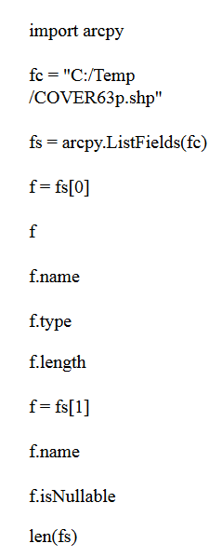
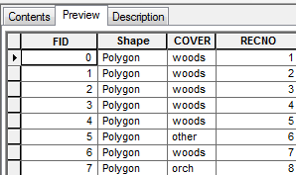
Predict what will be printed?

Slide 26
In class - check4Field.py
Check if an input file has a field named 'COVER'.
# check4Field.py
Example input: 'C:/Temp/COVER63p.shp'
Result:

Slide 27
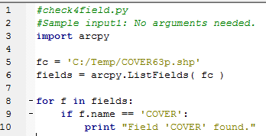
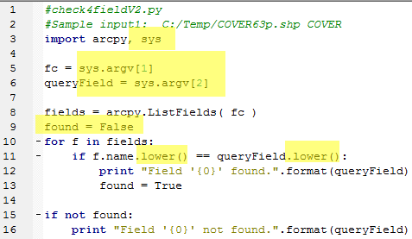
check4Field.py solutions
Notes:
#version 1
import arcpy
fc = 'C:/Temp/COVER63p.shp'
fields = arcpy.ListFields( fc )
for f in fields:
if f.name == 'COVER':
print "Field 'COVER' found.“
# OR --------------------
#version 2
import arcpy
fc = 'C:/Temp/COVER63p.shp'
fields = arcpy.ListFields( fc )
names = []
for f in fields:
names.append(f.name)
print 'Attribute names:', names
if 'COVER' in names:
print "Field 'COVER' found."

Slide 28
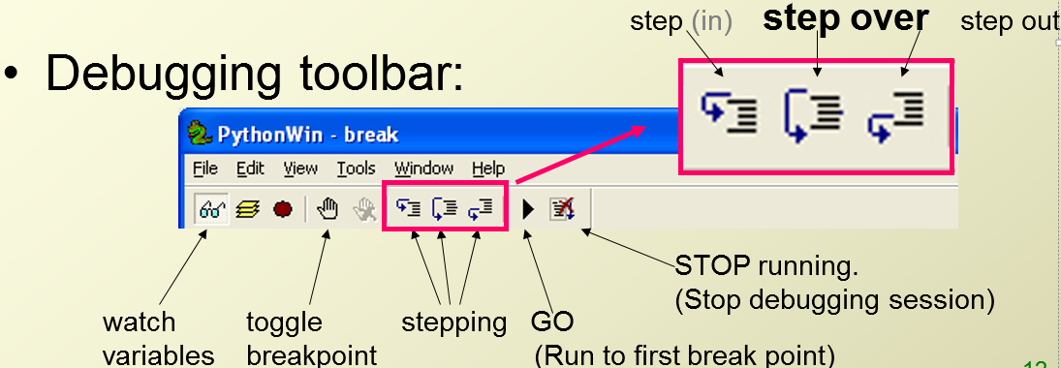
Debugging
Syntax errors
Built-in exceptions
Interpret traceback messages
Logic errors
Stepping through code in the debugger
Setting breakpoints and breakpoint conditions
Breaking in to running code

Slide 29
Summing up
Topics discussed
Basic Python components
Data structures
Calling ArcGIS tools
Handling user arguments and the os module
Representing workflow with pseudcode
Decision-making (if, elif, else, and, or, !=, ==, Describe)
Looping, while, for, listdir
Batch geoprocessing
Debugging

Slide 30
More practice exercises
Exam 1

Slide 31
Write a loops to print 20, 30, 40, 50, 60, 70
Write FOR and WHILE loops to print 21, 31, 41, 51, 61, 71
Notes:
#some loops
for val in range(21, 72, 10):
print val
i = 21
while i <=71:
print i
i = i + 10

Slide 32
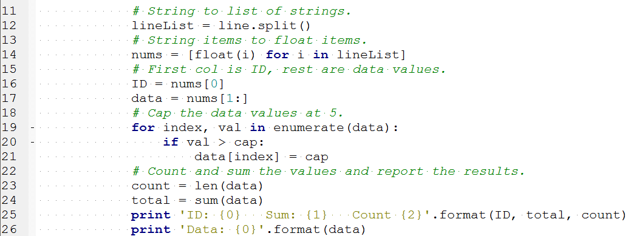
Parts of code…
Identify the string methods, list methods, Python keywords, built-in functions in this code.
Which lines of code use indexing? commenting? slicing?
Excerpt from C:\gispy\sample_scripts\ch19\parceTable.py
Notes:
string functions:
split, format
list methods:
there are none
keywords:
for, in, if, print
built-in functions:
enumerate, len, sum, print
indexing on line 16, 21
comments on line 11,13,15,18,21
slicing on line 17

Slide 33

Write a script that takes a speed limit in mph from the user and sets the road category for Alabama:
State or territory | Freeway | Divided (rural) | Undivided (rural) | Residential
Alabama^{[6][7]} | 70 mph (113 km/h) | 65 mph (105 km/h) | 45–64 mph (72–105 km/h) | 20–25 mph (32–40 km/h)
Notes:
import sys
speedLimit = int(sys.argv[1])
if 20 <= speedLimit <= 25:
roadType = “Residential"
elif 45 <= speedLimit < 65:
roadType = “Undivided (rural)"
elif speedLimit == 65:
roadType = “Divided (rural)"
elif speedLimit == 70:
roadType = “Freeway"
else:
roadType = "unknown"
print roadType

Slide 34
Given the tool signature, write a script that calls the tool
Given a full path file name from a user, if the data type is ShapeFile or Feature Class, and Polygon find the minimum bounding box (use the signature above). Use only required arguments. Place the output file in C:/gispy/scratch and name it the same as the input file, but with Out appended to the name (e.g., park.shp → parkOut.shp)
Notes:
# Example input: C:/gispy/data/ch02/park.shp
import sys, arcpy, os
fileName = sys.argv[1]
dsc = arcpy.Describe(fileName)
outputDir = "C:/gispy/scratch/"
if dsc.dataType == "ShapeFile" or dsc.dataType == "FeatureClass":
basename = os.path.basename(fileName)
base = os.path.splitext(basename)[0]
output = outputDir + base + "Out.shp"
print output
arcpy.MinimumBoundingGeometry_management(fileName, output)
print "Output created:{0}".format(output)

Slide 35
Do the same but for a batch
Given a workspace, for each file, if the data type is ShapeFile or Feature Class, and Polygon find the minimum bounding box (use the signature above). Place the output file in C:/gispy/scratch and name it the same as the input file, but with Out appended to the name (e.g., park.shp → parkOut.shp)
Notes:
# Example input: C:/gispy/data/ch02/
import sys, arcpy, os
arcpy.env.workspace = sys.argv[1]
files = os.listdir(arcpy.env.workspace)
for fileName in files:
dsc = arcpy.Describe(fileName)
outputDir = "C:/gispy/scratch/"
if dsc.dataType == "ShapeFile" or dsc.dataType == "FeatureClass":
basename = os.path.basename(fileName)
base = os.path.splitext(basename)[0]
output = outputDir + base + "Out.shp"
print output
arcpy.MinimumBoundingGeometry_management(fileName, output)
print "Output created:{0}".format(output)

Slide 36
Given the args on the left, what prints? Assume sys has been imported
Arguments | Python code | Output or error
5 4 3 | sys.argv.pop(0) sys.argv.reverse() print sys.argv
abc.txt park.shp | for i in sys.argv: print os.path.splitext(i)[1]
foo | val = sys.argv[1] mylist = ["a","b","c"] print val.join(mylist)
abc.txt park.shp | x = len(sys.argv) if x in [2,4,6]: print "ha! Ha!“ else: print "doh"
3 4 5 | 3 in sys.argv

Slide 37
Given the args on the left, what prints? Assume sys has been imported
Arguments | Python code | Output or error
5 4 3 | sys.argv.pop(0) sys.argv.reverse() print sys.argv | ["3", "4", "5"]
abc.txt park.shp | for i in sys.argv: print os.path.splitext(i)[1] | .py .txt .shp
foo | val = sys.argv[1] mylist = ["a","b","c"] print val.join(mylist) | afoobfooc
abc.txt park.shp | x = len(sys.argv) if x in [2,4,6]: print "ha! Ha!“ else: print "doh" | doh
3 4 5 | 3 in sys.argv | False

Slide 38
Challenge: ConvertTime.py
Sample input: 01-26-16 2143
Printed output:
Civilian time: 01-26-16 9:43PM
And vice versa
Notes:
import sys
mydate = sys.argv[1]
mytime = sys.argv[2]
if ':' in mytime:
mytimeParts = mytime.split(':')
hour = int(mytimeParts[0])
minutes = mytimeParts[1].replace("PM", "")
minutes = minutes.replace("AM", "")
if "PM" in mytime:
hour = hour + 12
else:
if hour < 10:
hour = "0" + str(hour)
print 'Military time {0} {1}{2}'.format(mydate, hour, minutes)
else:
hour = int(mytime[:2])
if hour >=12:
meridiem = "PM"
if hour > 12:
hour = hour - 12
else:
meridiem = "AM"
if hour == 0:
hour = 12
minutes = mytime[2:]
print 'Civilian time {0} {1}:{2}{3}'.format(mydate, hour, minutes, meridiem)

