Slide 1
User-defined modules
& tkFileDialog GUIs
Dr. Tateosian
GIS 540
North Carolina State University
Center for Geospatial Analytics

Slide 2
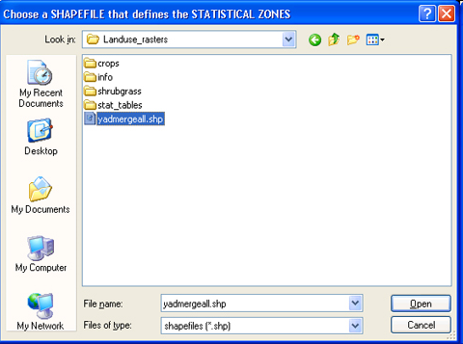
Outline
User-defined module
  using them
  sys.path
  reload
  __main__
Python File Graphical User Interfaces

Slide 3
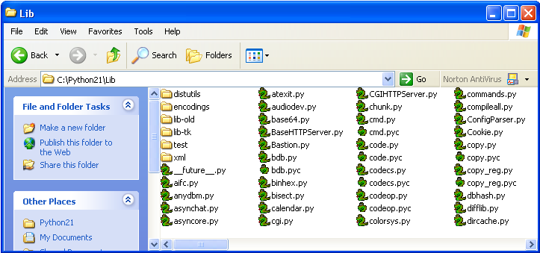
Standard modules
A module is a file containing Python definitions and statements
Python comes with a library of standard modules
Examples: datetime, math, os, random, sys, time …
You can make your own. (But don’t use standard module names for your own modules).
List of standard modules: http://docs.python.org/modindex.html

Slide 4
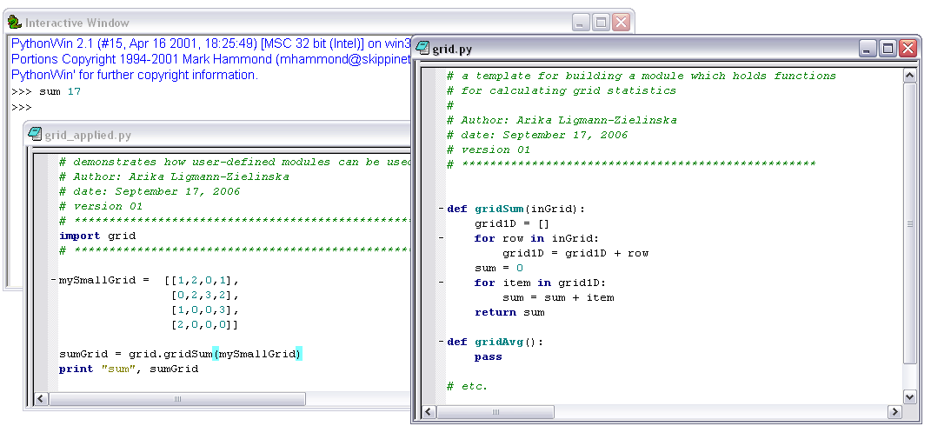
Define and use your own modules
script name: grid.py
module name: grid
script name
module name
a user-defined module with matrix operations

Slide 5
Using your own modules
General format:
import moduleName
moduleName.procedureName(arg1, arg2,...)
To refer to
this procedure
1. import the module
2. call procedure using module name
import grid
grid.gridSum(mySmallGrid)

Slide 6
In class – user-defined modules
Practice…
Copy and save sortString.py (our main script)
Copy and save listManager.py (our supporting script)
Then follow the instructions to …

Slide 7
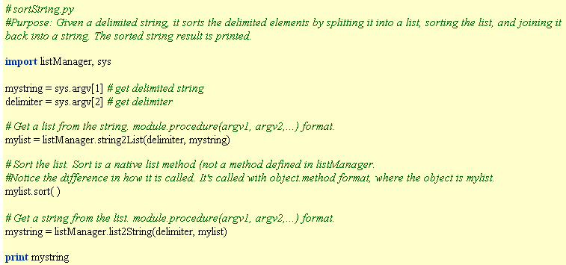
In class followup sortString.py
import listManager
listManager.list2String(delimiter, mylist)

Slide 8
Where to put your modules
Python stores a list of directories to search for modules and files.
>>> import sys
>>> sys.path
['C:\\Program Files\\ArcGIS\\bin', 'C:\\WINDOWS\\system32\\python24.zip', 'C:\\checkdir\\to_read', 'C:\\Python24\\DLLs', 'C:\\Python24\\lib‘]
sys.path is a Python list.
>>> sys.path.append(“C:/myModules”)
>>> sys.path
['C:\\Program Files\\ArcGIS\\bin', 'C:\\WINDOWS\\system32\\python24.zip', 'C:\\checkdir\\to_read', 'C:\\Python24\\DLLs', 'C:\\Python24\\lib‘, ‘C:/myModules’]

Slide 9

reload( )
Each module is only imported once per interpreter session.
If you change your support modules:
  you must restart the interpreter
  or, if it’s just one module you want to test interactively, use reload(moduleName)
  Reload is a built-in function.
Example:
  reload(listManager)
  same as clicking when your focus is on listManager

Slide 10
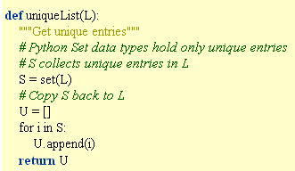
In class – Modifying support modules
In the same Pythonwin session…
Modify listManager.py
Add a procedure which returns a list with only unique elements.
Remove the list sort in sortString.py and replace it with code to call the new procedure.

Slide 11
When you import listManager…
When you import listManager, the code in listManager is executed.
It’s very much like executing the script directly with an IDE.
If you add print “foo” to listManager.py outside of the procedure definitions, when you import listManager, foo will be printed.
The import also creates a listManager.pyc file. If listManager.pyc already exists, the file will not be reloaded, unless you force it to reload.
If all the code in listManager is executed when it’s imported, you can’t include statements in listManager that are only meant for testing your procedure definitions. But there’s a way around this problem…

Slide 12
Using the __name__ variable
__name__ is a built-in string variable
__name__ is set to “__main__” when running the script as the ‘main’ file
__name__ is set to the name of the Python module when it’s being imported from another script .
For example:
  __name__ == “listManager” is True when sortString imports listManager
  __name__ == "__main__” is True when listManager is run from directly in PythonWin.
Place condition if __name__ == "__main__” after all procedure definitions.
Then use it to test a support module as an independent script, by placing code inside this conditional block.
if __name__ == "__main__":
import sys
print string2List(sys.argv[2], sys.argv[1])
Does not run when listManager is imported by sortString

Slide 13
Example of using __name__ variable
# listManager.py
def string2List(delimiter, s):
….
def uniqueList(L):
….
def list2String(delimiter, L):
….
if __name__ == "__main__":
import sys
print string2List(sys.argv[2], sys.argv[1])
Don’t need dot notation because
calling procedure from inside the
same module.
Two underscore characters.

Slide 14
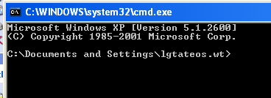
GUI
graphical user interface
a.k.a., “dialog box” window used to get information from users or inform them of something
‘dialog’ between script and user

Slide 15
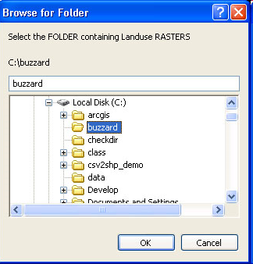
tkFileDialog
Python module tkFileDialog
Browse to a file or browse to a directory
tk stands for tool kit

Slide 16
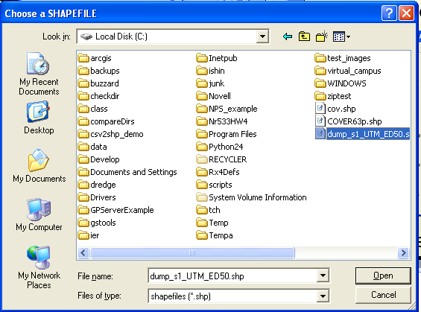
askopenfilename
>>> import tkFileDialog
>>> fc = tkFileDialog.askopenfilename( filetypes=[("shapefiles”, "*.shp")], title='Choose a SHAPEFILE' )
>>> fc
'C:/dump_s1_UTM_ED50.shp
Does it open the file for you?
No. Just returns a full path file name as a string.
Use askopenfile instead of askopenfilename if you want to open the file.

Slide 17
In class - Playing with tkFileDialog
>>> import tkFileDialog
>>> fc = tkFileDialog.askopenfilename()
>>> print fc
>>> fc = tkFileDialog.askopenfilename( filetypes=[(“spam”,"*.py")],
title=‘Boogiewoogie‘, initialdir = “C:/Temp”, multiple=True )
>>> print fc
>>> f = tkFileDialog.askopenfile(initialfile=“C:/Temp/poem.shp”
>>> print f.readlines()

Slide 18
askopenfilename Options Example
>>> import tkFileDialog
>>> fc = tkFileDialog.askopenfilename( filetypes=[("shapefiles","*.shp")], title='Choose a SHAPEFILE' )
options
filetypes

Slide 19
askopenfilename options
filetypes
  Specifies the file types listed in the 'Files of type' listbox.
initialdir
  Specifies that the files in the given directory should be displayed when the dialog pops up.
initialfile
  Specifies a filename to be displayed in the dialog when it pops up.
multiple
  Allow the user to choose multiple files from the Open dialog.
title
  on the top of the box

Slide 20
Options
fname = tkFileDialog.askopenfilename( initialdir = 'C:/Temp')
inside parenthesis in any order
all optional
option=value
Examples:
initialfile='myfile.shp'
filetypes=[("csv (Comma delimited) ","*.csv"),("Text Files ","*.txt")]

Slide 21
Multiple returns a Python list
import tkFileDialog
fnames = tkFileDialog.askopenfilename(multiple = True)
for fname in fnames: # for each file selected by the user
print fname # print the file name

Slide 22

askdirectory
import tkFileDialog, arcpy
arcpy.env.workspace = tkFileDialog.askdirectory( \ initialdir="/", \
title='Select the FOLDER containing Landuse RASTERS' )

Slide 23
Saving and opening files
asksaveasfilename(**options)
askopenfile(mode='r', **options)
asksaveasfile(mode='w', **options)

Slide 24
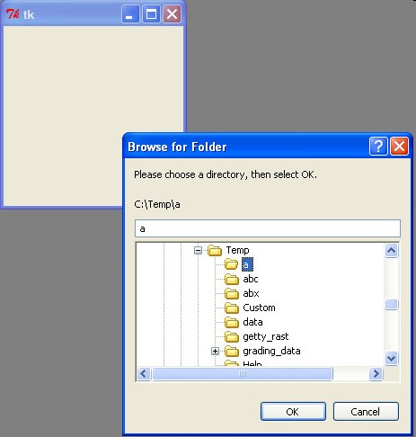
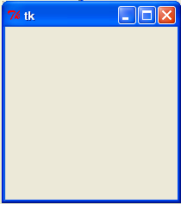
Forcing the tk window to close
import tkFileDialog, Tkinter
fatherWilliam = Tkinter.Tk( )
inputDir = tkFileDialog.askdirectory( parent=fatherWilliam)
fatherWilliam.destroy( )

Slide 25
Summing up
Topics discussed
    User-defined module
    using them
    sys.path
    reload
    __main__
    Python File Graphical User Interfaces
Up next
    User-defined classes
Additional topics
    wxWidgets, PyTk, … etc.

