Slide 1

R + Python with rpy2
Damian Maddalena
and
Laura Tateosian
References
R-Cran Project
rpy2
Quick R

Slide 2
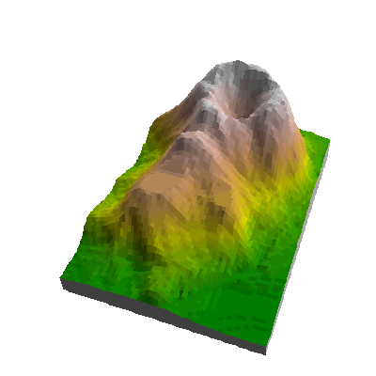
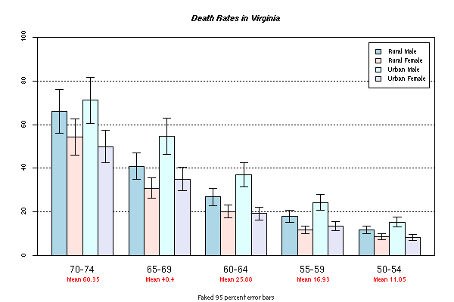
Topics
http://addictedtor.free.fr/graphiques/graphiques/graph_27.png
Stats in GIS
R
rpy2
http://addictedtor.free.fr/graphiques/graphiques/graph_54.png
2

Slide 3
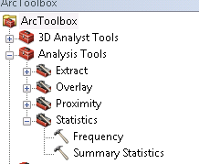
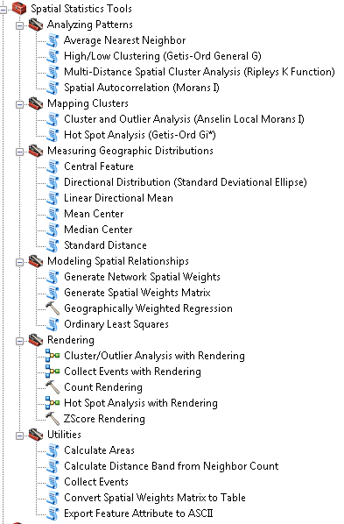
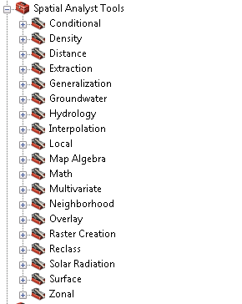
Stats with ESRI?

Slide 4

R
Open Source Statistical Package
Expanding every day
User supported
Statistical analysis
Descriptive analysis
Difference of means
Correlation
Spatial statistics
Graphics
Basic plots
Spatial plots

Slide 5


R – Basic Stat Examples
Summary stats
t-test
Multiple regression
http://www.statmethods.net/

Slide 6
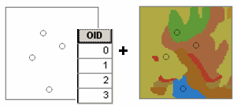
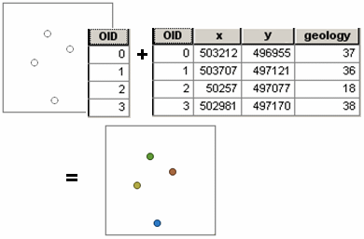
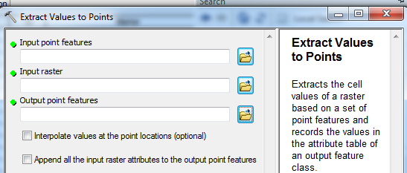
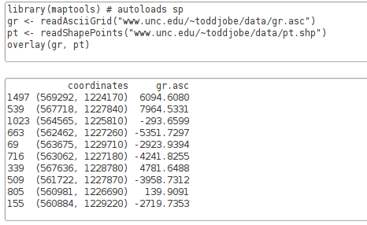
R – Extract raster value to points
http://toddjobe.blogspot.com/2010/07/extracting-raster-values-from-points-in_26.html
ESRI R
Notes:
images:
http://resources.esri.com/help/9.3/arcgisdesktop/com/gp_toolref/geoprocessing/surface_creation_and_analysis.htm

Slide 7

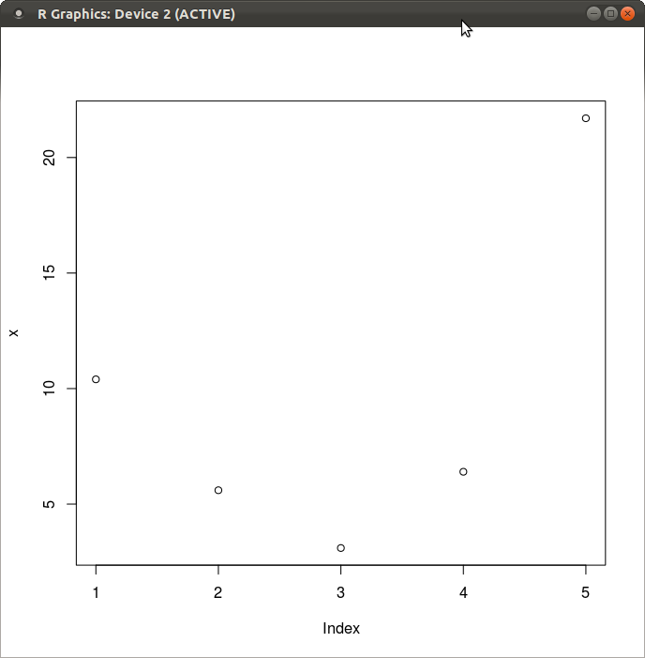
R – Basic Plot

Slide 8
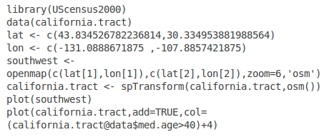
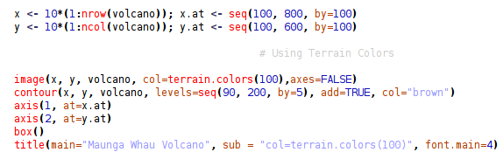
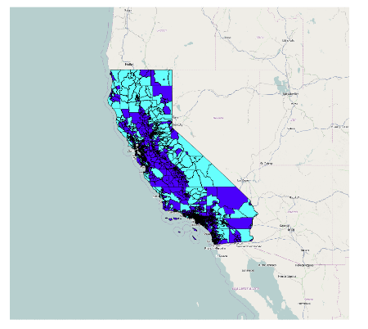
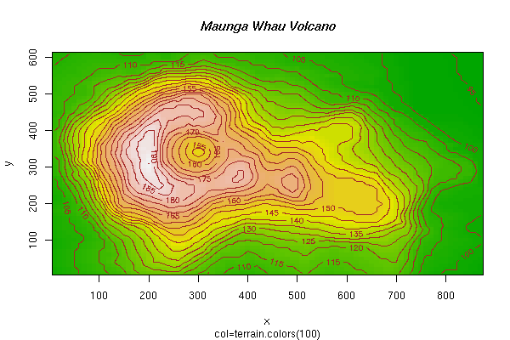
R Syntax: Plot Maps
http://addictedtor.free.fr/graphiques/graphiques/graph_22.png
http://www.r-bloggers.com/plot-maps-like-a-boss/

Slide 9

rpy2 Module
http://rpy.sourceforge.net/rpy2.html
Interface between R and Python
Not built-in. (must be installed)
Allows you to call R commands from within Python!!
Diabolical laughter
Import rpy2.
Create an r object.
Use r methods and properties.
Example:
>>> import rpy2
>>> r = rpy2.objects.r
>>> print r.seq(-1,1, length=10)
[1] -1.0000000 -0.7777778 -0.5555556 -0.3333333 -0.1111111 0.1111111
[7] 0.3333333 0.5555556 0.7777778 1.0000000

Slide 10
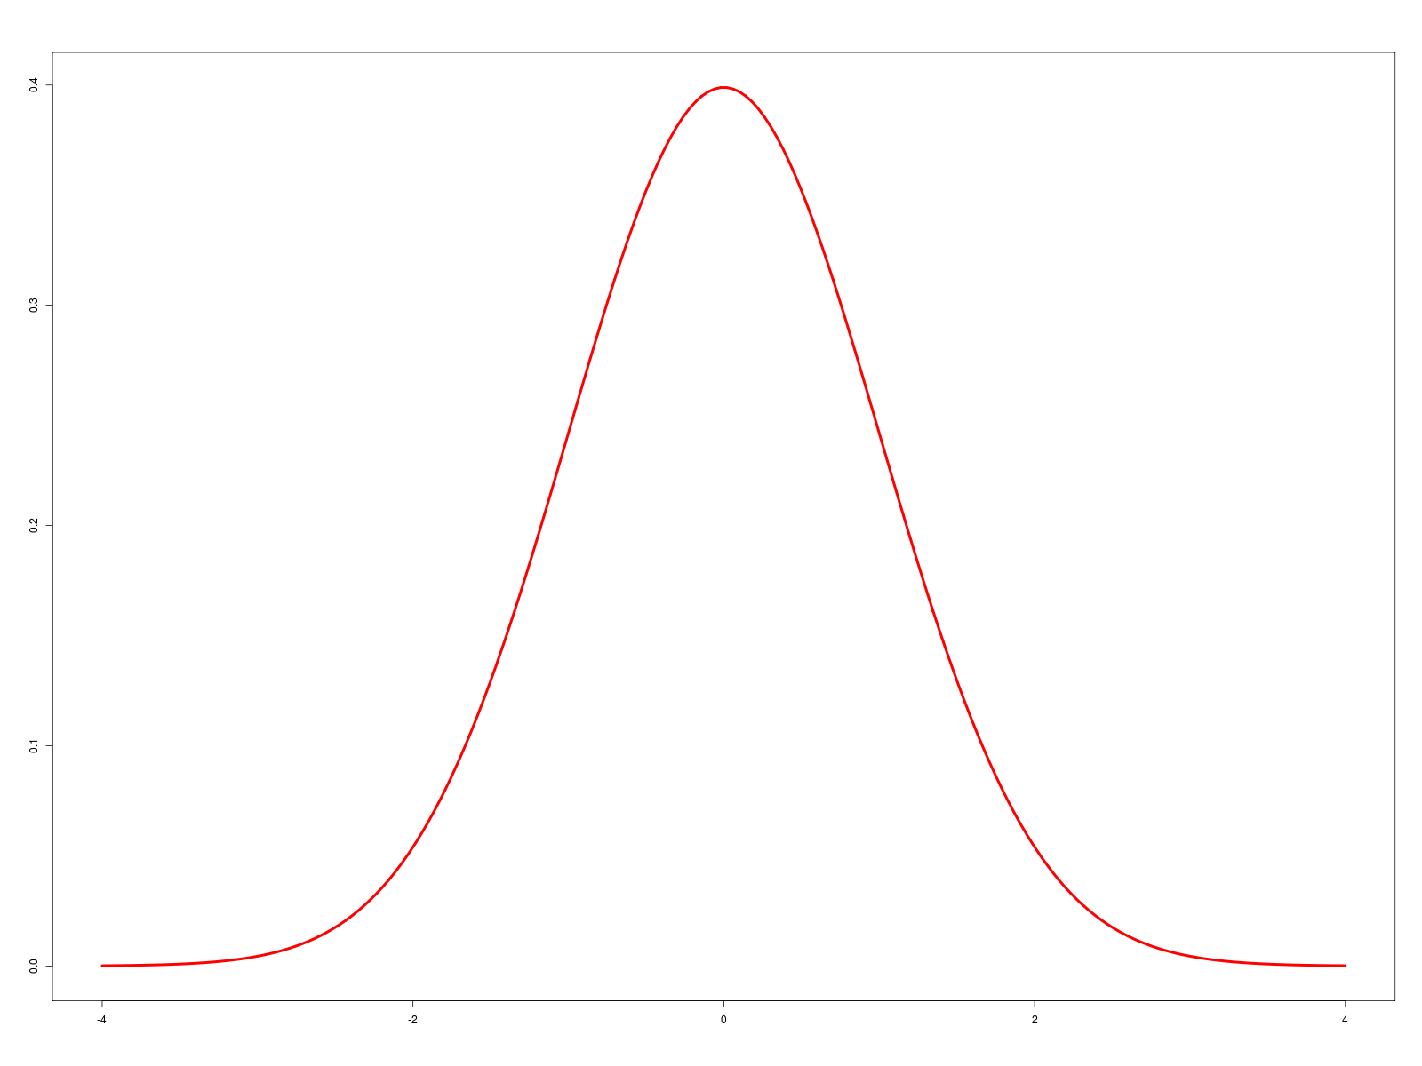
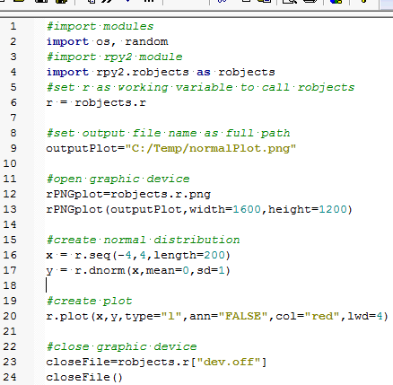
rpy2 plot example
Use rpy2 (and the power of R) to
graph this bell curve and save it as a png.
Lines 12-13 prepare output image settings
-- create the png object
-- set the name and dimensions
Lines 16-17 set the x and y values to be plotted.
-- x has 200 values between -4 and 4
-- y is calculated as the normal distribution of the x values.
-- x and y can also be given as Python lists of numbers.
Line 20 plots the line through the (x,y) points.
-- connects the points with a red line (type=‘l’) 4 pixels wide.
-- type = ‘p’ plots points, not a line.

Slide 11
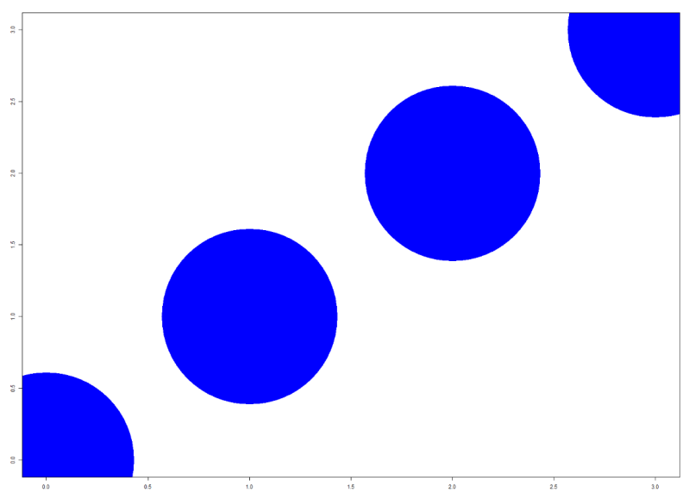
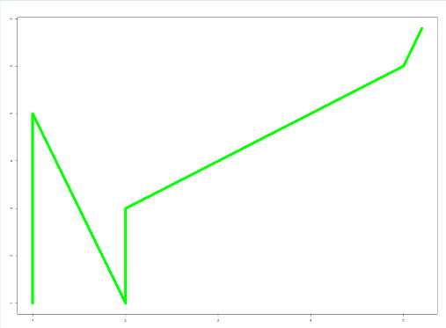

In class – plot.py
Modify plot.py to create this output graph
Use the Python built-in range function to define x and y
Large blue dots are centered at: (0,0), (1,1), (2,2), (3,3)
2. Modify the script again to create this output graph.
Add code to read xy1.txt. The 1st column is the x values. The 2nd column is y values.
Plot the points and draw a red line between the points.
xy1.txt

Slide 12
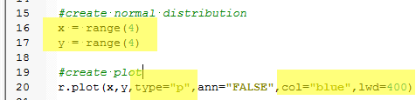
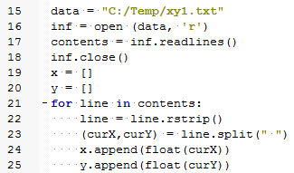
plot.py followup
Modify plot1.py to create this output graph
2. Modify plot2.py to create this output graph.
xy1.txt

Slide 13
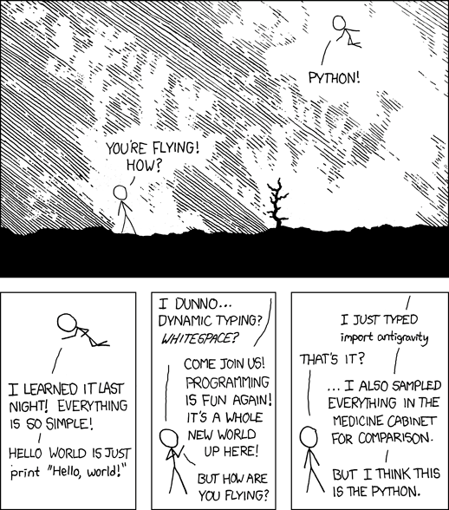
Rpy2, GRASS and Beyond!
Python within GRASS with R for stats/modeling and PostGreSQL for tabular database management!
http://xkcd.com/353/

Slide 14
Resources
R Project
http://cran.r-project.org/
rpy2
http://rpy.sourceforge.net/rpy2.html
Quick R
http://rpy.sourceforge.net/rpy2.html
R Bloggers
http://www.r-bloggers.com/
Computational Ecology Blog
http://toddjobe.blogspot.com/
http://bit.ly/IEVtcR

