Slide 1
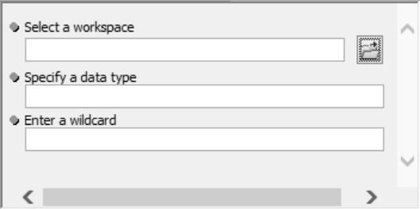
ArcGIS Script Tool Basics
  Relationship [Script Tool⬄Python script]
  How to create script tools and buttons
  Printing with script tools
  Relative paths strike again!
Dr. Tateosian
Notes:
A graphical user interface (or GUI for short), is a way to prompt users to provide the arguments needed for a script in a way that’s easier for them to understand than running the tool in an IDE or command line environment. The image on the right shows a simple GUI that was created by an ArcGIS Script Tool. ArcGIS Script Tools are a means for you, the programmer, to create graphical user interfaces for your Python scripts without having to learn about the complex libraries that are available for GUI development.
This video introduces ArcGIS Script Tools, there relationship with the Python scripts they are built for, how to create them, and how to use them. Also, that topic of relative paths reemerges.
After this lesson there are several follow-up lessons about setting the parameters. If you learn enough about Script Tools and their cousins, Python Toolboxes, you can make dynamic interfaces that can really help your users run your scripts more effectively.

Slide 2
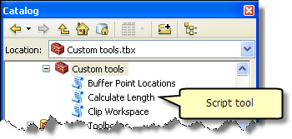
What’s a ‘script tool’?
‘script tool’ is an ESRI term
A custom GUI that points to a Python script.
TkFileDialog
  + Pro: Browse to files/directories
  + Pro: Good for simple apps.
  + Pro: No arcpy needed.
  -- Con: only input type files/directories.
  -- Con: Can’t get more than one file/directory at a time.
Other GUI libraries: wxPython, PyQT…
  + Pro: Powerful/flexible.
  + Pro: No arcpy needed.
  -- Con: Complex to learn
Script tools
  + Pro: Easy to create.
  + Pro: Can get many data types as input, include ArcGIS proprietary.
  + Pro: Can get more than one input at a time.
  -- Con: ArcGIS required. And need to know ArcGIS really well.
  -- Con: Some limitations (e.g., can’t make a wizard? Limited available widgets).

Slide 3
Create a script tool
To create a script tool, you need three things:
    A Python script.
    A custom toolbox.
    A list of desired script parameters and their types.
To create a Script Tool
  Browse to desired directory in ArcCatalog
  Right click > New > Toolbox
  In new toolbox, right click > Add > script
  Then follow the wizard…

Slide 4
In class – Create a script tool
Three things you need:
    A Python script (provided this time).
    A custom toolbox (you make it).
    A list of desired script parameters and their types. (this one doesn’t need any parameters.

Slide 5
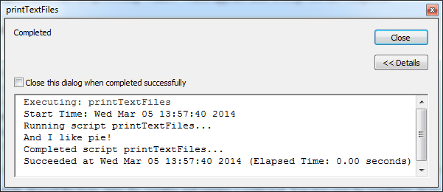
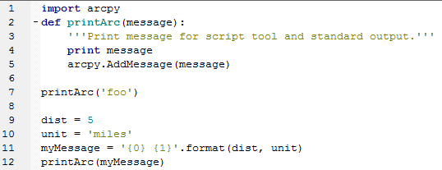
Printing from a script tool.
Where did ‘and I like pie!’ come from?
arcpy.AddMessage('And I like pie!')
>>> print ‘foo’ # doesn't display in the Geoprocessing Window
>>> arcpy.AddMessage(‘foo’) # doesn't print in the Interactive Window
Notes:
Import arcpy
def printArc(message):
'''Print message for script tool and standard output.'''
print message
arcpy.AddMessage(message)
printArc('foo')
dist = 5
unit = 'miles'
myMessage = '{0} {1}'.format(dist, unit)
printArc(myMessage)

Slide 6
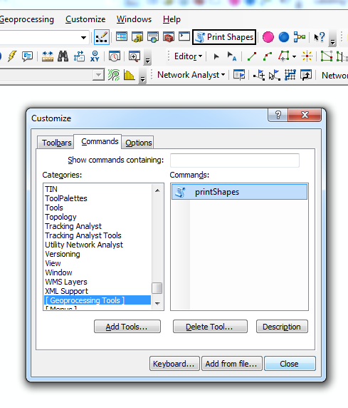
Adding script tool button to a map
To create a button on an ArcMap toolbar to launch a script tool
‘Customize’ > ‘Customize mode…’
‘Commands’ tab
Under Categories, scroll to select [Geoprocessing tool]
Add Tools… Browse to toolbox > Select script tool in toolbox > Add (Script tool appears under Commands )
Drag script tool from under Commands to an ArcMap toolbar
Before closing the ‘Customize’ dialog, right-click on the tool in the toolbar to display text and image and modify these as desired. (can also be done by reopening the customize dialog)
Notes:
http://resources.arcgis.com/en/help/main/10.1/index.html#//002400000005000000

Slide 7
Script tools in memory
Script Tools are pointers to Python scripts.
If you move the Python script it points to and change the script path in the Script Tool properties, it will no longer work!
Script Tools do NOT appear in Windows Explorer. They are part of a tbx file.
To share a Script Tool, you must copy the tbx file and the script, use relative path must be checked AND the script must be in the SAME relative position it was when set up.
Script tools are just a GUI interface for scripts.

Slide 8
In Class - Break a script tool
Right click on the 'printTextFiles' script tool, select 'Properties...', and then select the 'Source' tab. Note the Python script specified by the 'Script file' path on this tab ('C:\gispy\scratch\textLister.py'). Close the script tool properties by clicking 'OK'.
Browse to 'textLister.py' and open it. Add another message to 'textLister.py' and save the script:
arcpy.AddMessage('***I like kale***!')
Double click on the script tool to run it again. Do you see a change?
Rename 'textLister.py' to 'textLister2.py' and run the script tool again. What happens?
Rename the script back to its original name, 'textLister.py' and run the script tool again. Is it working? Why?
Now make a directory 'C:\gispy\scratch\breakStuff' and move 'textLister.py' down into it. Run the script tool again. What happens?
Copy the toolbox to your 'Documents' directory. Run the script tool again. Does it work? Why?
Move textLister.py to the 'Documents' directory. Run the script tool again. Does it work? Why?

Slide 9
Script tool concepts to remember
Script Tools do not appear in Windows Explorer. They are part of a tbx file.
Since a script tool points to a script, you can change the script and see the updates immediately when you run the tool.
If you rename, move, or remove the underlying script, the script tool will be broken.
For portability, check 'Store relative path names'. Then copy the toolbox and the script maintaining the relative path.
Script tools don't have a debugger, so it's important to test Python scripts thoroughly outside the script tool.
A simple way to maintain relative paths is to set up the script tools and scripts in the same directory and share that directory.

Slide 10
Summing up
Topics discussed
    Script tools
      GUI front end for scripts
      Create script tool & menu button
      Print from a script tool (print & arcpy.AddMessage)
      Use relative paths & maintain them
Up next
    Script tools parameters
Additional topics
    wxPython, PyQT

